Slide 2
Using Custom Reports in Circulation and Technical Services
Renee Patterson
Technical Services Administrator
JT Whitfield
Librarian, Cataloger
Alachua County Library District, FL

Slide 3
Alachua County Library District
12 locations, 2 bookmobiles, 1 Jail library
Serving a diverse population of 250,000
Circulation – over 4 million items
27% of circulation is digital
No fines (since 1978)
Floating collection
Moved from Sirsi to Polaris in May of 2012

Slide 4
Agenda
Circulation
Search lists
Claim notices
Floating
Evaluation
Error Checking
Technical Services
Collection
Weeding
Catalog
Processing
Funds
Notes:
Why custom reports?
To add information not in the canned report.
To set up different formatting.
To automate tasks.
The canned report doesn’t exist.

Slide 5
Circulation: Search Lists
Search lists
Holds
Missing
Claim Returned
Notes:
After moving to Polaris in 2012, we found that while staff could access more reports, they didn’t always remember to actually do so.
We set up subscriptions to most of our mandatory reports. Staff don’t forget, as it shows up in their inbox.
It’s also more efficient, as you don’t have 12 different staff at 12 different locations all individually spending time running the report.

Slide 6
Circulation: Search Lists
Holds Request search list
Daily subscription, morning and afternoon
No patron information
Graphic Novel column only appears if any graphic novels are on the list.
Barcode column only appears if any item level holds are on the list.
Notes:
Staff didn’t like the existing options for a printed list – the Hold to Fill report had too much information, and printing from Request Manager required too much adjusting and the font was too small. We tried a custom report in the early days, but couldn’t make it match up to the actual holds. ☹
Then, at an IUG conference, we connected with staff from the Richalnd library, and they had a successful custom holds report.
Richland sent us a copy – they have a multistory building, so had it customized by floor. (created by Mark Jarrell)
I’ve included the original report from Richland, and our adjusted report.
We didn’t need the multistory, and were more interested in the output.
Two things we added are indicators for Graphic Novels, as we shelve those separately, and Item holds.
Each has a column, AND that column only appears in the list if there are items. A barcode column appears for an item hold, and a GN indicator column for a graphic novel.
This report also benefitted from being a later addition. In many early reports, we set up individual reports per location. By the time we got to this one, we’d learned how to specify the location parameters in the subscription.

Slide 7
Circulation: Search Lists
Missing search listB
Branch specific
Monthly
District, monthly (3 months back)
Missing items not found during local branch search
Missing in Transit
Items in transit (transferred status) more than 7 days
Sent every Monday

Slide 8
Circulation: Search Lists
Claim Returned Search List
Weekly for large locations
Monthly for small locations
Includes Claim Never Had items
Notes:
HQ_etc. - Claims Returned
FOR HQ, TOW, NEW weekly search list. Back 22 days up to 8 days from report run date
We did fun math with the dates on these reports, as it goes to our busiest branch a week ahead of other locations.
We considered one comprehensive search list for missing and claimed items, but Branches preferred smaller staggered lists.

Slide 9
Circulation: Claim notices
Claims Returned Found Email List
The happiest report – this weekly subscription report generates an email merge list for all items that change status out off Claim Return in the previous week to notify patrons the item was found.
Only for patrons with email on file.
Claimed Items Not Found Email List Weekly
To let patrons know we looked for their item and it wasn’t found.
Runs after item has appeared on two search lists (relative date range)
Claimed Items Not Found 12-months Email List
For email merge to notify patrons they will be charged.
Also used to charge patrons 2 weeks later.
Notes:
Claims return was often an issue for us at the point of service. Patrons never got any information on the status of their claim. They could log in to their account to check, but rarely did, and not all knew how.
Since we inventory annually, [Schedule included in supporting documents] we do not charge for claims returned that aren’t found until a year after the claim was placed. This could result in uncomfortable conversations at the public service desks.
We now have subscribed reports and use the output Excel file in an email merge template to notify patrons – email notifications only.
Notifications:
Weekly – anything found the previous week
Weekly – anything claimed in the previous 2 weeks not found (28-35 days ago)
Items not found after 12 months
Your claimed item was not found after a complete inventory of the Library District and you will now be charged the replacement cost of the item.
Staff uses this list to charge the patrons, it’s done a couple weeks after the notices are sent, so patrons have time to respond before they are charged.

Slide 10
Circulation: Floating
Consider to Float by Call Number and LAD
Consider to Float by Collection and LAD
Consider to Float by Collection and LAD with No Destination Branch

Slide 11
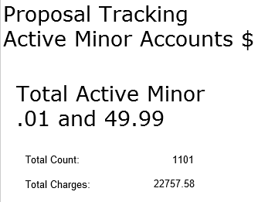
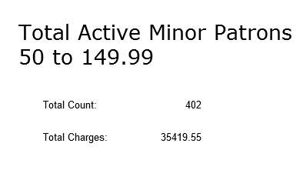
Circulation: Evaluation
Monthly Card Renewal
Autowaives for previous month – how many lost items returned and value
Patron and Account Summary reports
Run monthly to track changes after implementation of zero balance for card renewal policy.
Notes:
There wasn’t a way to tell how many cards were renewed, only new cards. This report uses expiration dates. We take the total number of cards with an expiration dates 2 years out from the month, then subtract the number of new patron registrations to get the number of renewals.
Proposal summary reports

Slide 12
Circulation: Evaluation
Circulation staff reports
Circ Staff Stats Checkin
Circ Staff Stats Checkout
Circ Staff Stats Patron Registration
Circ Staff Stats Ship Hold
Circ Staff Stats Trap Hold
Uses relative dates
Run monthly
Notes:
Both for comparison within a department and also across locations to evaluate workflows

Slide 13
Circulation: Evaluation
List of Checkouts and Lengths
Notes:
The list includes the call number, barcode, title, date checked out, the date of the next checkin and the number of days between the two dates. Parameters include the branch(es), collection(s), dates of original checkout, and a cutoff limit for returns so that extremely long checkouts will not be counted. It automatically excludes any checkouts that are for 3 hours or less.)

Slide 14
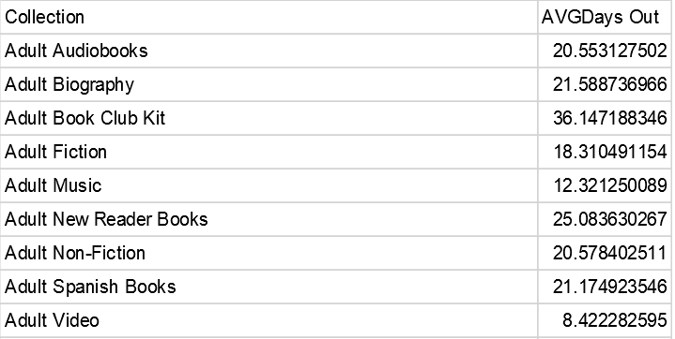
Circulation: Evaluation
Average length of checkouts by collection

Slide 15
Circulation: Error Checking
Active hold with items In on shelf
Notes:
I can tell by the use of ID columns this was probably written by JT.

Slide 16
Circulation: Error Checking
Holds placed with no good copies
Weekly
Catches when staff override the pop-up
Errors sent to staff to correct.
Holds not supplied
When an item goes lost.
Often on an item hold.
Staff can evaluate and see if the item hold was in error.
Notes:
If we get repeaters, it’s sent to their supervisor.
We had a staff person that thought they were doing Tech Services a favor, making the item show up in our holds alert lists; but not.
This was in response to a bug, but we still run it.
If a patron has a hold on an item, and the item goes into lost status, the hold moves to not supplied status.
Even if the item is returned later, the hold will not trap as it is no longer active. Most instances of this are with item level holds.
Review holds for your pickup location.
Check to see if your patron still wants the item, and change to a system level hold if indicated; or cancel the request.

Slide 17
Circulation: Error Checking
Check In Errors
Floating collection – catches if someone is logged in incorrectly and checks items in to the wrong location
Old checkouts which haven't been billed
Patrons exempt from bills
Patrons with no notification method
Notes:
This was one of our early ‘find a way to fix this report’
We have a floating collection. Through items on pick lists not being at the correct location, we found that if staff slipped and chose the wrong location when logging in to Polaris, everything they checked in, though physically at their location; would, in Polaris, be listed at the error location.
Nadia, our System Admin at the time, came up with the solution error check report. It looks for a mismatch between the workstation assigned location and the login location. This report runs daily so we can catch any errors right away.

Slide 18
Circulation: Discussion
Questions from the audience?
Favorite reports used at your library?

Slide 19
Technical Services
Collection
Weeding
Catalog
Processing
Funds
Notes:
Technical Services at our Library includes Collection Development/Selecting, Acquisitions, Cataloging, Database, Processing

Slide 20
Technical Services: Collection
Last Good Item withdrawn report with recently lost count
Holds Purchase Alert with LYC and Recently lost
Notes:
Both run weekly, along with the Fund Summary Report
For holds, parameters are number of items and number of holds, so can enter ratio for collection.
If your hold ration is 7 to 1, you would place a 1 in the first field and a 7 in the second field.

Slide 21
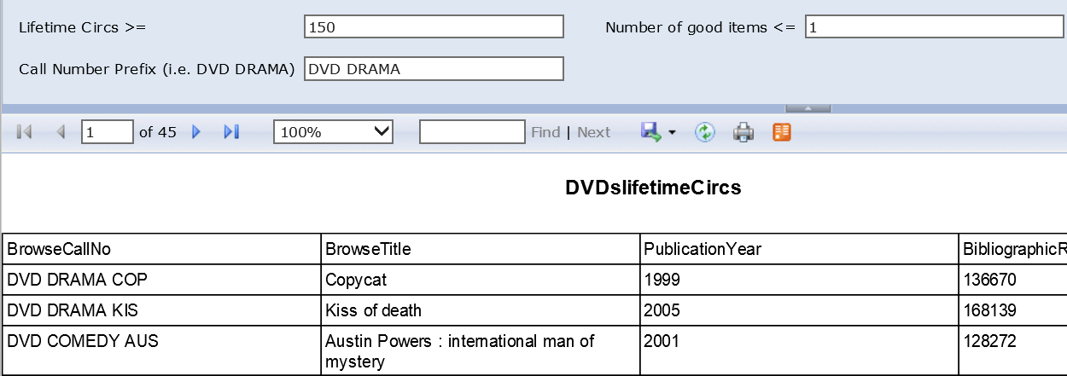
Technical Services: Collection
DVDs Lifetime Circs

Slide 22
Technical Services: Collection
Sizzlers Not Moving in Two Weeks
Sizzlers Evaluate to Extinguish
Notes:
Sizzlers that aren’t moving may be relocated to a more popular location

Slide 23
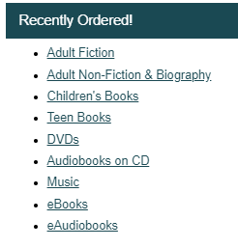
Technical Services: Collection
Update PAC – On Order record sets
Finds any bibs created in the past week with the call number ON ORDER with items in the specified Collection and updates a record set for PAC display of recently ordered titles. (The “real” report runs on the Production Server.)
Report for each collection listed in the PAC

Slide 24
Technical Services: Weeding
Weed list by record set sort by Branches with note
Notes:
Our process.
In ‘the old days’ Technical Services staff would go to one location a month to weed. A location was only weeded once a year; the shelves would be more than decimated, and patrons would freak out about what happened to the books… When we started floating our collection, it got trickier to catch items. When we moved to Polaris in 2012, the reporting functions gave us more options.
Now, we do the majority of our weeding centrally from reports based on age and use; and have an annual weeding schedule for which part of the collection is weeded each month, for each of out 5 selectors. [schedule is included with supporting documents]
Example - May ANF 300 Adult Fiction S-T JNF 500s, picture books Jazz, Pop AVIDEO drama A-L
Selectors create a weed list for their area, and the lists are sent out to all locations on the first of the month. Branch staff are responsible for pulling the items and putting them into withdrawn status. They then send the weeded/withdrawn items, along with items they’ve weeded through the month for condition, to Tech Services. (They also have a sending schedule, so the influx of withdrawn materials is spread out over the month.) Staff can also notify TS staff if there’s an item on the list they feel shouldn’t be weeded and why, for selectors to review. Technical Services staff then handle the final task of sorting the withdrawn items by destination – Deposit Collection, Jail, Friends of the Library for sale, recycle, or dumpster.
Using the reports
Selectors will start with a record set based on their criteria – example: ANF 500’s that haven’t circulated in 3 years, or are more than 10 years old.
(most use saved power or SQL searches)
They then run the record set through the ‘Weed list by record set sort by Branches with note.’ It puts the results in the format we use to send out the lists, and also gives additional evaluative data. Selectors then review and evaluate the items on the list before finalizing. Some items will be listed to pull and float instead of withdraw.
In part because we do most of our weeding centralized from reports now, where staff aren’t seeing the actual item, staff wanted a way to help make sure they didn’t accidentally weed ‘evergreen’ items - maybe it’s been a shelf sitter recently, but it’s a special award winner or classic of the genre so should stay. Or an item that may seem out of date at 15 years old, but happens to still be the bible of beekeeping. When identified, these items get a local note – evg acld, that shows up in the weed report and alerts selectors. (notes for local authors also appear here)
Selectors do still go out to locations for occasional weeding – a special project or request; and we also go to local staff meetings every other year for collection discussion and questions, and to review items on site.

Slide 25
Technical Services: Weeding
High Lifetime Circ Report with Mat Type and Number Good Items

Slide 26
Technical Services: Weeding
Low Lifetime Circ Report with Mat Type

Slide 27
Technical Services: Catalog
Bills Paid In Previous Week
Used to withdraw items
Bill activity on deleted item
Finds bill activity (Charge, Waive, Auto-waive and Pay) on an item that has been deleted and purged from the system. Includes the PatronID (Record ID in the Find Tool).
Used to waive bills on very long overdue items when they are returned in good condition.

Slide 28
Technical Services: Catalog
OCLC numbers with numbers
From bibs in a record set. Looks for the text string “(OCoLC)” followed by a number
OCLC numbers without immediate numbers
From bibs in a record set. Looks for the text string “(OCoLC)” followed by a letter, and omits any that were found using the report above.
Notes:
First: To unset holdings when you are getting ready to delete titles from your system. (finds most)
Second: Looks for strays – the few that don’t have numbers.
Select all the OCLC numbers and use connnexion client to unset the holdings.

Slide 29
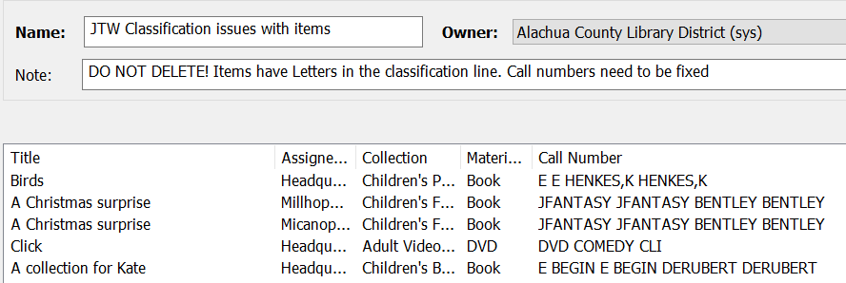
Technical Services: Catalog
Classification Issues with Items record set
Updates a record set with new items that have call number issues.
Deduplicates
Notes:
Updates a record set with new items that have call number issues.

Slide 30
Technical Services: Processing
Spine label Information from a Record Set
Output is sent to Word and a macro is used to format for Polaris spine labels
Sizzlers that are holdable or display in PAC
Notes:
Changes, recuttering.

Slide 31
Technical Services: Funds
Fund Summary report
Set us as a weekly subscription to assist staff in managing fund lines
Notes:
We just liked our formatting better. ☺

Slide 32
Technical Services: Funds
Fund summary report with POST and Total Available
Notes:
Using the word “POST” in the cart name when ordering allows Polaris to pull reports for items encumbered, but that won’t be published (and should not arrive) until the new year.
Total of all open purchase lines that are linked to a purchase order with the keyword POST
It adds the POST encumbrance back to the available balance to show what you actually have.

Slide 33
Technical Services: Discussion
Questions from the audience?
Favorite reports used at your library?

Slide 34
Contact information
Renee Patterson
Technical Services Administrator
Alachua County Library District
401 East University Avenue
Gainesville, Florida 32601
352-334-3960
rpatterson@aclib.us

