Slide 1
Analyzing the Usability of the University Libraries Digital Repository at the University of Memphis
Kenneth Haggerty, University of Memphis

Slide 2
Our Sites

Slide 4
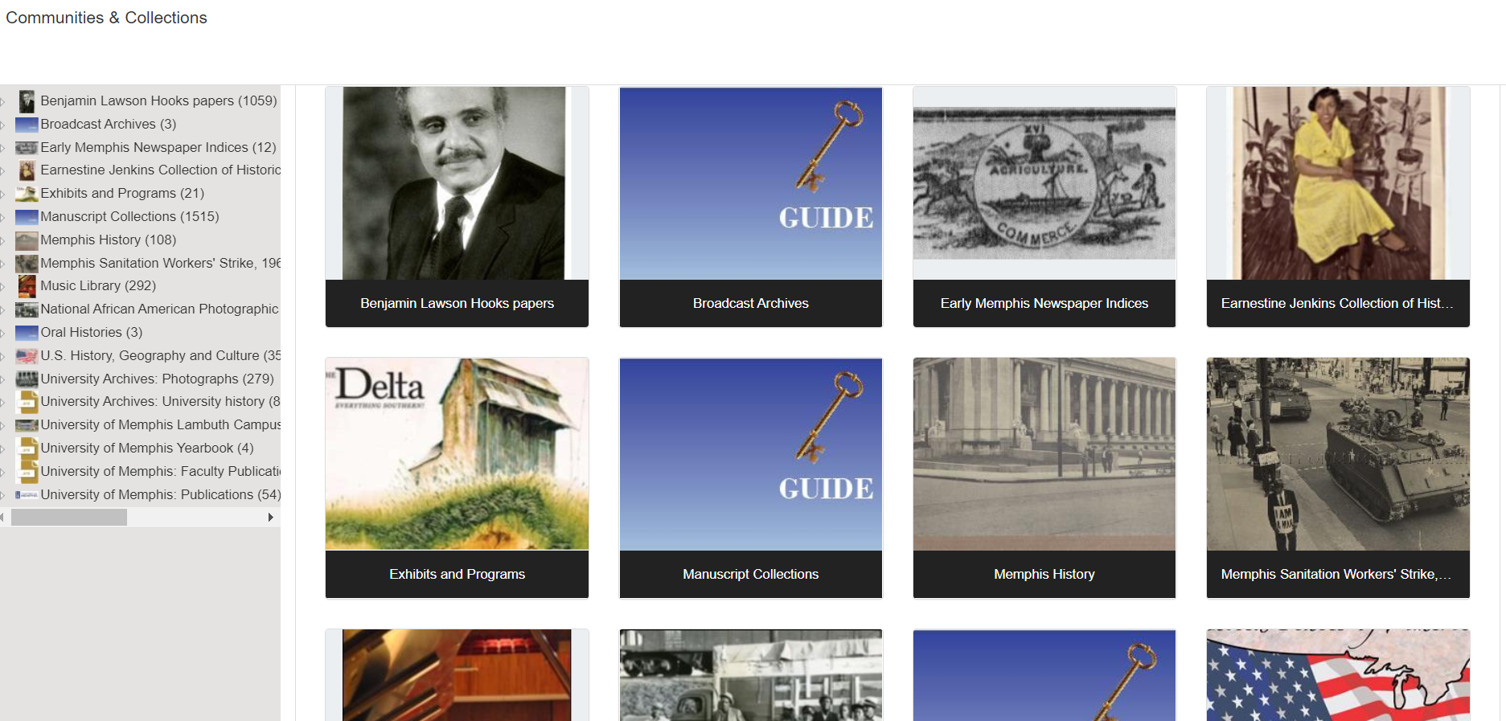

Slide 5
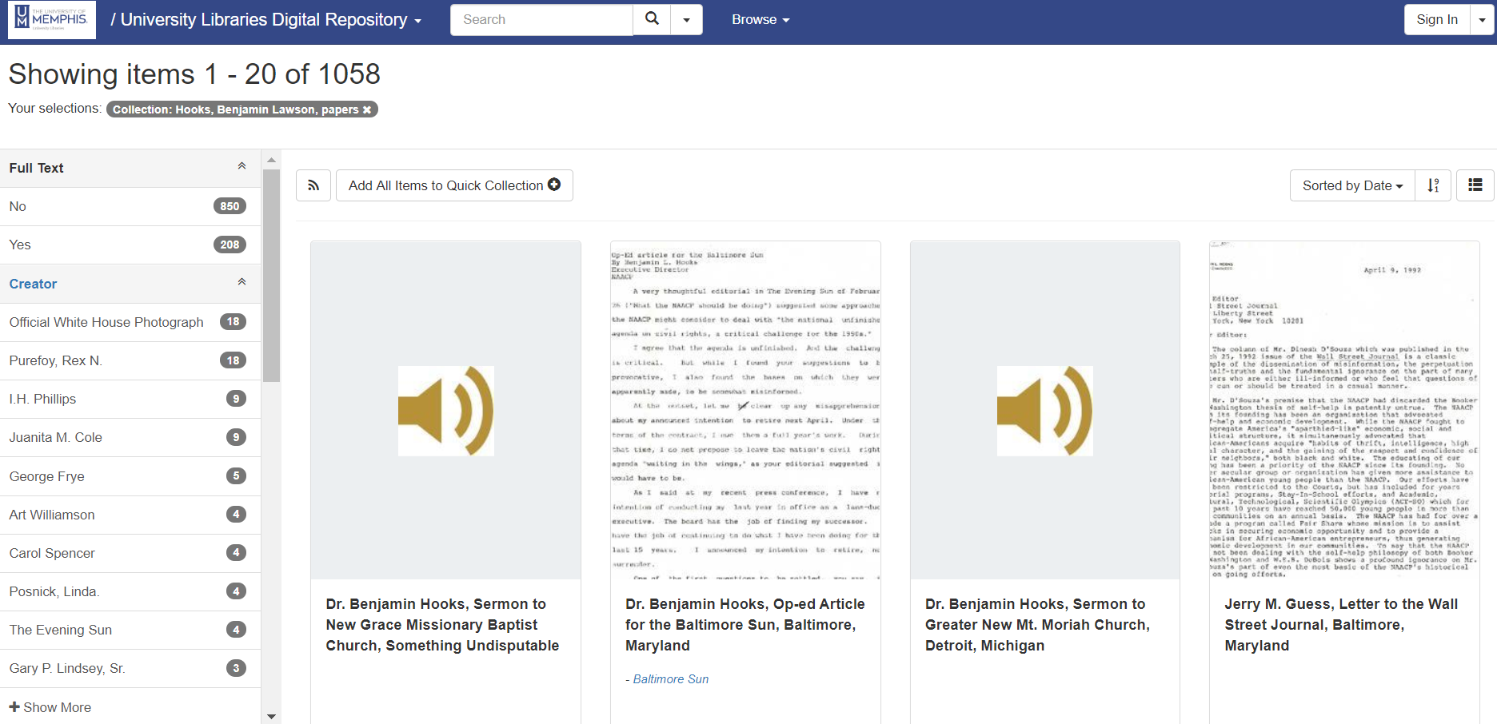

Slide 6
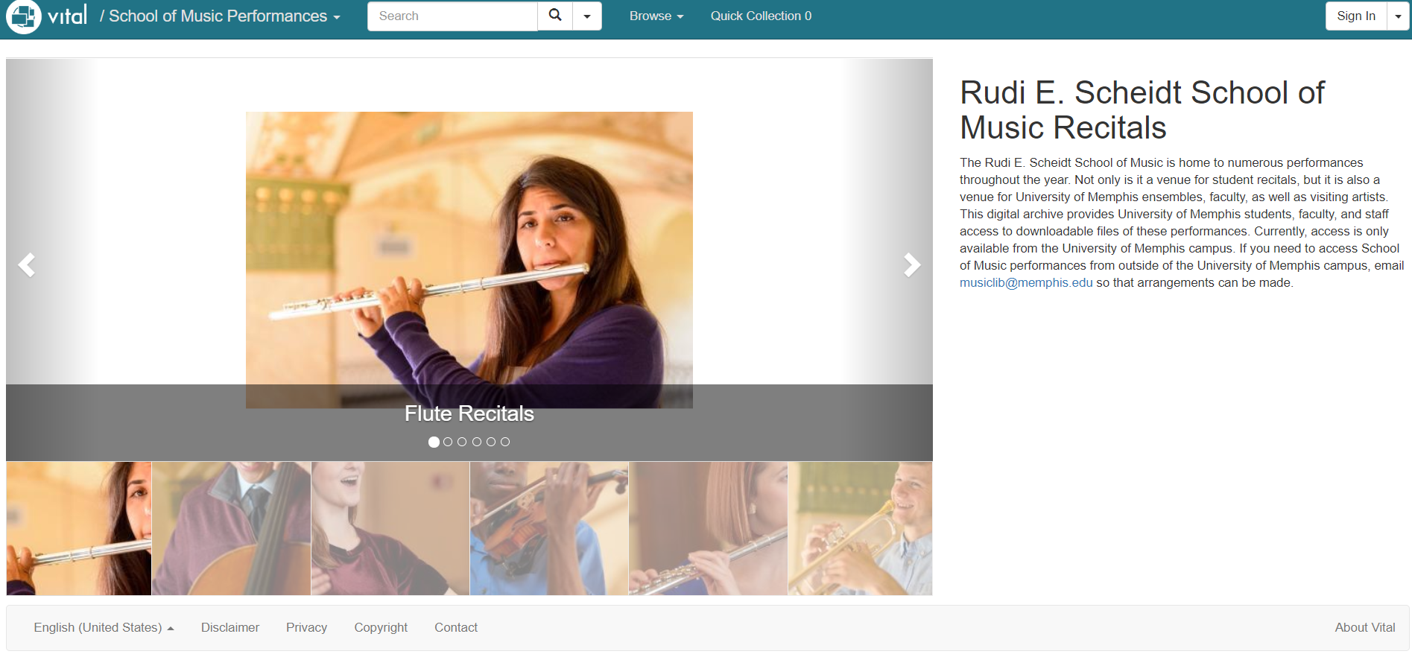

Slide 8
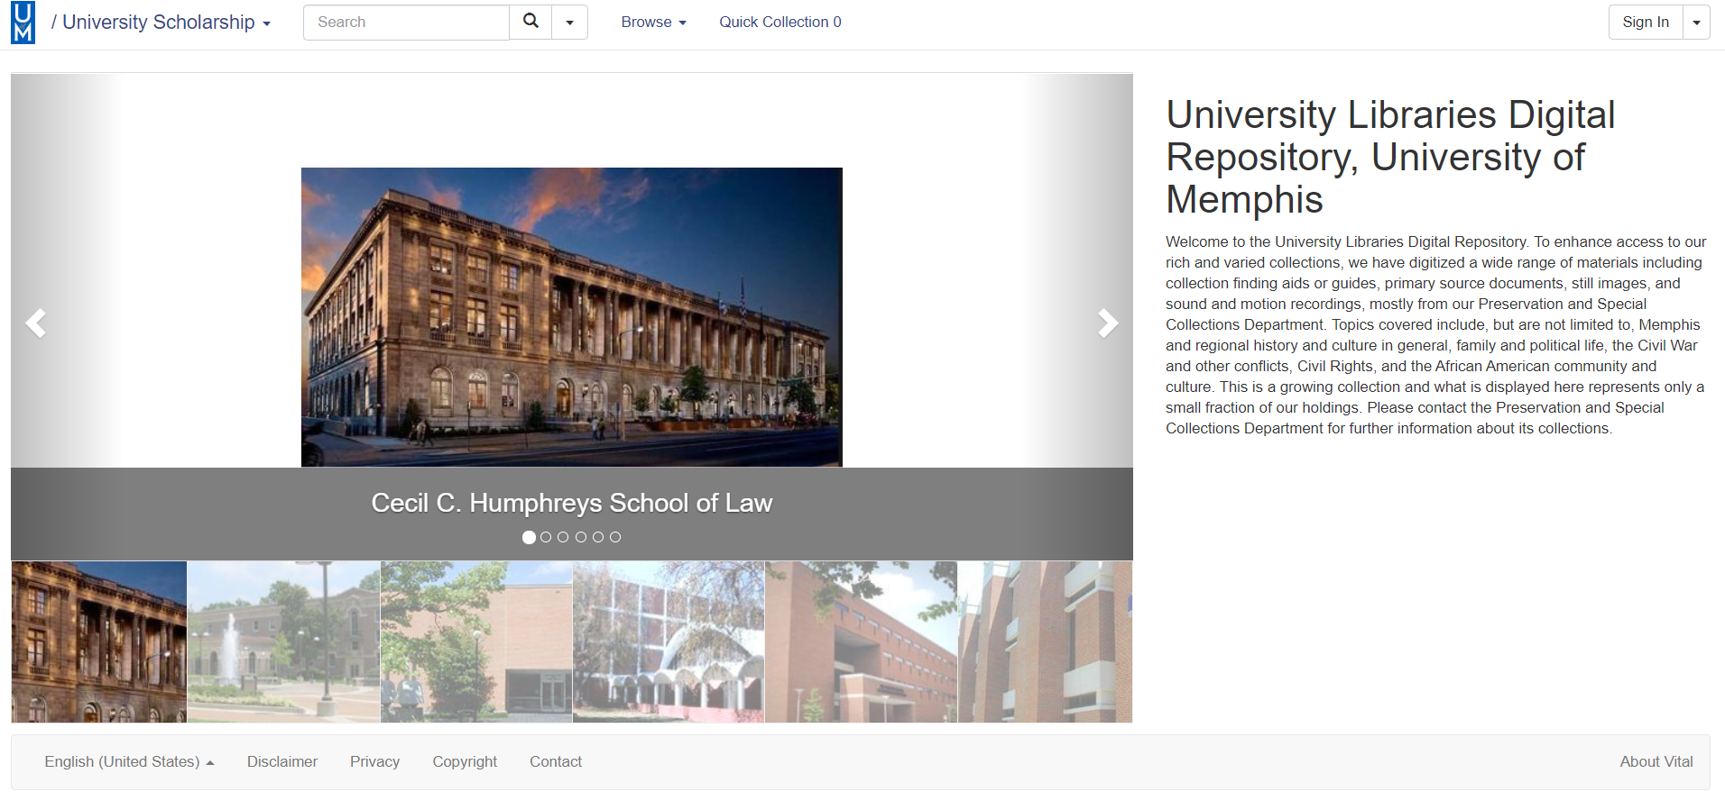

Slide 9
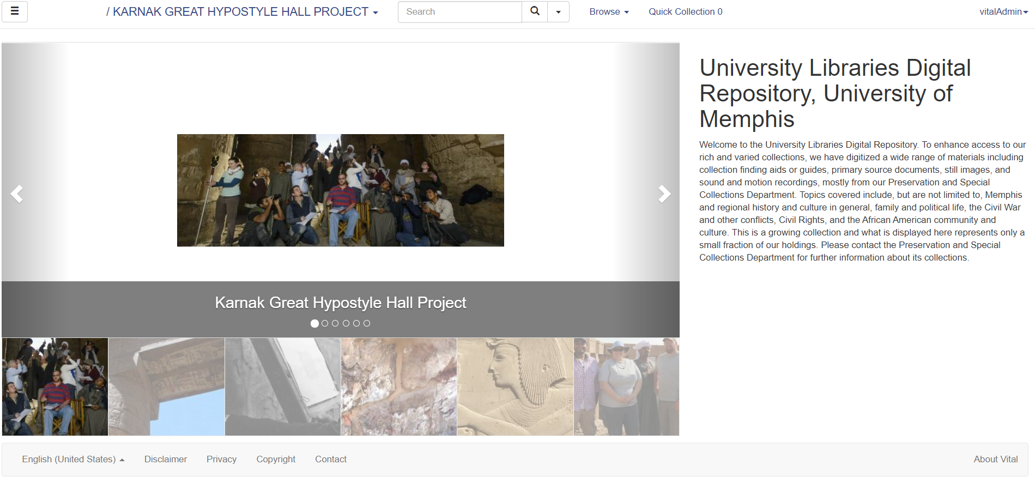

Slide 10
Usability of the Digital Repository

Slide 11
User Issues
Browsing Challenges
Changing the Text on Homepage, Copyright, Disclaimer, Privacy Page, etc.
Size Issues
Streaming
Searching

Slide 12
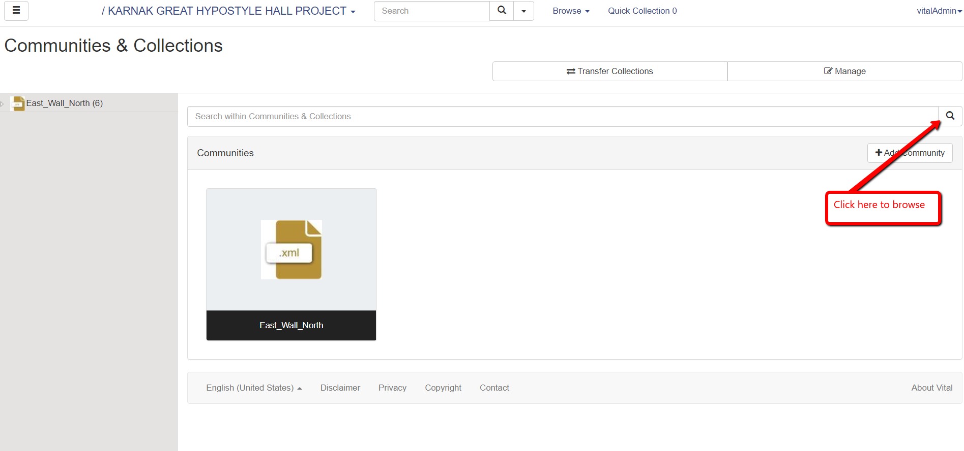

Slide 13
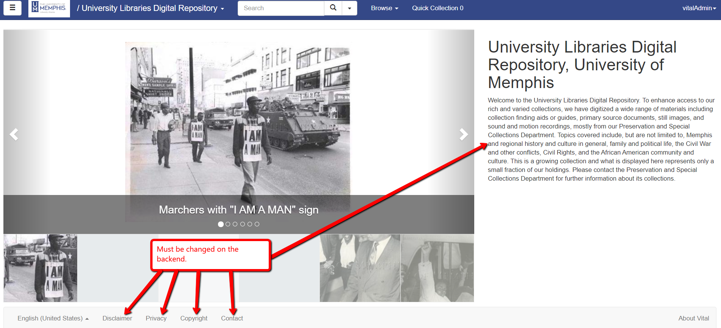

Slide 14
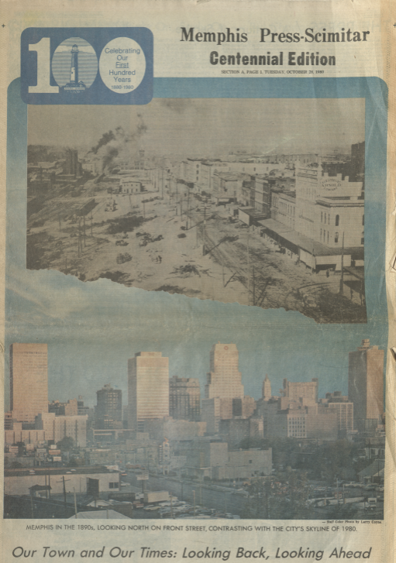

Slide 15
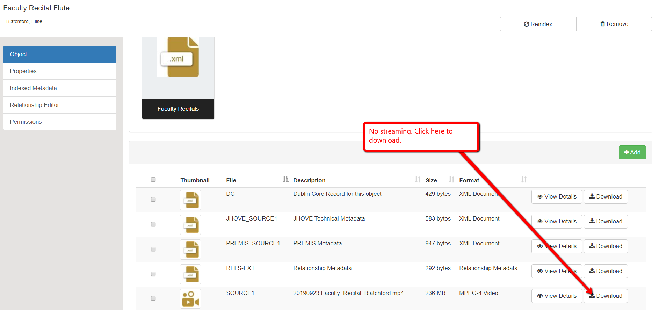

Slide 16
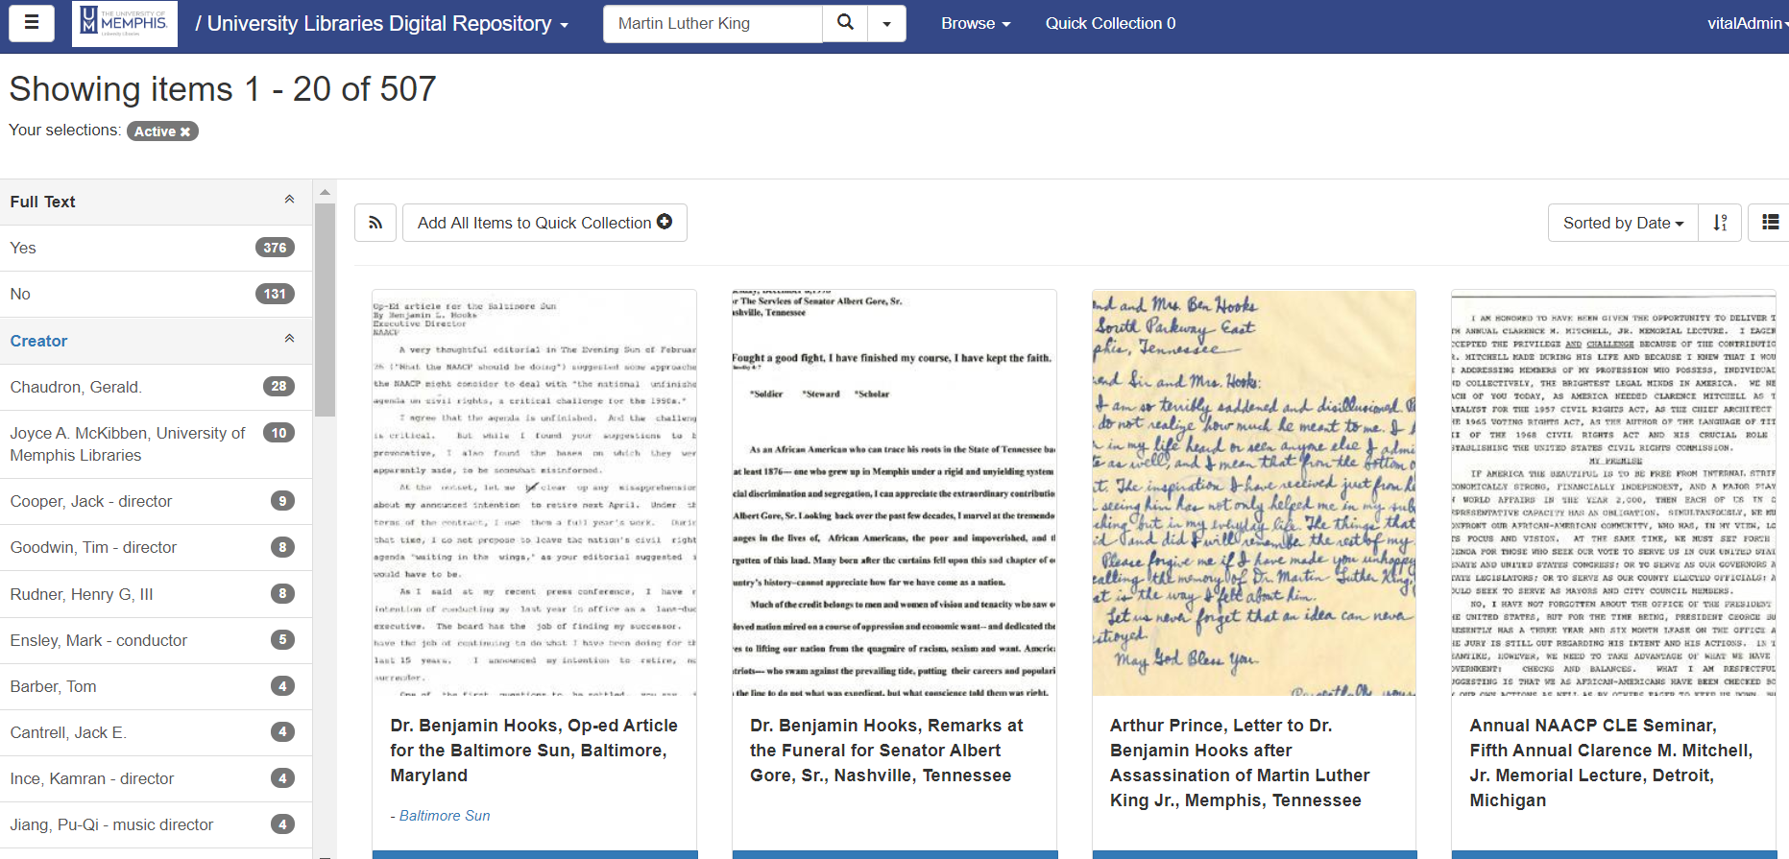

Slide 17
Thank You!
Questions?

