Slide 2
Starting Authority Control with a Vendor
Lisa Robinson, Michigan State University
Martha Rice Sanders, Innovative Interfaces

Slide 3
Outline
Why Use an Authorities Vendor
Creating an Request for Proposals
Filling out the Customer Profile
Working with Records
Working with Reports
Lessons Learned

Slide 4
Michigan State Authorities Project Timeline
Fall 2016 – put out RFP
March 2016 – vendor selected
Mid-April-mid-May 2016 – customer profile created
May 20 – started pulling “basefile” bib records
May 27 – records sent for processing
June 10 – processed records returned
Aug 8 - Sept 8 – bib & authority record re-loading
Oct 1 – 1st monthly file sent

Slide 5
Why Use an Authorities Vendor
Changes to national authority file coming fast & furious!
  Seeing 4-6 thousand names changes alone each month
  Regular flow of undifferentiated name authority records
    separated into differentiated NARs

Slide 6
Why Use an Authorities Vendor
Reduce time spent on routine searching
  MSU staff authority searching/exporting in OCLC
    Oct 2015: 12,428 searches, 3,745 exports
    Jan 2016: 11,764 searches, 3,677 exports
    Nov 2016: 2,050 searches, 98 exports (start of vendor project for staff)
    Feb 2017: 392 searches, 48 exports
  Staff now doing other much needed work
    Undifferentiated names!

Slide 7
Why Use an Authorities Vendor
Get a more complete authority file on Sierra
  MSU authority file went from ~500,000 records to 2.8 million records
  Getting all authority records
    Includes those with no 4xx or 5xx fields
    Includes non-LC genre records

Slide 8
Why Use an Authorities Vendor
Increase scale & scope of authority control
  Including e-resources records in authority control work
    Some Serials Solutions e-journal & e-book records
  Now controlling 11 genre vocabularies (LCGFT, AAT, RBMS, etc.)
  From evaluating ~4,000 records/month to ~44,000 records/month
  Authority work has now been done on 8.7 million records
    almost 40 million fully controlled headings
  84.3% of headings in catalog controlled in some way

Slide 9
Creating an Request for Proposals
RFP specifying your needs & criteria to compare vendors
  Sample RFP
The vendors will want to know:
  The current size of your catalog (both bib & authority records)?
  How many records you add each year?
  How often you want authorities processing done?
  Which types of processing desired?
Vendors do sample file processing

Slide 10
RFP – Key Questions for You
What types of bib records will be processed?
  Vendor records? Records without CatDates? Brief records?
  MSU excluded ERIC document microfiche records since they lack LC subjects
  Initially MSU excluded Archives records cataloged under DACS
How will you create a random record file?
What basic processing do you need?
What other processing would you like?
  RDA enhancement; adding TOCs; adding reading levels; Linked Data URIs?
Notes:
DACS = Describing Archives: A Content Standard (the cataloging standard for archival collections)

Slide 11
Filling out the Customer Profile
Set of instructions the vendor follows to process your records
Lots of decisions to make
  Customer Profile goes field by field
  Takes time to read through explanations of what will happen with each field
  Consult, consult, consult with your colleagues!
Local headings can be preserved if you create a local authority file

Slide 12
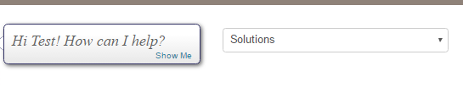

Supportal Solutions
Starting authority control with an outside vendor
Solution ID 160718145740608
Describes the ongoing processes for an Authority Control project
Solution ID 160822155518196

Slide 13
Vendor Reports
Vendors will supply *lots* of reports
  You choose which to receive
  Start with more and pare down
Authority Delete reports
  Fictional characters as subjects changed to personal name authorities
  Undifferentiated name records replaced by multiple NARs
Unrecognized subfield z
  $z should have been an $x or $y
  $z term is misspelled or not qualified correctly
  781 fields are your friends

Slide 14
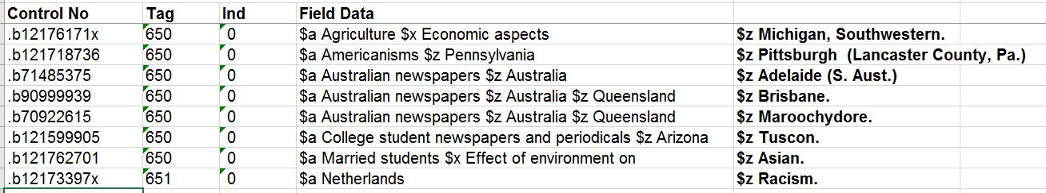
Example of Unrecognized Subfield z Report

Slide 15
Lessons Learned
Genre authority records may pose problems, but are worth it
  Loader might not be able to load genre authority records
    Initially at MSU, genre main entry field stripped out
  Non-LC genre authority record have no LCCN, so no overlay point for updated records; manual overlay required
    Fortunately, not many non-LC genre changes
  RBMS terms bring out characteristics specific to each manifestation (Alum tawed bindings)
  AAT terms identify record types in archival collections (scrapbooks, diplomas)
  LCGFT identifies music & movie genres (Psychobilly music, Romance films)

Slide 16
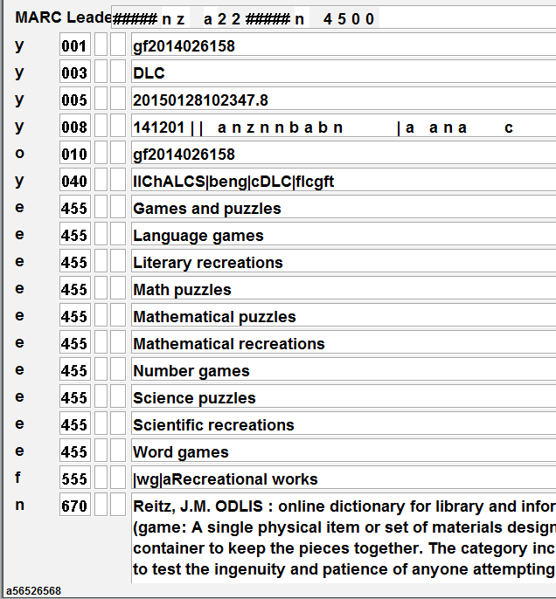
Initially loader stripped out main entry of genre authority records
Puzzles and games

Slide 17
Lessons Learned
Unexpected flips will happen
  less specific x-references in authority records
Some examples ….

Slide 18
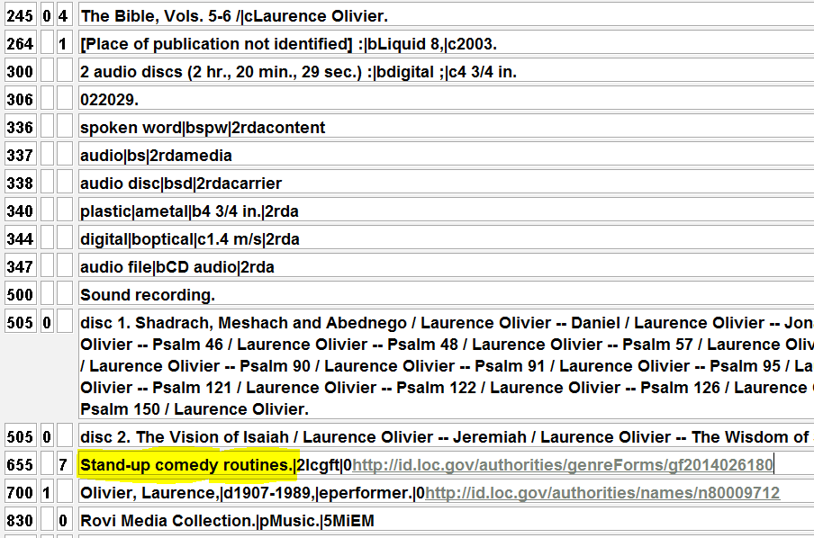
Lessons Learned
Records we created from vendor data contained “Comedy/Spoken Word” as a genre term
We coded it as 655_4
Was flipped to “Stand-up comedy routines.”
Oops!
Notes:
The URI at the end of the genre heading is a linked data enhancement we’re also getting with our authorities processing.
Also note we chose to get RDA enrichment, so 33X fields have been added.
We also chose to move GMDs to a 500 field so they could still be used in keyword searching.

Slide 19
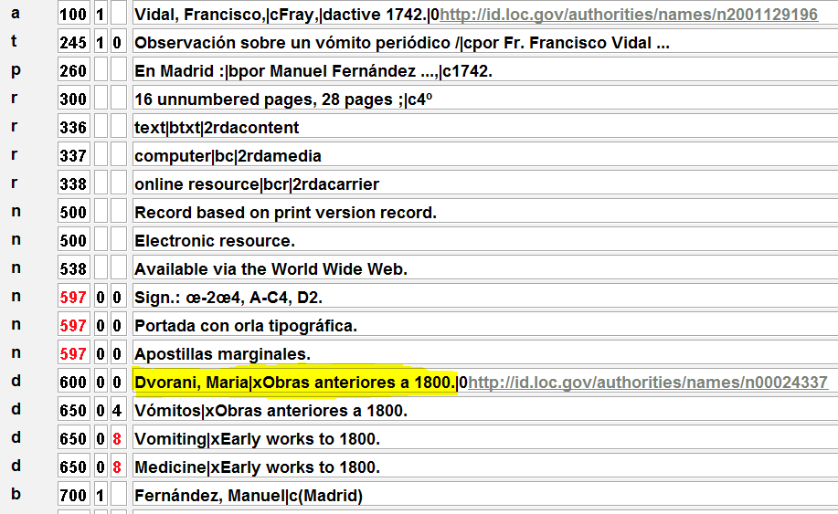
Lessons Learned
Spanish language subject “Medicina” in 650_0 flipped to a 600 00 “Dvorani, Maria” due to x-ref in authority record
Global Update!
Notes:
Vendor records coded as English language of cataloging were actually Spanish language of cataloging. Spanish subjects appeared in 650_0 (coded as LCSH).
Authority record for Dvorani, Maria has cross-reference for “Medicina.”
Note that these records also had the LCSH headings coded as Sears headings!

Slide 20
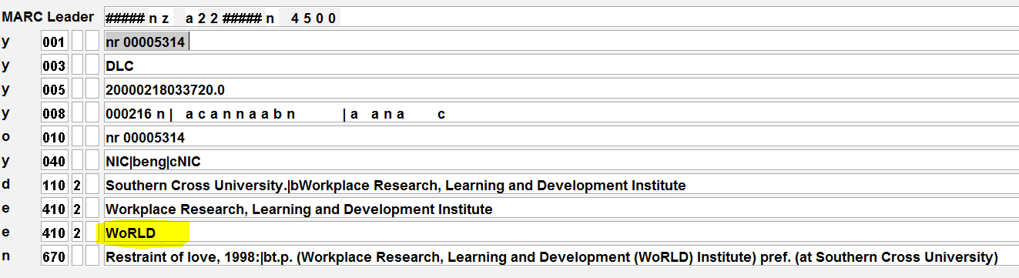
Lessons Learned
-Local project to add genre headings to music records added “World” as a 650_4
-We meant to add “World music.”
-Flipped to a corporate body name due to x-ref in authority record
-Global Update again!

Slide 21
You Can Do It!
Doing automated authority control on your entire catalog seems daunting, but it IS doable
  … and worth the effort!
Reminder about Supportal Solutions
Shameless Plug for III Advanced Authority Control Class
  April 18-20, noon-4 pm Eastern each day (12 hours total)
  To be repeated in the fall
  15% workshop coupon – ask Martha!

Slide 22
Questions?

Slide 23
Thank you!
Lisa Robinson
robin179@msu.edu
Martha Rice Sanders
martha.sanders@iii.com

