Slide 1
Len Davidson and Mary Cate Matta Slides: bit.ly/len-slides
Catholic University Law Library
SQL Direct Access
IUG 2017

Slide 2
SIERRA Only
Will not work with Millennium or Polaris
bit.ly/len-slides

Slide 3
Level of Presentation: Beginner
No experience with Sierra Direct Access
Experience with SQL
bit.ly/len-slides

Slide 4
Outline of Presentation
Advantages & Disadvantages
How to Connect - pgAdmin
SierraDNA - Table & Fields
Sample SQL queries
How to Connect - ODBC
bit.ly/len-slides

Slide 5
Sierra Direct Access VS Create Lists
Can have outside, third party applications | Only from Sierra
Can automate, have a script run every set time period | Can not automate
Can have regular expressions & math equations in query | No mathematics/pattern matching
Text based | Menu driven, prompts

Slide 6
 | Technology | Advantages | Disadvantages
Sierra Direct SQL Access | ODBC | Free All Tables | Dependent on OS, local database Read only Firewall issues, if hosted
Sierra APIs | REST & XML | Independent of OS, local database Read & Write No firewall issues | Cost (Patron API is free) Not all Tables

Slide 7
Documentation - Sierra Direct Access
Sierra Documentation
Sample SQL queries
SierraDNA (Table & Field Definitions)
IUG Clearinghouse
Sierra Listserv

Slide 8
IUG Clearinghouse
Sierra Direct SQL Access – Mark Strang
Sierra SQL Examples – Heather McHenry
Fine Purge Report - Jim Nicholls
Sierra: User Permissions - Mia Massicotte
GitHub Joe Montibello

Slide 9
First Step - Sierra Direct Access
Need Sierra User with correct permission
Login to Sierra Admin Access
Go to Authorizations & Authentication
Select User Name
Under Applications Tab, add Sierra Direct Access

Slide 10
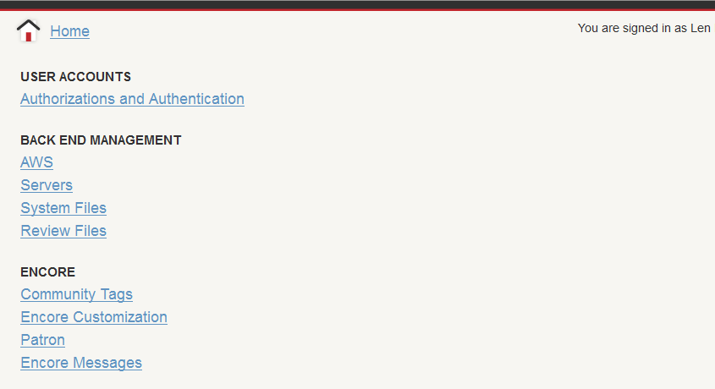
Sierra Admin
https://[your Sierra server]/sierra/admin/

Slide 11
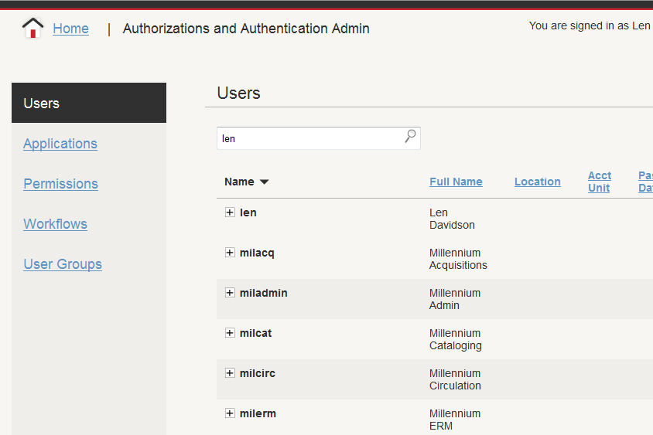
Sierra Admin

Slide 12
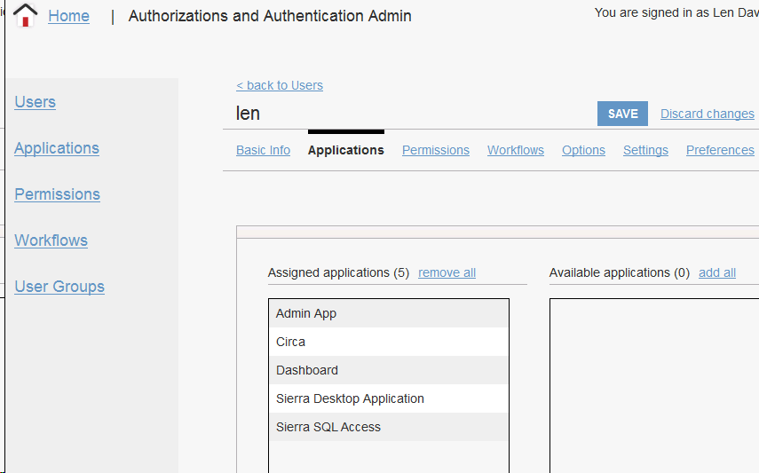
Sierra user for SQL Access
Sierra Administration Application

Slide 13
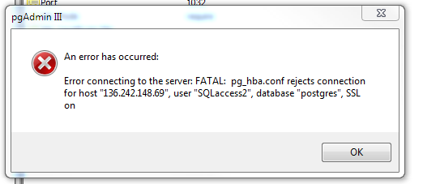
Username must be all lower case

Slide 14
Sierra Direct Access
pgAdmin Software
can test connection
run sample SQL queries
Connect to a Database
e.g. MS Access or MySQL
This tends to be complex, so save it for last

Slide 15
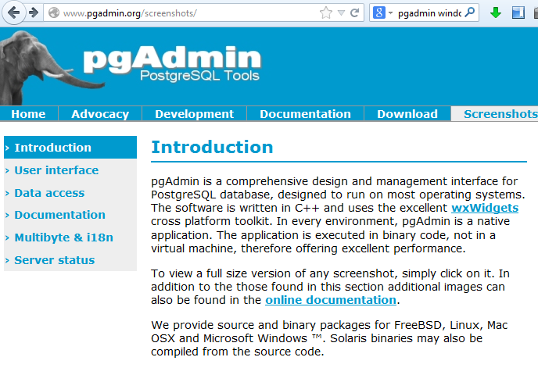
pgAdmin
Management
interface for
SQL database
Versions for:
Windows
Apple OSX
Linux
www.pgadmin.org

Slide 16
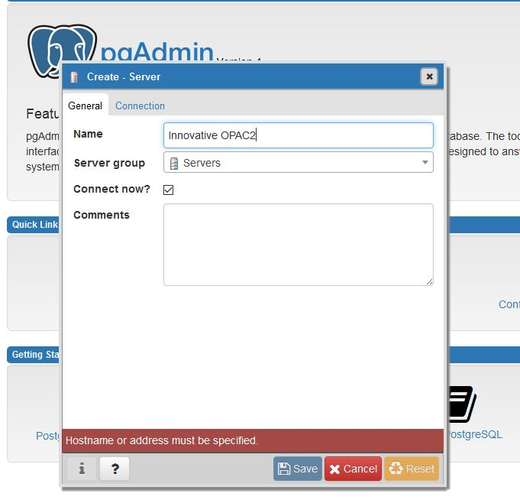
pgAdmin Setup

Slide 17
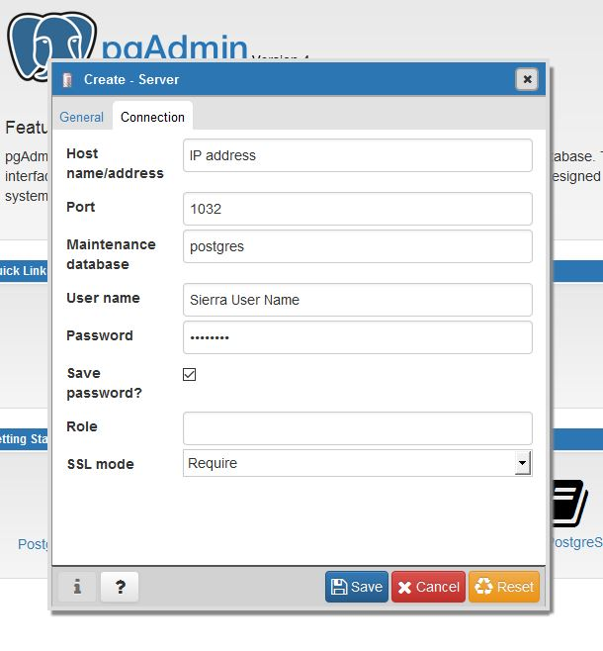
pgAdmin setup
Server IP Address
Port #: 1032
Sierra User Name
Password
database server IP,
not application server

Slide 18
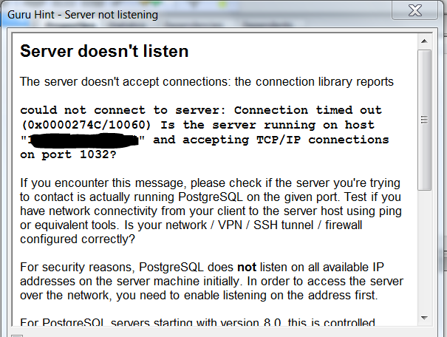
Firewall error

Slide 19
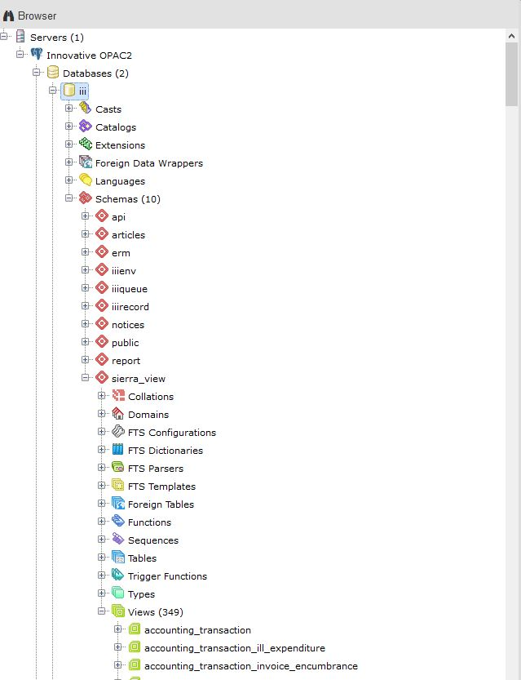
pgAdmin: view or tables

Slide 20
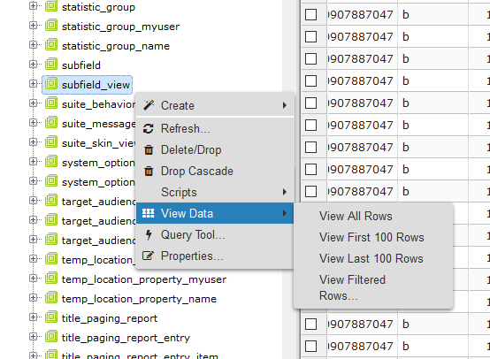
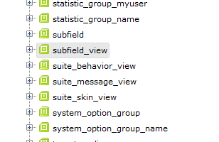
MARC record data: located in table SUBFIELD_VIEW

Slide 21
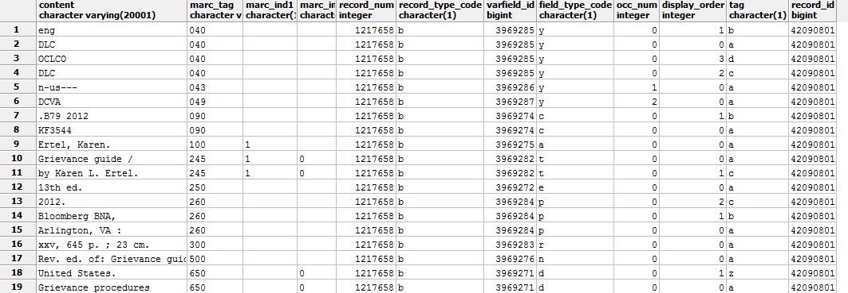
SUBFIELD_VIEW table

Slide 22
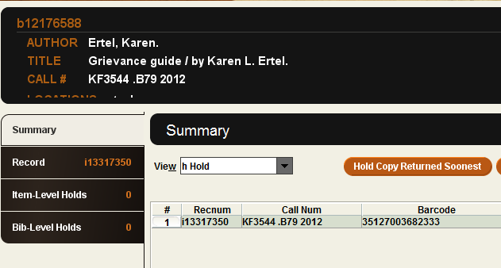
Record Numbers – check digits
Record numbers in
Sierra have check digit
In SQL they do NOT
1217658 vs 12176588

Slide 23
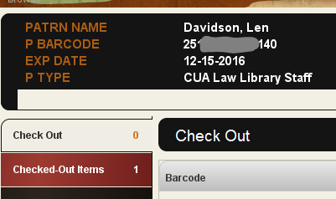
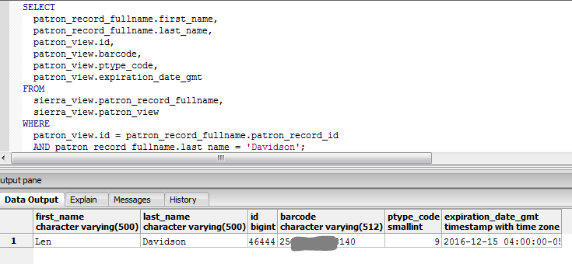
Barcodes – check digits
Both have check digits

Slide 24
Numeric VS Character Fields
WHERE
SUBFIELD_VIEW.RECORD_NUM = 1217658
WHERE
PATRON_VIEW.BARCODE = '1111000090123'
Character fields needs QUOTES

Slide 25
Character Fields, Where clause
WHERE
patron_rec_fname.last_name = 'Davidson'
For case-sensitive, exact match
WHERE
patron_rec_fname.last_name ILIKE ‘d%'
For case-insensitive matches and wildcards (%) use ILIKE
documentation link

Slide 26
Field Data Types, SUBFIELD_VIEW table

Slide 27
More than 340 views or tables
authority_record authority_view
bib_record bib_view
item_record item_view
patron_record patron_view
Advantage: faster more fields
Disadvantage: fewer fields slower

Slide 28
SierraDNA website
http://techdocs.iii.com/sierradna/
340+ views (tables)
Thousands of columns (fields)
Search box, top right

Slide 29
TechDocs - SierraDNA - Entities
  Authority
  Bib
  Contact
  Course
  Holding
  Invoice
  Item
  License
  Order
  Patron
  Vendor
  Volume
  Users
Tables for Patron Entity
iii_language_myuser
iii_language_name
mblock_property
mblock_property_name
notification_medium_property
patron_record
patron_record_address
patron_record_address_type
patron_record_fullname
……

Slide 30
Patron_View
Column | Data Type | Comment
id | bigint | System-generated sequential ID.
record_type_code | char | Record type code, i.e., 'p'.
record_num | int | Record number.
barcode | varchar | The patron's barcode.
ptype_code | int2 | The type of patron. Used to define groups of patrons that may have different borrowing privileges. The library defines ptype codes and definitions.
home_library_code | varchar | The code for the patron's home library.
expiration_date_gmt | timestamptz | The expiration date of the patron's borrowing privileges.
pcode1 | char | The library determines the name and purpose of this code and the code's definition.
SierraDNA:
Patron View

Slide 31
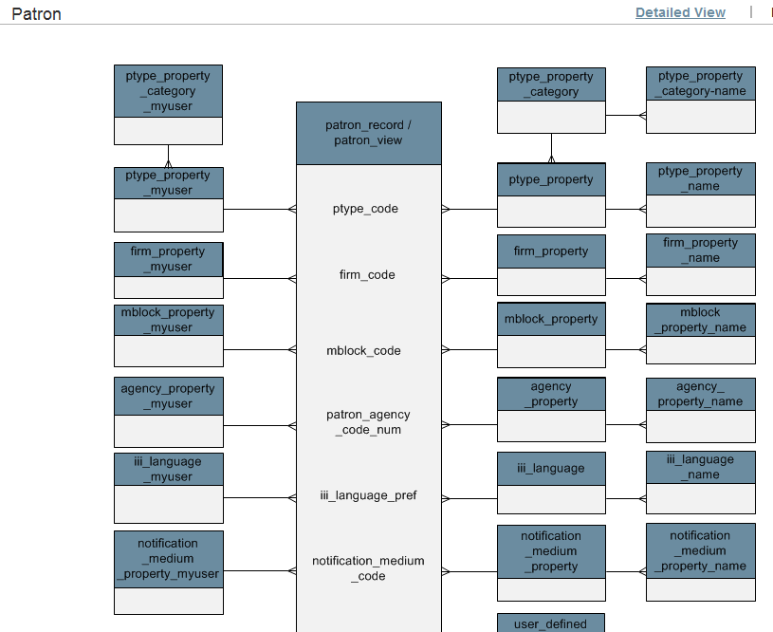
ERD view
ERD for patron view
(entity relationship diagram)
SierraDNA

Slide 32
Things that can go wrong
SQL query can slow system down
"FATAL: too many connections for role…"
Hard to get correct joins
Notes:
200,000 item records
What does hard to get correct joins mean? (give example)

Slide 33
SQL Syntax
SELECT
t1.field_name
FROM sierra_view.table1 t1 -- t1 abbr. for table1 name
JOIN sierra_view.table2 t2 -- t2 abbr. for table2 name
ON t1.record_number = t2.id
WHERE
t1.field_name2 = 'test'
ORDER by t1.field_name2 desc

Slide 34
SQL resources
Sample Queries – CSdirect
PostgreSQL documentation

Slide 35
Sample SQL Queries
Patron list with “bad” emails
New Books list
Previous borrowers of an item
Barcodes to Record Numbers
Find Patrons with > x holds
Expired patrons with checkouts

Slide 36
SQL #1: Bad email addresses
SELECT
email.field_content AS email,
pname.last_name || ', ' || pname.first_name AS name
FROM sierra_view.patron_view pr
JOIN sierra_view.varfield email
ON email.varfield_type_code = 'z' AND email.record_id = pr.id
JOIN sierra_view.patron_record_fullname pname
ON pname.patron_record_id = pr.id
WHERE
email.field_content !~ '[^@]+@[^@]+[.][^@]+'

Slide 37
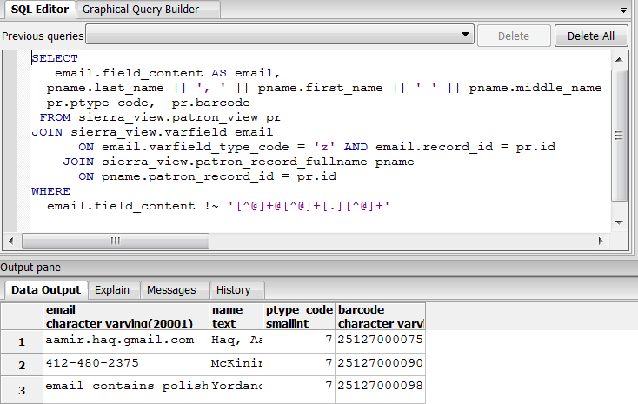
SQL #1

Slide 38
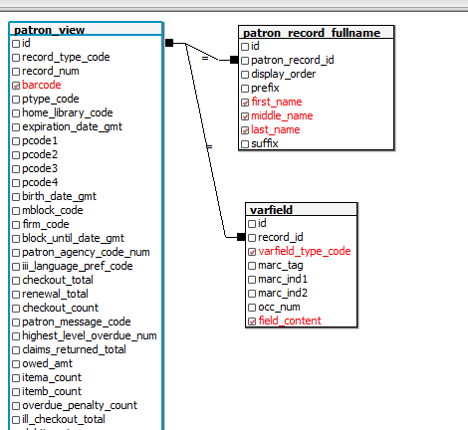
SQL #1

Slide 39
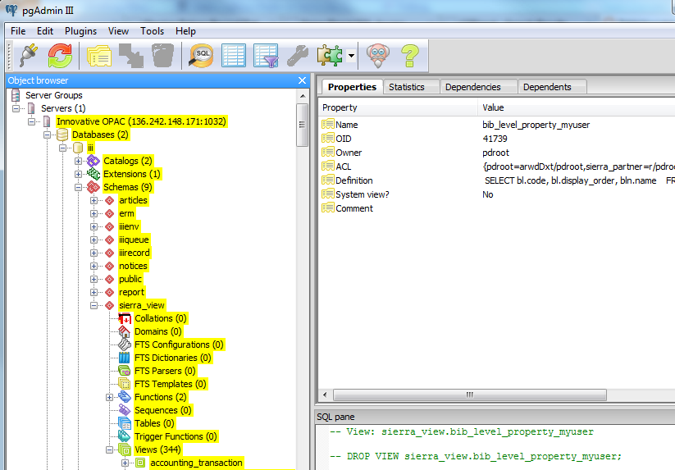
SQL tool

Slide 40
SQL #1: Bad Patron emails
email !~ '[^@]+@[^@]+[.][^@]+'
want email addresses that do NOT match expression
Can not be done in Create Lists,
which only allows MATCHES to regular expressions
postgreSQL regular expressions

Slide 41
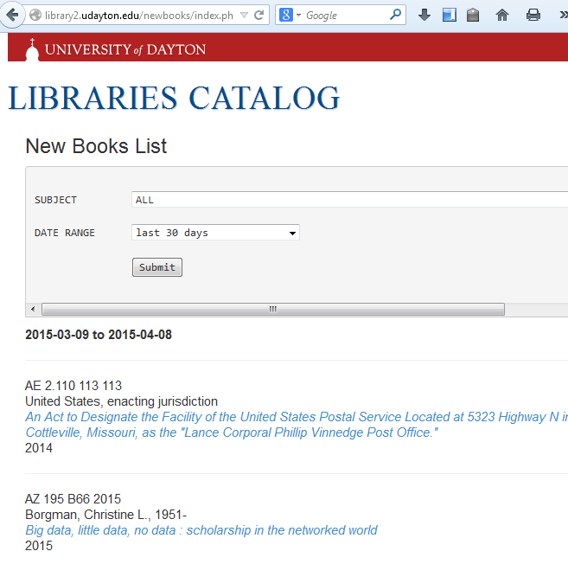
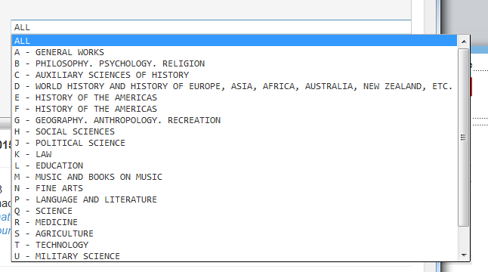
SQL #2: New Books List

Slide 42
SQL #2: New Books List
SELECT * -- S_V must be spelled out to sierra_view
FROM
S_V.bib_record b
LEFT JOIN S_V.bib_record_call_number_prefix n ON (b.record_id=n.bib_record_id)
LEFT JOIN S_V.bib_record_property p ON (b.record_id = p.bib_record_id)
-- now link the bib, to the record(s)
LEFT JOIN S_V.bib_record_item_record_link l ON (b.record_id=l.bib_record_id)
LEFT JOIN S_V.item_record_property I ON (l.item_record_id = i.item_record_id)
WHERE -- Example of limiting to a specific call number prefix (eg, law)
n.call_number_prefix like 'kf' AND
b.cataloging_date_gmt >= date('08/01/2015') AND
b.is_suppressed = FALSE
ORDER BY i.call_number_norm

Slide 43
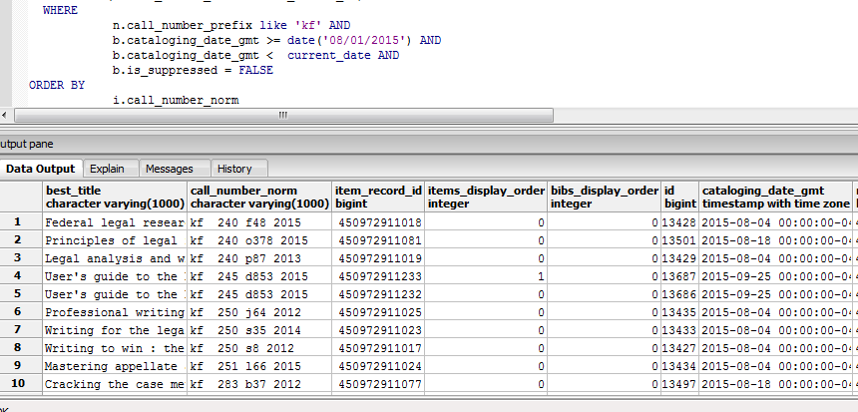
New Books List

Slide 44
SQL #2: Dynamic New Books List
By Raymond Voelker - University of Dayton
new books page: http://library2.udayton.edu/newbooks
view PHP & SQL: https://github.com/rayvoelker/DIY_API/tree/master/code_examples/new_books
ray.voelker@gmail.com

Slide 45
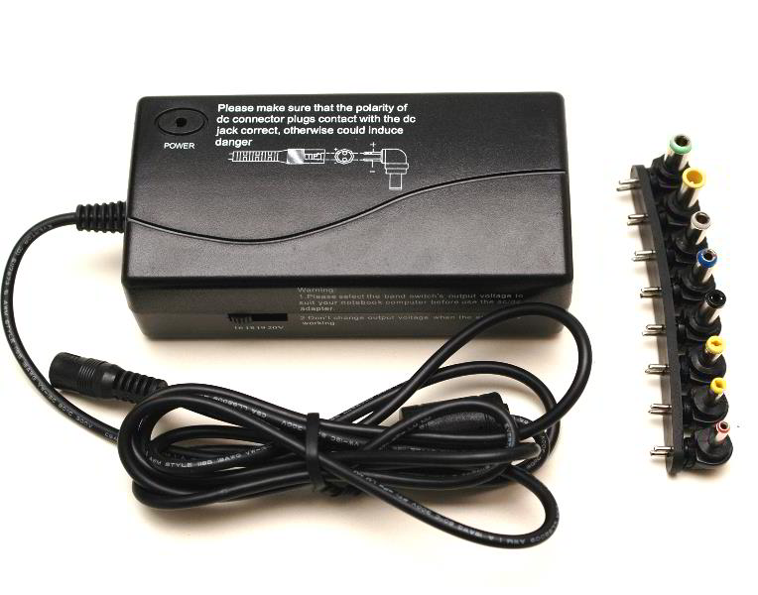
SQL #3: Patrons who have checked out item
Somebody forgot to return attachments
Who were the last people to check out the item?

Slide 46
SQL #3: Patrons who have checked out item
SELECT
circ_trans.patron_record_id, circ_trans.item_record_id,
circ_trans.due_date_gmt, patron_record_fullname.first_name,
patron_record_fullname.last_name
FROM
sierra_view.circ_trans, sierra_view.item_view,
sierra_view.patron_view, sierra_view.patron_record_fullname
WHERE
item_view.id = circ_trans.item_record_id AND
patron_view.id = circ_trans.patron_record_id AND
patron_record_fullname.patron_record_id = patron_view.id AND
item_view.barcode = '11111103690302'
ORDER BY circ_trans.due_date_gmt ASC;

Slide 47
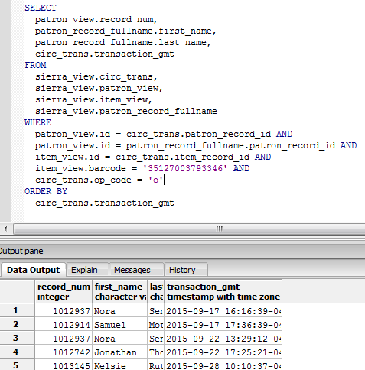
SQL #3:
CIRC_TRANS
table has 14 days
of circ transactions

Slide 48
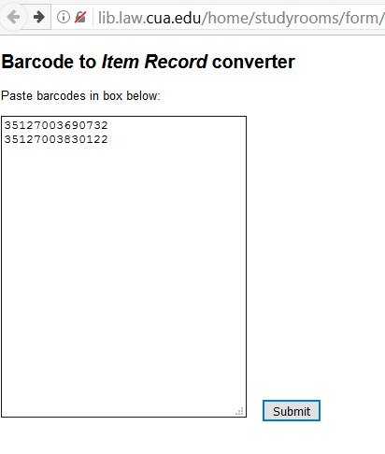
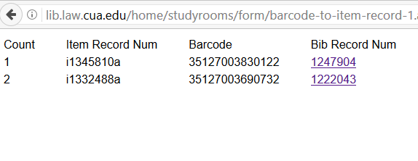
SQL #4: Barcodes to Record Numbers

Slide 49
SQL #4: Barcodes to Record Numbers
SELECT 'i' || i.record_num || 'a' AS item_record_num, i.record_num as item_num,
'b' || b.record_num || 'a' as bib_record_num,
b.record_num as bib_num, i.creation_date_gmt as item_creation_date,
i.deletion_date_gmt as item_deletion_date, b.creation_date_gmt as bib_creation_date, b.deletion_date_gmt as bib_deletion_date
FROM
sierra_view.phrase_entry AS e
LEFT OUTER JOIN sierra_view.record_metadata AS i
ON e.record_id = i.id
LEFT OUTER JOIN sierra_view.bib_record_item_record_link AS l
ON i.id = l.item_record_id
LEFT OUTER JOIN sierra_view.record_metadata as b -- now get the bib record num
ON l.bib_record_id = b.id
WHERE
(e.index_tag || e.index_entry) in ('b00000009690732', 'b00000009830122' );

Slide 50
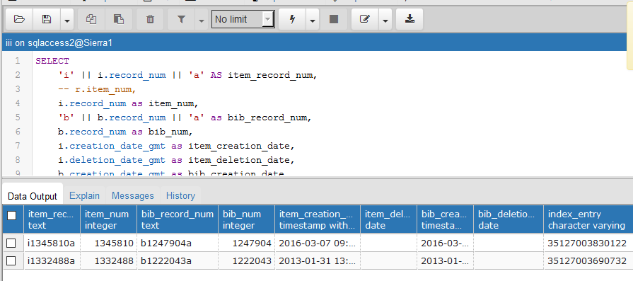
SQL #4: Barcodes to Record Numbers

Slide 51
SQL #4: Barcodes to Record Numbers
Purpose:
  scan items to get barcodes,
  convert to record numbers,
  import into Sierra Create Lists
By Ray Voelker ray.voelker@gmail.com
Code: http://github.com/rayvoelker/DIY_API/tree/master/code_examples/translate_barcodes

Slide 52
SQL #5: Find Patrons with > 5 holds
SELECT
p.record_num AS "patron_record",
count(h.id) AS "number_of_holds"
FROM sierra_view.patron_view p
JOIN sierra_view.hold h ON h.patron_record_id = p.id
GROUP by 1
HAVING count(h.id) > 5
ORDER by 2 desc
Notes:
From Sierra documentation

Slide 53
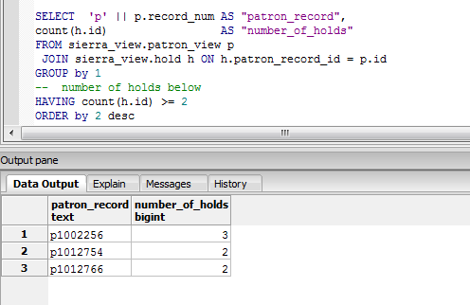
SQL #5:

Slide 54
SQL #6 – expired patrons with checkouts
select
p.record_num as "patron_record",
max(n.last_name) as "last_name",
max(n.first_name) as "first_name",
p.expiration_date_gmt as "expiration_date",
count(c.id) as "checkout_count"
from
sierra_view.patron_view p
join sierra_view.patron_record_fullname n on n.patron_record_id = p.id
join sierra_view.checkout c on c.patron_record_id = p.id
where
p.expiration_date_gmt < current_date -- SQL function, gives current date
group by 1,4
order by 5 desc

Slide 55
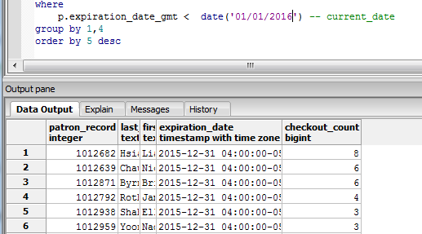
SQL #6: expired patrons with checkouts

Slide 56
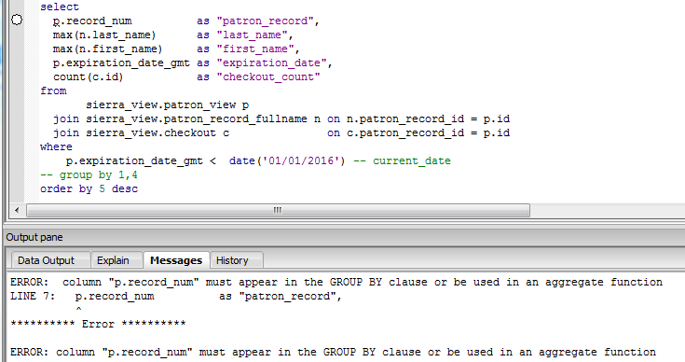
SQL 6#: expired patrons with checkouts

Slide 57
Using outside Databases
Using Sierra Direct Access
with outside applications

Slide 58
MS Access connection
Studyroom Reservation System
uses MS Access running on Windows OS
SQL to validate barcode from patron table

Slide 59
ODBC Setup - Windows
Download/install PostgreSQL database
drivers on the PC ( www.postgresql.org )
Open Data Sources (ODBC) and create
System DSN for the OPAC.
Open MS Access and connect to
ODBC DSN you created in step 2.
Sierra Documentation

Slide 60
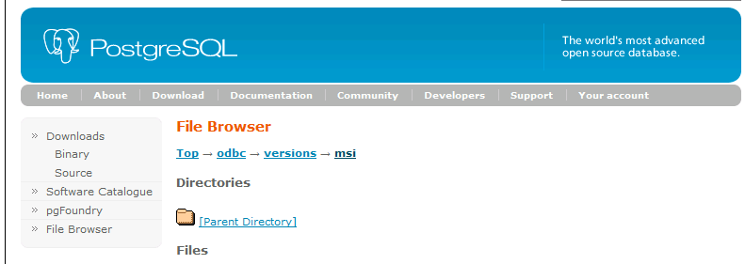
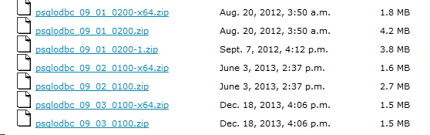
1. Download ODBC Driver
https://www.postgresql.org/ftp/odbc/versions/msi/

Slide 61
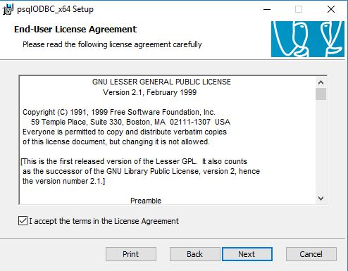
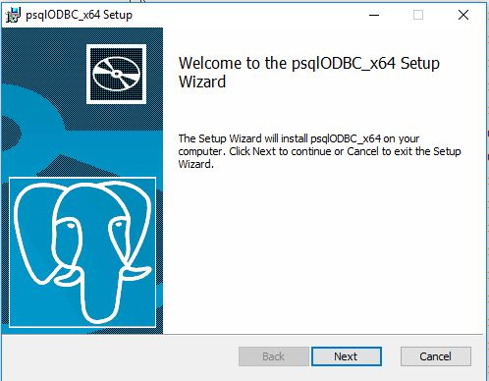
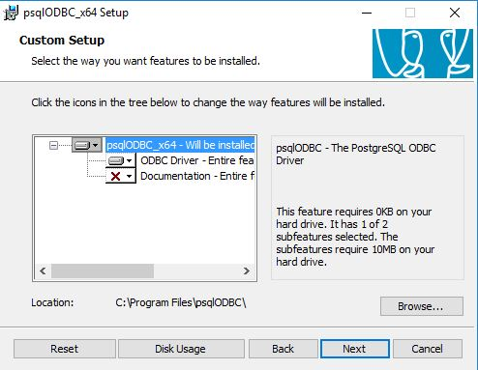
Install PostgreSQL driver

Slide 62
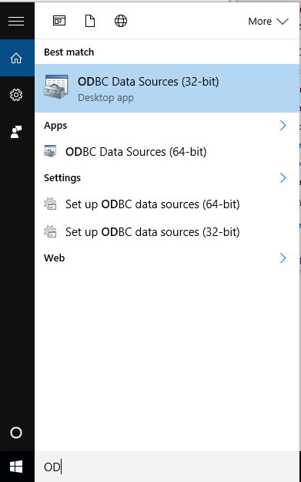
2. Create ODBC data source
Open Data Sources (ODBC)
ODBC = Open Database Connectivity
DSN = Data Source Name

Slide 63
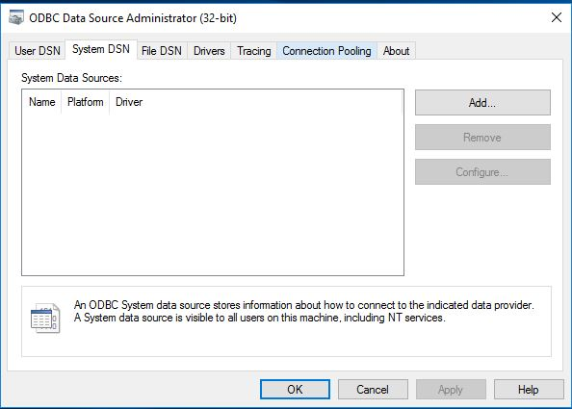
ODBC Data Source Administrator

Slide 64
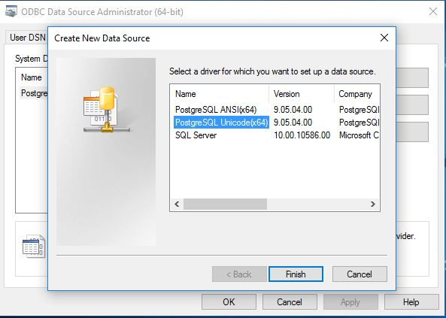
Unicode vs ANSI
PostgreSQL Unicode:
database uses UTF-8 character set
PostgreSQL ANSI:
database uses LATIN character set
Reference

Slide 65
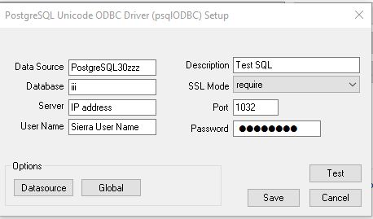
System DSN Settings
Database: iii SSL Mode: require
Server: server IP Port: 1032
User Name: Sierra user Password: password
NOTE:
database server IP,
not application server
Sierra Documentation

Slide 66
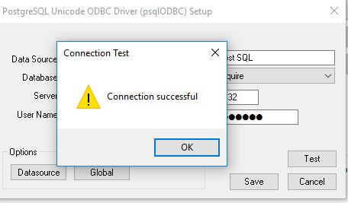
Testing Connection

Slide 67
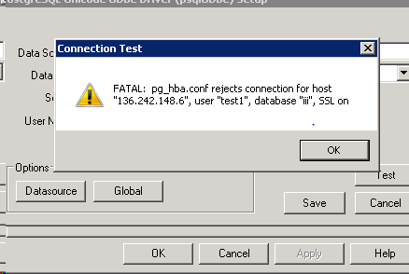
Error – permissions for Sierra User

Slide 68
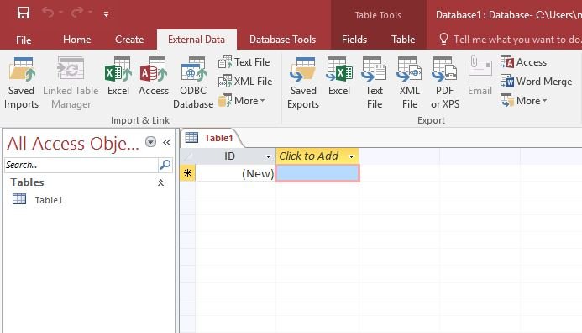
2. Connecting from MS Access
External Data tab, ODBC Database

Slide 69
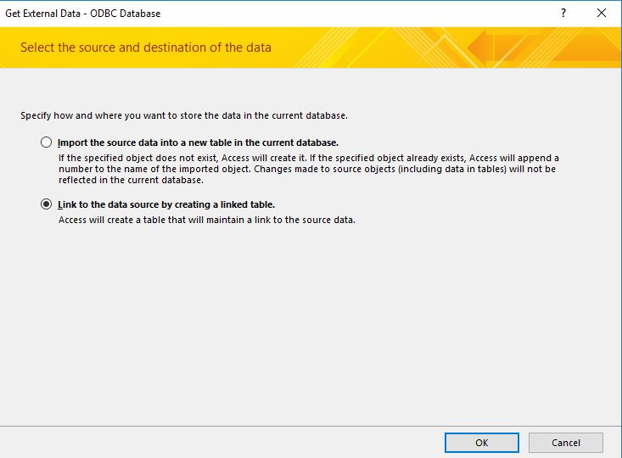
ODBC to MS Access connection

Slide 70
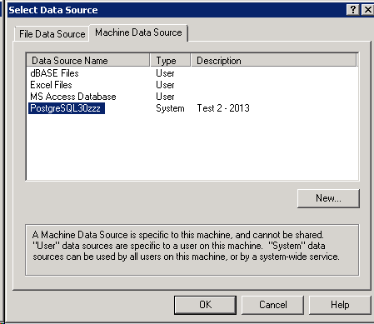
ODBC to MS Access connection

Slide 71
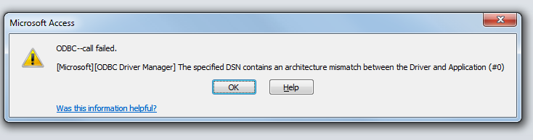
Error: DSN setup
"The specified DSN contains an architecture mismatch"
Problem: MS Access is 32 bit, operating system is 64 bit,
32 bit MS Office need 32 bit ODBC driver
Microsoft Documentation *** Sierra Documentation

Slide 72
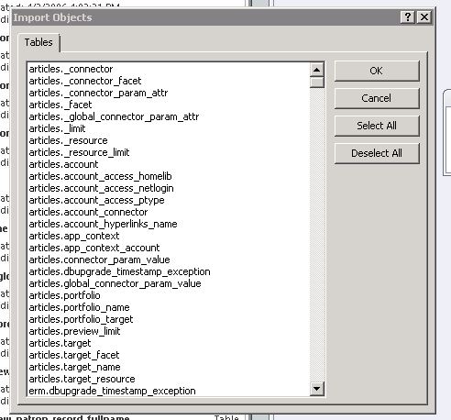
Tables from OPAC

Slide 73
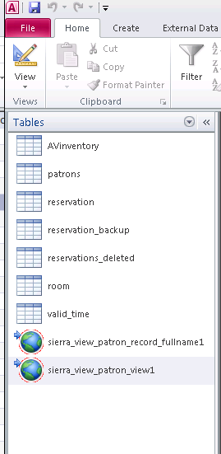
Linked tables in MS Access
If you do the link successfully

Slide 74
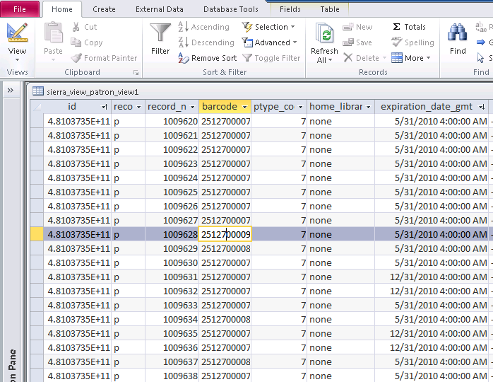
OPAC tables in MS Access

Slide 75
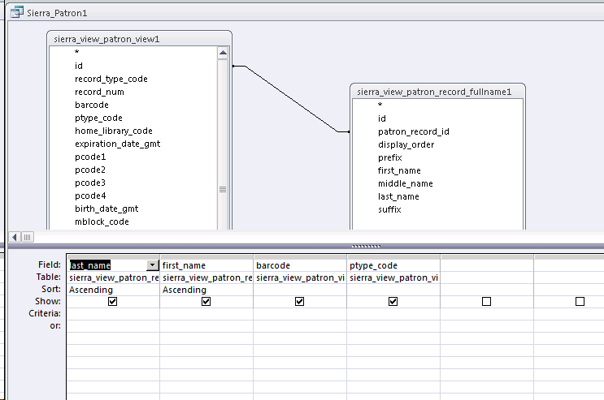
Access SQL query with Sierra Tables

Slide 76
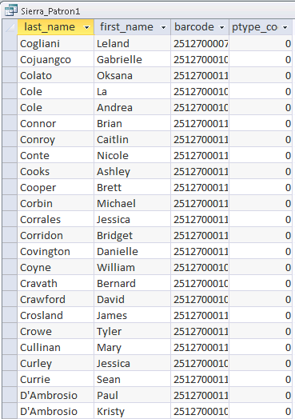
SQL output from Access database
Once you have data in MS Access,
you can take advantage of Word Mail Merge

Slide 77
Connecting to other databases
MySQL database ODBC setup
MS SQL Server ODBC setup
Filemaker Pro ODBC setup

Slide 78
The End
Len Davidson davidson@cua.edu
Mary Cate Matta mattamr@cua.edu

Slide 79
Appendix: SQL Access License
Permission to access this Sierra system's PostgreSQL database (hereafter, ACCESS) is granted, provided that;
1. ACCESS is limited to employees, contractors, or agents of the library or other organization licensing this Sierra platform instance (hereafter, PLATFORM LICENSEE)
2. ACCESS is limited to non-commercial use.
3. PLATFORM LICENSEE acknowledges that ACCESS can disclose individual's private or personal information stored in Sierra outside of Sierra's other protections, and that access to such information is commonly protected by local, state, and national law, and that the PLATFORM LICENSEE is responsible for the proper administration of ACCESS to assure compliance with applicable law, including but not limited to informing users of their obligations under applicable law.
4. ACCESS is limited to read-only (no update) access to the database table Views described by Innovative in the separately published Sierra database schema (hereafter, MANAGED DATA), further identifiable as that data to which access has been granted for these specific credentials, subject to the limitations of 5, below
5. PLATFORM LICENSEE acknowledges this Sierra system and database contain in addition to MANAGED DATA, certain other data including but not limited to configuration information, Sierra internal or Sierra generated transforms of managed data, passwords, license keys, or other license specific data which are considered by Innovative to be confidential, proprietary, and private extensions of the licensed Sierra platform software itself (hereafter, PRIVATE DATA), and agrees it will not attempt to gain access to this PRIVATE DATA either by circumvention of the limits placed on these credentials or by other means, and that should it gain access to PRIVATE DATA by any means, it shall make no use of such PRIVATE DATA and shall hold that PRIVATE DATA in the strictest confidence using the same degree of care, but no less than a reasonable degree of care, it uses to protect its own confidential information.
6. The PLATFORM LICENSEE acknowledges ACCESS is separate from, and incidental to, the claimed, supported, defined, or guaranteed capabilities of the Sierra platform licensed software including but not limited to the capabilities of the desktop application and published API's, and that Innovative makes no claim regarding the suitability or fitness for any purpose of this ACCESS beyond that the data is as described in the separately published Sierra database schema. In the event of a problem relating to the claimed, supported, defined, or guaranteed capabilities of the Sierra platform software, including but not limited to performance or response time, where that problem is found to be directly or indirectly due to use of the ACCESS, the PLATFORM LICENSEE agrees either to discontinue the ACCESS found to have been interfering with the Sierra platform software, or to accept the problem as a consequence of that ACCESS, waiving any other rights it might otherwise have to request remediation of the problem.

Slide 80
Alternative to pgAdmin
iReport Designer
https://community.jaspersoft.com/project/ireport-designer
Free, open source report designer

