Slide 1
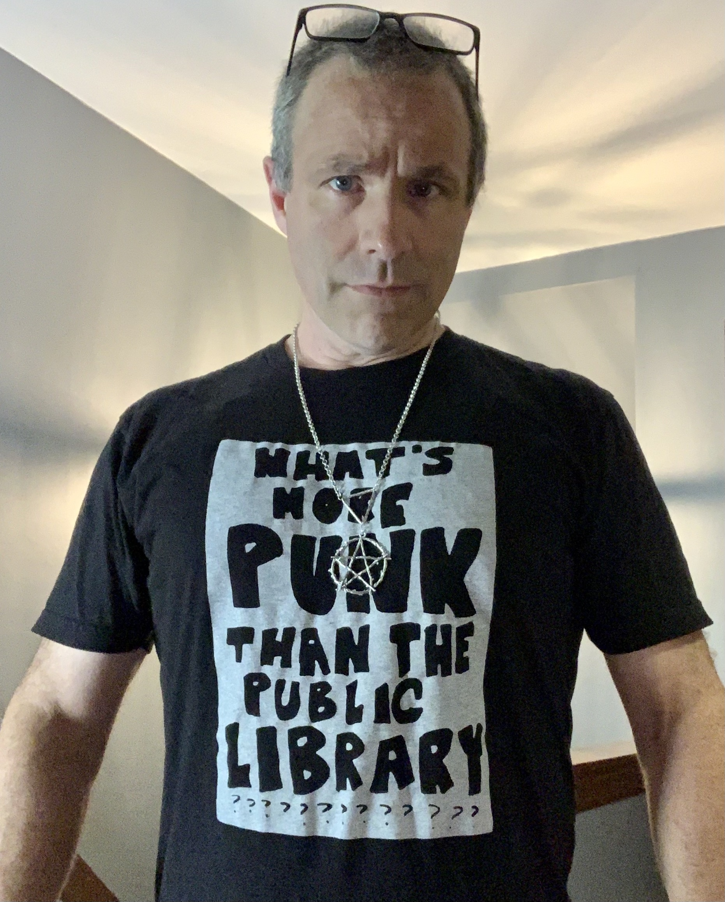
Daniel Messer
Library Systems & Services
Cyberpunk Librarian
Presentations:
A Good Idea at the Time: Polaris, Projects, and Pathos
Repo, Man: Curate Your Code Because Folders Aren’t Findable
You’ll find more information about the topics of my presentations at:
cyberpunklibrarian.com/iug2022
Questions, Comments, and Commiserations
Email: cyberpunklibrarian@protonmail.com
Mastodon: @cyberpunklibrarian@hackers.town
Discord: CyberpunkLibrarian#7569
Also…
Polaris SQL: cyberpunklibrarian.nohost.me/usefulpolarissql/
Semi-Competent Code: gitlab.com/cyberpunklibrarian
Podcasts: cyberpunklibrarian.com

