Slide 1
Solutions to two issues with Marcive authority process
Lloyd Chittenden
Marmot Library Network

Slide 2
Retrieving Deleted Record Numbers For Marcive

Slide 3
The only way to get these numbers from Sierra is SQL
SELECT 'b' || rm.record_num ||
COALESCE(
CAST(
NULLIF(
(
( rm.record_num % 10 ) * 2
+ ( rm.record_num / 10 % 10 ) * 3
+ ( rm.record_num / 100 % 10 ) * 4
+ ( rm.record_num / 1000 % 10 ) * 5
+ ( rm.record_num / 10000 % 10 ) * 6
+ ( rm.record_num / 100000 % 10 ) * 7
+ ( rm.record_num / 1000000 ) * 8
) % 11, 10 ) AS CHAR(1)
), 'x' ) AS "Bib NUMBER"
FROM
sierra_view.record_metadata as rm
WHERE
rm.deletion_date_gmt > '2021-11-14' AND rm.record_type_code = 'b'
LIMIT 100000;

Slide 4
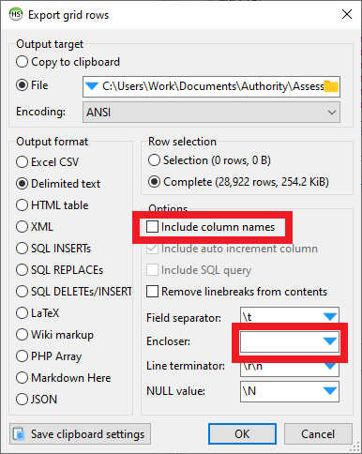
This process will add the check digits even though SQL does not normally include it
It will get all the records deleted after the date in the code
I keep a log of the date I get these records, so I know what date to use the next time
HeidiSQL
Export grid rows
Delimited text
Do not include column names
No Encloser

Slide 5
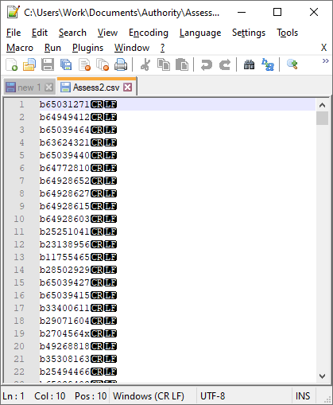
Submit only .b numbers

Slide 6
Using “RELATED” files from Marcive to create notes in MARC records

Slide 7
Marcive sends files with lists of problem headings
These are text files named RELATED, RELATED2 and RELATED3.
Our consortium members don’t use these files because we share a single database and the file doesn’t tell whose records have problems
This process converts the text files into MARC files that can be loaded into Sierra and added as notes directly to the records with problems
Each member can now find their records that have authority problems

Slide 8
Demostration
Processing instructions in google doc
https://docs.google.com/document/d/1ng8rZ0fzJezy8Xf3IKgLPOoc1bVhPJ_EgtZ1qPAm2pk/edit
Once files are processed and verified in MarcEdit, load into Sierra.
Special load profile will match on .b number in 907 field and only insert 933 note

Slide 9
THANK YOU
Questions can be emailed to Lloyd@marmot.org

