Slide 1
Automating the Authority Control Process
Stacey Wolf

Slide 2
Outline:
What is authority control?
Me and my library
Different ways to automate authority control processes
Some ideas on how to automate the authority control maintenance process
Tips
Resources and Questions
2
Notes:
Here's what I plan to cover today:
I'll tell you a little bit about me and the library I work at
I'll talk about the different ways you can automate the authority control process in general
I'll show you some different methods I have come up with to automate maintaining your authority file as new updates occur
I'll give you a few tips, some links to resources and then take any questions you might have.
I should probably state now that this presentation will be a bit technical, with regular expressions and JSON coding throughout. I hope everyone here has a basic knowledge of cataloging, MARC format, and maybe some authority control basics. I'm not expecting you to write your own Regular Expressions though. It'll mostly just be copy and paste instructions. I'll do my best to explain what each expression is doing. This can make the slides look very crowded, but I think it’s worth it for those who want to learn more about how what they’re doing works. I will provide a link to a text document of these procedures at the end of the presentation as well as some resources I find helpful when using Regular Expressions.

Slide 3
What is Authority Control?
“Authority control (or access point control) refers to the normalisation of controlled access points (headings) and the provision of alternative and related access points.” (pg 45, Žumer, 2009)
Collocates all works by a specific author
Helps disambiguate people, corporate bodies, or titles
Can “identify and relate resources by subject” (pg. 45, Žumer, 2009)
3
Notes:
So what is authority control?
Why do I want to do it, let alone automate it?
According to IFLA, “Authority control (or access point control) refers to the normalisation of controlled access points (headings) and the provision of alternative and related access points.”
For example, an authority record establishes a certain spelling and form of a name as preferred and lists alternate spellings, forms, etc. of that name, as well as related access points.
The same can be true with subjects and titles.
By using the same form of an access point (like the author or the subject or the series title), authority control helps users find everything by a certain author or on a specific subject.
Authority records contain information that can help users disambiguate names of people, corporate bodies, and titles; this is very helpful with common names, like John Smith.
Authority control can also help users identify other subject terms to use by providing broader or narrower terms related to that subject.

Slide 4
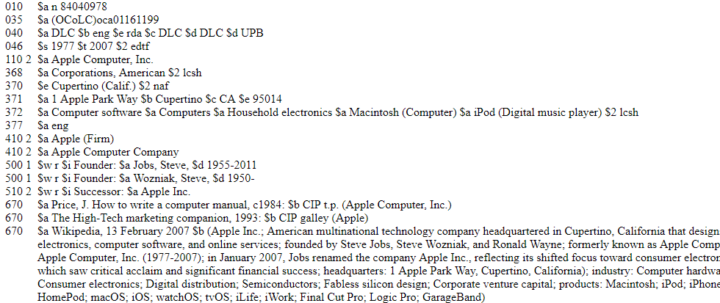
Name Authority Record-Apple Computer, Inc.
4
Notes:
Newer authority records have more information in them, while still maintaining the standard fields.
You have the authorized access point (Apple Computer, Inc.)

Slide 5
Name Authority Record-Apple Computer, Inc.
5
Notes:
Other names of the company are Apple (Firm) or Apple Computer Company. If you were to search by one of these names, the authority record would redirect you to the authorized form of Apple Computer, Inc.

Slide 6
Name Authority Record-Apple Computer, Inc.
6
Notes:
This record also has extra information linking it to the founders of the company, Steve Jobs and Steve Wozniak. It also tells you that this company has changed its name to Apple, Inc., and provides a link to that record.

Slide 7
Name Authority Record-Apple Computer, Inc.
7
Notes:
There is a lot more descriptive information in this record, like the company’s headquarters, their fields of activity (like computer software, household electronics, Macintosh, and Ipod).

Slide 8
Name Authority Record-Apple Computer, Inc.
8
Notes:
The sources for this information are listed at the bottom of the record.

Slide 9
About Me
Started at UNT in 2013
Batch e-resource record editing and loading
Juvenile books
Authority control
Notes:
I started at UNT in 2013, just as RDA was being implemented.
I started as a para-professional staff copy cataloger, specializing in juvenile books and authority control. My job responsibilities eventually grew to include batch e-resource record editing and loading
In 2016, I was promoted to Cataloging and Metadata Librarian. My tasks remained mostly the same (just more complicated), and now I supervise the staff person who does most of the library's authority work.
Over the last few years, I have led an enormous project to outsource our authority work to a vendor.

Slide 10
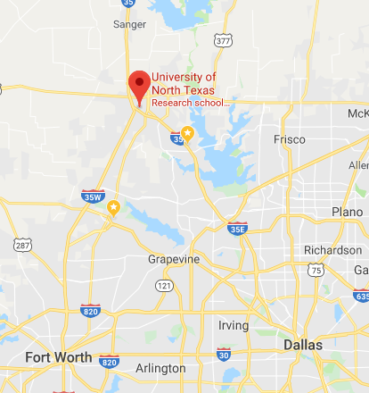

University of North Texas - Denton, Texas
Map source: google maps
10
Notes:
The university of north texas is located in Denton, Texas, which is about midway between the Oklahoma boarder and Dallas and Fort Worth Texas. UNT is one of the nation’s largest public research universities
We are Ranked as a Tier One research university by the Carnegie Classification. We have a world-reknown music college and a fantastic music library to support it.

Slide 11
UNT Libraries' Catalog
Sierra ILS
Nearly 3 million records
Add about 100,000 records annually
7 catalogers do their own authority work
Decentralized cataloging
1 person does all of the library's authority work
Notes:
The UNT library catalog runs on III's Sierra.
We have about 3 million records. We just sent about 2.8 million records to OCLC for a holdings reclamation project (but that's a whole other presentation).
We add about 100 thousand records each year, with about 75% of those being e-resources from vendor batch records.
UNT libraries has decentralized cataloging, with Media, Music, Government Documents, and Special Collections doing their own cataloging.
There are 7 catalogers in the main cataloging and metadata services department who all do their own authority work.
One staff person is trained to do the authority work for the rest of the library, sending new names and subjects or problems to that specific department.

Slide 12
Local authority control priorities (Then)
Search OCLC for every new name and subject
Download the authority record to the correct index if it was established and it had a cross reference or see also reference (4xx and 5xx)
Validate new names and subjects
Update authority records with closed dates and LCSH updates
12
Notes:
When I started at UNT in 2013, I worked with a librarian and another staff person to do all the library's authority control.
We would
Search OCLC for every new name and subject heading that came up on the heading report,
Download the authority record to the correct index only if it had been established and it had a cross reference or see also reference (4xx and 5xx)
This was the time we would validate new names and subject and make sure the form was correct in the newly cataloged record as well as existing records in our ILS. Sometimes, if a name had changed, we needed to update the authority record and the bib records.
We also used LC's updated subject heading lists and OCLC's closed dates lists to update our authority records (and in turn bib records).
We took turns running daily reports and everyone worked on the update lists as they had time.
This all became difficult to maintain as RDA changed hundreds of thousands of authority records and our library staffing changed
A three person team of staff and librarians working on authority control became a team of one or two (depending on staffing at the time)
Also around this time, our library started looking at what other institutions our size do for catalog maintenance. With the addition of a new head of cataloging in our department, we went ahead with exploring using a vendor for authority control, so we needed to re-prioritize our current authority work.

Slide 13
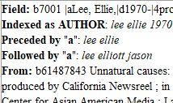

Local authority control priorities (Now)
Utilize the "preceded by" and "followed by" lines to see if there is a potential conflict and only investigate those
Don't load new subject headings records
Don't update authority records as the national authority file changes
General collection catalogers do their own authority work
13
Notes:
Now, instead of searching for every new name, we have started using the "preceded by" and "followed by" lines to see if there was a potential conflict and only investigate those in OCLC. If we search for a record in OCLC and find one, we can download it to our ILS if we want, even if there are no cross references. (if we spent that time to look for the record, might as well use it)
We are not loading new subject headings records.
We are not bothering to update our authority records with LC's updated LCSH lists and OCLC's closed dates lists. It took too much time to look up each listed heading in our catalog (in two different indexes for names).
We figure the vendor will eventually provide us with subject records and updated records, so we won't use precious staff time working on that now.
I also trained our department of 7 catalogers on how to do their own authority control work
They validate headings in OCLC or MarcEdit before importing records.
They should look through the new names list in the headings report in Sierra
They are supposed to look for duplicate records and invalid headings.
We still have one staff person doing the heading reports for the rest of the library. Using the new process though, it takes only an hour or two to complete, instead of several hours.

Slide 14


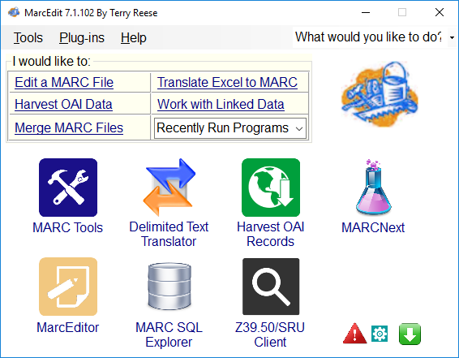




Automate!
14
Notes:
The most time-effective way to handle authority work is to automate it as much as possible. Working in large batches can often be quicker than individually trying to search for each new name or subject heading. There are a variety of ways to automate authority work. Some tools include OCLC Connextion, MarcEdit, your ILS, Notepad++, Excel and vendors. OCLC Connexion is where my library finds it's bibliographic and authority records to download into our ILS. We use Notepad++ and Excel all the time to examine and manipulate our data. Excel is helpful in many ways, especially with the text to column feature and conditional formatting where you can highlight duplicates. Notepad++ is great to use with Regular Expressions and save data in a plain text format. Throughout the rest of my presentation, I will try to indicate what program(s) I’m using on that slide with a thumbnail of the program’s logo. So bear with me.

Slide 15
Sierra (or your local ILS)
Heading Reports can identify new names and subjects, invalid uses, and duplicate records
Bibliographic Maintenance feature automatically updates bib records to a match new heading over night
15
Notes:
As I mentioned before, we use Sierra for our ILS. So during this presentation, I will probably use Sierra or your ILS interchangable. Hopefully, if you have a different ILS, yours has features similar as these.
I can run a heading report in Sierra to identify new names and subjects, invalid uses (usually appears because the bibliographic heading matches on a 4xx field in the authority record), and duplicate records.
Some ILS have a bibliographic maintenance feature that will automatically update bib records to a match new heading over night, but only if the heading in the bib record matches a 4XX in the authority record. I'm still not very familiar with how that program works.

Slide 16
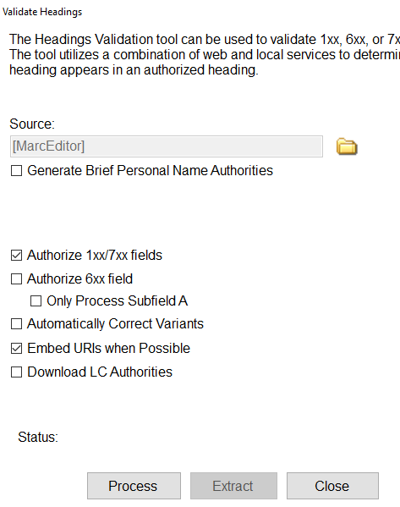
MarcEdit
Validate names and subjects
Correct variants to the right format
Download authority records
Add URI to $0
16
Notes:
MarcEdit is a free software that Terry Reese provides to catalogers. It will authorize/validate names and subjects for you so you know you have the right format before ever loading your records. It will provide a report for you to fix varients, or you can set it to automatically correct them.
It will even add the URI in $0 for you if you are preparing for linked data in your catalog (or it's handy for batch-searching OCLC later for the authority records to add to your catalog)
You can also have it download the authority records that match the validated headings in your file (but I haven't played with that feature very much).
MarcEdit is a great tool for editing batches of records quickly before loading them into the ILS where making mass changes is much more clunky. This is where I really learned how to use Regular Expressions.

Slide 17
Vendors
automated process for
on-going maintenance
cleaning up records
validating headings
providing authority records
notify the library if authorities change or are newly created from backfile
process new bibliographic records
17
Notes:
Vendors like Backstage and MARCIVE allow libraries to send a back file of all their records which are updated and validated. Each vendor has their own special programming to fix field tags, indicator errors, and incorrect subfield coding; both vendors offer RDA enrichment services, creating hybrid RDA records out of older AACR2 records by adding certain fields. The library can decide all kinds of customizations they want made to their processing profile, usually based on local practices and policies. Once the records are cleaned up, they are run through as many authority files as you want to validate headings. The library gets the updated bibliographic records back as well as files of authority records. Both vendors offer a current cataloging service so that you can send newly added bibliographic records to your profile. Ongoing maintenance keeps your authority records up-to-date as national authority files are updated. This can be a wonderful option, if you have the money to spend on it. It can cost tens of thousands of dollars depending on the size of your catalog. And you will still need a staff person to run reports, create files, and reload records.

Slide 18
Batch-loading
New Authority Records
Notes:
We've used a combination of heading reports, marc edit and oclc to batch load authority records for certain files of vendor records
(I'm just going to do a quick overview, because someone presented on something very similar last year here; while our process is a little less technical, I believe the next section that I want to cover in more detail is very similar)

Slide 19
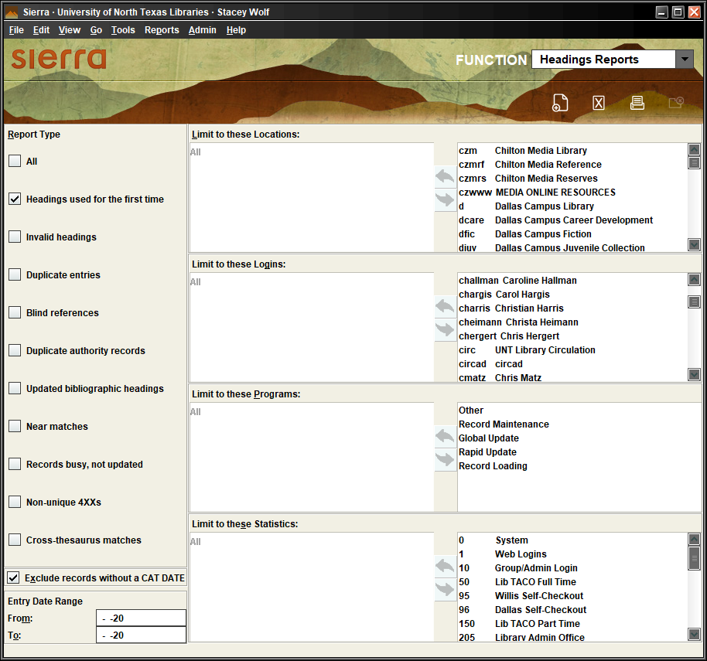
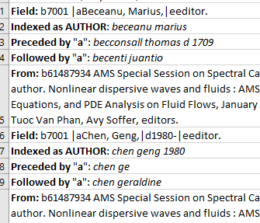
Load records into Sierra, run Heading Reports, copy new names to Excel
19
Notes:
Load records into Sierra, run heading reports, copy new names to excel

Slide 20
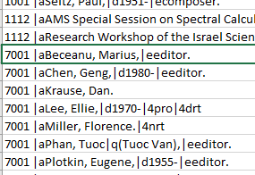
Clean up copied information so just the name remains​
20
Notes:
Clean up copied information so just the name remains
(you can just save these as a text document and run through OCLC batch authority search, but you get a lot of matches on some that you have to sort through)

Slide 21
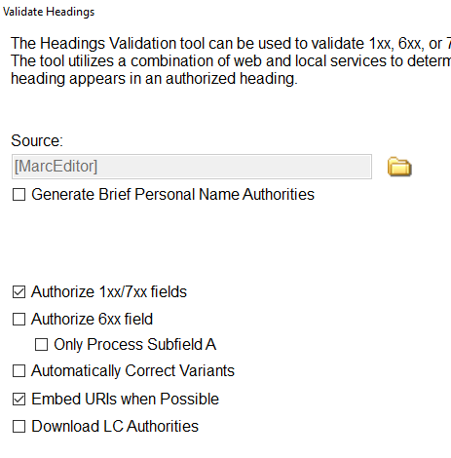
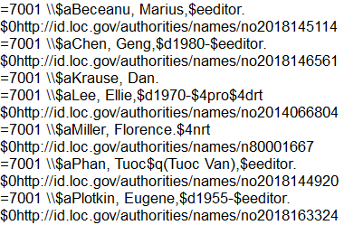
Validate names in MarcEdit, adding $0​
21
Notes:
We either use the original vendor file (if these will be the only bib records in the headings report) or turn the Excel file into MARC records, but we validate names in marc edit, adding $0

Slide 22
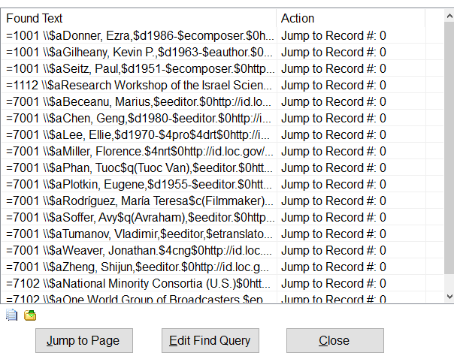
Copy $0 search to Excel
22
Notes:
Use a search in MarcEdit for $0 to copy to Excel

Slide 23
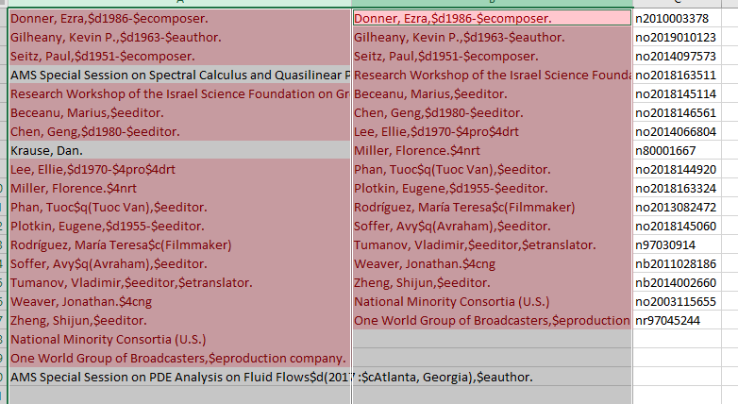
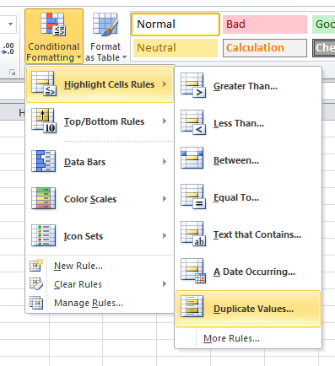
Compare against new names from the Heading Report​
23
Notes:
Isolate the LCCN and possibly the name in the same format you have from the Headings Report. If using a vendor file of records, we do not need all of the $0 because we may already have the authority record in our ILS. So use conditional formatting to find duplicates and use only those LCCN to search OCLC.

Slide 24
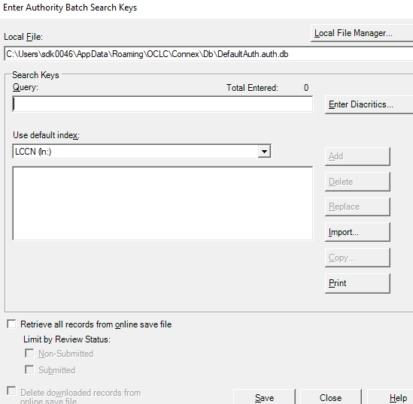
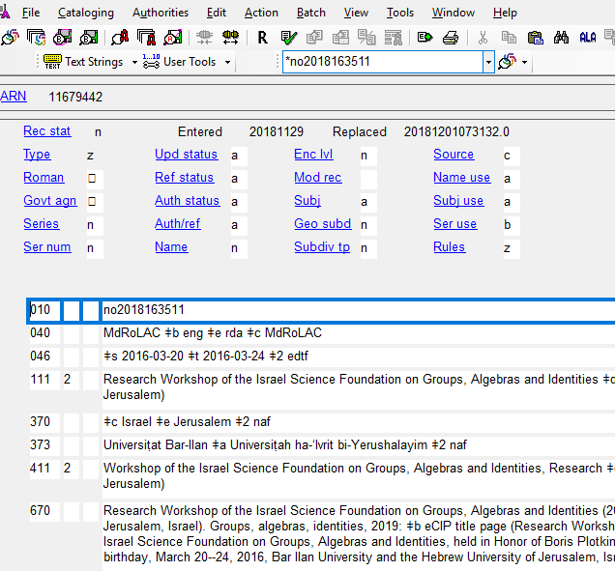
Batch search OCLC for LCCNs
Export the record to Sierra
24
Notes:
Run the batch process in OCLC, add any local information you might need (we use 949 tags to import into specific indexes), and export records either directly to your ILS or into a batch file on your desktop to load with Data Exchange.

Slide 25
Keeping Current
Maintaining authority files
Notes:
As I mentioned before, the name authority file and the subject authority files are always changing.

Slide 26
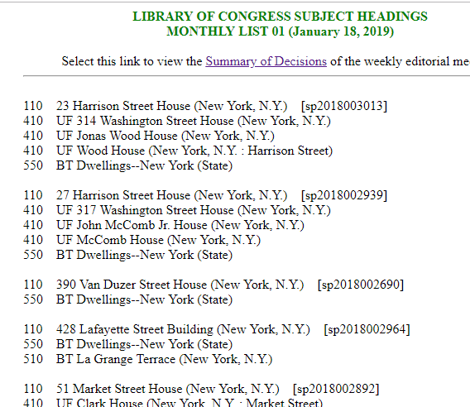
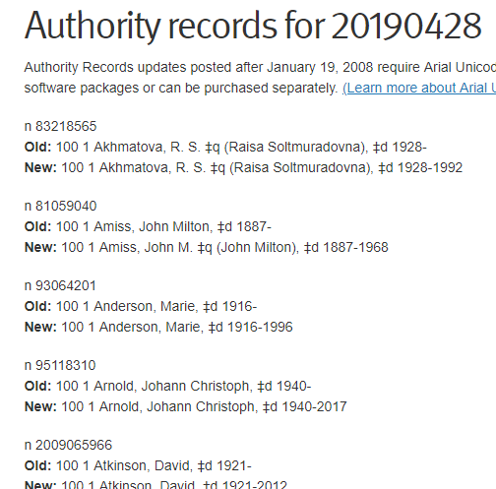
https://www.loc.gov/aba/cataloging/subject/weeklylists/
https://www.oclc.org/authority-records.html
26
Notes:
how can you keep these authority records up-to-date when LC makes a change?
OCLC provides a list of closed dates for names weekly
LCSH records get updated monthly
Both provide Lists summarizing the changes
The problem is, you have no way of knowing for sure if you have the updated heading in your catalog without searching each name/subject heading one by one
We used to stay up to date on these, as I mentioned before, but now we don't since we are moving to a vendor soon. The process was too time consuming to be considered worth continuing.

Slide 27
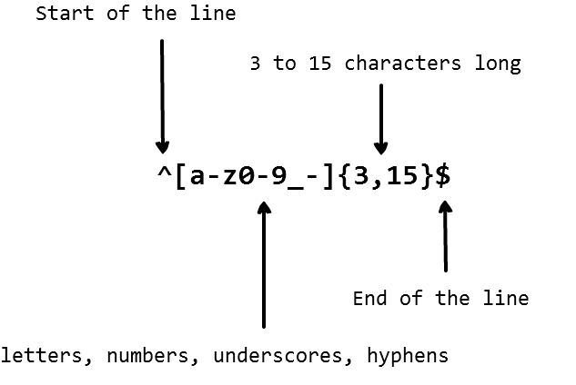
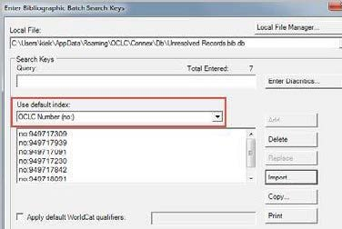
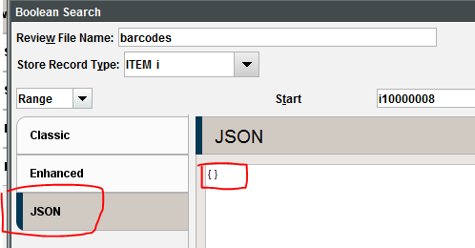
Automate the update
https://cdn-images-1.medium.com/max/ 1600/1*aT08Tmw6s4-t8tS8FXvVkA.png
https://help.oclc.org/@api/deki/files/2964/data-sync-worldcat-staging-14.jpg?revision=1&size=bestfit&width=399&height=267
https://sierraatcity.files.wordpress.com/2018/05/json.png?w=640
27
Notes:
However, I've learned a few things since then:
I've learned more about regular expressions and have gotten rather comfortable writing search queries with them
Our Create List feature in Sierra now allows for JSON queries as an input option instead of needing to enter each search command line by line
THis makes it so much easier to search for 100 names all at once. WIth a few simple tweaks to the data in notepad++, it's as easy as copying and pasting.
We've also played around with and figured out how to run batch searches for authority records in OCLC
Given all of these changes, I think I've come up with a decent system for updating these records
Essentially, turn the lists from LC and OCLC into a JSON query in Sierra to find any records that use the updated heading
Take just those headings and use oclc to batch search for the new authority records
Run another json query in sierra to delete the old authority records (or you could try to overlay the new record)
Load the new authority records
Hope the system automatically updates the headings overnight OR use global update to update the headings in the bib records

Slide 28
Batch-updating Subject Headings
Notes:
I'll start by explaining my process for subject headings

Slide 29
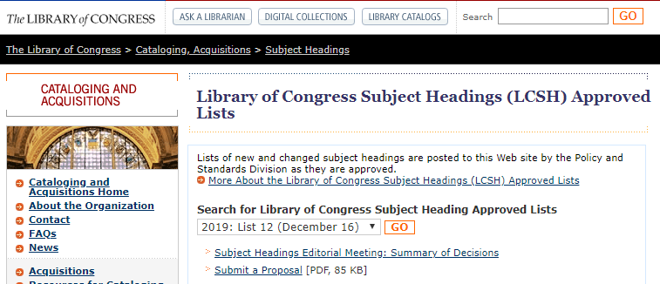
https://www.loc.gov/aba/cataloging/subject/weeklylists/
29
Notes:
Here is the website you can visit to get the updated lists

Slide 30
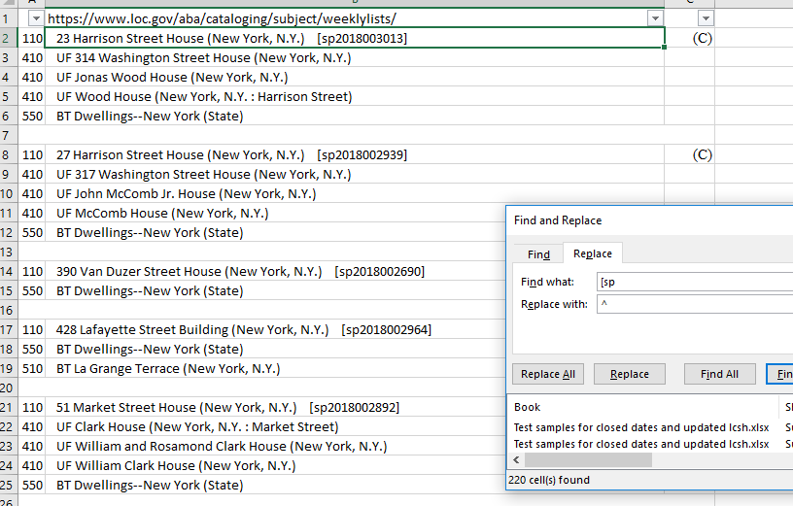
Extract the LCSH record number from the list of changed headings
Copy the subject change list into Excel
Highlight everything and unmerge cells
Use (ctrl+f) Find/replace to replace [sp with ^
Notes:
First Extract the LCSH record number from the list of changed headings
Copy the subject change list into Excel
Highlight everything and unmerge cells
Use (ctrl+f) Find/replace to replace [sp with ^

Slide 31
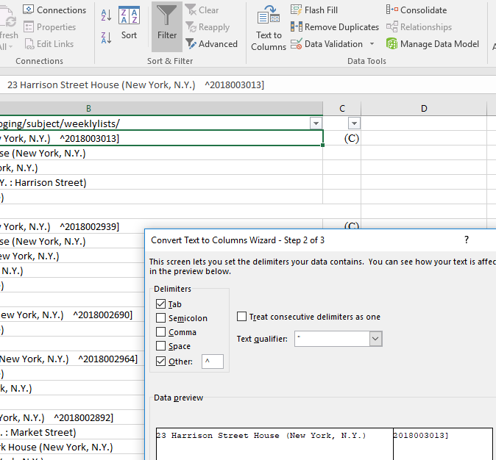
Extract the LCSH record number from the list of changed headings
Use (ctrl+f) Find/replace to replace ] with nothing
Use the Text to columns feature to separate ^ to its own column.
  Delimited →
  Other: ^ →
  Finish
Notes:
Use (ctrl+f) Find/replace to replace ] with nothing
Use the Text to columns feature to separate ^ to its own column.
Delimited -->
Other: ^ -->
Finish

Slide 32
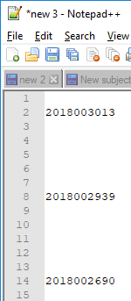
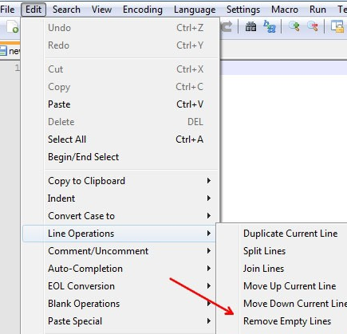
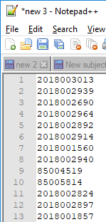
Build the JSON query in Notepad++
1
2
3
32
Notes:
https://notepadhelper.com/wp-content/uploads/remove-blank-lines-Notepad-plus-plus.jpg
Paste the copied numbers from step 1 into a new tab in Notepad ++
Each number should be on its own line
Remove any empty lines (EDIT--LINE OPERATIONS--REMOVE EMPTY LINES)

Slide 33
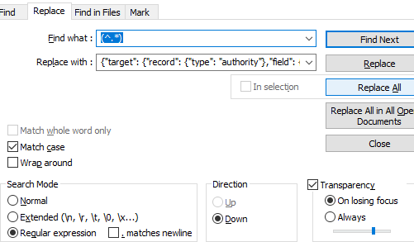
Build the JSON query in Notepad++
Use Search -> Replace (Ctrl-H) to add the necessary text around the numbers
  Find what: (^.*)
  Replace with: {"target": {"record": {"type": "authority"},"field": {"marcTag": "010"}},"expr": {"op": "regex","operands": ["sh\s*$1"]}},"or",
  Check “Regular expression”
  Click “Replace All”
33
Notes:
https://notepadhelper.com/wp-content/uploads/remove-blank-lines-Notepad-plus-plus.jpg
Paste the copied numbers from step 1 into a new tab in Notepad ++
Each number should be on its own line
Remove any empty lines (EDIT--LINE OPERATIONS--REMOVE EMPTY LINES)

Slide 34
Build the JSON query in Notepad++
Use Search -> Replace (Ctrl-H) to add the necessary text around the numbers
  Find what: (^.*)
  Replace with: {"target": {"record": {"type": "authority"},"field": {"marcTag": "010"}},"expr": {"op": "regex","operands": ["sh\s*$1"]}},"or",
  Check “Regular expression”
  Click “Replace All”
This finds everything in that line, or in this case, the LCCN
This search query finds authority records with 010 that have “sh[as many spaces as needed][one LCCN]”. The “or” on the end of the line indicates that there are more searches to perform.
34
Notes:
https://notepadhelper.com/wp-content/uploads/remove-blank-lines-Notepad-plus-plus.jpg
Paste the copied numbers from step 1 into a new tab in Notepad ++
Each number should be on its own line
Remove any empty lines (EDIT--LINE OPERATIONS--REMOVE EMPTY LINES)

Slide 35
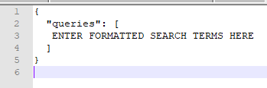
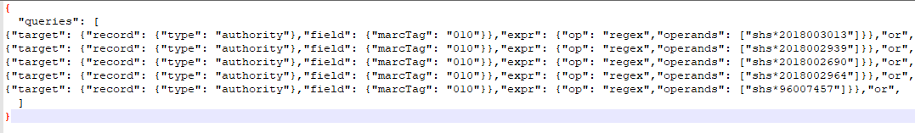
Build the JSON query in Notepad++
35
Notes:
Open a new tab in Notepad ++
Copy the following JSON code into that new tab
{
"queries": [
ENTER FORMATTED SEARCH TERMS HERE
]
}

Slide 36
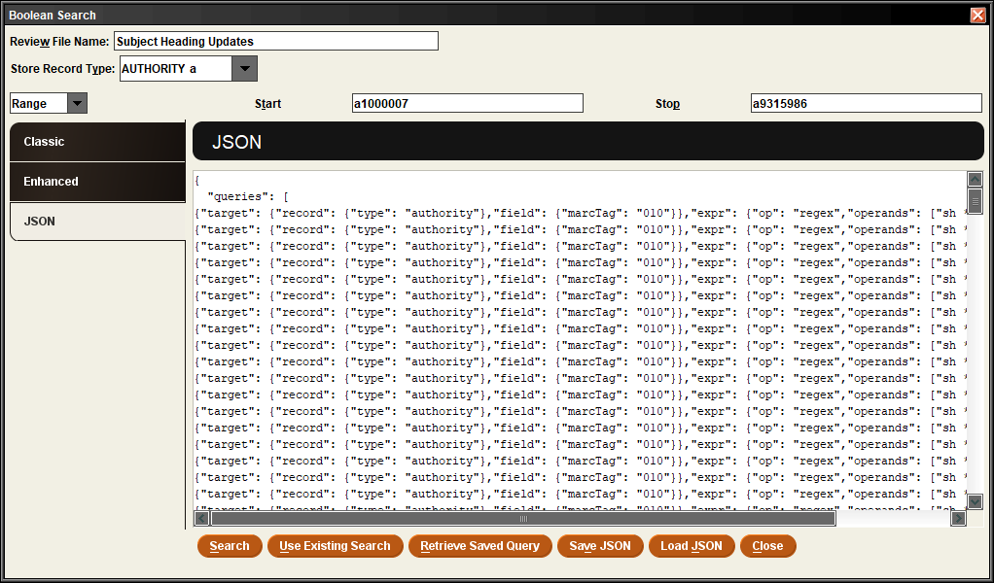
Run query through Sierra Create Lists
Name your file
Store record type =
a authority
Select JSON
Highlight the {} and paste your search from Notepad++
Click Search
36
Notes:
Copy and paste the JSON query into a create lists that holds a large amount of records (Or at least the number of record numbers you have)
The search will likely take a while. Work on something else while you are waiting on it to finish

Slide 37
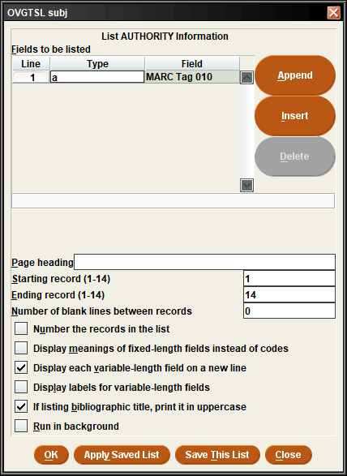
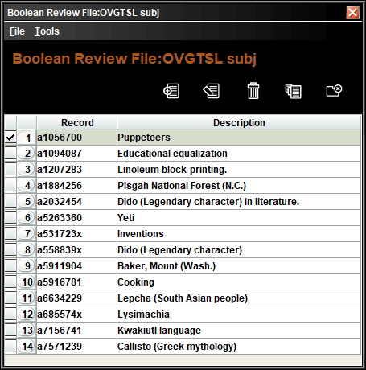
Search Results
We have 14 out of the 220 records on the list.
From here, export the 010 fields to a text file.
Keep the list to delete old records later
37
Notes:
We have fourteen out of the two hundred and twenty records on the list.
From here, export the 010 fields to a text file.
Keep the list to delete old records later

Slide 38
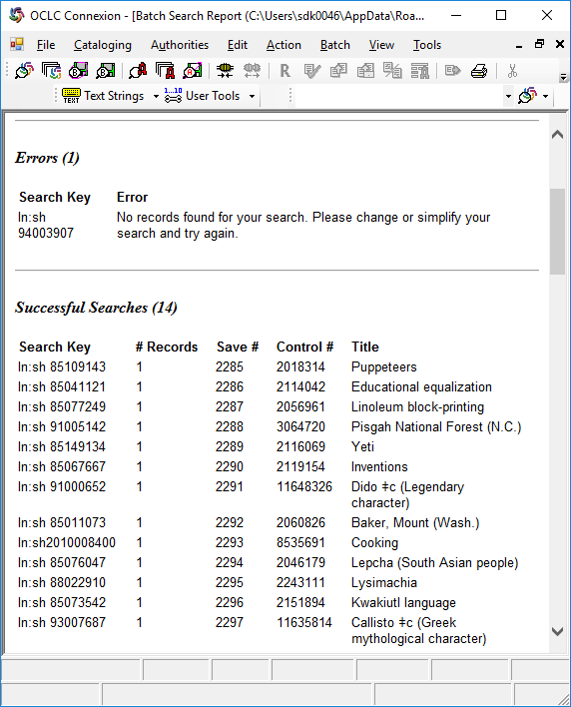
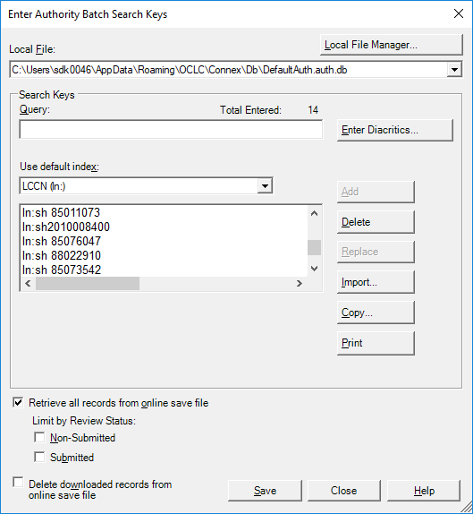
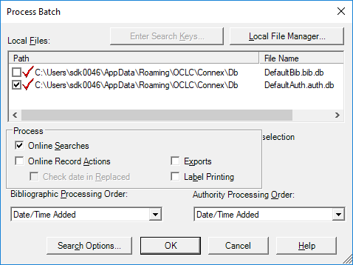
Format data to batch search OCLC
38
Notes:
Use the list of 010 fields you exported from Sierra and save them as a text file.
In OCLC, under "Batch" select "Enter AUthority Batch Search Keys". You will want to use the default index of "LCCN (ln:)" and then hit import. FInd your file location and select it. I always click no when it asks me if I want to delete my original import file.
The dialog box under the default search index should have populated with your search terms.
Hit save and then close.
Next, under "Batch" select Process Batch.
Check the box next to the default auth file name (as opposed to bib)
Click online searches and then click ok.
You should get a "Batch Search Report"

Slide 39
Format data to batch search OCLC
Dido (legendary character) in fiction was deleted, so the record doesn’t exist anymore
39
Notes:
Use the list of 010 fields you exported from Sierra and save them as a text file.
In OCLC, under "Batch" select "Enter AUthority Batch Search Keys". You will want to use the default index of "LCCN (ln:)" and then hit import. FInd your file location and select it. I always click no when it asks me if I want to delete my original import file.
The dialog box under the default search index should have populated with your search terms.
Hit save and then close.
Next, under "Batch" select Process Batch.
Check the box next to the default auth file name (as opposed to bib)
Click online searches and then click ok.
You should get a "Batch Search Report"

Slide 40
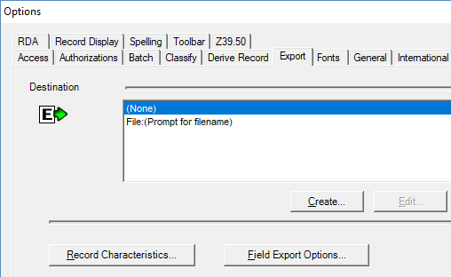
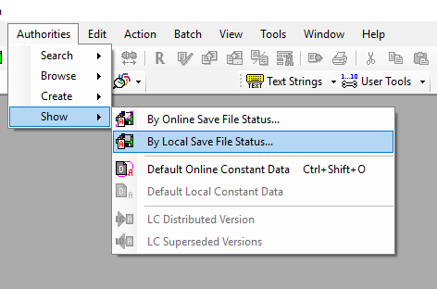
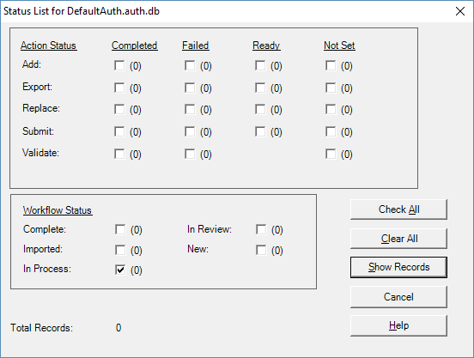
View your authority records in OCLC
40
Notes:
View the records you just saved to the local file by using the Authorities – show- by local save file status. Then check the "in Process" box under Workflow status and click show records.
Select all of the records you need to export and hit F5 or "Export".
In my export setting in OCLC, I have destination set for "File:(prompt for filename). This allows me to save the file wherever and under whatever name I want.

Slide 41
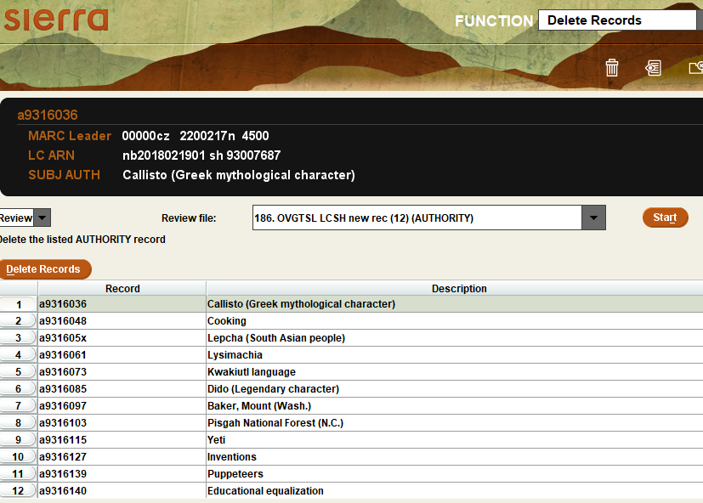
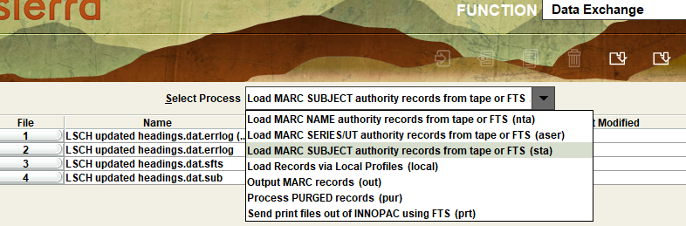
Export updated authority records
Batch Export from OCLC and then upload using the Subject Load table in Data Exchange
Delete old headings to prevent duplicates
41
Notes:
Once I have my file saved, I can import it into Sierra via Data Exchange. I select the "Load MARC SUBJECT authority records from tape or FTS" (I think this was a default process that came with Sierra). Then "Upload files from PC" using the "sfts" type when it asks you. SElect your newly uploaded file and "preprocess" it. Click on the newly created "sub" type line and select load. Check "use review files" and test your file. If there are no errors, then load the records. In a perfect world, they would overlay the old one. My testing wouldn't do that for me and I don't know enough about the load table to fix that. So to fix that, I just use the list I created earlier and delete those records in the "Delete Records function" of Sierra. If you don't have too many in your list, you could do it individually and check for local additions that you may not want to lose. Or if you want to export each individual subject record from OCLC, you can use a 949 overlay text string.

Slide 42
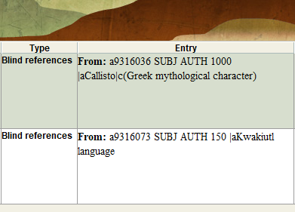
Resolving problems
Check your headings reports for duplicate authority records and blind references
Delete the old authority records that are duplicated by the upload
Resolve blind references (which come from headings changing, like fictional characters)
Most of the records were only deleting or adding subfields to the record, not changing the 1XX, so there shouldn't be too many to fix.
Notes:
Check your headings reports for duplicate authority records and blind references
Delete the old authority records that are duplicated by the upload
Resolve blind references (which come from headings changing, like fictional characters)
Most of the records were only deleting or adding subfields to the record, not changing the 1XX, so there shouldn't be too many to fix.

Slide 43
Batch-updating Name authorities

Slide 44
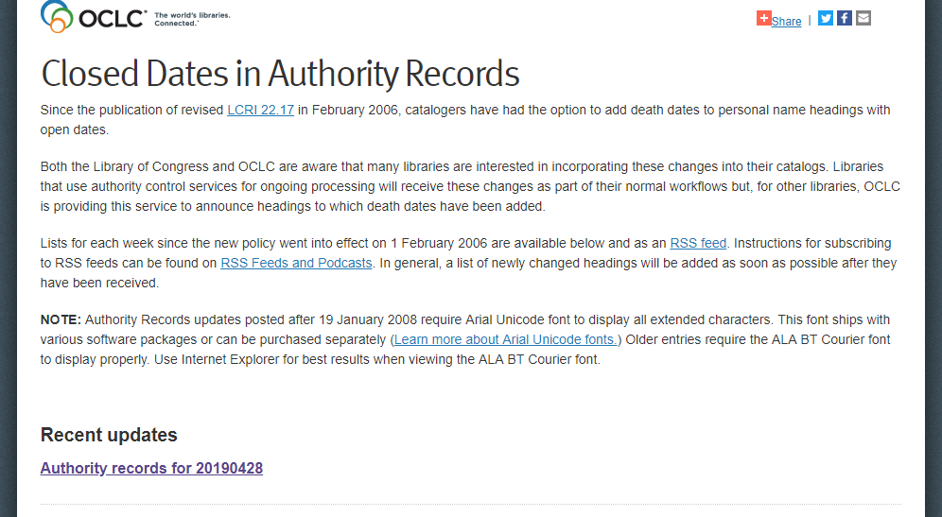
https://www.oclc.org/authority-records.html
44
Notes:
Closed dates are a bit more complicated because they can occur in more places.

Slide 45
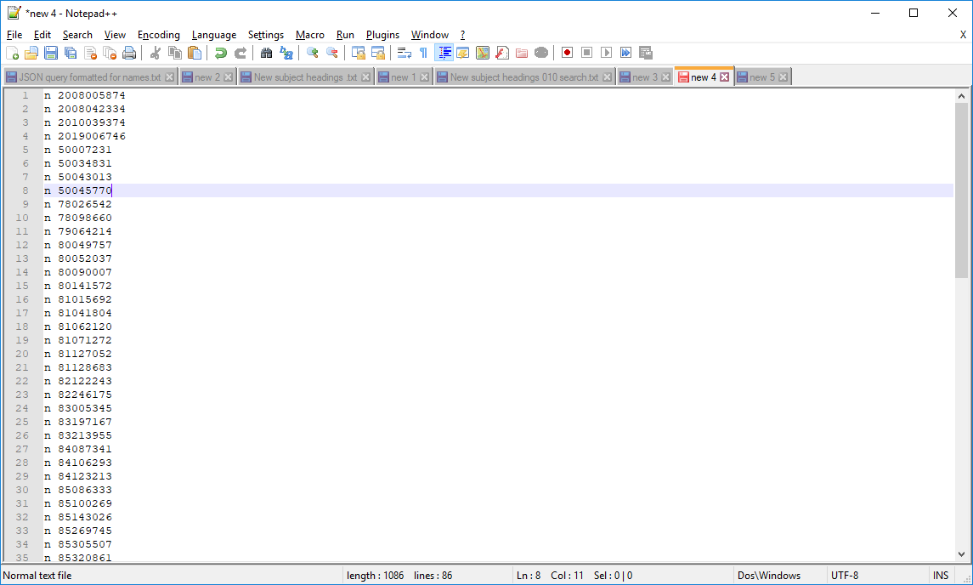
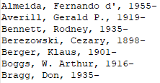
Build the JSON query in Notepad++
Option 1:
Record number
Option 2:
Old name format
45
Notes:
There are different levels of thoroughness you can work towards. Each level requires more and more manual work, so it's up to you to decide what's worth it in the end.
Option 1: You can just search the authority records for the closed dates (like we did with the updated subject headings). This will find the authority records of any names on the list in your catalog, but then you will still need to change the corresponding bib records. In our catalog, we didn’t load authority records for every name, so we may used the name in a bib record, but not have the authority record. We would never know if we only used this option.
Option 2: You can search your bibliographic records for headings that match the old name. This does a pretty good job returning a name match.

Slide 46
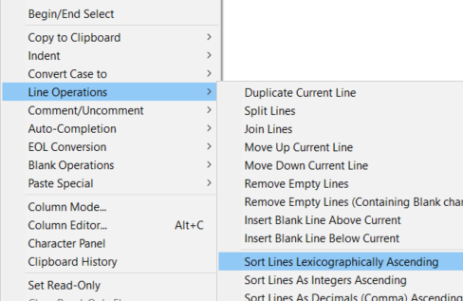

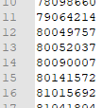
Build the JSON query in Notepad++:
Option 1: Record Numbers
46
Notes:
https://i.stack.imgur.com/3bsk9.png
Copy and paste the list from the OCLC website into Notepad++
Deleted the header text and remove any empty lines like we did with the subject headings (EDIT--LINE OPERATIONS--REMOVE EMPTY LINES)
Sort your list so that the record numbers are all together at the end of the document. (EDIT—LINE OPERATIONS—SORT LINES LEXICOGRAPHICALLY ASCENDING) This will easily allow you to extract the record numbers to search option 1
We want to search just name authority records in our ILS, so we want to include the “n” part of the record number, but the spaces and other letters before the numbers may vary. So we want to make those wildcards in our search. Replace ^[^0-9]+([0-9]*) and replace with $1

Slide 47
Build the JSON query in Notepad++:
Option 1: Record Numbers
This finds lines that starts with [one or more non-numbers]([all of the numbers]). The information inside the parentheses will be retained, as noted by “$1”, leaving just the numbers.
47
Notes:
https://i.stack.imgur.com/3bsk9.png
Copy and paste the list from the OCLC website into Notepad++
Deleted the header text and remove any empty lines like we did with the subject headings (EDIT--LINE OPERATIONS--REMOVE EMPTY LINES)
Sort your list so that the record numbers are all together at the end of the document. (EDIT—LINE OPERATIONS—SORT LINES LEXICOGRAPHICALLY ASCENDING) This will easily allow you to extract the record numbers to search option 1
We want to search just name authority records in our ILS, so we want to include the “n” part of the record number, but the spaces and other letters before the numbers may vary. So we want to make those wildcards in our search. Replace ^[^0-9]+([0-9]*) and replace with $1

Slide 48
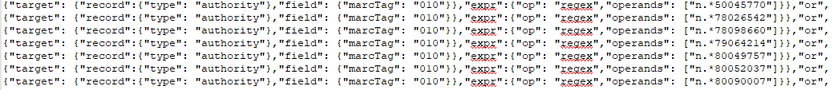
Build the JSON query in Notepad++:
Option 1: Record Numbers
Find what: (^.*)
Replace with: {"target": {"record": {"type": "authority"},"field": {"marcTag": "010"}},"expr": {"op": "regex","operands": ["n.*$1"]}},"or",
48
Notes:
Now that you have just numbers, use ctrl+h to replace the following regular expression:
Find everything and add the target information with this find/replace. This will search for the 010 field of authority records to see if any of the names on the closed dates list have authority records in our catalog.
I'll show you how to build the rest of the query once I have shown you option 2, since at that point, they use the same regular expressions.

Slide 49
Build the JSON query in Notepad++:
Option 1: Record Numbers
This finds everything in that line, or in this case, the LCCN
This search query finds authority records with 010 that match “[n(zero or more of any character)LCCN]”. The “or” on the end of the line indicates that there are more searches to perform.
Find what: (^.*)
Replace with: {"target": {"record": {"type": "authority"},"field": {"marcTag": "010"}},"expr": {"op": "regex","operands": ["n.*$1"]}},"or",
49
Notes:
Now that you have just numbers, use ctrl+h to replace the following regular expression:
Find everything and add the target information with this find/replace. This will search for the 010 field of authority records to see if any of the names on the closed dates list have authority records in our catalog.
I'll show you how to build the rest of the query once I have shown you option 2, since at that point, they use the same regular expressions.

Slide 50
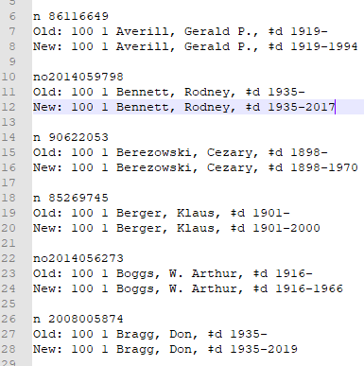
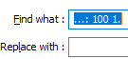
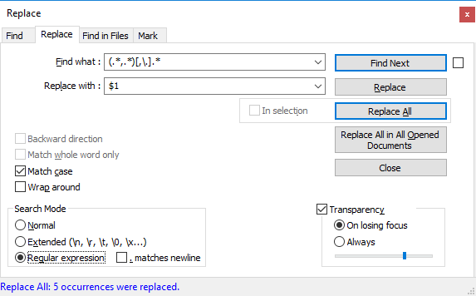


Build the JSON query in Notepad++:
Option 2: Old name format
50
Notes:
Just like before, Copy and paste the list from the OCLC website into Notepad++
Deleted the header text and remove any empty lines (EDIT—LINE OPERATIONS—REMOVE EMPTY LINES)
Sort your list alphabetically. (EDIT—LINE OPERATIONS—SORT LINES LEXICOGRAPHICALLY ASCENDING)
Now here's the part that's different:
We want just the old version of the name, so delete all of the new name entries and the record numbers. They should be grouped together at the beginning and the end. To remove the Old: 100 1 information, replace "…: 100 1." with nothing and check regular expression for the search mode.
Let's get rid of everything past subfield a by removing everything after the last comma or period with this expression: (.*,.*)[,\.].*
Repeat as necessary until all of the subfields are removed. Search for the delimiter symbol to see if there are any that were missed and take care of those manually.
We are left with just the $a of the old formats of the names.

Slide 51
Build the JSON query in Notepad++:
Option 2: Old name format
This finds [any 3 characters][colon][space]100[space]1[any 1 character] and replaces it with nothing.
This finds ([all characters up to][comma][all characters up to])[comma or period][all characters]. The information inside the parentheses will be retained, as noted by “$1”. The last comma or period and all characters after will be deleted.
51
Notes:
Just like before, Copy and paste the list from the OCLC website into Notepad++
Deleted the header text and remove any empty lines (EDIT—LINE OPERATIONS—REMOVE EMPTY LINES)
Sort your list alphabetically. (EDIT—LINE OPERATIONS—SORT LINES LEXICOGRAPHICALLY ASCENDING)
Now here's the part that's different:
We want just the old version of the name, so delete all of the new name entries and the record numbers. They should be grouped together at the beginning and the end. To remove the Old: 100 1 information, replace "…: 100 1." with nothing and check regular expression for the search mode.
Let's get rid of everything past subfield a by removing everything after the last comma or period with this expression: (.*,.*)[,\.].*
Repeat as necessary until all of the subfields are removed. Search for the delimiter symbol to see if there are any that were missed and take care of those manually.
We are left with just the $a of the old formats of the names.

Slide 52
Build the JSON query in Notepad++:
Option 2: Old name format
Find what: (^.*)
Replace with: {"target": {"record": {"type": "bib"},"field": {"marcTag": "100"}},"expr": {"op": "starts_with","operands": ["$1"]}},"or",
Replace with: {"target": {"record": {"type": "bib"},"field": {"marcTag": "700"}},"expr": {"op": "starts_with","operands": ["$1"]}},"or",
Replace with: {"target": {"record": {"type": "bib"},"field": {"marcTag": "600"}},"expr": {"op": "starts_with","operands": ["$1"]}},"or",
52
Notes:
BEcause these names could be in the 100, 700 or even used as a subject in the 600 fields, we want to search in each index.
We need three sets of the old names, so highlight all of them and copy and paste twice.
Highlight the first set of names and use ctrl+h to replace everything and add the target information in the first box.
Highlight the second set of names and use the second box's target information
And then do the third set of names with the third box's information.

Slide 53
Build the JSON query in Notepad++:
Option 2: Old name format
This finds everything in that line, or in this case, the name
Find what: (^.*)
Replace with: {"target": {"record": {"type": "bib"},"field": {"marcTag": "100"}},"expr": {"op": "starts_with","operands": ["$1"]}},"or",
Replace with: {"target": {"record": {"type": "bib"},"field": {"marcTag": "700"}},"expr": {"op": "starts_with","operands": ["$1"]}},"or",
This finds bibliographic records with 100 (or 700 or 600) that start with “[this specific name]”. The “or” on the end of the line indicates that there are more searches to perform.
Replace with: {"target": {"record": {"type": "bib"},"field": {"marcTag": "600"}},"expr": {"op": "starts_with","operands": ["$1"]}},"or",
53
Notes:
BEcause these names could be in the 100, 700 or even used as a subject in the 600 fields, we want to search in each index.
We need three sets of the old names, so highlight all of them and copy and paste twice.
Highlight the first set of names and use ctrl+h to replace everything and add the target information in the first box.
Highlight the second set of names and use the second box's target information
And then do the third set of names with the third box's information.

Slide 54

Build the JSON query in Notepad++:
Option 2: Old name format
54
Notes:
So you will have a very long list of formatted names. We will finish the query after I show you option 3.

Slide 55
Build the JSON query in Notepad++:
Final Step
{
"queries": [
ENTER FORMATTED SEARCH TERMS HERE
]
}
55
Notes:
Open a new tab in Notepad++ and Copy this information. Then copy the formatted numbers or names where it says to enter them here. Simple as that. I promise formatting the names and the query gets easier the more you do it.

Slide 56
Run query through Sierra Create Lists
Name your file
For option 1, Store record type =
a authority
For option 2, Store record type =
b bibliographic
Select JSON
56
Notes:
Copy and paste the JSON query into a create lists that holds a large amount of records (Or at least the number of record numbers you have)
The search will likely take a while. Work on something else while you are waiting on it to finish

Slide 57

Search Results
Option 1:
12 results out of 86 record numbers searched
Option 2:
100+ results out of 86 old names searched in 258 total searches; 18 were more closely investigated; 9 more names found
57
Notes:
Searching by just the record number, I found 12 instances where we already had an authority record for the name in either our subject or name index.
When I searched by the old names and the multiple names (option 2), I found several more that we did not have authority records for. I found at least 18 names that seemed promising for further investigation. A few of them were indeed other people, but there were about 8 names that needed to be updated in the name index alone that didn’t have authority records.
So while it may be more work, I still believe that by searching by option 1 and 2, you should be able to maintain a more updated catalog in less time.

Slide 58


Compare Names to Updated List
To Delete Duplicates:
Find: ^(.*?)$\s+?^(?=.*^\1$)
Replace with nothing
Check regular expressions
58
Notes:
Look through the results and compare them to the original list of names
a. Export the 100, 700, and 600 fields from Sierra
b. Copy the list to Excel and alphabetize the list (or you can use Notepad++)
c. Remove duplicates from the list
i. If using Notepad++, remove duplicates with the following Replace
ii. Find what: ^(.*?)$\s+?^(?=.*^\1$)
iii. Replace with:
iv. Check "regular expressions"
d. Compare the names on the list to the list from OCLC
e. Copy the record number from the OCLC list of matched names and use them to run a batch search in OCLC
f. You may need to investigate some names to make sure that a name without a date in your ILS isn't the same person as the updated name. You can search by names instead of LCCN in OCLC to help gather the authority records quicker, but it will still take alot of manual investigation.

Slide 59

Format data to batch search OCLC
59
Notes:
Use the list of 010 fields you exported from Sierra and save them as a text file.
In OCLC, under "Batch" select "Enter AUthority Batch Search Keys". You will want to use the default index of "LCCN (ln:)" and then hit import. FInd your file location and select it. I always click no when it asks me if I want to delete my original import file.
The dialog box under the default search index should have populated with your search terms.
Hit save and then close.
Next, under "Batch" select Process Batch.
Check the box next to the default auth file name (as opposed to bib)
Click online searches and then click ok.
You should get a "Batch Search Report"

Slide 60
Format data to batch search OCLC
60
Notes:
Use the list of 010 fields you exported from Sierra and save them as a text file.
In OCLC, under "Batch" select "Enter AUthority Batch Search Keys". You will want to use the default index of "LCCN (ln:)" and then hit import. FInd your file location and select it. I always click no when it asks me if I want to delete my original import file.
The dialog box under the default search index should have populated with your search terms.
Hit save and then close.
Next, under "Batch" select Process Batch.
Check the box next to the default auth file name (as opposed to bib)
Click online searches and then click ok.
You should get a "Batch Search Report"

Slide 61

Format data to batch search OCLC
61
Notes:
Use the list of 010 fields you exported from Sierra and save them as a text file.
In OCLC, under "Batch" select "Enter AUthority Batch Search Keys". You will want to use the default index of "LCCN (ln:)" and then hit import. FInd your file location and select it. I always click no when it asks me if I want to delete my original import file.
The dialog box under the default search index should have populated with your search terms.
Hit save and then close.
Next, under "Batch" select Process Batch.
Check the box next to the default auth file name (as opposed to bib)
Click online searches and then click ok.
You should get a "Batch Search Report"

Slide 62



Export updated authority records
Update bibliographic records
62
Notes:
Export into a batch file or individually. Here I overlaid each record so I could look to see what we had. Most seem to have a 4XX that should allow bibliographic maintenance to make the changes for me. I think in reality, it did two of the 7 names I loaded, so I still needed to go back and correct several bib records.

Slide 63
Tips
Google is your friend
Combine several lists into one
Create a search in the classic view, then switch over to the JSON view to find how to write the code. Use "INSERT VALUE HERE" as your value A and it'll be that much easier to copy your own values
Try to avoid copying your Regular Expressions from Word because the automatic-formatting might cause problems
Reuse! Reuse! Reuse!
63
Notes:
Google is your friend. If I don't know how to do something in Excel or Regular Expressions, I google it and can usually find a decent formula or two that can meet my needs.
Create a search in the classic view, then switch over to the JSON view to find how to write the code. Use "INSERT VALUE HERE" as your value A and it'll be that much easier to copy your own values
Wait until you have several lists to combine and then do the search all at once, instead of setting it up weekly (as would be the case with the names)

Slide 64


Tips
You will run into times where the code doesn't want to work. Use the line and column information from Sierra’s dialog box in Notepad++ to find what might be wrong.
Experience will make this easier to troubleshoot.
64
Notes:
You will run into times where the code doesn't want to work. Sierra will prevent you from continuing your search with a dialog box. This box shows where the problem is but it's hard to work with it in Sierra. Use your version from Notepad++ to find the line and column and see what might be wrong. Usually you don't have enough brackets or too many, or you might be missing a comma. This last time, my spaces weren’t exactly spaces, but I didn’t realize this until I had Notepad++ show all characters. Some spaces were missing a little orange dot.
Experience will make this easier to troubleshoot.

Slide 65
Resources
Getting Started with Regular Expressions in Marcedit
  https://www.youtube.com/watch?v=7YXvS4xBEfw
Regular Expressions in Create Lists
  https://wiliug.files.wordpress.com/2015/02/matches-handout-2015.pdf
Regular Expressions Cheat Sheet
  https://www.rexegg.com/regex-quickstart.html
Batch Processing in the Client: Overview- OCLC
  https://help.oclc.org/@api/deki/files/5147/connexion-client-batch-processing.pdf
65
Notes:
Here are some resources that I use when doing this type of work.
The first is a YouTube video tutorial by Terry Reese, the creator of MarcEdit. He really breaks down regular expressions for anyone unfamiliar with them and shows how to do some basic expressions. This video is over an hour long.
The second is a great document on how to use regular expressions in Sierra Create lists. You can select R matches under condition to use these regular expressions in Sierra’s create lists. The document also covers Millenium. I love this document’s explanations and examples on how to search for different situations. It’s really helped me find things I never thought I’d be able to in order to do clean up for out automated authority control vendor prep.
The third document is a concise listing of different regular expressions, what they mean, and an example. Helpful for writing new ones I don’t use very often.
The last document is a link to OCLC’s overview of their batch processing in the Connexion client. They have a lot of documentation on their website on how to do different things.

Slide 66
Thank You!
Questions?
Contact me:
Stacey Wolf
stacey.wolf@unt.edu

