Slide 2
Access Data Hacks
Using Databases to make my life easier … I think

Slide 3
About me – Trevor Smith
Monograph Acquisitions and Metadata Librarian
Douglas College, Vancouver, BC Canada
We recognize and acknowledge the Kwikwetlem First Nation, as well as all Coast Salish Peoples, on whose traditional and unceded territories we live, we learn, we play, and we do our work.
http://activehistory.ca/2017/08/150-acts-of-reconciliation-for-the-last-150-days-of-canadas-150/
Notes:
pronounced "Kee-Kite”
https://students.ubc.ca/ubcfyi/what-land-acknowledgement

Slide 4
My goal
This presentation comes from my frustration with getting results out of my ILS and being left with this data I couldn’t share
I’ve been inspired by IUG sessions so I hope this will give you a few new ideas

Slide 5
By the end of this session
How to gather your data into a database
How to transform it with queries
How to present it in a report
How to customize your data for the proper audience
How to use Excel & SharePoint with Access

Slide 6
Why?
Sierra finally provided direct queries of the database
SQL with PG Admin is helpful for getting data OUT

Slide 7
But!
I need to do things with the data
I need to store it
I need to transform it
I need it to do math for me
I need to give the data to Librarians/ staff / faculty
I need to format it into a report

Slide 8
Overview
Age of Collection Reports
Weekly Funds
CPSLD monthly stats
Reformatting Canned Reports
Track progress
Local area data
Access
Why Microsoft?
Extending Access
Excel
SharePoint

Slide 9
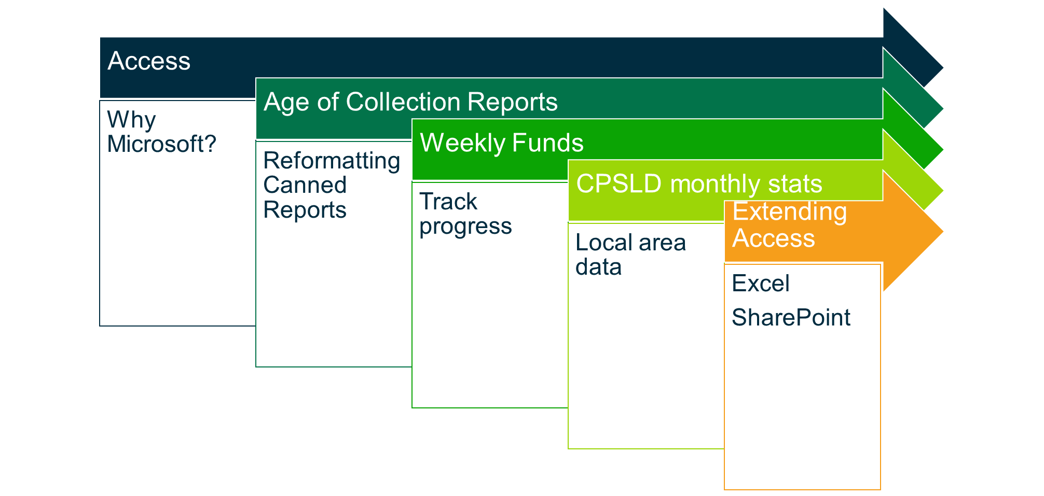
Access
Why Microsoft?

Slide 10
But why Access?
Hard to get things installed
Access is already part of the MS Office suite
Easy to connect to Excel, Word, Outlook, SharePoint
Wanted to learn more about PgAdmin but …..
Image Source: https://en.wikipedia.org/wiki/Microsoft_Access#/media/File:Microsoft_Access_2013_logo.svg
Notes:
Available
Interoperable
Accessible
not a lot on pgadmin

Slide 11
Books?
PGAdmin / PostgreSQL
Microsoft Access
2
4,888
Image Source: https://en.wikipedia.org/wiki/Microsoft_Access#/media/File:Microsoft_Access_2013_logo.svg

Slide 12
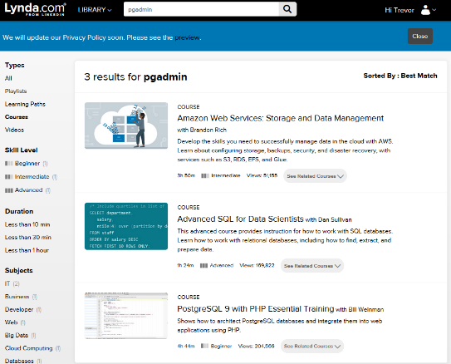
Lynda.com
PGAdmin / PostgreSQL
Microsoft Access
3
35

Slide 13
What can Access do?
Save data in tables
Calculations & Queries
Present data in different ways
Group it
Filter by date
Present like a spreadsheet
Produce Reports
Image Source: https://en.wikipedia.org/wiki/Microsoft_Access#/media/File:Microsoft_Access_2013_logo.svg

Slide 14
Audience
Perspective / Attitude | High | EXECUTIVES | EXPERTS
 | Low | GENERAL/LAY PEOPLE | TECHNICIANS
 |  | Low | High
 |  | Technical
EXPERTS – formally qualified and prefer sufficient information to understand the detailed status
EXECUTIVES – decision makers who prefer “bottom line” information and conclusions
TECHNICIANS – varying qualifications/skills but prefer to have more technical information
GENERAL/LAY PEOPLE– non-specific and non-technical who want general info
Project Management Body of Knowledge (PMBOK)

Slide 15
Age of Collection Reports
Reformatting Canned Reports

Slide 16
Collection Development
Age of Collections report has been a long established part of our year-end reports.
Based on our Statistical CATegories (SCAT)
The report groups call ranges into “easier to read” categories and provides basic info on:
Orders
Bibs
Items
Circ

Slide 17
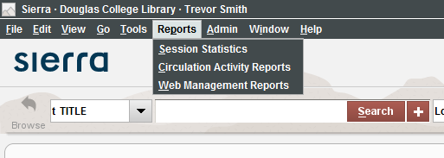
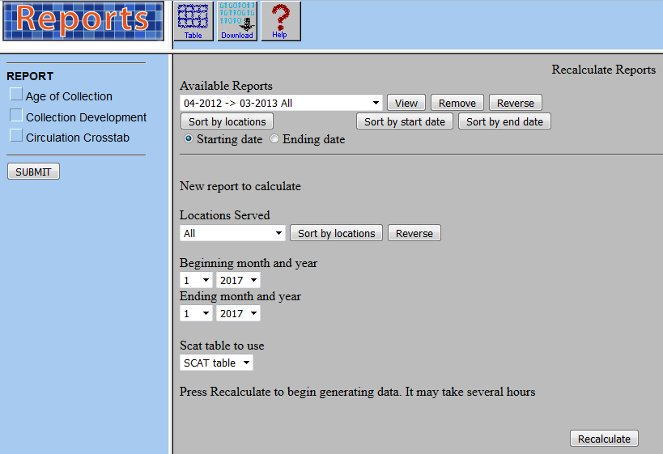
Report

Slide 19
Problem
Yearly report takes a couple of HOURS to run
Had data in Excel, but in different docs
Did some basic calculations
Old, but still useful
Could not gather information together to do long-term analysis
Actually really hard to understand

Slide 20
Database basics
Table
Load all excel files into one table with date
Query
Choose values you need
Report
Group and sort to tell a story
Basic & Complex math

Slide 21
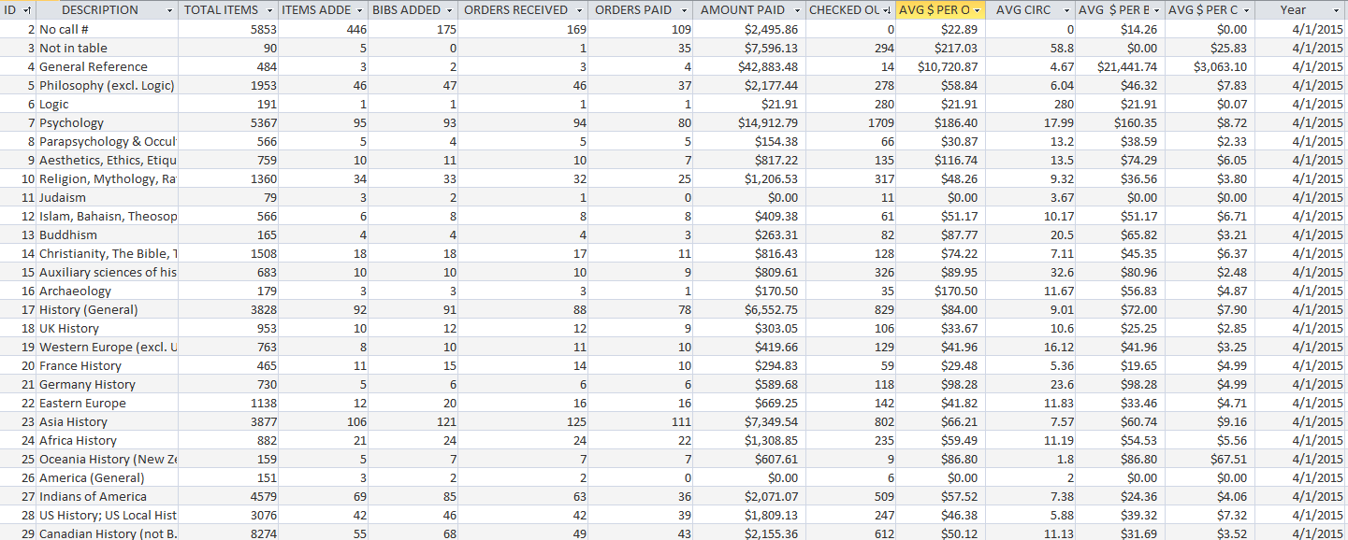
Table
Having everything in one table means you can group things together

Slide 22
Sort it all together
Sort by Description & Year
All the data is together
Not terribly useful to read

Slide 23
Query & do some math
See the Avg, Max, Min of Items and Costs
Fine for me
But not user friendly

Slide 24
Reports
Reports in Access allow you to take your data and present it in an easy to read summary
Aka rather than reading everything like Excel, make it look like Word

Slide 25
Standard Report

Slide 26
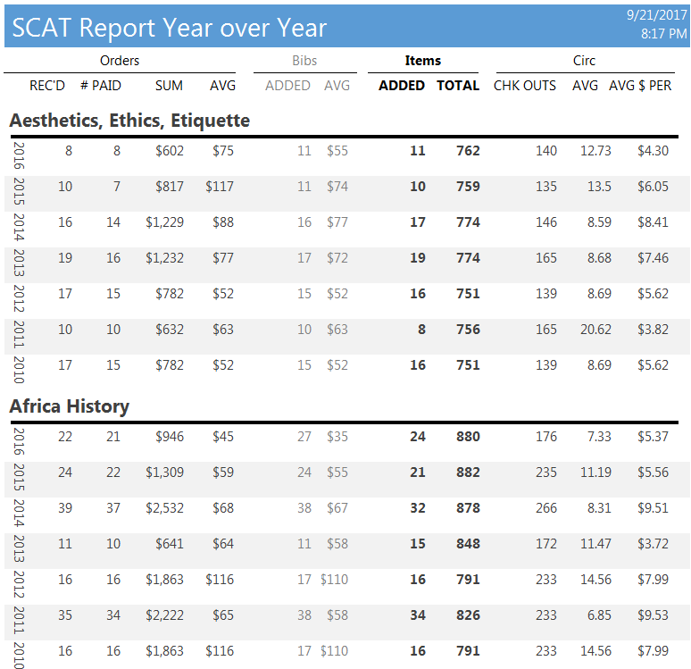

Slide 27
Give the data some room

Slide 28
Grouped by lifecycle
Orders
Rec’d
Bibs
Added
Items
Added
# Paid
Sum
Avg
Avg
Total
Circ
Chk Outs
Avg
Avg $ Per Circ

Slide 29
Formatting goes a long way
Slight variation between the big groups
Lines will draw attention
Color gradation helps grouping
Turn the year on the side to save space & anchor your view

Slide 30
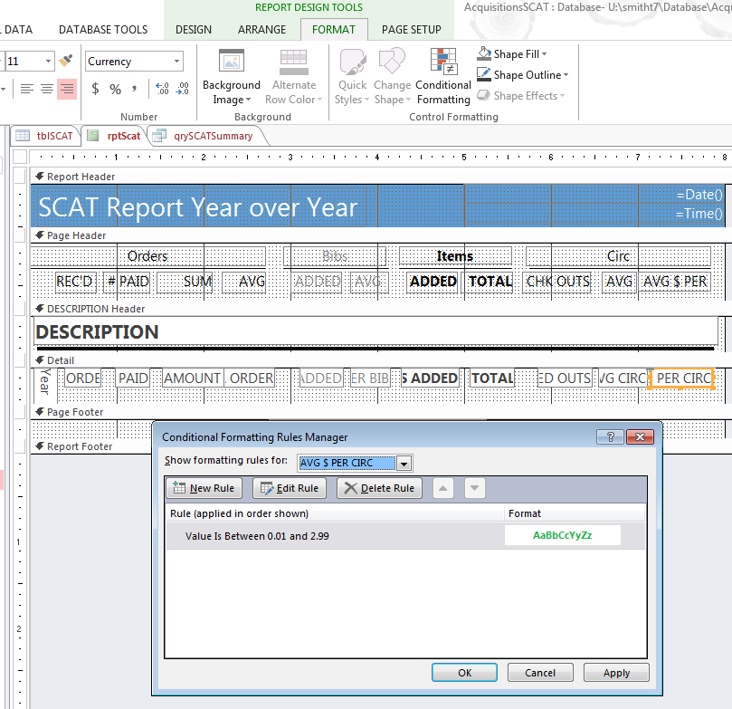

Slide 31
Conditional formatting
Checkouts over 1000
Avg circ over 50
Avg price per circ under $3

Slide 32
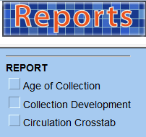
BUT….
What if you want to compare data between different reports???

Slide 33
Combined Reports
Age of Collection
Collection Age Range

Slide 34
Make an UberReport
Link tables by the title column
Query the Avg, Max, Min of Items and Costs
Show collection age range

Slide 35
Notes:
Take a filtered version to meetings with liaison faculties

Slide 36
Reformatting Canned Reports
Tables
Keep all data together
Add Columns
Query
Sort
Do math things: Avg, Sum, Max, Min
Link tables
Reports
Group
Format
Conditional Formatting

Slide 37
Weekly Funds
Track Progress

Slide 38
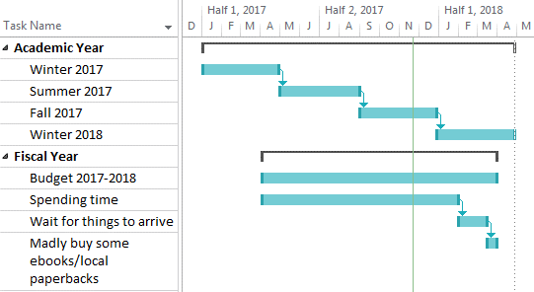
Problem
New Acquisitions Librarian
Had to spend my budget to 95% by the end of January
Budget ~$275,000

Slide 39
http://www.livememe.com/ct6ozc1

Slide 40
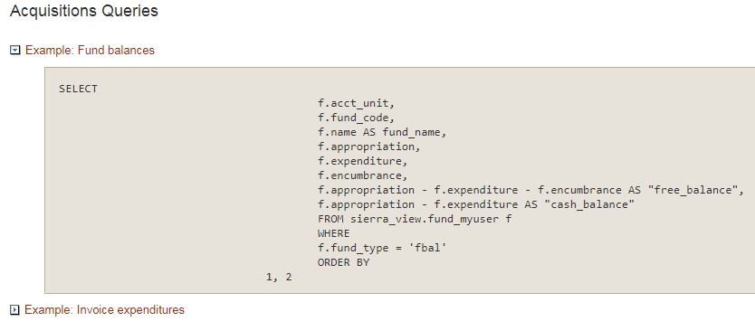
Fund balance
Sierra Direct SQL Access
Acquisition Queries
Fund Balances
https://csdirect.iii.com/sierrahelp/Content/ssql/ssql_query_examples.html

Slide 41
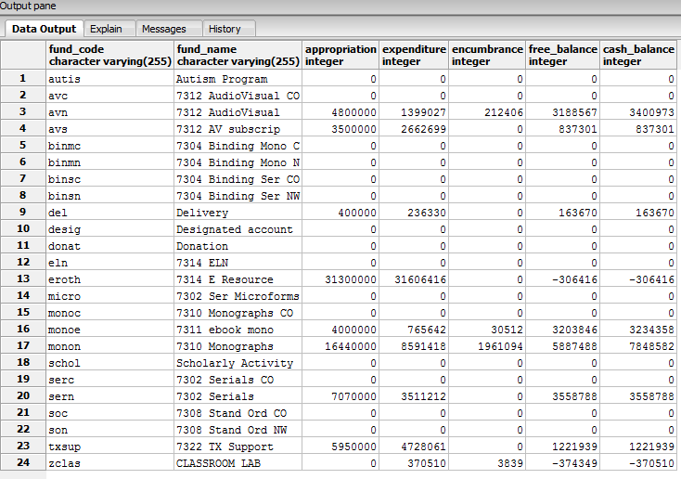
RESULTS

Slide 42
But how do I get the data?
Open PgAdmin
Connect to database
Open query
Run it
Get results
Open Excel
Copy results in Access
Append it to the master table

Slide 43
But how do I get the data Now …..
Open Access
Connect to database
Open query
Run it
Get results
Open Excel
Copy results in Access
Append it to the master table

Slide 44
Connect Access ODBC
Apologies, I cited the
wrong presentation.
See next slide
See Dejah Rubel & Kriss Tessin’s 2017 IUG presentation “Create a List via Batch Catalog Searching with Sierra 2.3.0” http://innovativeusers.org/index.php/conferences/search-presentations.html

Slide 45
Connect Access ODBC
See Len Davidson and Mary Cate Matta’s 2017 IUG presentation “SQL Direct Access
” http://innovativeusers.org/index.php/conferences/search-presentations.html

Slide 46
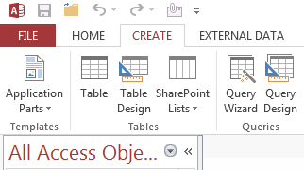
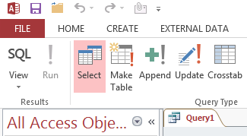
Get the SQL Query

Slide 47
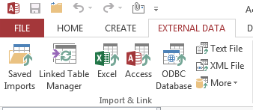
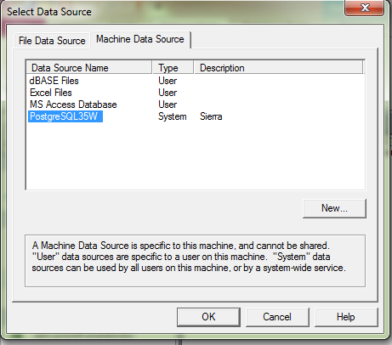
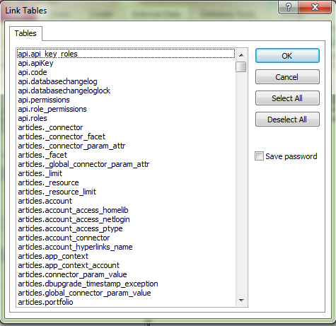
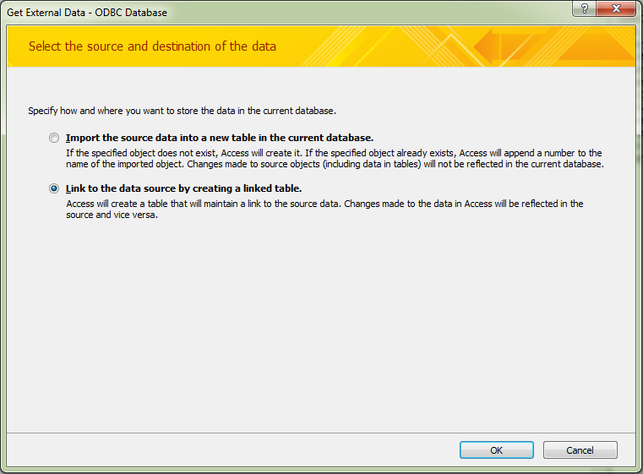
Create linked table in Access

Slide 48
Run 2 queries
qryFunds
qryAppend
SELECT f.fund_code AS [Fund Code], f.name AS [Fund Name], f.appropriation AS Appropriation, f.expenditure AS Expenditure, f.encumbrance AS Encumbrance, f.appropriation - f.expenditure - f.encumbrance AS [Free Balance], f.appropriation - f.expenditure AS [Cash Balance]
FROM sierra_view_fund_myuser AS f
WHERE f.fund_type = 'fbal'
ORDER BY 1, 2;
INSERT INTO tblLedger ( [Date] )
SELECT qryFunds.*, Date() AS [Date]
FROM qryFunds;

Slide 49
Ok I have the numbers ….. Now what?

Slide 50
Target?
How much money do I really have?
(Are these numbers right?)
Am I on target for this week?

Slide 51
Q 1: How much money do I really have?
ExpEnc: [Expenditure]+[Encumbrance]
“How much have I spent” + “what has been requested but hasn’t come in yet”
= SPENT

Slide 52
Q2: Are these numbers right?
The query gives you a whole number
You need to trim it down
No pennies!

Slide 53
http://www.cbc.ca/news/canada/obituary-canadian-penny-1858-2013-1.1315144

Slide 54
Currency of data types
Expenditure: CCur(IIf([tblLedger]![Expenditure]=0,0,Trim(Left([tblLedger]![Expenditure],(Len([tblLedger]![Expenditure])-2)))))
Find the Expenditure field
If it is 0, then keep it at 0
Not 0, then Trim it by 2
(but how long is it?)
Start from the left
And find the length
(now you can subtract the last 2 numbers)
Finally, make it look like currency

Slide 55
Q3: Am I on target for this week?
Each line has a date
Find the difference between date & Jan 31, 2018
Display it as a percentage
Take that percentage and multiply it by the Appropriation

Slide 56
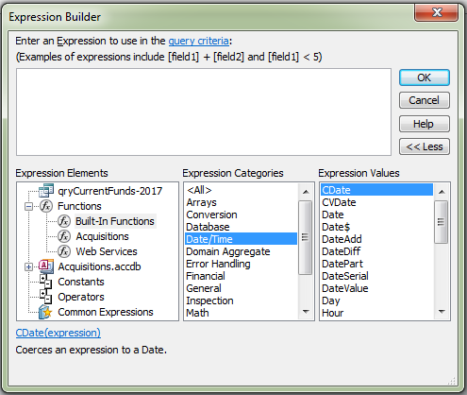
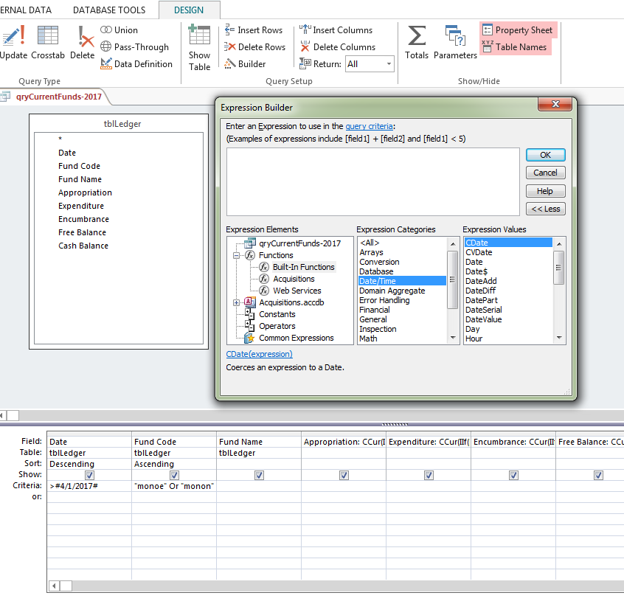
Expression Builder
SQL has formulas to help you with standard calculations
Use Expression Builder to find them
(Use Bing to find out what you need to do)

Slide 57
Date Difference
Target Budget Remaining: ((((DateDiff("d",[Date],#1/31/2019#))/305)*-1)+1)

Slide 58
Just the data

Slide 59
SQL
SELECT
tblLedger.Date, tblLedger.[Fund Code],
tblLedger.[Fund Name],
CCur(IIf([tblLedger]![Appropriation]=0,0,Trim(Left([tblLedger]![Appropriation],(Len([tblLedger]![Appropriation])-2))))) AS Appropriation,
CCur(IIf([tblLedger]![Expenditure]=0,0,Trim(Left([tblLedger]![Expenditure],(Len([tblLedger]![Expenditure])-2))))) AS Expenditure,
CCur(IIf([tblLedger]![Encumbrance]=0,0,Trim(Left([tblLedger]![Encumbrance],(Len([tblLedger]![Encumbrance])-2))))) AS Encumbrance,
CCur(IIf([tblLedger]![Free Balance]=0,0,Trim(Left([tblLedger]![Free Balance],(Len([tblLedger]![Free Balance])-2))))) AS [Free Balance],
CCur(IIf([tblLedger]![Cash Balance]=0,0,Trim(Left([tblLedger]![Cash Balance],(Len([tblLedger]![Cash Balance])-2))))) AS [Cash Balance],
[Expenditure]+[Encumbrance] AS ExpEnc,
[Expenditure]/[Appropriation] AS ExpVsAppr,
[Encumbrance]/[Appropriation] AS EncVsAppr,
[ExpEnc]/[Appropriation] AS ExpEncVsAppr,
[Free Balance]/[Appropriation] AS FreeVsAppr,
[Cash Balance]/[Appropriation] AS CashVsAppr,
((((DateDiff("d",[Date],#1/31/2018#))/305)*-1)+1) AS [Target Budget Remaining], (1-[Target Budget Remaining]) AS [Target Budget Spent],
CCur(((DateDiff("d",[Date],#1/31/2018#))/305)*1*[Appropriation]) AS [Spent Target],
[Spent Target]-[Free Balance] AS [Free Balance vs Spent Target],
tblLedger.Appropriation AS Appropriation_tblLedger
FROM tblLedger
WHERE
(((tblLedger.Date)>#4/1/2017#)
AND
((tblLedger.[Fund Code])="monoe" Or (tblLedger.[Fund Code])="monon" Or (tblLedger.[Fund Code])="avn" Or (tblLedger.[Fund Code])="avs"))
ORDER BY
tblLedger.Date DESC , tblLedger.[Fund Code];

Slide 60
Sierra

Slide 61
Report
Fund Code
Fund Name
Appropriation
Expenditure
Encumbrance
Free Balance
Cash Balance
Weekly % Target
Spent
Spent %

Slide 62
Database tips
Queries
Expressions
Expression Builder
Bing
Reports
Separate reports between standard & calculated data

Slide 63
CPSLD monthly Stats
Local Area Data

Slide 64
CPSLD stats

Slide 65
Select your materials
http://cpsld.ca/ld.php?content_id=2711562

Slide 66
Problem: Highly localized
CPSLD numbers are just for BC Academic libraries
Nobody else uses this or needs it
No special III report to build off of
Not going to be on the Sierra Direct SQL website
Gotta make it myself

Slide 67
Old Process
Run a List to Locate the Materials
Associate location codes to general categories
* Monographs
* AV
Export to Excel
Get tables in Excel
Run multiple calculations
Get a Count
Summary
Bring all the counted summaries together for final results
Notes:
Took me a week

Slide 68
My old Adage
Anything you want to do
Brent Searle
has already done it
Notes:
I started to work on this problem in 2014. Brent had already done it in 2009

Slide 69
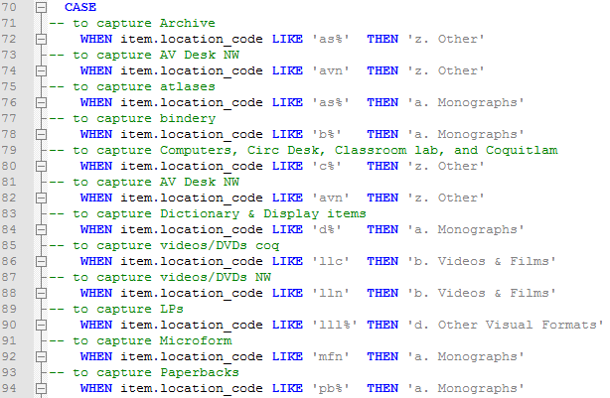
Select Item location to category

Slide 70
Join tables together

Slide 71
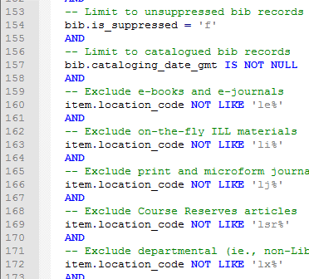
WHERE
Notes:
Not suppressed
Ebooks
ILL
Course Reserves

Slide 72
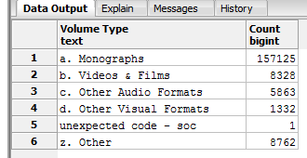
Result: 5 lines,1 error, 3 seconds

Slide 73
Access

Slide 74
Problem
What about when I need to share the holdings number?
Library Director is meeting with the VP and needs current holdings
Faculty is doing a review of their program with a governing body
Just need representative totals of the library collection
What if the numbers are needed as a spreadsheet?

Slide 75
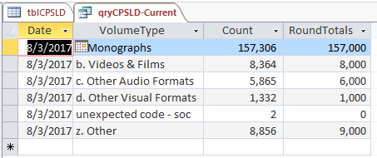
Rounded Totals

Slide 76
Rounded Totals & Date
SELECT
tblCPSLD.Date,
tblCPSLD.VolumeType,
tblCPSLD.Count,
1000*Round([tblCPSLD]![Count]/1000,0) AS RoundTotals
FROM tblCPSLD
WHERE
(((Year([Date]))=Year(Date())) AND ((Month([Date]))=Month(Date())));

Slide 77
Database tips
Queries
Select
Join
Where
Expressions
Round ()
Date ()

Slide 78
Extending Access
Excel & SharePoint

Slide 79
Displaying Results
Good for storage and saving queries to transform data
Not easy to use
Excel pivot tables are great for quick questions or charts
SharePoint is great for displaying data for staff with different views

Slide 80
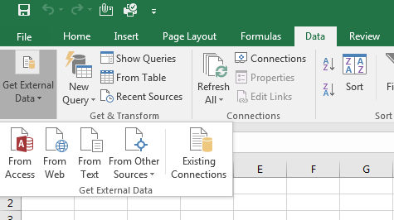
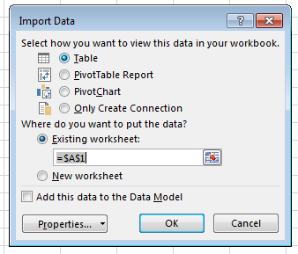
Use Excel to connect to Access
4
1
2
3

Slide 81
Pivot Tables and Pivot Charts
How busy were we on the Ref Desk last summer?

Slide 82
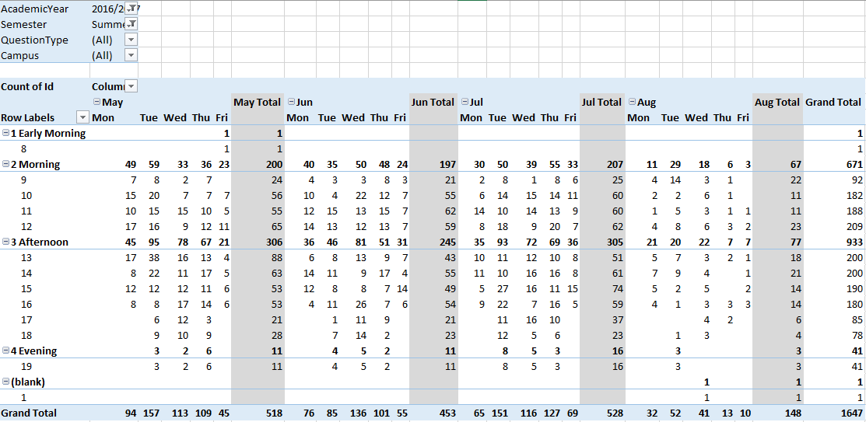
Pivot table in 1 minute
Time of Day
Month
Weekday

Slide 83
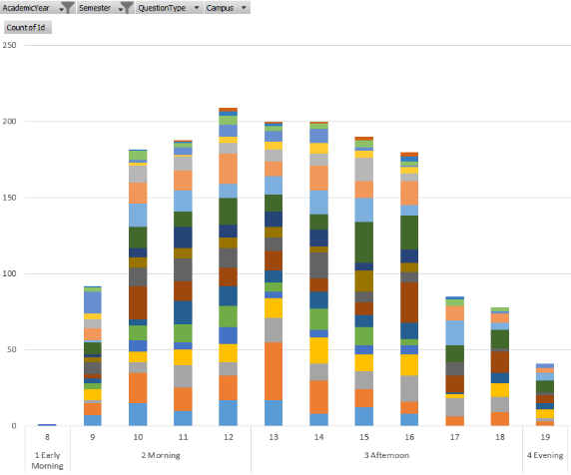
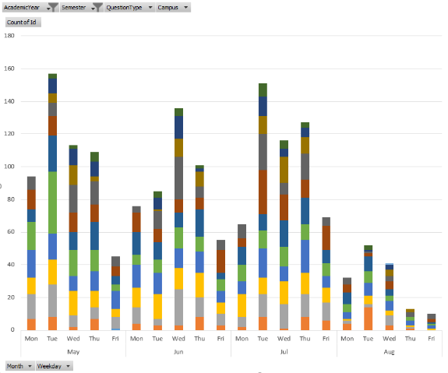
Send data to a Pivot Chart & Pivot data on the axis
Questions by time of day
Questions by Month / Day of the Week

Slide 84
SharePoint
Textbook for Reserves Database
Share the results with staff at different campuses
Includes titles & decisions
Staff can view by Location or by Dept/Class
https://upload.wikimedia.org/wikipedia/commons/3/38/SharePoint2013Logo.png

Slide 85
Boring List

Slide 86
Group by Class

Slide 87
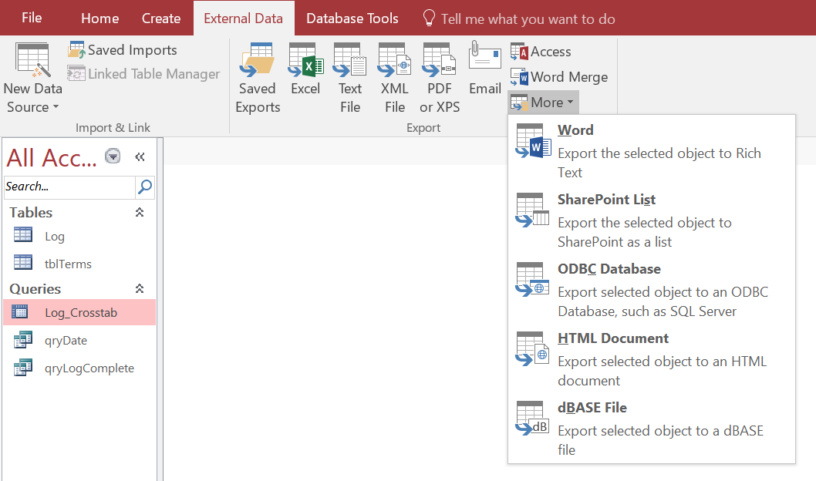
How to add an Access table to SharePoint

Slide 88
Conclusion

Slide 89
Audience
Perspective / Attitude | High | EXECUTIVES | EXPERTS
 | Low | GENERAL/LAY PEOPLE | TECHNICIANS
 |  | Low | High
 |  | Technical
EXPERTS – formally qualified and prefer sufficient information to understand the detailed status
EXECUTIVES – decision makers who prefer “bottom line” information and conclusions
TECHNICIANS – varying qualifications/skills but prefer to have more technical information
GENERAL/LAY PEOPLE– non-specific and non-technical who want general info
Project Management Body of Knowledge (PMBOK)

Slide 90
Close()
Age of Collection Report
Create a Year-over-Year analysis
Report with meaningful data
Formatting to help you review the data
Weekly Funds
Have it do the math for you – proper currency, days remaining, $ Spent
Create the results you NEED

Slide 91
Close()
CPSLD monthly Stats
Much of our work is done OUTSIDE of the ILS
Use databases to streamline long processes
(and ask around as someone probably has already done it!)
Excel & SharePoint
Use Excel to ask quick questions of your data
Use SharePoint to share custom views with staff

Slide 92
Close()
Why Access
Librarians are typically not from Comp Sci, but we understand data
Access has plentiful training opportunities
Streamlines work we often do in Excel
Allows you to make your own canned reports
Lets you share data with the right tool in your organization

Slide 93
Thank you
Trevor Smith MA, MLIS Monograph Collections and Metadata Librarian Douglas College Library (604) 527-5259
smitht7@douglascollege.ca
http://www.douglas.bc.ca/library.html
@Douglas_Library
@trevordsmith100

