Slide 1
Fine-Freedom
Making the Case and Making the Change
Kathy Setter and Lori Roholt, IFLS Library System​ Eau Claire, Wisconsin

Slide 2
About our Library System
Resource-sharing consortium in Western Wisconsin​
Near Minneapolis-St. Paul metro
Membership: 51 independent public libraries​

Slide 3
About our Library System
Half of member libraries are in communities with fewer than 2,000 residents
31 had total annual expenditures under $200,000 in 2019
Since 2017, 22 libraries have permanently switched to no fines (before 2017, 2 were fine-free)

Slide 4
About our Circulation Policies
Libraries determine loan rules (including fine rates) applied to any items checked out at that library
Patrons are typically billed after items are 4-5 weeks overdue​
Patrons are blocked from checkouts, placing holds, and renewing if they have any billed item, or owe $10 or more, per the patron blocks table​
Libraries keep any fine money collected at their library
Libraries may waive any fines for patrons they serve directly

Slide 5
Making the Case

Slide 6
Qualitative Data
​”Long Overdue: Eliminating Fines on Overdue Materials to Improve Access to San Francisco Public Library,” January 2019 https://sfpl.org/sites/default/files/2020-02/Fine-Free-Report011719.pdf
“A librarian’s case against overdue book fines,” Dawn Wacek, February 2018 https://www.ted.com/talks/dawn_wacek_a_librarian_s_case_against_overdue_book_fines
​Collaboration with local colleagues on access issues
Staff feedback

Slide 7
Quantitative Data: Fine Revenue Snapshots
How much money are we talking about?
Outstanding fines
Sierra’s Globally Purge Charges
Sierra DNA: fine tables
Paid
Sierra’s Fines Paid​
Sierra DNA: fines_paid table​
Replacement charges assessed and paid, if helpful for comparison

Slide 8
Quantitative Data: Patron Impact
How many patrons are affected?
Sierra’s Create Lists to find patrons blocked due to:​
Fines only​: charge types 2, 4, and 6
Bills only​: charge types 3 and 5, charge type 1 for manual charges
Fines and bills​
Blocked patrons under age 18

Slide 9
Quantitative Data: Other Metrics
Staff time
Fine-collection
Record-keeping and accounting
Online payment fees

Slide 10
Making the Change

Slide 11
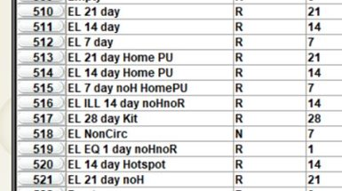
Loan Rule Changes
Each library has a unique set of loan rules
Each library decided their effective date
Changes made to loan rules the night before the effective date
No unintended consequences from changing the fines in active loan rules
Libraries did not want fines on items checked out before their effective date

Slide 12
Waiving Existing Fines
Member libraries are allowed to waive fines for any patrons they serve directly, so most opt to waive existing fines when going fine-free
Our process:
Use Sierra's Create Lists to gather up patrons with some "money owed" by home library value
Use Sierra's Globally Purge Charges to waive fines (by Charge Type) for patrons in that review file
For publicity purposes, libraries may want an overview of fines waived
Save information from the original review file to determine the patrons affected and/or "unblocked"
Note fines waived from Globally Purge Charges
Sierra DNA: fines_paid table

Slide 13
THANK YOU
Questions?
Lori Roholt roholt@ifls.lib.wi.us
Kathy Setter setter@ifls.lib.wi.us

Slide 14
Tips for an Accessible Presentation
While preparing:
Make text and visuals big enough to be read from the back of the room. Try to keep your font size at 18 or above.
Use an easy-to-read font. Fonts are easiest to read when the thickness is consistent.
Check your color-contrast. Use a light text background and dark text when presenting in a bright room, or a dark background and a light text when presenting in a darkened room.
Run an accessibility check. Microsoft PowerPoint has a free accessibility checker to help you identify and adjust any issues.
Source: "Giving Accessible Presentations" by Lillian Hogendoorn, used under CC BY-SA 4.0 / Edited

Slide 15
Tips for an Accessible Presentation
While presenting:
Be visible when speaking. Seeing your face can help participants hear and understand better.
Use a microphone. Even in a small space, some people may need audio electronically. If you ask, “Can everyone hear me?”, some people may be uncomfortable identifying they cannot. If possible, encourage participants to use a microphone to ask questions. If this is not available, repeat questions through your microphone.
Describe visual information. For example, if you have an important chart or image on your slide, describe the key points. Or, if you ask participants to move in some way (i.e. “raise your hand if you have been to IUG before”), describe the response (i.e. “Okay, that seems like about half of you!”).
Source: "Giving Accessible Presentations" by Lillian Hogendoorn, used under CC BY-SA 4.0 / Edited

Slide 16
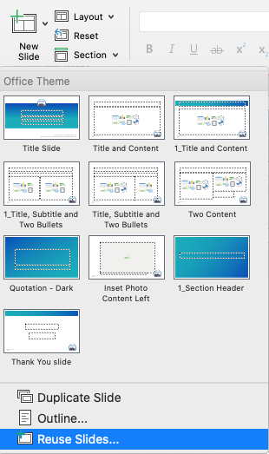
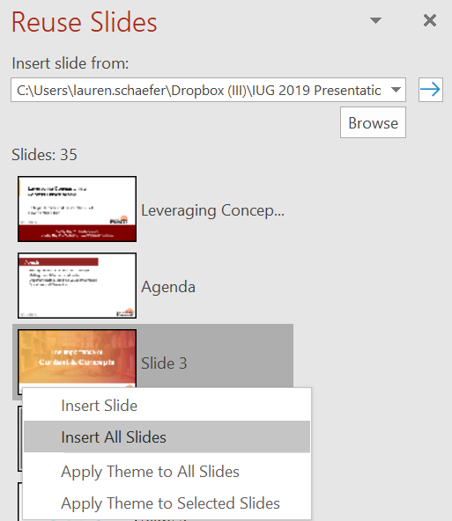
How to import slides into the template
Select “New Slide” > “Reuse Slides…”
Choose “Browse File” to select from your computer
Click on each slide to add them individually, or right-click to select “Insert All Slides”
Use “Reset” to help reset the layout on individual slides

