Slide 1
Using Custom Batch Processes to Create Better Quality eBook Records
for less Money and Minimal Time – Pt. 2
Casey Cheney
Notes:
Starting Comments:

Slide 2
Setup and implementation

Slide 3
Review of Requests
Merge OverDrive data into OCLC records
Global changes to records
Notes:
Lisa first came to me at IUG 2018 with the predicament she found herself in, just as she described to you. When we first started talking there were 2 pretty general requests … merge data from one MARC record into another and then make some global changes.
After spending some time talking in generalities we realized this could be a pretty fun project and it could be one that would also lighten the burden of existing Ocean State staff.
We had originally chatted possibly about OUR searching for the OCLC records in which to merge the OverDrive data, but the desire to keep costs minimal had the focus switch to us just merging the data and then cleaning up the data.

Slide 4
Review of Requests
Merge OverDrive data into OCLC records
Global changes to records
Remove “non-filers” from series title
Edit “volume” information within the series statement
Genre edits/conversions/additions
Addition of specific fields
Deletions of specific fields
Notes:
About a month later, more discussion began to develop what some of those global changes might look like. Mind you, these really are just a small sample of the types of requests we had received. Some of these requests were very straightforward while others took a little more planning and reasoning.

Slide 5
Goals
Create a process to minimize the work of Library staff
Keep the majority of the processing on Backtage’s side
Incorporate into existing monthly processing
Notes:
Our overall goals were as follows.
1. We wanted to create a process that would minimize the work of the Library Staff by
2. Automating much of the processing that Ocean State was doing with other various scripts and processes on their end
3. and then to incorporate those newly designed processes into the regular monthly Authority Control work that Backstage was already doing.

Slide 6
Challenges
Communication of expectations
JavaScript knowledge
Transitioning process to brand new Project Manager
Notes:
A few of the challenges we, at Backstage had...
1. Communication of expectations with Lisa and her staff. It is no surprise that communicating via email and over the phone both have their downfalls. Sometimes writing things in an email grants some clarity that verbal communication cannot, and vice versa. So we had to be sure to remain vigilant in our communication and how results were looking with various tasks and iterations of those tasks. With as many emails and conversations we were having, it’s also not surprising that some requests got lost in the shuffle and had to be readdressed.
2. Many of the "custom rules" or "custom processes" that we write to incorporate various requests like this are written in JavaScript. This is great for the novice like myself who doesn't know anything at all about programming. With some simple online crash-courses, I was able to set up and write many of the rules myself and if I couldn't, I luckily had help from our programming team. But as with all collaborative work, sometimes you're at the mercy of the other person's timescale for completion of tasks.
3. During all of our communication I had kept my project manager in the loop. She was still relatively new to the role so while I spearheaded the changes I tried to keep her copied in on emails and then we'd have additional conversations to let her know what Lisa and I were up to and that she understood all of the changes we were making.

Slide 7
Closer look at Record Merging
2 files come in from Lisa (OverDrive copy & OCLC copy)
Double-check character encoding of the file
Remove certain fields from OCLC copy with scripts
Merge specific OverDrive fields into OCLC copy with program
Map “overlay command field” (949$a) from 907$a with script
Notes:
Let's take a quick look at some of the things we were up to in order to fulfill Ocean State's requests.
The first task at hand was to look at the record merging process. This is a process we do relatively frequently, so it wasn't a hard workflow to put into place.
We'd receive 2 separate files from Ocean State staff: one includes the basic Overdrive records and the other contains are the corresponding WorldCat records. We'd first double-check that the character encoding of both files was the same; nobody wants to mess with character encoding problems caused by merging records together! We'd then remove requested fields from the OCLC record and merge in selected fields from the original OverDrive record into the OCLC record. Finally we'd map the overlay command field so records could be reimported and overlaid properly once we send them back to Ocean State.

Slide 8
Processing profile – 1 or 2?
Notes:
After the record merging workflow was in place, it was time to think about how to implement all the remaining requests.
We did consider creating all of the rules directly in the existing processing profile for Ocean State. But since I wasn't clear on how long everything would take to implement, I didn't want these rules to be "live" and be running until we were ready. There are some quirks within our system that would require the rules to be live immediately. Even though I was writing the rules to run only on records with “overdrive” in the 037, we shouldn’t have had any issue, but I prefer to be cautious and after some consideration we decided we'd create a separate processing profile. This way we could take our time with testing and only allow this profile to be “live” when we were ready.
Because there were some existing custom requests already in place with the MAIN profile that we'd want to keep in place, and because we certainly didn't want to have to set up those rules by hand; we cloned the original profile so we'd have a good starting point.

Slide 9
Closer look at new rules
Notes:
My next plan of attack was to look at the EASIEST rules to incorporate. Naturally, these would be tag deletions, as seen here. The majority of these were already in the profile settings so we did double-check that those were in place and added a couple rules to handle the remaining.

Slide 10
Closer look at new rules
Notes:
After some initial testing & review, some additional fields were requested to be removed. Some of these requests included deleting fields with specific phrases present.

Slide 11
Closer look at new rules
Notes:
Next on the list was to tackle some of the more difficult requests. Some of these requests included adding Genre Form terms when certain criteria were met in the 008 Fixed Field.
Some of these requests were more than what my knowledge of JavaScript allowed but as long as I could receive help with one, I was able to write the remaining. We do have an environment that when we're building our rules we can test them before "saving" them so there was quite a bit of trial and error with some requests.

Slide 12
Closer look at new rules
Notes:
In November 2018 Lisa had mentioned that they were still having trouble with some blank LTxt fields. With some guidance from Lisa on what she would like to achieve and with some re-use of some of our previously created rules. We were able to incorporate adding some LTxt fields based on specific data within the Subject Headings. We ended up created 6 different rules for this specific request.

Slide 13
Closer look at new rules
Notes:
One of the more complicated requests came in the form of changing certain Subject and Genre terms into something more appropriate. We received a spreadsheet similar to this one (with 309 lines).
In order to create some sort of "logic" behind the spread that could be translated into our processing rules

Slide 14
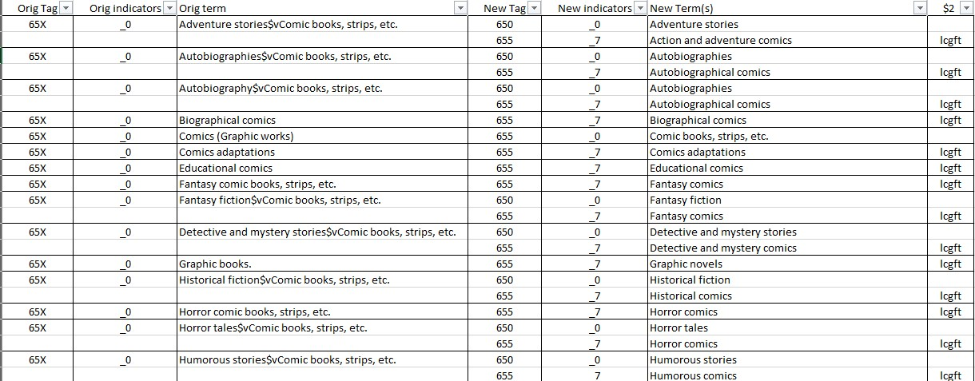
Closer look at new rules
Notes:
I had to convert the spreadsheet to something more like this (which ended up with 313 lines). With a set-up like this, one of my programmers could create a list to import into our system and create a rule that essentially says "if an incoming field is (what's represented in Column A) also has indicators from column B AND has the phrase in column C, then add the fields in Column D with the indicators and phrases/subfields from columns E, F & G).

Slide 15
Closer look at new rules
Notes:
Once that rule & list were imported into our system, it will remain housed in an environment that can be added to later. So if additional terms are desired, we can certainly edit the "list" itself and the rule that's in place will automatically take those changes into account.

Slide 16
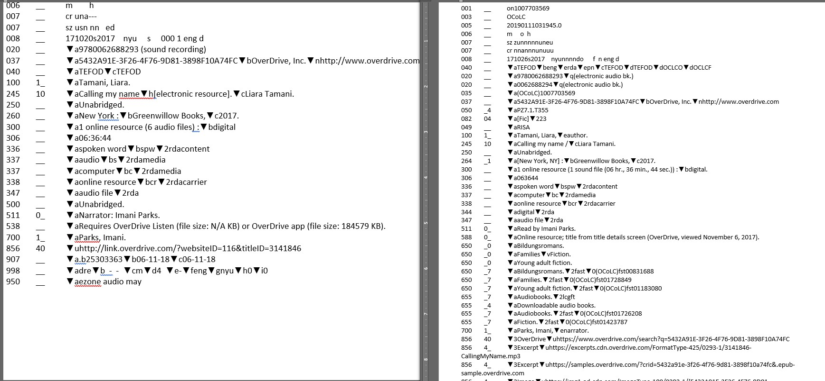
Closer look at new rules
Original OverDrive record
OCLC Record
Notes:
So, I just wanted to take a few minutes to kind of show you some screen shots of the overall process.
So on this slide we have examples of the two records that we received from Ocean State. On the left is the original OverDrive record and the record on the right is the OCLC record that is preferred.

Slide 17
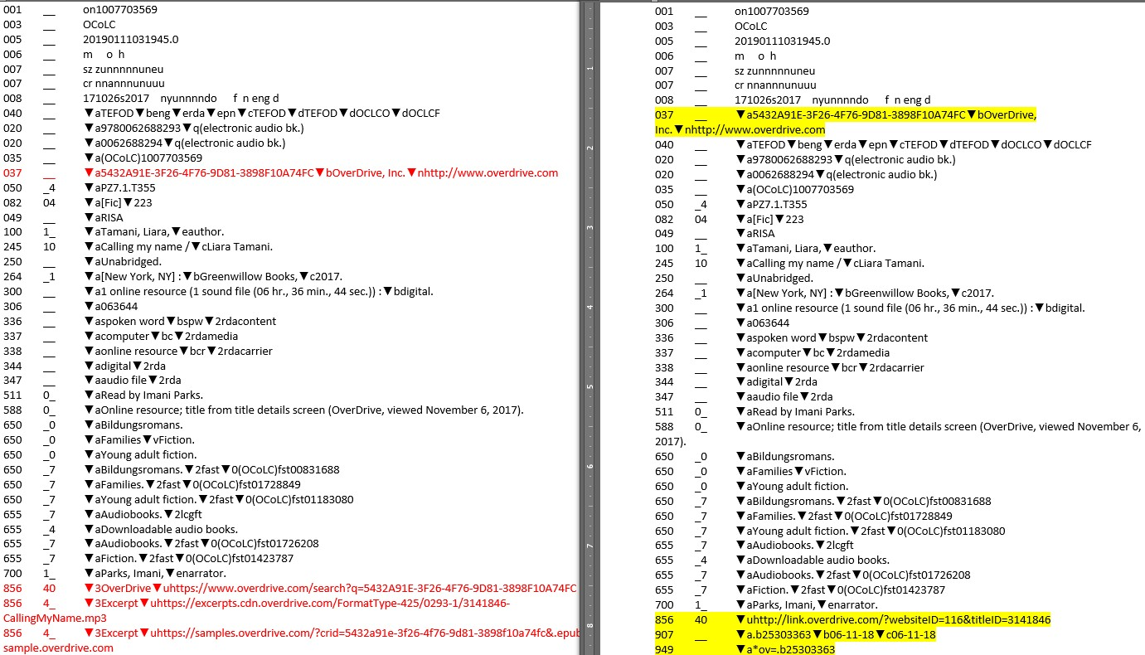
Closer look at new rules
Original OCLC record
Post-merge OCLC Record
Notes:
So in the OCLC record we're first removing a couple of fields, which are shown in red on the left. Then we merge in specific fields from the over drive records (which are highlighted in yellow). We also create the 949 field as shown at the bottom.

Slide 18
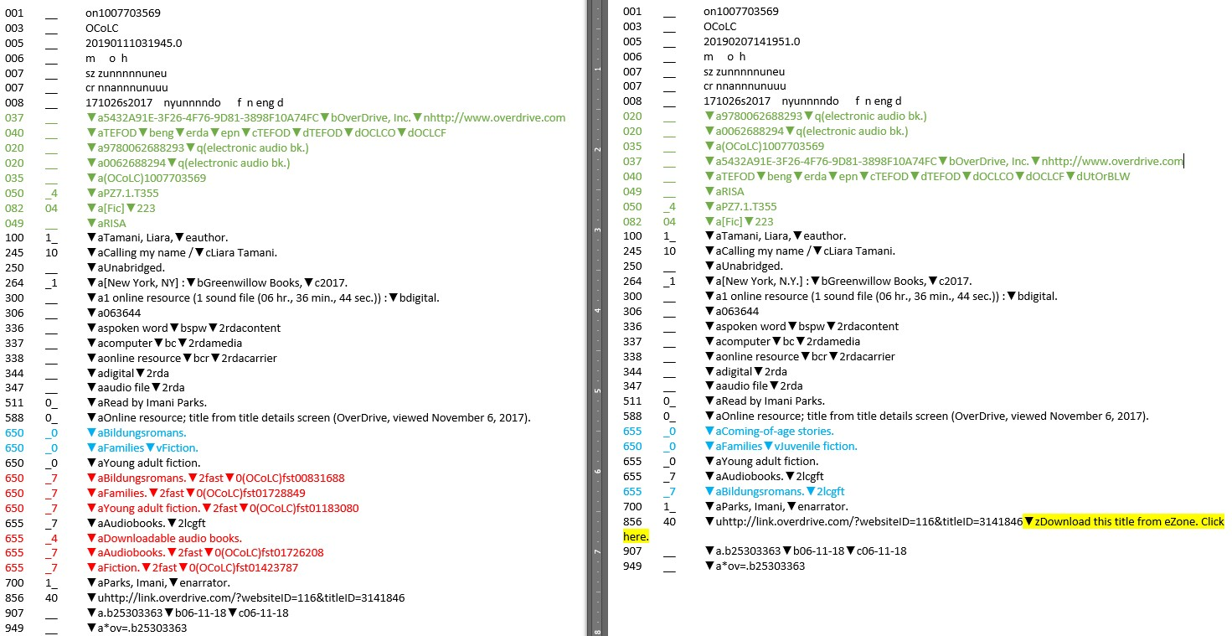
Closer look at new rules
Post-merge OCLC Record
Fully Processed Record
Notes:
Once the record merge is complete, we run the records through our Authority Control process … which includes all the new specifications that we'd put into place. On the left is the record before processing and on the right is the completed record.
The items highlighted in green were re-ordered, no other changes besides the addition of Backstage's symbol to the 040 were made. On the left you'll see a number of fields in red that were deleted during processing... these were all specifically requested by Ocean State. You'll also notice some fields in a bluish color. The terms on the left hand of the screen were ones that appeared in the spread sheet of terms to correct. So on the right you'll see the adjustments based on that original term list.
The yellow highlighted portion was added to finish off the 856 to its final form.

Slide 19
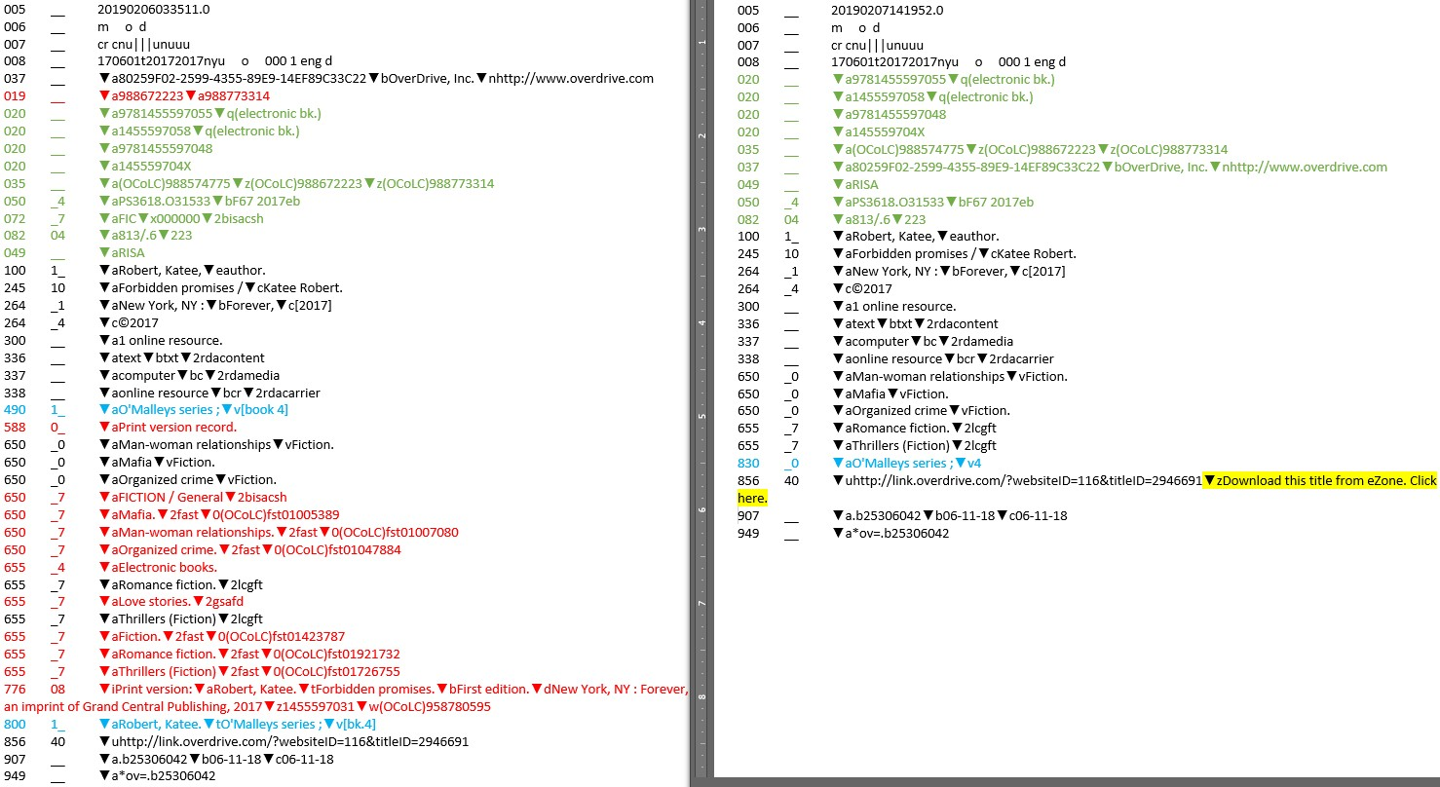
Closer look at new rules
Post-merge OCLC Record
Fully Processed Record
Notes:
here is another example of a record before and after processing. There are a considerable number of additional fields that are being deleted here. You'll also notice that the previous 480/8xx combination was changed to just a single 830; this is another custom specification for ocean state.

Slide 20
Results
Record Merging is partially automated, partially manual
29 new custom rules added to processing specification
Currently run the OverDrive records on a separate profile – can merge profiles in the future if it makes sense to do so
Notes:
After a few months of back and forth, and much testing, we got to a place where we were happy with the results.
We were able to automate much of the record merging and create 29 NEW custom rules to handle the OverDrive record requests. Like I mentioned earlier, we currently have processing set up for the Overdrive records under a separate profile, but potentially could be merged with the regular Ocean State profile in the future, if it made sense. Occasionally, some requests come up that require a tweak of the settings or add a new rule or two. We’re happy to accommodate whatever we can!

Slide 21
Notes:
Thanks again for having us both here to speak to you about this project. We welcome any questions that you might have at this time!

