Slide 1
Sierra to Summon at the University of Colorado, Boulder

Slide 2
Laura Wright
Serials Cataloging Manager,
Metadata Services
University of Colorado, Boulder Libraries
Boulder, CO

Slide 3
OUTLINE
Overview of the library, our users, & our collections
Discovery implementation & decisions
MARC field mapping
content type definitions
The evolution of our routine processes (the good and the bad)
Ongoing challenges (the sometimes ugly)

Slide 4
University of Colorado, Boulder and our Libraries
30,000+ students (undergraduate and graduate)
2,166 academic faculty and 1,984 research faculty, 700+ visiting international scholars, 3,600+ staff members
Our libraries hold 5,840,000+ titles (including records from Serials Solutions) with 7,326,300+ items attached
~4,705,500+ tangible volumes (includes microform); ~2,620,800+ e-volumes
~2,494,800 (about 53%) of tangible items are in offsite storage

Slide 5
The system includes five libraries:
Howard B. Waltz Music Library
Jerry Crail Johnson Earth Sciences & Map Library
L.H. Gemmill Engineering, Mathematics & Physics Library
Norlin Library
William M. White Business Library
Norlin (the main library) houses general humanities and social sciences collections, life sciences, Asian languages collections, Government Documents, and Special Collections and Archives
We are a regional Federal Depository

Slide 6
Discovery
Purchased Summon in 2015, with a soft launch in the fall
Launched as “OneSearch” along with new website in January 2016

Slide 7
Implementation and Ongoing Management
Metadata Services Department:
E-resources librarian and e-resources access manager
Serials cataloging manager
Libraries IT
Libraries applications manager
Instruction Working Group

Slide 8
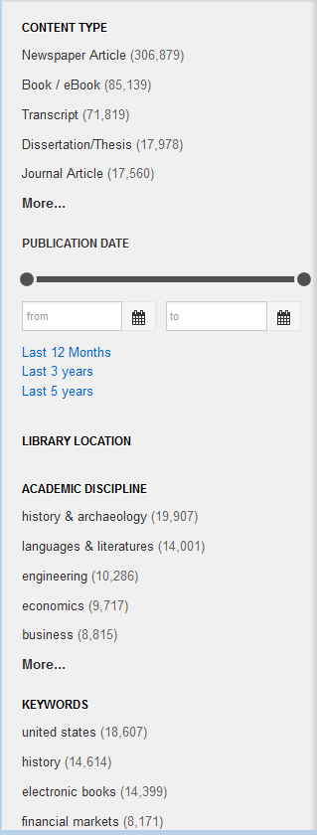
Mapping Decisions
Initial concerns
SuDoc numbers for Government Documents
default content type definitions
filter (facet) labels
Ongoing concerns
custom content type limitations
relevancy (outside the scope of this discussion)

Slide 9
Decisions, Revisited
Deletes
separate files vs. single file
leader position 05 vs. BCODE3 (998$e in III .out file)
Mapping changes
based on feedback from users
example: added 027 and 088 to standard number index to facilitate retrieval of engineering standards

Slide 10
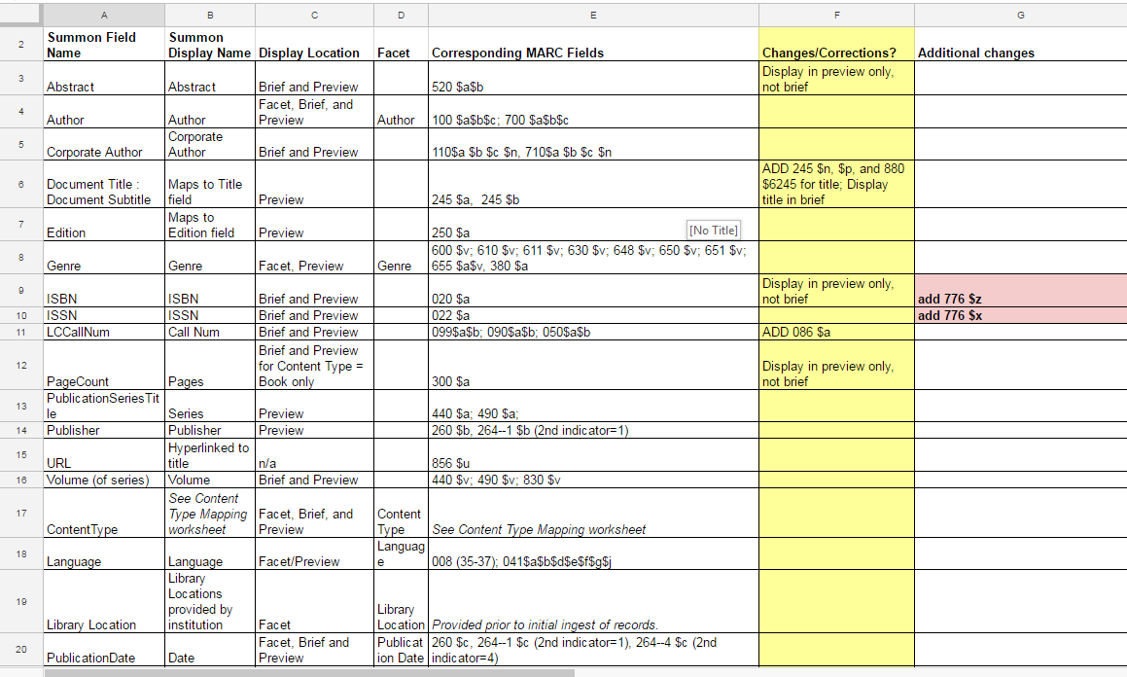

Slide 11
Routine Processes
Daily (weekdays): list created in Sierra by one of two staff members
saved search, we update the date manually (conditional date could be used if we ran the list 7 days/week)
output file uploaded to Proquest server via ftp
Weekly: records marked for deletion deleted from Sierra
Quarterly: full holdings re-uploaded to Summon index
create successive lists in our largest review file (holds 1 million records)

Slide 12
Challenges – Databases and other “E-resources”
(…OR, to bib or not to bib?)
We have displayed Resource records (from the ERM) in our public catalog for many years
Instruction is predicated on being able to search for databases in whatever our main search option is
Public outcry* ensued when we first brought up Summon and searches for popular databases by name did not yield expected results
Usage statistics verify that our users frequently search database names (e.g. “Web of Science” “JSTOR” or “J Store”) in Summon
But Resource records are not MARC & Proquest cannot ingest non-MARC metadata
*within the libraries at least

Slide 13
Initial Solution
“Dummy” bibs, suppressed in Classic catalog
derived from Resource records
used MarcEdit to create initially, then did manual clean-up
this was conceived of as a temporary solution
maintenance is a challenge (any edits made to resource records must also be made in corresponding bib records)
these records still don’t provide adequate discovery unless the users are savvy enough to limit their search by content type

Slide 14
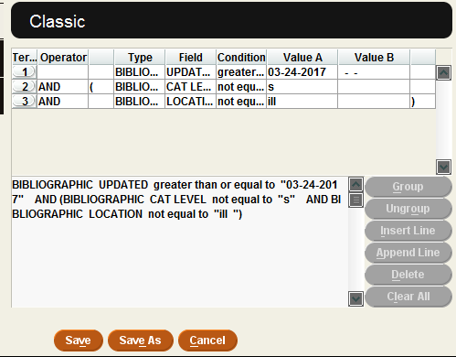
Search strategy
Before new BCODE3…
After
This is the search we run every weekday (updating the date).

Slide 15
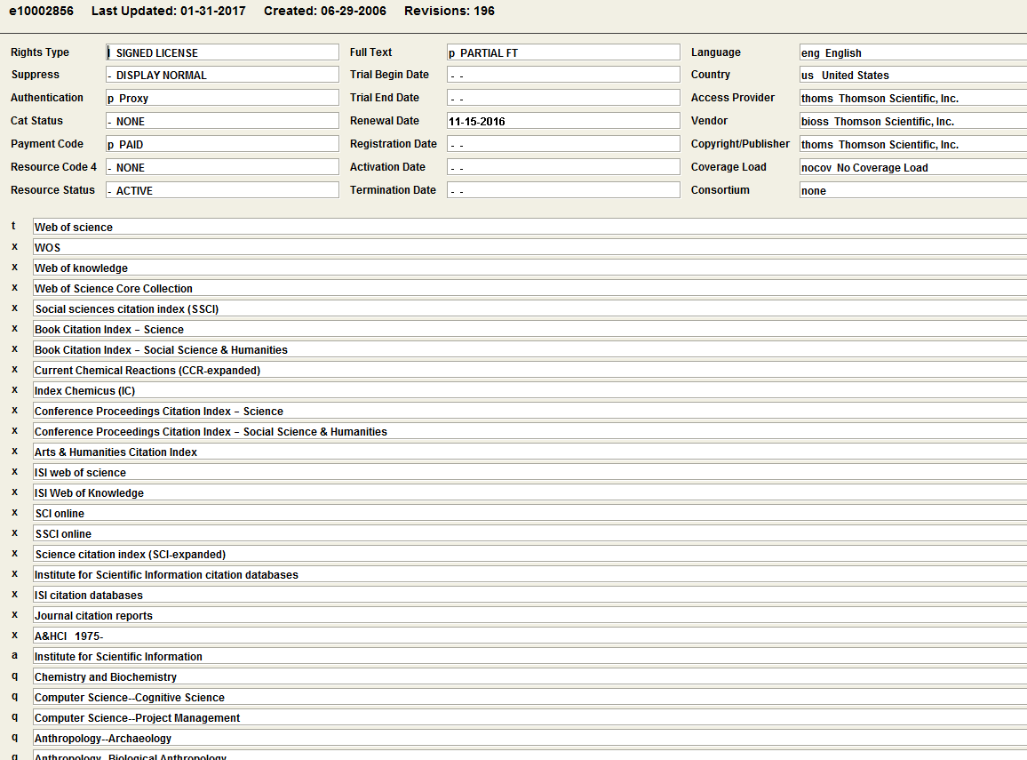
resource record → “dummy bib”

Slide 16
Other options for representing databases
Best bets
cannot use same tag for two different resources
character limits
Database recommender
recommendations limited to two
suggestions are randomized
Custom search box limited by content type
usability testing shows most users ignore dropdowns
A-Z Databases (LibGuides)
works really well, but…
how to best direct users here?
this is going to require ongoing discussion and collaboration

Slide 17
Questions?
(and a greeting from my dogs)
Laura.Wright@colorado.edu

