Slide 2
Your Presenters:
Martha Hood
University of Houston – Clear Lake
Associate Director for Technical
Stephanie Rodriguez
Nashville Public Library
Branch Manager

Slide 3
Finding Bad Codes
How often do you navigate your crew
towards a smooth harbor (clean catalog)?
Nashville
Dedicated staff member to run reports
Reports run when vendor records loaded
Ad hoc review of records by staff
UHCL
2-3 times a year
Deciding which reports to run regularly
When discovered

Slide 4
Finding Bibliographic Errors Using……
Field Statistics
Found in the Statistics Function
New Query
Create your query (Query Type is Field Statistics)
Save
Run!
View results file
Numerous methods of exporting
Word
Excel
csv

Slide 5
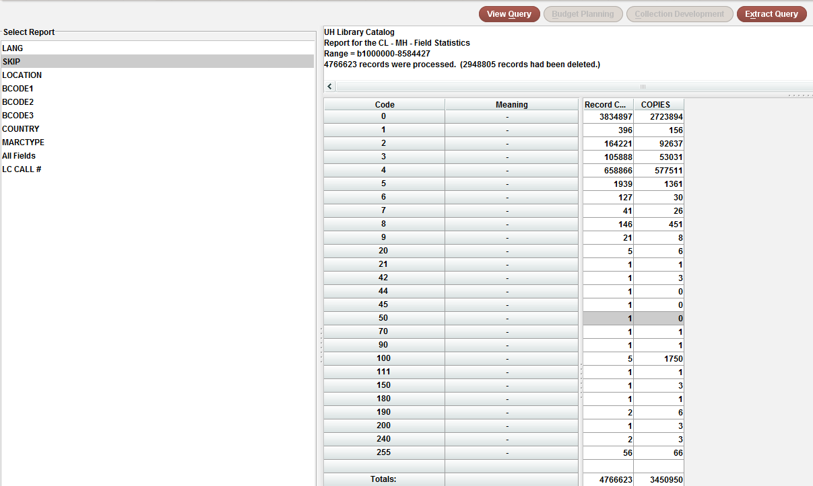
Looking at the Skip Report

Slide 6
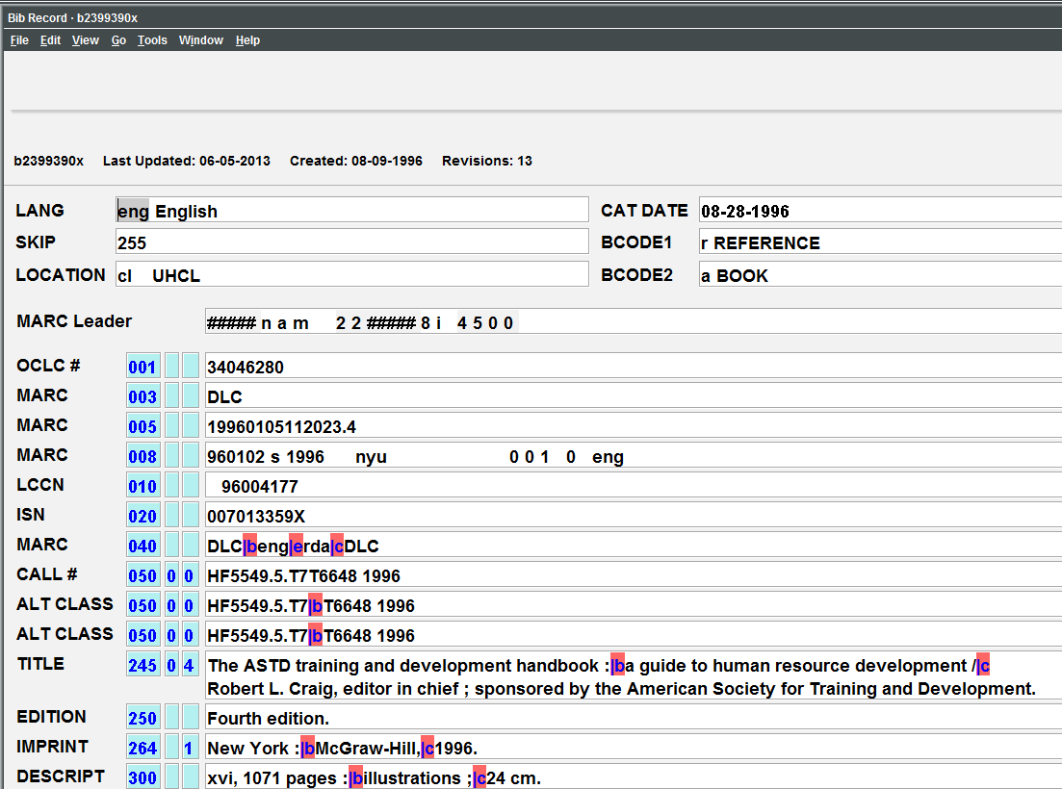
Create List of Results

Slide 7
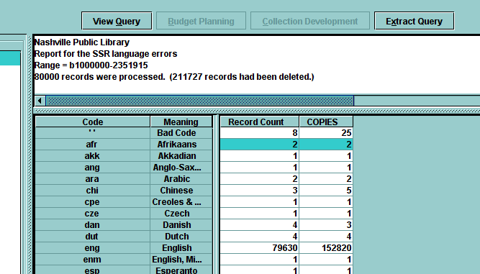
Language Errors

Slide 8
Language Errors

Slide 9
Create List to Find Errors

Slide 10
. . . & also Location Errors
What is wrong? Besides the “Bad Code”?
Only 2 letter codes are bibliographic locations at UHCL.
Five letter codes are item locations
Exception: cinet is the bibliographic code for electronic resources

Slide 11
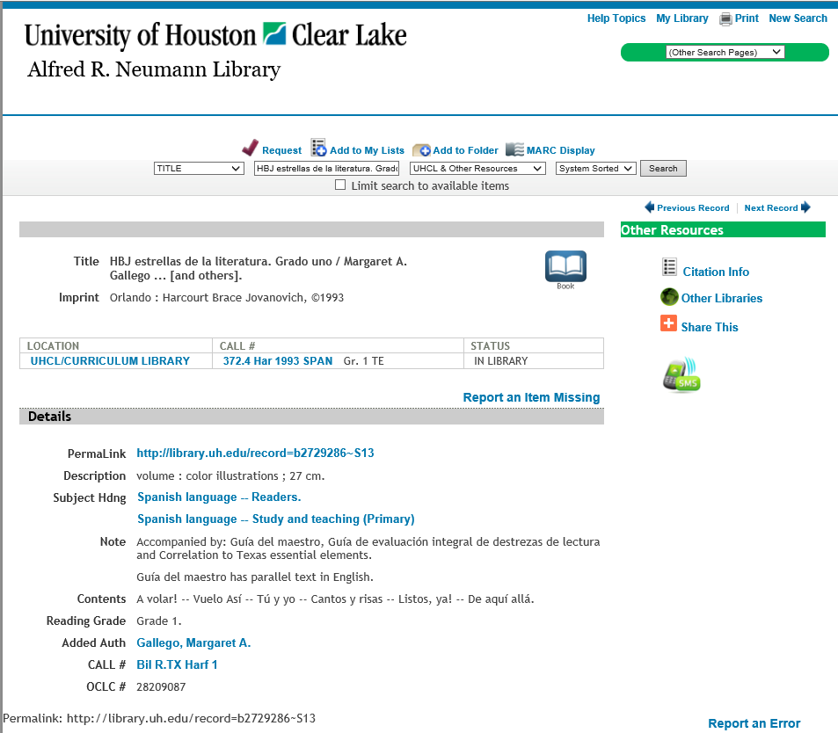
Lucky Find - UHCL
http://www.picgifs.com/graphics/four-leaf-clover/

Slide 12
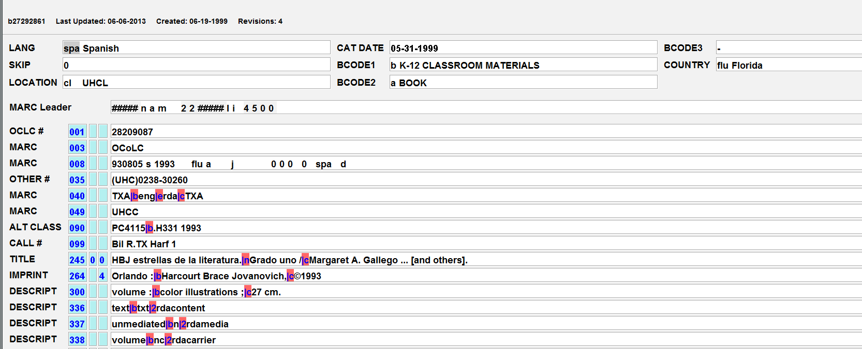
Looking at the Bibliographic Record

Slide 13
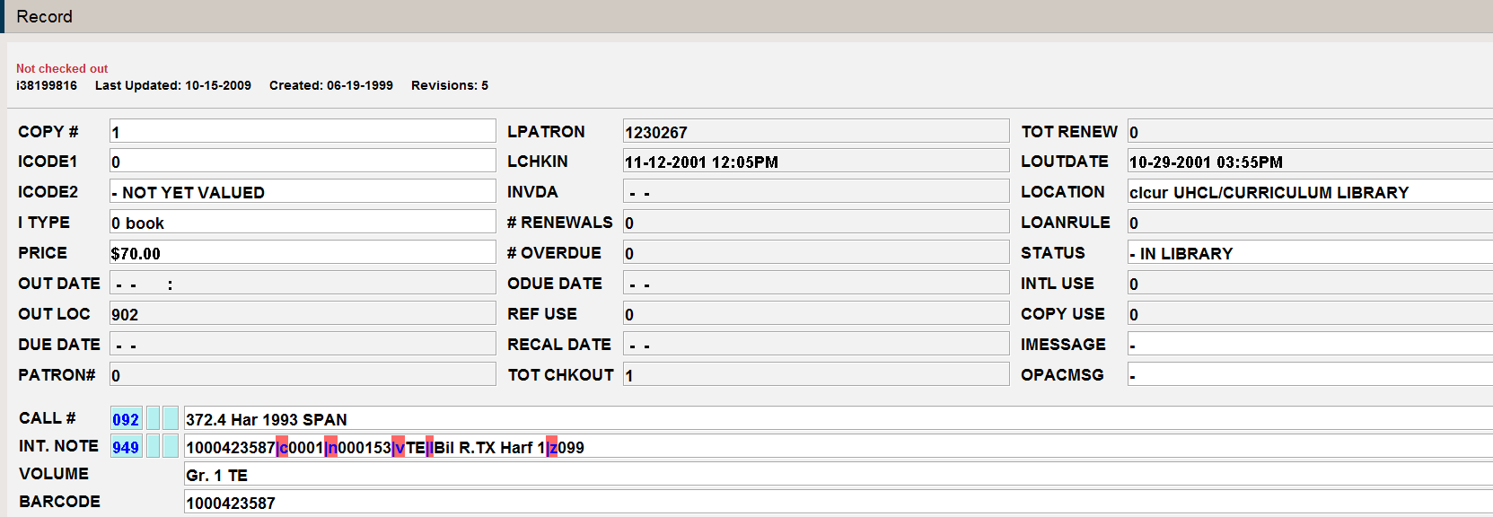
Need to Look at Item Record Too

Slide 14
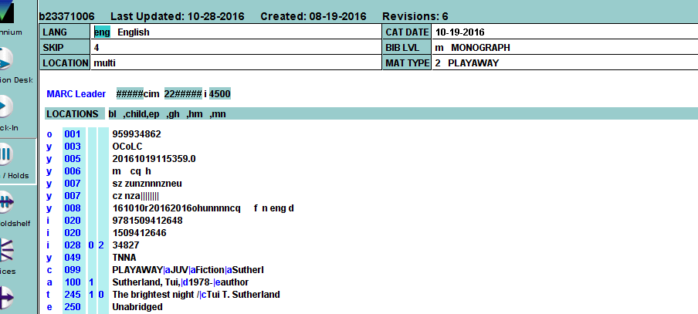
Lucky Find - Nashville

Slide 15
And what about item errors?
It's not how we make mistakes but how we correct them that defines us.
http://cache.marriott.com/propertyimages/w/wasgn/0-modules/custom/xxxxx_seasonal/wasgn_seasonal_home.jpg

Slide 16
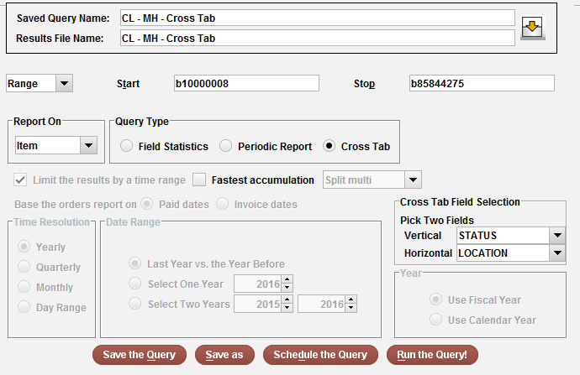
Finding Item Errors Using . . .
Cross Tab

Slide 17
Looking at the Results
Space Code?
Location
Status
Space Code means that the Status field is blank in the item record.

Slide 18
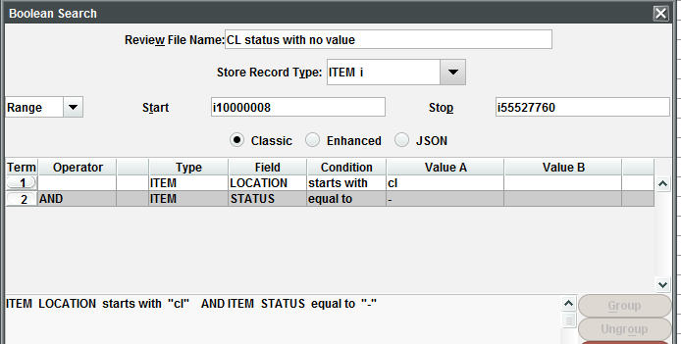
How do you run this query?
Could be EXTREMELY long or . . .
How do we remove the ‘–’
(in library)?

Slide 19
With a little creative thinking . . .
"and",
{
"target": {
"record": {
"type": "item"
},
"id": 88
},
"expr": {
"op": "equals",
"operands": [
"-",
""
https://tenor.co/utoL.gif
Remove – (dash)

Slide 20
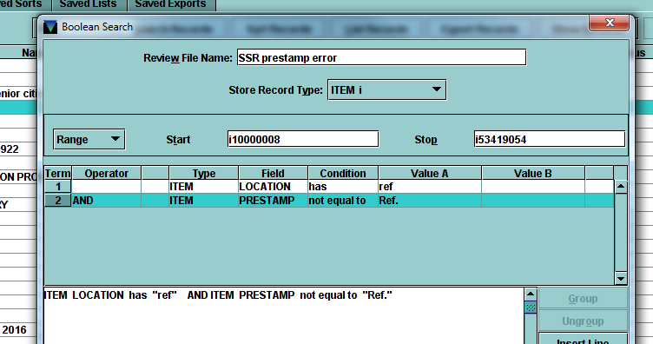
Finding Item Record Errors Using…
Create Lists - Nashville

Slide 21
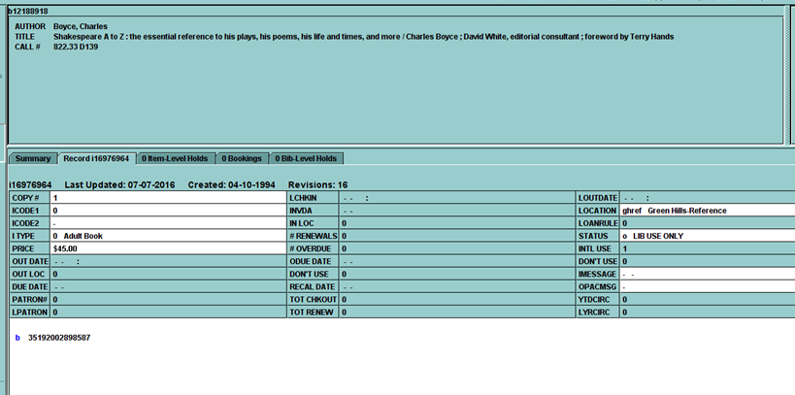
Prestamp Error
Item record does not have pre-stamp for call label

Slide 22
Item record has pre-stamp for call label

Slide 23
Helpful Websites & Ideas
Fixing Bad Codes FAQ
Cataloging Cleanup Projects
Catalog Maintenance Tasks: Housekeeping in the Database
Administration Checklists
Cataloging Checklists
OPAC Display Troubleshooting for Catalogers

Slide 24
Thanks for attending!
Contact us:
Stephanie Rodriguez
Stephanie.Rodriguez@nashville.gov
Martha Hood
hood@uhcl.edu

