Slide 1
The Rules of SQL-Sitions
Jeremy Goldstein
Data Curation Librarian
Minuteman Library Network

Slide 2
Previously In learn About IUG 2024
Thank you Wes and Jeff
Notes:
As seen in Wes and Jeff’s Learn About IUG 2024 presentation

Slide 3
The Rules of SQL-Sitions
Jeremy Goldstein
Data Curation Librarian
Minuteman Library Network
Notes:
Check in Meeting Agenda on Slide 1

Slide 4
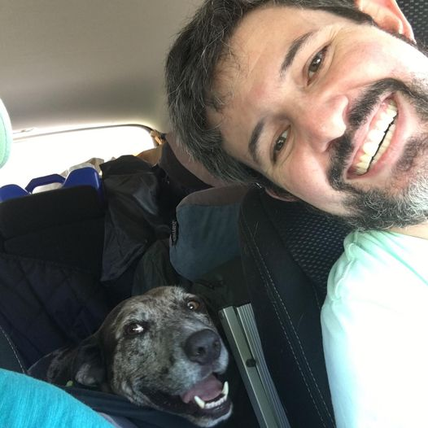
About Me
Librarian since 2006
With Minuteman since 2013
All but 1 year of that has been on Millennium / Sierra
Originally a cataloging/acquisitions person
now handle analytics….developer projects….training…and still acquisitions
Learned SQL to deal with accounting units

Slide 5
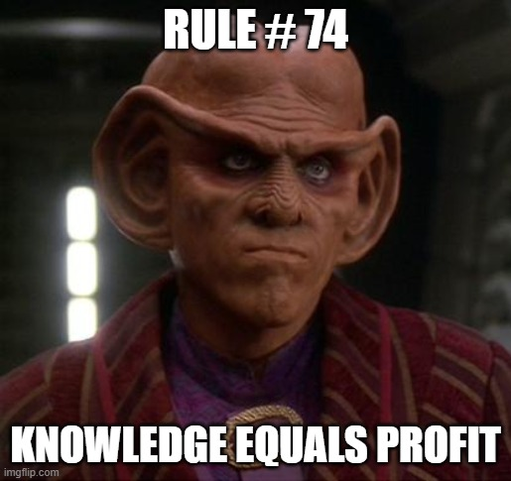
Out of Scope Orders
Working with Order Data

Slide 6
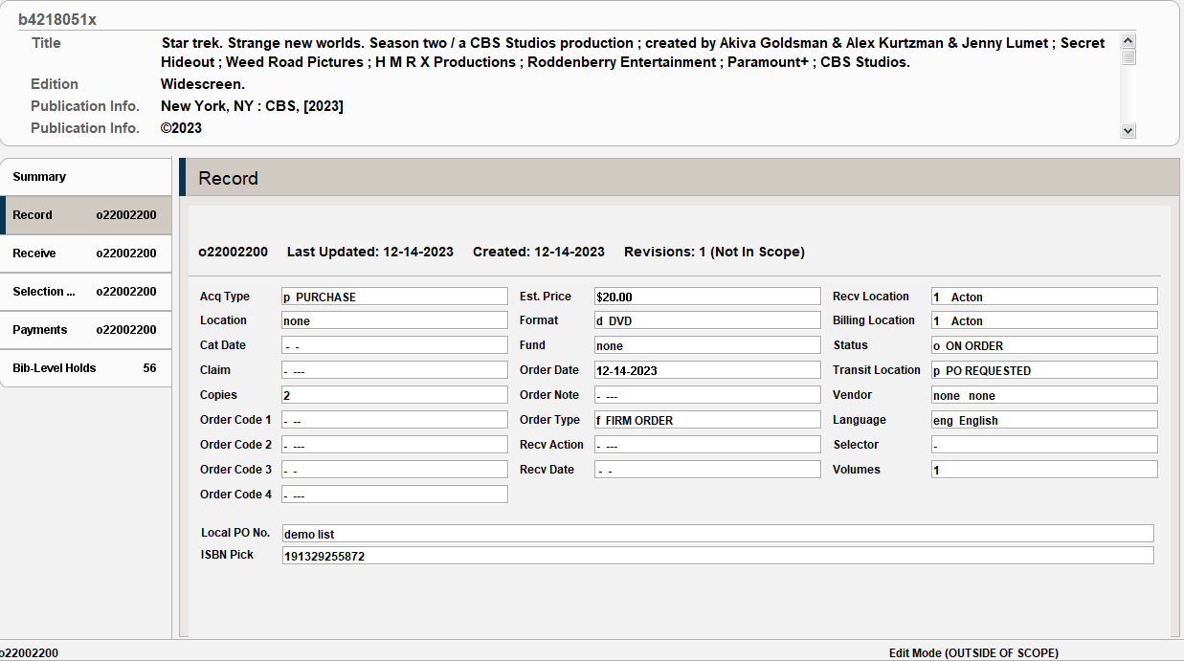
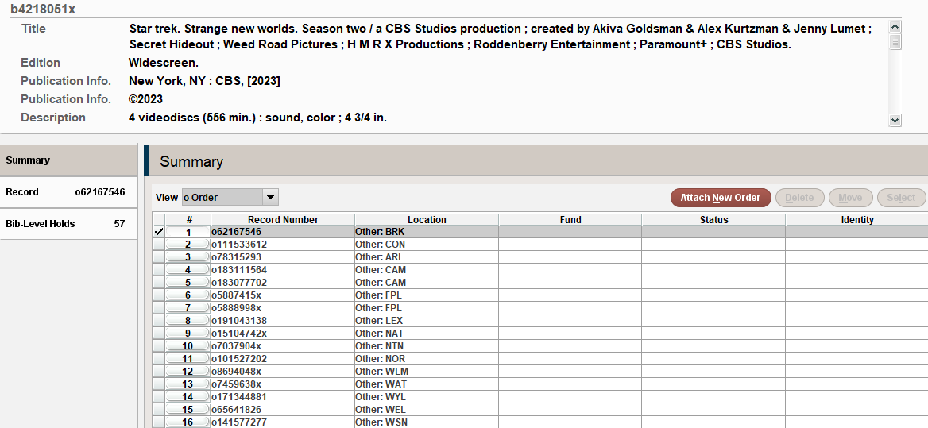
The Problem
Notes:
Out of Scope orders typically occur when someone downloads a cart from a vendor site through quick click and does not correctly apply a grid. The records load with the fund, location, and vendor missing, and since the location is none the record falls out of the accounting unit and becomes locked. The only way to correct these records is to use a login set to that accounting unit but a scope of none. To make matters worse, you can’t search for these easily in Sierra as Create Lists will not return records outside of the current accounting unit, in Minuteman we have 43 of those.

Slide 7
The Solution
Notes:
SQL does not share that limitation and returning a list of order records will return the data for them all regardless of the unit they belong to.

Slide 8
The Other Problem
id
record_id
accounting_unit_code_num
acq_type_code
catalog_date_gmt
claim_action_code
ocode1, ocode2,
ocode3, ocode4
estimated_price
form_code
order_date_gmt
order_note_code
order_type_code
receiving_action_code
received_date_gmt
receiving_location_code
billing_location_code
order_status_code
temporary_location_code
vendor_record_code
language_code
blanket_purchase_order_num
country_code
volume_count
fund_allocation_rule_code
reopen_text
list_price
list_price_foreign_amt,
list_price_discount_amt,
list_price_service_charge,
is_suppressed,
fund_copies_paid
Notes:
That’s a whole lot of fields but there’s a few real conspicuous ones missing, and with the exception of vendor code, they’re the ones we need to look for to identify these out of scope records.

Slide 9
The Other Problem
fund_code
location_code
copies

Slide 10
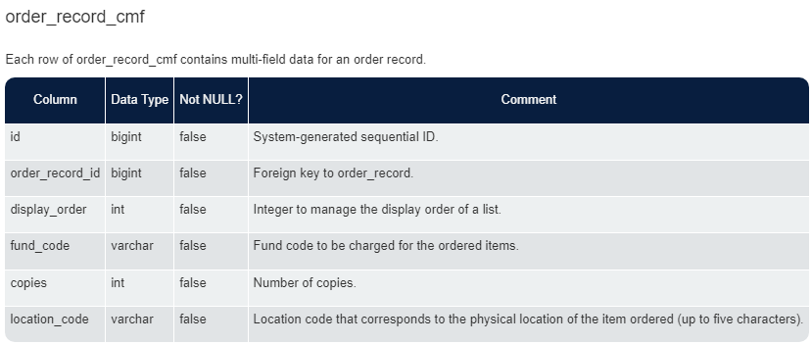
Notes:
A search of SierraDNA reveals the order_record_cmf table, with a note saying in contains multi-field data, which is why this is broken out separately from the rest of the order record. You see something similar with the bib_record_location table

Slide 11
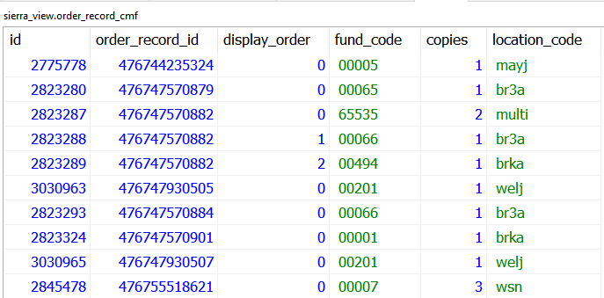
Notes:
So there’s a peak at the table, highlighting an order that includes multiple funds, just to provide a sense of why this structure exists. This library has ordered 2 copies for two different branches, using a different fund for each…we’ll get back to this table shortly.

Slide 12
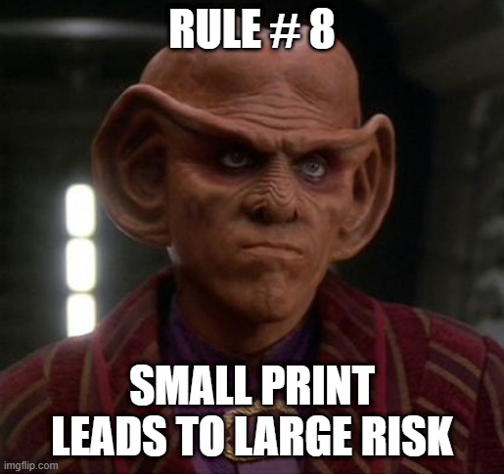
Out of Scope Orders
SELECT
rm.record_type_code||rm.record_num||'a' AS onumber,
o.accounting_unit_code_num,
rm.creation_date_gmt::DATE AS created_date,
o.vendor_record_code,
cmf.location_code,
cmf.fund_code,
cmf.copies
FROM
sierra_view.order_record o
JOIN
sierra_view.order_record_cmf cmf
ON
o.id = cmf.order_record_id
JOIN
sierra_view.record_metadata rm
ON
o.id = rm.id
WHERE
cmf.location_code = 'none'
Notes:
Now we can join the order_record table to the order_record_cmf table (along with record_metadata just to get the record number) and filter to records with a location_code = ‘none’ and we’ve found all our out of scope records….but also our next mystery to untangle.

Slide 13
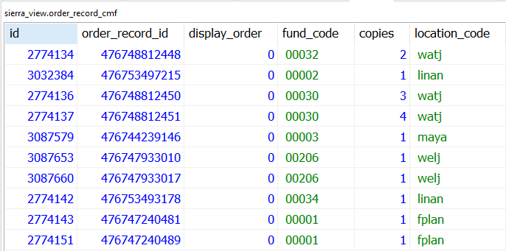
Results
& Another Problem
Notes:
There is no fund code of 00000.
Not just an issue for the orders missing data. If you preview the order_record_cmf table all the funds are like this. None of these fund codes make sense for our libraries.

Slide 14
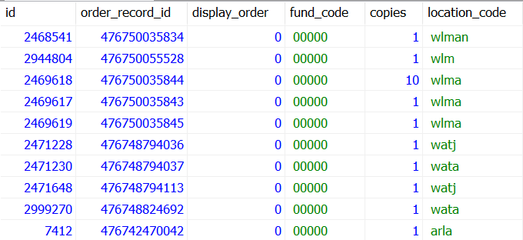
Results
& Another Problem
Notes:
Looking further at this table, we can also see that these fund_codes are shared between locations, which makes even sense with how funds work with our accounting units.

Slide 15
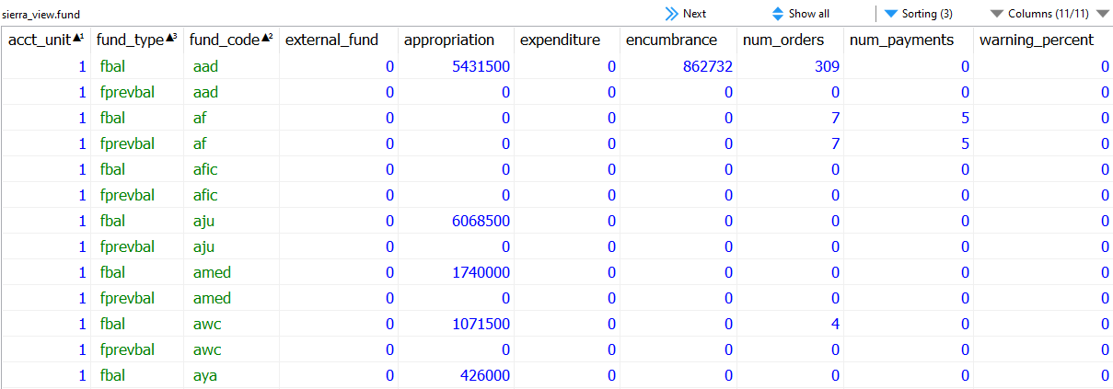
Hunting for Fund Codes
Notes:
The fund table has codes…but it doesn’t have ids or anything else that looks like it would work to join to the cmf table.

Slide 16
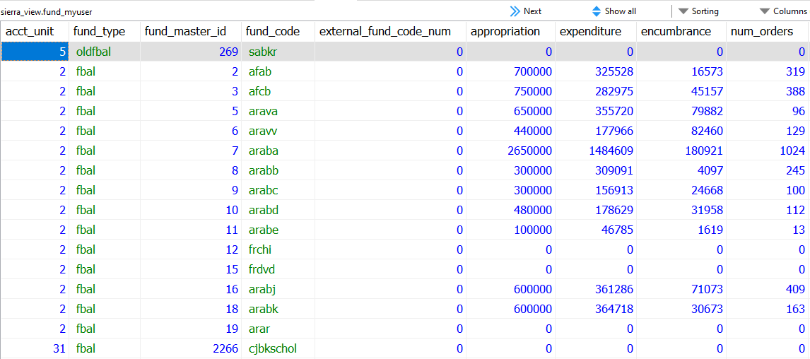
Hunting for Fund Codes
Notes:
There’s a fund_myuser table. Typically myuser tables provide translations between codes and labels. This table does have both our fund_codes and an id that’s maybe something, but it’s labeled as fund_master_id and doesn’t quite look like those 5 character fund codes we saw before. So what is that a foreign key to.

Slide 17
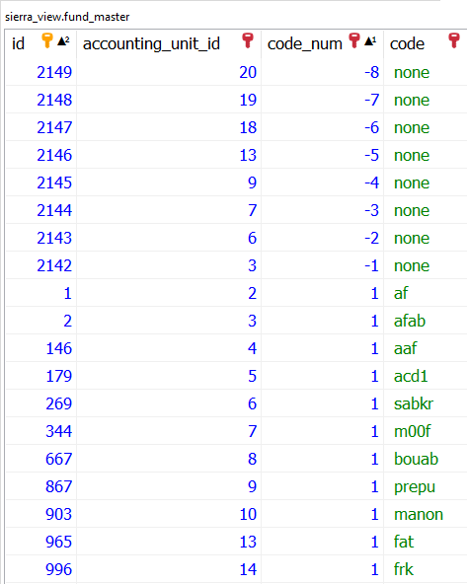
Hunting for Fund Codes
SELECT
rm.record_type_code||rm.record_num||'a' AS onumber,
o.accounting_unit_code_num,
rm.creation_date_gmt::DATE AS created_date,
o.vendor_record_code,
cmf.location_code,
cmf.fund_code,
cmf.copies
FROM
sierra_view.order_record o
JOIN
sierra_view.order_record_cmf cmf
ON
o.id = cmf.order_record_id
JOIN
sierra_view.record_metadata rm
ON
o.id = rm.id
WHERE
cmf.location_code = 'none'
Notes:
There is in fact a fund_master table, and it contains ids, accounting unit ids codes and code numbers that still don’t look like what we saw in the cmf table but do explain how it’s possible for the codes we saw before to seemingly be shared among accounting units. Here we can see that each accounting unit has a distinct set of code_num values. However, we can also see that there is no entry in this table for a code_num = 0.
Because anything with a location code of none will also wind up with a fund code of none (it’s out of scope/accounting unit and thus has not access to those fund codes), we’ll simply never have fund information to work with in this query so we can just remove that from our select statement. And we’ll come back to those fund codes in a bit.

Slide 18
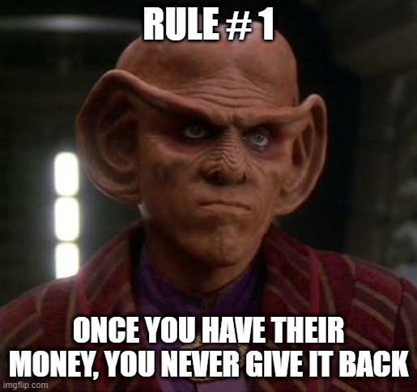
Negative Encumbrances
Working with Fund Data
Notes:
To explore this further let’s look at another common acquisitions problem that can be difficult to research in Sierra.

Slide 19
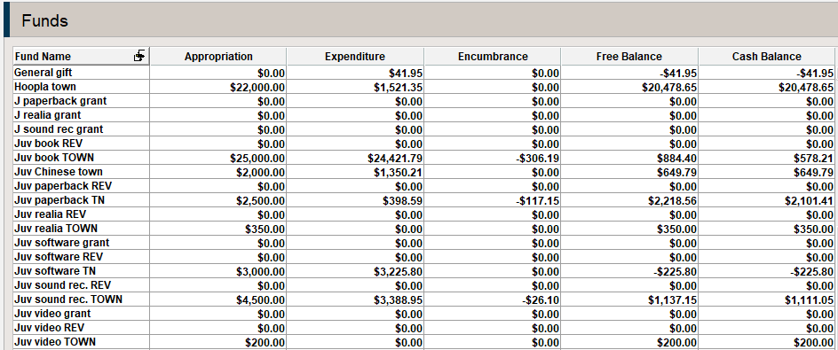
The Problem
Notes:
Most commonly caused by setting encumbrances to $0 during fiscal close while open orders remain in the system.

Slide 20
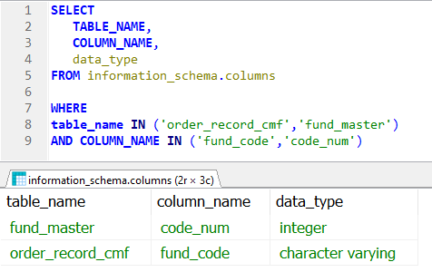
Back to Fund Codes
Notes:
So we’re pretty sure those codes mostly match. But a quick data type lookup using the information_schema table, which contains metadata for the database itself reveals that to two fields are using different datatypes, so we’re going to have to address that if we want to join the tables together.

Slide 21
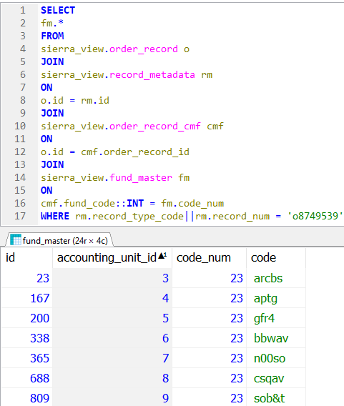
Testing
JOIN
sierra_view.fund_master fm
ON
cmf.fund_code::INT = fm.code_num
Notes:
Here I’m testing out joining order_record_cmd to the fund_master table we were looking at earlier, casting the cmf table’s fund_code to an integer so the data types match. What we discover is that while the our desired fund code is coming up, so is every other accounting unit’s fund that shares a value of 23.
So as part of this join we need to also limit on accounting unit….but this order does not belong to accounting unit 5.

Slide 22
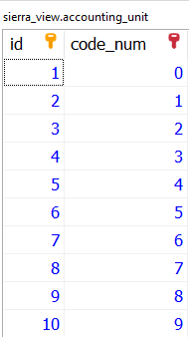
Accounting Units
Notes:
Fund master and order_record both have foreign keys to the accounting unit table, but they aren’t a match for each other. Order_record uses the code_num field while fund_master instead references the id. So in order to make this work you have to take the extra step of going through the accounint_unit table to join everything together.

Slide 23
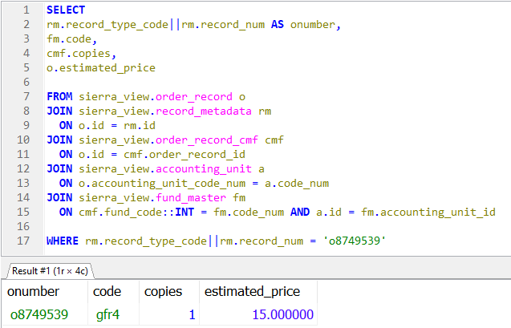
Putting This Together
Notes:
So here we join to that table and limit the appropriate accounting unit and we’ve got all our needed data together.

Slide 24
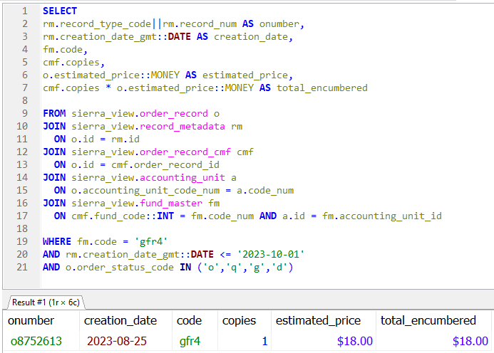
Putting This Together
Notes:
Now we can just adjust our filters a bit so we’re searching for open orders created before a specified date using our desired fund code and we’ve got some data we can work with.
However, this isn’t accounting for partial paid orders yet, so we have one more table to bring in still.

Slide 25
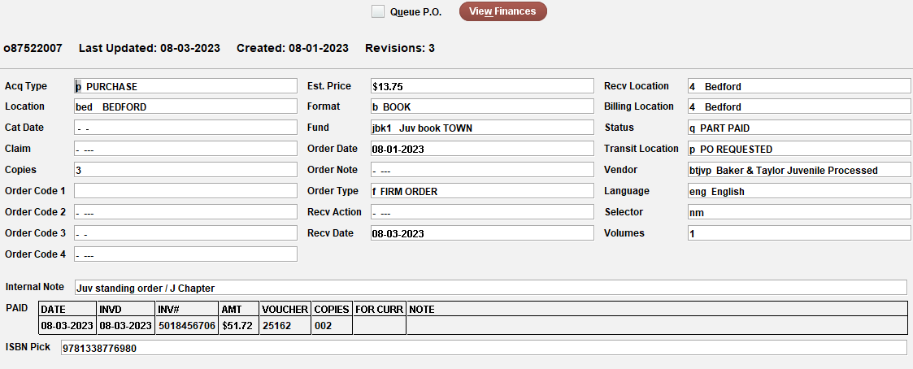
What About Partially Paid Orders
Notes:
Order_record_paid includes the full contents of the paid fields you can see in orders, which in fact appear already as tables in Sierra.

Slide 26
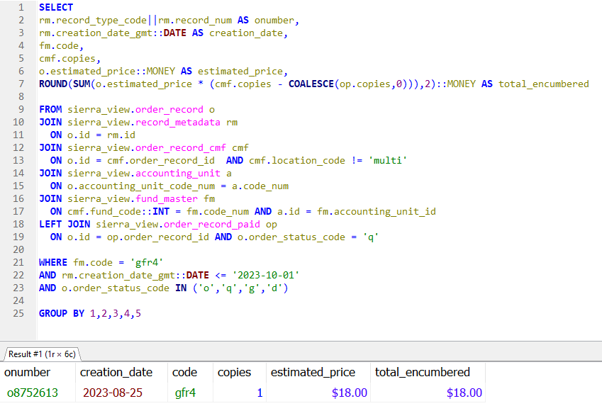
Putting This Together
Notes:
Now we can left join to the order_record_paid table, if it was a standard join we’d only be looking at orders where a paid field happens to exist.
Now we can calculate a proper total by subtracting paid copies from copies. Note the COALESCE function used with the paid_copies field, which accounts for null values (when paid doesn’t exist at all). You can’t really perform basic math on null values, 1-null = null. This function looks at everything in the parenthesis and returns the first entry it sees that isn’t null. Most of the time that will be the copies field, but when copies = null then it moves on and selects the 0 instead.

Slide 27
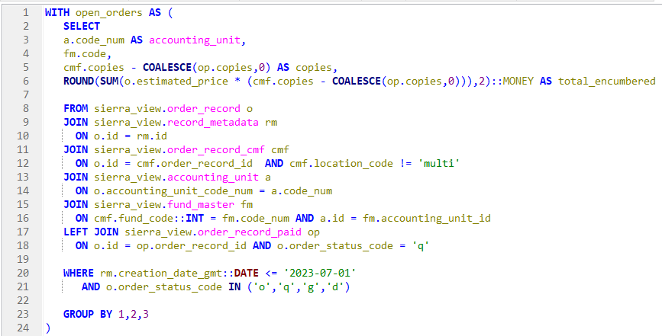
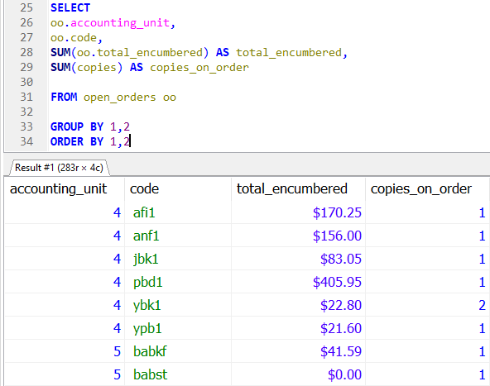
A Different Approach
Notes:
So that was how to hunt for the orders contributing to a negative encumbrance, but if you don’t know which funds to look at, with just a little adjustment we can do that too.
The bulk of our prior query is now packaged into a Common Table Expression, which you can think of as an on the fly table. By doing this we can now treat the results of our prior query (streamlined just a bit to remove fields we won’t be using) the same way we would any table that’s natively within Sierra DNA. So now we can do some simple math on those rows and for each fund with an open order just add up the individual encumbrance totals and there’s are the totals contributing to our negative encumbrances.

Slide 28
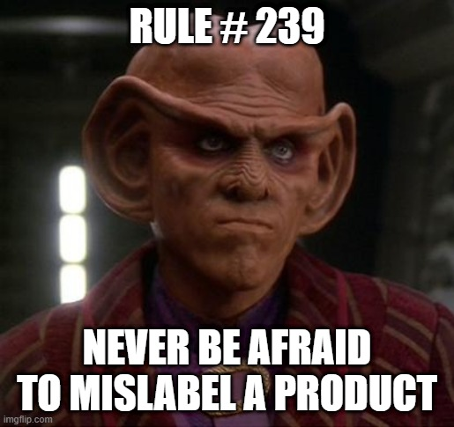
What if you want fund names?
Notes:
One last bit of fund information before we move on to other acquisitions datasets. Lets say your staff are accustomed to interacting with funds by their names instead of their codes. We need a way to incorporate those into our query. After some skimming of the available SQL views we can see that there’s one just for these fund_property_name. However it doesn’t have a foreign key that matches anything else we’ve looked at so far, just this one called fund_property_id, which implies the existence of a fund_property table

Slide 29
What if you want fund names?
Notes:
So let’s look and there in fact is one of those. Here we can find the warning and discount percent fields for a fund, though we aren’t terribly interested in those right now. More importantly we do have a foreign key to the fund_master table that we’re already using. So we can just be sure to join fund_master to fund_property to fund_property_location and get our fund names in to our query from there, right?

Slide 30
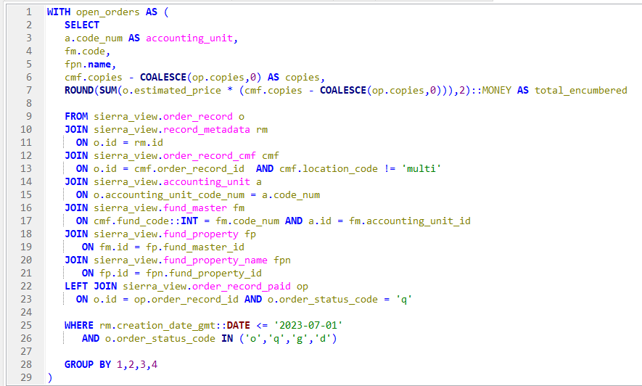
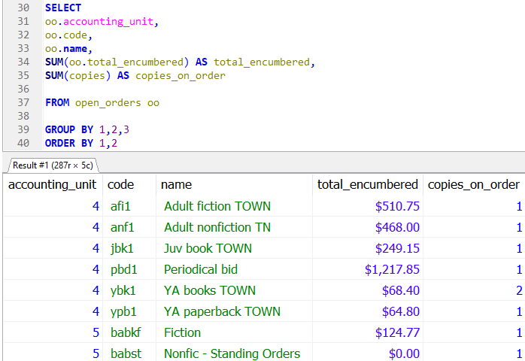
Wrong
Notes:
So here we’ve added in those two joins and the name field to our select statement and we can now see fund names side by side with our codes, everything looks great….unless you were paying real close attention to the totals earlier.

Slide 31
With and Without Fund Name
Notes:
Here’s the screenshot from our original query before we added the fund name side by side with the new results, the totals are now exactly three times greater in each case. So there’s probably some sort of one-to-many join error happening where our data is creating extraneous rows in our dataset.

Slide 32
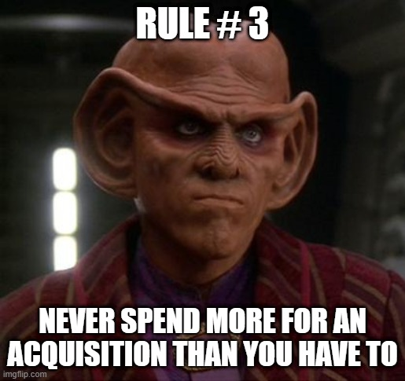
Finding Our Error
Notes:
Let’s take another look at the view we just joined into our query. What we ignored earlier was this additional id column, fund_type_id. Now we’ll need to go look for a fund_type table.

Slide 33
Finding Our Error
Notes:
But once again if you were paying attention to the very small print you might have seen fund type appear before in actually a few places. Here it is in the sceenshot we saw earlier for the fund table, which will actually reveal the nature of our problem. Note that each fund code appears here multiple times, with different fund types and totals.

Slide 34
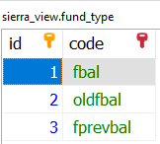
Fund Type
Notes:
What we’re seeing here are a few different instances of each fund. Looking at the fund_type table now reveals that there are in fact three of these that exist (giving us our three times greater expenditure when we inadvertently joined on each of these). Fbal is the current fund balance. Oldfbal is the old fund balance from the last time you ran fiscal close. Fprevbal is the fund balance from the last time you ran a fund activity report. If you’ve ever seen a out of balance error while running one of those, that’s a discrepancy between fbal and fprevbal.

Slide 35
Putting this together
Notes:
So to fix this all we have to do is specify a fund_type_id as part of our join to the fund_property table….going with 1 for the current fund balance and now our results are back where they ought to be.

Slide 36
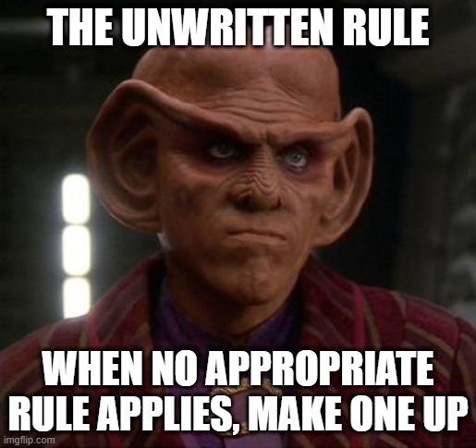
Finding X Records
Working with Invoice Data
Notes:
One last data set to explore. We’ve touched orders and funds, invoices remains the major component of acquisitions we’ve yet to explore.

Slide 37
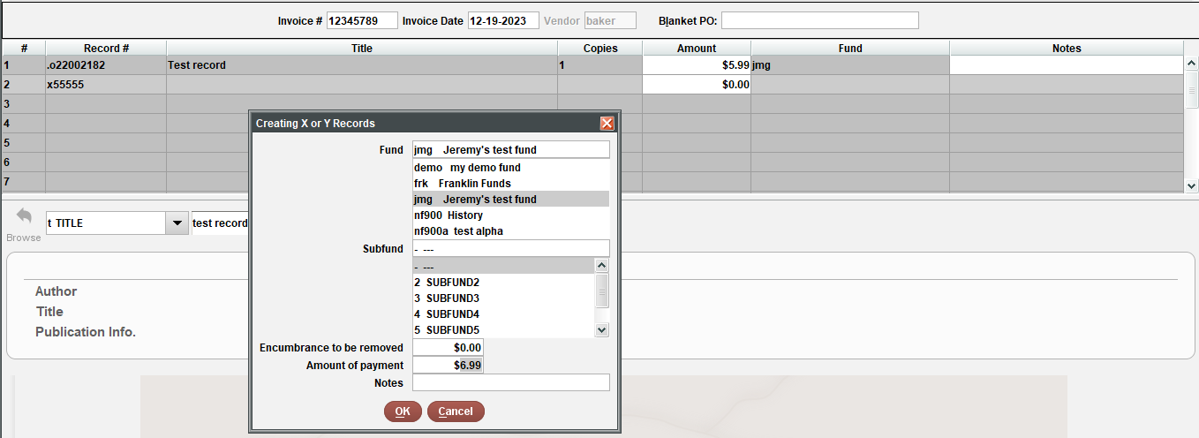
The Problem
Notes:
X-Records allow you to enter invoice line items that normally require an order record to exist, without bothering to create an order. They can be a huge time saver for odd instances that you want to invoice in Sierra but don’t have a need for actual records (replacement discs, Overdrive purchases). The issue with them however is that they leave very little in the way of a data trail and there isn’t a way to search for them directly as they are records that don’t truly exist.
But as we just saw with the prior query, in SQL there are ways to work with NULL data.

Slide 38
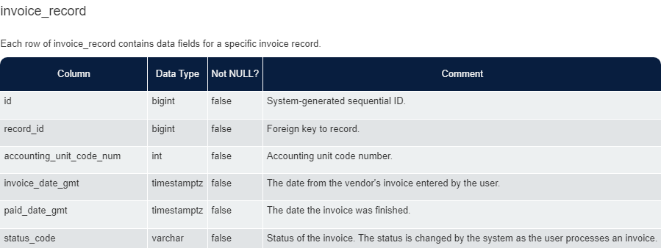
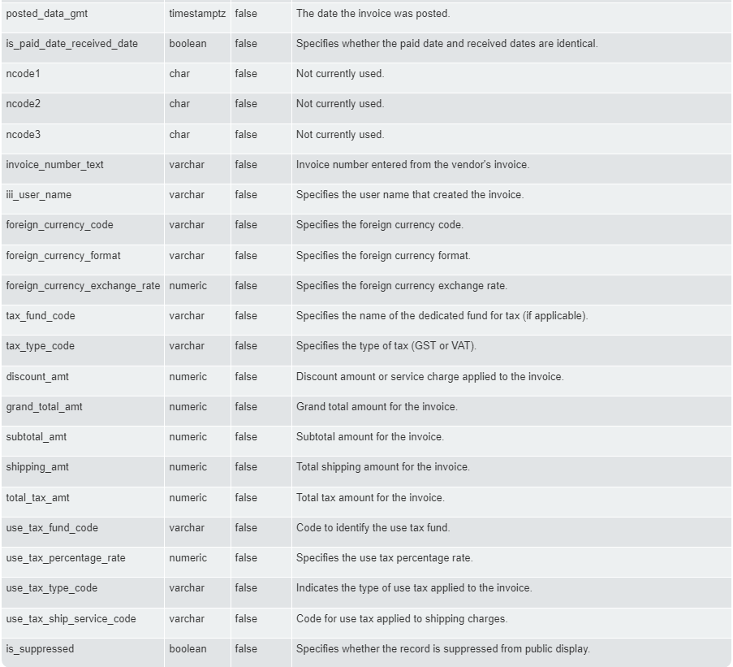
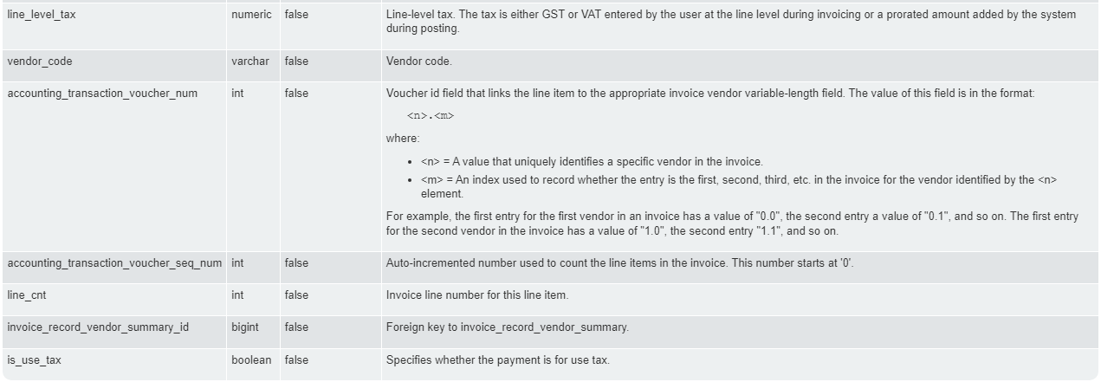
Invoice Tables
Notes:
We can review the documentation and see that there are separate tables for invoices and the individual invoice line items, which gives us a lot of data fields we can work with.

Slide 39
Invoice_record_line
Notes:
Now let’s do some research. Here we have an invoice that happens to contain an x record for a line item. We can run a quick SQL query to take a look at the line entries for the invoice with this record number. And what we discover is that the order_record_metadata_id is NULL, giving us a very simple marker of other x-records we can then search on.
It’s worth noting that table specifically uses the record_metadata_id instead of order_id. This is an indicator that this field is meant to be a foreign key to record_metadata instead of order_record. This fits the data retention in Sierra where orders can be deleted but invoices are forever, so even if the order this references is later removed from the system the invoice will not generate an error.

Slide 40
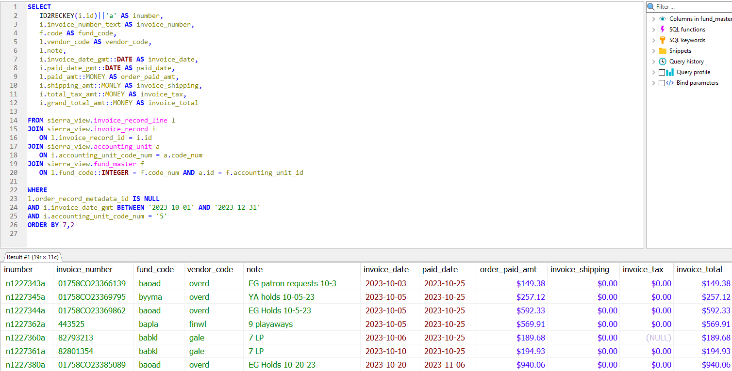
Putting This Together
Notes:
Much of this is borrowing things we’ve seen previously, though the key here is simply to search for invoice lines with a order_record_metadata_id of null.
I’ve added in the joins to accounting_unit and fund_master so we can utilize a meaningful fund code.
From the invoice table we can pull the invoice number, paid_date and shipping, tax and total cost fields. That’s bit of an odd inclusion here where we’re looking at line items but as you can see from the results in many if not most cases (for this library at least) these are single record invoices so for those instances this data is useful to have.
I used the id2reckey function to convert that invoice_id to a record number. I usually avoid that function as it throws confusing errors when used on record types that could include virtual records, but that’s not a concern for invoices.
There are a variety of options for filtering that could be useful. Here I opted to look for all entries belonging to a particular accounting unit on invoices within a given date range. Other options could include limited to particular vendors or funds codes, payments of a certain amount, or searching by paid_date instead of invoice date.

Slide 41
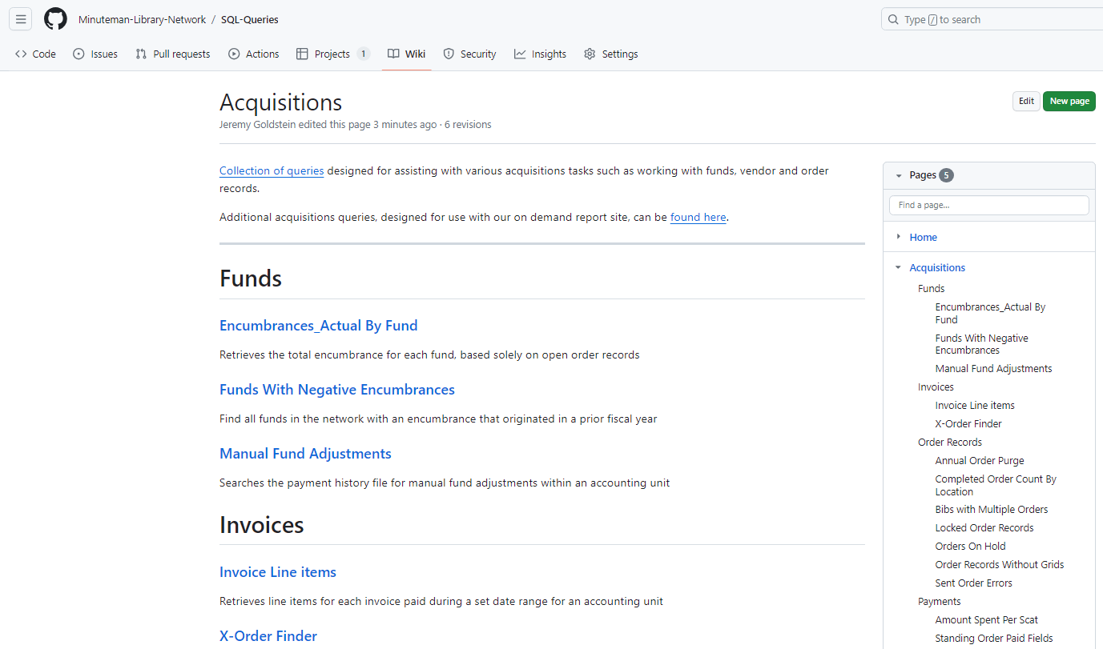
More Queries
https://github.com/Minuteman-Library-Network/
SQL-Queries/wiki/Acquisitions

Slide 42
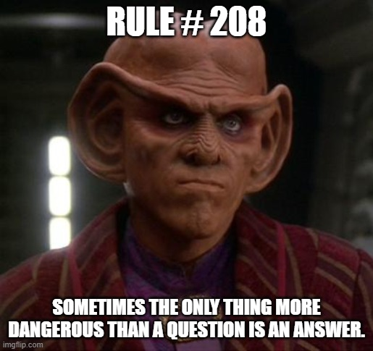
Questions?
Jeremy Goldstein
jgoldstein@minlib.net
https://github.com/Minuteman-Library-Network/SQL-Queries/wiki/Acquisitions

Slide 43
Jeremy Goldstein
jgoldstein@minlib.net
https://github.com/Minuteman-Library-Network/SQL-Queries/wiki/Acquisitions
“Rules of Acquisition.” Memory Alpha, 26 Jan 2024, https://memory-alpha.fandom.com/wiki/Rules_of_Acquisition

