Slide 2
Floating Collections
The Good, the Bad, and the Ugly

Slide 3
Floating Collections: The Good, the Bad and the Ugly
Marilyn Borgendale
GMILCS, Inc.- a nonprofit consortium of public and academic libraries in New Hampshire.
Janet Cox
Plano Public Library Systems – a 5 library system in Plano, TX
Cathy Wortman
Baltimore County Public Library – a 19 branch system with 4 bookmobiles in Baltimore County (separate jurisdiction from Baltimore City).

Slide 4
Plano Public Library System

Slide 5
Plano Public Library System
5 community libraries
Population of 275,000 and still growing
Over 4.7 million items checked out per year
Over 528,000 hold requests
Annual budget has been stagnant since 2008 but the number of collections and formats has increased.

Slide 6
PPLS: how we started
Started in 2011 with the Early Reader collection
Opened up a majority of the collections after the initial test
Eased the burden of transporting hundreds of materials back to their home libraries each day
50 collections float between all libraries
5 collections float between libraries with similar collections
For example, Hindi floats between 2 libraries
47 collections do not float
Too Hot to Hold, Bluebonnet Award Nominee Books, STEAM kits, reference, etc.

Slide 7
PPLS: the good
One collection, one library
One label stating Plano Public Library System instead of individual library names
Materials are instantly on the shelf and not waiting to be transported back to a “home” library
Patrons have access to more variety of materials
Less handling of materials
Fewer bins for van drivers to move
Started to create in how items are labeled and processed – award stickers, labels

Slide 8
PPLS: the bad and the ugly
Multiple copies tend to gravitate to one library
Some libraries ran out of shelf space
Materials were weeded to create space
Series are broken up
i.e. The Maze Runner, Stephanie Plum series
Discovered libraries had different standards of when items should be weeded and/or repaired
Popular material doesn’t return to lower circulating libraries

Slide 9
PPLS: lessons learned
Do not turn everything on to float at once
Have a firm weeding plan in place and weed prior to floating
Understand how to reroute materials to other libraries when shelves are too full
Materials end up where they will be most loved

Slide 11
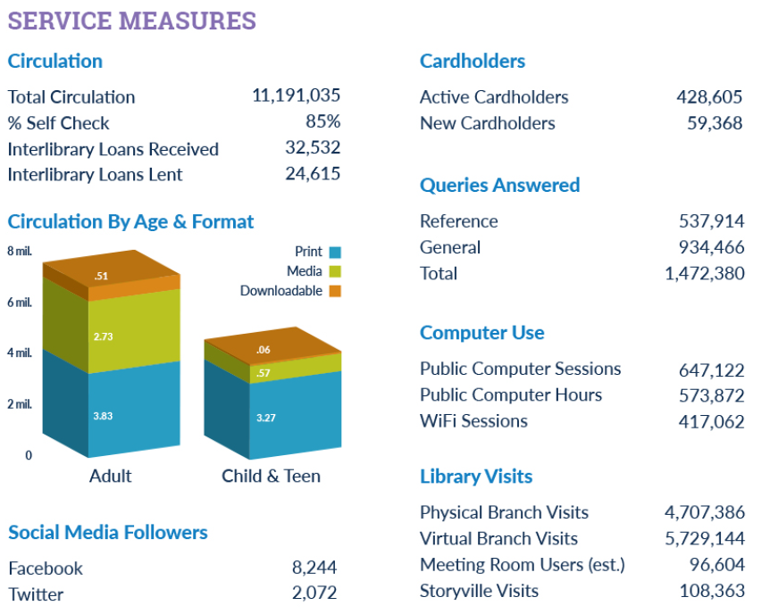
Baltimore County Public Library (BCPL)

Slide 13
BCPL : how it started
BCPL used to charge for every movie "rental"
Collection had to be self sustaining
Staff and administration realized we were losing revenue while materials sat in bins waiting to go back Home.
Pilot - put videos and talking books on CD on carts for pickup
Proved especially useful on weekends when there is no delivery.
Expanded floating to almost everything . . .

Slide 14
BCPL : what do we float?
EVERYTHING, except:
Magazines and Comic Books
Reference material (not much left)
Book Club Kits
Interlibrary Loan material
(Everything includes AV material, Playaways, Chromebooks, every type of print material, etc.)

Slide 15
BCPL : Benefits to Floating
Materials available to customers much more quickly; especially good for popular materials
Materials not sitting in bins on nights and weekends.
Able to eliminate one truck/delivery route.
Delivery is processed more quickly, freeing branch staff for other duties.

Slide 16
BCPL : One System, One Collection
All ordering and processing done centrally for the system
Hard to get branch librarians to change view from "my branch collection" to "system-wide collection"
Some tried to game the system by placing holds to pull materials to their branches (Big no-no!)
Collection Development Department developed a system approach to weeding and collection maintenance

Slide 17
BCPL : Collection Maintenance Approach
System-wide Collection Maintenance Schedule
Collection Maintenance Flow-Chart
Shelf Inventory by Branch
Items and Comfort Factor by Branch
Simply Reports – Item Counts by Collection
Collection Development department manages shifting of collection when too much lands at any one branch.

Slide 19
GMILCS, Inc.
Greater Manchester Integrated Consortial System
10 public libraries, 2 academic libraries
Manchester City Library also has a branch
Colleges are private
Libraries are independent--funded by town property taxes
Membership in GMILCS is voluntary

Slide 20
GMILCS, Inc.
Serve 20-25% of the population of the state: about 300,000 people
Circulation = 2.1 million
Items = 1 million
Hold requests = 263,000

Slide 21
GMILCS: how we started
Mission = sharing, but we've come at it slowly
Common Borrower Card—customer goes to the library
Open Requests—items come to the customer's library
3 libraries tried pilot project of Large Print and Biographies
Added 2 more libraries and Audiobooks, Graphic Novels, DVDs and Blu-Ray discs
Meanwhile, Manchester City began floating collections with its West branch.

Slide 22
GMILCS: keeping afloat
Needed to change some collection names
LP, LP Books, LP Fiction, LP Non-fiction...
Accepted shelf locations disappearing
Even Manchester had to review collection codes and changed a significant number of shelf locations
New materials
On-order item templates
Need to change item later to uncheck "do not float"
Lots of item clean-up

Slide 23
GMILCS: the good
Customers like finding "new" materials
Reduces moving of materials
Fewer items in the delivery service
Less wear and tear on material
Polaris allows multiple floating groups
Libraries are working together to share and create procedures where necessary
Email discussion list and annual meetings
Procedure on returning materials

Slide 24
GMILCS: the good continued
Different ways to shelve floated materials
Some libraries inter-shelve
Some libraries have an "out-of-towners" cart or section

Slide 25
GMILCS: the bad and the ugly
Searching
Staff need to be taught to use Home branch and not Assigned branch when reviewing donations or purchasing older materials
Reports
Toolbar reports are by assigned branch
Request reports are based on assigned branch
ILL
State Union Catalog lists the Home Library

Slide 26
GMILCS: the bad and ugly continued
Packaging
Labels on DVDs for load periods and fines
Call numbers and labels differ between libraries
Billing for lost or damaged items
Assigned branch bills, but that may not be the library that purchased it

Slide 27
GMILCS: Lessons Learned
It works!
Can be a small project
Need to communicate
Need to be flexible

Slide 28
Questions?

