Slide 1
SUSHI Made Easy
Using the COUNTER 5 Report Tool for Harvesting Usage Statistics
Scott Carlton
Library Associate for Electronic Resources
Thomas J. Watson Library
The Metropolitan Museum of Art
scott.carlton@metmuseum.org / scott.a.carlton@gmail.com
SUSHI Made Easy / Carlton / Slide 1

Slide 2

Agenda
Background
  COUNTER 5
  SUSHI API protocols
COUNTER 5 Report Tool
  Installation
  General Functionality
  Demo
    Vendor Management
    Fetch Reports
    Fetch Special Reports
    Search
    Cost Input
    Visualizations
Conclusion
Source: Sushi Count, http://www.sushicount.com/
SUSHI Made Easy / Carlton / Slide 2

Slide 3
Introduction - What is COUNTER 5?
“COUNTER provides the Code of Practice that enables publishers and vendors to report usage of their electronic resources in a consistent way. This enables libraries to compare data received from different publishers and vendors.” (Project COUNTER, n.d.)
Project COUNTER homepage: https://www.projectcounter.org/
SUSHI Made Easy / Carlton / Slide 3

Slide 4
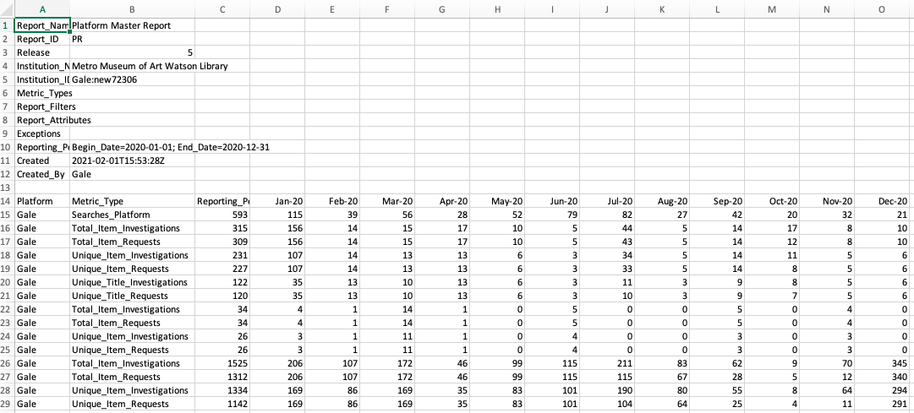
Introduction - What is COUNTER 5 (continued)
SUSHI Made Easy / Carlton / Slide 4

Slide 5
Introduction - What is SUSHI?
SUSHI automates library’s retrieval of COUNTER statistics from vendors via an API protocol.
  The user (librarian) runs client software to harvest reports from the vendor’s SUSHI-compliant server.
The API returns COUNTER reports in JSON
The vendor requires the user to have credentials to identify their account when they request statistics.
  Customer ID
  Requester ID
  API Key
SUSHI Made Easy / Carlton / Slide 5

Slide 6
Introduction - What is SUSHI? (cont) - URL Requests
A SUSHI URL request specifies, in order, a base URL identifying the vendor’s server, the particular report requested, authentication credentials, and date range, followed by any other report specifications.
https://sushi.vendorname.com/reports/tr_j1?customer_id=12345&requestor_id=678989&api_key=7f89dhj489f0dajk348&begin_date=2020-01&end_date=2020-07
https://sushi.vendorname.com/reports/tr?customer_id=12345&requestor_id=678989&api_key=7f89dhj489f0dajk348&begin_date=2020-01&end_date=2020-07&data_type=Book&attributes_to_show=Data_Type|Access_Method|YOP|Access_Type|Section_Type
https://www.jstor.org/sushi/reports/dr?customer_id=metmuseum.org&requestor_id=carlts&api_key=&begin_date=2020-01&end_date=2020-09
SUSHI Made Easy / Carlton / Slide 6

Slide 7
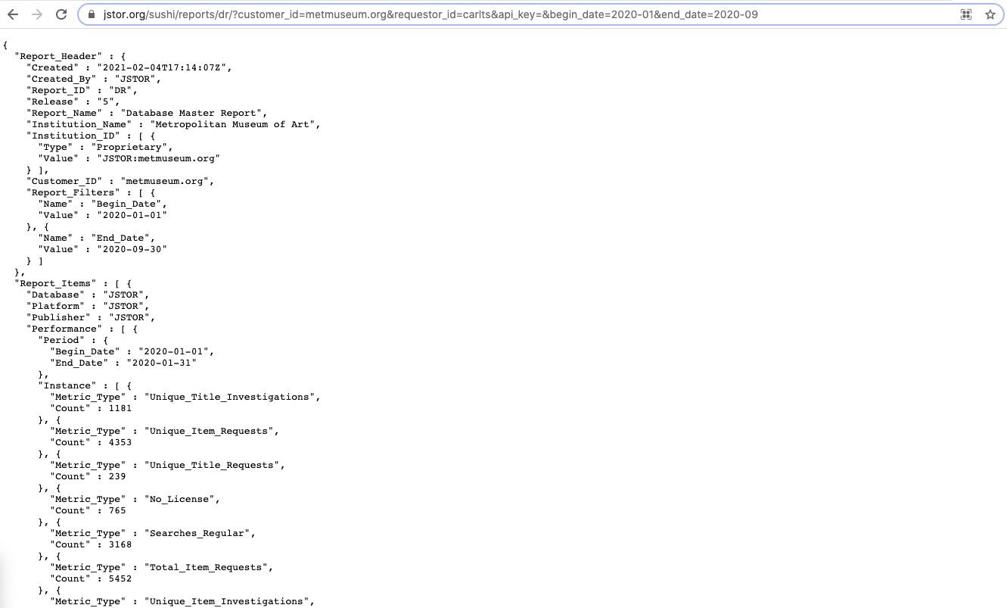
Introduction - What is SUSHI? (cont) - URL Requests
SUSHI Made Easy / Carlton / Slide 7

Slide 8
The COUNTER 5 Report Tool Overview
The COUNTER 5 Report Tool is a SUSHI client software developed by Melissa Belvadi and her team at UPEI. It is a data harvester, report manager, and data analysis application.
Available freely on Github: https://github.com/CS-4820-Library-Project/COUNTER-5-Report-Tool
SUSHI Made Easy / Carlton / Slide 8

Slide 9
The COUNTER 5 Report Tool Overview (cont) - Functionality
Functionality
  Vendor management -- stores SUSHI credentials for each vendor
  Report harvesting
    Fetches all COUNTER 5 reports that are supported by vendors
    Creates a searchable database of calendar year reports
    Fetches reports with user-specified characteristics and date ranges
  Reports generated elsewhere can be imported into the client
    Converts some COUNTER 4 metrics to COUNTER 5 standards
  Generated basic data visualizations
  Tracks e-resource costs and incorporates them into data visualizations
SUSHI Made Easy / Carlton / Slide 9

Slide 10
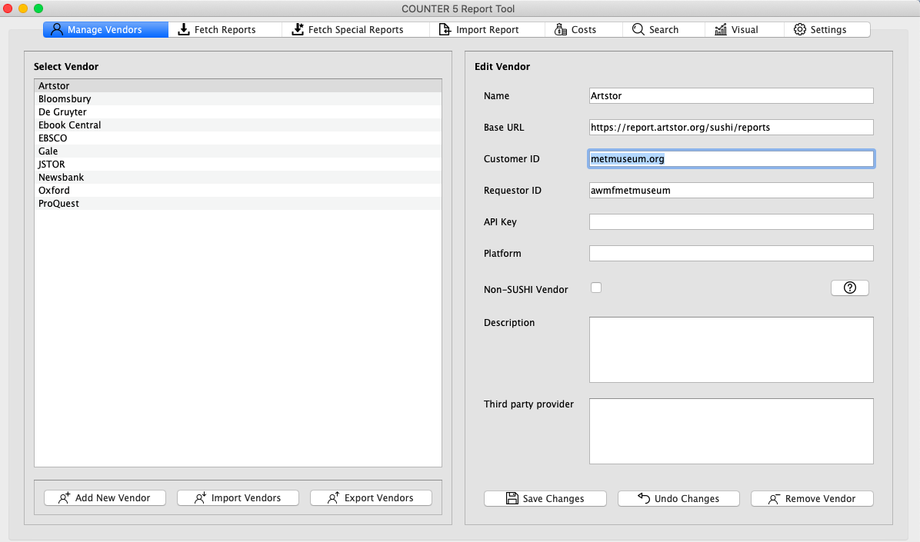
The COUNTER 5 Report Tool Demo - Vendor Management
Non-SUSHI Vendor - For vendors for which you will be manually importing reports
Users can import/export tsv file with vendor credentials which facilitates use the client across multiple devices
SUSHI Made Easy / Carlton / Slide 10

Slide 11
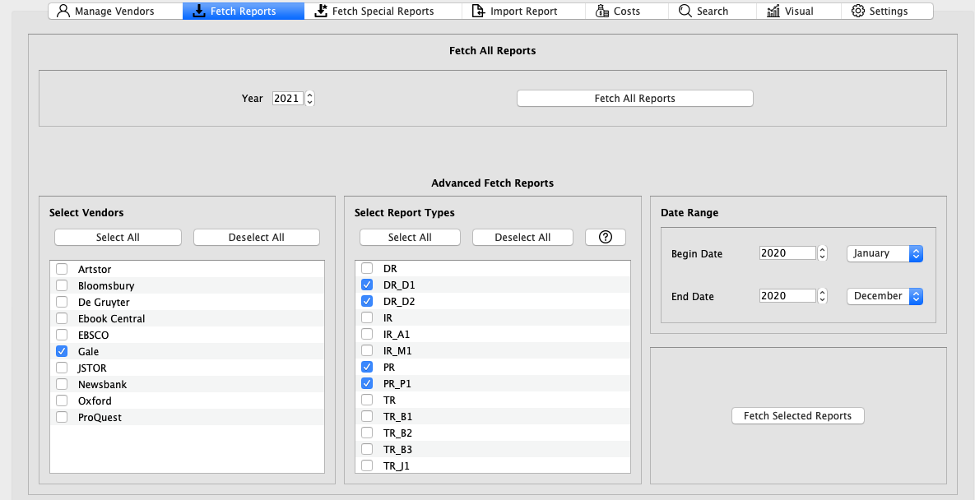
The COUNTER 5 Report Tool Demo - Fetch Reports
Automatically generate all report types for all vendors with one click
Alternatively, select particular vendors, report types, and date ranges for which to retrieve reports. Only calendar year data gets saved to the searchable database.
SUSHI Made Easy / Carlton / Slide 11

Slide 12
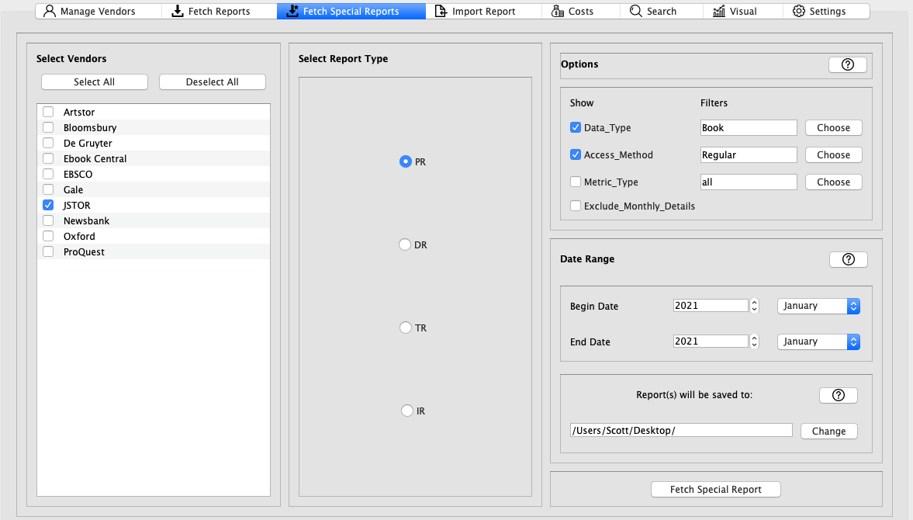
The COUNTER 5 Report Tool Demo - Fetch Special Reports
Further customize report output beyond the standard views
  The configuration shown will generate a platform report which contains only books that were accessed regularly
Special reports are not incorporated into the search database
SUSHI Made Easy / Carlton / Slide 12

Slide 13
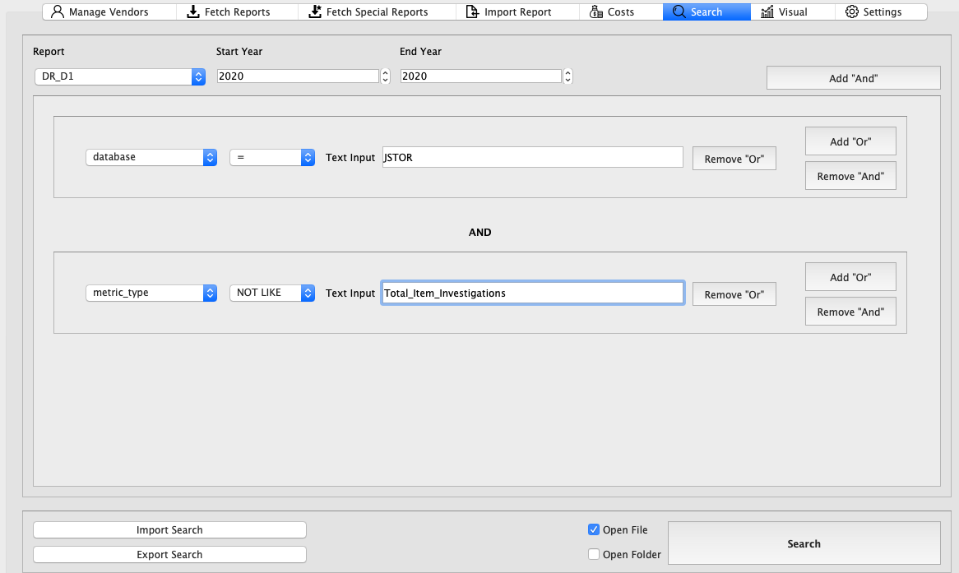
The COUNTER 5 Report Tool Demo - Search
This feature searches on a database of calendar year reports the user has already generated under “Fetch Reports” tab.
Boolean search
The search at left will pull the JSTOR database report I’ve previously generated but exclude total item investigation data.
SUSHI Made Easy / Carlton / Slide 13

Slide 14
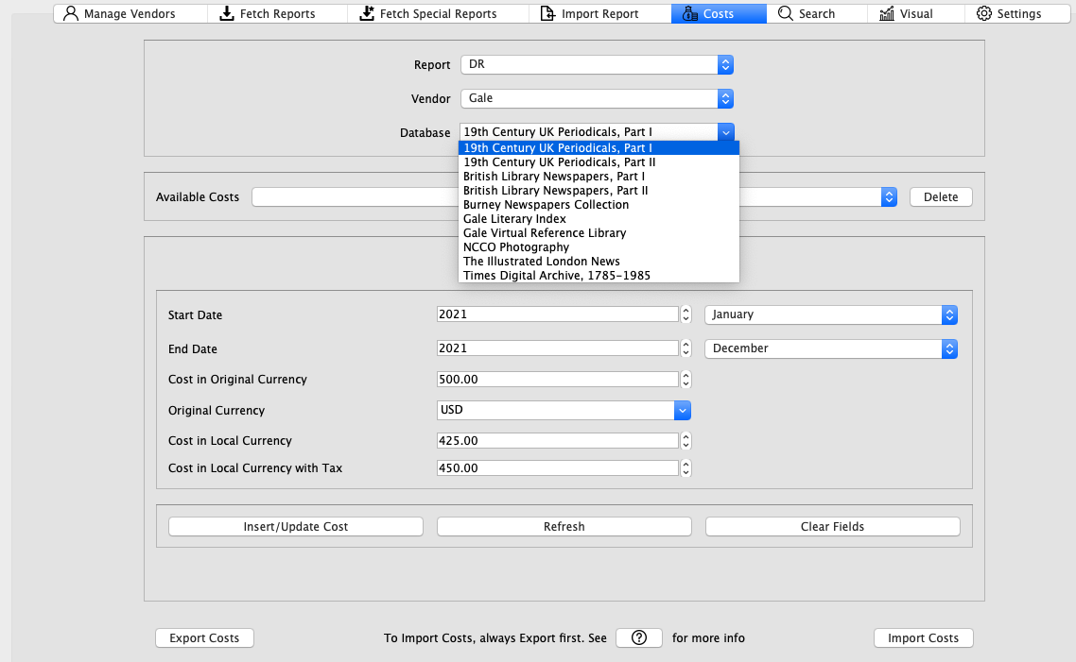
The COUNTER 5 Report Tool Demo - Costs
Input costs at title level, database level, vendor level, etc
Users may only enter costs for entities about which they have already pulled a report
  In the example at left, I can input a cost for Times Digital Archive because I have previously generated a database report which includes Times Digital Archive)
SUSHI Made Easy / Carlton / Slide 14

Slide 15
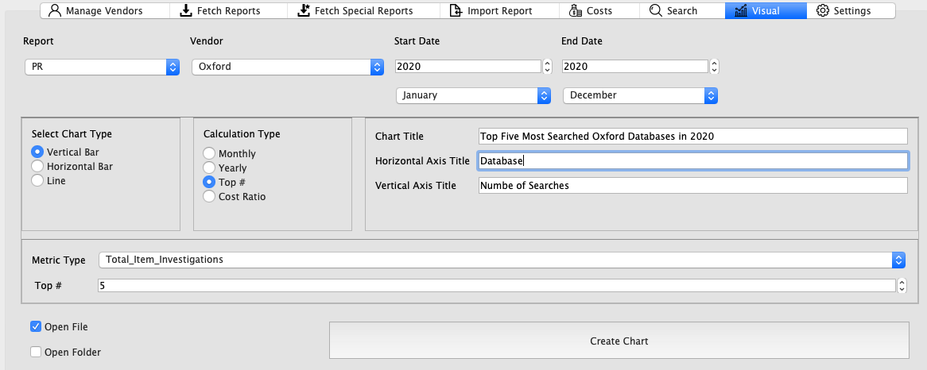
The COUNTER 5 Report Tool Demo - Visual
Produce basic bar and line graphs in Excel
Visualize costs per use based on the costs entered under the “Costs” tab
Visualize usage for only the top databases by a particular use metric
In this example, I have requested a bar graph which will show number of investigations by database for the 5 Oxford databases with the most searches.
SUSHI Made Easy / Carlton / Slide 15

Slide 16
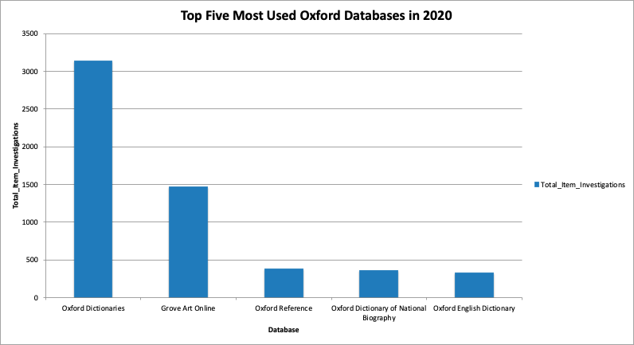
The COUNTER 5 Report Tool Demo - Visual (cont)
SUSHI Made Easy / Carlton / Slide 16

Slide 17
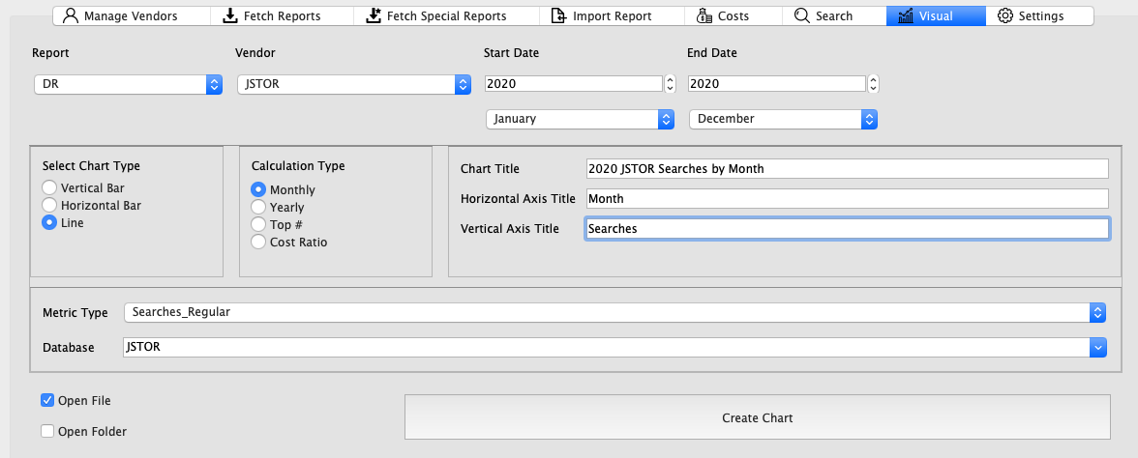
The COUNTER 5 Report Tool Demo - Visual
In this example, I have requested a line graph which will show JSTOR usage (in number of searches) by month during 2020.
SUSHI Made Easy / Carlton / Slide 17

Slide 18
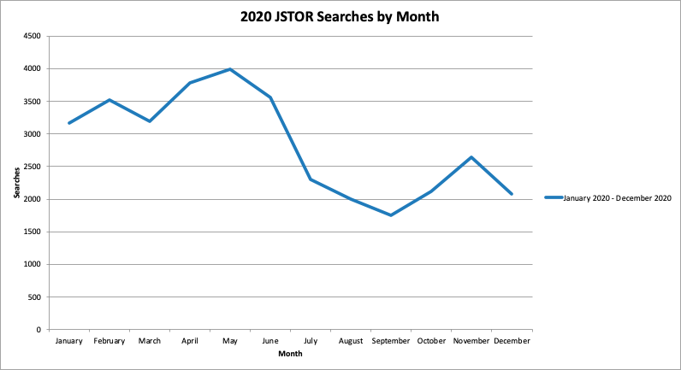
The COUNTER 5 Report Tool Demo - Visual (cont)
SUSHI Made Easy / Carlton / Slide 18

Slide 19
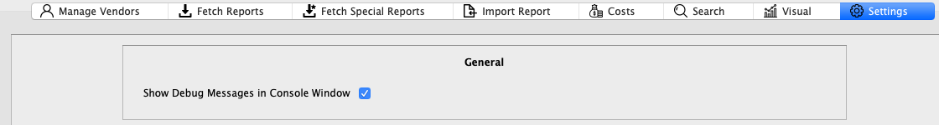
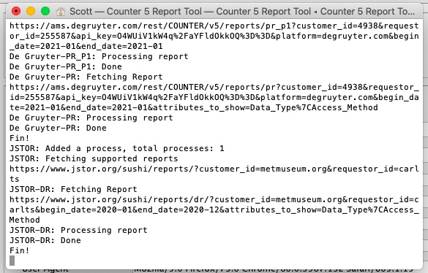

The COUNTER 5 Report Tool - Troubleshooting
For easier troubleshooting, I recommending checking “Show Debug Messages in Console Window”
When report fetching fails, examine the structure of the SUSHI API request URLs in the console.
SUSHI Made Easy / Carlton / Slide 19

Slide 20
Final Thoughts
The COUNTER 5 Report Tool not only harvests data, but also:
  Tracks vendors and associated account information
  Creates a searchable database of past reports
  Tracks costs
  Creates customized reports
  Generates data visualizations
  Calculates cost per use
Thanks to Melissa Belvadi and her team at UPEI, The COUNTER 5 Report Tool is freely available to install from Github.
The COUNTER 5 Report Tool offers an effective and easy alternative to Sierra for the automated collection of COUNTER 5-compliant usage statistics via the SUSHI API protocol.
SUSHI Made Easy / Carlton / Slide 20

Slide 21
Questions?
Scott Carlton
Library Associate for Electronic Resources
Thomas J. Watson Library
The Metropolitan Museum of Art
scott.carlton@metmuseum.org / scott.a.carlton@gmail.com

