Slide 1
Inventing an Inventory Process
How One Academic Library Used the Innovative Inventory Module to Conduct its First-Ever Inventory
Lynn Gates, Director of Cataloging & Metadata Services
Joel Tonyan, Interim Director of Web Services & Emerging Technologies
Kraemer Family Library, University of Colorado Colorado Springs

Slide 2
Overview
Who We Are: The Kraemer Family Library
Setting up the Innovative Inventory Control Module for Sierra
Setting up an FTP Site to Host Barcode Files
Project Management
Developing a Scanning Workflow
Running Reports in the Inventory Module
Processing the Inventory Reports
Workflow for checking the Shelves
Lessons Learned

Slide 3
Who We Are: The Kraemer Family Library
Academic library serving the University of Colorado Colorado Springs (UCCS)
UCCS established in 1965
Recently designated an R2 research university, "high research activity"
Staff of 29 employees, including the dean, associate dean, librarians and staff members
Print collection contains approximately 400,000 volumes
Print collection has NEVER been inventory in the library's history

Slide 4
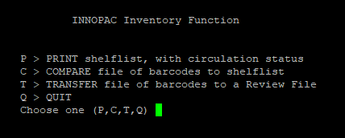
Setting Up the Innovative Inventory Control Module for Sierra
Inventory Control is an add-on product for Sierra
The Inventory Control module is one of the two products Innovative offers for Sierra, the second being Circa Wireless Inventory
Inventory Control is in Admin Corner, the character-based interface accessible via SSH/PuTTY
Notes:
Inventory Control is an add-on module for Sierra
Innovative now includes it in the Sierra bundles
Not available for the Sierra Desktop App; accessible via Admin Corner character-based interface

Slide 5
The Innovative Inventory Control Module
Inventory Control has three capabilities:
Printing a shelf list from the call number file. The list shows the status, barcode, call number, and title of each item in the range. You can compare the printed list with the order in which titles have been actually shelved.
Comparing the system's internal shelf list to a file of barcodes scanned into the file in their shelved order. The comparison report suggests which items in the file may be mis-shelved.
Transferring a file of barcodes to a review file.
Inventory Control can inventory a maximum of 5,000 items at one time.
(Taken directly from the Sierra manual located at https://csdirect.iii.com/sierrahelp/Default.htm#sadmin/sadmin_admin_corner_inventory_ctrl.html)
Notes:
Inventory includes three main features:
- The ability to print out an inventory shelflist for a specific call number range
- The ability to ingest a list of barcodes and compare them against the expected shelf list to see what items are missing
- The ability to transfer a file of barcodes to a review file

Slide 6
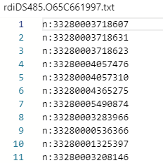
Getting Items into the Inventory Control Module
Two methods for ingesting barcodes:
Using a barcode scanner with a built-in memory.
Scanning barcodes into a text file and then manually uploading the file to Inventory Control via FTP.
File must be in .txt format
File name must begin with ‘rdi:’ and contain no spaces.
One barcode per line.
Barcodes must be preceded by ‘n:’

Slide 7
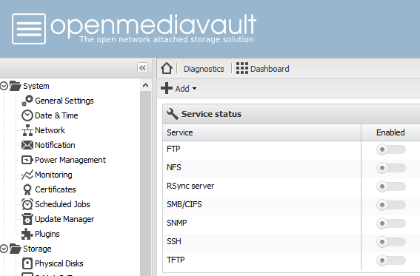
Setting up an FTP Site to Host Barcode Files
Need an FTP site to host barcode text files
The Inventory Control module connects to the FTP site to transfer the inventory file into Sierra
The Kraemer Family Library did not have access to an FTP site, and our OIT department was unwilling to set one up for us.
I ended up setting one up using Open Media Vault, an open-source, Linux based network attached storage system: openmediavault.org
I then worked with Innovative Interfaces to whitelist the IP address for the FTP site.
Notes:
If you go with option two, ingesting a list of barcodes stored in a text file, you will need an FTP site to host the file for Sierra to grab it.
FTP stands for File Transfer Protocol. It differs from newer file transfer protocols like SFTP, which are more secure.

Slide 8
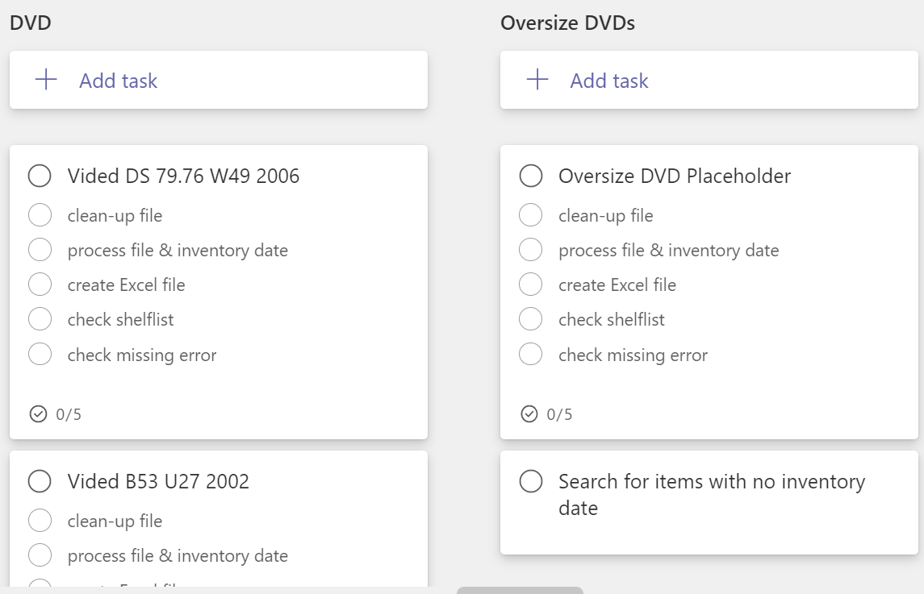
Project Management
Plan ahead
Who is going to be involved
Necessary technology
Workflow
Use a tool that works for your library:
Paper checklist
Web tool: like MS Planner or Trello
May integrate into other library products
May help with file management
May help with project communication
Check access & provide training
Keep back-ups of all files
Notes:
Think about file management, backups, and communication between members
Paper vs. electronic
Paper easy to pass around, harder to track where the project is if you don’t have the sheet
Consider having printed lists for students they can mark as they complete without looking at project
Group training, one-on-one, and paper instructions for frequently encounter processes

Slide 9
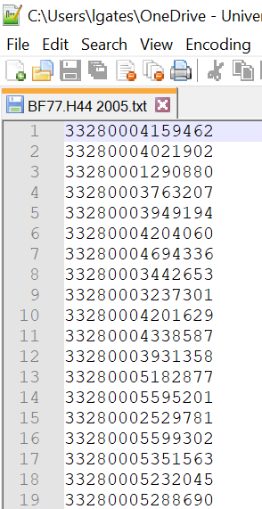
Scanning Workflow: The Student Part
Used student employees
Cart with laptop, scanner, flash drive, & instructions
Standardized file naming
Mark the last book scanned on the shelf with a piece of paper
Started with Notepad++ because it has row numbers – Students told to not scan more than 5,000 books in one file
Returned flash drive to staff member
Notes:
Initially we used Admin students – hired during pandemic for general duties
Not super consistent about file naming; intended to help track progress-but didn’t really work
Learned the hard way about marking the shelf
Preferred Notepad++ because it includes a row count column; had to switch when laptop died & moved to Chromebook (**check instructions**
Rarely had more than 3,000 barcodes in a files

Slide 10
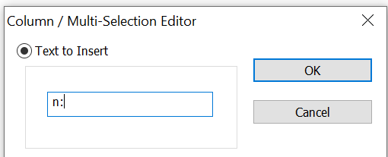
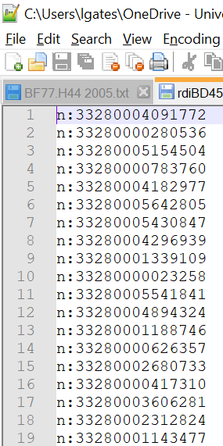
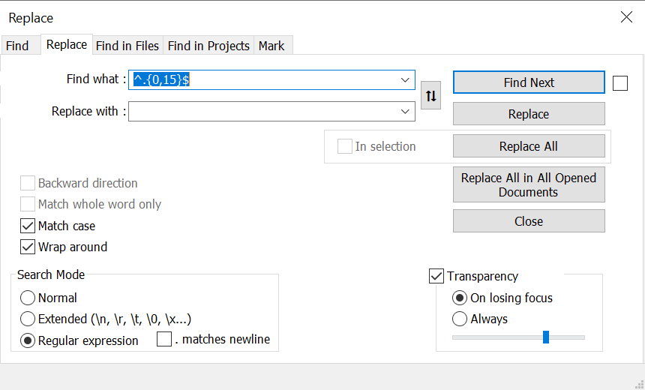
Scanning Workflow: The Staff Part
Copied files from flash drive to Teams & back-up location
Used Notepad++ to clean up the file (misscans) and add required prefix to each row
Saved the file and renamed it for the inventory process
Replaced the original .txt file with the new one in Teams
Notes:
Again, learned the hard way about keeping back ups ☺
Notepad++
Column edit to add n: to every row
Used regex to look for too short barcodes
Removed empty rows from regex results
Saved as .txt with rdi at the beinning

Slide 11
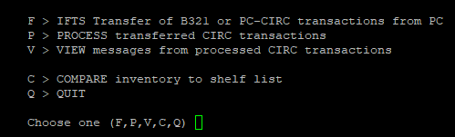
Transferring a Text File of Barcodes into Inventory Control
Select IFTS Transfer of B321 or PC-CIRC transactions from PC
Enter the FTP server address, username, and password.
Enter the number of the text file on the FTP site that you want to transfer to Inventory Control
Choose TRANSTER files

Slide 12
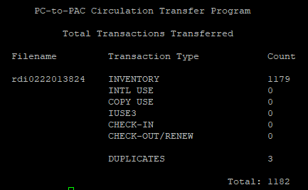
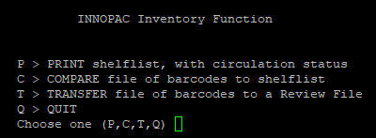
Running Reports in the Inventory Control Module
The Inventory control Module will then provide an overview of the imported file
# of barcodes in file
# of duplicate barcodes
Once the barcode file is imported from the FTP server, choose Compare Inventory to Shelf List
Next, select Compare file of barcodes to shelflist to run the inventory report for the items in the barcode file

Slide 13
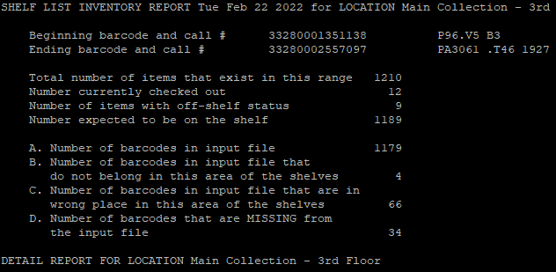
Running Reports in the Inventory Control Module
The resulting report provides the following statistics:
Starting and ending barcode numbers and call numbers
Total number of actual items in the range
Number of titles currently checked out
Number of items with an off-shelf status
Expected number of items on the shelf
Number of barcodes in the input file that are outside of the range
Number of items that are misshelved
Number of expected items that are missing

Slide 14
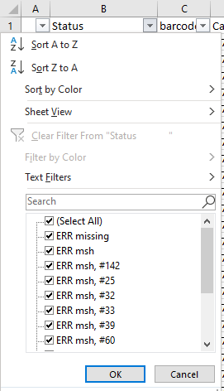
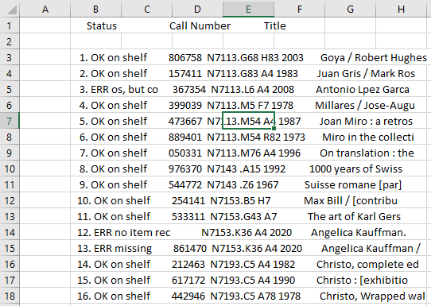
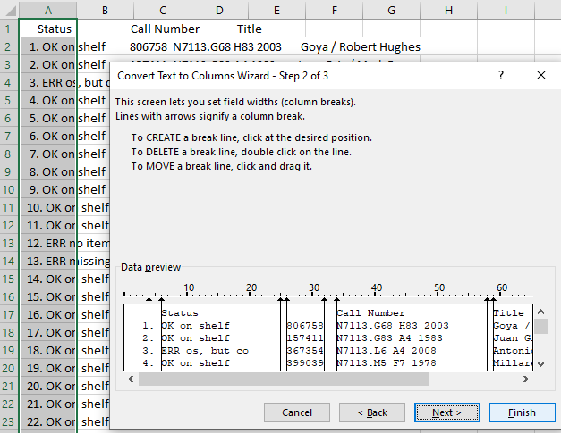
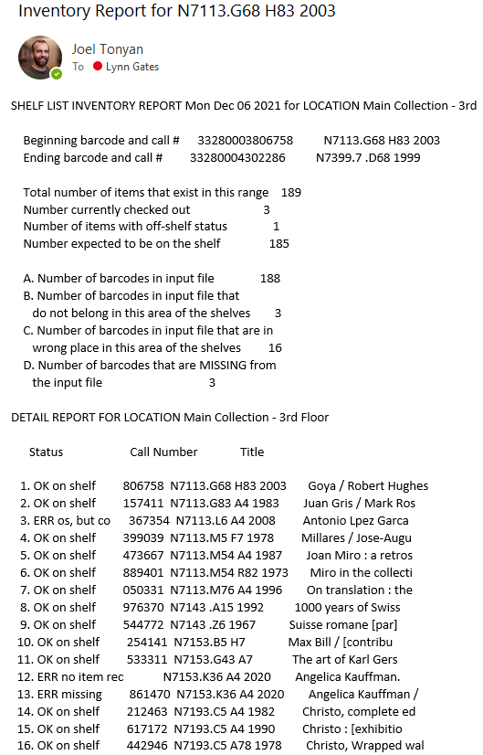
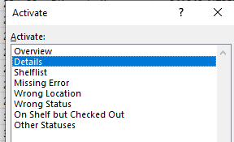
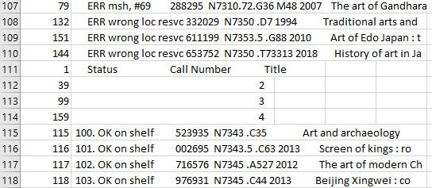
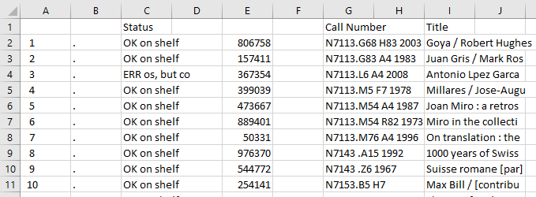
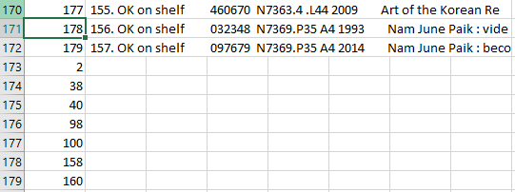
Processing the Inventory Reports
Notes:
Recommend having a spreadsheet template (turn off autosave); there are page number breaks you will want to remove when filling column numbers make sure to choose fill series (blank lines means excel prefers to copy); columns are fixed width;
Separate spreadsheet with pulled out barcodes scanned with no record and call number range of each spreadsheet to check for unscanned areas

Slide 15
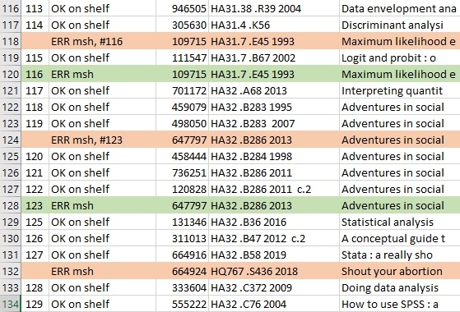
Working with the Inventory Reports
Used students, with cart, laptop and instructions.
Each worksheet had a different error to be checked
Added a column to mark F(ound) or M(issing) and a column for notes
Only brought books back to Access Services in specific situations
Senior student/staff trained to fix errors in Sierra
Used call number to search in Sierra to fix items found on the shelf
Notes:
M/F might mean different thing for different report

Slide 16
Lessons Learned for Next Time
It can take some time to get your FTP whitelisted by III, so plan ahead accordingly
Run inventory report and check the errors as close to scanning as possible
Formalize training of process, including creating documentation before training
Develop tracking methods for work completed before starting, even if they feel like extra work
Add reminders to worksheet about special rules for handling the error on the sheet
"funny-pictures-cat-messed-with-pen" by rikkis_refuge is marked with CC BY 2.0.
Notes:
Training: everyone trained by the same person; students not as computer literate as expected so things like saving files were unfamiliar (

Slide 17
Thank you!
Questions for us?
lgates@uccs.edu
jtonyan@uccs.edu

