Slide 1
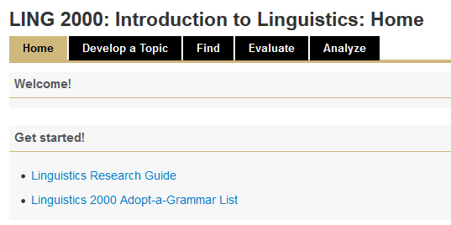
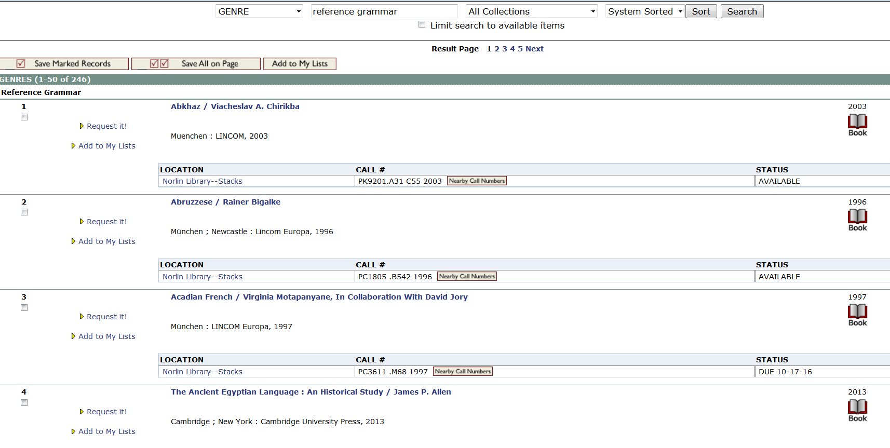
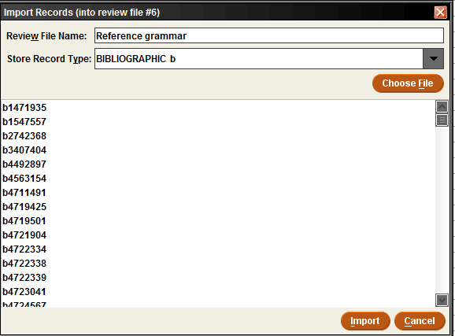
Import Lists in Action
A collaboration among a cataloger, a subject librarian, and Linguistics faculty
The problem
THE tools used
the end results
Linguistics students had trouble finding appropriate resources for their “adopt a grammar” project
“…faculty teaching the LING 2000 course would really love to have an up-to-date list of the various linguistics grammars we own. Currently, students are assigned a language for the duration of the semester, they need to check out a grammar and use it for assignments each week during the semester. In the past, this has been problematic as there could be 100 or more students taking the course in different sections, all of them needing some of the same materials…”
(e-mail from Lindsay to Laura, 2/10/16)
Sierra Create Lists: Search Records, Sort Records, Export Records, Import Records
Excel
Sierra Global Update
“Adopt-a-Grammar” links to a catalog search for “Reference grammar” in the genre/form index. This shows students titles, call numbers and availability.
the solution
A link to a search in our WebPac for a genre term added to appropriate resources (selected by Linguistics faculty members based on a list provided by the librarians)
(We originally considered an RSS feed as well)
The spreadsheet generated via Export Records from Laura & Lindsay’s initial list, sent to and reviewed by Linguistics faculty
the collaborative process
Import Records
(a new feature at the time)
made this project possible
“Yes, they have really appreciated it! I visited a class of about 100 LING 2000 students last week and all of them had already found a grammar using the saved search! It seems like a much more streamlined process for them.”
(e-mail from Lindsay to Laura, 9/9/16)
Identification of potential resources
Review file created and edited by Lindsay and Laura, exported to a spreadsheet for Linguistics faculty to view; used bib record number to create a stable link to the catalog record so they could easily see more about each title
Vetting of resources by Linguistics faculty
This provided us with a list of resources considered appropriate for this assignment
Choosing appropriate genre term
Laura consulted with fellow catalogers (on listservs and locally) and chose a term from MLA’s thesaurus
Ongoing
Laura and Lindsay will repeat the identification of new resources yearly (Outlook Calendar reminder set for the beginning of the year)
The players
The Global Update in Sierra
(to add the genre term)
Laura Wright (Serials Cataloging Manager)
Lindsay Roberts (Education and Linguistics Librarian)
Linguistics Faculty of CU-Boulder, including Zygmunt Frazyngier, Bhuvana Narasimhan
Donna Hamilton (Monographic Copy Cataloging Manager)

