Slide 1
Conquer Your ILS Upgrade
Mieko Fujiura-Landers
Member Services Librarian for Public Services, CCS
mlanders@ccslib.org

Slide 2
Agenda
Background
Our Upgrade Toolkit
Our Upgrade Process
Questions

Slide 3
Agenda
Scale
Up!
= If you have the capacity for a little more
Scale Down!
= If you have the capacity for a little less

Slide 4
Background

Slide 5
About Cooperative Computer Services
Catalog consortium in Chicago suburbs

Slide 6
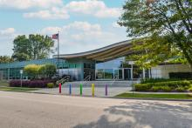
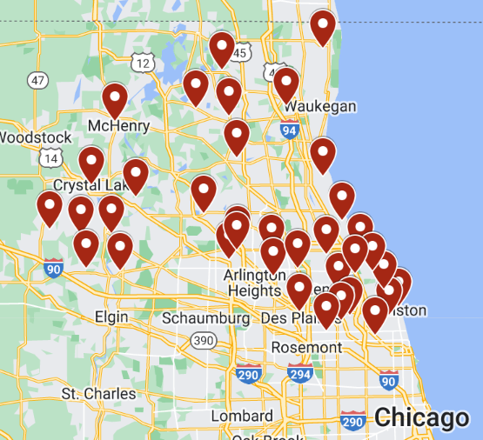
About Cooperative Computer Services
Catalog consortium in Chicago suburbs
30 libraries

Slide 7
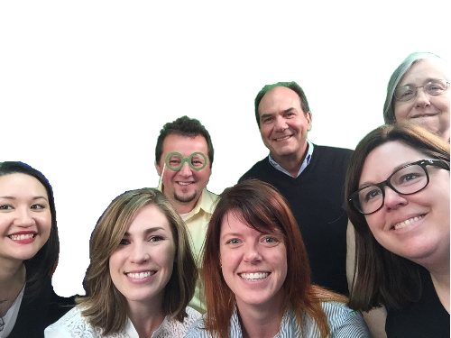
About Cooperative Computer Services
Catalog consortium in Chicago suburbs
30 libraries
9 staff

Slide 8
About Cooperative Computer Services
Catalog consortium in Chicago suburbs
30 libraries
9 staff
Hosted Polaris site

Slide 9
CCS and Upgrades
From December 2018 and August 2022, CCS led seven upgrades
April 2018
Live on 6.0
Dec 2018
6.1
Aug 2019
6.3
Aug 2020
6.5
June 2021
6.7
Dec 2021
7.0
May 2022
7.1
7.2
Aug 2022

Slide 10
Our Upgrade Toolkit

Slide 11
Our Upgrade Toolkit
At first, didn't have documented procedure in place for upgrades
Live and learn and then create documentation!
Developed upgrade toolkit

Slide 12
Our Upgrade Toolkit
Innovative's "What's New" document
Upgrade guide
Communication scripts
QA tasks

Slide 13
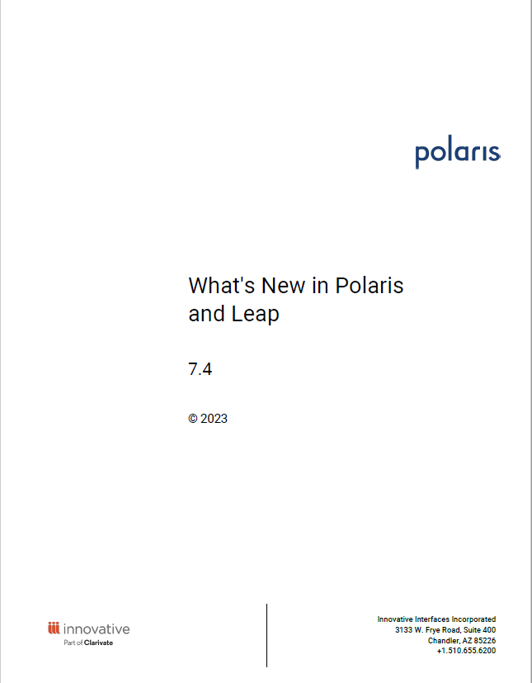
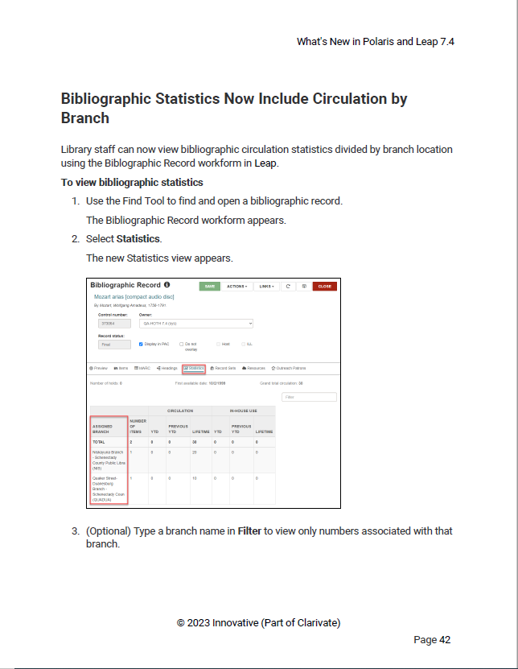
Our Upgrade Toolkit
Innovative's "What's New" document
Upgrade guide
Communication scripts
QA tasks

Slide 14
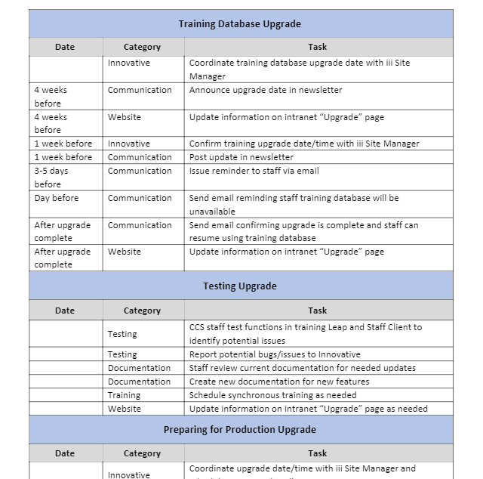
Our Upgrade Toolkit
Innovative's "What's New" document
Upgrade guide (LINK)
Communication scripts
QA tasks

Slide 15
Our Upgrade Toolkit
The Upgrade Guide includes:
What to do and when!
Day-of upgrade notes
Solutions for common post-upgrade issues
Instructions for restoring PowerPAC customizations

Slide 16
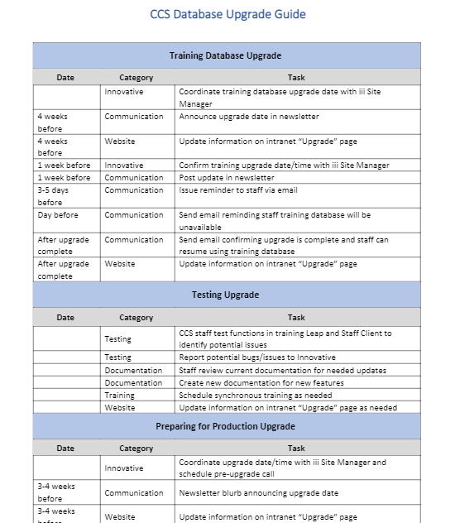
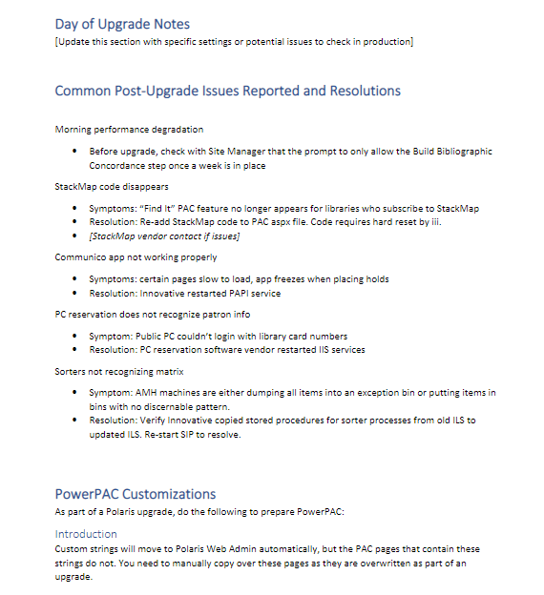
CCS Upgrade Guide

Slide 17
Our Upgrade Toolkit
Tips for your Upgrade Guide
Keep track of potential issues you run into during testing and QA so you can check on them after production upgrade
Maintain running list of common issues and solutions that you can easily reference during each upgrade
Include important 3rd party vendor info

Slide 18
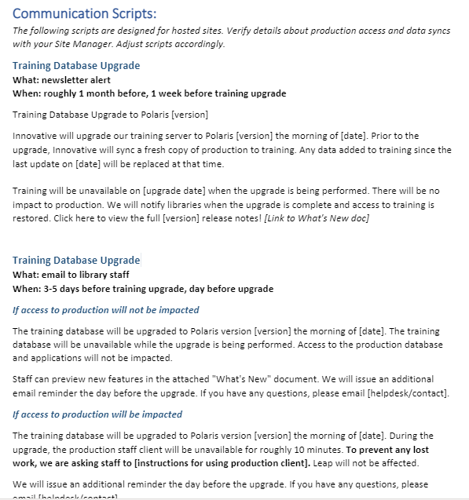
Our Upgrade Toolkit
Innovative's "What's New" document
Upgrade guide
Communication scripts (LINK)
QA tasks

Slide 19
Our Upgrade Toolkit
Communication Scripts include:
Messaging for newsletter alerts, emails to staff about training database upgrade
Messaging for newsletter alerts, email to staff about production database upgrade
Messaging for emails to IT staff about installing new version of local offline client

Slide 20
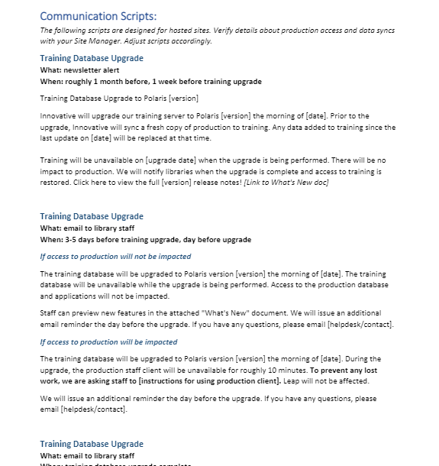
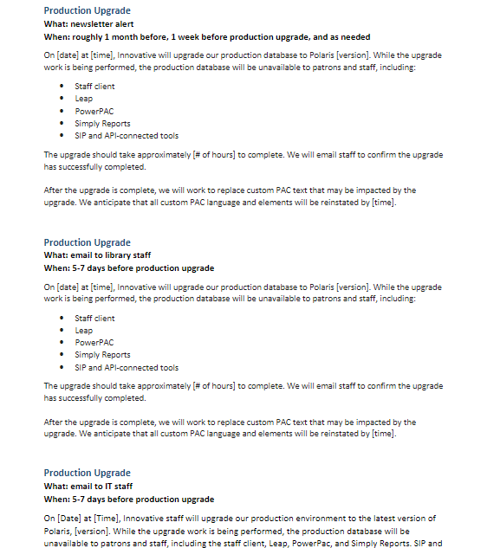
CCS Communication Scripts

Slide 21
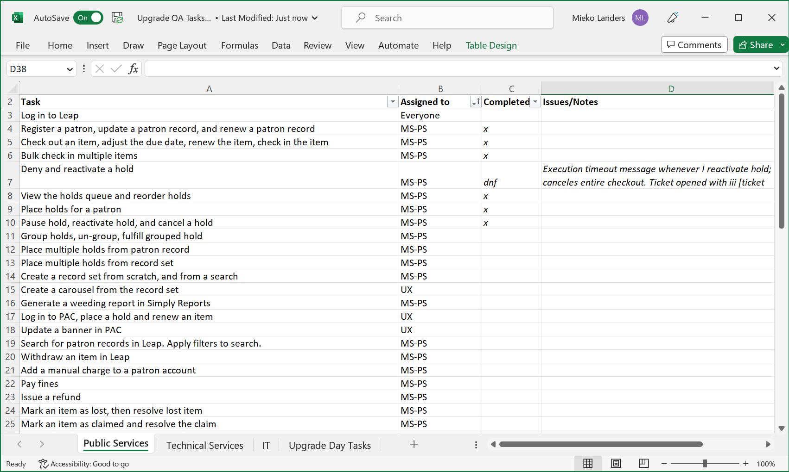
Our Upgrade Toolkit
Innovative's "What's New" document
Upgrade guide
Communication scripts
QA tasks (LINK)

Slide 22
Our Upgrade Toolkit
The QA Tasks spreadsheet includes
Tasks to test on the upgraded training database
Who is responsible for completing each task
Space for notes in case testers run into errors or issues

Slide 23
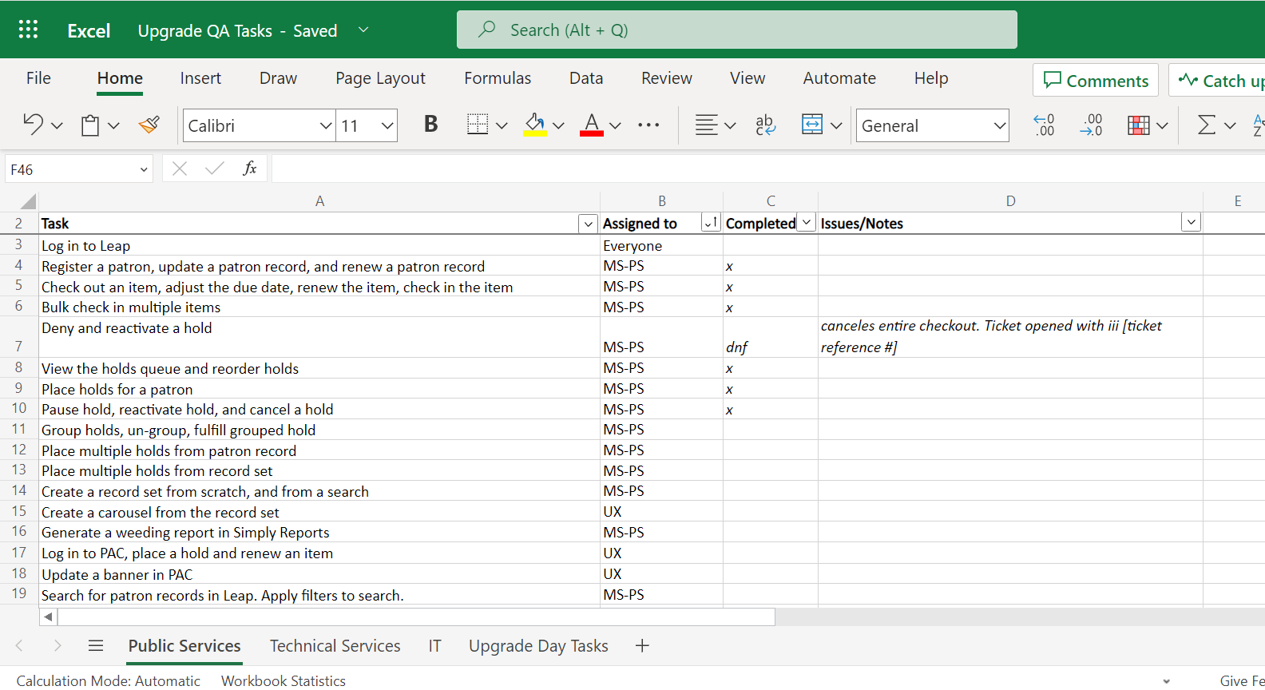
CCS QA Task List

Slide 24
Our Upgrade Toolkit
Innovative's "What's New" document
Upgrade guide
Communication scripts
QA tasks

Slide 25
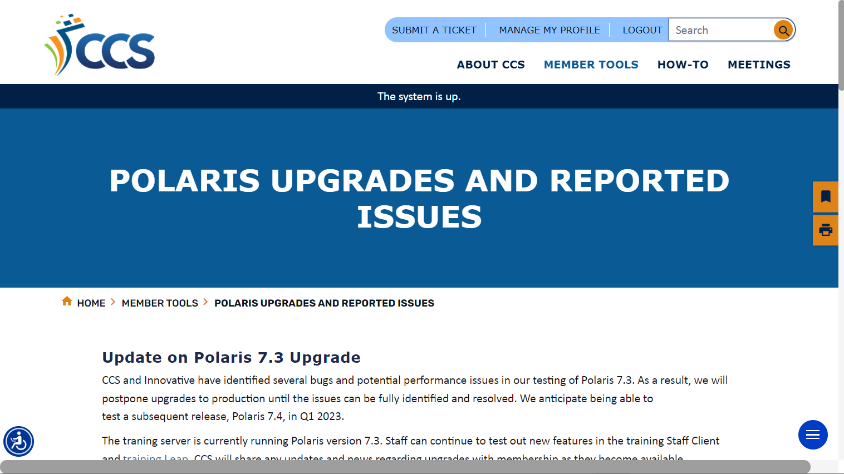
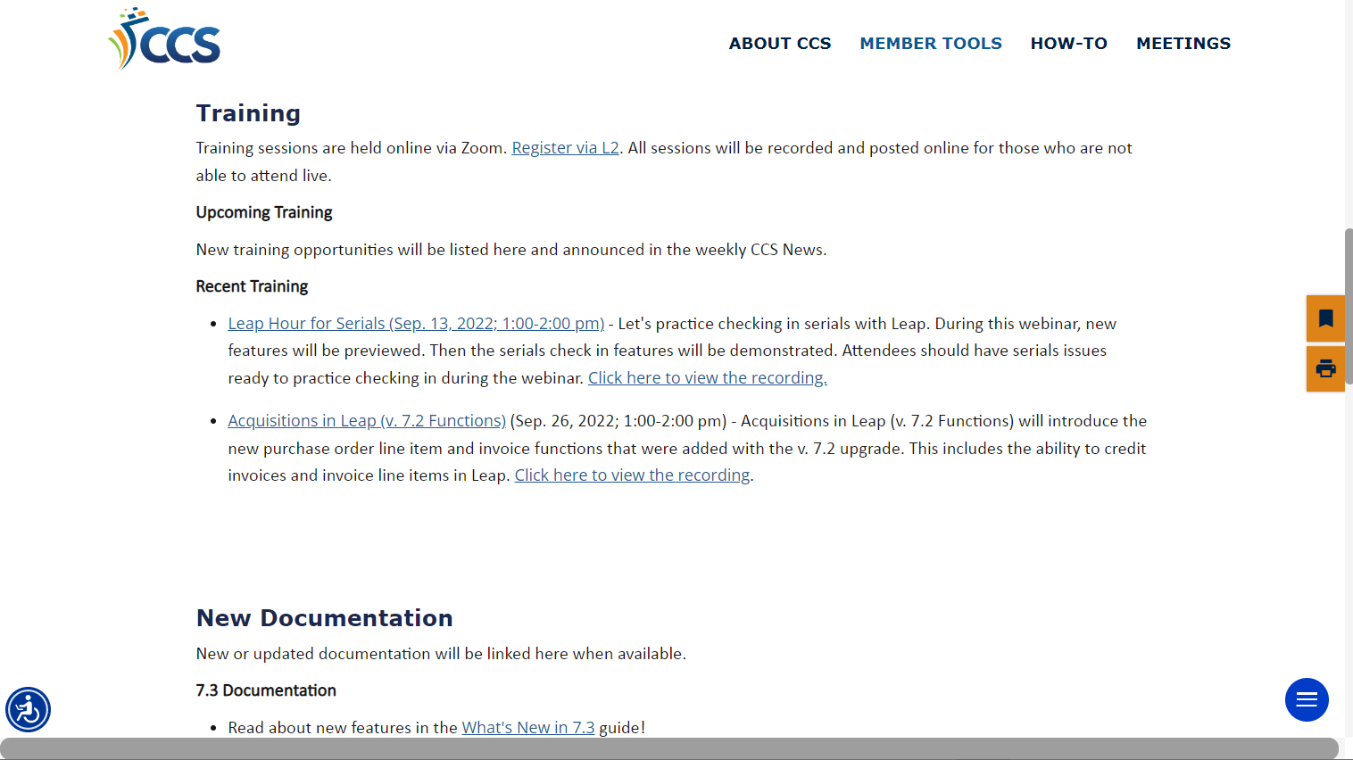
Our Upgrade Toolkit
Scale Up!
Page on website/intranet
Upgrade-related info in one spot
Dates for upgrade, downtime info
Training and documentation resources
Issues log

Slide 26
Our Upgrade Process

Slide 27
The Upgrade Process
Decide if you want to upgrade
Get organized
Upgrade the training database
Testing and QA
Documentation and training staff
Schedule production upgrade
Upgrade

Slide 28
The Upgrade Process
Decide if you want to upgrade
Get organized
Upgrade the training database
Testing and QA
Documentation and training staff
Schedule production upgrade
Upgrade

Slide 29
Step 1: Decide if You Want to Upgrade
Just because a software upgrade comes out does not mean you should automatically take it!

Slide 30
Step 1: Decide if You Want to Upgrade
What to do
Review What’s New document for new features, Known Issues page for bug fixes
Watch webinars put on by iii to see an overview of new features
Considerations
Will you benefit from new features or Bug fixes?
Does it fit in with your current project schedule?

Slide 31
The Upgrade Process
Decide if you want to upgrade
Get organized
Upgrade the training database
Testing and QA
Documentation and training staff
Schedule production upgrade
Upgrade

Slide 32
Step 2: Get Organized
Use your guides and scripts
Verify project steps in the Upgrade Guide
Verify communication strategy and scripts
Once you have an upgrade guide, this part won't take long!
Update QA Tasks
Add new features you want to test
Update QA assignments

Slide 33
Step 2: Get Organized
Figure out your priorities (examples: bug fixes, certain new Leap functions)
Use that to inform the QA tasks and future steps, like training
Scale Down!

Slide 34
The Upgrade Process
Decide if you want to upgrade
Get organized
Upgrade the training database
Testing and QA
Documentation and training staff
Schedule production upgrade
Upgrade

Slide 35
Step 3: Upgrade the Training Database
Coordinate training database upgrade with Innovative
Will you ask for a data sync between production and training?
Send communication as needed to your libraries or staff
Alerts that training will be upgraded and (if needed) data synced
Confirmation when training upgrade complete and available

Slide 36
Step 3: Upgrade the Training Database
Staff don't use the training database?
Scale back on communication
Scale Down!

Slide 37
The Upgrade Process
Decide if you want to upgrade
Get organized
Upgrade the training database
Testing and QA
Documentation and training staff
Schedule production upgrade
Upgrade

Slide 38
Step 4: Testing and QA
Once the training database is upgraded, you can start testing out new features and work through QA tasks.
QA tasks include:
Standard actions we test every time
New functions or features we would like to use
Testing bug fixes
Solicit help from team or other library staff

Slide 39
Step 4: Testing and QA
Reduce QA tasks to features/actions your staff use or day-to-day essential functions
Scale Down!

Slide 40
Step 4: Testing and QA
Issues come up during QA testing?
Decide if you need to postpone the upgrade.

Slide 41
The Upgrade Process
Decide if you want to upgrade
Get organized
Upgrade the training database
Testing and QA
Documentation and training staff
Schedule production upgrade
Upgrade

Slide 42
Step 5: Documentation and Training Staff
Take a closer look at changes using the "What's New" document
What needs staff training?
New documentation?
Updated documentation?
What impacts current workflow?
Do you need to update any SA settings?

Slide 43
Step 5: Documentation and Training Staff
Inform staff of new features and/or bug fixes
Create in-house documentation or update procedure manuals as needed
Train staff on new features, workflow changes as needed

Slide 44
Step 5: Documentation and Training Staff
Get formal input on new functions or features that will change existing workflow
Scale Up!
Share "What's New" document with staff in place of training or in-house documentation
Scale Down!

Slide 45
The Upgrade Process
Decide if you want to upgrade
Get organized
Upgrade the training database
Testing and QA
Documentation and training staff
Schedule production upgrade
Upgrade

Slide 46
Step 6: Schedule Production Upgrade
Coordinate upgrade date and time with Site Manager
Confirm if you will do a data sync at the same time
Tip: Avoid upgrading at the end of the week. If you can, schedule upgrades for Monday or Tuesday. More staff will be on-hand to troubleshoot in the following days vs the weekend.

Slide 47
Step 6: Schedule Production Upgrade
Inform staff of production upgrade
Use your communication scripts
We give libraries 3-4 week notice before production upgrade, with reminders 1 week and day-of the upgrade
Inform patrons of upgrade/catalog maintenance
Add an alert to library website
Alert banner on PowerPAC (LINK)
3rd party mobile apps may have an alert option, too!

Slide 48
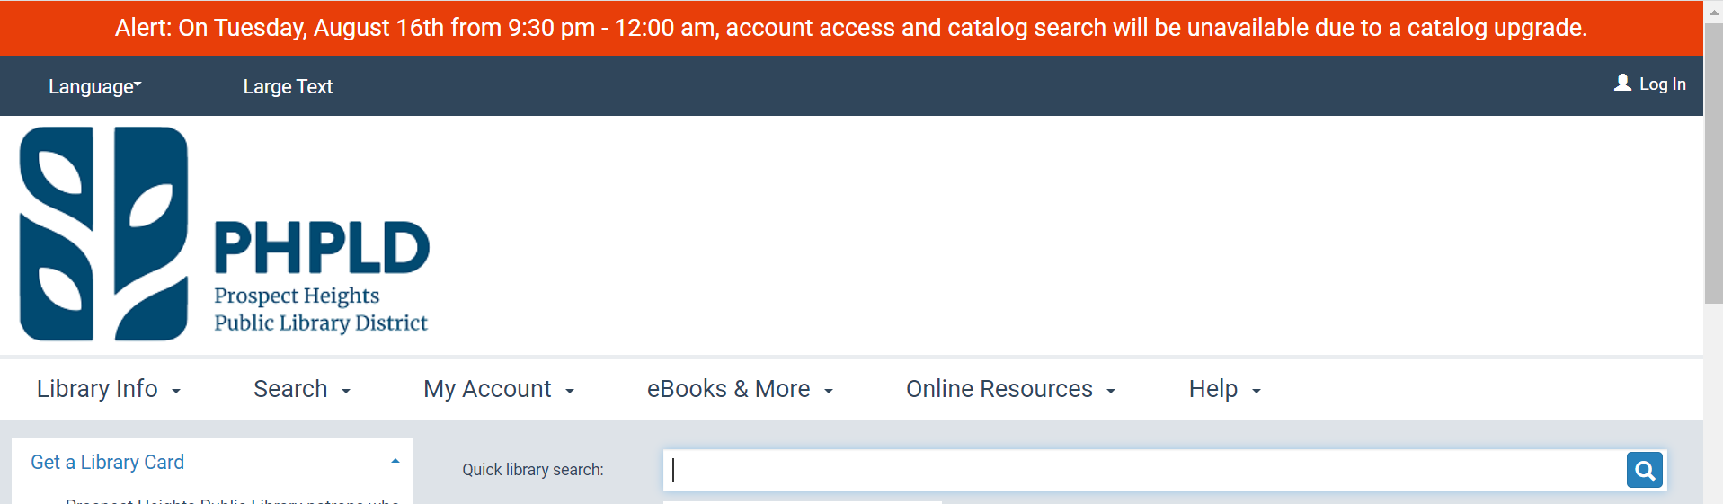
PAC Alert Banner
<div>
<p style="color:white; background-color: #e83e09; text-align: center; padding: 10px; margin: 0; font-size: 1.25em;">
Alert: On Tuesday, August 16th from 9:30 pm - 12:00 am, account access and catalog search will be unavailable due to a catalog upgrade. </p>
</div>

Slide 49
Step 6: Schedule Production Upgrade
Prepare for upgrade
Know what needs to be done and who will do it
Includes post-upgrade QA, restoring any PAC customizations, sending communication to library staff
If you have an upgrade guide, you don't need to think about this!

Slide 50
The Upgrade Process
Decide if you want to upgrade
Get organized
Upgrade the training database
Testing and QA
Documentation and training staff
Schedule production upgrade
Upgrade

Slide 51
Step 7: Upgrade
Innovative upgrades your production environment
After the upgrade is complete
Do your post-upgrade QA
Take care of any "Day-of Upgrade" notes
Let staff know the database is available
Finish any PAC adjustments/restore customizations
Re-install local offline client and update MDB files
Check on any “fixed in future release” tickets

Slide 52
Step 7: Upgrade
Congratulate yourself on a job well done!

Slide 53
Links to Toolkit Resources
CCS Upgrade Guide
CCS Communication Scripts
CCS QA Task Spreadsheet
PAC Alert Banner How-To

Slide 54
THANK YOU
Questions?
Reach out to me at mlanders@ccslib.org!

