Slide 1
The Unofficial Guide to Sierra’s SQL Views
Jeremy Goldstein
Minuteman Library Network

Slide 2
Overview
Views Not Tables
362 views
2821 columns
How to reference a field
schema.table.column
sierra_view.item_record.id
Alternate option
Start queries with SET search_path = 'sierra_view';
Notes:
Views are virtual tables made up of data from the actual underlying tables via their own queries. Keeping the data at a remove aids in keeping server data secured
Many tables simply replicate a single underlying table. Using the more complicated ones can lead to less efficient queries.
So that’s a lot of fields to memorize but hopefully by the end of this presentation you’ll at least learn where to look for the data you wish to access
Pg_catalog provides metadata and system tables for postgres

Slide 3
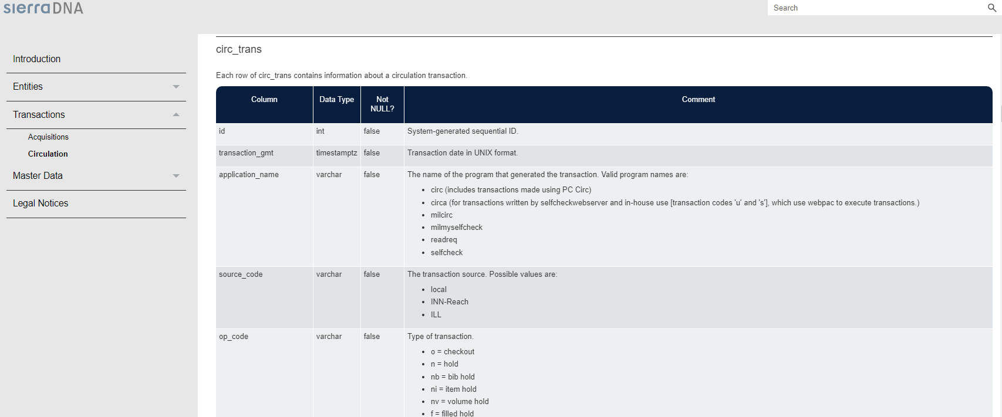
Sierra DNA
Sierra DNA (Database NAvigator)
http://techdocs.iii.com/sierradna/
The Sierra DNA describes all the SQL tables and the columns in those tables.

Slide 4
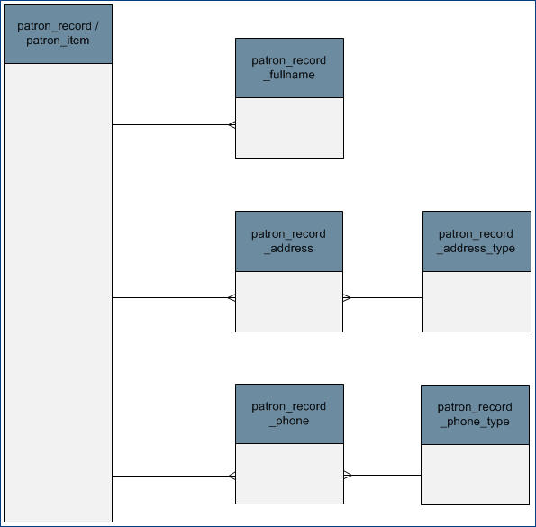
Documentation
ERD (Entity Relationship Diagram) View
This shows which tables are linkable – there is a column in one table that matches a column in another.
In this example, you can link patron_record_address_type to patron_record via patron_record_address

Slide 5
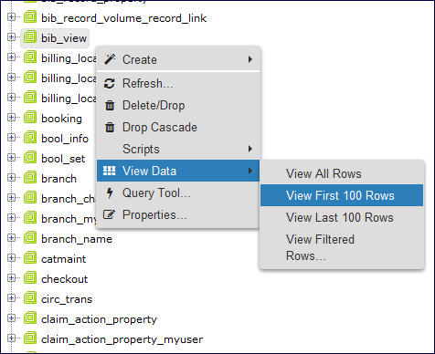
Previewing Your Data
To see sample data from a table, right click on the table (bib_view in this example) and then View Data and then View Top 100 Rows
Screen using PGAdmin https://www.pgadmin.org/
Notes:
Many clients have some means of browsing available tables, this is what you see in PGAdmin

Slide 6
Explore your data
Screens using HeidiSQL https://www.heidisql.com/
Notes:
I personally like using HeidiSQL as a client which has a more direct data previewing feature.

Slide 7
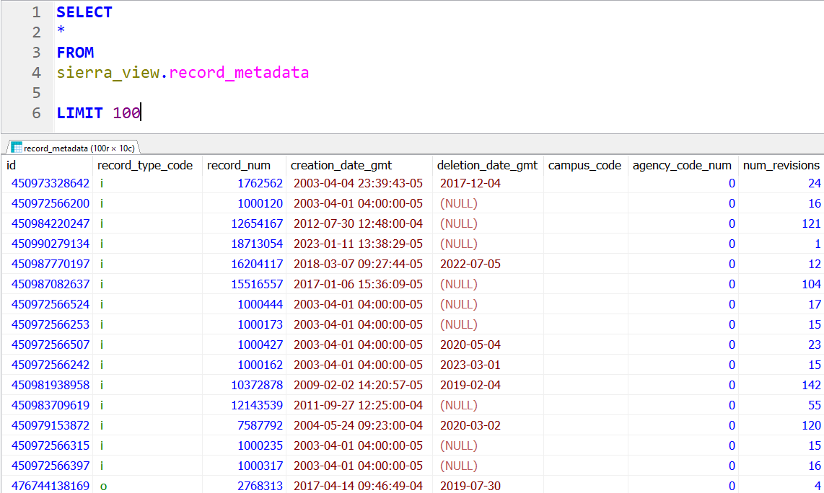
The Query Based Approach
Notes:
Show me the first 100 rows of data from a given view.

Slide 8
Keys
Notes:
Now that we have a sense of how to explore the tables lets start looking at some tables of note

Slide 9
Matching Keys
Notes:
Fields labeled simply as id are uniformly primary keys, meaning they are a unique value for each row of a given table and typically a match point for a corresponding foreign key in another table. Nearly all tables include them
All record.id fields serve as foreign keys to the record_metadata table.
All fields labeled as [blank]_id are a foreign key pointing to a table they can be joined to, in this case bib_record
Each id number is unique, thus no need to worry about matching to incorrect record types.
In this example we’re looking at the bib_record_property table, more on that shortly

Slide 10
Joining views
FROM
sierra_view.bib_record_location
JOIN
sierra_view.bib_record
ON bib_record_location.bib_record_id = bib_record.id
FROM
sierra_view.[table_1]
JOIN
sierra_view.[table_2]
ON [table_1].[table_2]_id = [table_2].id
Notes:
Most of the time joining views will work like this, though there will be cases where you join on fields other than id.
As most views follow this structure you can easily identify what views and fields you can join to from a given table

Slide 11
Record Views
Notes:
Now that we have a sense of how to explore the tables lets start looking at some tables of note

Slide 12
record_metadata
Key Fields:
id
record_type_code
record_num
creation_date_gmt
deletion_date_gmt
record_last_updated_gmt
previous_last_updated_gmt
campus_code
Use For:
filter queries on creation date
filter out ILL records
obtain record numbers
count deleted records
Tips and Tricks:
id serves as foreign key to all record_id fields
data persists when a record is deleted
Notes:
All record types represented in this one table
Record_num lacks check digit
Data that can persist after a record is deleted
Campus_code useful for identifying inn-reach records

Slide 13
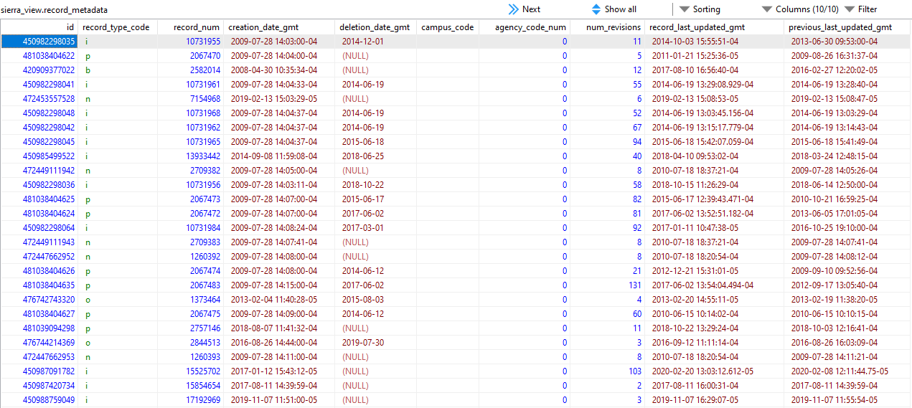
record_metadata

Slide 14
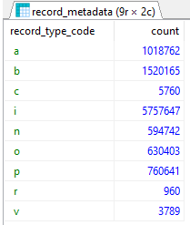
Record Totals
SELECT
record_type_code,
COUNT(id)
FROM sierra_view.record_metadata
WHERE deletion_date_gmt IS NULL
AND campus_code = ‘’
GROUP BY 1
ORDER BY 1
Notes:
Simple query to gather current record counts in the system

Slide 15
record_metadata.id
patron_record, item_record, bib_record, etc…
JOIN sierra_view.[table name]
ON record_metadata.id = [table name].id
Notes:
from record_metadata can join to any record type

Slide 16
bib_record
Key Fields:
language_code
bcode1, bcode2, bcode3
cataloging_date_gmt
country_code
is_on_course_reserve
Is_suppressed
Use For:
bib fixed field data
Tips and Tricks:
bib_record_location exists as its own table
Join to myuser tables to translate field codes to their labels
Notes:
Most record views will look fairly similar and will provide fixed field data for that record type
bib_record_location is a outlying table so it can accommodate multiple location entries

Slide 17
bib_record
Notes:
Note the id and record_id fields that contain the same data. Designed as such to provide the standard primary key vs foreign key data structure even though this is redundant data in this instance

Slide 18
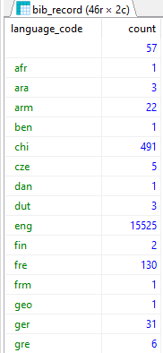
Titles Added In each Language This Year
SELECT
b.language_code,
COUNT(b.id)
FROM sierra_view.bib_record b
JOIN sierra_view.record_metadata m
ON b.id = m.id
AND m.creation_date_gmt >= ‘2023-01-01’
GROUP BY 1
ORDER BY 1
Notes:
Gather number of titles in each language. Join to record_metadata to obtain creation_date for use in filtering

Slide 19
bib_record_property
Key Fields:
material_code
best_title
best_title_norm
publish_year
best_author
best_author_norm
Use For:
bib record details
Tips and Tricks:
_norm fields contained indexed version
Use to avoid accounting for punctuation, capitalization and articles
Notes:
Get to know this table, can often use it entirely in place of bib_record

Slide 20
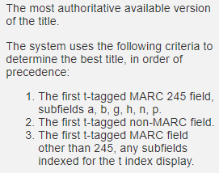
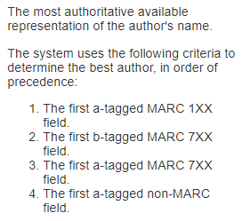
Normalized Fields
Notes:
Norm fields remove all capitalization and punctuation
Details from SierraDNA on how best title and author are calculated

Slide 21
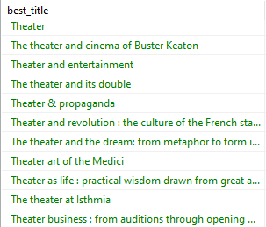
Sorting on Titles
SELECT
best_title
FROM sierra_view.bib_record_property
ORDER BY best_title_norm
Notes:
sort on normalized titles but list the standard version

Slide 22
bib_view
Key Fields:
record_num
language_code
is_available_at_library
bcodes
cataloging_date_gmt
record_creation_date_gmt
title
Use For:
combines data from bib_record, bib_record_property and record_metadata
Tips and Tricks:
Trade off convenience for performance
Notes:
A view table exists for each record table
In this case title comes from bib_record_property, record_num and record_creation_date_gmt come from record_metadata
In my own testing, Count(id) on bib_view took about 5 times longer than on bib_record

Slide 23
Titles Added In Each language This Year (Redux)
SELECT
b.language_code,
COUNT(b.id)
FROM sierra_view.bib_record b
JOIN sierra_view.record_metadata m
ON b.id = m.id
AND m.creation_date_gmt >= ‘2023-01-01’ GROUP BY 1
ORDER BY 1
SELECT
language_code,
COUNT(id)
FROM sierra_view.bib_view
WHERE
record_creation_date_gmt >= ‘2023-01-01’
GROUP BY 1
ORDER BY 1
Notes:
Same results without the need to join on the record_metadata table.

Slide 24
item_record
Key Fields:
icode1, icode2
itype_code_num
location_code
Item_status_code
price
checkout_total
last_checkout_gmt
is_available_at_library
Is_suppressed
Use For:
item fixed field data
Tips and Tricks:
virtual_type_code can be used to isolate virtual items that lack standard record numbers
Notes:
Very similar to bib_record, But as they have more fixed values there are more fields available

Slide 25
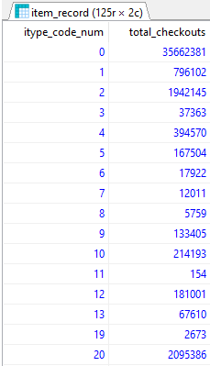
Total checkouts Per IType
SELECT
itype_code_num,
SUM(checkout_total) AS total_checkouts
FROM sierra_view.item_record
GROUP BY 1
ORDER BY 1
Notes:
Gather total checkouts for each itype

Slide 26
item_record_property
Key Fields:
call_number
call_number_norm
barcode
Use For:
item record details
Tips and Tricks:
call number includes field delimiters
_norm includes extra spaces & may remove wanted punctuation or non-indexed subfields

Slide 27
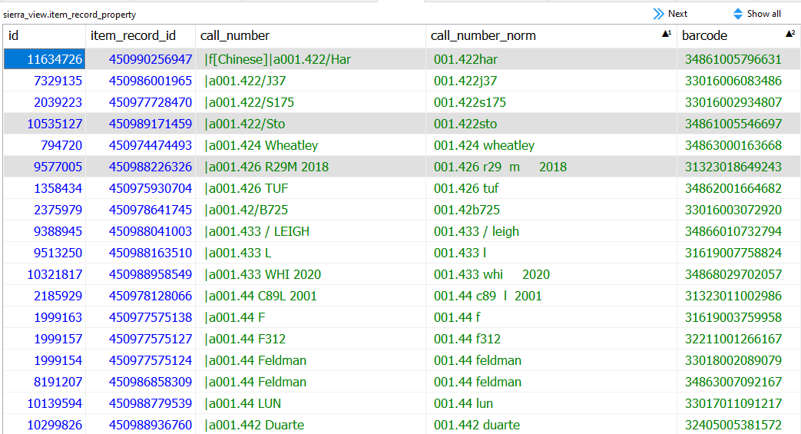
call_number vs call_number_norm
Notes:
Note missing field delimiters, and backslashes
In our system subfield f is not indexed and then does not appear in the normalized call number

Slide 28
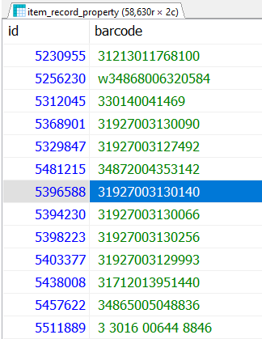
Find invalid barcodes
SELECT
id,
barcode
FROM
sierra_view.item_record_property
WHERE barcode !~ '^\d{14}$'
AND barcode != ''
Notes:
Finds items where the barcode is not a 14 digit number (happens all the time with barcode scanners)
Also picks up on barcode fields with extra spaces.

Slide 29
Other Record Types
Course | Invoice | Resource
Fund | Order | Vendor
Holding | Program | Volume

Slide 30
Supplemental Views
Notes:
So now we’re looking at linking tables together let’s look at some supplemental data sources

Slide 31
Linking tables
bib_record_item_record_link
id
bib_record_id
item_record_id
items_display_order
bibs_display_order
bib_record_holding_record_link
bib_record_item_record_link
bib_record_order_record_link
bib_record_volume_record_link
course_record_bib_record_link
course_record_item_record_link
Notes:
more linking if using other products

Slide 32
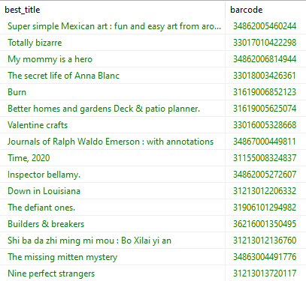
List titles and barcodes
SELECT
b.best_title,
i.barcode
FROM sierra_view.bib_record_property b
JOIN sierra_view.bib_record_item_record_link l
ON b.bib_record_id = l.bib_record_id
JOIN sierra_view.item_record_property I
ON l.item_record_id = i.item_record_id
Notes:
How to link attached records in SQL, you will use this JOIN (or similar ones to other record types) a lot!
Save the code somewhere you can easily cut and paste it from
Note this query uses both of the record_property tables instead of the standard record tables.

Slide 33
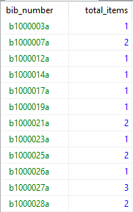
Count of items attached to a bib
SELECT
rm.record_type_code||rm.record_num||’a’ AS bib_number,
COUNT(l.item_record_id) AS total_items
FROM sierra_view.bib_record_item_record_link l
JOIN sierra_view.record_metadata rm
ON l.bib_record_id = rm.id
GROUP BY 1
Notes:
Table is also quite useful for gathering counts of attached records

Slide 34
myuser views
code
display_order
name
use to translate fixed field codes to their labels
name field contents will match the language setting of the user
JOIN sierra_view.item_status_property_myuser
ON item_record.item_status_code = item_status_property_myuser.code
Notes:
some will include “property” in their table names

Slide 35
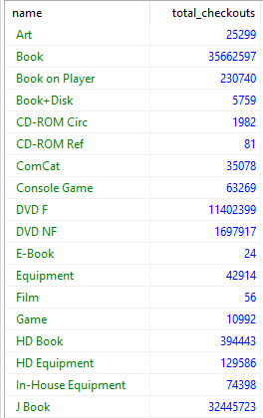
Total checkouts Per IType (Redux)
SELECT
it.name,
SUM(i.checkout_total) AS total_checkouts
FROM sierra_view.item_record i
JOIN sierra_view.itype_property_myuser it
ON i.itype_code_num = it.code
GROUP BY 1
ORDER BY 1
Notes:
Same query we saw earlier but now with itype labels instead of codes

Slide 36
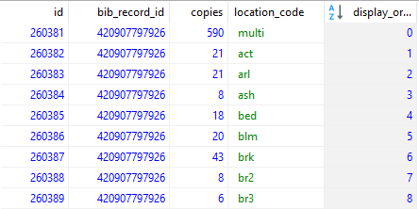
Multi Fields
bib_record_location
bib_record_id
copies
location_code
display_order
order_record_cmf
order_record_id
copies
fund_code
location_code
display_order
Notes:
Instances where a single fixed field can contain multiple entries
Unsure exactly what cmf stands for , contains multiple funds?

Slide 37
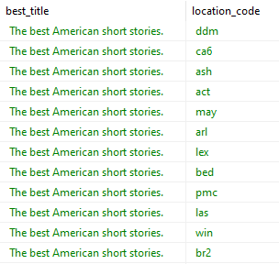
Who Owns a Title
SELECT
p.best_title,
b.location_code
FROM bib_record_location b
JOIN sierra_view.bib_record_property p
ON b.bib_record_id = p.bib_record_id
WHERE b.bib_record_id = ‘420907797926’
AND b.location_code != ‘multi’
Notes:
Because this join is one to many a new row is produced for each location

Slide 38
Who Owns a Title (redux)
SELECT
p.best_title,
STRING_AGG(b.location_code, ‘,’) AS locations
FROM bib_record_location b
JOIN sierra_view.bib_record_property p
ON b.bib_record_id = p.bib_record_id
WHERE b.bib_record_id = ‘420907797926’
AND b.location_code != ‘multi’
GROUP BY p.best_title
Notes:
Use string_agg function to condense those duplicate rows into a single comma delimited field.

Slide 39
MARC and Varfields
control_field | 006, 007, 008
leader_field | MARC leader
phrase_entry | Indexed varfields
subfield / subfield_view | Individual MARC subfields
varfield / varfield_view | Full varfield content, including subfield delimiters
Notes:
41 million phrase entry rows in Minuteman
73.5 Million varfield rows
136 Million in subfield

Slide 40
phrase_entry
Key Fields:
record_id
index_tag
varfield_type_code
occurence
index_entry
Use For:
retrieving indexed varfields for all record types
Tips and Tricks:
reliant on system indexing and thus not always as current as varfield/subfield tables
Notes:
Indexed fields less reliable but far more efficient to search on, plus normalized data
Does not distinguish between record types, must join to a record table to limit to rows associated with a particular type of record

Slide 41
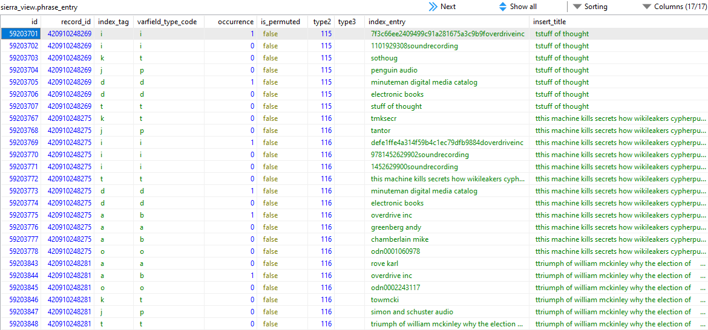
phrase_entry

Slide 42
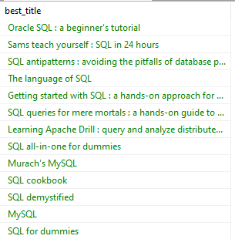
Find SQL materials
SELECT
b.best_title
FROM sierra_view.bib_record_property b
JOIN sierra_view.phrase_entry p
ON b.bib_record_id = p.record_id
AND p.index_tag = ‘d’
AND p.index_entry
LIKE ‘sql computer program language%’
Notes:
using replace to remove spaces for a more reliable search.
Like search allows for subjects with additional subfields in the entry, such as textbooks

Slide 43
Varfields With their own Views
patron_record_address
patron_record_id
addr1, addr2, addr3
village
city
region
postal_code
country
patron_record_fullname
patron_record_id
prefix
first_name
middle_name
last_name
suffix
Notes:
Some non-standard tables exist as well, generally they are labeled by data type they are associated with, patrons in these cases
Region equates to state
Separate fields for data entered into a single varfield within Sierra

Slide 44
Transaction Views

Slide 45
Circulation Transactions
accounting_transaction
checkout
circ_trans
fine
fines_paid
hold
hold_removed
reading_history
Additional views with products like collection agency and material booking
Notes:
Most of this information is ephemeral
More reliant on joining other tables to provide details

Slide 46
checkout
Key Fields:
patron_record_id
item_record_id
due_gmt
loanrule_code_num
checkout_gmt
ptype
renewal_count
overdue_count
Use For:
Current checkouts
Tips and Tricks:
Row is removed from table upon checkin
Notes:
Links to patron and item tables. Many transaction tables can roughly function as record_link tables, just with added data
Notably checkout location is missing from this table
data exists for duration of the item being checked out, but data can persist past that in the circ_trans table

Slide 47
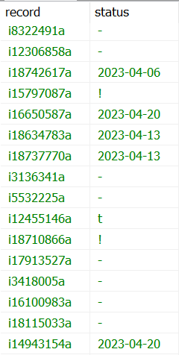
Item Status & Due Dates
SELECT
i.record_type_code||i.record_num||’a’ AS record,
CASE
WHEN o.id IS NULL THEN i.item_status_code
ELSE TO_CHAR(o.due_gmt,’yyyy-mm-dd’)
END AS status
FROM sierra_view.item_view i
LEFT JOIN sierra_view.checkout o
ON i.id = o.item_record_id
Notes:
Checkouts are not a status or technically part of the item data. Instead a checkout is identified by its presence in the checkout table
Use conditional logic of a case statement to use the due date when a checkout exists in place of the status code, to replicate the experience of Sierra/Encore

Slide 48
hold
Key Fields:
placed_gmt
record_id
patron_record_id
is_frozen
delay_days
expires_gmt
status
is_ir,
on_holdshelf_gmt,
expire_holdshelf_gmt
Use For:
Current holds data
Tips and Tricks:
Does not distinguish between bib/ item/volume holds
Join to record_metadata to identify record type
Notes:
determine hold type by linking to record_metadata table or converting record_id field with id2reckey() function
delay_days is not wanted before day
sadly not date placed on holdshelf, but ready for pickup is a status

Slide 49
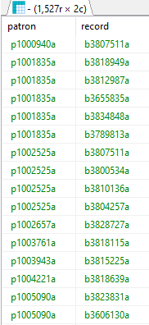
Old frozen holds
SELECT
id2reckey(h.patron_record_id)||’a’ AS patron,
rm.record_type_code||rm.record_num||’a’ AS record
FROM sierra_view.hold
JOIN sierra_view.record_metadata rm
ON h.record_id = rm.id
WHERE h.is_frozen = TRUE
AND h.placed_gmt < ‘2022-07-01’
ORDER BY 1

Slide 50
circ_trans
Key Fields:
patron_record_id
item_record_id
bib_record_id
volume_record_id
transaction_gmt
application_name
op_code
stat_group_code_num
item_location_code
patron_home_library
Use for:
Capturing recent circ data for checkouts, checkins, renewals, filled and placed holds
Tips and Tricks:
Retains 2 weeks of data by default, III can expand on request
Similar data to that stored by Web Management Reports & Decision Center
Backdated checkins will override transaction_gmt
Notes:
Checkout captures active checkout data while circ_trans is really a transaction log
And more fields that won’t fit on this slide.
due_date_gmt, icodes, pcodes, count_type, itype_code_num
At Minuteman we retain 5 weeks of data, Ohionet keeps 2 years (but still has fewer rows than Minuteman)

Slide 51
circ_trans – op_code
o = checkout | i = checkin
n = hold nb = bib hold ni = item hold nv = volume hold | h = hold with recall hb = hold recall bib hi = hold recall item hv = hold recall volume
f = filled hold | r = renewal
b = booking | u = use count
Notes:
Some transactions will yield double entries (checkout and filled hold)
Note, placing items in transit or on hold shelf are not recorded in this table
Table can be found in sierradna

Slide 52
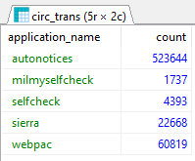
Compare Auto and Manual Renewals
SELECT
application_name,
COUNT(id)
FROM
sierra_view.circ_trans
WHERE op_code = ‘r’
GROUP BY 1
Notes:
autonotice is listed as an application, identifies autorenewals, which we just implemented January 1st

Slide 53
Other Views of Note

Slide 54
bool_set
Key Fields:
bool_info_id
record_metadata id
Use for:
Extracting records from review files
Tips and Tricks:
Join to bool_info to gather additional information about the review file
Notes:
bool_info_id = review file number
Great for automating tasks, customizing exports that can’t be done with create lists. Can then be reused for any record search that staff may happen to need without rewriting the query.
bool_info includes file name, record range, the query used, user name, etc...

Slide 55
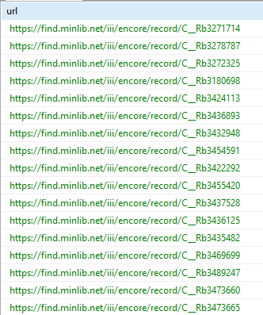
Create Encore links from file
SELECT ‘https://find.minlib.net/iii/encore/record/C__R’||
rm.record_type_code||rm.record_num
FROM sierra_view.bool_set bs
JOIN sierra_view.bib_record_item_record_link l
ON bs.record_metadata_id
IN (l.bib_record_id, l.item_record_id)
JOIN sierra_view.record_metadata rm
ON l.bib_record_id = rm.id
WHERE bs.bool_info_id = ‘42’
Notes:
matches either items or bibs, makes it easier to reuse the query for multiple files

Slide 56
iii_user views
iii_user_permission_myuser
iii_user_id
user_name
permission_num
permission_name
iii_user
iii_user_application_myuser
iii_user_desktop_option
iii_user_permission_myuser
iii_user_printer_myuser
iii_user_workflow
Notes:
Fantastic for helping to maintain logins
You can see a typical table here with the permission_myuser

Slide 57
iii_user_desktop_option
Key Fields:
iii_user_id,
desktop_option_id,
value
Use for:
Identifying user settings and options
Tips and Tricks:
desktop_option_id and value fields are not documented.
Notes:
The one less straightforward table is desktop_option, which is also one of the most useful
Pinpoint values by querying all rows rows associated with your user id, change a setting and then see what changes.
I recommend using the conditional formatting feature in excel to spot duplicate/unique values

Slide 58
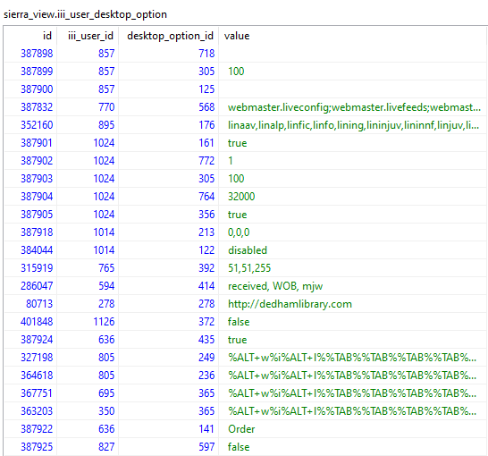
iii_user_desktop_option
Notes:
The one less straightforward table is desktop_option, which is also one of the most useful
Pinpoint values by querying all rows rows associated with your user id, change a setting and then see what changes.
I recommend using the conditional formatting feature in excel to spot duplicate/unique values

Slide 59
Logins not using e-mailed due slips
SELECT u.name
FROM sierra_view.iii_user u
JOIN sierra_view.iii_user_desktop_option o
ON u.id = o.iii_user_id
AND o.desktop_option_id = ‘905’
AND o.value NOT LIKE ‘Email%’
AND u.name LIKE ‘%circ%’
ORDER BY 1
Notes:
option 905 is the print/e-mail due slip delivery option
We rolled this out to users with the 5.0 upgrade and wanted to monitor its adoption

Slide 60
Other Views of Note
accounting_transaction | Acquisitions transaction log
catmaint | Headings reports
network_access_view | Network access table
record_lock | Locked orders and invoices
record_range | Allotted record ranges by accounting unit
collection | Collection table from Decision Center
hold_removed | Cancelled and expired holds including clear holdshelf
Notes:
Hold_removed new for 2023

Slide 61
GitHub SQL Repository:
https://github.com/Minuteman-Library-Network/SQL-Queries
Find me in the IUG Discord Server:
https://discord.gg/vuHTEGPf8d
Jeremy Goldstein
jgoldstein@minlib.net

Slide 62
Funds Cut for Time

Slide 63
fund
Key Fields:
acct_unit
fund_type
fund_code
appropriation
expenditure
encumbrance
warning_percent
Use For:
Fund record data
Tips and Tricks:
Different structure from other record tables
Lacks an id field and no fund_view table
Contains values for current funds, old funds, and activity reports
Notes:
Funds table are complicated by having a different data structure from other record tables
No primary key, no fund_view and some extra hoops you must jump through when linking tables together.

Slide 64
fund_master
Key Fields:
id
accounting_unit_id
code_num
code
Use For:
linking fund data to orders and invoices
Translate code_num to code
Tips and Tricks:
code_num has different data type in other tables, must cast those to integer when joining
Notes:
The primary one of those hoops is the fund_master table, which you must link through in many cases
Is the source for translating code_nums to codes, and also the place to get a primary key for a fund
Must often link via code_num as well, such as when joining to the fund table itself, where you will find that the matching field has a different data type

Slide 65
Link Fund code to Invoice
Invoice_record
Invoice_record_line
fund_master
accounting_unit
accounting_unit.code_num = invoice_record.accounting_unit_code_num
invoice_record_line.invoice_record_id = invoice_record.id
accounting_unit.id= fund_master.accounting_unit_id
invoice_record_line.fund_code::INT = fund_master.code_num
Notes:
In many case you will also have to make a series of joins to tie together the data you wish.
Here we want to link a fund name to an invoice, which requires finding the trail to get from point a to point b
In this case the name is found in fund_master which links in turn to invoice_record_line and invoice, with two of those linking to the account_unit table to ensure you’re matching on the correct funds in instances where the same code could be used by two different accounting units.
Funds are tricky but everything else is far more straightforward than this so don’t let this scare you off, but if you’re new to sql, focus on some other areas of the system before working with acquisitions data.

Slide 66
Invoice line items for a fund
SELECT i.*
FROM sierra_view.invoice_record_line i
JOIN sierra_view.fund_master f
ON i.fund_code::int = f.code_num
AND f.code = ‘abc’
JOIN sierra_view.accounting_unit a
ON f.accounting_unit_id = a.id
AND a.code_num = ‘2';
Notes:
Note the cast to an integer to allow the join to occur
fund_code is a varchar, same issue exists for order_cmf table
Also need to join to accounting unit table to make sure that the fund code limit is tied to the correct account unit

