Slide 2
Sierra Cross-Training for Public and Technical Services
Ashley Krenelka Chase
Associate Director
Jason M. Buckmelter
Systems Administrator
Stetson University College of Law
Dolly & Homer Hand Law Library

Slide 3
Notes:
Introduction
JB Background
AKC Background
Why the cross-training

Slide 4
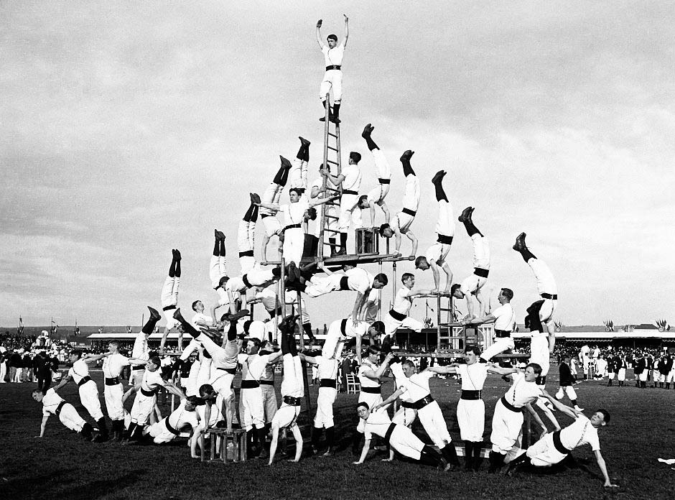
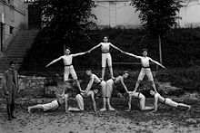
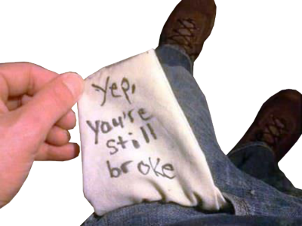
2012
2017
https://en.wikipedia.org/wiki/Human_pyramid
http://www.atlasobscura.com/articles/a-visual-history-of-the-human-pyramid
https://wonkette.com/579735/obamacare-death-panels-oklahoma-old-people-by-giving-them-so-much-money
http://www.officialpsds.com/-No-Money-PSD94236.html

Slide 5
The Merger
Technical Services
Access Management & Services
Public Services

Slide 6
THE TEST
https://www.pinterest.com/shlindstrom/tips-for-test-taking/

Slide 7
https://steemit.com/steemit/@everittdmickey/test-results

Slide 8
http://stepelevencomesalive.blogspot.com/2013/09/going-forward-now-what.html

Slide 9
QUESTIONS?
Ashley: akrenelk@law.stetson.edu
@AKrenelkaChase
Jason: jbuckmel@law.stetson.edu

