Slide 1
No SQL, No Simply Reports, No Problem!
Power Search in Polaris
Paul Delaney & Diane Perry

Slide 2
PRESENTERS
Diane Perry
Tampa-Hillsborough County Public Library Cooperative
Business Systems Department Specialist
perrydi@hillsboroughcounty.org
Paul Delaney
Tampa-Hillsborough County Public Library Cooperative
Library Services and Technology Guide 2
delaneyp@hillsboroughcounty.org

Slide 3
WHAT IS A POWER SEARCH?
Power Search is a tool for creating custom patron and item lists in Polaris. Though SQL and Simply Reports are more robust and recommended in some applications, access is limited to selective staff; however, all staff have access to Power Search.

Slide 4
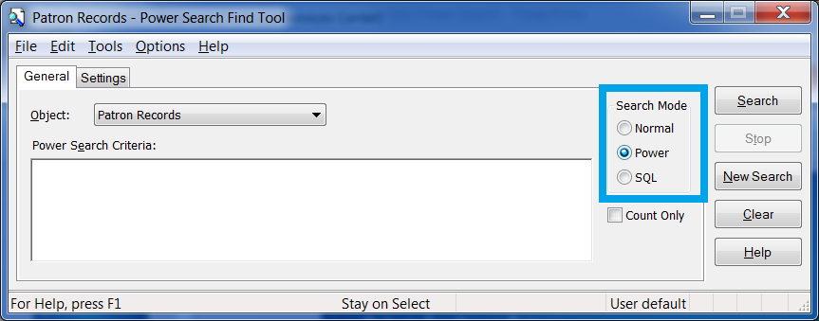
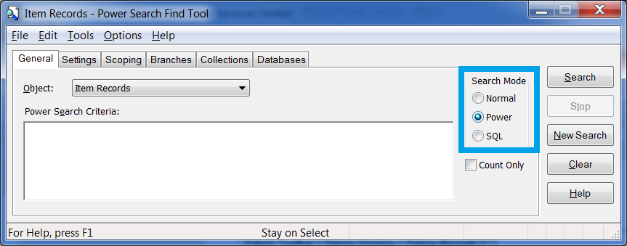
ACCESSING POWER SEARCH
Patron Power Search: Polaris Toolbar > Patron Services > Patron Records (F7)
Search Mode: Power Search
Item Power Search: Polaris Toolbar > Cataloging > Item Records (CTRL+ALT+F9)
Search Mode: Power Search

Slide 5
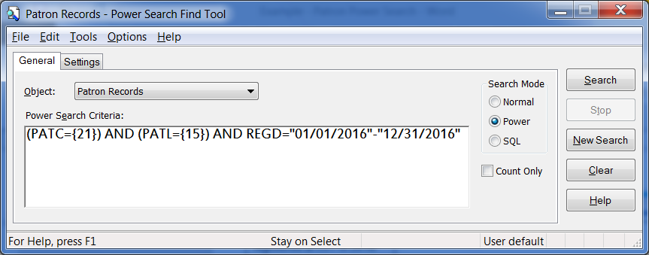
ACCESSING POWER SEARCH
Unlike a Normal Search, Power Search allows you to search using more than two search criteria.
Power Search uses coded abbreviations rather than clicking through drop-down menus. Like SQL, it utilizes integers assigned by Polaris.
But don’t fret, this presentation will walk you through the codes you need to create your own personalized lists.

Slide 6
PATRON POWER SEARCH

Slide 7
PATRON POWER SEARCH
Let’s say we want to generate a list of all patrons with patron code “Reciprocal Borrower” who were registered at the Lutz Library (LUT) in 2016.
The information we’d search for is:
Patron Code: Reciprocal
Registered Library: LUT
Registered in: 2016

Slide 8
PATRON POWER SEARCH
The three codes we need to perform this search are located in the Power Search Codes spreadsheet.
Go to the Patron Search tab.
CRITERIA | CODE | NOTES
Patron Code | (PATC={X}) | Enter Patron Code #
Patron's Registered Library | (PATL={X}) | Enter Branch Code
Registration Date | (REGD="XX/XX/XXXX"-"XX/XX/XXXX") | Enter beginning and end date range

Slide 9
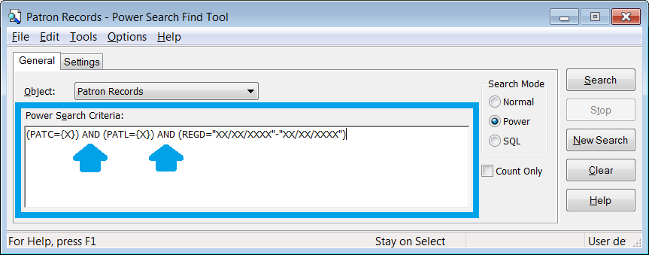
PATRON POWER SEARCH
Copy and paste each code from the spreadsheet into the Power Search Criteria field.
Include “AND” between each code segment to group them together.
Do not click Search yet.
Note: it does not matter what order you use.

Slide 10
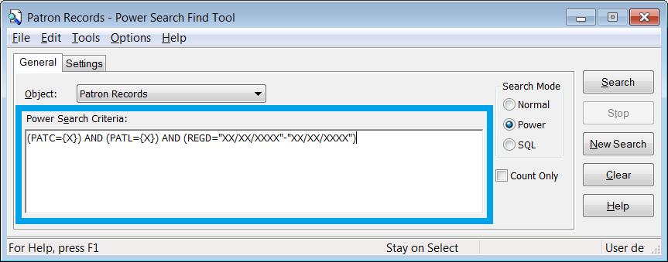
PATRON POWER SEARCH
The “X” in each code needs to be changed to reflect our search criteria.
We need to enter the integers for Patron Code “Reciprocal Borrower” and for Registered Library “LUT”.
But what if I don’t know what the integers are?
PATRON CODE | #
Reciprocal Borrower | 21
BRANCH | #
LUT | 15

Slide 11
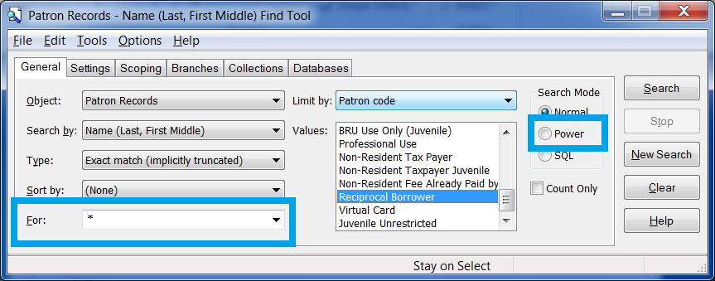
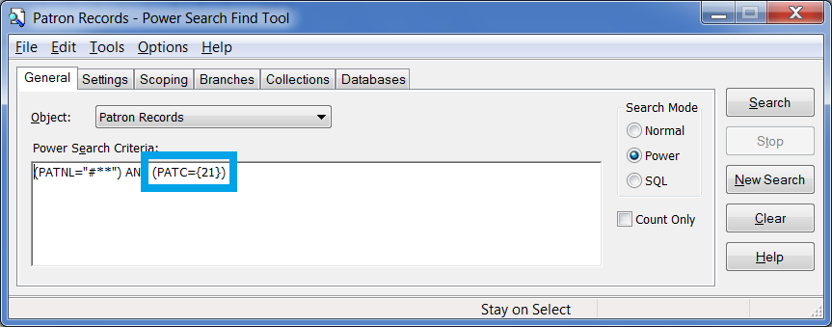
PATRON POWER SEARCH
To determine the Reciprocal Borrower integer, open a new patron search. In the For field, type an asterisk, then in Limit By, select Patron Code, highlight Reciprocal Borrower, then click the Power button.
This displays the Power Search query and most importantly the integer for the Patron Code.

Slide 12
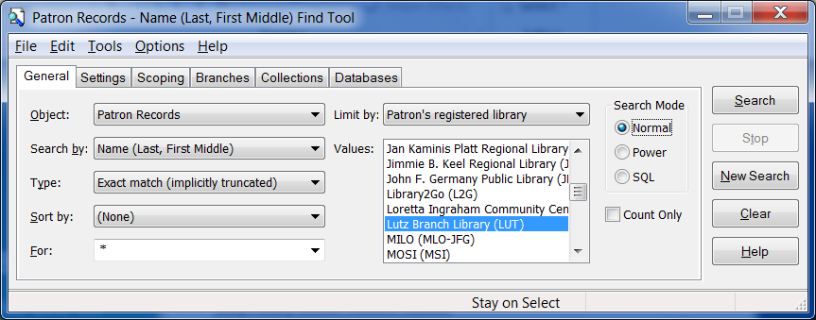
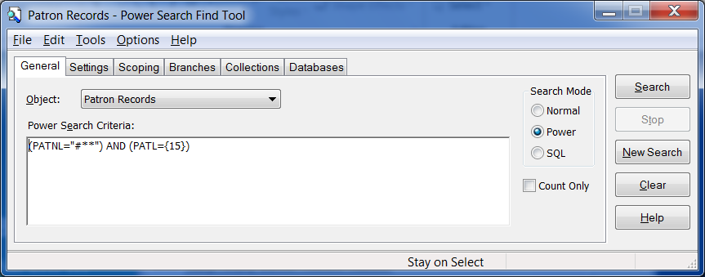
PATRON POWER SEARCH
The same process can be done for the Patron’s Registered Library.
It’s recommended to save the integers in a spreadsheet so they can easily be retrieved for next time.

Slide 13
PATRON POWER SEARCH
Enter the code #’s:
PATC (Patron Code) = 21.
PATL (Patron Registered Library) = 15.

Slide 14
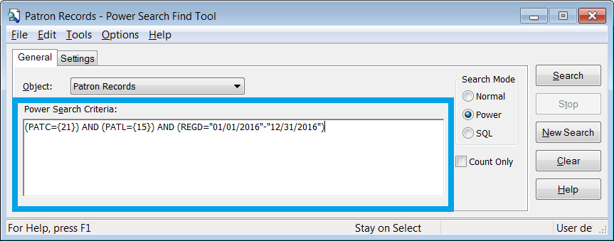
PATRON POWER SEARCH
The last step is the list needs to include all LUT reciprocal borrowers from 2016.
Change “X”’s in the REGD | Registration Date to reflect the date range of 2016 (01/01/2016 – 12-31-2016).
NOTE: you must use this exact date format.

Slide 15
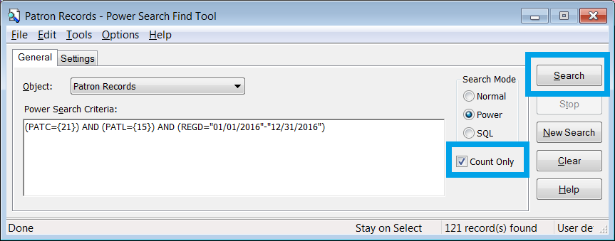
PATRON POWER SEARCH
If you only need the total number results, click the box next to Count Only.
To display your results, click Search.
The total Reciprocal Borrowers registered at LUT in 2016 is: 121.

Slide 16
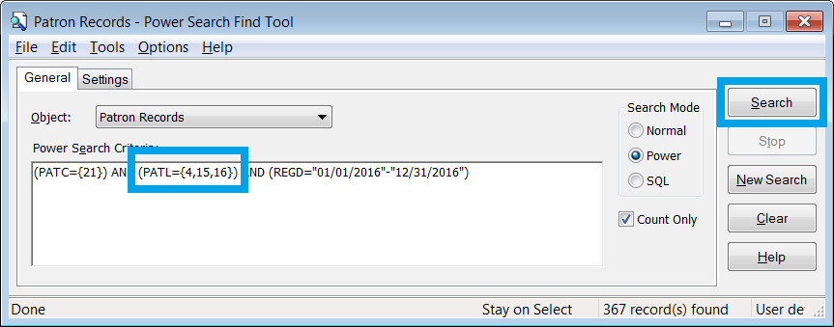
PATRON POWER SEARCH
What if you want to build upon this list and include two other libraries?
The Branch Code #’s for ADL is 4 and NTR is 16.
Using commas, add 4 and 16 to PATL (Patron Registered Library).
Click Search. Your new result is: 367.

Slide 17
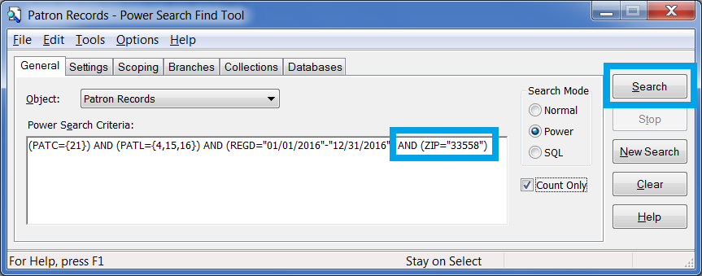
PATRON POWER SEARCH
What if you want to narrow this list and limit to postal code 33558?
Type into the criteria: AND (ZIP=“33558”)
Click Search. Your new result is: 9.

Slide 18
ITEM POWER SEARCH

Slide 19
ITEM POWER SEARCH
Let’s say we want to generate a list of all items with the Circulation Status “Claim Missing Parts” for the Brandon Regional Library (BRD) older than 60 days.
The information we’d search for is:
Circulation Status: Claims Missing Parts
Circulation Status Date: 60+ days
Last Checked In Location: BRD

Slide 20
ITEM POWER SEARCH
The three codes we need to perform this search are located in the Power Search Codes spreadsheet.
Go to the Item Search tab.
CRITERIA | CODE | NOTES
Circulation Status | (CS={X}) | Enter Circ Status #
Circulation Status Date | (CSD="XX/XX/XXXX"-"XX/XX/XXXX") | Enter beginning and end date range
Check In Location | (CIL={X}) | Enter branch #
Why didn’t you choose Assigned Branch instead of Check In Location?
Because the Assigned Branch doesn’t always reflect the location Special Item Check In was performed.

Slide 21
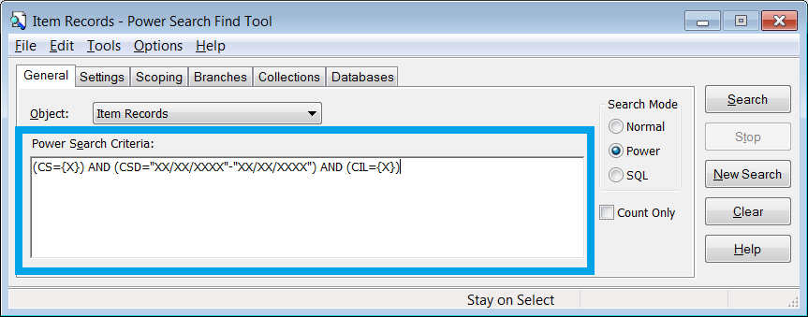
ITEM POWER SEARCH
Copy and paste each code from the spreadsheet into the Power Search Criteria field.
Include “AND” between each code segment to group them together.
Do not click Search yet.
Note: it does not matter what order you use.

Slide 22
ITEM POWER SEARCH
The “X” in each code needs to be changed to reflect our search criteria.
We need to enter the integers for Circulation Status and Check In Location.
But what if I don’t know that the integers are?
CIRCULATION STATUS | #
Claims Missing Parts | 21
Check In Location | #
BRD | 7

Slide 23
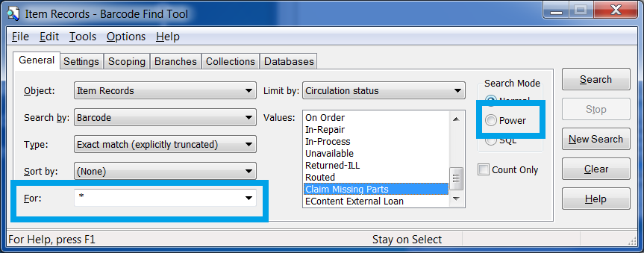
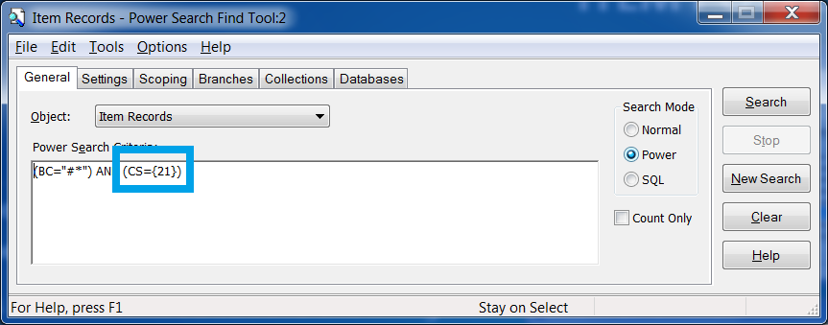
ITEM POWER SEARCH
To determine the Claims Missing Parts integer, open a new item search. In the For field, type an asterisk, then in Limit By, select Circulation Status, highlight Claims Missing Parts, then click the Power button.
This displays the Power Search query and most importantly the integer for the Circulation Status.

Slide 24
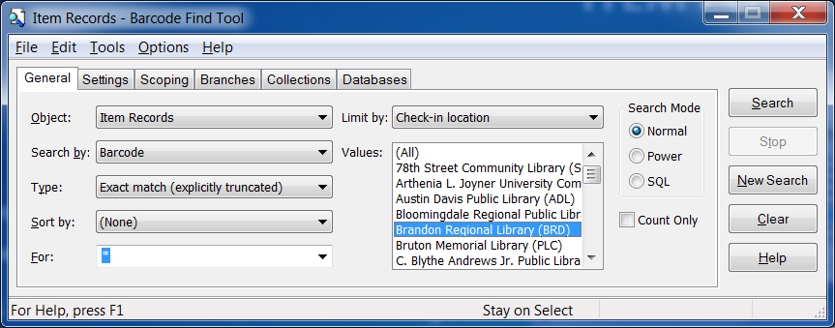
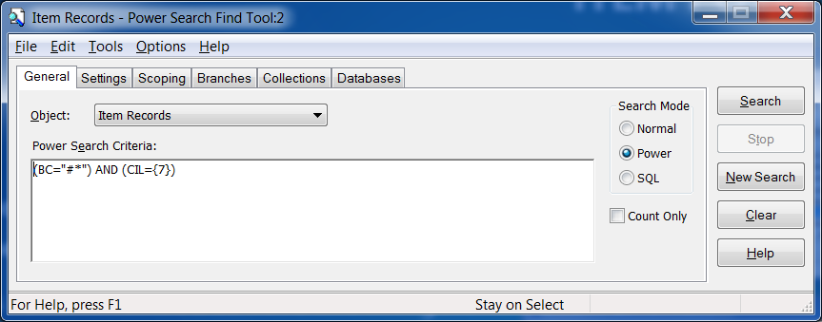
ITEM POWER SEARCH
The same process can be done for the Check In Location.
It’s recommended to save the integers in a spreadsheet so they can easily be retrieved for next time.
Note: if the Check In Location integer for Brandon Regional is 7, the Assigned Branch integer will also be 7.

Slide 25
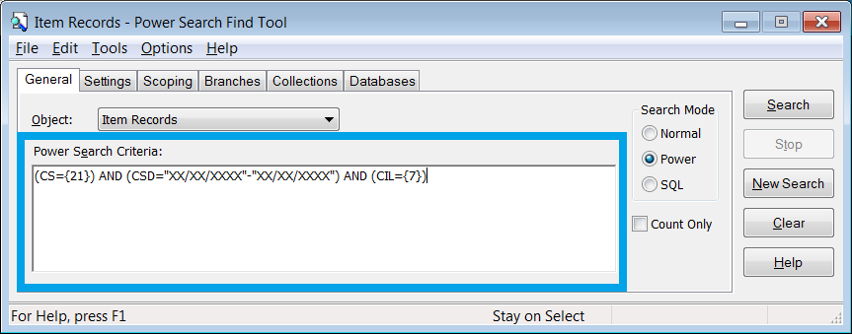
ITEM POWER SEARCH
Enter the code #’s:
CS| Circulation Status = 21.
CIL | Check In Location = 7.

Slide 26
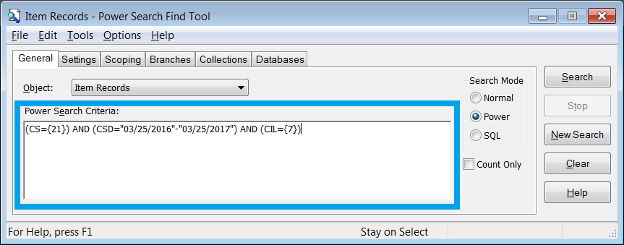
ITEM POWER SEARCH
The last step is to narrow the search results to a particular Circulation Status Date range.
Change “X”’s in the CSD (Circulation Status Date) to reflect 60 days and older from today’s date: (04/01/2016 – 04/01/2017).

Slide 27
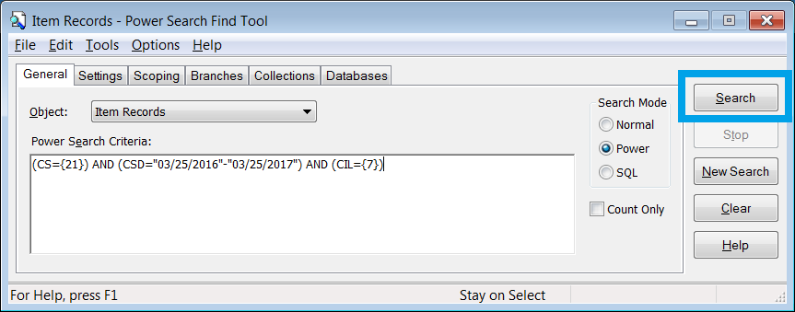
ITEM POWER SEARCH
To display your results, click Search.

Slide 28
PRINTING RESULTS
You may need to sort your results by Collection and Call Number prior to printing.
First, click on Call Number.
Then, click on Collection twice to sort ascending.

Slide 29
PRINTING RESULTS
To print, click File > Print > List View.

Slide 30
FAQs

Slide 31
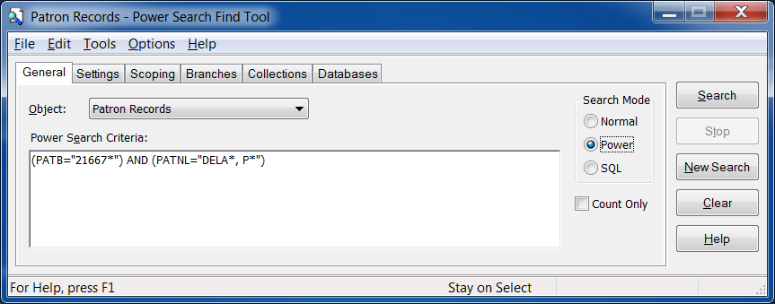
FAQs
Can I combine an Item and Patron Power Search?
No.
Can I use wildcards in a Power Search?
Yes, in fields that permit open text. So, in this example, we have an asterisk after a barcode prefix and an asterisk at the end of the last and first name.
A wildcard cannot replace a date field.

Slide 32
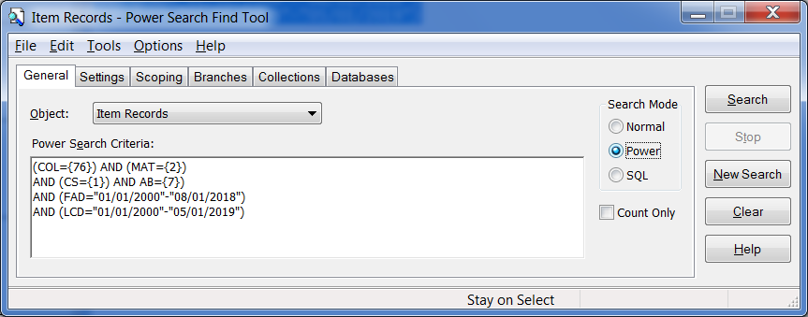
FAQs
Can I save my results to a Record Set?
Yes.
Can you provide an example of a more complex Power Search?
Yes, in this example, we’re looking for a particular Collection (leased books), Material Type (book), Circulation Status (checked in), Assigned Branch (Brandon Regional), First Available Date and Last Circulated Date.

Slide 33
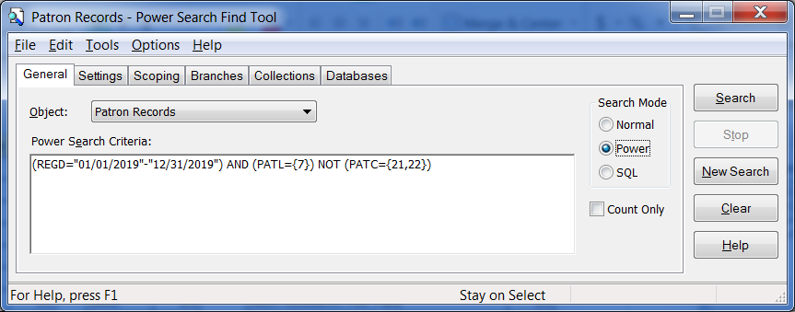
FAQs
If using “AND” includes that particular data, is there a way to omit certain results?
Yes, in this example, we’re looking for patrons registered in 2019 at a particular library but omitting patron codes 21 & 22. By using “NOT” instead of “AND”, we exclude those from the results.

Slide 34
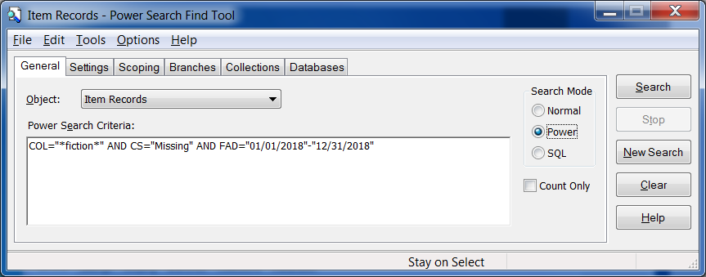
FAQs
Can a Power Search be run without using integers?
Yes, but it may not always be as precise. In this example, we’re looking for items in the Fiction collection with a Circulation Status of “Missing” and First Available Date of 2018.
Quotation marks have to be used for free text terms, such as “fiction” or “missing“ if using in place of an integer.
Wildcards were placed at the beginning and end of “fiction”, however searching this way will display items from any Collection with the term “fiction” in it. The only way to be more precise without using integers is to use the exact Collection name in the search criteria.

Slide 35
THANK YOU!
ADDITIONAL QUESTIONS?

