Slide 1
It’s not just for inventory anymore
Colleen Medling
Salt Lake County Library Services
cmedling@slcolibrary.org
Notes:
NOTE:
To change the image on this slide, select the picture and delete it. Then click the Pictures icon in the placeholder to insert your own image.

Slide 2
We just don’t inventory anymore
Time consuming
We found ROI was low
But these wands are expensive!
Notes:
18 locations, 8 sorters, 10 wands – 5 in a rotation schedule, 5 locations have own wand

Slide 3
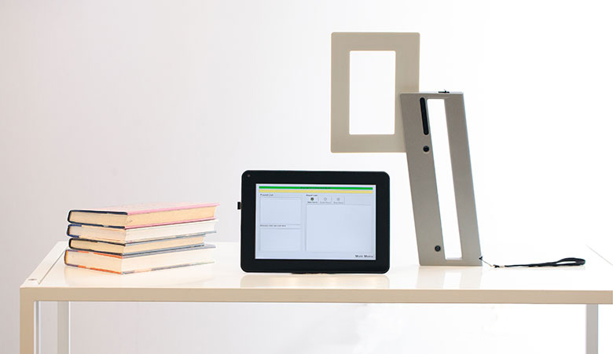
Is that a Klingon Batleth?
What we do use it for
Lost
Trace
In Delivery
Not on File
Other Uses
Weeding
Grubby (ewww) List
Under Achievers
PS. Make sure your wand connects to your IMS

