Slide 1
Bite-size projects backend library staff can do to for your library systems Diversity, Equity, and Inclusion Goals
Recorded Session 1:15 – 2:00 pm, Thursday, April 7, 2022
Presenter Engagement: 2:00 – 2:45 pm, Thursday, April 7, 2022
Mark Strang, Manager, Library Information Technology Services,
University Libraries, Bowling Green State University

Slide 2
Land Acknolwledgement
The region Bowling Green State University inhabits is in the Great Black Swamp and the Lower Great Lakes region. This land is the ancestral territory of the Wyandotte, Huron, Kickapoo, Erie, Miami, and Peoria. We recognize these historical and contemporary ties in our efforts to further the conversation around decolonizing history and honoring Indigenous individuals and communities who have been living and working on the land from time immemorial.
Map provided by: Native-Land

Slide 3
Agenda
Diversity, Equity, and Inclusion statement and Library website
Communication: Enhancements, Trials, and Implementations
Collection Diversity: Choice Reviews Diversity Collection Assessment
Stephanie Church, Case Western Reserve University, Bite Size Project
Databases A-Z, Diversity, Equity, and Inclusion subject headings
Sierra preferred name / Campus Chosen name projects
Live Q&A audience projects to similar assist others

Slide 4
Diversity, Equity, and Inclusion statement and Library website

Slide 5
DEI statement and Library website
“Academic libraries have an established history of offering virtual services and providing online resources for students, faculty, staff, and the general public. In addition to these services and resources, information on academic library websites can contribute to an institution’s demonstration of value placed on diversity, equity, and inclusion (DEI).”
“This article examines the DEI statements on academic library websites and examines the presence, or lack thereof, and content of these statements to address the following research question: How do DEI statements on academic library websites contribute to the construction of institutional value of diversity, equity and inclusion?”
Eric Ely, University of Wisconsin – Madison
Ely, E. (2021). Diversity, Equity & Inclusion Statements on Academic Library Websites. Information Technology and Libraries, 40(4). https://doi.org/10.6017/ital.v40i4.13353

Slide 6
DEI statement and Library website
Examined Erik Ely analysis of Big Ten University Library websites.
Evaluated BGSU University Libraries website with his criteria.
BGSU University Libraries adapted a Diversity Statement (passed fall 2021)
https://www.bgsu.edu/library/about/diversity.html
Promptly posted to CMS directory of Dean’s office pages by staff.

Slide 7
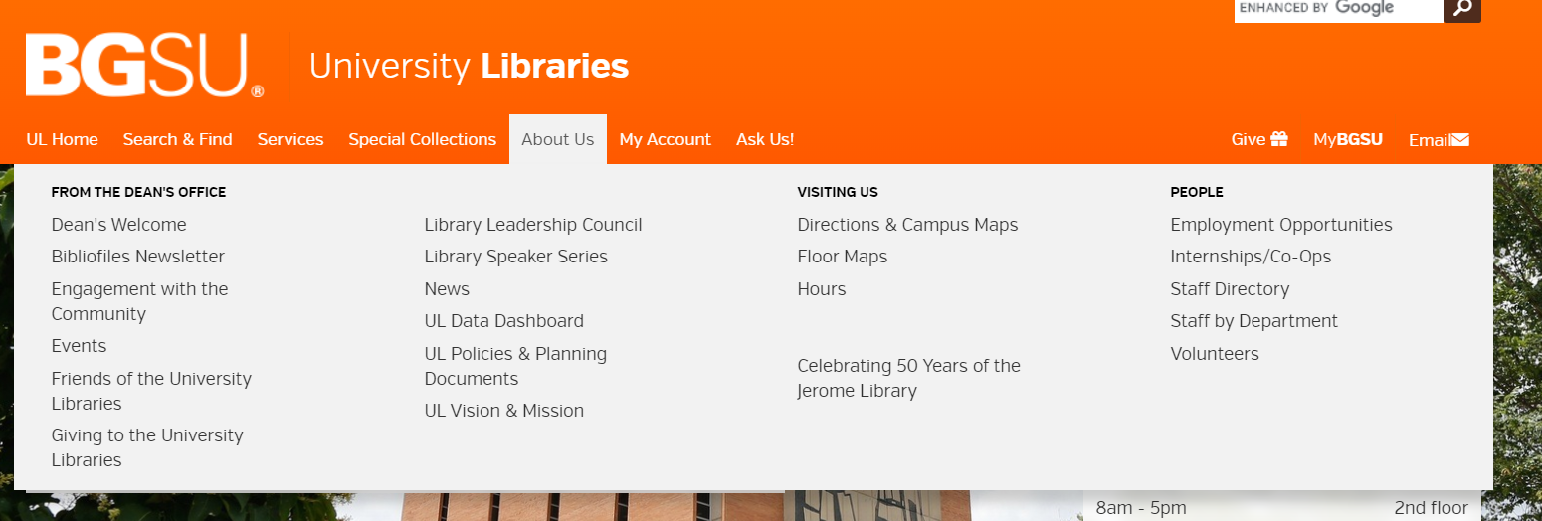
DEI statement and Library website
Discoverability:
Navigation options: Not located on the main About Us pulldown (1 click)

Slide 8
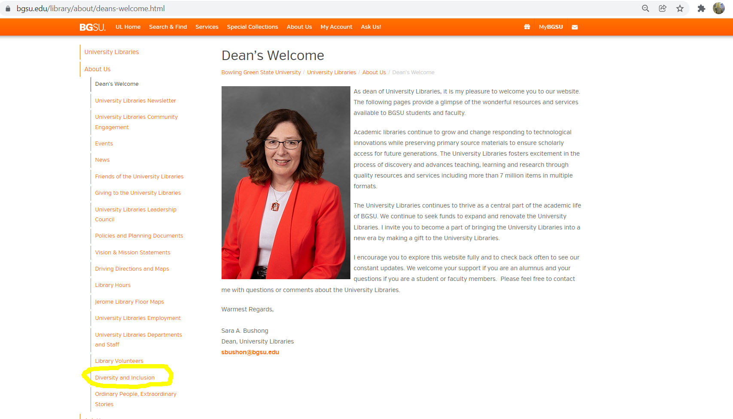
DEI statement and Library website
Diversity statement located towards the bottom of About us pages list on left column bottom
(2+ clicks)

Slide 9
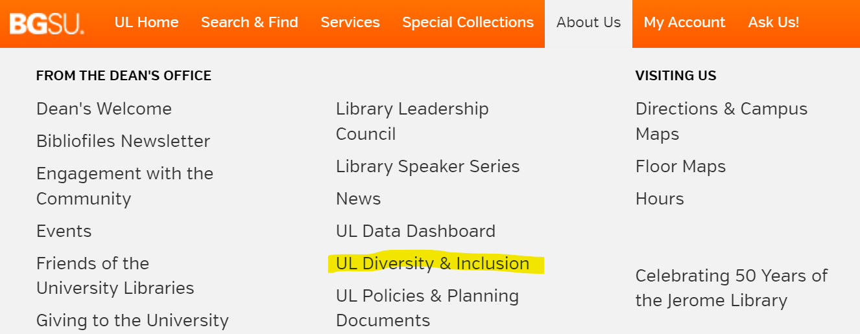
DEI statement and Library website
Discoverability Improved
Added to About Us pulldown (1 click)

Slide 10
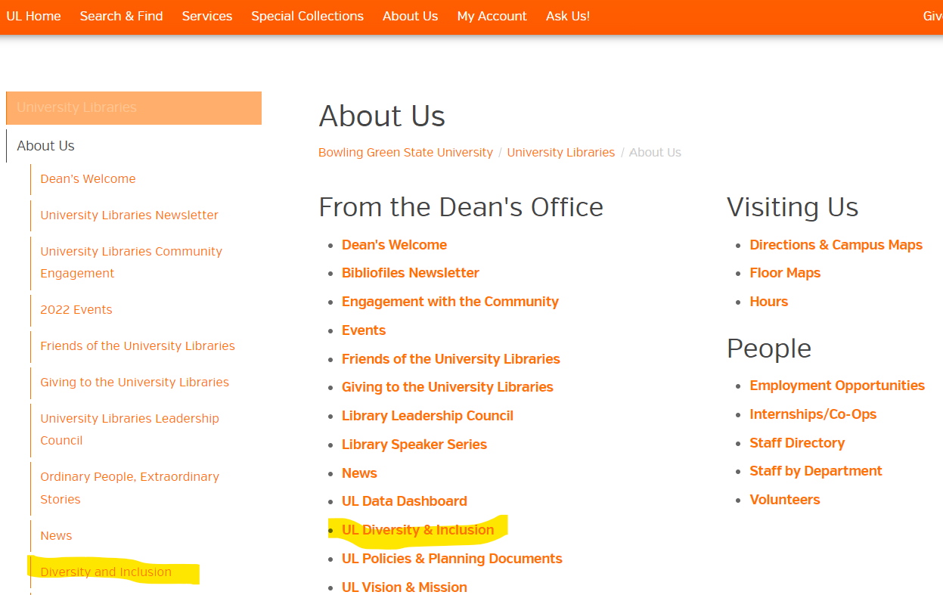
DEI statement and Library website
Discoverability Improved
2) Added to About Us Page
(3 clicks)
3) Added to Discovery Layer Index

Slide 11
Communication: Enhancements, Trials, and Implementations

Slide 12
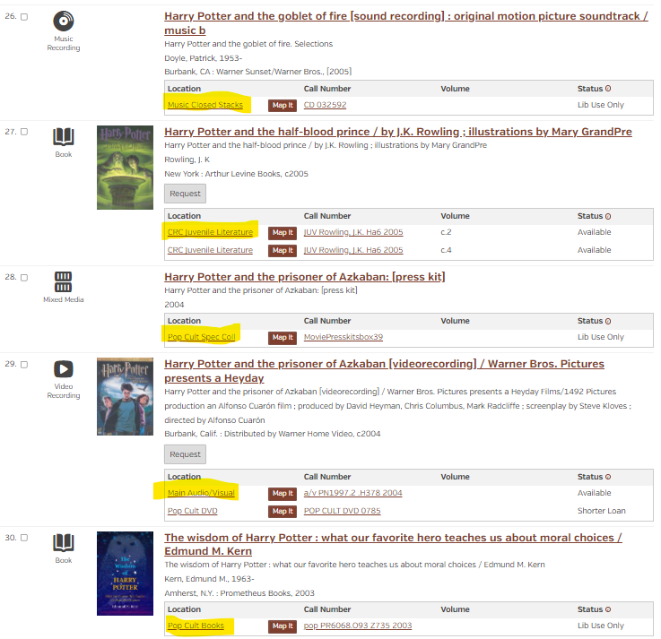
Communication
Go to search 15 years ago:
Harry Potter and the…
Why:
The results included both Academic and Popular materials from a good cross set of our holdings:
Music Library & Bill Shurk Sound Archives
Curriculum Resource Center
Brown Popular Culture Library
Main A/V and stacks
Notes:
15 Years ago my favorite example of communicating Innovative changes to Sierra was to do a quick Word search: Harry Potter and the …

Slide 13
Communication
With an increased awareness of Diversity, Equity, and Inclusion goals, I have an appreciation for how my previous search fell short.
Now when I need a search term to communicate an enhancement, trial, or implementation,
I will spend time seeking out and finding titles from non majority topics or authors from non majority populations.
Unfortunately, our systems aren’t very well setup for these searches so it takes time and effort to find current examples. I consider it to be time well spent since it is a personal effort to achieve Library strategic goals on Diversity, Equity, and Inclusion.
Examples the past year:
Affordable Learning Community of Practice - licensed eBooks
Software Upgrades
Diverse Children's Literature
Notes:
15 years later

Slide 14
Communication: Affordable Learning Community of Practice - licensed eBooks
Titles used to illustrate finding eBooks in Summon; determining simultaneous use limits; different vendor platforms, permalinks, and proxying for off campus use.
Owyoung, C. (2022). All are welcome: How to build a real workplace culture of inclusion that delivers results. McGraw-Hill.
[O’Reilly eBooks] https://learning.oreilly.com/library/view/all-are-welcome/9781264269792/?ar=
French, J., Muse, P., & eBook Academic Collection - North America. (2020). Inclusive curating in contemporary art A practical guide. Project Muse.
[Ebscohost] https://search.ebscohost.com/login.aspx?direct=true&db=e000xna&AN=2568391&site=ehost-live&scope=site&ebv=EB&ppid=pp_Cover
Aboagye, E., 1957, Dlamini, S. N., 1962, & JSTOR (Organization). (2021). Global citizenship education: Challenges and successes. University of Toronto Press. [JSTOR] https://www.jstor.org/stable/10.3138/j.ctv1hggkjt
Dutra-Thomé, L., Rabelo, D. F., Ramos, D., Góes, E. F. (2022). Racism and human development. Springer.
[SpringerLink] https://link.springer.com/book/10.1007/978-3-030-83545-3
Belmonte, L. A., & EBSCOhost. (2021;2020;). The international LGBT rights movement: A history. Bloomsbury Academic.
[Ebschost] 3 users at a time 2021 https://search.ebscohost.com/login.aspx?direct=true&db=nlebk&AN=2681827&site=ehost-live&scope=site&ebv=EB&ppid=pp_Cover
Murti, L., Flores, G. M., & Ohio Library and Information Network. (2021). Gender, race, and class in the lives of today's teachers: Educators at intersections. Springer. [SpringerLINK 2021] https://link.springer.com/book/10.1007/978-3-030-73551-7
Mena, J. A., Quina, K., & Ohio Library and Information Network. (2019). In Quina K., Mena J. A.(Eds.), Integrating multiculturalism and intersectionality into the psychology curriculum: Strategies for instructors. American Psychological Association. [APA PsycNet] https://doi.org/10.1037/0000137-000
Notes:
Here is a list of titles that I found to share with enrolled faculty to use as illustrations. I share them with you in the hopes of saving you time when you need one.

Slide 15
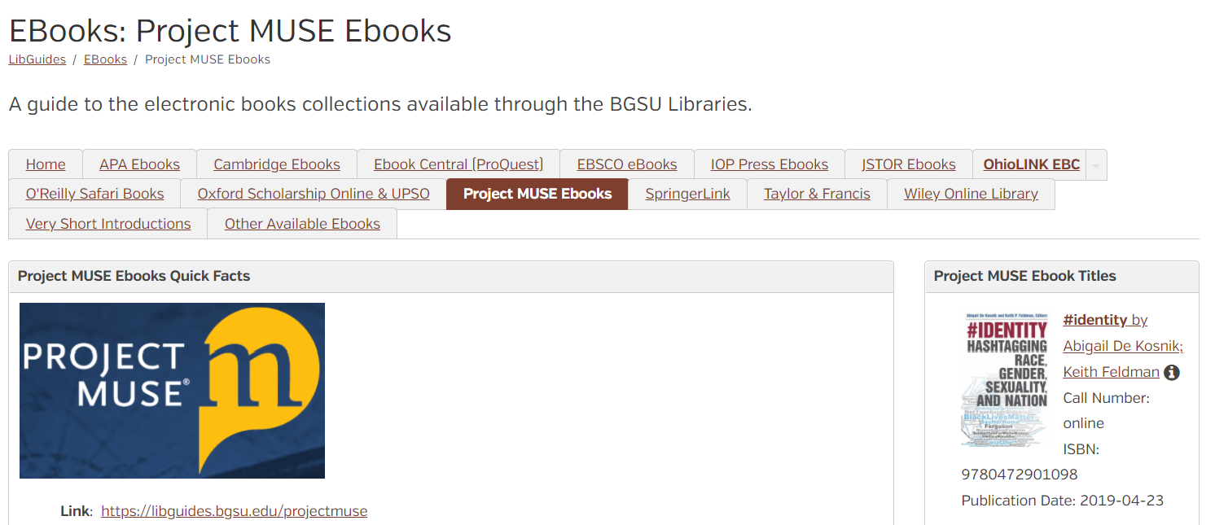
Communication: LibGuides: eBooks example
Project MUSE Ebooks - EBooks - LibGuides at BGSU University Libraries
http://libguides.bgsu.edu/ebooks
Notes:
#Identity Hashtagging, Race, Gender, Sexuality, and the Nation by Agigail De Kosnik

Slide 16
Communication: December Discovery Layer Summon Software Refresh
Search Term: Hazel Scott: the Pioneering Journey of a Jazz Pianist
https://bgsu.summon.serialssolutions.com/#!/search?ho=t&include.ft.matches=f&l=en&q=hazel%20scott&spellcheck=true
Notes:
Hazel Scott: The Pioneering Journey of a Jazz Pianist, from Café Society to Hollywood to HUAC. By Chilton, Karen - Music Library local collection

Slide 17
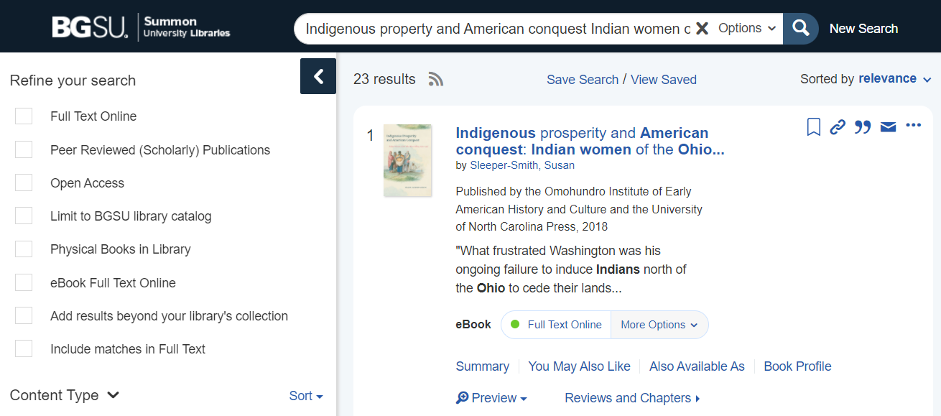
Communication: December Discovery Layer Summon Software Refresh
Search: Indigenous prosperity and American conquest: Indian women of the Ohio River Valley
https://bgsu.summon.serialssolutions.com/#!/search?ho=t&include.ft.matches=f&l=en&q=Indigenous%20property%20and%20American%20conquest%20Indian%20women%20of%20the%20Ohio%20River%20Valley
Notes:
Regional Title: Indigenous prosperity and American conquest: Indian women of the Ohio River Valley by Sleeper-Smith, Susan

Slide 18
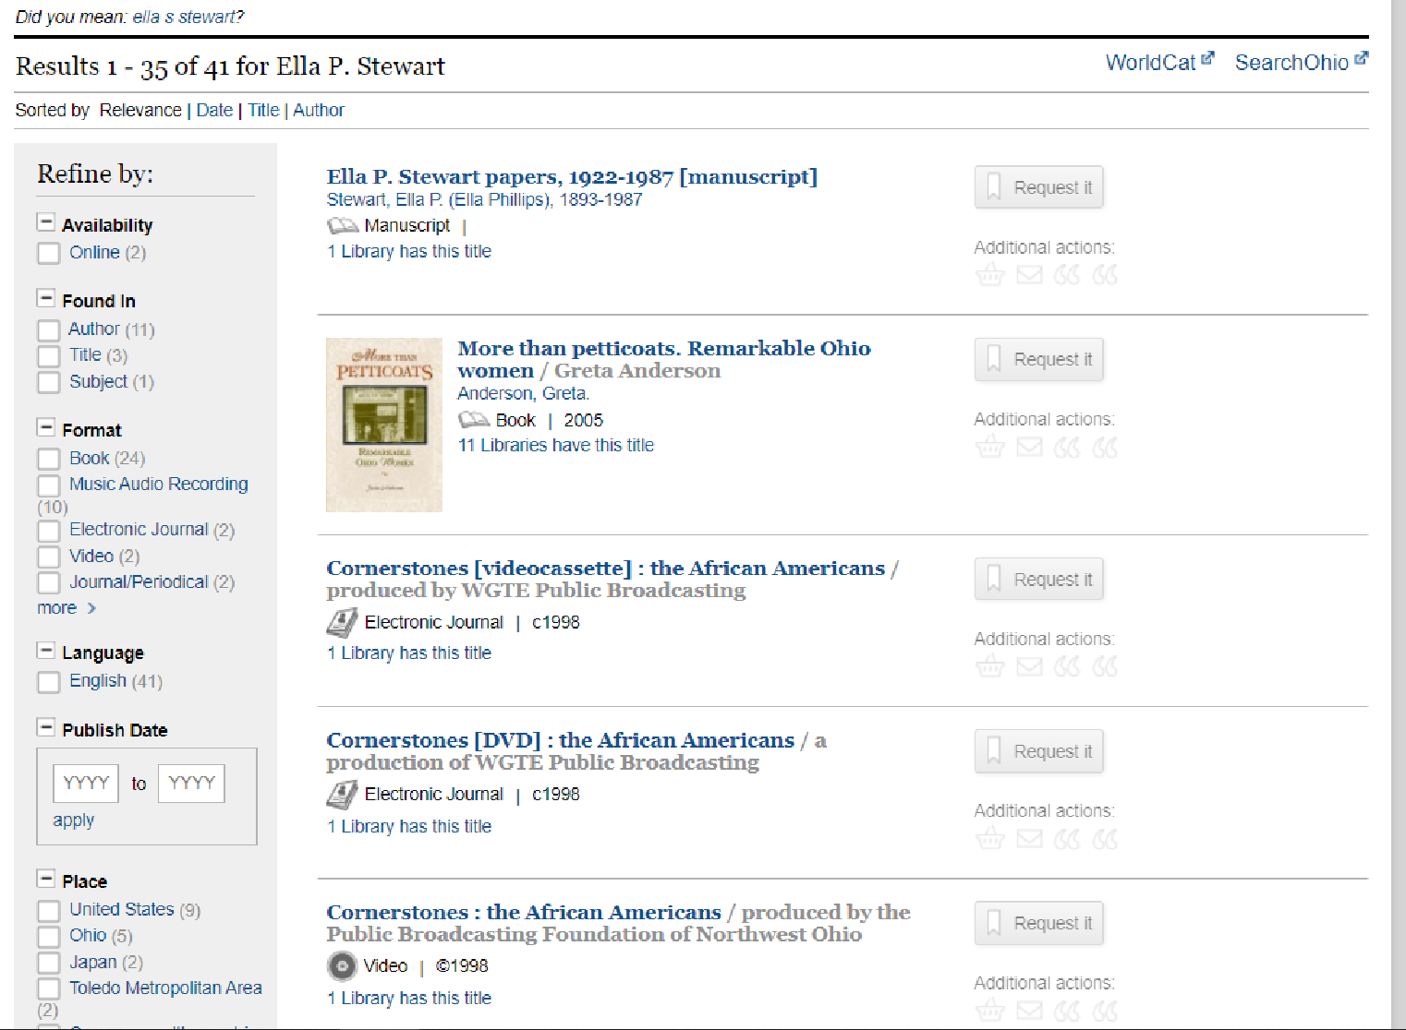
Communication: September Discovery Layer EBSCO EDS OhioLINK Software Update
EBSCO EDS Search Term:
Ella P. Stewart
http://catalog.ohiolink.edu/iii/encore/search/C__SElla%20P.%20Stewart__Orightresult__U?lang=eng&suite=def
Highlight Local History Collections
First African American women pharmacist in Toledo, Ohio
Notes:
Local history connections

Slide 19
Communication: LibGuides: Diverse Children's Literature
Resource to find Print Book examples:
Diverse Children's Literature https://libguides.bgsu.edu/diversechildrenslit
by Joe Prince, BGSU Curriculum Resource Center
Examples included: Picture Books and Early Readers, Middle Grade, Young Adult
African American - Diverse Children's Literature - LibGuides at BGSU University Libraries
Asian American - Diverse Children's Literature - LibGuides at BGSU University Libraries
Exceptionalities - Diverse Children's Literature - LibGuides at BGSU University Libraries
Immigration & Refugees - Diverse Children's Literature - LibGuides at BGSU University Libraries
Indigenous - Diverse Children's Literature - LibGuides at BGSU University Libraries
Latinx - Diverse Children's Literature - LibGuides at BGSU University Libraries
LGBTQ+ - Diverse Children's Literature - LibGuides at BGSU University Libraries
Middle Eastern - Diverse Children's Literature - LibGuides at BGSU University Libraries
Notes:
A good resource to Find Print Books

Slide 20
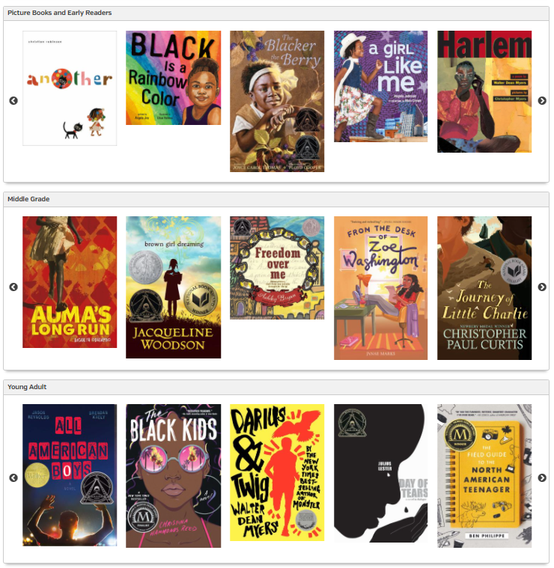
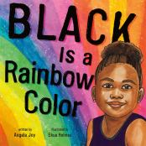
Communication: Diverse Children's Literature
African American
https://libguides.bgsu.edu/diversechildrenslit/african-american
Black is a rainbow color / written by Angela Joy ;
illustrated by Ekua Holmes
http://maurice.bgsu.edu/record=b6398708~S3
Notes:
Joe used our Syndetics Unbound to create nice book jacket display wheels

Slide 21
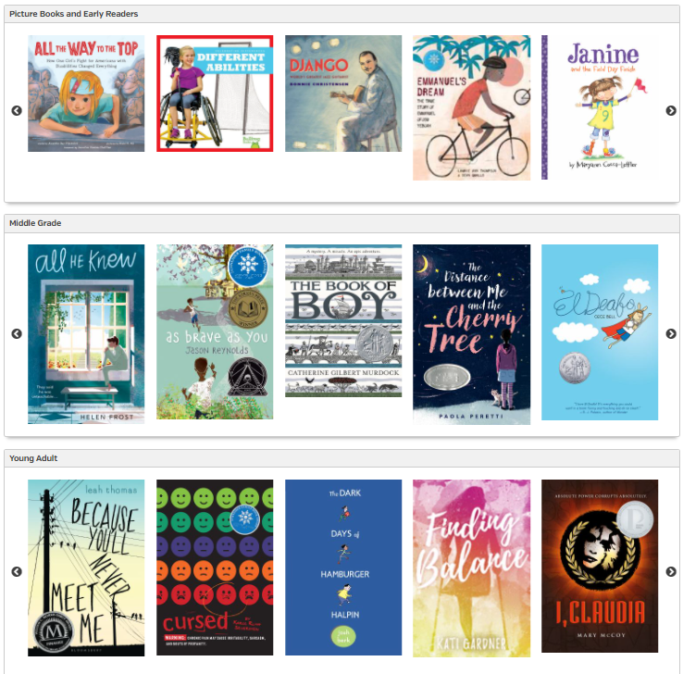
Communication: Diverse Children's Literature
Exceptionalities
https://libguides.bgsu.edu/diversechildrenslit/exceptionalities
All he knew / Helen Frost
http://maurice.bgsu.edu/record=b6474218~3
Notes:
Joe used our Syndetics Unbound to create nice book jacket display wheels

Slide 22
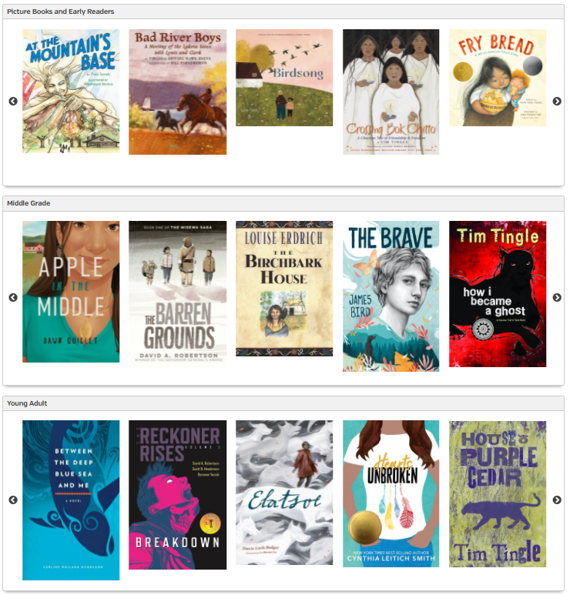
Communication: Diverse Children's Literature
Indigenous
https://libguides.bgsu.edu/diversechildrenslit/indigenous
Fry Bread: a Native American family story
Written by Kevin Noble Maillard;
Illustrated by Juana Martinez-Neal
http://maurice.bgsu.edu/record=b5095672~S3
Notes:
Joe used our Syndetics Unbound to create nice book jacket display wheels

Slide 23
Collection Diversity
Choice Reviews Diversity Collection Assessment
Stephanie Church
Case Western Reserve University
sap68@case.edu
Notes:
Much like other institutions, CWRU libraries are improving and building upon the Diversity Equity and Inclusion within all aspects of the library. I am on the Diversity Working Group’s Collections Initiative Taskforce and we are developing a library wide standard for collections. We are looking to adapt a framework that aligns with the ACRL Diversity Standards on collections

Slide 24
Notes:
Choice Reviews is a magazine published through ACRL in which scholars review monographs. Choice is considered the premier source for reviews in higher education.
Using Choice Reviews’ “Outstanding Academic Titles” lists, which are titles they magazine deem essential, I began a comparison analysis between the holdings at Case Western Reserve University as compared to specific interdisciplinary subjects identified as Outstanding.

Slide 25
Interdisciplinary Subjects Analyzed
African and African American Studies
Asian and Asian American Studies
Gay, Lesbian, Bisexual, and Transgender Studies
Islamic Studies
Latin American and Latina/o Studies
Middle Eastern Studies
Native American Studies
Racial Justice
Women's and Gender Studies
Notes:
The interdisciplinary subjects identified and analyzed include: African and African American Studies, Asian and Asian American Studies, Gay, Lesbian, Bisexual, and Transgender Studies, Islamic Studies, Latin American and Latina/o Studies, Middle Eastern Studies, Native American Studies, Racial Justice, and Women's and Gender Studies.

Slide 26
Considerations
Compiled list of 1,144 “essential” unique titles
In holdings vs. Not in holdings
Format ownership (print and/or eBook)
Temporary access is access
Included in “In holdings” count
Notes:
The analysis considers a title "in holdings" if a CWRU campus library owns a physical copy and/or an eBook copy. "Not in holdings" means CWRU researchers do not have immediate access to a title as a physical book or an eBook.
When it came to permanence, it was decided that access is access, regardless of whether the title was owned as a physical copy, a perpetual eBook license, or if we had temporary access through a user-driven initiative such as DDA or EBA or an eBook subscription.

Slide 27
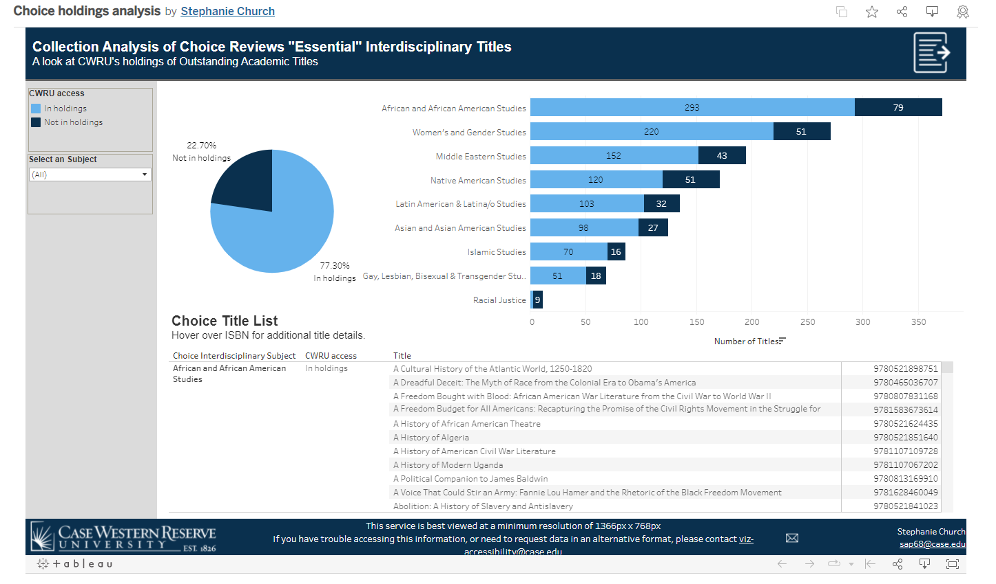
https://public.tableau.com/app/profile/stephanie.church/viz/Choiceholdingsanalysis/CWRUChoiceDiversityAuditFindings
Notes:
I concluded this analysis in March 2021 and part of my deliverables as an outcome included Tableau visualizations and a LibGuide to promote findings to our liaison librarians.
So roughly this time last year, what I found was that we had access to 3/4 of the essential Choice Reviews titles.
So for the remaining 23% of titles, which was just under 300 titles not in our holdings, I estimated it would be roughly $20,000 to purchase everything.
Unfortunately, I would love to wrap this in a bow and say the outcome is we bought everything, but that simply isn’t the case. I wish our budget allowed for that but it simply does not.

Slide 28
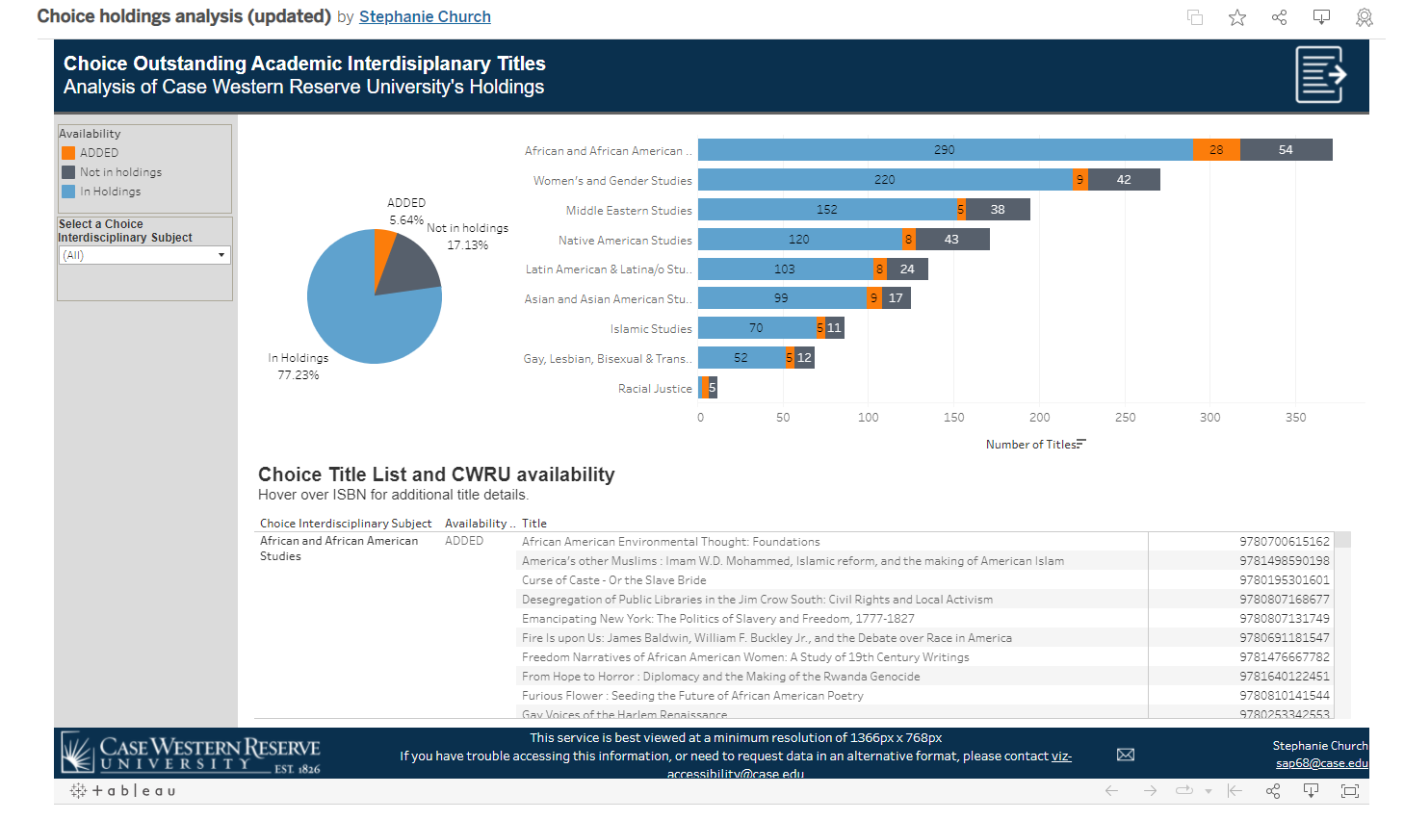
https://public.tableau.com/app/profile/stephanie.church/viz/Choiceholdingsanalysisupdated/DashboardTemplate
Notes:
However I can say that the change has been incremental and I am proud to say that we did make progress. I went back to assess the collection one year later and we have added 66 titles to the collection, which was nearly a 6% increase in titles.
I have included an updated Tableau visualization, which I can include in the chat that highlights the growth in subject areas as well as the exact titles that were added by our librarians.
I do hope to revisit this project again in the future, my intention is to add more “essential” titles as that Choice Review list grows every year. And this was my bite-sized way to tackle a diversity audit of an academic collection.

Slide 29
Databases A-Z list: Diversity, Equity, and Inclusion subject headings

Slide 30
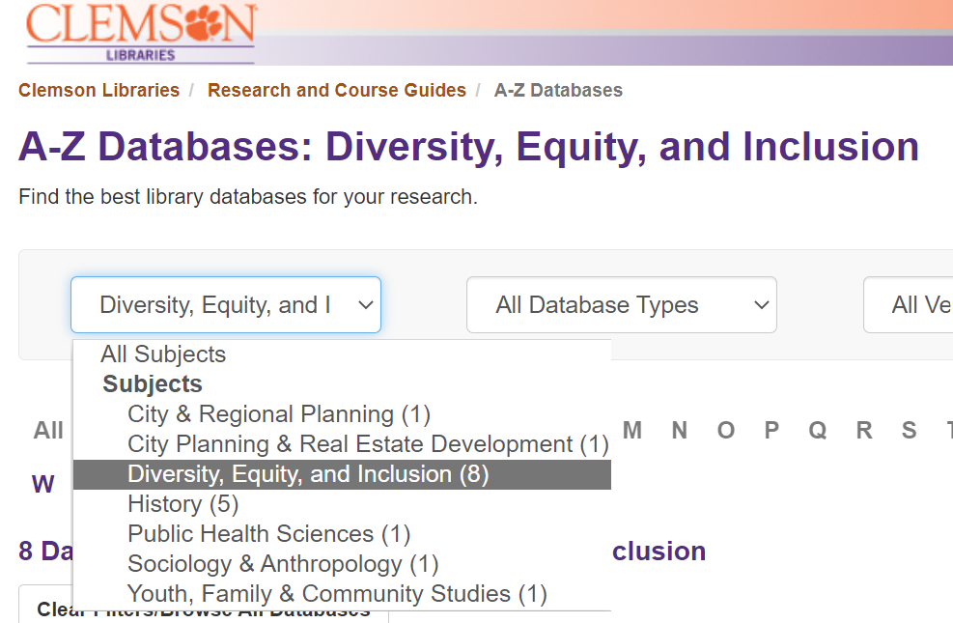
Databases A-Z list: Diversity, Equity, and Inclusion subject headings
Clemson: Libraries: Diversity, Equity, and Inclusion https://clemson.libguides.com/az.php?s=174163

Slide 31
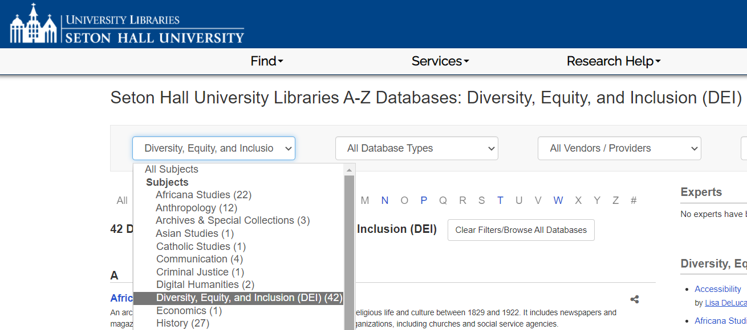
Databases A-Z list: Diversity, Equity, and Inclusion subject headings
Seton Hall University Libraries: Diversity, Equity, and Inclusion (DEI) https://library.shu.edu/az.php?s=204940

Slide 32
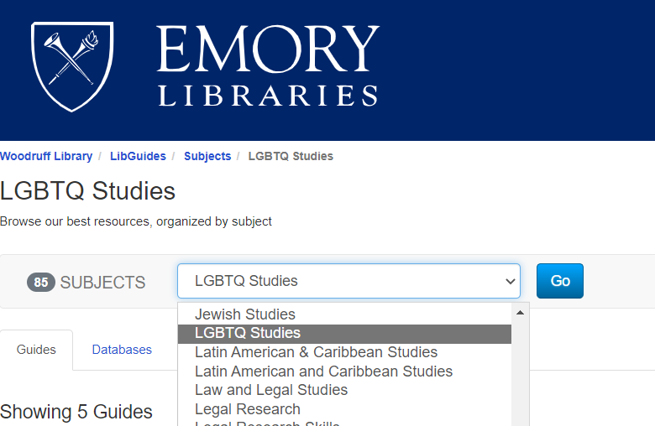
Databases A-Z list: Diversity, Equity, and Inclusion subject headings
Emory Libraries: LGBTQ Studies https://guides.libraries.emory.edu/sb.php?subject_id=174055

Slide 33
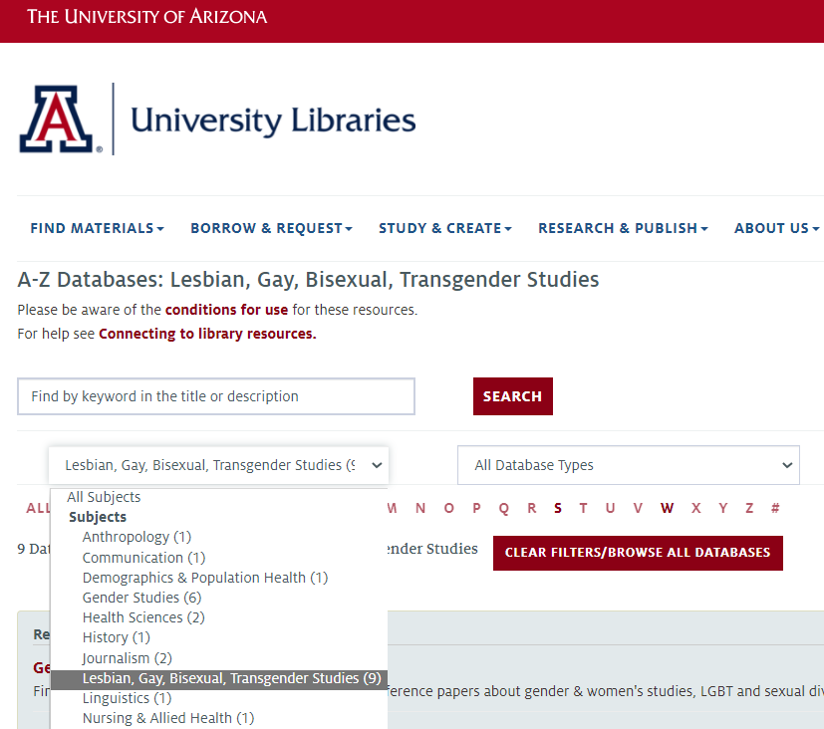
Databases A-Z list: Diversity, Equity, and Inclusion subject headings
University of Arizona
LGBT Studies
https://libguides.library.arizona.edu/az.php?s=160055

Slide 34
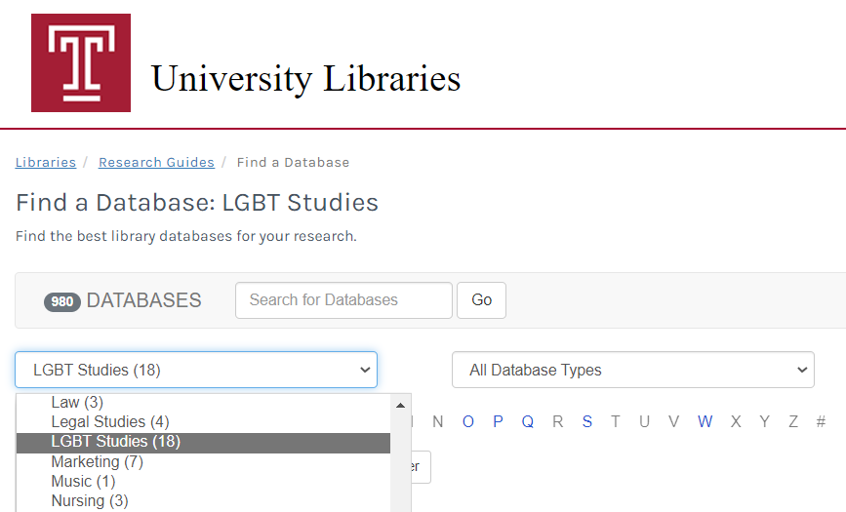
Databases A-Z list: Diversity, Equity, and Inclusion subject headings
Temple University Libraries: LGBT Studies https://guides.temple.edu/az.php?s=19750

Slide 35
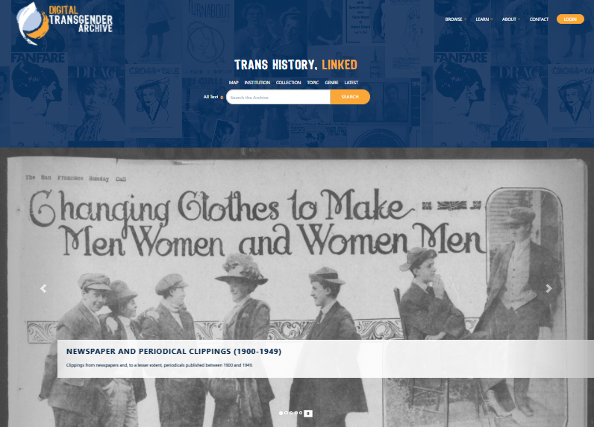
Databases A-Z list: Diversity, Equity, and Inclusion subject headings
Digital Transgender Archive (free resource) https://www.digitaltransgenderarchive.net/
Notes:
Interesting free database on the subject I discovered from visiting one of these libguides! I past it along to our subject librarian specialist in this area!

Slide 36
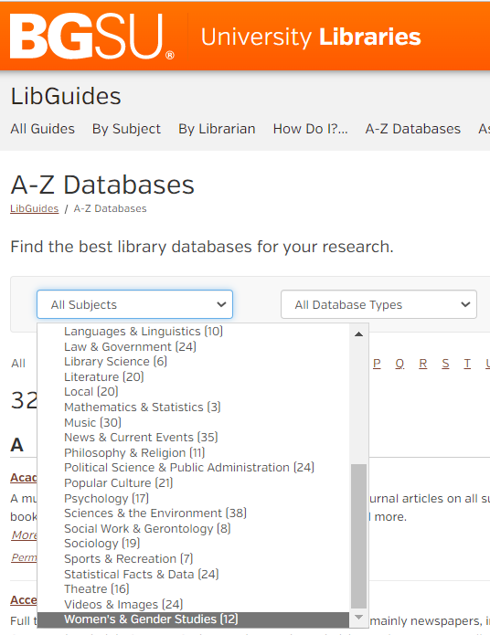
Databases A-Z list: Diversity, Equity, and Inclusion subject headings
Locally I discovered that:
The subject naming conventions used when we setup LibGuides are aligned with academic departments.
Ethnic & Cultural Studies (22)
Women’s & Gender Studies (12)
The rationale is that this will make it easier for folks to find resources in terms of academic conventions in those areas.
https://libguides.bgsu.edu/az.php
Notes:
We have some key positions currently in the search process so we tabled a review of our Subject Areas until critical positions filled.

Slide 37
Sierra preferred name Campus chosen name projects

Slide 38
Sierra preferred name option
"Sierra: Empower your patrons with a Preferred Name option" video by Jason Boland
https://vimeo.com/405024947

Slide 39
Central IT campus Chosen Name implementation
BGSU central IT campus chosen name project:
BGSU Chosen Name round 1 PeopleSoft backend go live June 2021
University Libraries identified for round 2
Start: Oct 2021, go live: March 7, 2022
Library Software Services impacted:
Innovative Sierra patron database
OCLC Tipasa Inter Library Loan
VitalSource Verba student/faculty course textbook finder: Textbooks.bgsu.edu

Slide 40
Sierra preferred name implementation
PeopleSoft generates a csv file of data for Sierra Patron Database
The file gets loaded nightly via Sierra scheduler product
Previously we had only the n tagged patron name
Outputted in a csv file which had the name in the 6th position
We used a loader to drop the data in that field into the n tagged field
Innovative addition of the Preferred Name field we changed:
n tagged chosen name
l tagged legal name
The csv file had the chosen name in the 6th position and the legal name in the 26th position
(last field of file)
By dropping the chosen name into the n tagged field, all existing print templates and email templates would continue to grab the desired name once we had the new information coming into the system.

Slide 41
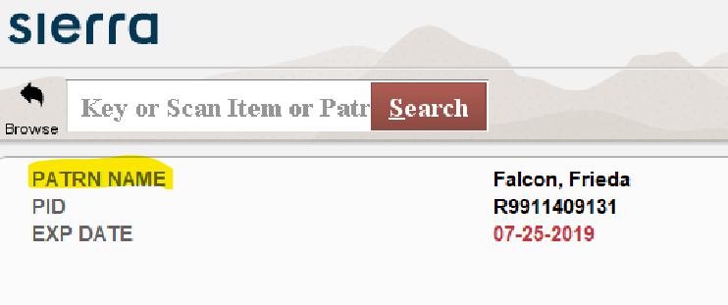
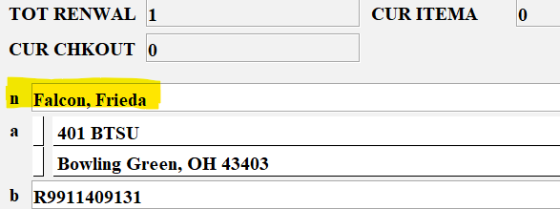
Sierra preferred name implementation
Sierra Checkout view screens before:
Sierra View patron record screen:
Notes:
Patron Name n tagged field

Slide 42
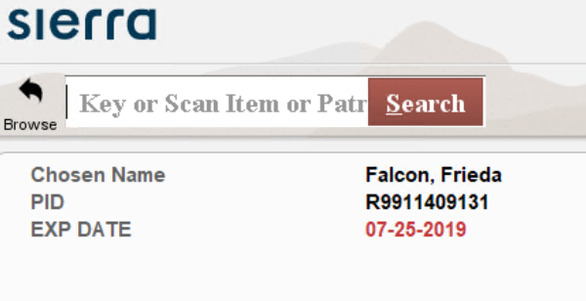
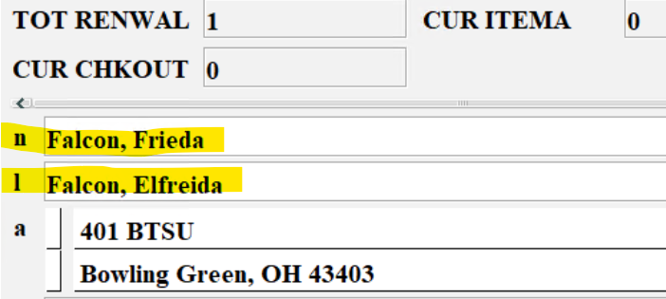
Sierra preferred name implementation
Sierra Checkout view screens before:
Sierra View patron record screen:
Notes:
Choosen Name n tagged field; Legal Name is the l tagged field

Slide 43
Sierra preferred name implementation
Chosen name Issues:
OhioLINK Support Incident # INC0362212
OhioLINK consortium uses the old Millennium Patron API to determine ezproxy authentication of patrons who start there searching Central Catalog.
OhioLINK has some locally customized code that takes the Patron API output and determines some access parameters from that
(for example, taking the PTYPE into account) to grant access.
After the new l tagged field added, this code no longer worked. Our patron’s could not easily get to OhioLINK resources by starting at OhioLINK anymore.
Had to re teach patrons and staff to add ezproxy preface to OhioLINK urls: http://ezproxy.bgsu.edu/login?url=

Slide 44
Sierra preferred name implementation
Chosen name Issues:
BGSU ticket # 1031632; Kris McCullough was great!
1) The preparation of the csv file needs to be told to process new field 26
“I am writing to follow up on the patron Legal name field and the patron loading.
I have added the new Legal Name field to the end of patron preprocessing table and assigned it the field number 110.” 780| final student affiliation 800| barcode 110| patron legal name

Slide 45
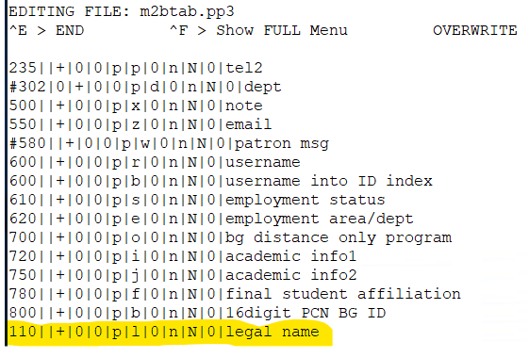
Sierra preferred name implementation
Chosen name Issues:
BGSU ticket # 1031632; Kris McCullough was great!
2) The patron load table m2btab.pp3 needs to have code to load information
[I figured it out on my own due to load profile training but Kris willing to do!]
780||+|0|0|p|f|0|n|N|0|final student affiliation 800||+|0|0|p|b|0|n|N|0|16digit PCN BG ID 110||+|0|0|p|l|0|n|N|0|legal name

Slide 46
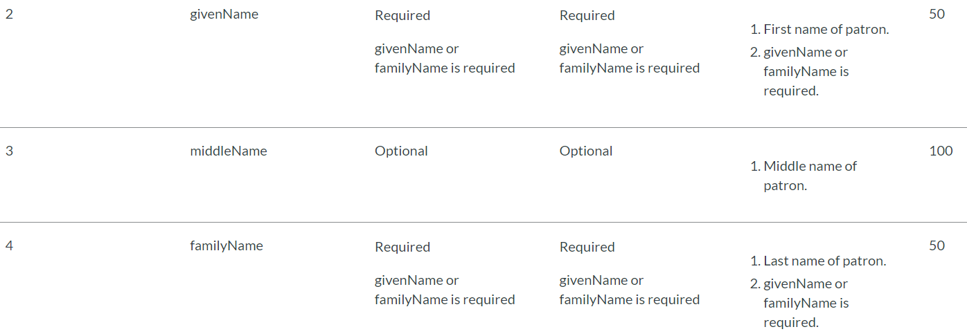
Central IT campus Chosen Name implementation
OCLC Tipasa Inter Library Loan
csv file for patron information load:
https://help.oclc.org/Librarian_Toolbox/Patron_data_files/030Tab_delimited_patron_data_loading
Tipasa only has options for:
givenName
middleName
familyName
And
nickname
We put chosen name data into givenName since few staff access these menus and could look in Sierra if need more info!
Notes:
We choose to have name field data replaced with chosen name data
Only a few library staff operate in Tipasa and they do not have face to face
interactions with there users.

Slide 47
Central IT campus Chosen Name implementation
If necessary this staff could look user up in Sierra if they need additional name clarification.
Patrons will see their chosen name on all their system correspondence!

Slide 48
Central IT campus Chosen Name implementation
VitalSource Verba student/faculty course textbook finder:
https://textbooks.bgsu.edu
Our PeopleSoft system provides faculty members names and term, course, and section
information to Verba. This service provides students with information about their required
textbooks for their classes. [BGSU no longer has a traditional bookstore on campus]
We choose to have name field data which used to have the legal name replaced with chosen name information
Now students see the Faculty Instructor’s chosen name when they search for their
course textbooks

Slide 49
Central IT campus Chosen Name implementation
Faculty Instructor’s chosen name display for course textbook search.

Slide 50
Open Sharing of projects you, audience members, have undertaken that help others with DEI goals.
Or that might fit in future presentations along this line?
Feel free to speak up during the live Q&A discussion your accomplishments. Emailing me your details in the event of timing, preference, or technical issues is also encouraged.
mstrang@bgsu.edu

Slide 51
Questions?
Mark Strang mstrang@bgsu.edu
Stephanie Church sap68@case.edu
THANK YOU

