Slide 1
Surviving Migration to Hosted
From Chaos to Confidence with AWS
Karen Perone, Rodman Public Library
Joe McMorris, Innovative
Hilary Newman, Innovative

Slide 2
Karen Perone Head of Technology and Technical Services Rodman Public Library

Slide 3
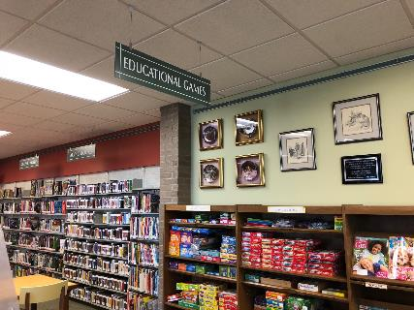
What We’ll Cover
Background
Why we migrated
How we migrated
Migration day
Cleanup
Pros and Cons
Notes:
What I would like to cover today includes a little background of Rodman Public Library and our history with Innovative Interfaces. Then I’ll talk about why we migrated to hosted and the actual process we went through. I’ll cover what led up to and what the actual processes for both the library and Innovative included and then talk about the cleanup procedures after the migration happened. Finally, I’ll talk about the pros and cons that we discovered with our migration to hosted.

Slide 4
Disclaimer
YMMV: The experiences shared today are those encountered by Rodman Public Library and Louisville Public Library and may or may not be the same experiences that your library may encounter.
Notes:
And as any good technology talk should include, I offer this disclaimer: The experiences shared today are those encountered by Rodman Public Library and Louisville Public Library and may or may not be the same experiences that your library may encounter.
And with that, let’s get started.

Slide 5
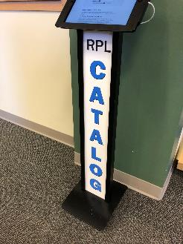
Background
Innovative customer since 1994
Standalone turnkey system
Move to Sierra January 2013
Louisville joined 2016
Server nearing end of life
Migration to hosted AWS June 2017
Notes:
Rodman Public Library purchased the INNOPAC system in 1994 and we were the first public library in the state of Ohio to do so. The original system consisted of a server, backup tape drive, system printer, Lantronix boxes, and many, many dumb terminals. This was the first of our standalone turnkey purchases. Over the next 20 years, we would migrate hardware another 3 times with staff from Innovative in California, traveling to Alliance, Ohio to swap out equipment. These hardware migrations usually lasted about 4-6 hours.
Fast forward to 2013 when we upgraded our Millennium system to Sierra. We still remained a turnkey system but now we had 2 servers to replace when our next upgrade would come.
In 2016, our system expanded as Louisville Public Library joined us in a lending consortium. We knew at this point that our servers were nearing the end of their useful life and that they would have to be replaced in 2017 or 2018.

Slide 6
The “Other” Players
OPLIN – Ohio Public Library Information Network
SearchOhio
AWS – Amazon Web Services
Notes:
We have a couple other players that we needed to consider in our decision-making when it came to the move to hosted. These include OPLIN, the Ohio Public Library Information Network and SearchOhio. OPLIN supplies our internet connection and maintains our DNS records. Rodman and Louisville libraries are also members of the SearchOhio INNReach system.

Slide 7
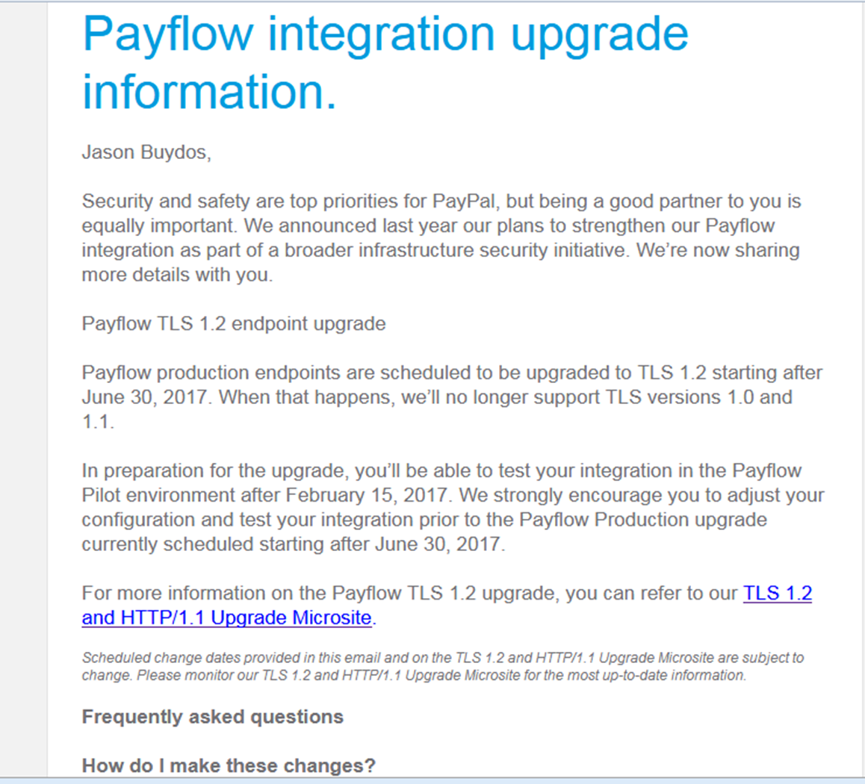
Motivation to Migrate
Talks with Innovative:
4 year-old server was not compliant
OS upgrade necessary
Was server robust enough to handle?
Info gathering at IUG
Now was the time to migrate to hosted
Notes:
As we moved into the early months of 2017, we received a notification from PayPal outlining a deadline that we would have to meet in order to continue using our credit card payment system with them. Approximately 23% of fines and charges are paid via credit card and PayPal, so we knew that we had to take care of this. Basically, if our server couldn’t handle TLS 1.2 by June 30, 2017, we would no longer be able to accept credit card payments.
After checking with Innovative, we discovered that our 4-year old server might not be able to be upgraded. We needed the next version of Sierra to become compliant for PayPal, but in order to do that, we had to have our OS upgraded. There was a possibility that our hardware would be able to handle the upgrade, but it couldn’t be guaranteed. This all was coming to light a few weeks before IUG, so I knew that I would be searching for information during the conference that would help with our decision making.
About this time, the announcement was made that all new hosted systems would be handled by AWS. This was a big part of our decision to move to hosted and upgrade sooner rather than later.

Slide 8
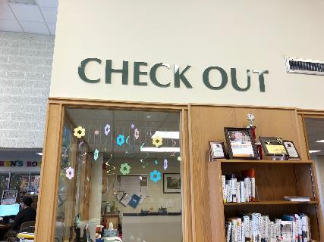
More negotiations
Not as simple as we thought
New contract needed
1994 contract no longer applicable
New perpetual license agreement 2017
Notes:
Once we made that decision, we had some legal and technical paperwork to tackle involving a new licensing agreement with Innovative. Our 1994 contract was no longer applicable since we would not be a turnkey site any longer. We signed a new perpetual license agreement effective with the migration to hosted.
This may also be the time for your library to check out bundle packages if you are looking into that.

Slide 9
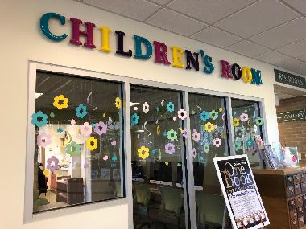
Deadline Looming
June 20 – Migration to hosted/Sierra 3.0
June 20-June 27 – Resolve migration issues
June 28 – Upgrade to Sierra 3.1
June 30 – PayPal deadline for upgrading
July 1 – Everything still worked!
Notes:
As you can see, we had a tight schedule to migrate, troubleshoot, and upgrade Sierra to the proper version. One thing that you need to keep in mind is that your site can only migrate to the same version of software. If you need to update your version as we did, that is a separate step, usually a week after the migration so that all the issues with connections and firewalls can be resolved prior to the upgrade.
On July 1, credit card payments were still working with PayPal and there was great rejoicing in Alliance and Louisville.

Slide 10
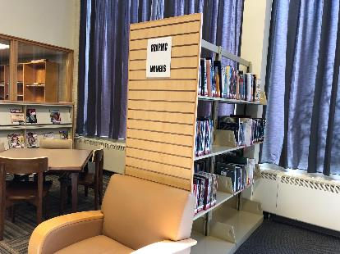
The Process
Allow 4-6 weeks to schedule
Can only be done M-Th, 8 a.m.- 5 p.m. PDT
Able to work out 9 a.m. EDT start time
Plan to be down all day
Could take as little as 2-3 hours
Started testing 10:30 a.m.
Everyone back online about 1 p.m.
Notes:
The process lasted about 4-6 weeks in total. Documentation told us that the migration could only be scheduled Monday-Thursday and between 8 a.m. and 5 p.m. PDT. We were able to work out a start time of 9 a.m. Eastern time so that circulation services would be impacted as little as possible. A colleague who just recently migrated told me that for an extra fee, you can migrate during other hours than are listed here.
In preparation, we planned to be down all day, just in case something would go wrong, but the process could take as little as 2-3 hours. We publicized this to our patrons and reminded them that if they came in to check something out, they had to have their library card because we wouldn’t be able to look them up.
About 10:30 a.m., I received word from Innovative that their work was complete and I should start testing. Once we determined that everything necessary for regular operations was complete and all staff and patrons were back online at all locations by 1 p.m.

Slide 11
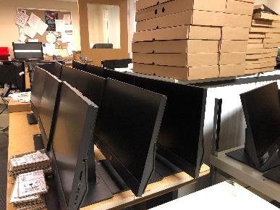
Prep Phase - Innovative
Builds new hosted server
Performs test database copy
Prepares current Sierra systems for migration
Notes:
During the 4-6 weeks prior to the migration date, a number of things needed to be done by both Innovative and the library.
Innovative was responsible for doing the heavy lifting as they built the new hosted server environment, copied the test database to the new server, and prepared the current Sierra system for migration.

Slide 12
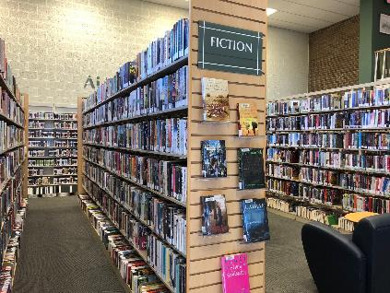
The Nitty Gritty
New IP numbers
App Server
Database Server
DNS needed CNAME alias entries
roc.rodmanlibrary.com → rodma.iii.com
OPLIN handled
SSL and domain name
WAM, web links
OPLIN proxy service
Notes:
So what all goes into the preparation for moving to hosted?
The first step in the process was to receive our new IP numbers from Innovative for the AWS servers. The DNS for the AWS servers needed to have CNAME (Canonical Name) alias entries set up so that we could continue to use our familiar domain name for our catalog as you can see here. OPLIN took care of this for us. If we had changed our domain name to the iii.com format, Innovative would have taken care of the new SSL certificate for us. We decided to stay with our familiar domain name which required us to renew our SSL at this time. We decided to drop WAM and moved to OPLIN’s web link proxy service, but if you rely on WAM for your database connections, you will need to consider those links when setting things up.
Overall, instructions for what needed to be done and by whom was spelled out very clearly on Innovative’s website.

Slide 13
Prep Phase - Rodman
Contact vendors for IP change
Make sure SDA clients are pointed to domain name, not IP
Send list of IPs to Innovative for access
Sierra Desktop App
SQL
Admin Corner (SSH access to server)
Express Lane
Patron API
Notes:
Both Rodman and Louisville needed to contact all of the vendors that use our PatronAPI for verification and let them know that our IP would be changing. This included databases as well as material vendors. We needed to verify that our SDA clients were pointing to our domain name and not our IP so that when the system came back up we would be able to access and login to Sierra.
Innovative required a list of all the IPs that our libraries would use to access the Sierra server because of the AWS security. Any device used to access SDA, SQL, Admin Corner, Express Lane, or PatronAPI calls had to be submitted.

Slide 14
Prep Phase - Rodman
Vendors contacted that use Patron API
Axis 360 (B&T)
Hoopla (Midwest Tape)
OverDrive (State Library)
Syndetics/LTFL (Proquest/LibraryThing – mobile catalog)
Limit Network Access table
Internal IP addresses → External IP addresses
Notify SearchOhio (INNReach)
Bookmobile access via static IP for MiFi devices
Notes:
We had a number of vendors who use the Patron API to validate users of their databases and services. You can see them listed here.
Any local or internal IPs needed to be changed to external numbers and the AWS IPs needed to be added to the network access tables in Sierra.
We had to notify our INNReach central IT department of the changes to our IPs and our bookmobile MiFi devices used for remote access needed to be changed to static IP addresses. Our carrier for the devices was able to supply that for us.

Slide 15
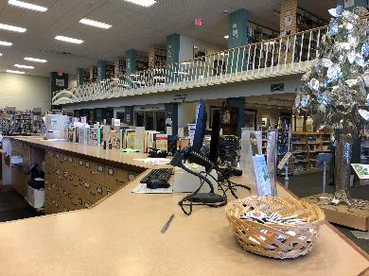
Migration Day - Innovative
Halt Sierra and disable access
Migrate software and database
Reconfigure system for hosted access
Startup and test Sierra
Troubleshoot with library
Notes:
On the morning of our migration day, Innovative confirmed the start of our migration and stopped Sierra and disabled all access to the system. They…

Slide 16
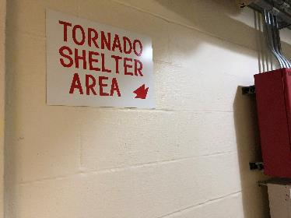
Migration Day - Rodman
Modify DNS for new servers (OPLIN/OIT)
Be prepared to test access and functionality
Key Rodman staff
Key Louisville staff
Have IT staff available to address network/DNS issues
OPLIN
Notes:
During this downtime with Sierra, circulation staff went to offline circulation and cataloging staff worked on book repairs. But the systems staff carried on with preparations for DNS changes and testing.
OPLIN modified our DNS to point to the new AWS server. Key staff at both libraries were ready to test things out when Innovative told us the migration was complete. OPLIN staff was also alerted that we may need their help with any network or DNS issues that may arise during our testing.

Slide 17
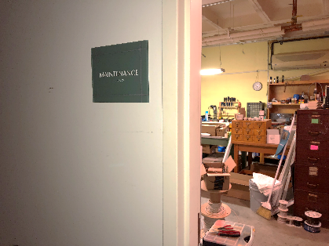
Migration Day
No one could login
No webPAC
No SearchOhio
No digital download services
No Envisionware services
No Express Lane
No Teleforms
Notes:
We had to notify the public that they would not be able to access or use our webPAC, SearchOhio, digital downloads, or Express Lane checkout services during the migration. We also had to use a workaround for our Envisionware printing and public computer access so patrons could access the internet and use our local software while Sierra was down.

Slide 18
Migration Day
BEFORE staff get any access…
TEST, TEST, TEST
Be sure you can login to:
Admin corner
SDA
Local database – staff and public sides
Express Lane
Quick Click
Sierra post-event checklist
After IT staff check logins
Pick key staff to test their area of the system
Have team report any issues to IT
Notes:
Once word came from Innovative, it was important for the lead implementer and IT staff to test everything BEFORE granting access to any staff members. We made sure that we could login via the SDA, access Admin Corner, and check things out with Express Lane. We also had a local database that still used Millennium so we needed to test that both the public and staff sides were working. Both this and Quick Click offered some challenges but were not high priority for getting Sierra back up and running.
Innovative has a very good post-event checklist on CSDirect that we used. We had key staff members in each area of the system test things out after the IT staff gave the go-ahead. These team members reported any issues directly to IT, who in turn reported them to Innovative for troubleshooting and fixing.

Slide 19
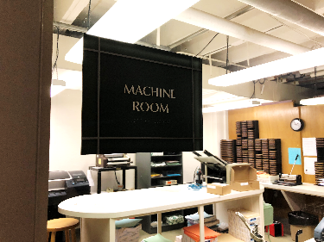
Bumps in the Road
SMS through OPLIN worked fine
Email notices fine except to ATT.net & SBCGlobal.net
Bounced as spam
Fixed by altering the FROM address
“No licenses available”
Old DNS links not mapped to CNAME roc.rodman.lib.oh.us
Notes:
Nothing ever goes completely the way it should, so there were a few bumps that needed to be ironed out.
OPLIN acts as an SMS gateway for our text notices and we were happy that this worked fine. Our email notices worked for the most part, except for patrons who had AT&T and SBCGlobal addresses. All of these messages bounced back to us as spam because the emails looked like they were using a relay server. We were able to solve this issue by altering the FROM address so that it matched the library’s domain name, rather than using an Innovative AWS domain name.
We ran into a “No licenses available” issue which was quickly fixed by Innovative staff. We also discovered some old domain name links that we had forgotten about. OPLIN updated our CNAME records to include this legacy form of name and the links were once again accessible.

Slide 20
Bumps in the Road
Unable to access text-based Reference Database
Needed to update DNS for alias roc.rodmanlibrary.com:81 = allianceindex.com
Administrative side not accessible through Admin Corner
Teleforms Server
ODBC needed new IP
Notes:
As I mentioned earlier, we had a local, text-based reference database on our system. In addition to the port 81 address for the database, we also have a user-friendly domain name for it. If you have one of these, be sure to remind Innovative that you need to have Millennium installed as well as Sierra. We were not able to login or access the database either directly or through the Admin Corner. After a couple tweaks adding the alias to the DNS records we were back in business.
The Teleforms server could not access the new hosted system. We were unaware that the ODBC that connects to Sierra needed to be made aware of the new IP address. Once we updated that connection, the data began to flow again. We purchased i-tiva at this time but were told that it would be best to wait to migrate to that service until after the migration was settled in. We installed i-tiva about 3 months later. Another library I heard from had i-tiva installed prior to their migration and is having similar database connectivity issues with their i-tiva connection.

Slide 21
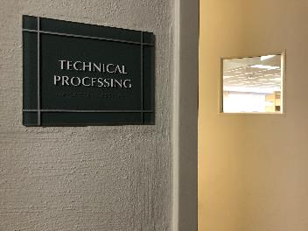
Bumps in the Road
Quick Click
Could not connect to Sierra
Passwords reset
IPs OK in Limit Network Access
Permissions? Could connect through FileZilla
Vendor IPs needed to be added to AWS firewall
Ports not open on firewall
Took 2 weeks to fix
Resolution – Shared feedback with III to help customers avoid issue going forward.
Notes:
Quick Click gave us our biggest challenge. We could not connect through Sierra. We reset our passwords, we verified that the IPs to the vendors were updated, and checked our permissions. After 2 weeks of troubleshooting, we finally discovered that the vendor IPs needed to be added to the AWS firewall and that the necessary ports on the AWS firewall were not open. So if you run into this problem, refer the support staff to our installation for the fix.

Slide 22
Other Journeys, Other Issues*
MS Exchange/Office 365 relay causing blacklisting issues
“System” printers vs. Local printers
Vendors who didn’t update IP addresses
Price quotes: Ask about optional services
Slow logins
Ports not opened correctly on AWS firewall
Passwords for FTP, catalog access, SQL needed to be reset
Encore Mobile not found
Generating new certificate for SSH access to Admin Corner
*Again, YMMV. Just things to look out for.
Notes:
As I was preparing for this presentation, I gathered a few remarks from others who have completed this journey and thought I would share some of their “bumps in the road” with you.
Printers had to be reinstalled or reselected
Price quotes: for migrating “off hours”
Price quote for setting up a VPN/Stunnel

Slide 23
Pros and Cons for Migrating
Pros:
No more tapes to change or buy
Updates done by Innovative
Restarts can be scheduled during the night
No OS upgrades to maintain
Better for budgeting
Server room is quieter!
Redundancy for uptime
Harder to access remotely (security)
Neutral:
FTP and Telnet – gone
“System” printers – gone
SSL certificates
Cons:
Harder to access remotely (staff login)
A bit more expensive
If using IPs for SDA or other access, all need to be changed (WAM)
No visual access
Notes:
We discovered many positive reasons for migrating during the process. These include:
Not having to buy any more expensive tapes and no more hassle of remembering to change the tapes.
Updates are now done by Innovative staff and can be scheduled to be completed during the night by staff in Australia or Ireland.
There are no longer any operating systems or hardware to maintain which makes it easier to budget from year to year.
This may seem like a little thing, but our server room is so much quieter now! The Sierra servers sounded like jet engines at times.
Uptime has improved due to all the redundancy that is built into AWS.
And a definite plus for migrating is that Sierra is now much harder to access remotely, so security is tighter.
On the down side of having the server available on AWS:
Sierra is now much harder to access remotely, because security is tighter. Remote staff access now has to be accomplished through a VPN or a dedicated IP hotspot.
The cost is a bit more expensive than the one-time purchase of a server that will be in service for 4-5 years – or more.
If your library uses IPs for SDA or other access to databases, etc. through WAM, they will all need to be changed. If you’ve used domain names, your shouldn’t have as much trouble.
And I know this seems silly, but there was a certain comfort that came from looking through the server room door and seeing that green light blinking to reassure me that the server was working.
And things that didn’t really phase us in our migration but are still good to include when planning include:
The replacement of FTP and Telnet with SFTP and SSH access and the move from system printers to local printers.
SSL certificates, which are the bane of my existence, changed slightly. If you use the yourlibrary.iii.com domain, Innovative will handle the SSL registration for you. But if you have your own domain name, as we do, then you will still need to handle the certificate registration process.

Slide 24
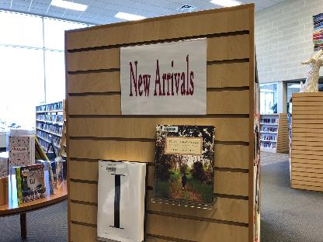
How’s It Going?
Speeds
Same or better as in-house turnkey
Updates
Easy to schedule
Internet down at one library doesn’t affect other library
Notes:
So how’s it going almost two years into the new hosting setup? Our system speeds are now the same, or in some cases, better than they were when we were a turnkey, in-house system. Updates to the software are easy to schedule and can be done during the night. And having the internet down at one library doesn’t affect the other library from using the system.
Overall, I would say that we are glad that we made the move when we did. Originally, we were concerned about network latency issues, but when the announcement was made that the hosting service would be AWS, we had the confidence we needed to make the jump to hosted.
To sum it all up, this was the shortest and smoothest hardware upgrade we’ve ever had.

Slide 25
Joe McMorris CIO Innovative Interfaces
Hilary Newman
SVP Customer Support
Innovative Interfaces

Slide 26
How Long Does Server Hardware Last?
3
200
14
40
Notes:
Average server lifespan: 3 years. With maintenance, maybe 5 or more
BUT the older they are the costlier they are to maintain – maintenance costs increase by 200% after 3 years
AND even if it lasts more than 3 years, server performance declines by about 14% each year after 3 years.
SO by the time your server is 5 years old, it’s only operating at 40% of it’s original capacity.

Slide 27
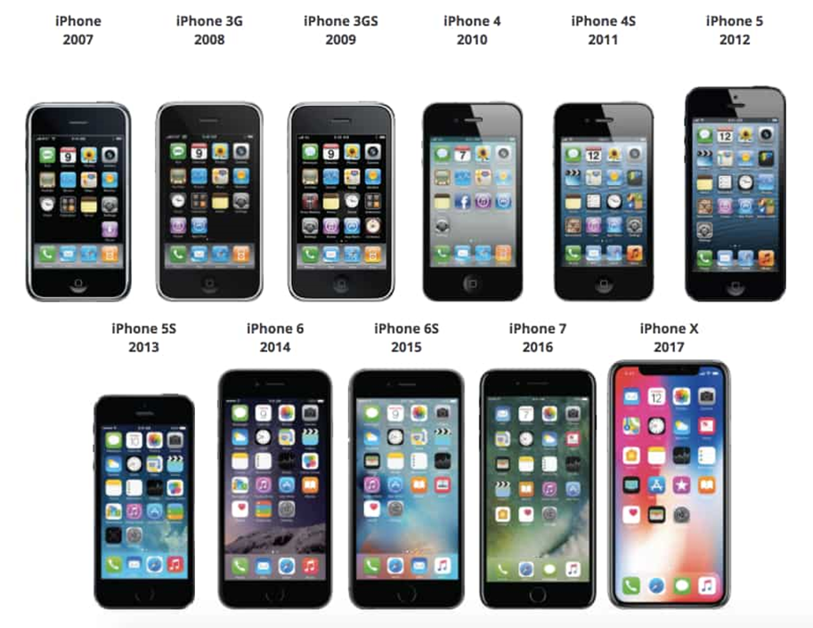
How old is too old?

Slide 28
What you should expect: 3-5 Year Life
Years 1-3
Good performance
Highly reliable and stable
Smooth software upgrades
Year 4
Performance starts to degrade
Analog parts may start to fail
Time to get hardware in the budget
Year 5 +
Hardware failures increase
Many batteries and tape drives fail in year 5
Emergency disk replacements common
Expect the unexpected – likely to experience downtime to address problems
Time to replace is NOW!
Notes:
All hardware fails, it is a question on when.
Disk Drives
Library systems are running 24x7x365
This means those disks are spinning constantly
Over time they become highly sensitive to change
Shutting down an older system, the disks increasingly won’t spin back up again (even RAID).
Non-digital part failures
Tape drives wear out, not available new
Resistors, transistors, capacitors, power supplies handling constant thermal expansion and contraction age and wear out and drift out of spec.

Slide 29
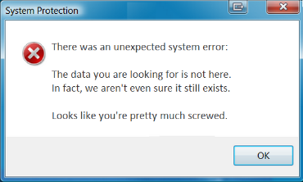
Warning Signs that Hardware Failure is in Your Near Future
Does your server:
Slow down
Make new noises, like grinding or a loud fan
Have an amber alert light
Require frequent re-booting due to
Random failures
Boot up and reboot slowly
Display corrupt file messages
Divert to “read only” for no clear reason

Slide 30
SPOF: Ready for your System to Go Down Unexpectedly?
Here’s how it might go – choose one or all!
Hard Disk Drives Fail
Tape Drives Wear Out
Overheating
Electronic Components Fail
1
2
3
4
Notes:
All hardware fails, it is a question of when.
Disk Drives
Library systems are running 24x7x365
This means those disks are spinning constantly
Over time they become highly sensitive to change
Shutting down an older system, the disks increasingly won’t spin back up again (even RAID).
Non-digital part failures
Tape drives wear out, not available new
Resistors, transistors, capacitors, power supplies handling constant thermal expansion and contraction age and wear out and drift out of spec.
Recovery time from an on premise crash is 24-48 hours minimum.
Troubleshoot, id parts that fail, find parts, ship replacements.
Rack, power up, system restores 12 hours alone depending on size of your systems.
Be prepared for unexpected downtime – always happens during summer reading or finals.

Slide 31
The Benefits of Hosting: Large and Small
Hosting is a true turnkey solution; get out of the hardware business! Cloud is now the new norm.
Peace of mind – eliminate distractions, focus on what matters most
Reduce IT expenses, gain positive ROI, predictable spend year over year.
Security - Highest levels of network and data protection, full encryption for all data, ISO 27001
Redundancy and elasticity of the cloud, daily backups and Disaster Recovery capabilities
24x7x365 monitoring with uptime SLA guarantee of 99.9%
Dedicated team of subject matter experts
All inclusive. OS management, patching and maintenance, all software licensing

Slide 32
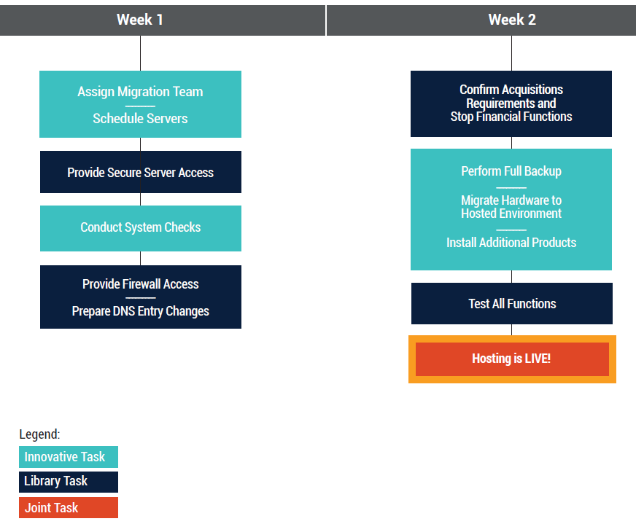
Over 200 iii Customers Successfully Migrated to Hosting
Typical Hosting Migration Timing:
Allow 4-6 weeks to schedule
As quick as 2 weeks start to finish
Single day of downtime
We’re Here for You the Whole Time:
Our experts have experience and technical knowledge
Fully supported migration experience

Slide 33
Thank You!
Questions?

