Slide 2
First Time to an IUG Conference
Renee Brumett, Vice Chair/Chair Elect
Springfield-Greene County Library
Mark Strang, Chair
Bowling Green State University

Slide 3
First Time Attendees
Who to ask for help
Local Arrangements
Wi-Fi
Program types
Exhibits
App
Events
Alphabet Soup
Conduct Statement
After the conference
IUG 2019

Slide 4
Welcome
Pro tip 1: Feel free to leave
Pro tip 2: Devices…
Pro tip 3: No one bites

Slide 5
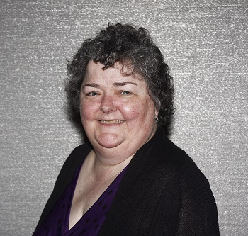
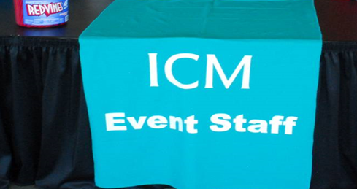
Need Help? Ask:
Business Manager
Kathy O’Gorman
ICM Event Staff
Conference Management Team
Steering Committee Members

Slide 6
Local Arrangements
Local arrangements table
Book swap
Door prizes!

Slide 7
Wi-Fi
Network: Renaissance_CONF
Password: IUG2018
Pro tip 4: Guest room Wi-Fi and conference Wi-Fi are two different networks

Slide 8
Conference Program
Sessions by both IUG members and Innovative staff
Tracks for ILS platform, topic (Circulation, Cataloging, Sysadmin, etc.)
9-10 concurrent breakouts
Pro tip 5: Attend sessions for tracks or platforms outside of your expertise – you never know what you might learn!

Slide 9
Lightning Round Presentations
None this year
Round of several quick presentations
Tips and tricks or new brief information
5-10 minutes each with several grouped in one breakout session
Low pressure presentation opportunity
Poster Sessions
3 this year
Crystal C-E, near Exhibits
Tuesday, 11-noon after opening session

Slide 10
Forums
Member-guided conversations
No or few prepared remarks
Innovative staff are generally present to answer questions or help guide
Presenter is to moderate the discussion to stay focused and address as much as possible
Recorders are recruited to share notes and discussion later
Pro tip 6: Enhancements Forum is not about new enhancements; rather, the enhancements process (Idea Lab)

Slide 11
Birds of a Feather
Informal discussion sessions, “round tables”
Those submitted before conference are in the app
Rooms: Nomeus, Palani A, Palani B (2nd floor)
Many pop up during the conference — watch the app
You – YES, YOU – can form one
Check at the registration desk if you’d like a room
Post in the app, Birds of a Feather Channel
Regional meetings – WILIUG, Oberlin, SCIUG, Canada

Slide 12
Innovative Presentations
Innovative staff present
Ask questions! Swap business cards
Pro tip 7: “What’s New” sessions by Innovative are very popular but often repeated
Pro tip 8: “Product enhancement timelines are named after cheeses, and there is no schedule for when these cheeses will be released.”

Slide 13
Quick Hits Theater
Series of brief presentations by Innovative staff
20-minutes, during breaks
Sierra Tech: The Future of Turnkey: Planning Considerations
Customizing Header in Responsive Polaris PAC
The Suite Life with Encore
Auto Renewals in Sierra – You Gotta Keep ‘Em Circulating
Fiscal Year Rollover in Polaris
The Wonderful World of Web Options
New Services Offerings
Is Hosting/Cloud Right for Your Library? Current State; Decision Points
Getting Started with Idea Lab — *IUG presenter Beth Juhl*
Encore Harvesting – Cultivating Your Collections

Slide 14
IUG 2018 Program Cancellation
M10 Age of Community – Context Management Partner Panel

Slide 15
Conference Program
Pro tip 9: Plan ahead. If you want.
Pro tip 10: Sit next to someone
Pro tip 11: Don’t try to attend every session

Slide 16
Innovative Hall of Solutions — Crystal A
Room near Exhibits
Drop in or make appointment
Ask questions of Innovative staff
Meet with your account manager

Slide 17
Exhibits – Crystal C-E
Support the conference
End Thursday at 1:30
Walk through, talk, and learn something
Almost 30 exhibitors
Sponsors
Innovative (App, Dessert Reception)
EnvisionWare (Internet, Copy, Scan, & Print stations)
Marcive (Wednesday morning snack break)
Pro tip 12: Allow more time for exhibits

Slide 18
Conference App
Tinyurl.com/IUG2018app
iOS, Android, browser
Official program
Registration desk, ICM desks have printed information
Share and connect with others
Create agenda
Respond to session surveys
Changes & cancellations
Channels

Slide 19
Events
All Conference Dessert Reception
Tuesday, 8-10 pm
Oceans Ballroom & Pool Terrace
Ruby
All Conference Lunch
Wednesday, noon-1:15
Atrium
Snack Breaks — Exhibits, Oceans Foyer
Tuesday, 2:30
Wednesday, 10:00 *sponsored by Marcive*
Wednesday, 2:30
Thursday, 10:00
Thursday, 2:30

Slide 20
Events
Pro tip 13: Take advantage of snack breaks – and stay hydrated
Pro tip 14: Dessert Reception is a great place to meet people
Pro tip 15: Dessert Reception is loud and awkward

Slide 21
Alphabet Soup
IUG
III
API
RDA
SQL
PIAC
IGR
SSL
LNA
SSO
AWS
AWS
EDS
EDI
WAM
SIP
NCIP
ICM
PLS
VTLS
ILS
CRC
LRM
CSM
VPAT
BoF
PPOR
SCAT
PUG
H2O

Slide 22
Conference Conduct Statement
Be welcoming
Be considerate
Be respectful
Be collaborative and consult others when you disagree
When we need it, we ask for help
Full statement on the IUG Website

Slide 23
Key Contact List
911
Hotel Front Desk/Security
IUG Chair, Mark Strang, 419-277-0542
IUG Vice Chair, Renee Brumett, 417-894-2467
IUG Past Chair, Kathy Setter, 715-222-3204
ICM Event Staff

Slide 24
After the Conference
Conference survey emailed
IUG website
IUG Forums — subscribe!
Clearinghouse
Regional groups
Idea Lab

Slide 25
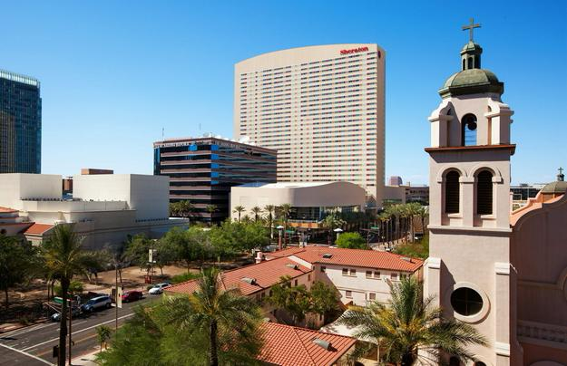
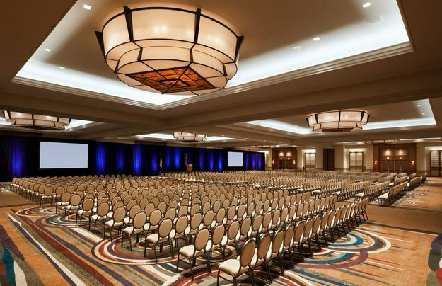
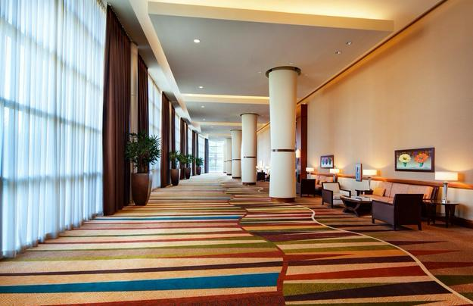
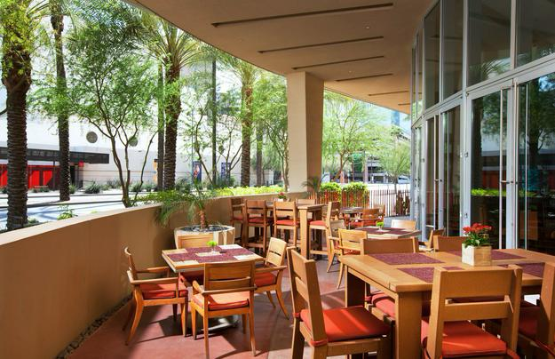
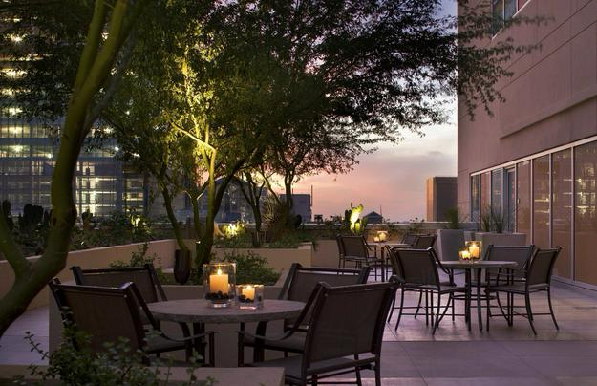
IUG 2019
Sheraton Grand Phoenix
340 North 3rd Street
Phoenix, Arizona
Pre-conference: Sunday, May 5, 2019
Main Conference: Monday, May 6 - Wednesday, May 8, 2019

Slide 26
Just a few more…
Pro tip 16: Give yourself a break every day
Pro tip 17: Carry as little as possible
Pro tip 18: Don’t be afraid to ask questions

Slide 27
Enjoy the Conference!

