Slide 1
Leaping Forward with Technical Services
Debra Wischmeyer, Director of Member Services, CCS

Slide 2
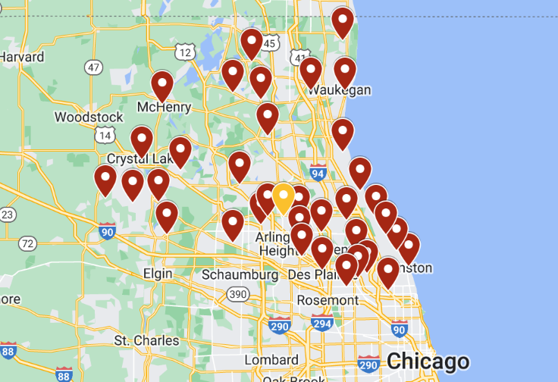
About CCS
Consortium of 31 public libraries
CCS = 8 staff
Over 2,000 staff at members
Hosted Polaris customer since 2018
Public services trained on Leap
TS staff trained on client
Training new members almost entirely on Leap

Slide 3
Leap vs Client by the Numbers in CCS

Slide 4
Why Leap?
Active development of technical services features
Opportunity to understand new features
Can we optimize workflows by using new features?
Share feedback on what is working well and what can be improved
New functionality being added to Leap only
Damaged item workflow
Weeding workflow
Future success

Slide 5
Our Approach to Introducing Technical Services Staff to Leap
Asynchronous training opportunities
Synchronous training opportunities
Interactive staff activities

Slide 6
Training & Learning Opportunities

Slide 7
Training Types
Asynchronous:
How to documentation
Online courses
Synchronous:
Quarterly training opportunities
Quarterly group meetings

Slide 8
Asynchronous Training – How To Documentation
How To Documentation
Step-by-step procedures with screen shots
Organized by software or by department
Updated with each upgrade

Slide 9
Asynchronous Training - How To Documentation
Managing Upgrades
Review new settings and features
Identify documentation needs
Staff member assigned ownership
Training database is upgraded first so staff can work on updates
Documentation updates completed prior to upgrade

Slide 10
Asynchronous Training - How To Documentation

Slide 11
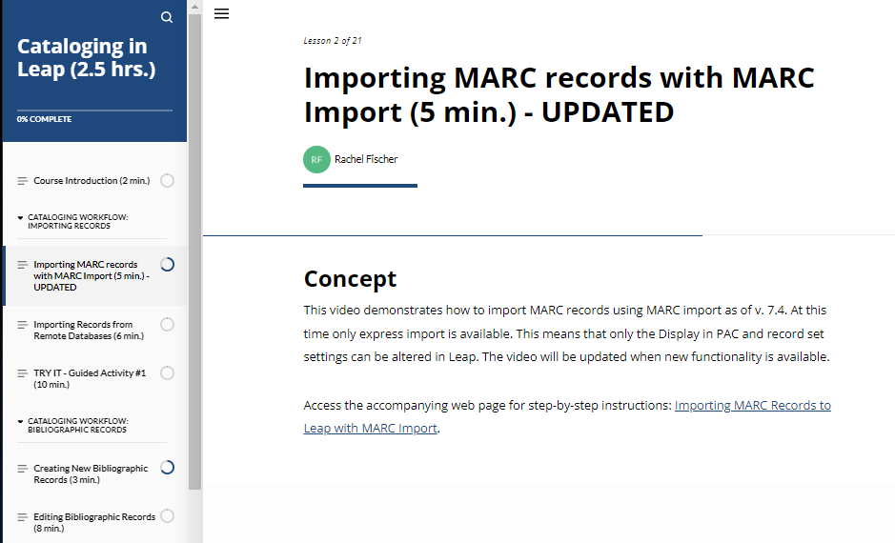
Asynchronous Training - Online Courses
Online Courses
Over 25 interactive online courses covering both Leap and the Client
Usage for TS courses increased 30% in 2023
Built using Articulate 360
"Tell, Show, Do, Review" learning model
Cataloging in Leap online course

Slide 12
Synchronous Training – Quarterly Training Opportunities
Quarterly Training
Plan our training in quarters
Review:
Evaluations
Help desk tickets
Suggestions and observations submitted by team
Polaris upgrade documentation

Slide 13
Sample Leap-focused sessions for Technical Services
Leap Basics for Technical Services
Searching in Leap for Technical Services
Decoding the Leap Item Record
Reviewing Bibliographic Records in Leap
Serials in Leap
Acquisitions in Leap

Slide 14
Synchronous Training: Technical Groups
Cataloging, Acquisitions groups
Meet quarterly
Every meeting includes a CE component
Members can suggest a demo or CE topic in RSVP form
CCS adds demos based on upgrades, tickets, etc

Slide 15
Sample Leap demos for TS staff
Declare Damaged
Exporting Contents of a Record Set
Transferring holds in Leap

Slide 16
Encouraging Leap Exploration through Staff Activities

Slide 17
Goals
Encourage staff to get hands on experience working in Leap
Gather feedback from members in positive and constructive manner
Share feedback with Innovative; submit Ideas

Slide 18
Staff Activity: Leap Hour
Schedule Leap Hour in advance
Staff set aside work to practice with
CCS hosts leap hour Webinar
Attendees practice their tasks
CCS staff answer questions live

Slide 19
Staff Activity: Leap Month for Cataloging and Serials
Week 1-2: Staff completed Leap online courses
Week 3-4: Staff used Leap for daily tasks for a minimum of one hour and completed “Rose, Bud, Thorn, Questions” exercise
Week 5: Staff participated in an in-person meeting and activity

Slide 20
Leap Month: Example Tasks
Cataloging:
Importing records (with MARC Import or with Z39.50)
Review and edit MARC records
Review and edit item records
Withdraw item records
Create record sets
Bulk change item records
Bulk change bibliographic records
Serials:
Check in new issues
Withdraw old issues
Combine issues in the check in record
Copy an existing SHR to create a new SHR

Slide 21
Leap Month: Rose, Bud, Thorns, Questions
Roses: Things that work “really well” in Leap
Buds: Suggestions or ideas for how Leap could be “enhanced or improved”
Thorns: Things that cause “difficulties” in Leap
Questions: Questions about Leap

Slide 22
Rose, Bud, Thorn Worksheet

Slide 23
Leap Month: In Person Activity
Self reflection (5 min) | Group Discussion (20 min) | Group Debrief (20 min)

Slide 24
Leap Month: Summary Report

Slide 25
Leap Month Takeaways
Staff are not a homogenous group
Library workflows and department structures differ
What some staff liked, others didn’t like
Leap pros: General usability is excellent. Staff appreciate Leap's overall ease of use, design, and navigation.
Leap cons: Efficiency is key. Leap is less efficient than the client in a few notable areas:
MARCeditor
Higher number of clicks required to do most work
Missing functionality, isn’t keyboard friendly

Slide 26
Requested Features in Development
Feature | Description | Polaris Version Upgrade
Advanced MARC Editor | This function will make the MARC editor more keyboard friendly. The preview image looks like OCLC Connexion. | Polaris 7.6 (Q2 2024)
Adhoc Item Bulk Change | Support the ability to perform adhoc bulk change on item records from the item record find tool and bibliographic record items view. | Polaris 7.6 (Q2 2024)
Split Screen MARC Editor | Provide a way for staff to edit multiple bibliographic records on a single screen in Leap. | Polaris 7.7 (Q4 2024)
Show all option in record sets | This will load all records in a record set. | Polaris 7.7 (Q4 2024)

Slide 27
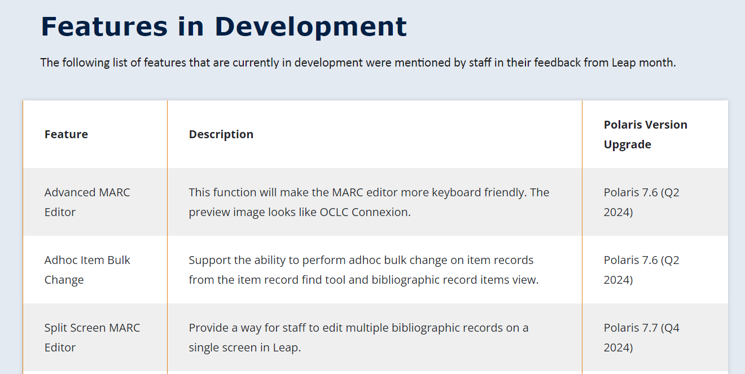
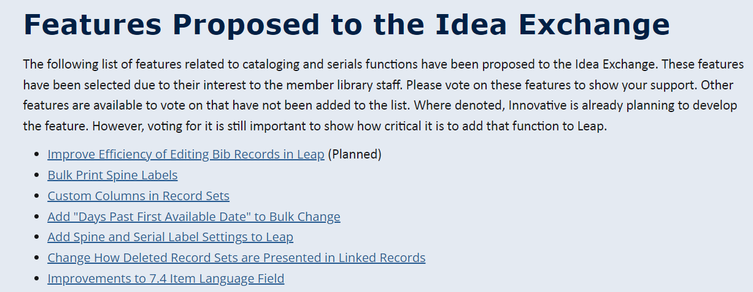
Leap Month: Follow up
Leap Month Follow-up Webpage:
Features in Development
Idea Exchange Links
Answers to questions
Links to documentation

Slide 28
THANK YOU
Questions?

Slide 29
Resources
Online Courses
Creating a quarterly training plan
Sample quarterly training plan
Leap Month project plan
Rose, Bud, Thorns, Questions worksheet

Slide 30
Missing in Leap as of 7.5
Cataloging | Serials | Acquisitions
Create import profiles Full import Create new bib and item templates (item – 7.6) Ad hoc bulk change from the list of items attached to a bib or search results (7.6) Viewing two bibs side by side without opening Leap in another tab (7.7) Copy and paste multiple fields in bib record (may not be added) Button to check for duplicates without needing to save the record. Printing labels from record sets Macros for MARC records. Undelete records from record sets. | Create subscription records Create item templates Full subscription management of SHR Route lists Full claims management (7.6) | ASN (7.7) EDI processing of partial shipments Sub-fund management (7.7) Adjust encumbrances and expenditures Create PO, bib, and item templates Create import profiles and full import Ability to uncancel a POLI Links in the bibs and items to the POs and invoices Rapid receipt Print vouchers (7.6) Multi-fund editor Distribute charges and discounts across all line items Fiscal year rollover utility Use invoice to receive and create items

