Slide 1
Small Budget and Small Staff
a Sierra acquisitions workflow
Rebecca Grantham
Notes:
I am Rebecca Grantham and I am the Technical Services Librarian for Emory & Henry College in Emory, Virginia.

Slide 2
Introduction
Emory & Henry College, Emory, Virginia
FTE between 1100 and 1200
Technical Services Department:
TS Librarian (Full Time)
TS Specialist (Full Time)
TS Assistant (Part Time)
None of these positions have only TS duties partly due to future personnel changes (and the pandemic of course), and partly because we are a small library
Part of a consortium (2 academic libraries and 2 public libraries)
Notes:
We are a small college of between 1100 and 1200 full-time undergraduate and graduate students.
Our library staff consists of 7 full and 3 part-time pleasantly quirky individuals split between the main campus and the health sciences campus. This is the middle of the road for small libraries: We are huge compared to some small libraries, and tiny compared to others and we recognize that.
Our Technical Services Department has a full-time librarian, a full-time tech services specialist, and a part-time tech services assistant. As is the nature of small libraries everywhere, we all have job duties outside of technical services. Though presently, with upcoming personnel changes and the current world we live in, these positions are varying even more.
Our library also shares Sierra as part of a consortium that has 1 other academic library and 2 public libraries. We love our consortium and sometimes we have to be very creative with problem solving.

Slide 3
Takeaways
Case study of the parts of the acquisitions and receiving process
The management of monograph orders in Sierra
How part of the workflow can change as needed
I really just want something in this session to spark ideas on how to reframe and rework existing workflows in your own library.
Notes:
Some of the things I hope to cover in this presentation.
This is a case study of some of the acquisitions and receiving processes for Emory & Henry College.
How we currently manage our monograph orders in Sierra
And how parts of the workflow can change as needed
I am very new to Acquisitions and Sierra, so I am still learning all the things I can do with this program. So, this is also not the end result. I have other ideas I want to experiment with both before and after my fiscal close this summer, in preparation for next year.
Together under the guidance of our library director, my coworkers and I have been working to make things in Sierra so they are more efficient for our library.

Slide 4
Let’s Begin
Notes:
Let’s Begin

Slide 5
Workflow
Notes:
WORKFLOW PAGE
This is a general overview of the workflow in tech services, new acquisitions only. I have boxed around the items in this workflow that cannot be moved.
The Tech Services librarian is responsible for ordering and recording all monograph/standing orders both physical and electronic. I keep track of the orders on a financial level in one spreadsheet that the Library Director also sees. The second Spreadsheet is one seen by the tech services department. This helps us track each book until sent for final physical processing.
The technical services librarian is also responsible for updating both spreadsheets as items come in and paying the invoices in Sierra.
I will come back to those spreadsheets later.
Currently, the call number labels can only be printed by our tech services assistant. We have one label printer and it is located at her desk, the same for RFID tags for our health sciences library items. Due to pandemic precautions, we no longer have all of tech services using this machine. As the pandemic will not be over when our personnel changes occur, printing call numbers will change positions from the part-time position to the full-time position for efficiency.
Other than those items, these job duties can be moved from person to person if someone is out, or is overloaded with other job duties.
Outside of New Acquisitions for monographs we also receive gift/donations, leased books, gov docs, and standing orders.
Normally, Gift/donated items are given to the tech services assistant. This is a part-time position, and the need to quickly catalog these is usually not as great as for new acquisitions. This position also processes gov docs (which used to be done by a student worker), and must RFID tag the health sciences items as well as print call# labels for everything that needs it.
The leased book program, some standing orders, and new acquisitions are given to the tech services specialist. This position also catalogs our gov docs.
None of these are set in stone, and only applies to an ideal situation. Who gets what frequently changes as needed.
Here are some examples:
During holiday and summer breaks, we do not have our part-time evening staff. We can change this workflow and I can also take on the copy-cataloging along with the tech services specialist. Our tech services assistant will continue from Call number labels and the remainder of the physical processing.
At the beginning of each semester our tech services specialist is busy with more public services duties, the tech services assistant and I will pick up more of the copy cataloging and reroute only specific acquisitions such as our leased books through the specialist’s position.
Recently, we have had less new acquisitions and have had tons of donations. Normally, the tech services assistant would copy catalog the gift items, leaving much of the new acquisitions for the tech services specialist to catalog. Due to the abnormally large amount of donations we have received, we have routed gift items between all three of us.
Sometimes, if an item comes in that needs rush processing and cataloging, I can do the entire portion, with the exception of course, of the call number.
All new physical monograph purchases are added to the new acquisitions spreadsheet, it is easy to track where an item is in the process.

Slide 6
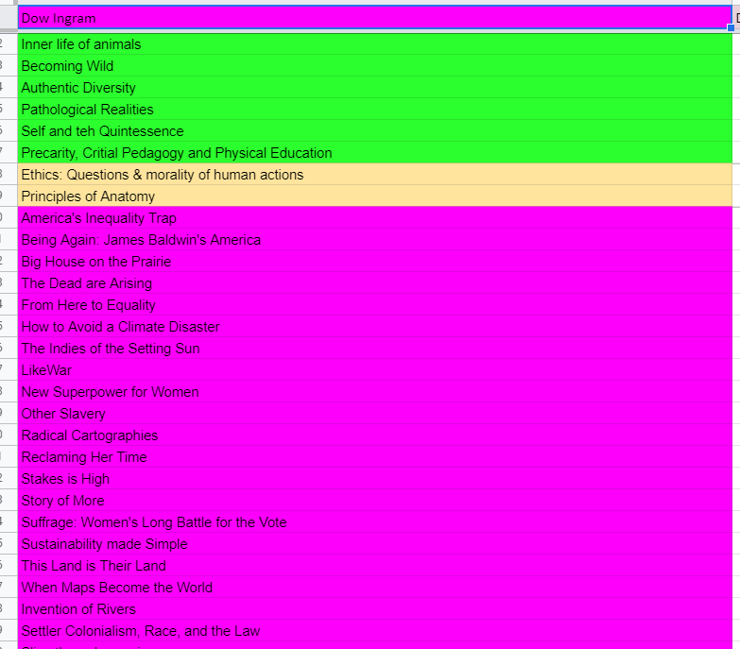
Spreadsheets
Books Ordered Spreadsheet New Acquisitions Spreadsheet
Notes:
Ordering books. I only use a few vendors for monographs. At present, we do not order or pay anything through Sierra to the vendor.
Before placing the order I have learned to check our holdings in WorldCat and the catalog. WorldCat will show e-book titles that have been/will be added to the collection during batch loading once a month.
In the past I found that I could order a book that would be added to the catalog in two days later in the batch load. Prompting me to cancel (if I can) or return the book once it arrives. Which is really annoying.
Once I ordered directly from the vendor, I place the order in this spreadsheet
You will notice that I have the funds in the spreadsheet. This purpose is two-fold.
One, it is easy to reference for when I place the order in Sierra, and In our book expenditures tab, I can track how many monograph titles I order for collection development. This spreadsheet is tracked by our Library Director and the Librarian in charge of monograph collection development, who don’t spend as much time in the ILS.
The different tabs at the bottom are the different (I call them macro funds/or college funds) that I work with. Some of these I have no way of seeing in the college’s billing system, so detailed record-keeping is important.
At the top, the Estimate Spent, is generally the order plus shipping (if necessary), (This tends to be on the high sides because of discounts I don’t consider.) The item+Shipping is what I am invoiced for and should actually be in the account. If there are returns I adjust accordingly.
(I have several fund sources that I don’t currently track in Sierra, but I am working on how to do this starting next year.)
Go back to powerpoint, link to sheet.
Pause Recording: Change to New Acquisitions Spreadsheet. (102 at the top)
After entering items in the book orders spreadsheet, I copy and paste the titles into the New acquisitions spreadsheet. This is where I track the workflow.
The Order Invoice page is where I track my portion (the yellow part of the workflow). I enter location code and the barcode once the item arrives.
These transfer to the next page where we track the portion the tech services specialist/assistant work on (The Blue portion of that workflow).
The location code triggers an if-then statement for the New Sticker column and if RFID tagging is necessary for all Health Science Library materials.
Whoever copy catalogs the book enters their initials in the columns.
Once they add the item record, it triggers another if-then statement in my sheet to let me know to go ahead and move the order record to the correct bib and item records. More about this later.
So this is where I will go over my workflow in Sierra.

Slide 7
New Acquisitions Suppressed Bib Records
Notes:
I didn’t want to import individual dummy bib records for each title I ordered, but I also need to be able to immediately encumbrance all orders for fund reporting and general checks and balances for tech services. I have found this last part is hard with any small library as we all have so many duties.
I created a “New Acquisitions” suppressed bib record. It functions as a dummy bib record, but I don’t have to deal with it except at the end of the fiscal year. And I attach all orders to it.
Currently, I have one record for each campus, Main (KL for Kelly Library) and SHS for our School of Health Sciences.
Next year, I might use an E-New Acquisitions for each campus to cover single title e-book and streaming video purchases. I now have a shs operations bib record, to deal with operational transactions rather than having tons of separate bib records, again the orders are all under one. This is a very recent change and I am still working on adopting it.
For this example, I will work with an order for main campus.

Slide 8
Go to the suppressed new acquisitions bib record
Notes:
This is what the suppressed bib record looks like., or rather looked like. You will novice that I have the different funds and titles, and some of the records have the invoice paid, others we are waiting on the item to arrive. That is the a or o status. Currently, the e-book and single streaming video purchases on in this bib record as well. I will probably change that next year.
Because we are a small library, I never have an uncontrollable amount of titles in this record at one time.

Slide 9
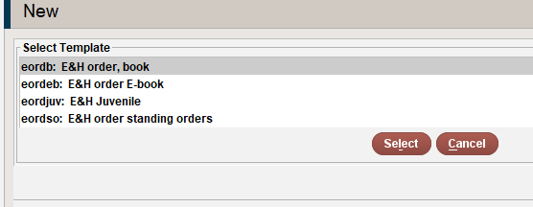
Attach a new order
Notes:
For orders I use a template. They look the same for physical monographs. I have several things that are not automatically chosen for me in the template.
This probably takes more time. But when I first started, there was no Health Science Library and later we were constantly having to go back and correct the location for bib, item and order records.
Go to order
Attach new order

Slide 10
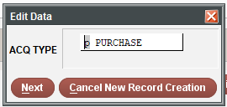
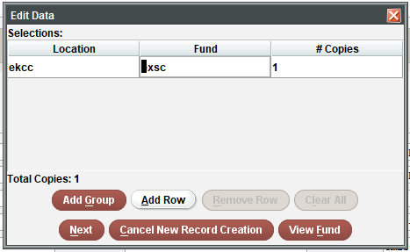
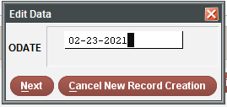
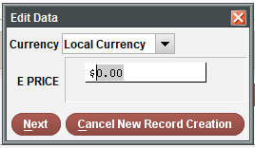
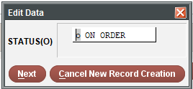
Notes:
Purchase:
Price:
Location: I have my orders location match the ultimate location of the item. For example: Most new books go into a new books location (and shelf). After 6 months most will go to main collection. I make sure the order location is main collection. So if I have any doubt about where I should place something, I can look at the order record. I also do not want my order records to have a “new books” location forever.
I choose the fund that I would like to use. Which I find in the Books Ordered Spreadsheet
I keep the status as on order.
I add the order date

Slide 11
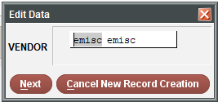
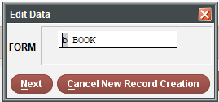
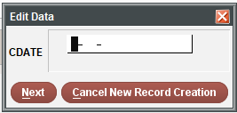
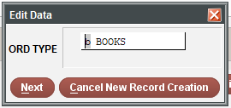
Notes:
Choose the correct vendor
I keep the CDate blank for now.
I make sure the form and order type are correct.
Sometimes order types don’t exactly match what the item is. We do this to help run statistics for reporting. We have yet another spreadsheet that tells us what each order type really means. This is another process we have been adopting and implementing this year.
There are a limited number of fields for order type, so we make it work for us.

Slide 12
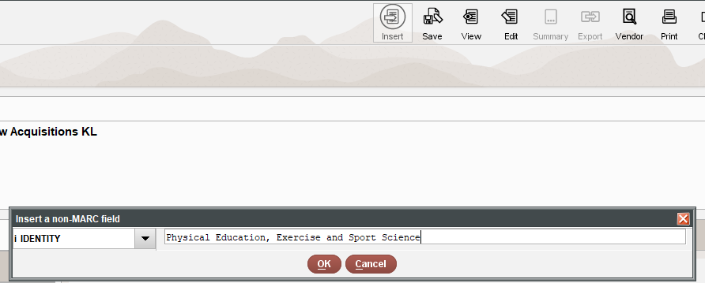
Notes:
Insert Identity: I place the title here to easily find this later.
Save and accept.

Slide 14
Notes:
Here is the order record.

Slide 15
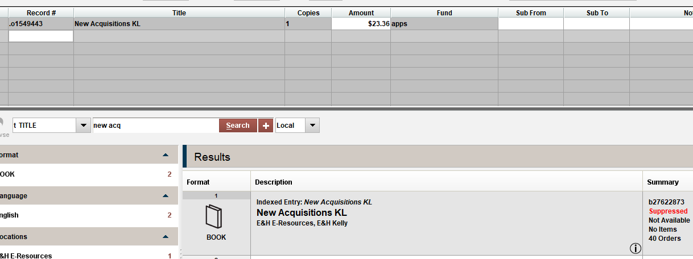
Notes:
When the items come in, I add the invoice to the books ordered spreadsheet, updating the totals.
I then go to the New Acquisitions spreadsheet, update the location code for the item, and scan the ISBN. This way my coworkers can just control F(ind) and scan the isbn to easily find it in the list. Next year, I may add a column for who gets each title.
The books get sent to the tech services specialist, or tech services assistant, depending on the nature of the item and the workload.
I pay the invoice using “today’s date as the received date”. Regardless of when the item is received. It is usually only a few days difference at most.
Go to Pay invoices
Select an open field, or a grouping and open a new invoice
Type in the invoice number
Invoice date
And instead of searching for the title, I will look up new acq

Slide 16
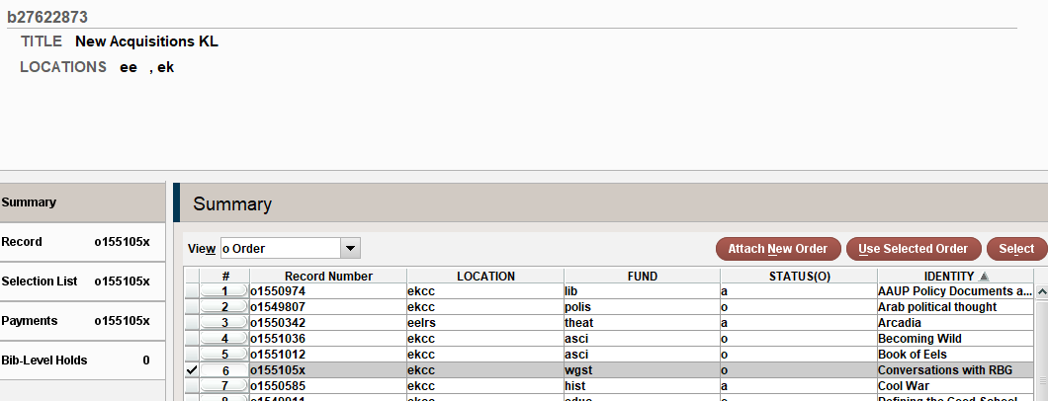
Notes:
I go to order so I can alphabetize for easy searching. Click on “Identity” to alphabetize. If not, your most recent additions to the orders will be at the bottom.
Choose the correct item “Use selected order”

Slide 17
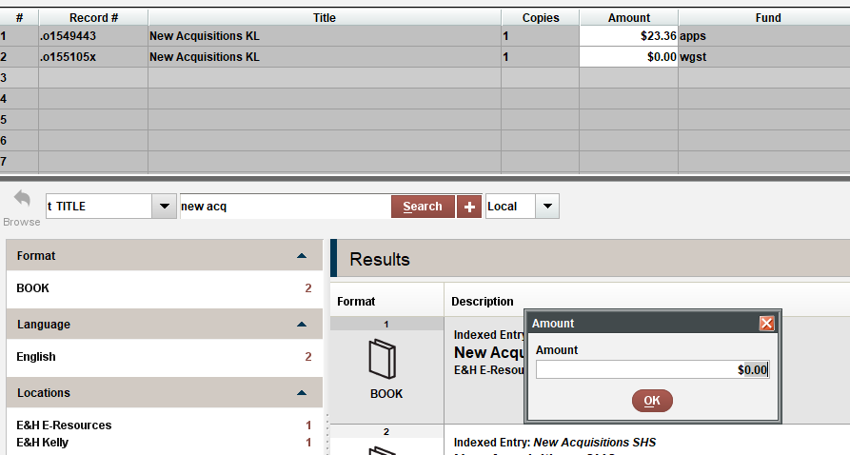
Notes:
Add the price and any notes
Then I can just hit the Search button again, not having to type out each title.
Finish out the invoice.
I keep record of the voucher number in several places for future reference. Especially if I ever end up working from home before fiscal close again.

Slide 18
Notes:
This is a line item of a fund report where a book from that invoice should be. You will see this New Acq Title. Once I finish, the correct title will be here.

Slide 19
Workflows
Placing the order in Sierra
Completed immediately after placing the order with the vendor
Paying the invoice
Completed upon receipt of item and invoice
Connecting the order record to the correct bib and item
Completed in batches several times a week as needed.
Several times per week/weekly.
Transferring to the correct bib record and attaching to the correct item record are simpler if they happen in batches
Notes:
As far as my workflows
I add the order to Sierra right after I place the order with the vendor.
I pay the invoice once I receive both the item and the invoice.
The next portion I do in batches: several times a week or weekly as needed.
Transferring the order to the correct bib record and attaching that order to the item record is more easily done in the same batch for each item.
We discovered in the last two weeks, that this has created a hiccup within our consortium that I will discuss later.

Slide 20
Item and Order/Invoice sheets from the New Acquisitions Spreadsheet
Notes:
For the next portion I go back to the New Acquisitions Spreadsheet. Because once the TS Specialist or TS Assistant check that they have created the item record I do the rest. You will notice the “Ready” Column. This turns green with “Yes” when the item record has been added.

Slide 21
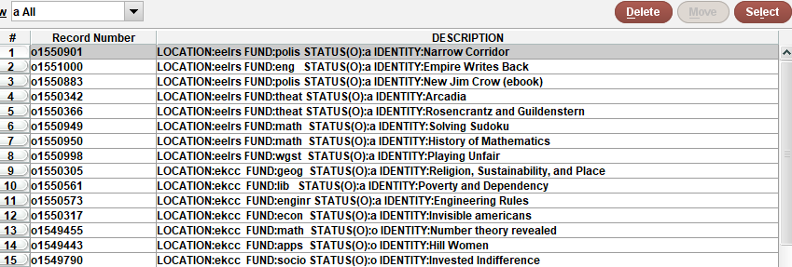
Notes:
Moving the order record and attaching it to the bib and item records.
I go to the new acq bib.

Slide 22
Notes:
Go to the order I want to use.

Slide 23
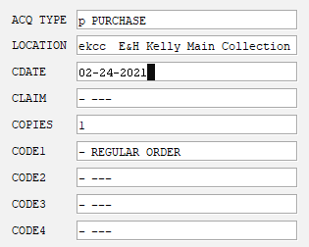
Notes:
I first edit the CDATE in the order, this is the date that I move the record and see the copy cataloging.
Edit
Transfer attached, find bib

Slide 24
Notes:
Choose the right bib, Go to summary
Use bib

Slide 25
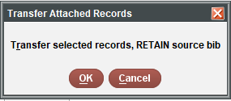
Notes:
Always retain source bib
Save, Close out.
You will see that the order record is now on the bib record.
Since I am staying under the new acq bib, I do this portion for multiple titles.
I then do the next step with those same titles, this way I am not going back and forth between the item’s bib record, and the dummy new acquisitions bib record.

Slide 26
Search Title
Notes:
Find the title

Slide 27
Import order information
Notes:
Open item record
Edit, import order information

Slide 28
Use selected order
Notes:
Use Selected order
Then it will show the invoice information, you have to pay the invoice before you can move or attach order records.
Select Use
Save

Slide 29
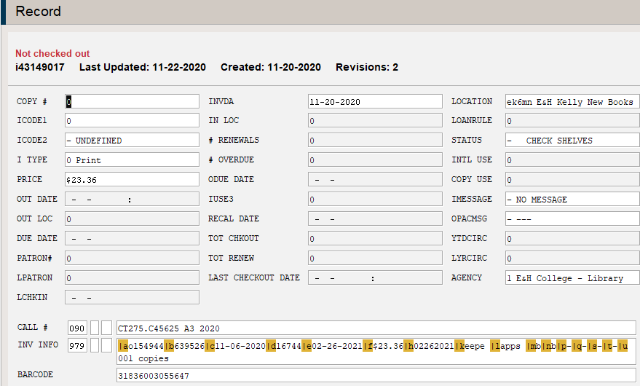
Notes:
If you look at the order record, you should see the invoice information. This is the first check for me.

Slide 30
The fund report with the title
Notes:
After the batch is done, I go back to the fund report a few minutes later, the titles have changed. This is checks and balances to make sure things are in properly.

Slide 31
From beginning process to current
What changed for the better:
The TS Librarian is not the hold up for getting items into the system and to the shelves/patrons
More trackable (I know what is in what part of the process, both for me and others.)
It actually did save me time
What I would like to improve:
Making vendor records work to my favor
Exploring more parts of the order record
There is so much of this I am still not using
Notes:
Some great things that came out of this:
I am not the rut in the system. Before, when I could only see how to go in and receive an order record, to make sure the order was attached to the item record, I had taken on all of cataloging, both copy and original. (To be fair, my predecessor, did not use order in Sierra the way we are now using them, so that may not have been an issue at the time.)
More trackability.
It actually did save time and make me more efficient. So much so, that my examples are very pieced together.
Things I would like to change
I want to make the order records, and vendor records work more in my favor.
I keep finding parts of various records that we are not using.
I would like to figure out what I can use and change to work for us, but not messing up things for the consortium.
While I have never hit a max number of order records per bib, or a point where the number of titles on one bib record are uncontrollable, I do have a contingency plan if that happens. I may split them by e-resource and campus, or split them by macro or college funds.
If this becomes a useful way to deal with orders for any of the libraries in our consortium, we may need to consider New Acquisitions as a title. Placing an E or E&H in front of things, as is our standard for other parts of the catalog.

Slide 32
So something new we discovered
Post first-recording (Panic!)
Within the consortium, other library’s patrons can actually place holds on bibs with order records, even if the item record has blocks to keep this from happening.
The location for new books has specific loan/hold rules for our consortium patrons.
Notes:
About that hiccup I mentioned.
So after I recorded this presentation the first time, our systems librarian and our circ overlord were discussing a problem. Being part of a consortium, we have it set up that only our library’s patrons can place holds on New Books. This gives our patrons priority until, after 6 months, when the new books move to the main collection. The problem was a non-Emory & Henry patron placed a hold on an item in New Books. After much experimenting, we discovered that the existence of an order record on the bib record, made title holds allowable.
Honestly, for a small academic library, the odds of patrons fighting over “Spatial Analysis Methods” are pretty slim, unless it is required reading. And pre-pandemic, when acquisitions were arriving regualarly, this was not a problem for any of the libraries. At this time, as it is such a new problem, I do not have a confident confident to this.
These are one of those times we must be creative for solutions.

Slide 33
THANK YOU
Questions?
Notes:
I probably go overboard with tracking things. But to be fair within my first year working in my position and with Sierra, I ended up working from home without access until a week before fiscal close, and scrambled to catch everything up and learn everything about fiscal close in a week. This year, I hope to do better, with less stress.
Another thing to note: As a small academic library, we don’t have tons of people putting holds on items before they arrive. This will not work for anyone whose patrons rely on the ability to place holds on items before they are received.
This is the end of my presentation. Thank you for watching. I will try to answer any questions you might have.

