Slide 1
Caffeinated and Confused: When Quarantine Life and New Job Stress Collide
Stefanie Maclin-Hurd, MLIS ILS Support Librarian
WAGGIN District Libraries

Slide 2
About
Started job October 2019
Manage ILS (Polaris) for 20 public libraries across 3 SW PA counties
NOT a tech person.
MLIS in 2010 with a specialization in Archives.
Spent ~7 years in corporate librarianship, focuses on reference, research, and cataloging.

Slide 3
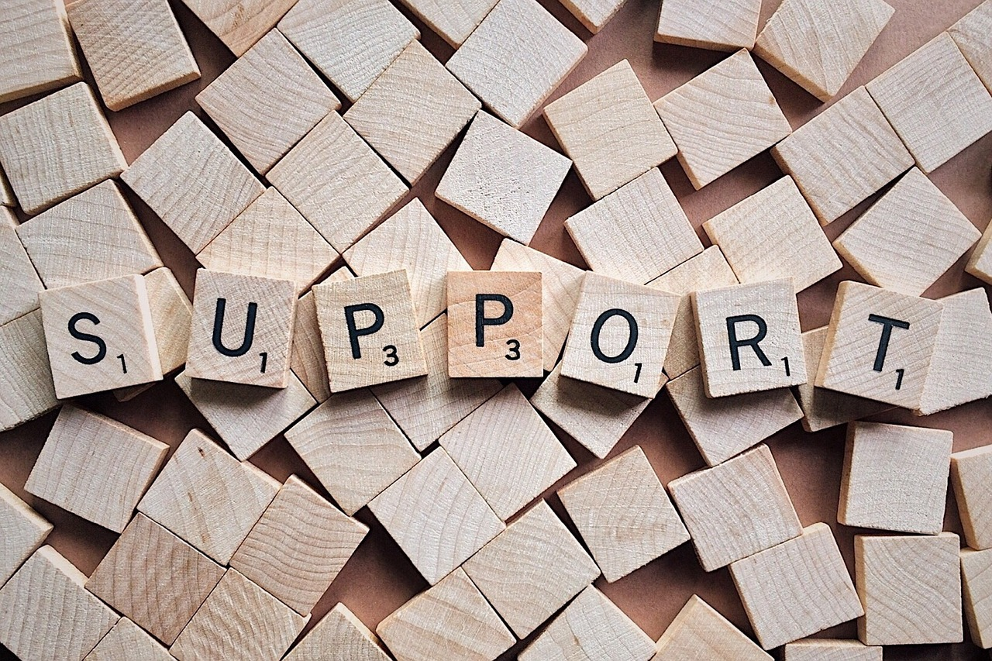
Support? What support?
Met with Predecessor 3x
Each library needed different support
At this time, I didn’t know about the IUG Discord. I would pour over the Knowledgebase, and send near-daily emails to my Site Manager.
Many of emails received with varying answers of, “trying to determine this also.”
Much of my process was breaking something, then attempting to retrace my steps to fix it again.
Notes:
I met with the previous person in my job three times in the first month-ish of my starting, He had left the position before I started.
And while I took copious amounts of notes, those notes did not cover a global pandemic.
Of my 20 libraries, each one needed different ways of support, and many of the changes we need to make to account for the shutdown, needed to be system-wide.
In these early months of Quarantine, I didn’t know about the IUG support system yet. I would pour over the Innovative Knowledgebase, scour the web for answers, and sent near-daily emails to our Site Manager. Many of the emails I received back had varying answers of, “trying to determine how to do this also.”
Much of my process involved breaking something, then attempting to retrace my steps to fix it again.

Slide 4
Shutdown - the early weeks
Routinely broke Polaris on purpose
Had NO IDEA as to what I was doing
During the early months, I had my then toddler home.
Much flexibility with my hours, no one questioned if I took a two hour lunch to tag team naptime.
Notes:
Routinely broke Polaris on purpose at I attempted to turn off holds, add close dates, determine any additional staff permissions
While also fielding questions/requests regarding LEAP logins for home computer use
Had NO IDEA as to what I was doing
During the early months, I also had my then-toddler home. At that time, I was working 24 hours a week, however, my hours increased to 30 hours early in the pandemic. (Moved to FT in late 2021).

Slide 5
Just how did I break it?
Holds
Upgrade Days/Cataloging
Notes:
Holds - Early in Quarantine, we needed to turn off Holds in Polaris, both at the local level and at the district (or consortia) level. Initially, I considered it was just unchecking a few boxes, except my libraries still reported Holds being… held. An email to Polaris revealed they didn’t at that time have an easy way to turn off holds without removing the data itself.
I spent a morning removing 400 lines of data to break every link within the catalog that instructed which hold from one library to go to a different library. It worked, Holds were nonexistent. However, it wasn’t until however many months later, when reinstating Holds, and I was needing to re-add each of the 400 lines of data, that perhaps, a different way would have been more helpful.
That was a high tea count day, involved a lot of cursing, and at one point, I had a purple ribbon tied tightly around my right wrist. I couldn’t find my wrist brace, and my wrist needed some support.
In another example, whenever we did an Upgrade with Polaris – it seemed something broke. The first upgrade I scheduled (sometime in 2020), it was to help resolve some issues in the catalog records as we had certain fields that were either not displaying in the correct locations, and one field not showing at all.
We did the upgrade, however, whereas it didn’t quite fix the catalog records, and it was a couple weeks of work going through records with a fine tooth comb (along with the two centralized catalogers), figuring out how many records we would still need to resolve.

Slide 6
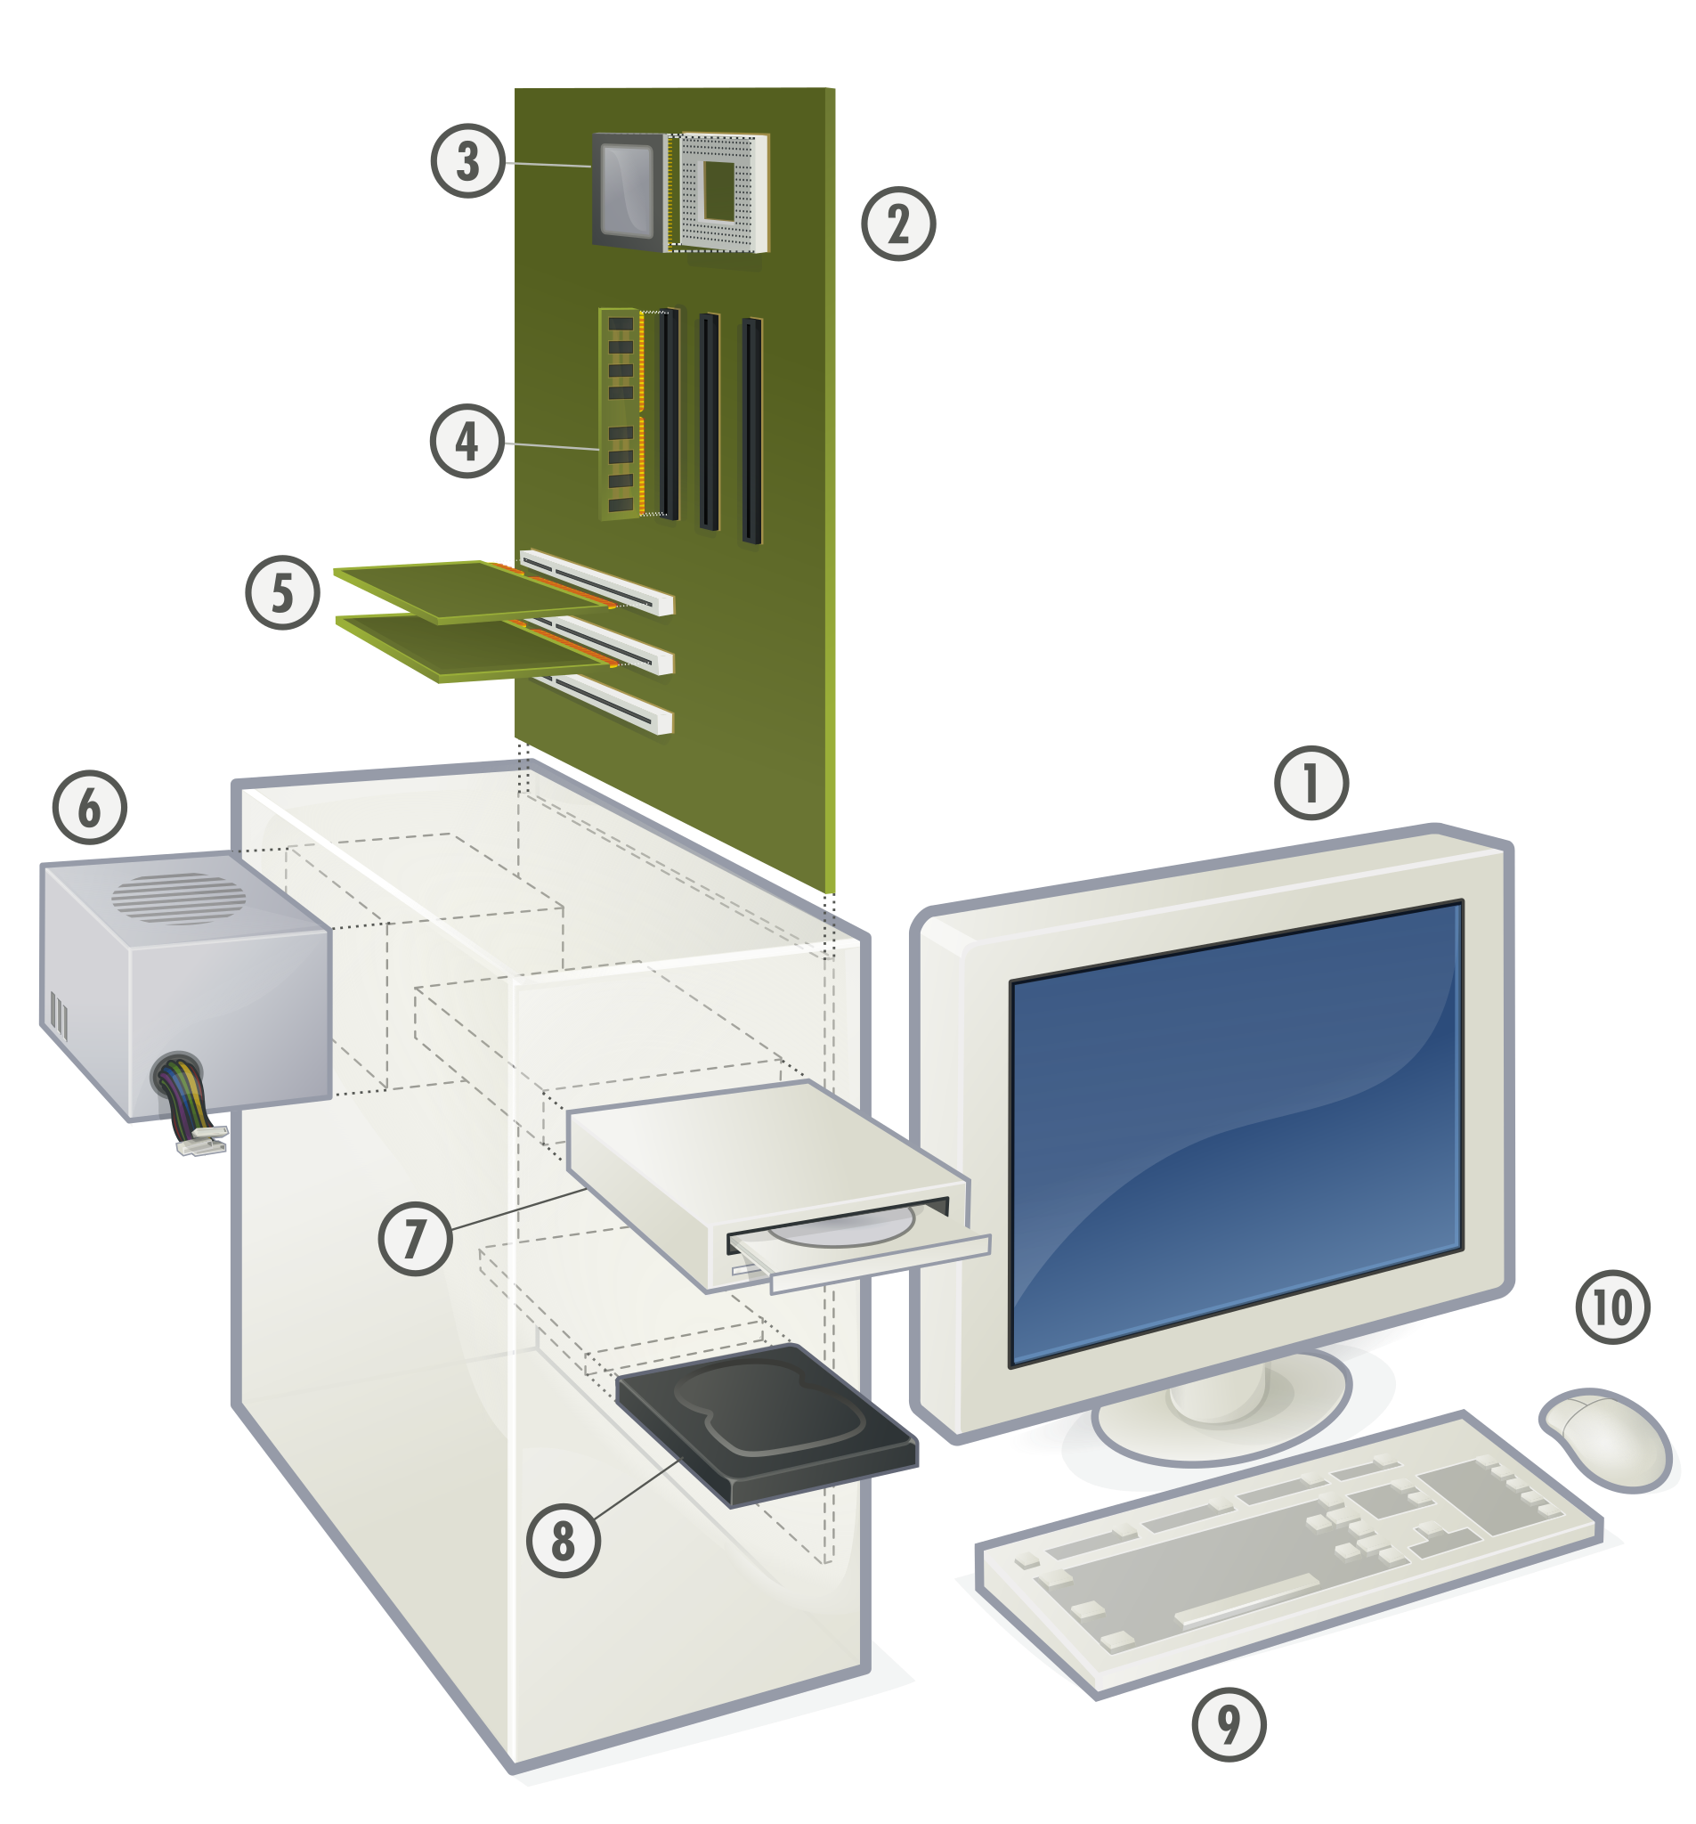
So you want to learn “tech”?
WAGGIN offers free Gale courses with library card.
Taught myself extremely basic Python and Javascript via Youtube videos.
Crowd-sourced information through FB groups and Twitter.
Notes:
WAGGIN offers free Gale courses with a valid library card. I took a number of courses in Cloud Computing, Networking, Wireless Networking, and SQL.
Also taught myself extremely basic Python and Javascript via Youtube Videos, took advantage of additional classes through sites like Stack Social and Coursera.
Would email the Tech Reference Librarian at one library location, often asking him to test certain things to make sure they worked.
And I also crowd-sourced information through FB groups, LinkedIn, and Twitter.

Slide 7
All about those links
Gale Courses: Online Courses from Washington, Greene & Fayette County Libraries (gale.com) Python Course (Youtube): https://www.youtube.com/watch?v=_uQrJ0TkZlc

Slide 8
Everyday conflicts
No access to remote support
Fielded emailsnear 24/7 in early months.
Had one staff member threaten to fire me because I wasn’t “prioritizing their library.”
Notes:
We had no access to Remote Support, and limited ways for the libraries and library staff to collaborate online. We have a private Facebook group, and most communication about the libraries went through the FB group or email. Majority of the library staff knew less about technology than I did.
I had to continually send out reminders to please NOT post about Polaris issues to the FB, to PLEASE email me. Also became apparent quickly, many staff did not know how to take and send basic screenshots, and I would often get a photo they took with their cellphone. Repeatedly, I would need to send step-by-step instructions (with my own screenshots) of how to take a screenshot. (This is STIIL an ongoing issue.)
I was fielding emails near 24/7 in the early months. Which certainly contributed to the hours increase. I also almost immediately set up my work email on my phone, so if it was a day I was not officially working, I could keep abreast of any issues or questions.
And during this period, I had one staff member threaten to fire me because I “wasn’t prioritizing their library”. They had absolutely no authority to do so.

Slide 9
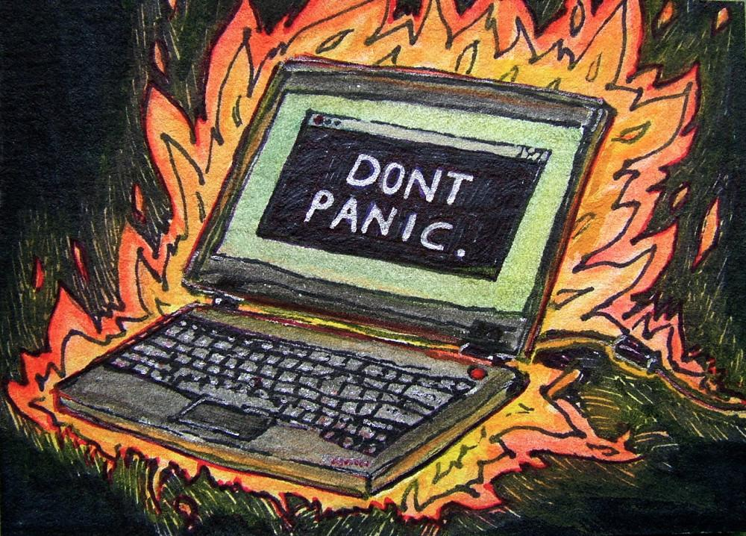
Stress, anxiety, and isolation, oh my!
During second or third week, I had a massive Panic Attack
Called my boss in tears.
Reminded these were unprecedented times
Notes:
It was during my second or third week in Quarantine – around the same time that Staff Member threatened to fire me – that I had an absolutely massive Panic Attack, thoroughly convinced I had ruined the ILS, and unable to do my job.
Called my boss in near tears.
My boss reminded me these were unprecedented times, no one knew what they were doing, that I was doing my best given the circumstances and with no official training, and that I would never please everyone. And that most of the libraries were just thankful I was still keeping the ILS functioning.
She also reminded me to breathe, and to go get a cup of tea.

Slide 10
In a 900sqft box
No dedicated office space.
No “alone time” to work.
Daniel Tiger was my background noise
Notes:
Up until August 2022, we lived in a 900sqft apartment. I had no dedicated office space. My “desk” was our coffee table.
This did mean no true “alone time” to work. If I had a meeting, my kid would there, showing off his cars and trucks, often with no all clothes on. It was also around this same time, we started early potty training. (Curious seeing Mom and Dad do it all day.) Which meant sometimes needing to interrupt meetings to get to the toilet.
And also what classes and trainings I did, I often did while Daniel Tiger played in the background.

Slide 11
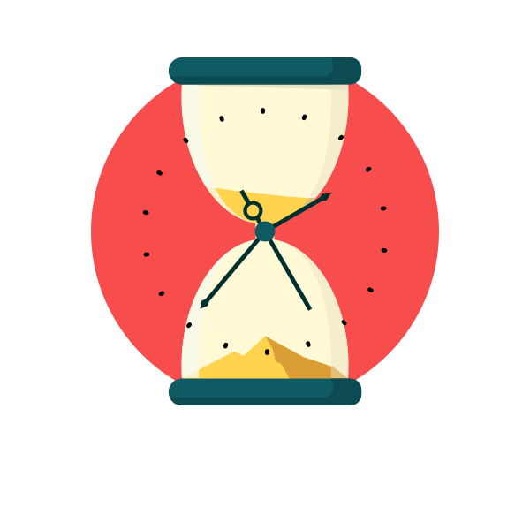
Learning flexibility…
Needed to learn how to work from home
And how I best learned new tricks
That some days, I needed to “let it go”.
Notes:
Like many, I needed to learn HOW to work from home. Teaching yourself new skills, especially ones as expansive as “technology” required relearning time management and organization, required self-forgiveness when I didn’t take to something right away.
Learned quickly I don’t absorb as much information with “self-directed learning”, that I thrive in a more “classroom” like setting with forums, discussion, and being able to talk problems out. None of which I had.
I needed to learn to “let it go”. I would never be able to learn everything, it was ok to ask questions, that no one faulted me for getting something wrong, and that some days, work was not the important thing. There would always be more work, breaks were important.

Slide 12
…because you want me to do what?
“Duties unassigned”
Default IT person for the smaller libraries in my district (consortia)
Notes:
Ah yes, the proverbial “duties unassigned”
Officially, my role is to manage and support the functions of the ILS for each of the 20 libraries. Some of my libraries are more self-sufficient, and may have the budget and resources to employ some sort of tech person on staff. However, for the smaller libraries, I am the tech person.
This means I’ll often receive emails involving printer malfunctions, internet malfunctions, and questions about what new computers to buy.
For the internet malfunctions, the go-to answer is “call your internet provider”, but I have spent the equivalent of months researching printers, and installing printer drivers, and trying to figure out why Windows does not recognize the device (and not even for just the receipt printers).
Early in the pandemic, one library’s internet provider changed their IP address. Updating it with Polaris was the easy part, but then they expected me to also update it everywhere else. I’m on the phone with the internet provider, trying to figure out what I need to do, and they say something to the extent of, “well, normally the IT person does this.”
And I take a deep breath, and answer “as far we’re concerned, I am the IT person. Now, tell me what I need to do.”

Slide 13
What were the results?
Improved my tech skills
Remote working resulted in better productivity, but more caffeine drinking
Required greater flexibility, adaptability, and multitasking.
Notes:
While never an expert, I improved my tech skills
Ultimately, moving from an in-office job to remote resulted in better productivity with more time to test things within the ILS, but also more caffeine consumption
It also improved my adaptability to new situations, and multitasking. (Early potty training WHILE managing an ILS? New level up to mention in future interviews.)

Slide 14
And Finally… Just for Laughs…
Average 2-4 cups of tea each day
My kid learned basic SQL with me, and still draws “computers” to work too.)
But seriously…
Learned how to be a “tech person” on the job
Notes:
I average 2-4 cups of tea each day, which goes up on more difficult Polaris days, and learned the hard way I shouldn’t drink caffeine after 2pm. Several of my library staff would jokingly send me tea on “upgrade days” with Polaris, and create polls within the FB group as to how many they thought I had already drank.
I like to think my kid learned basic SQL with me, as they would often want to “help” write queries. (To this day, my kid will still draw “computers” so they can work alongside Mommy and Daddy.)
But seriously…
I learned how to be a “tech person” on the job, and really only broke the ILS beyond repair once. Maybe twice.
But then I fixed it.

Slide 15
Contact Information
smaclin-hurd@citlib.org LinkedIn: Stefanie R. (Maclin) Maclin-Hurd | LinkedIn I can also be found on Discord and Slack.

