Slide 1
Espoo City Library – A new era of Collection Management with Lirp
IUG 2023
Oswald Kaipainen
oswald.kaipainen@espoo.fi

Slide 2
7-year history of developming multiple scripts and tools for saving staff time on routine work: creating handling of new items, Auto RFID item shipment receiver, readlists for children availability in libraries, Decision Tool (for making collection work decisions), mobile item and title paging (presented in IUG 2018 in Orlando), so lots to upkeep
Decided to centralize to one service – Lirp – Library resource planner - Multi platform online tool for library staff to streamline library work and processes
One full time developer for a year + me developing and as project leader
Development began in January 2021, deployed feature by feature, in full usage by summer 2022
Today with Lirp automation we save over a dozen of person-workyears worth of labor

Slide 4
Numbers
3,5 million total item records (Helmet)
850 000+ bibliographic records (Helmet)
With Lirp:
6+ million RFID item mass scans
40 000+ item searches
130,000+ item records created

Slide 5
Under the hood
Backend
Frontend

Slide 6
Under the hood
Synchronization of item, bib and order-records
RFID server
Lirp DB
Sierra API
Other Programs
Sierra
Notes:
asdasdasddas

Slide 7
Main features
Ultra fast item, bib and order search with quick filters and advanced query tools
Taking inventory (RFID Mass scanning) and library collection segment browser to look for missing or material with broken RFID –tags – first full Espoo City library inventory 2021, 100% digital collection match to physical collection
Receiving new material shipments, automated shipment check with RFID
Acquisitions and new material shipment management
Creating new items to Sierra, whole batch as one unit

Slide 8
Other features
Index based self service holds pickup system, missing holds and clear hold shelf data emailed from Sierra
Collection tasks (collect Sierra title paging, Sierra item paging, Lirp item deletion and Lirp collection task requests, custom task distribution algorithm)
Item scan charts and hold self charts to monitor daily work routines at locations
View to item and bib records with item/rfid scan data, graphical shelf view and spine label view
Edit Sierra item records
Accounts management, account settings, links and log browsing
RFID readers management
Lirp internal broadcast messages
Transit volume map
Predefined queries of interest (Most travelled items to discover glitches, duplicate barcodes, items in transit for extended periods)

Slide 9
More advanced title paging
Title paging algorithm takes into consideration:
Number of items of the title in certain library
Amount of time item has been sitting in a location
Possibility to do float balancing via float metrics
Number of active calls per location
Location opening hours and hours with staff present
pagedTitleLocationWeights –table to favor certain locations that logistically good choises

Slide 10
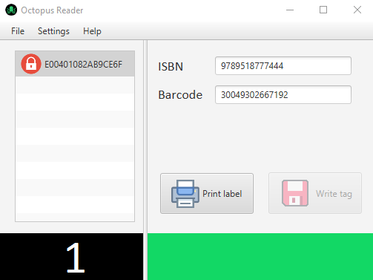
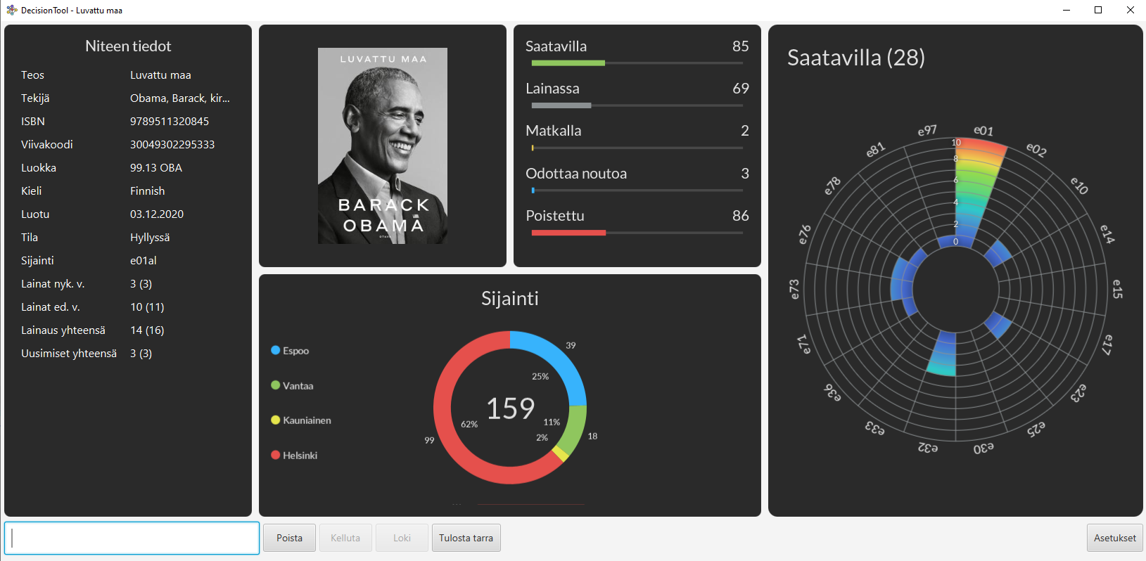
Lirp API serving other programs and services
Octopus Reader – RFID read / write desktop Java app, and spine label printer utility
Decision Tool – Collection management visual Desktop Java app
Kunnarilistat – Real time read lists item availability in chosen location

Slide 11
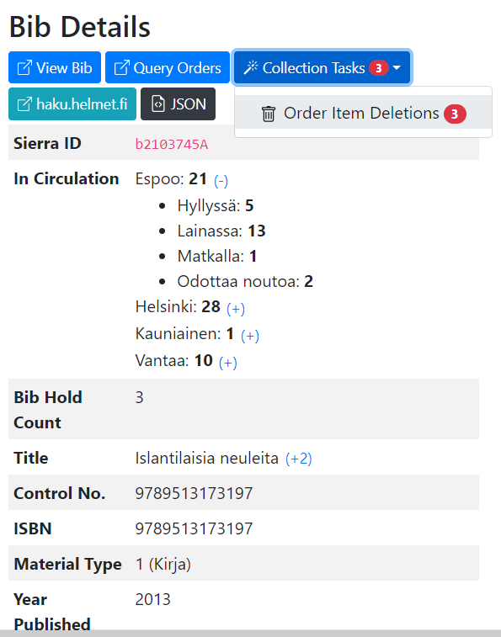
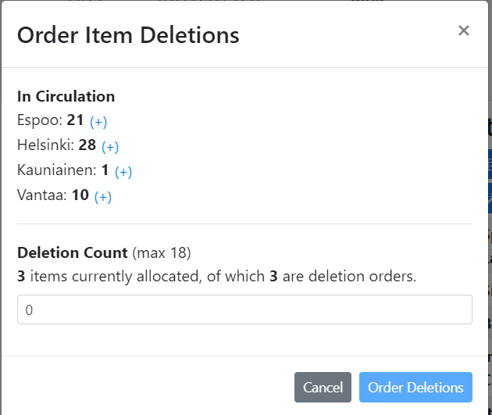
Deletion order and collection tasks
Centralized weeding with deletion orders

Slide 12
Future plans

Slide 13
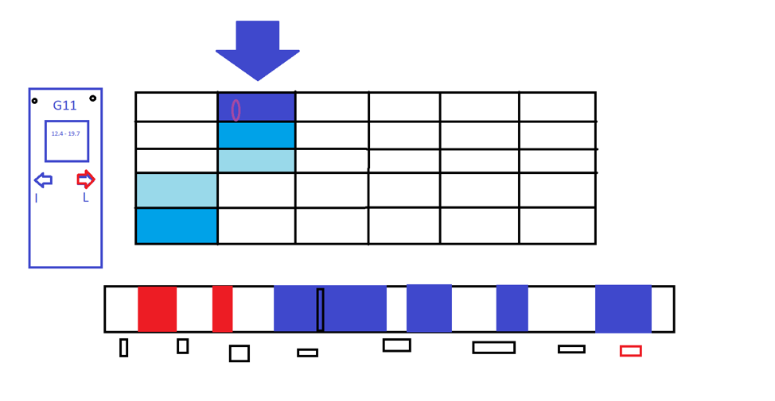
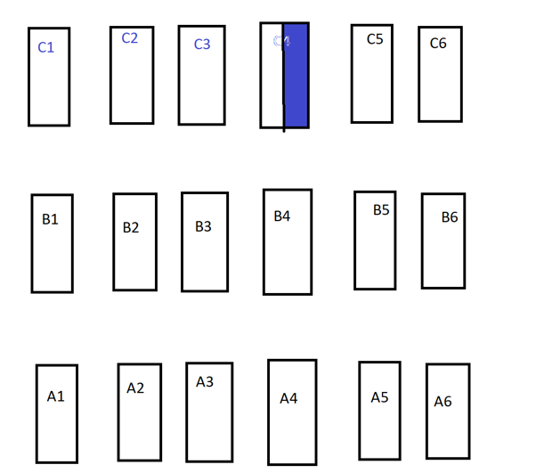
Bib and item lists ->Save personal item and bib lists of interest, get notification on updates on a certain list
Items / bibs mass update -> think global update, but with more functionality and possibilities
RFID tags to all shelves -> Virtual library shelf map with time based rfid scan coloring and easy navigation in library space
Automatic float balancing -> allocate automatic float balancing with item searches

Slide 14
“Lirp transforms challenges into opportunities, making the complex simple, the time-consuming swift, and the mundane captivating.”
-ChatGPT-4

Slide 15
THANK YOU
Questions?
oswald.kaipainen@espoo.fi

