Slide 1
From Feedback to Focus
Crafting Responsive Training for Library Staff
Mieko Fujiura-Landers, CCS

Slide 2
Agenda
A little bit about us
The CCS training evaluation plan
Let’s walk through the plan
Wrapping it up

Slide 3
A Little Bit About Us

Slide 4
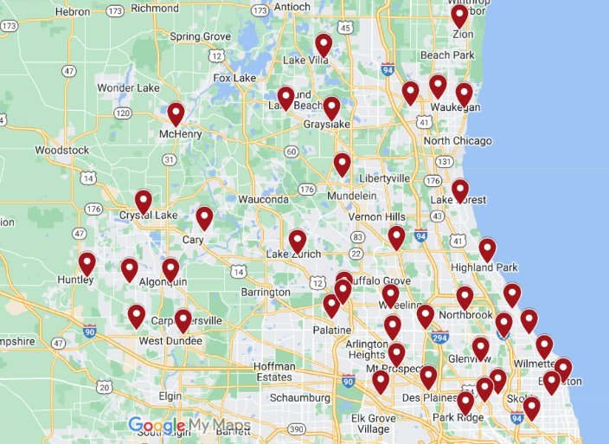
About Cooperative Computer Services
Catalog consortium in the Chicago suburbs
32 libraries
2,700 member library staff
9 CCS staff

Slide 5
The CCS Member Services Department
Director of
Member Services
Member Services Associate
Member Services Associate
Member Services Librarian,
Public Services
Member Services Librarian, Technical Services
User Experience Specialist

Slide 6
Reaching Our Member Libraries
Synchronous Training
In-person (16 attendees)
Zoom webinars (up to 100 attendees)
No hybrid format
Asynchronous Content
Documentation on website (How-To pages)
Online courses
Technical Groups
(User Groups)
Member library staff groups by service area
Develop/share best practices, network, continuing education

Slide 7
Reaching Our Member Libraries
In FY23-24, we
Held 21 technical group meetings
Led 46 training sessions
840 live attendees
180 instructional videos
25 online courses
430 how-to pages

Slide 8
Reaching Our Member Libraries
In FY18-19, we
Led 62 training sessions
535 live attendees
In FY23-24, we
Led 46 training sessions
840 live attendees

Slide 9
The Before Times
(Or, what we thought staff wanted)
Set schedule of intro-level sessions
Very broad content
No consistent evaluation method
Only in-person (pre-2020)
Training Schedule
Offered every 3 months: | Offered every 4 months: | Offered 2x per year:
Leap for Circulation | Serials | ILL
Leap for Public Services | Acquisitions | Cataloging
 | Simply Reports
Former Training Cadence

Slide 10
What Sparked the Change
New strategic plan July 2021
Strategic Direction: Develop flexible, responsive services that will continue to improve the patron and staff experience
Objective: Regularly evaluate synchronous and asynchronous training offerings to meet the changing needs of member library staff.

Slide 11
The CCS Training Evaluation Plan

Slide 12
Goals for the Training Evaluation Plan
The plan should define:
How we identify what training to provide
Responsibilities of trainers
The evaluation schedule
What data is used during the planning process
Training priorities

Slide 13
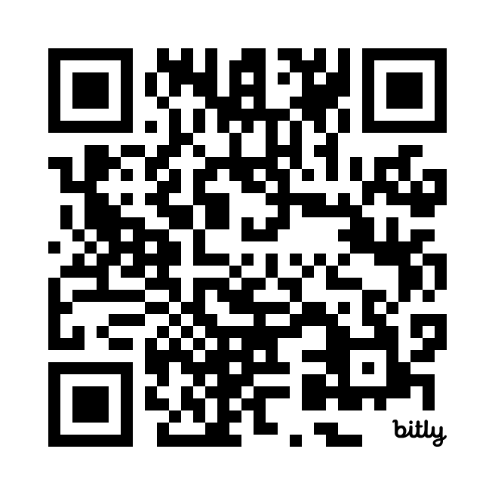
The CCS Training Evaluation Plan
Process
Schedule
Priorities
Tools
Administrative Tasks
Evaluation
Reporting
View the plan

Slide 14
Process
Data
Gather training data
ID Topics
Identify possible training topics or opportunities
Share Plan
Review plan with Member Services team
Review data
Identify patterns or themes (takeaways)
Determine most effective method of delivery (training session, documentation, group demo)
Draft Plan
Draft a short list of training sessions and documentation needs, including target dates
Assign to Member Services staff based on area of expertise
Finalize dates

Slide 15
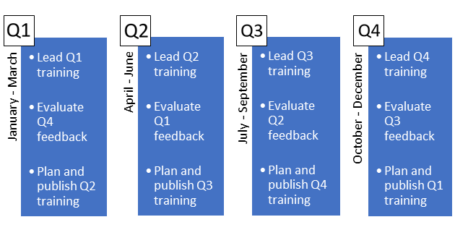
Schedule

Slide 16
Priorities
Migrations
New library migrations
New Services or Resources
Polaris upgrades
New service rollout
Requests
Requests from libraries for specialized training
Migration to new ILS
“Member Services may need to prioritize certain training based on concurrent projects or member needs. These types of training will take priority when planning the following quarter’s sessions.”

Slide 17
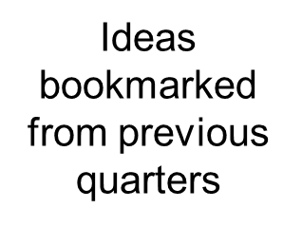
Tools
Training Statistics
Online Courses
Training Eval Forms
Online Course Quiz Results
Help Desk Tickets
Anecdotal Feedback

Slide 18
Administrative Tasks
Includes prep work and marketing tasks, such as:
Finalizing dates
Reserving rooms or creating Zoom meeting
Creating title and session blurb
Setting up registration
Communicating with registrants

Slide 19
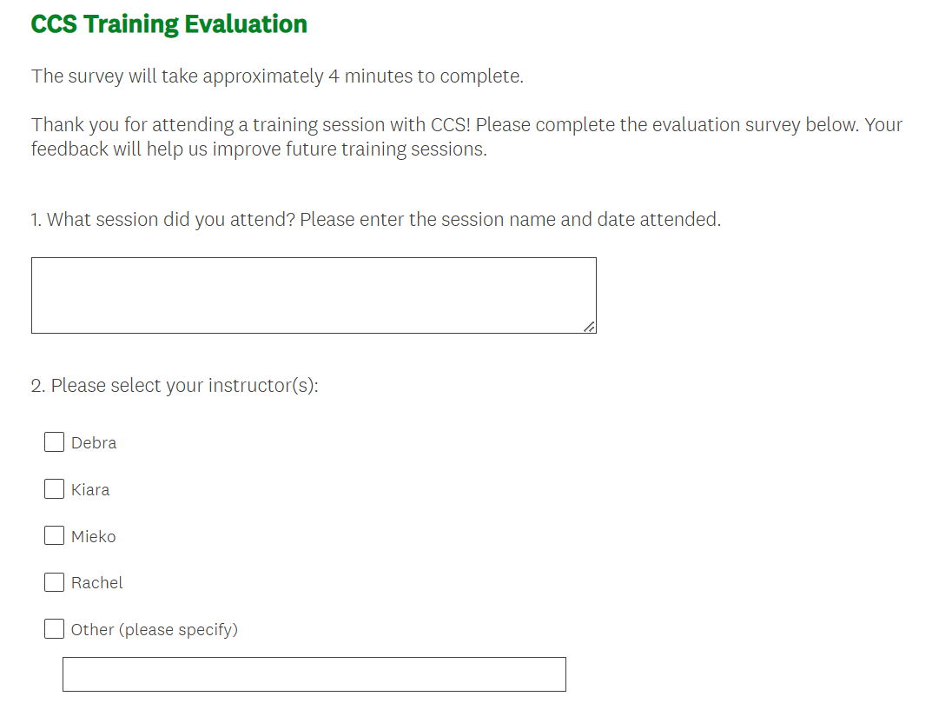
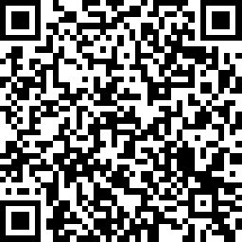
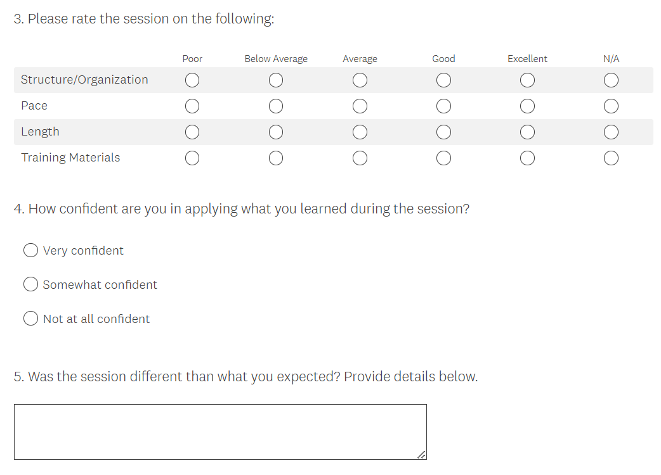
Evaluation
Snippet of the CCS training evaluation survey
We include the QR code to the survey at the end of each training slide deck

Slide 20
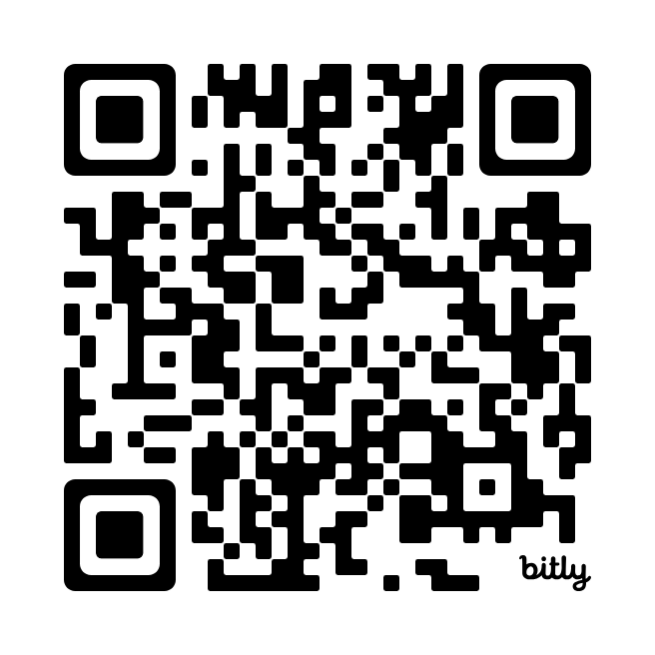
Reporting
View the
full report
Stats report from first half of FY24-25

Slide 21
Let’s Walk Through the Plan

Slide 22
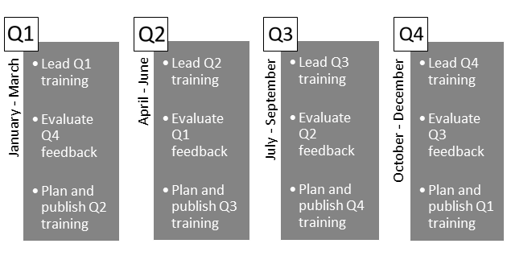
Quarter 4 (2024): Schedule

Slide 23
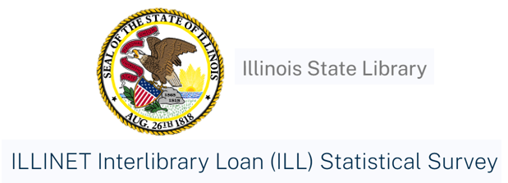
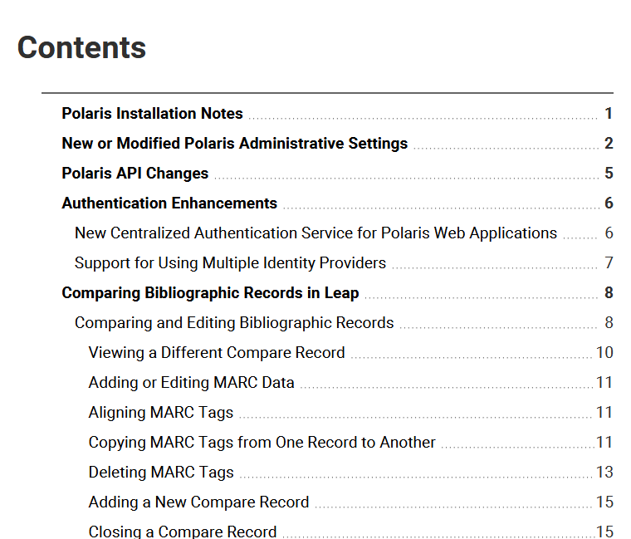
Quarter 4 (2024): Priorities

Slide 24
Quarter 4 (2024): Tools

Slide 25
Quarter 4 (2024): Tools
Training Eval Forms
Help Desk Tickets
Anecdotal Feedback
Ideas bookmarked from previous quarters
Data consulted for this review included:

Slide 26
Quarter 4 (2024): Training Ideas or Topics
“Anything!”
Searching in Leap
Item History Reports
Reports Training!
Find Tool SQL
Leap Hacks

Slide 27
Quarter 4 (2024): Final Training Lineup for Q1
New in Leap 7.7
Leap Hacks
Intro to Simply Reports
New Acquisitions Features in Leap

Slide 28
Quarter 4 (2024): Other Continuing Ed Opportunities
New documentation on 7.7 features
Demo new 7.7 features at user groups
Demo how to run item history report at Circ user group meeting
Review resources for completing ILLINET survey at ILL user group

Slide 29
Quarter 4 (2024): Takeaways from Eval
More time for independent activity
More movement breaks
Watch out for library/ILS jargon

Slide 30
Wrapping it Up

Slide 31
Lessons Learned
Watch out for too much data
Use data for permission to drop things
Training may be all project-driven….and that’s OK!
Some ideas don’t work….and that’s OK, too!
When in doubt, offer reports training

Slide 32
Steps You Can Take
Define your priorities
Identify evaluation tools
Consider the delivery
Evaluate and revise

Slide 33
Links and Resources
CCS Member Services Training Evaluation Plan: bit.ly/4bnCciM
CCS FY24-25 Mid-Year Training Statistics Report: bit.ly/4btKiqo
CCS Online Training Courses: www.ccslib.org/online-courses
Depict Data Studio: https://depictdatastudio.com/

Slide 34
THANK YOU
Questions?
Reach out to me at mlanders@ccslib.org!

