Slide 2
Polaris PAC Forum
Laurie Meeske, BCCLS – laurie@bccls.org

Slide 3
QUESTIONS?

Slide 4
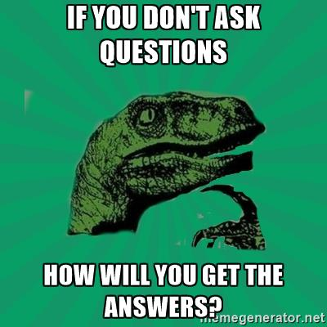

Slide 6
QUESTIONS?

Slide 9
Polaris PAC Forum
Laurie Meeske, BCCLS – laurie@bccls.org

