Slide 1
Leap into Service
Maximizing LEAP at Public Service Desks
Kristen Tait

Slide 2
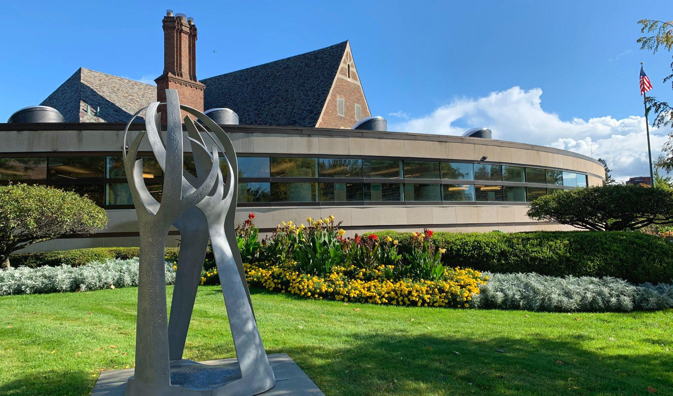
Kristen Tait
Baldwin Public Library
kristen.tait@baldwinlib.org
Notes:
Thank IUG, PIAC
Introduction: years worked, titles held, fun fact

Slide 3
Baldwin Public Library
Birmingham, Michigan
Class V Library - 38K service area
Open 67 hours/week, Monday-Sunday
Single branch
~23K sq feet main floor
140K circulating items
3 self checks
12 public computers
3 study rooms
Notes:
Always nice to know a bit about the library to see what is the same and what is different

Slide 4
Baldwin Public Library
Birmingham, Michigan
bigmoods.com
Notes:
Birmingham michigan suburb of Detroit (sticker by bigmoods.com in Berkley, one suburb over), suburban library in an urban setting (i.e. landlocked and parking is awful!).

Slide 5
Baldwin Public Library
Birmingham, Michigan
93 staff currently, including substitute librarians
3 service departments:
Youth, Adult, Access Services
3 public desks:
Youth, Adult, Circulation
Desks staffed by:
Librarians, Reference Assistants, Clerks, Circ Supervisors
Notes:
Staffed more hours than that (74 hours plus at least 10 more IT/Acquisitions hours)

Slide 6
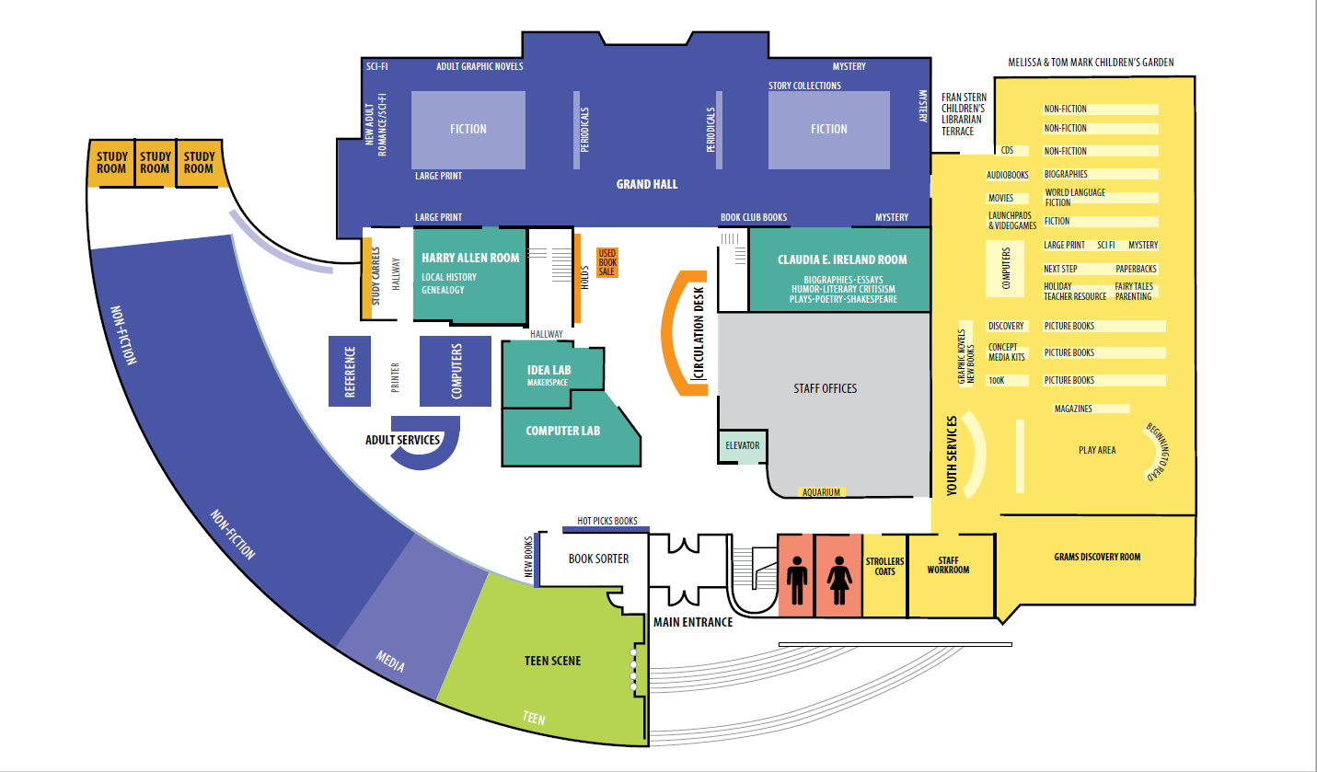
3 Public Service Desks: Youth, Adult, Circulation
Notes:
Location of desks

Slide 7
3 Public Service Desks: Youth, Adult, Circulation

Slide 8
3 Public Service Desks: Youth, Adult, Circulation
Notes:
Circ desk moving, renamed Information desk

Slide 9
ILS History
CLSI/Voyager ?-2006
Sirsi 2006-2019
Polaris (hosted) 2019-present
Started with 6.1
Currently on 7.3 since 2/23
LX starter notices since 5/23
Notes:
Only thing we miss about Voyager is the popup note that displays upon opening!
And Sirsi…nothing!

Slide 10
Maximizing LEAP
At
Public Service Desks
Shared settings & training
Youth Desk
Adult Desk
Circulation Desk
Questions/Suggestions
Notes:
Roadmap for presentation, caveats (talk too fast, oten prepare too much)

Slide 11
LEAP vs client
Aesthetics
Intuitive Design
Easy settings
One search box/find tool
One workform
Hyperlinks vs icons, menus
Web-based
Notes:
Leap is not perfect, client still better for cataloging (sidebyside workforms) plus sometimes easier to see linked information b/c right clicking mouse
Some of what I present is more than likely possible in the client, but either is cleaner-looking or easier to see in Leap
Click through each aspect:
Aesthetics - clean, white background not grey of early programs, easy on eyes
Intuitive Design - easy to train no matter the age/experience of staff - operates like most web pages
Settings are easy to change and utilize familiar web icons such as the hamburger menu, talked about in just a bit
One big change from client, touted I’m sure incessantly (!), is 1 search box “to rule them all”, plus a omni-directional find tool - can search first, then refine, rather than decide first what to search
Hyperlinks - rather than hard to see icons (although you memorize those) usually easy to bring up more information quickly
Also one workform to hold more information - patron registration, checkouts, holds, etc.
Web-based - no need to use separate program when out, at home plus for hosted no need for RemoteApp, can use even on phone or tablet

Slide 12
Baldwin Polaris Setup for public desks
Service Desk workstations
Individual credentials
Hold wrapper printer
Service Desk credentials
Notes:
Generic service desk workstations easily identify where an action happened, and since with Leap you can’t have two staff on same workstation, prevents that
Scroll wheel on mouse very helpful
Individual credentials also identify/pinpoint in case of issues, tracking of behavior for training, for example always misassigning the patron code/stat class. Also allows staff to work on own record sets and with own permissions. - workstations set to Admin permissions
We use sticky-backed hold wrapper paper, but also did not want to invest in too many new receipt printers (need special ones), so have 1 station logged in with generic credentials, these also have slightly more permissions that aren’t really advertised

Slide 13
Shared Settings & Training
Settings
Hamburger Menu
Search Box
Find Tool
Permissions
Applies to all public service desk staff
Training database useful beforehand

Slide 14
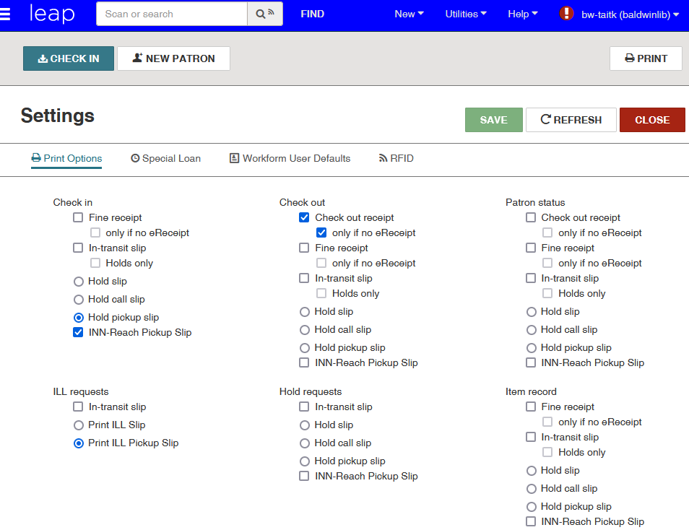
Shared uses & training: Settings/Print Options
2
3
Notes:
We set every desk staffer’s print options the same, so can float wherever and have same response

Slide 15
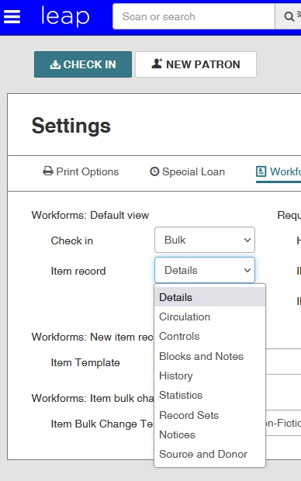
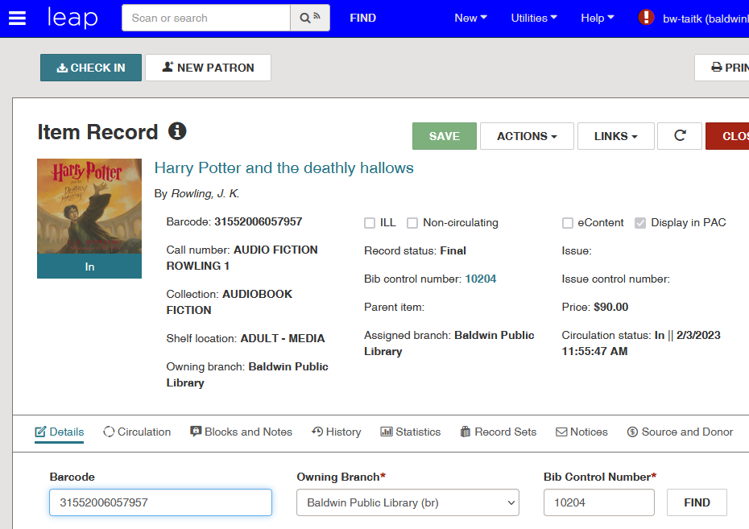
Shared uses & training: Settings/Workform Defaults - Item
2
3
*
*initial opening of workform
Notes:
We initially set to history, but found most staff like it set to details for easy editing. Note that this is only for the initial opening of a workform, if you close and return it will reopen where you left off, same with patron workform

Slide 16
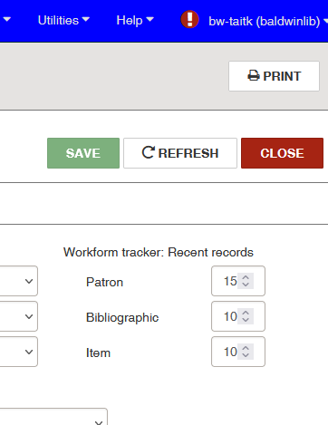
Shared uses & training: Settings/Workform Defaults - Tracker
2
3
Notes:
Encourage this to be high at first, esp patrons/Circ, items/bibs/Youth & Adult - this helps with next shared use of…

Slide 17
Shared uses & training: Hamburger Menu
2
3
Notes:
This menu, click to next

Slide 18
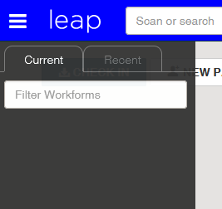
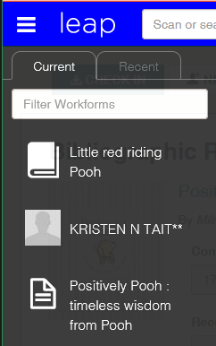
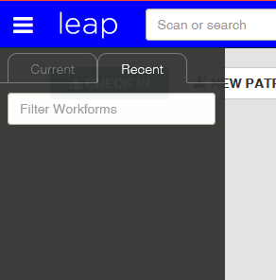
Shared uses & training: Hamburger Menu
2
3
Notes:
Current & Recent workforms tracked, icons for both - sometimes forget which is bib and which is item (bib in middle of list)
Single most helpful tool in Leap! Great for going back to fix an item record, or track a patron

Slide 19
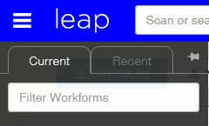
Shared uses & training: Hamburger Menu
2
3
Notes:
Another feature is pinning open the menu - left up to staff, it does resize the remainder of screen so if not wide monitor don’t advise

Slide 20
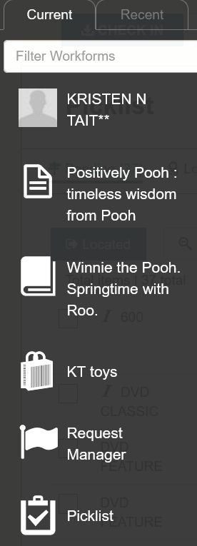
Shared uses & training: Hamburger Menu
Patron
Bib
Item
Record Set
Request Manager
Picklist
2
3
Notes:
Current will show icons for all workforms, but currently recent is only patron, bib, and item records - enhancement request for record set tracking!

Slide 21
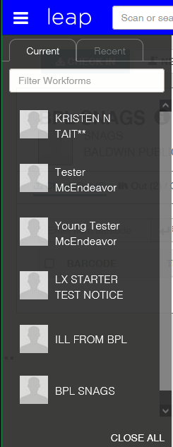
Shared uses & training: Hamburger Menu
2
3
Notes:
Best feature is close all - b/c we want staff to close everything and “see the quote” screen before logging off (remember we have individual logins at desks). Perennial problem of too many open workforms - just like your coworker with 30 tabs open in every browser and a desktop full of icons - and of course the dreaded “object lock”...

Slide 22
Shared uses & training: Search Box
2
3
Don’t skip training on this box!
More nuanced than just a straight boolean/keyword search
Notes:
Demo with Leap live? 2nd best thing about using Leap at desks is the quick retrieval/refinement of searches
Important to spend time training - amazing how staff hobble themselves with not utilizing all of the search capabilities in Leap
Less nuanced than search engine, though - beware!

Slide 23
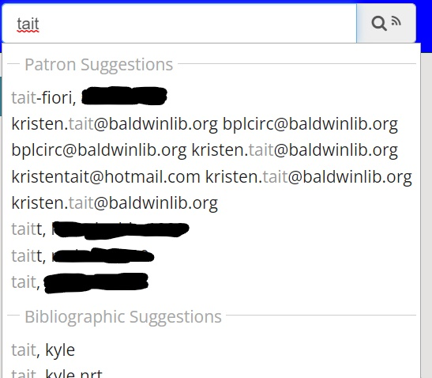
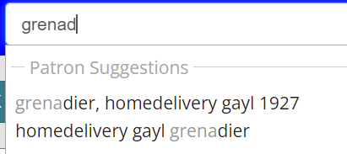
Shared uses & training: Search Box
Scan or type into the box
Be wary of predictive lists!
2
3
Notes:
Demo with Leap live? Predictive list has patrons listed by name, also email - name on ID too. Same patron can be listed twice, or email addresses listed before names (looks like 8 results display)

Slide 24
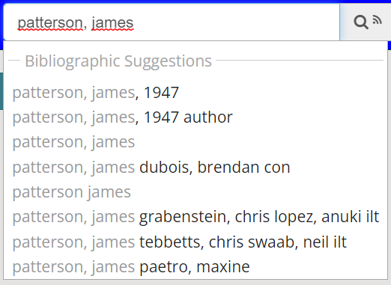
Shared uses & training: Search Box
Scan or type into the box
Be wary of predictive lists!
2
3
Notes:
Demo with Leap live? Here we see the value of authority records as well as the complicated search that will always be James Patterson! Come back to this example when discussing autopopulated find tool

Slide 25
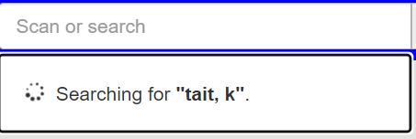
Shared uses & training: Search Box
Scan or type
Be wary of predictive lists!
It’s not Google either!
2
3
Notes:
Demo with Leap live? Incomplete names will not pull up as a “best guess” result if you hit enter before completing the name

Slide 26
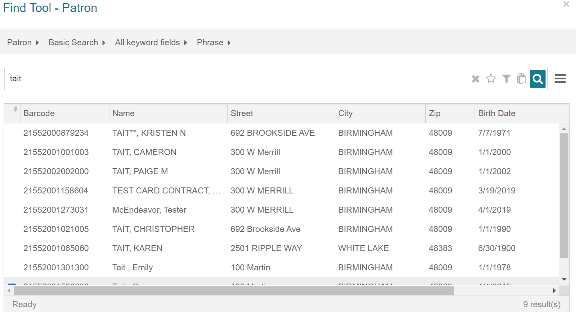
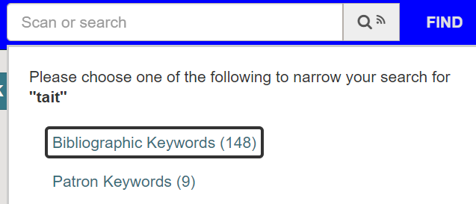
Shared uses & training: Search Box
Less is More
Use box to bring up autopopulated Find Tool
2
3
Notes:
Demo with Leap live? Type in one name, hit enter and Find Tool will pop up, sort by columns and generally narrow down more easily - also can find mistakes, duplicates, etc.

Slide 27
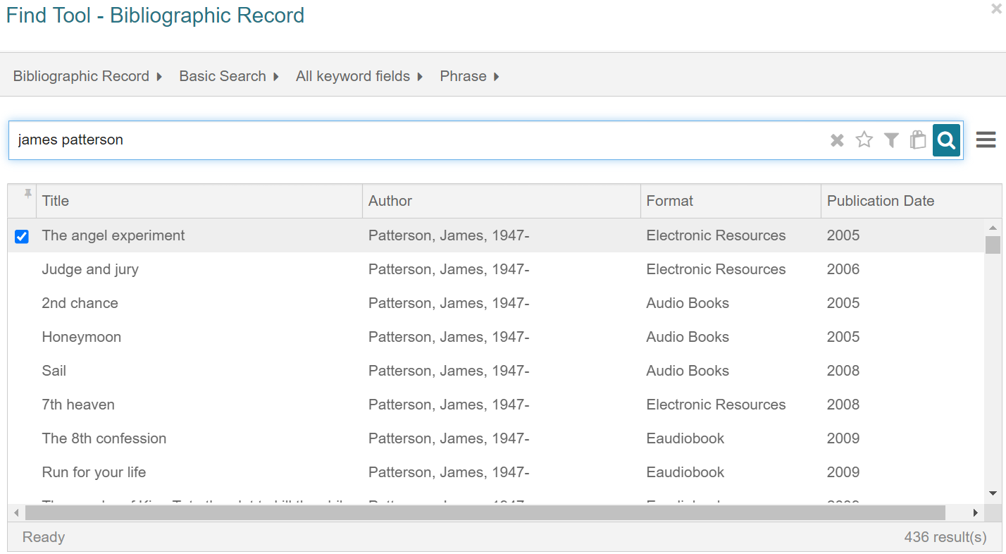
Shared uses & training: Search Box
2
3
Notes:
Demo with Leap live? Back to James Patterson By selecting just one you might not see all of the books, but if you hit enter instead it will bring up a Bib search in the Find Tool. If an author or title doesn’t match a patron then you will automatically get a bib search, vice versa for patron name etc that isn’t a bib record

Slide 28
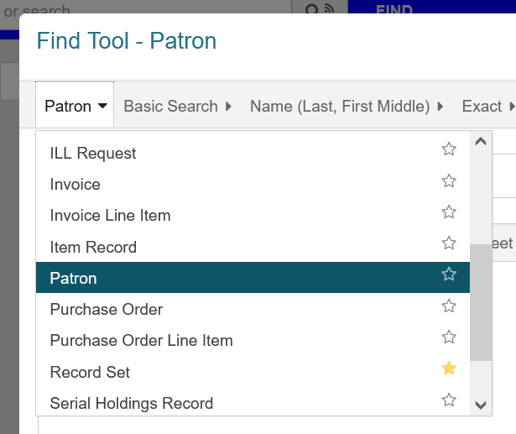
Shared uses & training: Find Tool/Default search option
Set up default search
17 possible now
Recommended:
Circulation - Patron
Adult - Bib
Youth - Item
2
3

Slide 29
Shared uses & training: Find Tool/Defaults for searches
Set up defaults for each search used
Mode
Qualifier
Relation
2
3
Notes:
Does anyone really remember these 3 names? We just say “skip the first, choose what to search by, then how”

Slide 30
Shared uses & training: Find Tool/Defaults for searches
Set up defaults for each search used
Mode
Qualifier
Relation
2
3
Train on titles like Room, Becoming
Notes:
Demo this search - nothing you can’t already do in client but visually makes more sense (left to right refinement of search)

Slide 31
Shared uses & training: Find Tool/Default Column Settings
Don’t forget about Column Settings!
2
3

Slide 32
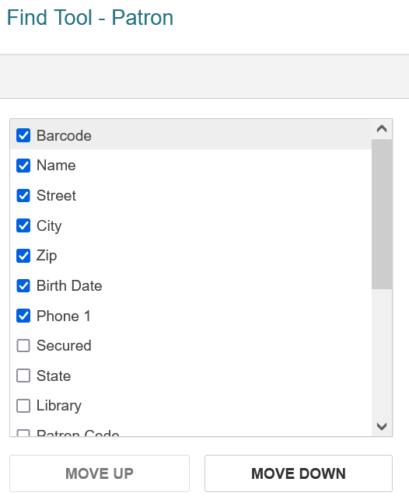
Shared uses & training: Find Tool/Default Column Settings
2
3
Notes:
Resized columns will stick too!

Slide 33
Shared uses & training: Find Tool/Default Column Settings
2
3
Notes:
Resized columns will stick too!

Slide 34
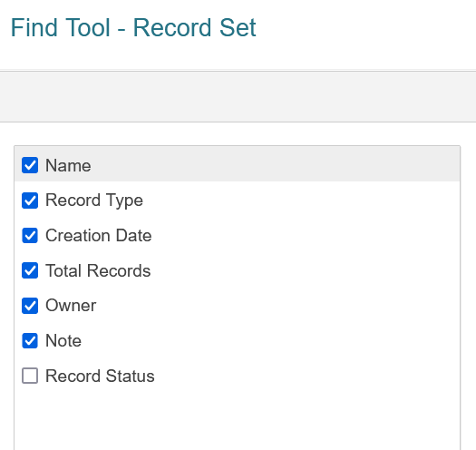
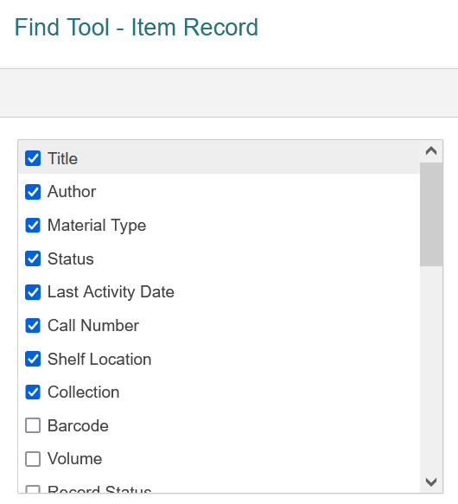
Shared uses & training: Find Tool/Default Column Settings
Customize for each type of search
2
3

Slide 35
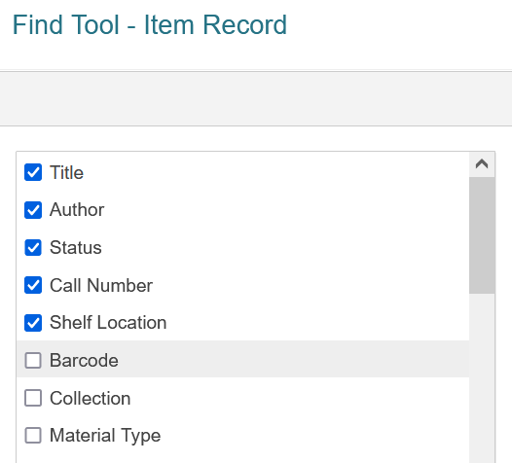
Shared uses & training: Find Tool/Default Column Settings
Customize for
each desk
2
3

Slide 36
Shared uses & training: Permissions
Use Permission Groups
As desk jobs change, add/subtract to reflect new duties (or prevent mistakes!)
Be open to allowing Clerks and Assistants basic cataloging permissions, if only from Checkin
Same with Sub Librarians, also for serials
2
3
Notes:
Yes, this is what Polaris always encourages - good advice! Just remember to have staff screenshot the permission they need if they are blocked from doing something
Not as intimidating for desk staff and assistants

Slide 37
Public Desks
Dedicated browser for LEAP (usually Firefox)
Staff log in with own credentials but to desk workstation
Separate browser for email, schedule, public catalog (usually Chrome to allow for login to profile)
Notes:
Hold wrapper issue with size of font, use Chrome at that station for Leap

Slide 38
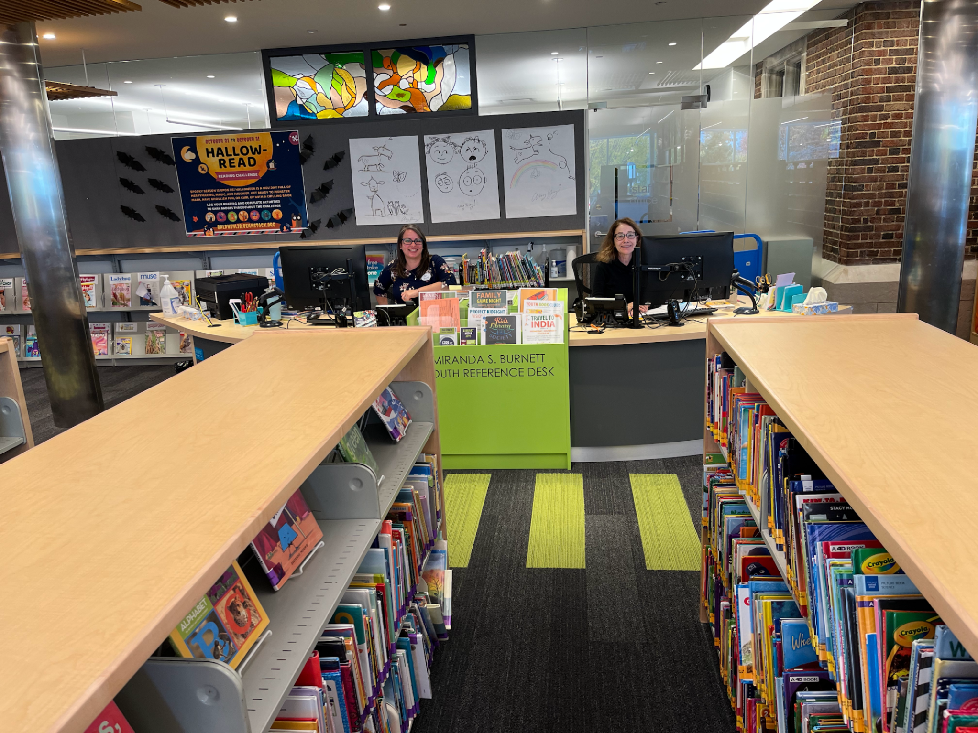
Youth Desk
Room for 2
Staffed by
Youth Librarians and/or
Reference Assistants
Notes:
With each desk highlight another use of Leap

Slide 39
Youth Desk
Record Sets for topics
Naming conventions
Notes:
With each desk highlight another use of Leap
Subject headings PAC still better/faster b/c search box

Slide 40
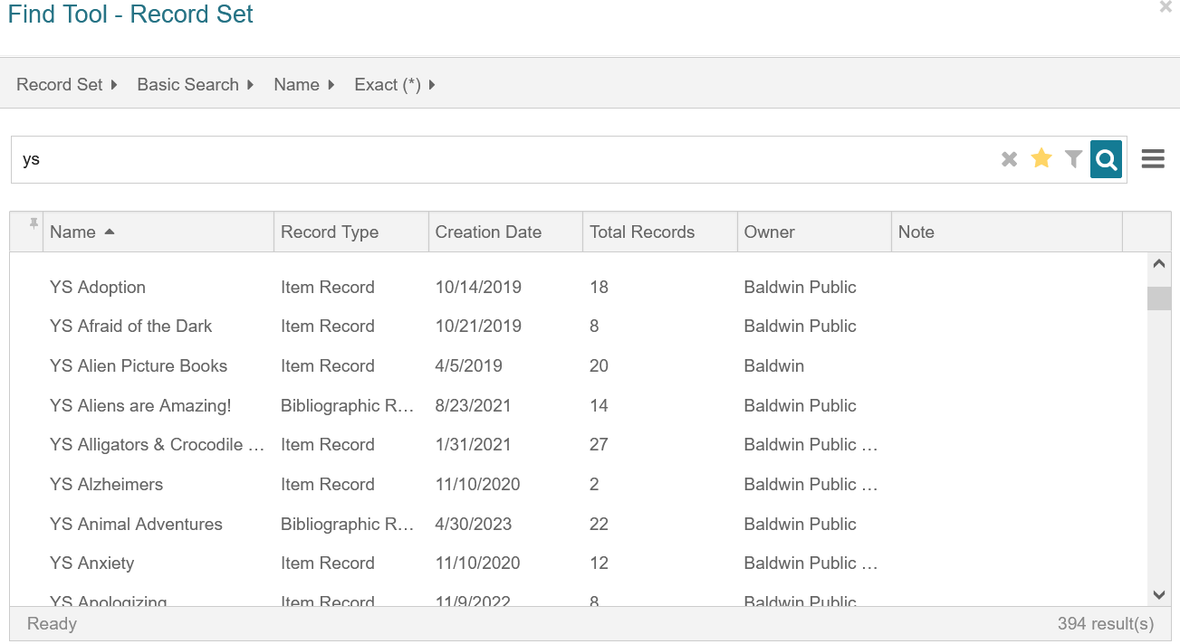

Slide 41
Youth Desk
Record Sets for topics
Naming conventions
Quick updates to Patron accounts
Bulk changes and cataloging fixes
Done remotely by volunteer
“Un-newing”
Record Set template
Notes:
With each desk highlight another use of Leap
Subject headings PAC still better/faster b/c search box

Slide 42
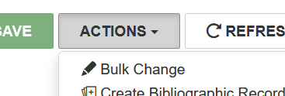
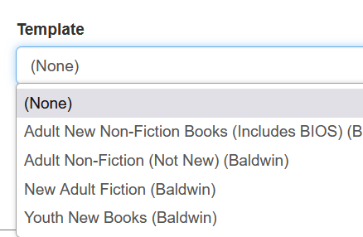

Slide 43
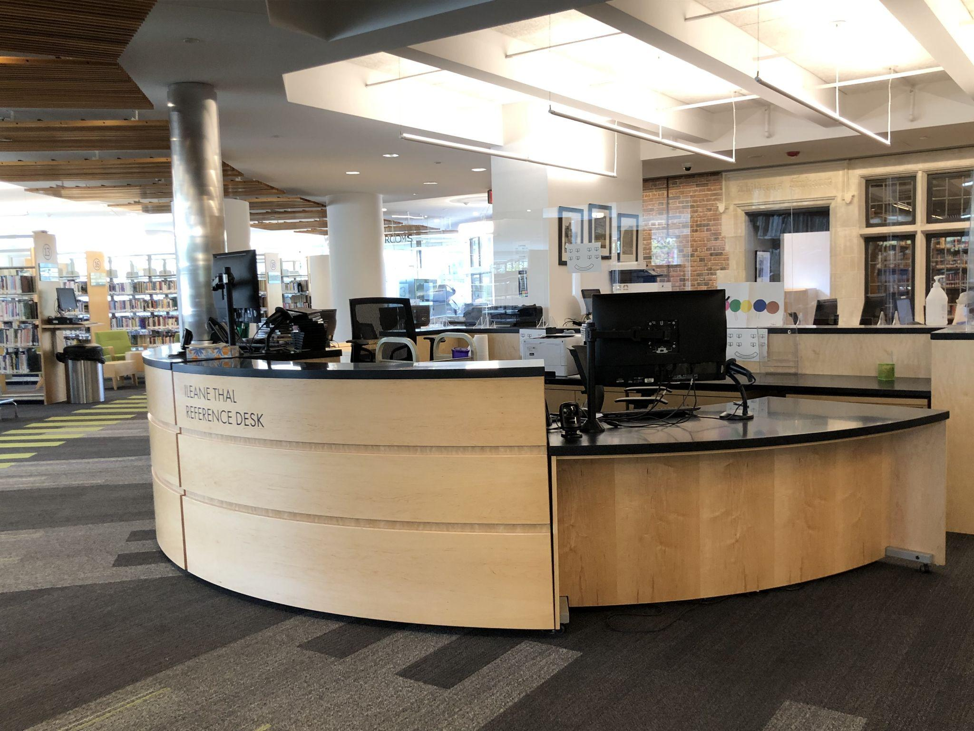
Adult Desk
Room for 2
Staffed by
Adult Librarians and/or
Reference Assistants
Notes:
Has changed from 2017 when first built, low station used to be by high station, also staffed by 3, one for each section and not open on one side

Slide 44
Adult Desk
Checking Patron accounts
Computers, Study Rooms
Notes:
Easy to tell at a glance if patron qualifies for study rooms, also quick updates for computer users
When placing holds, any patron workform that’s open will carry over as an option
Serials Checkin - mainly newspapers as have Reference Assistant who handles most serials

Slide 45
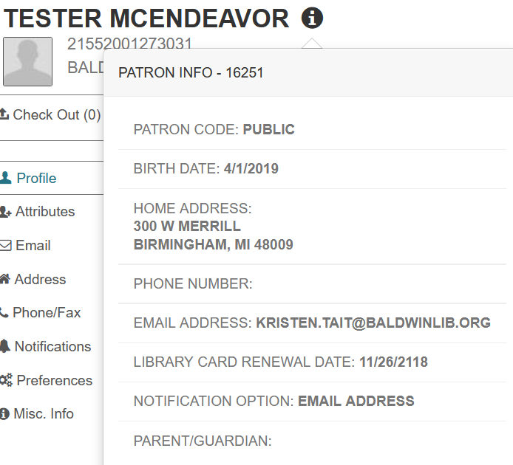
Notes:
Hover or click

Slide 46
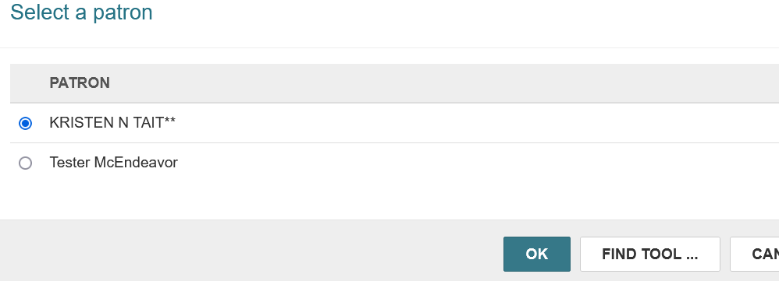
Adult Desk
Checking Patron accounts
Computers, Study Rooms
Placing Hold/multiple Holds
Patron carries over if open
Notes:
Easy to tell at a glance if patron qualifies for study rooms, also quick updates for computer users
When placing holds, any patron workform that’s open will carry over as an option

Slide 47
Adult Desk
Checking Patron accounts
Computers, Study Rooms
Placing Hold/multiple Holds
Patron carries over if open
Serials checkin
Ordering
Still switching librarians over
Notes:
Easy to tell at a glance if patron qualifies for study rooms, also quick updates for computer users
When placing holds, any patron workform that’s open will carry over as an option

Slide 48
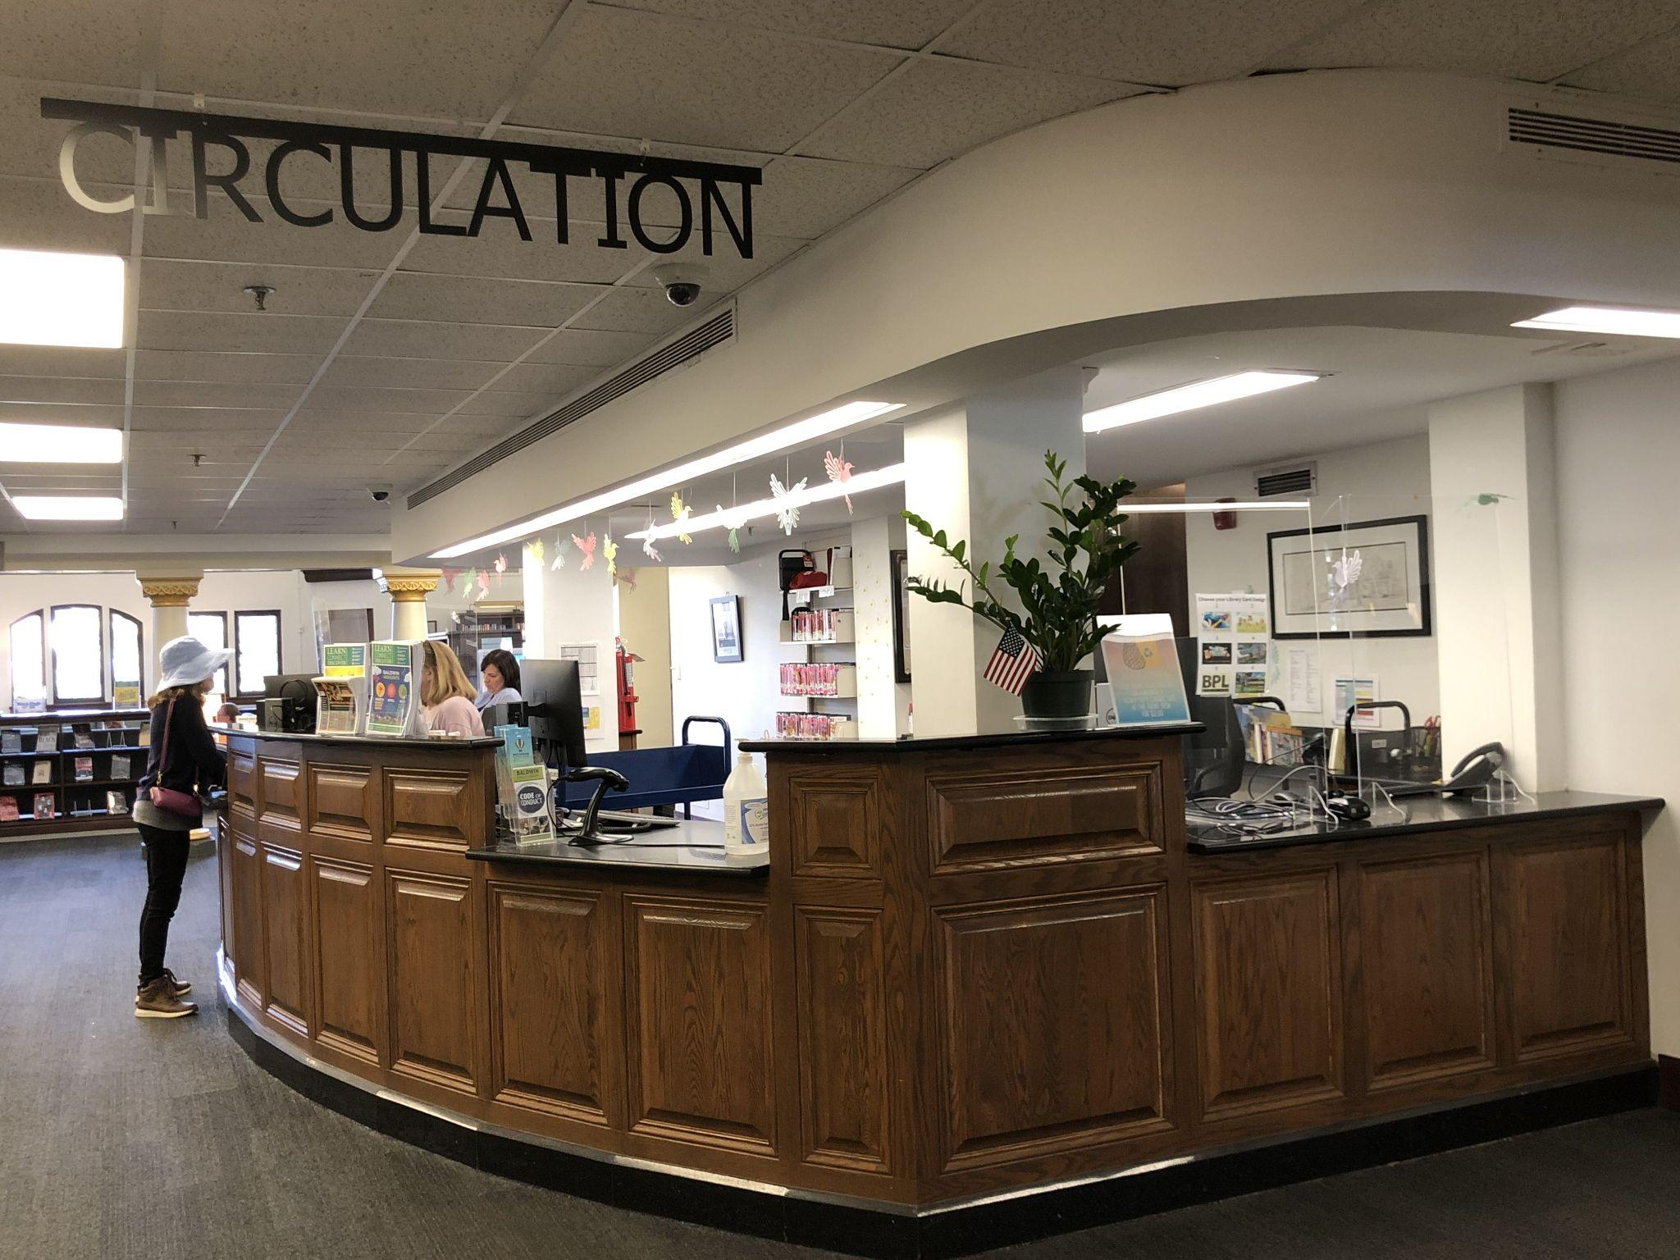
Circulation Desk
Room for 4 (!)
Always staffed by
Curbside Clerk
2nd Desk Clerk
Until 7pm M-F, all day Sa
3rd Desk Clerk all day Su
1 station for holds and as needed use by Supervisor

Slide 49
Circulation Desk
Searching for patrons
First name, Street, etc.
Notes:
Searching - can be done in client, yes, but no refinement needed with search box
Chester street fix as example
Inventory - karate chop sub (still not great)
Catalog fixes - demo live? Fixing call number, non-circ to circ, holdable to not holdable, Circ status changes for kits, toys - either from checkin or record

Slide 50
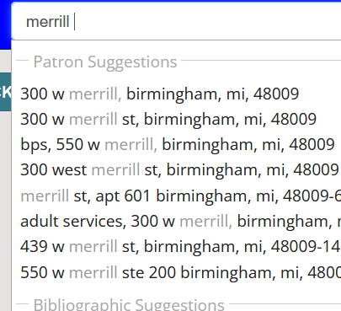
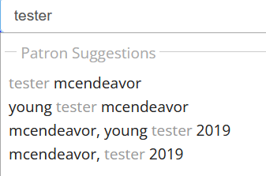
Notes:
First name - don’t have to preselect/choose which search to use
Street - can start with # or go straight to road
Useful for creating record set of addresses to fix (200 Chester as example if need)

Slide 51
Circulation Desk
Searching for patrons
First name, Street, etc.
Record Sets for Inventory
Alternative to CTRL-SHIFT-A
Notes:
Record sets display 250 at a time
Inventory - karate chop sub (still not great)
Catalog fixes - demo live? Fixing call number, non-circ to circ, holdable to not holdable, Circ status changes for kits, toys - either from checkin or record

Slide 52
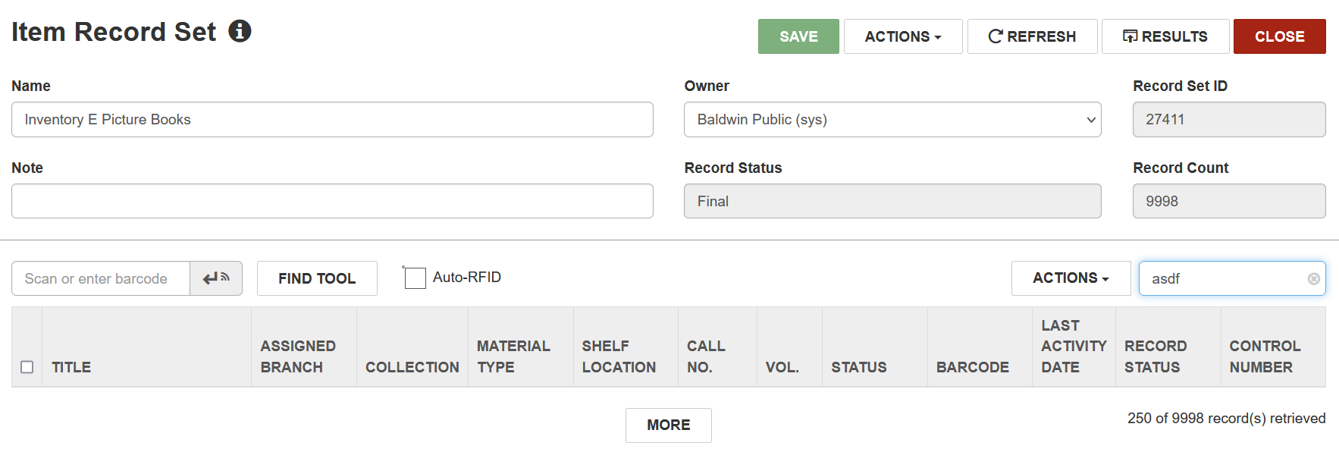
Notes:
If type nonsense into filter box then “more” button is in middle of screen (don’t have to scroll down 250 items) - demo live?

Slide 53
Circulation Desk
Searching for patrons
First name, Street, etc.
Record Sets for Inventory
Alternative to CTRL-SHIFT-A
Quick cataloging fixes
Magazines, call numbers
Changing Circ status
Notes:
Searching - can be done in client, yes, but no refinement needed with search box
Chester street fix as example
Inventory - karate chop sub (still not great)
Catalog fixes - demo live? Fixing call number, non-circ to circ, holdable to not holdable, Circ status changes for kits, toys - either from checkin or record

Slide 54
Circulation Desk
Record sets for mistakes
Record sets for Withdrawals
Easy duplication of patrons
Computer Users
Minors
Holds and ILLs (MeL) in one spot
Notes:
Searching - can be done in client, yes, but no refinement needed with search box
MeL - statewide lending, uses Inn-Reach - tabs next to each other

Slide 55
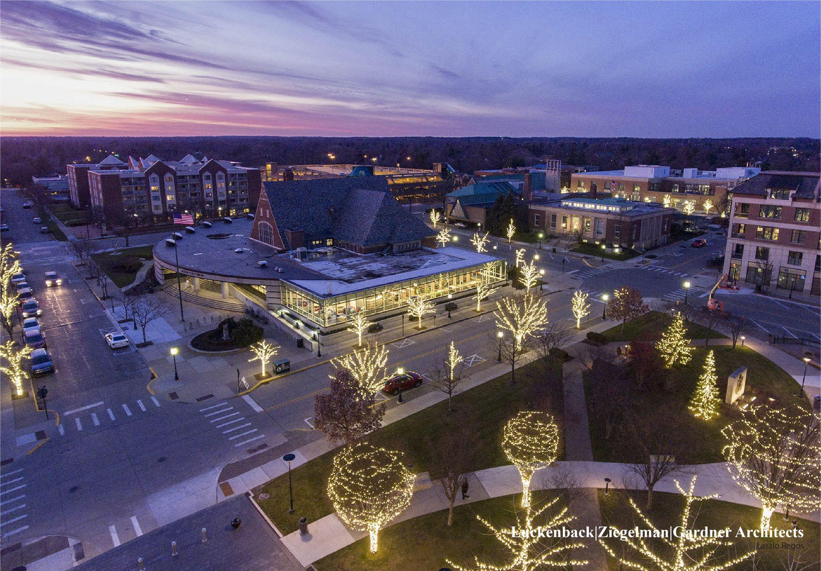
Kristen Tait
Baldwin Public Library
kristen.tait@baldwinlib.org

Slide 56
THANK YOU
Questions?

