Slide 1
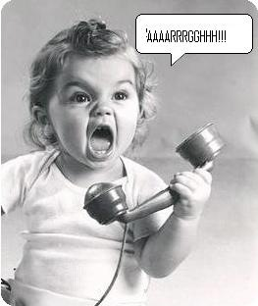
MANAGING STUDENT WORKERS
If he calls in sick one more time I’ll scream!!!!
This is not the time to do homework!!

Slide 2
RELAX AND TAKE A DEEP BREATH

Slide 3
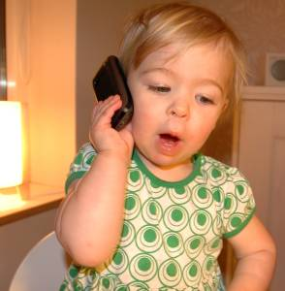
Everybody is Talking About It!

Slide 4
GALLOP POLL
A Gallup poll of more 1 million employed U.S. workers concluded that the No. 1 reason people quit their jobs is a bad boss or immediate supervisor. "People are quitting their bosses not their companies.”

Slide 5
Miss! Can I check this book out

Slide 6
Managing Student Workers is Important…….
This student worker has not idea what is going on

Slide 7
PRESENTATION IS THE KEY

Slide 8
Not My Problem

Slide 9
Know how you will Supervise
Be firm
Be fair
Be kind
Let employee know expectations during the interview.
Give feedback – if the job is good….say so. If the job needs more work…..say so.

Slide 10
I LOVE MY JOB! CAN’T YOU TELL!
Notes:
The way you feel about your job comes through
Help me with this next group of patrons

Slide 11
Select the Best Candidate
One huge mistake supervisors make when hiring is they look and act desperate for employees, so there’s no real planning
Please don’t hire without a scheduled interview
For “Pete’s Sake” check references

Slide 12
Looking the part

Slide 13
Ready to meet the public
Hard Worker

Slide 14
Motivate
Encourage
Acknowledge
Awards
Spotlight

Slide 15
Priority – Development of Student Workers
Represent the library
Promoted to Leaders
Changed a Life

Slide 16
Give Constructive Feedback
State why you’re giving feedback
Describe and Give Specifics
Describe your Reactions
Give an opportunity for response
Be clear and give examples
Summarize and give support

Slide 17
TRAINING! TRAINING! TRAINING!
Detailed Checklist with every task expected
Encourage questions
Provide and Train with Manual
No one is released to the desk alone before probationary training is over.

Slide 18
Alissa - inattentive

Slide 19
Aretha Video
ARETHA VIDEO

Slide 20
RESPECT – HARVARD BUSINESS REVIEW STUDY
Harvard Business Review(HBR) – study of 20,000 employees say respect is what they want most.

Slide 21
Managing with Respect
No other leader behavior had a bigger effect on employees across the outcomes that were measured. Being treated with respect was more important to employees than recognition and appreciation.

Slide 22
Dorothy Hargett
Regent University Library
Librarian – Head of Access Services
dorohar@regent.edu

Slide 25
Lawson, Willow, November 2005, Good Boss, Bad Boss, Psychology Today
Adair, J. E. (2010). Develop Your Leadership Skills. Philadelphia: Kogan Page.
Covey, Stephen, (1989) The Habits of Highly Effective People
Phillips, A. a. (2014). What Do We Mean By Library Leadership?
Leadership in LIS Education. Journal Of Education For Library & Information Science, 55(4), 336-344.
Leatherman, D. (2008). Quality Leadership Skills : Standards of Leadership Behavior. Amherst, Mass: HRD Press
Maxwell, John C. , Leadership 101: What Every Leader Needs to Know
Winston, Bruce (2002). Be A Leader for God’s Sake

