Slide 1
Improving Paging
Tuesday, April 24, 2018
4:30 PM
Oceans 4
Notes:
Jeff Start Here

Slide 2
Presenters
Robert Pesale
Automation Coordinator
Clayton Nummer
Information Technology Specialist
Jeff Crocker
Main Library Branch Manager

Slide 3
Our Library
Two locations
71,755 service area population
69,559 users in system
2,879,560 million circulation

Slide 4
Holds Filled
77,051
Title Paging – Librarians
INN-Reach Paging – Circulation Assistants
Holds Triggered – Circulation Clerks

Slide 5
Why Paging?
We observed occasions where there were systematic breakdowns
Items fall off the paging list after a set number of days
Holiday weekends are majorly affected
Unfound items could be forgotten about
List was split up by building, not department causing bleed-over
Multiple requests show up on the hold list for the same item even if only one copy is available
Ambiguous item descriptions
Notes:
Rob Starts Here
All items at Main were defaulting to both Adult and Youth (Harry Potter Example)
Items show up on the paging list that aren’t able to be grabbed (Best Sellers Items)

Slide 6
Why Paging? (Continued)
We identified areas in the process where the workflow could be greatly improved
Staff need to constantly go to the desk to find out more information about the hold
Difficult for multiple staff to participate on the same list together
Paging required printing, forcing a set time (once an hour) which delays response time
Notes:
Needed to wait for holds to be triggered before running paging again to ensure you weren’t looking for the exact same item
Harry Potter Example
As soon as the list is printed it’s inaccurate

Slide 7
The Plan
Hash out a system that will appropriately address all issues
Decide what programming language(s) and APIs to utilize
Establish the necessary logic and then code, code, code
Optimize Logic and SQL queries
Present working product to staff and find out if anything is missing
Identify beta group
Roll it out

Slide 8
Programming Languages Used
PHP
Primary coding language used to interact with databases
Used to dynamically display information to the Librarians
MySQL
Stores information pulled from SierraDNA
Used to track comments and items paged
PostgreSQL
Database language used to interact with SierraDNA
HTML / CSS
Used to layout a mobile-friendly frontend digital paging system

Slide 9
What is SierraDNA and Why Choose It?
PostgreSQL database that can only be used to view information (doesn’t allow you to change anything in Sierra)
Requires a Sierra user with permission to SierraDNA
https://techdocs.iii.com/sierradna/
SQL queries are more efficient than RESTful APIs for pulling large amounts of data
More data is accessible through SierraDNA
We had no need to write any information to the database

Slide 10
Logic Overview
Use SierraDNA with an extremely elaborate query to pull all page-able holds
Identify which hold gets priority
Determine the best department to look for the item
Populate MySQL table with those items
Use HTML to display paging system to librarians
Notes:
Clayton Start Here
263 Lines of code in initial query using 5 temp tables and referencing 11 tables
Department determined by pickup location and number of copies available per department

Slide 11
Logic Overview Of System Functions
MySQL:
Display Record Num
SierraDNA:
Display Item Info
Location, Barcode, Call #, etc.
MySQL:
Comments Section
MySQL
Display Patron Barcode
Display Patron Last Name
MySQL
Logs Current Date / Time
Clear Date / Time Every 15 Minutes
Notes:
Patron information allows for a quick MeL Request without going back to the desk and checking Sierra

Slide 12
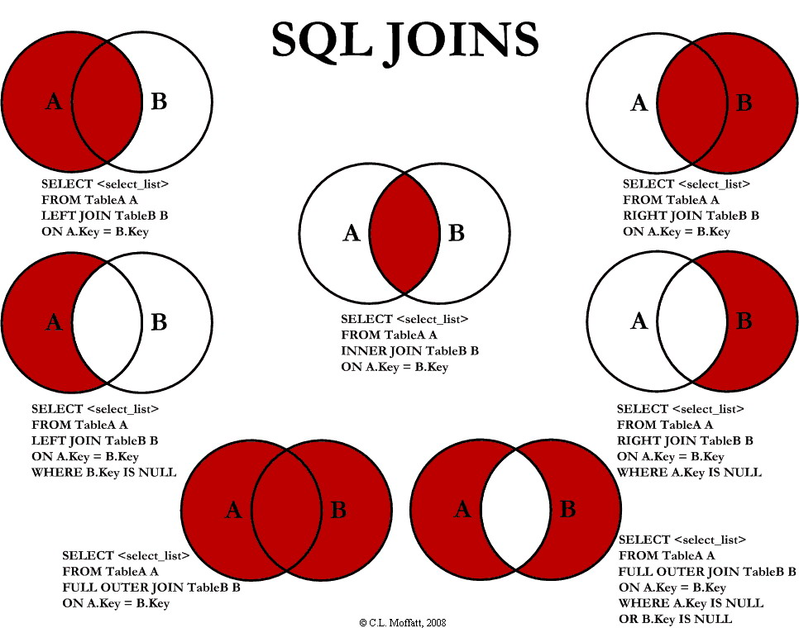
How To Best Optimize Your Code
Reduce the amount of records being polled as quickly as possible
Know your JOINS
Not all tables are the same
Make sure you use the appropriate one
SQL handles data more efficiently than PHP
Notes:
Know the order that you want to make your joins
Two tables might have the same number of records, but one could have 10 fields whereas the other has 25. Use the one with 10 if you can

Slide 13
Initial Query Results
Holds with issues
332 holds not triggered because the Bib Record status was “On Order” even though items were available
199 holds on bibs that no longer contain any items
143 items stuck “In Transit”
70 holds for ineligible patron types
Manually triggered 8 holds from our system that no longer displayed on Sierra’s paging report to confirm our system was accurate

Slide 14
Asked The Staff What Was Missing
To our delight, they only asked for three things:
Utilize OPAC Message to help identify item locations
Add the ability to have a comments section
Improve the display order of holds
Notes:
Rob Start Here
OPAC Message: Items in storage, TV Series, Displays

Slide 15
The Beta Test Results
Rolled out the system to an isolated location
For one month, staff printed out paging lists from Sierra and compared it to our list of items to make sure we weren’t missing anything
Our system was displaying Frozen Holds to be paged
Items that shouldn’t have holds were showing up on paging
Patrons that shouldn’t have holds were showing up on paging
Post Results
Established a method for identifying specialty hold cases
Notes:
Items that shouldn’t be displaying (eBooks, eAudiobooks). To resolve this we hide them from paging now, but run a monthly report to help staff correct the BibRecords that have issues.
Specialty Holds: Homebound and Outreach
Allows the staff member to have the items given directly to them for processing and delivery

Slide 16
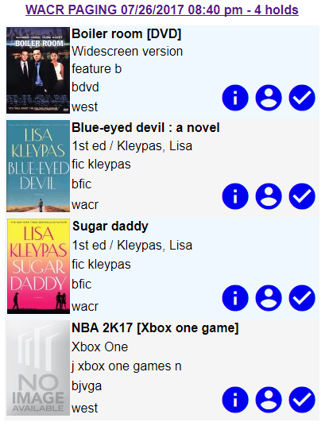
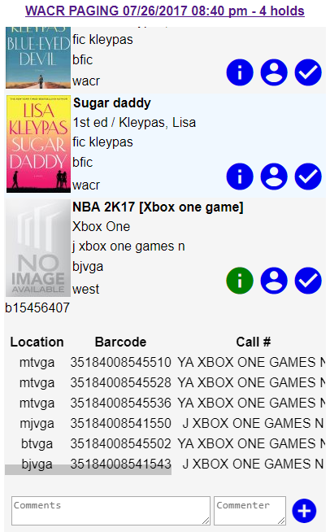
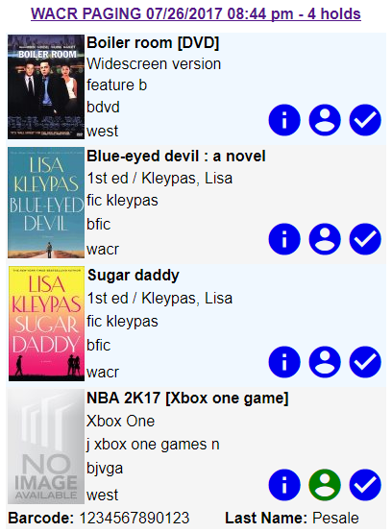
Screenshots
Notes:
1st screenshot shows what the paging system looks like
2nd Location, barcode, call#, status, Created/Last Checked In date and location where last checked in
3rd Shows Barcode and Lastname of patron
Check button is used to mark item found

Slide 17
Hacks and Hints
Use PGAdmin and SQLWorkbench to optimize and develop queries
Temp tables are permitted in SierraDNA
Create a method to notify the coders of additions and deletions of any statically defined fixed fields
Innovative has a sandbox database that you can use to play around and learn
Notes:
Statically defined fixed fields: Opac Message Notifies Automation

Slide 18
Live Demo
Let’s see this thing at work
Notes:
Clayton does Demo

Slide 19
Cause And Effect
We now run the following reports to help keep the system clean and know when we need to contact patrons
Bib Records On Order
Billed Items*
High Holds (weekly)
Items On Holdshelf Too Long*
Items In Transit Too Long*
Items Lost & Paid*
Missing Barcodes
Missing Items*
* Run for each department (Adult, Youth, Branch Location)
Notes:
Jeff Starts Here
High Holds Report differs from III because ours takes the current orders into account when it processes

Slide 20
Enhancements
Track user productivity
Allow filtering of paging list
Incorporate the MeL API for facilitating a MeL request
Convert to an App so that the NFC reader can be incorporated

Slide 21
Questions?
Robert Pesale – pesalero@wblib.org
Automation Coordinator
Clayton Nummer – nummercl@wblib.org
Information Technology Specialist
Jeff Crocker – crockerj@wblib.org
Main Library Branch Manager

