Slide 1
“What’s in a name?”
Quite a bit! Language matters!
Emily O’Neal – Deschutes Public Library

Slide 2
Overview
I am here to discuss changes you can make within your bibliographic data to add more inclusive language for your customers. Examples include:
Removing old, offensive or archaic terms
Adding new, more inclusive and socially accepted terms using locals subject headings and alternative vocabularies
Using your ILS and vendors to keep the data current with your new terms
Notes:
Respectful language choices in access points is one way to work towards anti-oppressive librarianship and cataloging word choice and content does exactly that.

Slide 3
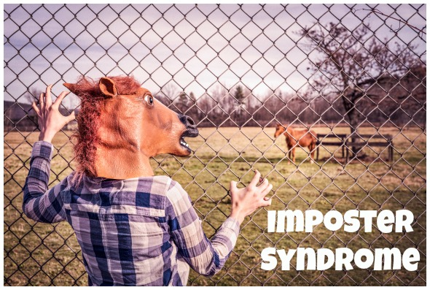
Introduction and Starting the Conversation
Emily O’Neal – Technical Services Manager, Deschutes Public Library
Photo credit: https://www.debbish.com/wp-content/uploads/2016/04/imposter-syndrome-.jpg
Notes:
Worked in innovative systems most of my library career – consider myself an expert by way of exposure
I am not an expert but instead, see the importance of the work and stepped up to the call for help – I was asked to do this presentation.
This means you don’t need to be an expert to do the work. This is more about realizing the need than to expect to know everything.
I stepped forward because it is important to do so
I’ve been thinking about this for some time, so my headspace was already where it needed to be when I was asked to present.
Perhaps the first step for everyone, is simply to set intention and to create that thought process and headspace.

Slide 4
Step 1 – Out with the old, in with the improved!
Photo credit: http://www.onyxtruth.com/wp-content/uploads/2016/09/brown-liquor-experience-onyx-truth-podcast-network-onyx-truth.jpg
Notes:
The first step is to identify and change immediately obviously bias and inappropriate subject headings
Example: Illegal aliens, Indians and mixed-race people, tomboys

Slide 5
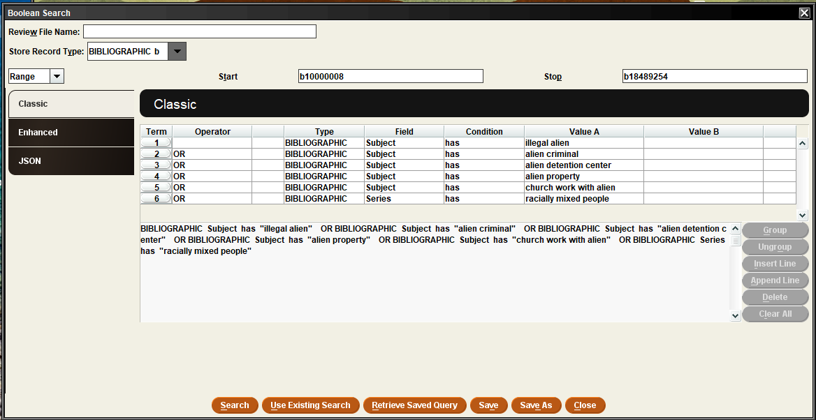
Specifically, it looks like this:
Notes:
Create lists – search for terms

Slide 6
Global Update
Notes:
Global update
Be aware of case – you may need to go back and change some upper case to lower case by hand
Process on a regular basis – weekly?
NOTE: typo on this screen – you would want to update the indicators as well as part of our global update

Slide 7
Step 2 – think like your user
Photo credit: https://res.cloudinary.com/people-matters/image/upload/q_auto,f_auto/v1501659036/1501659034.jpg
Notes:
Add local subject headings (or alternative vocabularies, such as ERIC or homorsaurus) to add additional subject headings for better and more inclusive search results.
Examples: “queer”, “LGBTQ”, and “#ownvoice”
Use other keyword searchable fields if needed
You’ll care more about local subject heading based off our discovery layer. We use Bibliocommons, which doesn’t use the authority records, so we are really looking into keyword access from the bib record. This may be different for you based off your systems.

Slide 8
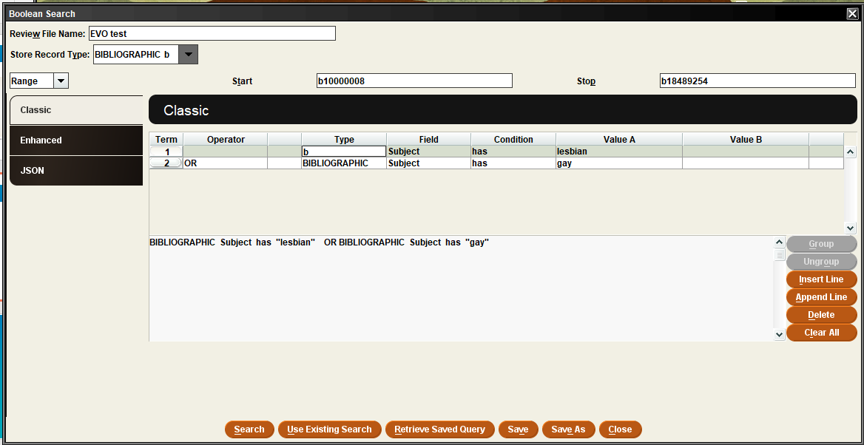
Specifically, it looks like this:
Notes:
Create lists – search for terms

Slide 9
Global Update
Notes:
Global update to insert variable-length field

Slide 10
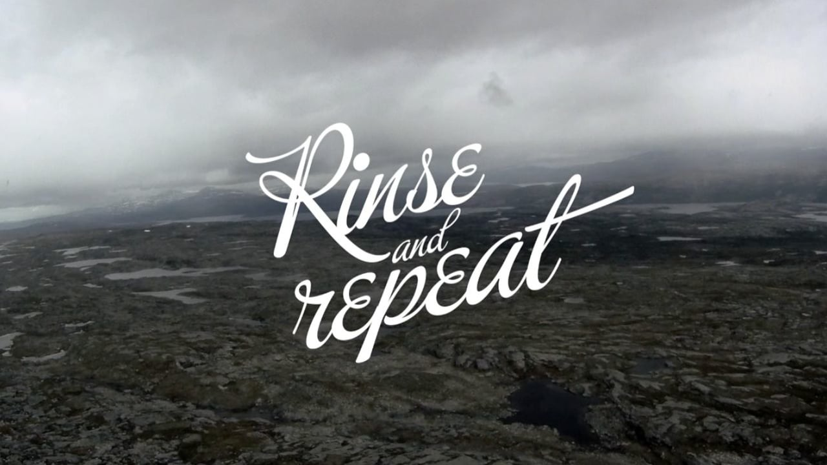
Make it automatic: Option 1
Photo credit: https://i.vimeocdn.com/video/266696869_1280x720.jpg
Notes:
Do the same work weekly by catalogers using global update. Good place to start, but as you gain more and more terms to change, may need another plan.

Slide 11
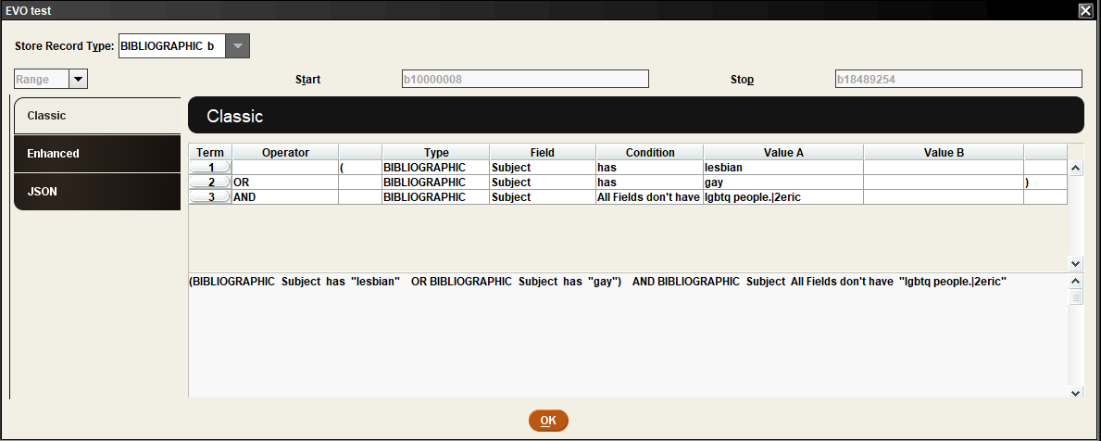
Ongoing maintenance reminder:
Option 1:
Option 2:
Notes:
To avoid duplicates

Slide 12
Make it automatic: Option 2
Photo credit: https://cdn.pixabay.com/photo/2017/10/24/12/30/charge-2884416_960_720.png
Notes:
Load profiles

Slide 13
Load Profiles – now we’re getting technical
Use translation tables
%map=(“m2bmap.subject”)
Means %map – command to map the line using
M2bmap – a mapping table
Subject – called subject ← where you will outline the mapping/translating to happen.
Sooooo, example:
600-699||-w|0|0|0|b|d|0|y|N|0|%map=(“m2bmap.subject”)
Says, for all subject lines, refer to subject translation table
However, can only do one translation table (ex: m2bmap.subject) per command line, so your subject translation table will need to have all possible translations within it’s command
i.e. all of the subjects you would want to change, need to be outlined in this single translation table.
It may also be helpful to add @stop_on_map=true,
As soon as it finds a match, stops, makes the change, and moves on.

Slide 14
Translation tables – even more technical…
m2bmap.subject
Input the command: <comparison>|<replacement>
Example:
Line 1: Children of illegal aliens|Children of undocumented immigrants
Line 2: Illegal aliens|Undocumented immigrants
NOTE: do the longest subject heading first to make sure it catches it and makes the appropriate changes

Slide 15
But then there are subfields… you’ll need regular expressions to protect those
Example:
(.*|a)$0Illegal aliens(.*)$1:\0undocumented immigrants\1
.* ← any character any number of times
|a ← subfield a
( ) ← content within the parenthesis assigned to a value of $0
Illegal aliens ← the current subject heading
.* ← any characters are number of times
( ) ← content within the parenthesis assigned to a value of $1
: ← translate to
\0 ← re-add the any characters assigned to $0
Undocumented immigrants ← new replacement subject heading
\1 ← re-add the any characters assigned to $1
BUT… this won’t change the indicators, only the subfield data (so 650 _4 to 650 _7)
PLUS, you need to consider duplicate subject headings
Notes:
AND, this is a LOT of work, for even just one term, what if you have hundreds of terms?

Slide 16
That’s all fine for one term, but what if you have hundreds?
Photo credit: http://erinmakesitwork.files.wordpress.com/2011/03/photoxpress_5462141.jpg
Notes:
AND, this is a LOT of work, for even just one term, what if you have hundreds of terms?

Slide 17
Make it automatic: Option 3
Photo credit: https://cdn.pixabay.com/photo/2017/10/24/12/30/charge-2884416_960_720.png
Photo credit: http://www.picpedia.org/highway-signs/images/vendor.jpg
Notes:
Authority vendors!!

Slide 18
Identifying terms
Areas of focus – Government Protected Classes:
Race
Color
Religions
National Origin
Age (40+)
Sex
Disability
Added areas of focus include:
Sexual orientation
Familial status
Veteran status
Genetic info
Pregnancy
Identify alternative vocabularies:
ERIC - Thesaurus Category - Social Processes and Structures (ed.gov)
Homosaurus Vocabulary Site
Notes:
First, identify a full list (or as full as you can) that you would like to add or change.
A good way to focus this work is by looking at protected classes
You can also use alternative vocabularies to help find better terms to use

Slide 19
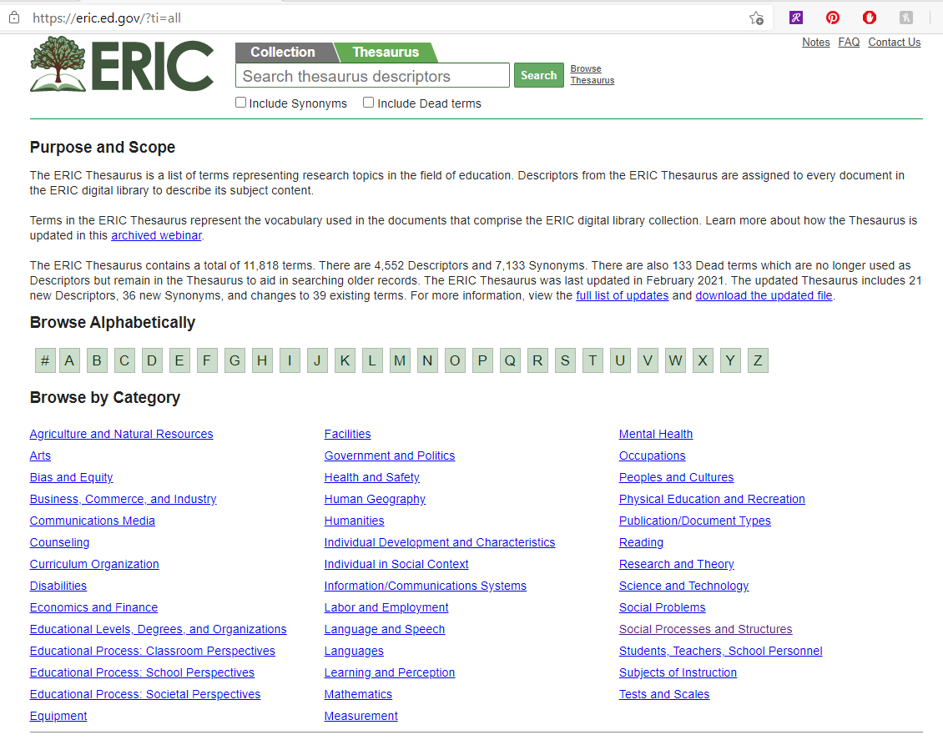
Notes:
Browse thesaurus
Identify headings of focus based off the above listed protected class
Use the ERIC term identified
Assess the heading with the following:
Decide if you want to use this heading
Determine if this subject heading is one to add to our current records or
Replace an LC subject heading
Review narrower, use instead, and broader terms for additional possible changes/additions

Slide 20
If “this”, replace with/add “that”
Notes:
Create a worksheet of the changes you want to outline

Slide 21
If “this”, replace with/add “that”

Slide 22
“Shout out!” to Backstage
Photo credit: http://www.pngall.com/wp-content/uploads/2016/04/Thank-You-PNG.png
Notes:
Truth be told, we haven’t gotten this far yet – but the way it is supposed to work is:
Identify all of the 100% of the time, add this or replace with that statements – needs to be black and white, no grey area
Send mapping of terms to Backstage
Backstage adds these changes to our automatic processing profile
Every time we send new bib files, the data will automatically be changed to our mapping based off the computer program

Slide 23
Automatic, but not perfect
You will still need catalogers for the grey areas! No computer program can do all of the work.
You can add the broader terms with more confidence but narrower terms will need human intervention
Example:
Adding Native American tribe and region information
Okay to add “Economic status” to all books with subject heading “poverty” but cannot immediately add “poverty” to all subject headings with “Economic status”.
Be careful with full removal of subject headings
Remember this is an access point – would someone still use that term to search by?
If so, is that term so offensive that you are accepting removal of the access point in favor of a more sensitive catalog?

Slide 24
Remember that the catalog is an extension of your library, it is a part of your brand and the words and terms used represent you. Make sure you can stand behind those words.

Slide 25
THANK YOU
Questions?

