Slide 2
When what you need don’t meet your eyes…
Automating Polaris with AutoHotkey

Slide 3
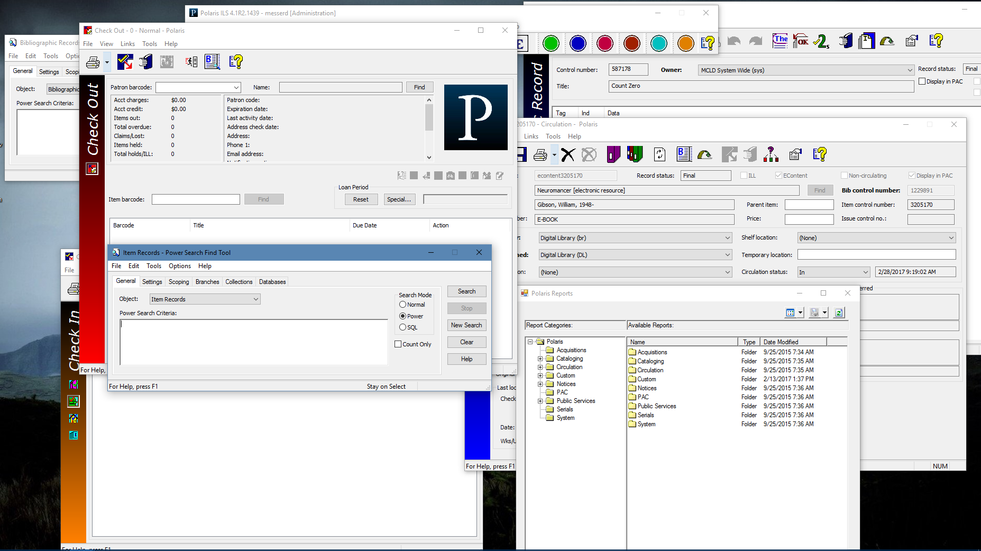
Isn’t Polaris awesome? It does so many things!

Slide 4
Except for all the things it doesn’t do

Slide 5
You have tools you might not be aware of…

Slide 6
AutoWhatNow?
Scripting language for Windows
Free and open source software (FOSS)
Create hotkeys
Write macros
Automate programmes
Fairly easy to learn
Lots of documentation and forums to help

Slide 7
Have a look!
MsgBox Settings saved. `nBranch Selected: %Branch%`nCheck In: %WillCheck%`nClick okay to set up Polaris.
; --------------------------------------------------------------------
; RUN AND LOGIN TO POLARIS
run, "C:\ProgramData\Microsoft\Windows\Start Menu\Programs\Polaris\4.1R2\Polaris ILS" && pause
Sleep, 5000
send {Tab}{Tab}{Enter}
Sleep, 1000
send ^l
Sleep, 1000
send +{Tab}**USERNAME**{Tab} ;INSERT YOUR POLARIS USER NAME HERE
Sleep, 1000
send **PASSWORD**{Enter} ;INSERT YOUR POLARIS USER PASSWORD HERE
Sleep, 2000
send {Down %BranchSelect%}
Sleep, 2000
send {Enter}
Sleep, 2000
send !ci
; --------------------------------------------------------------------
; --------------------------------------------------------------------
; UNCLAIMED PROCESSING WORKFLOW
ProcessUnclaim:
^!u:: ;Triggered with CTRL ATL U manually, but also will be called by subroutine
send {Enter}

Slide 8
And now, four problems in ~8 minutes
Importing from Excel into record sets
Processing unclaimed holds and adding a fee to patron accounts
Waiving ~1,000 fines from a Food for Fines event
Updating a feature on PowerPAC Dashboards

Slide 9
Importing from Excel into a Record Set
Spreadsheet contained bib record control numbers
Needed data out of Simply Reports
Use AutoHotkey to emulate keyboard commands
Create a CSV file from the spreadsheet
Set up Polaris – Bib record set find tool set to search for control numbers
Create a loop that bounces back and forth between the CSV and Polaris – copy and paste

Slide 10
Processing Unclaimed Holds
Emulate keyboard commands and activate with a hotkey trigger
PUMMEL – Processing Unclaimed Materials Manually is Essentially Lame
Start with the item find tool and scan the barcode
CTRL + ALT+ U (U is for Unclaimed)
Runs a macro that handles all the user input, including adding a note
Version 2 can work from a list of barcodes

Slide 11
Waiving ~1,000 Fines
Automating Patron Status -> Account -> Waive
Pulling from a CSV with two entries per line: the patron barcode and the amount to be waived
Since it involved money, there were two exceptions written into the script to catch errors
Errors were documented in a file: exceptions.csv
Fire it off and watch it work

Slide 12
Updating a Feature on PowerPAC Dashboard
On-order items – three links to Wowbrary
Every week, a number in the middle of the link increments by one
Automating Administration -> Explorer -> System -> Profiles -> PowerPAC -> Dashboards: Web part construction -> User Defined
Edit the web part, get the link, check the number, add one, hit enter, repeat two more times, and save

Slide 13
Everything I do is open source
github.com/cyberpunklibrarian
danielmesser@mcldaz.org
Daniel Messer
Integrated Library System Administrator
Maricopa County Library District

Slide 14
Thank you!
Enjoy the rest of the conference!

