Slide 1
Troubleshooting
NETLOGON
Presented by: Wes Osborn - Central Library Consortium

Slide 2
Stuff NETLOGON says....

Slide 5
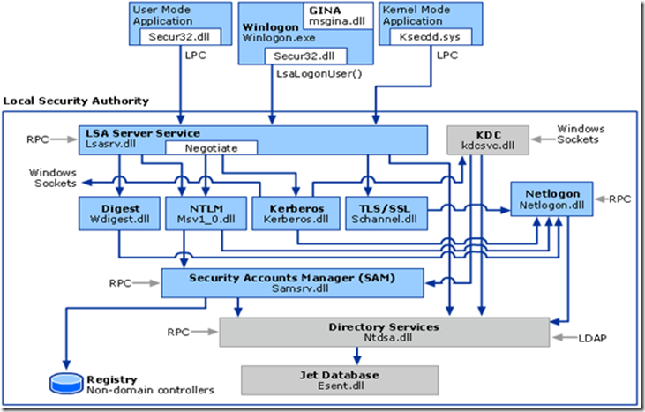

Slide 6
If NETLOGON dies

Slide 9
Have any of these ever happened to you?
1. Users may be prompted for authentication even though correct credentials are used.
2. Slow authentication (may be intermittent or consistent); this may mean authentication slows through the day, or is slow from the hours of 8a-9:30a but fine the rest of the time.
3. Authentication may be sporadic (10 user sitting next to each other may work fine but 3 other users sitting in the same area may not be able to authenticate)
4. Microsoft and/or 3rd party applications fail to authenticate users

Slide 10
You could be suffering from NETLOGON problems

Slide 11
Polaris = Windows
Notes:
Remember that Polaris is Windows and...

Slide 12
Notes:
Recall NETLOGON is at the heart of everything

Slide 13
How can you fix it?

Slide 14
Notes:
Knowledge is POWER!

Slide 15
Debugging NETLOGON
Figure out where NETLOGON happens
Turn on more debugging
Make the necessary sacrifices to the MS NETLOGON gods

Slide 16
Where does NETLOGON processing happen?
Domain controllers
All of them; including cross-forest domain controllers
Application servers
Anywhere the ERMS process is running

Slide 17
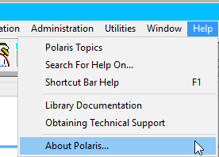
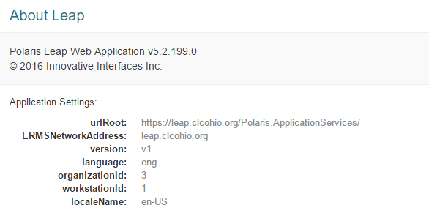
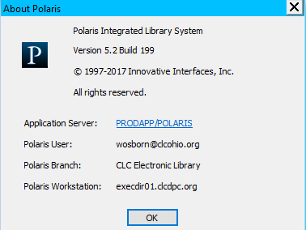
Finding your Polaris application server

Slide 18
Enabling NETLOGON debugging
From admin command prompt:
Nltest /DBFlag:2080FFFF
To turn off (from admin command prompt):
Nltest /DBFlag:0x0
When turning on/restart netlogon service:
net stop netlogon ; net stop netlogon

Slide 19
Enabling NETLOGON debugging
Via Group Policy
\Computer Configuration\Administrative Templates\System\Net Logon\Specify log file debug output level
A value of decimal 545325055 is equivalent to 0x2080FFFF (which enables verbose Netlogon logging). This Group Policy setting is specified in bytes.

Slide 20
Checking the log
Notes:
By default rolls over after 20MBs into a .bak file

Slide 21
Typical entries

Slide 22
Searching for common errors
Search log for “Can’t allocate Client API slot”
Are there ports being blocked between the domain controller being used and the application server?
Is the domain controller that is being selected having performance issues (low RAM/high I/O latency, etc.)
In a multi-domain/forest environment is the application using the expected domain controller?
Make sure to check all possible domain controllers or app servers.

Slide 23
Additional resources
https://support.microsoft.com/en-us/help/109626/enabling-debug-logging-for-the-netlogon-service
Excellent article on NETLOGON:
https://blogs.technet.microsoft.com/askpfeplat/2014/01/12/quick-reference-troubleshooting-diagnosing-and-tuning-maxconcurrentapi-issues/

