Slide 1
Reporting with a twist
Eleanor Crumblehulme | Matt Hammermeister | Katie LeBlanc | Daniel Messer

Slide 2
Overview
Intros
OverDrive reporting for a consortium (Eleanor)
You Saved email to patrons (Katie)
Storing data in an external database (Matt)
FOSS for fun and functionality (Daniel)
Discussion/Q&A

Slide 3
Introductions
Eleanor Crumblehulme
Library Systems Administrator,
Saskatchewan Information and Library Service Consortium
Matt Hammermeister
Director,
Pinnacle Library Cooperative
Katie LeBlanc
Head of Customer CARE/System Admin
Clinton-Macomb Public Library
Daniel Messer
Integrated Library Systems Administrator
Library Systems & Services

Slide 4
OverDrive reporting for a consortium
Consortium-level contract with OverDrive
Each member library has an AdvantagePlus account and does its own purchasing
New items purchased by each library are available only to their own patrons for 9 weeks, then shared (but own patrons still have priority)
The member libraries have a spending and item purchase agreement based on their circulation

Slide 5
OverDrive reporting for a consortium
Library staff can access reporting for their own library down to the branch level
Some metrics are needed at the consortial level or are easier to access by SILS Office staff
Circ and spending targets
User activity over time
Comparing OverDrive and physical library user activity

Slide 6
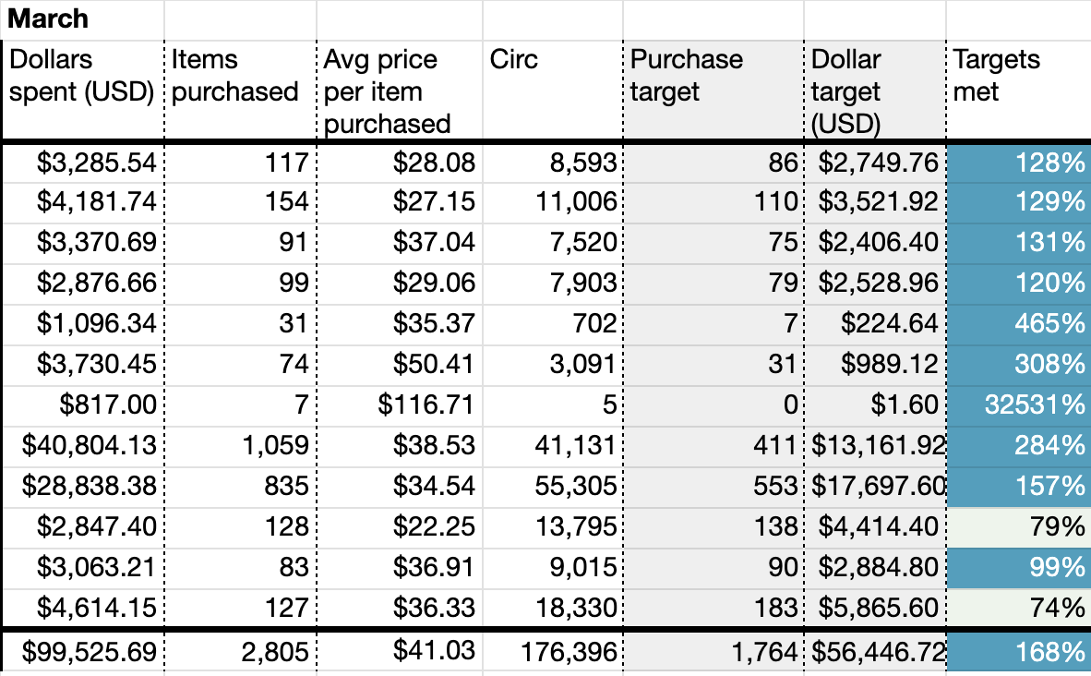
OverDrive reporting for a consortium
Providing OverDrive reporting for the member libraries developed organically, starting with monthly (and YTD) purchasing tracking

Slide 7
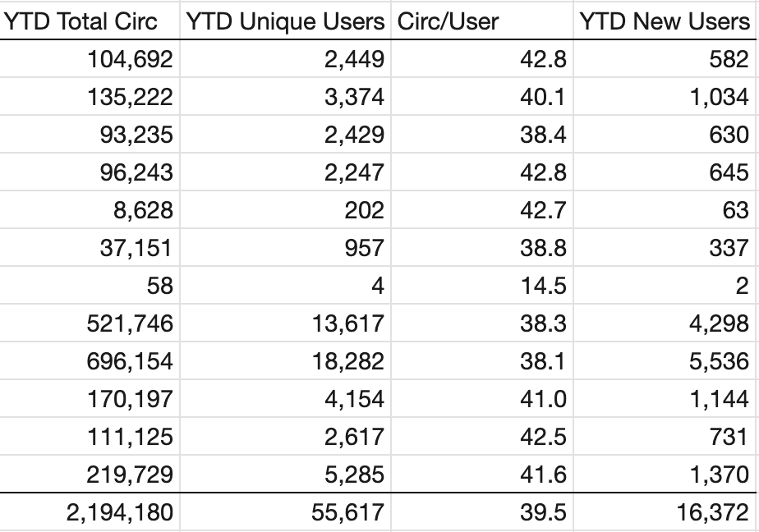
OverDrive reporting for a consortium
Monthly and YTD circulation and user counts

Slide 8
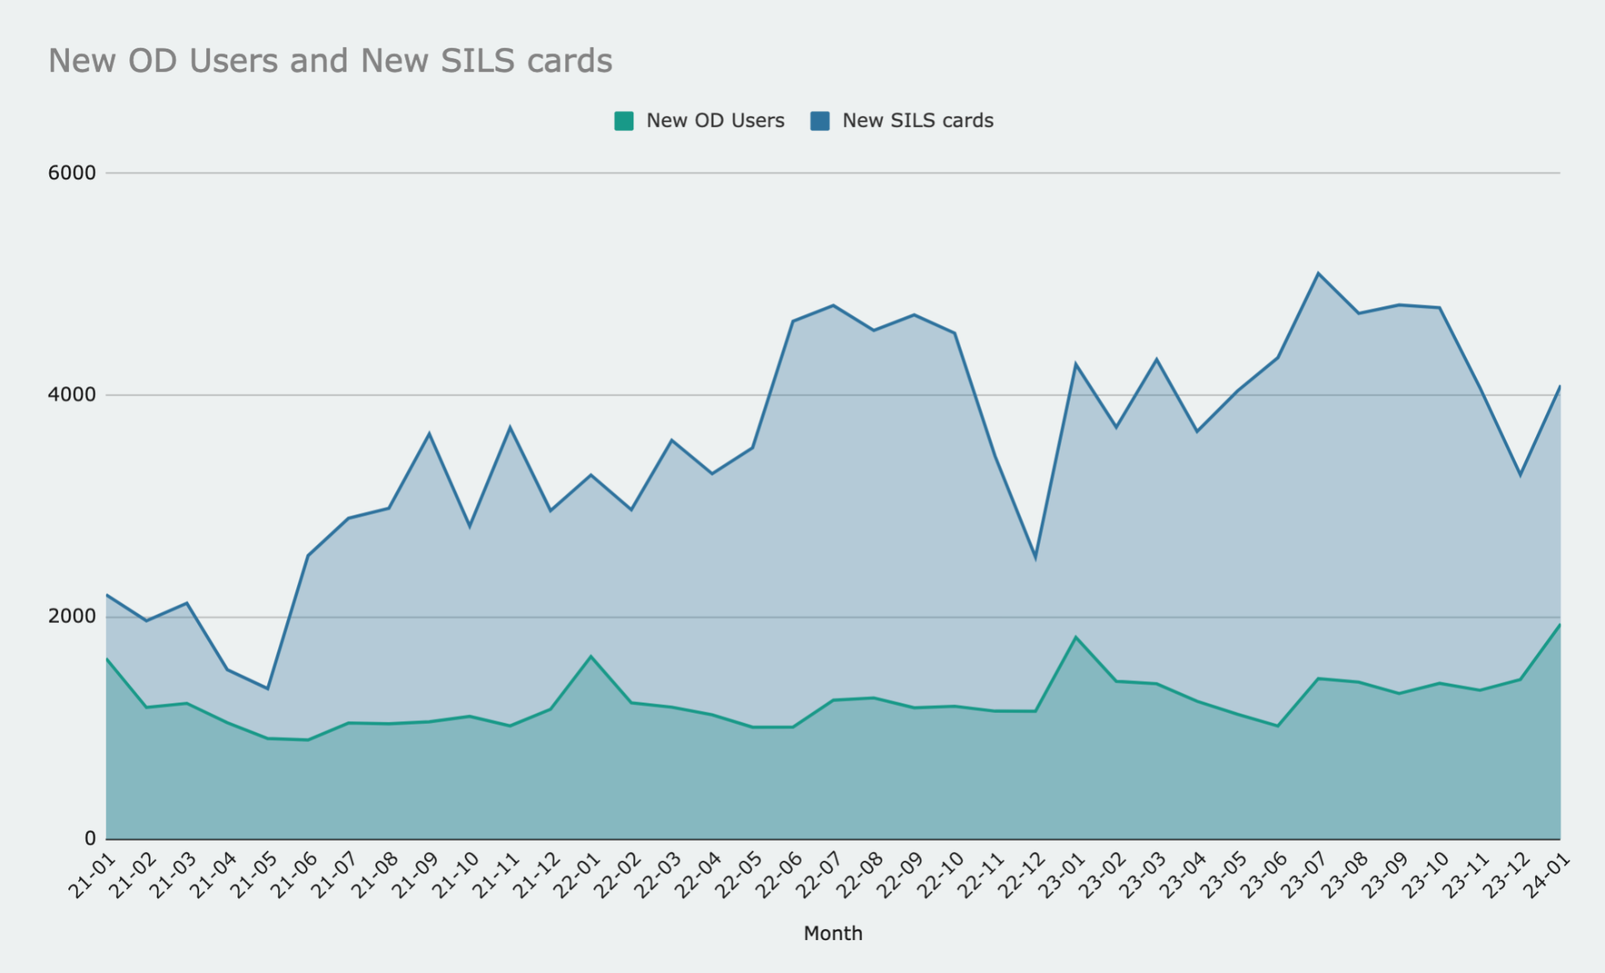
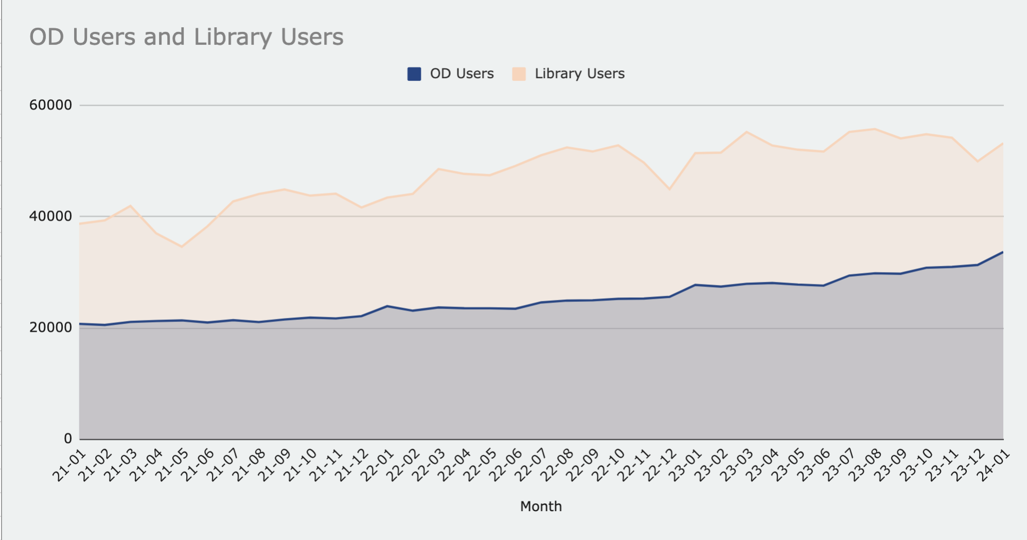
OverDrive reporting for a consortium
Comparing new and unique users against physical library users (Jeremy Goldstein’s idea)

Slide 9
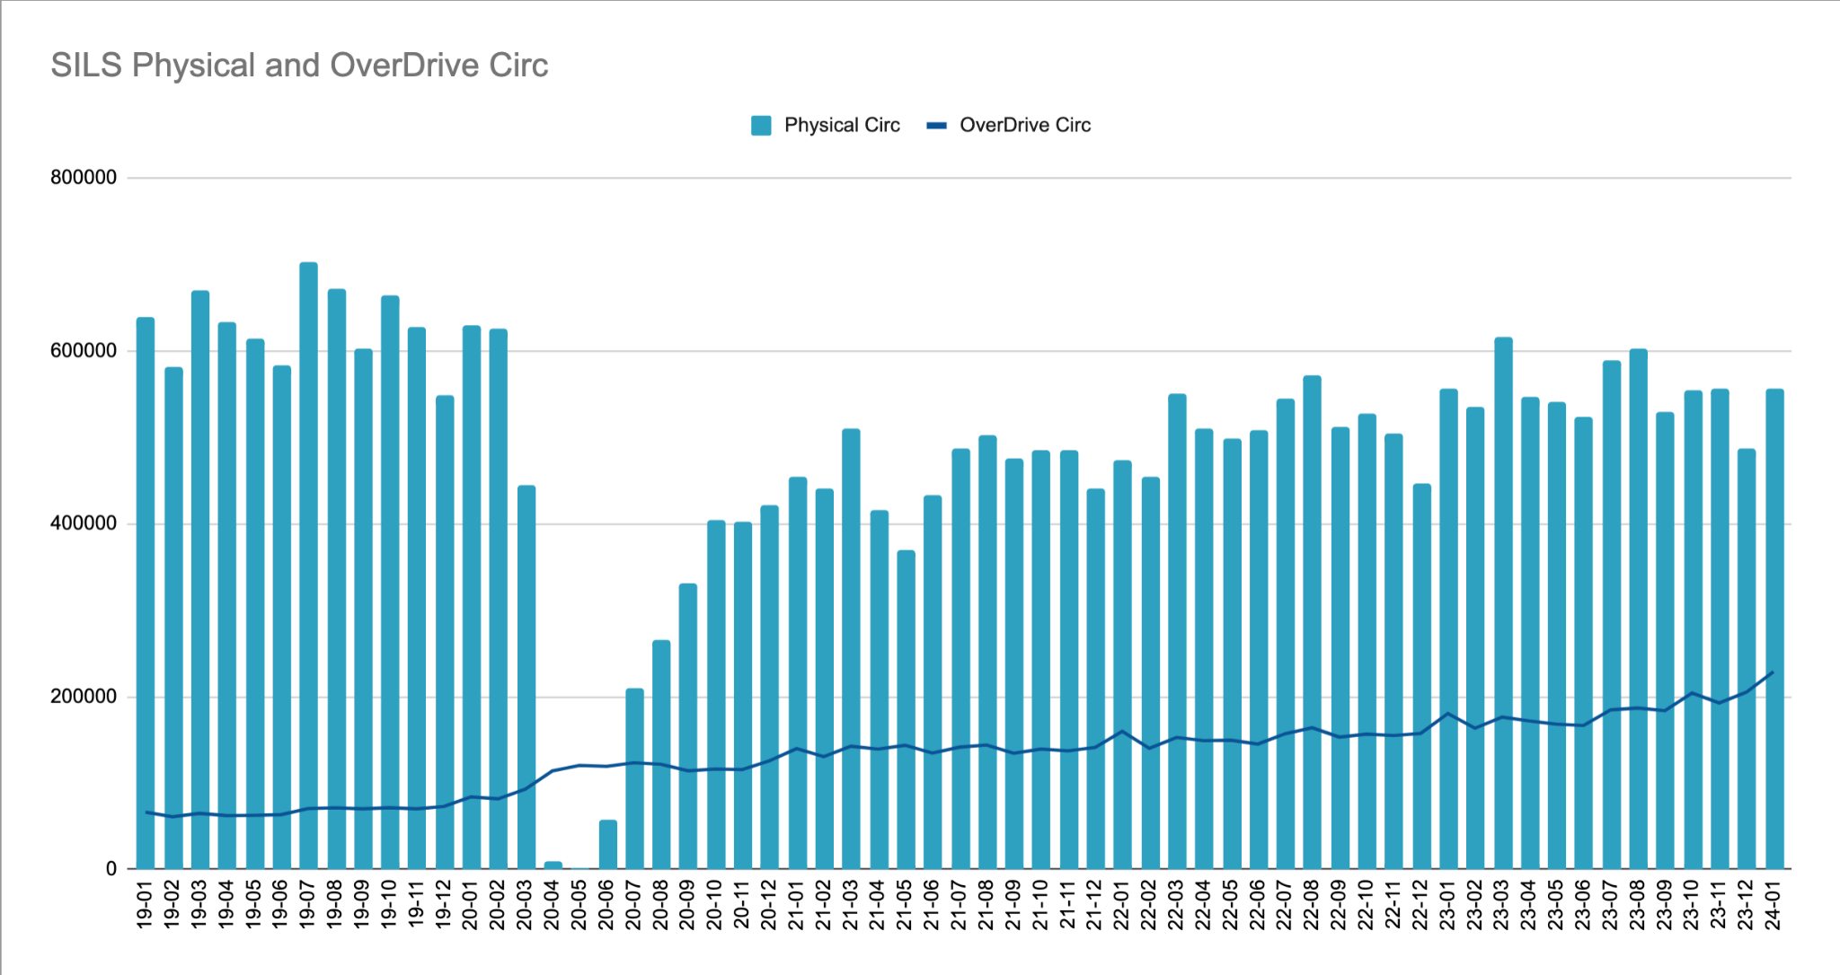
OverDrive reporting for a consortium
Tracking OverDrive and physical circulation

Slide 10
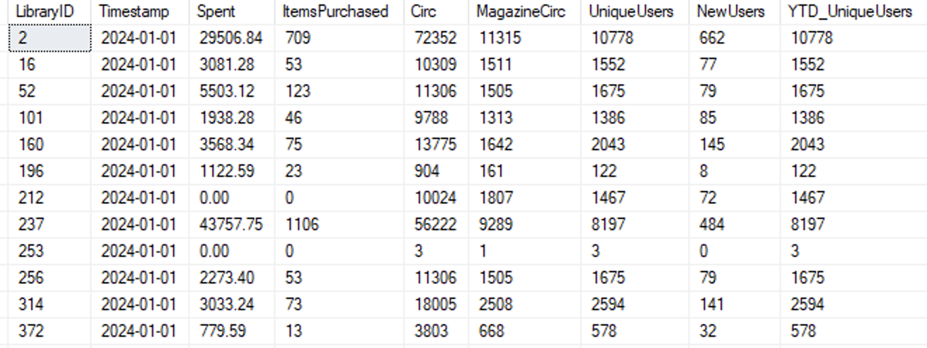
OverDrive reporting for a consortium
Currently experimenting with:
Adding monthly data to a custom table in the Polaris database
Replicating the spreadsheet charts with custom SSRS reports
Potential of combining with Polaris data

Slide 11
Emailing Patrons a You’ve Saved email
Started sending in 2014
Data pulled directly from the server
3rd party data
Overdrive
Hoopla
Freegal
Tools used
Microsoft SQL Server Management
Excel
Access
Word

Slide 12
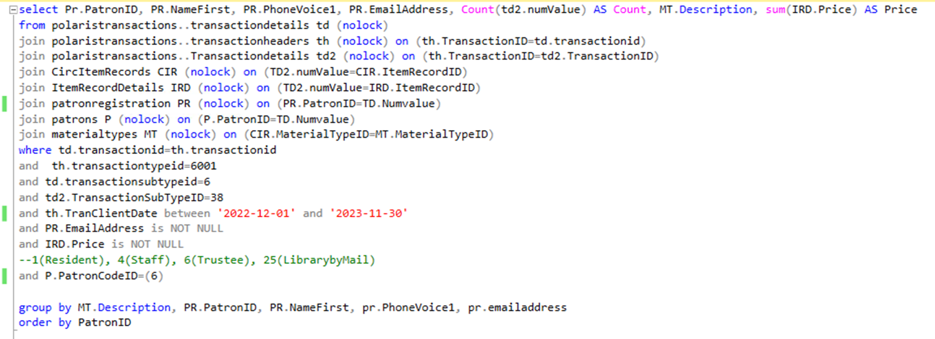
Emailing Patrons a You’ve Saved email

Slide 13
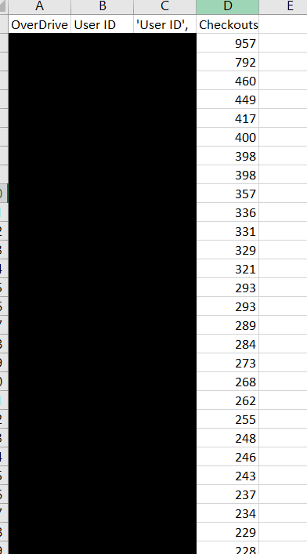
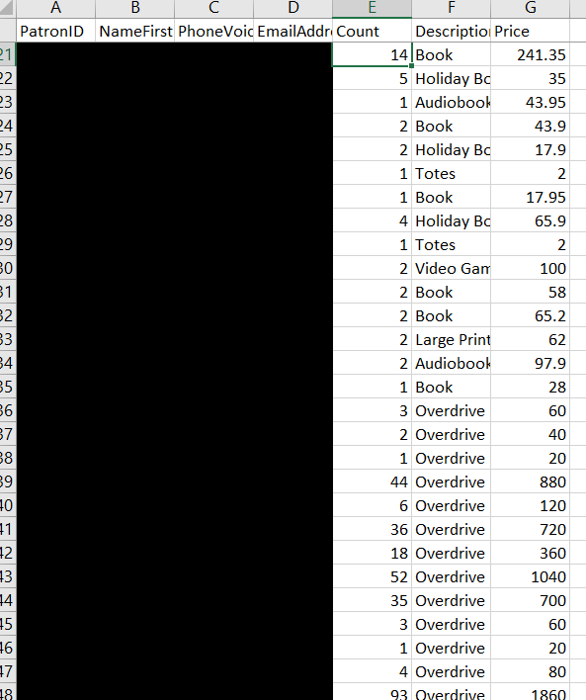
Emailing Patrons a You’ve Saved email

Slide 14
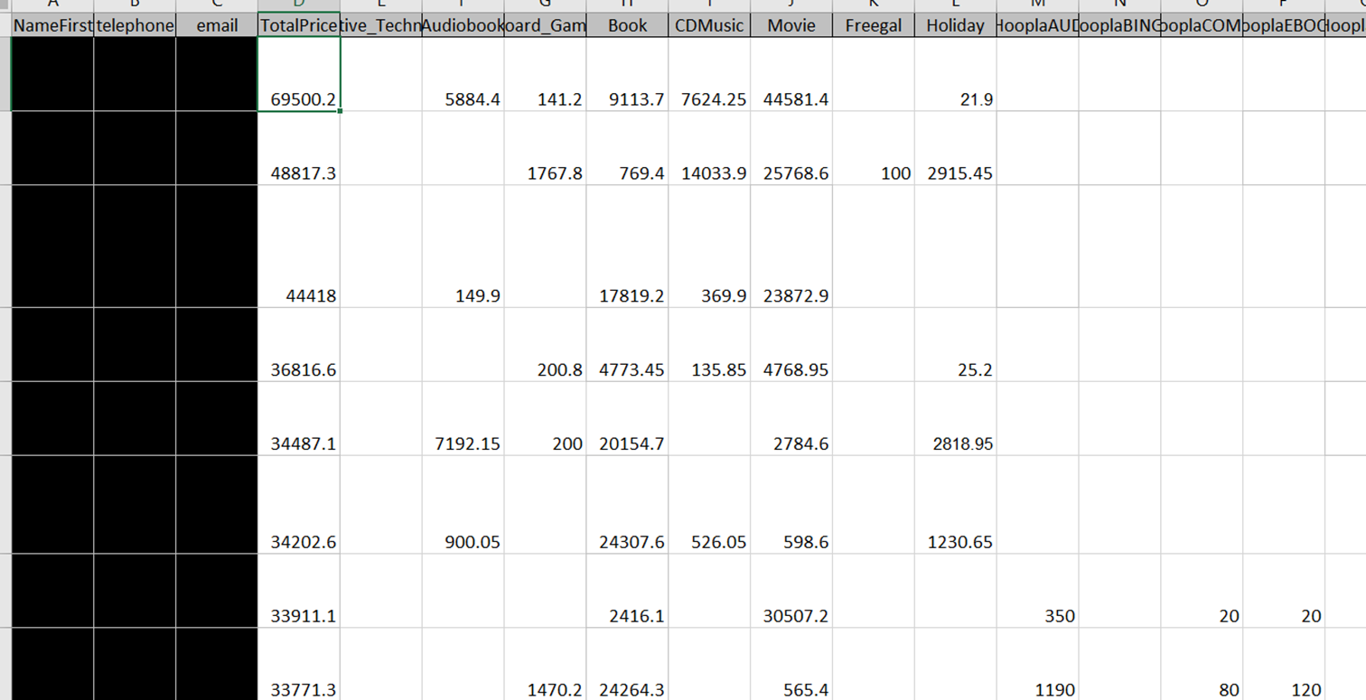
Emailing Patrons a You’ve Saved email

Slide 15
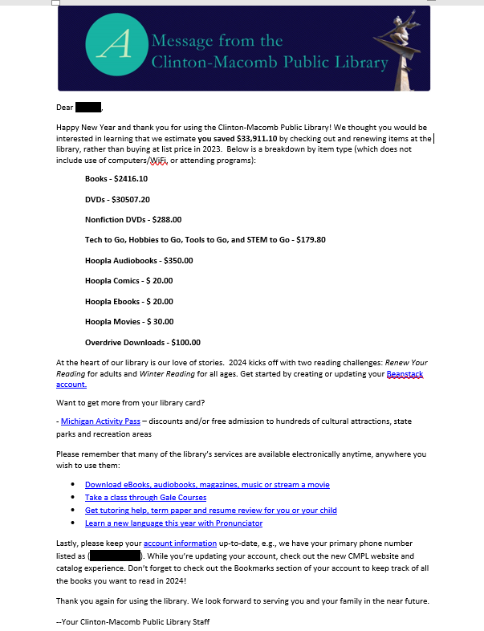
Emailing Patrons a You’ve Saved email

Slide 16
Storing Data in an External Database

Slide 17
Pinnacle Library Cooperative
6 member public library consortium in the southwest suburbs of Chicago
Population: ~400,000 people
Collection size: Over 1 million items
Shared OverDrive Collection, EBSCO database subscription, and more.
2 FT Staff Members

Slide 18
Sources of Library Data
Polaris Data
eContent
Databases
InterLibrary Loan
Chat Service
Door Counts
Event Registration

Slide 19
Bringing them All Together
Retrieve Data from Each Vendor
Combine it into a Single Database
Add Reporting / Visualization Layer

Slide 20
BigQuery
One of many data warehouse options available
Cloud-based: no need to maintain a server
Easy to manage data: tables, views, functions, etc.
Comes with a built in SQL engine
Part of the Google Suite – integrates well with other Google products, including Google storage
Widely popular
For smaller data sets, free.

Slide 21
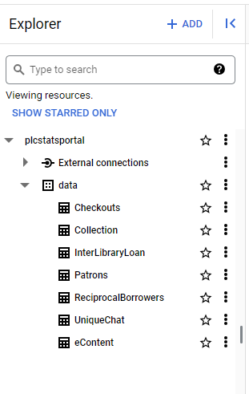
Data Sources in BigQuery
Each library data source added as its own table in BigQuery
Checkouts
Collection Size
Patron Aggregate Info
InterLibrary Loan
eContent
Etc.
Uploads
CSV Uploads
Google Sheets
Google Cloud Storage

Slide 22
Visualizations
Looker Studio (formerly, Google Data Studio)
Tool to create and share reports with others
Interactive
Easy to use
Google product – connects to BigQuery directly

Slide 24
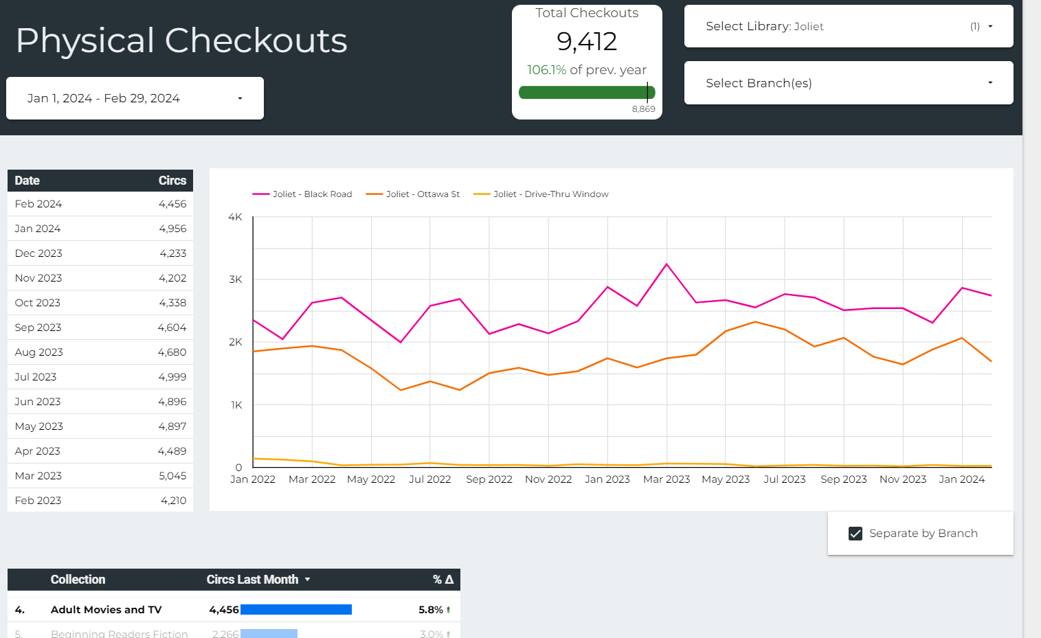

Slide 25
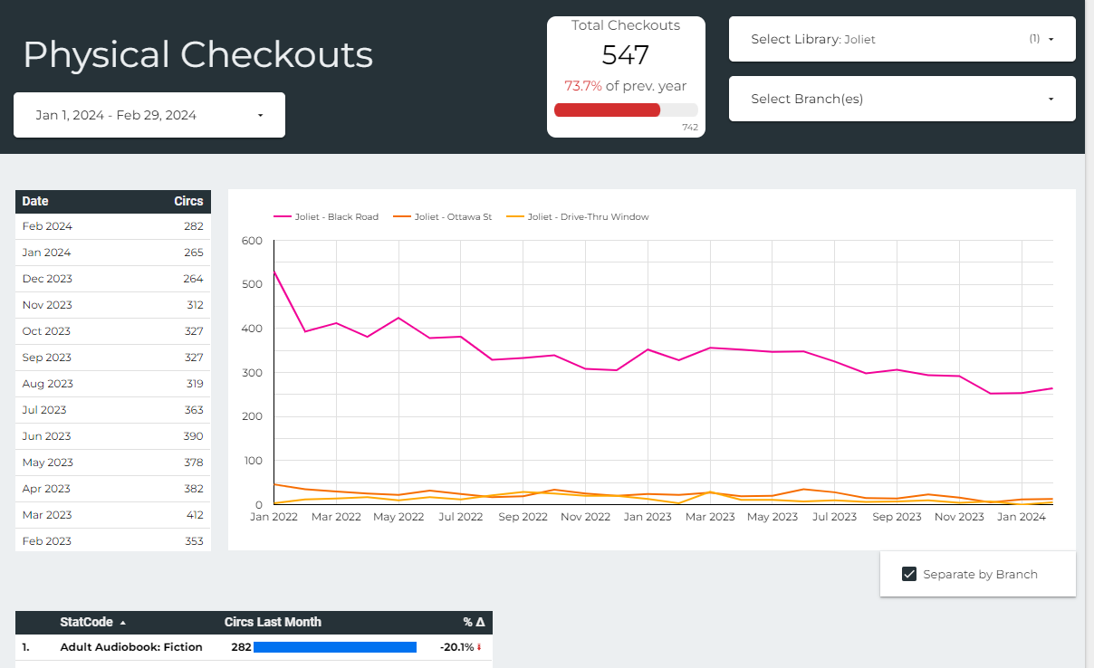

Slide 26
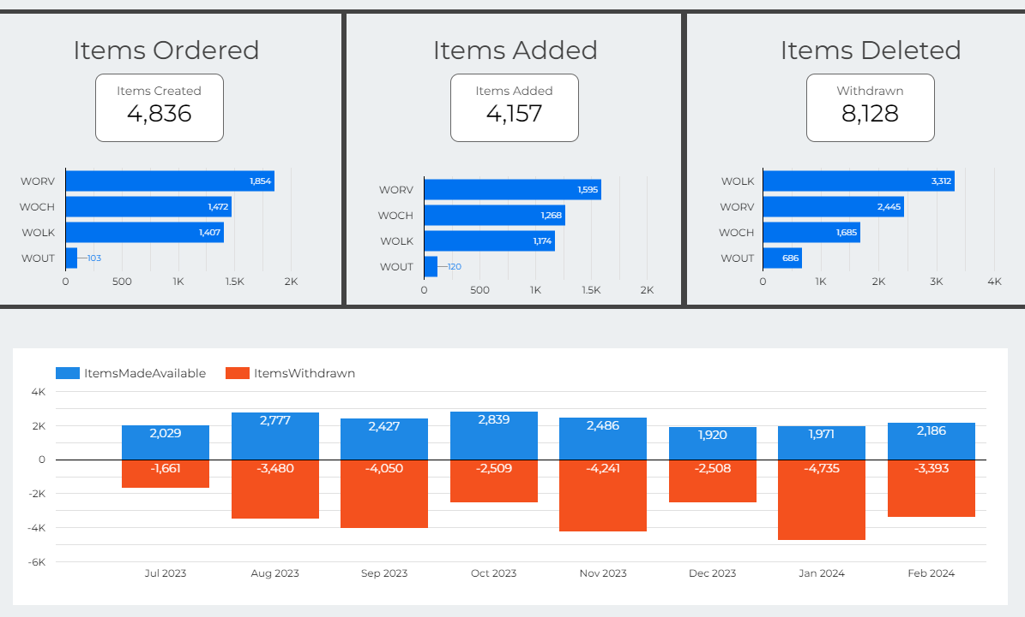

Slide 27
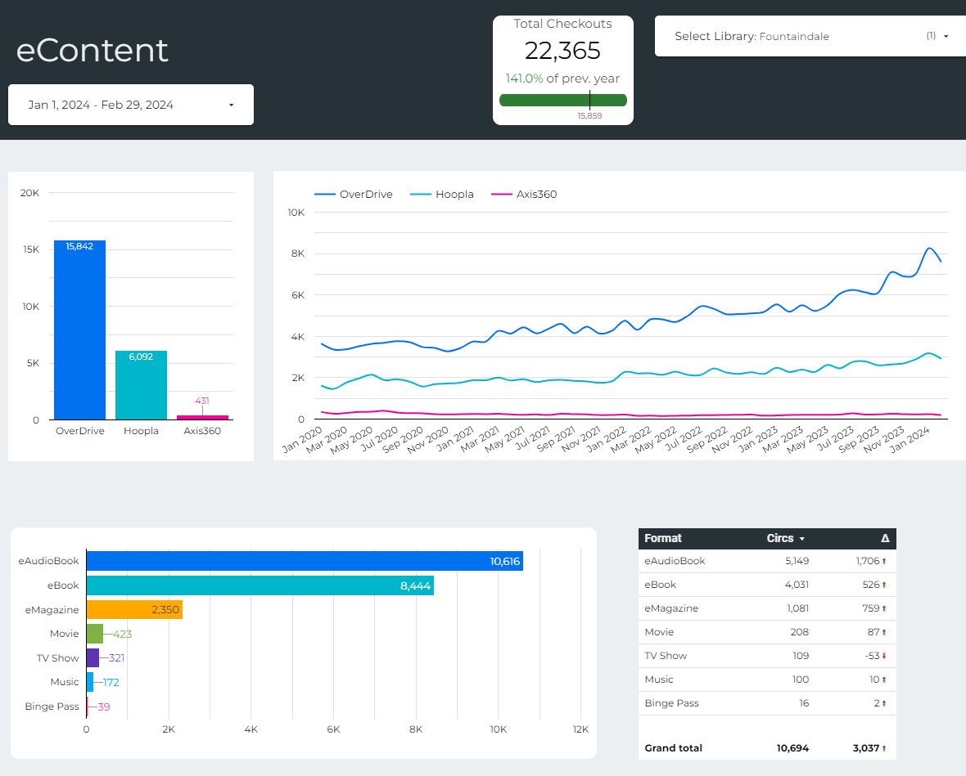

Slide 28
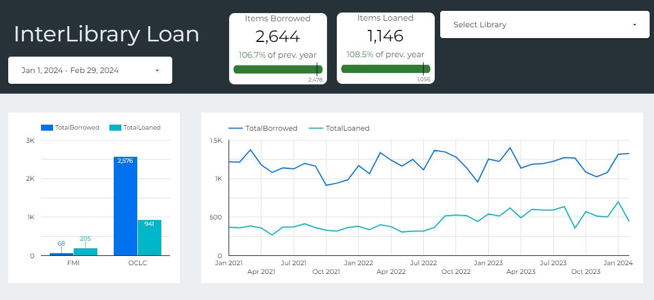

Slide 29
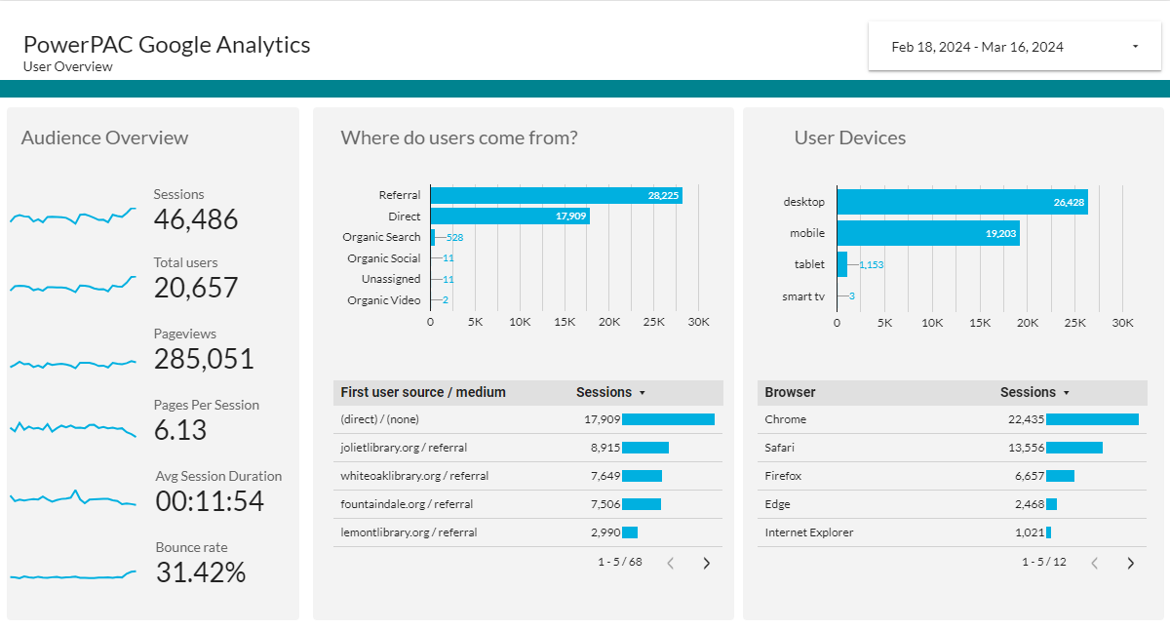

Slide 30
Future Development
More Comparisons
How metrics affect one another
Cross-Library comparisons
Library Submitted Data
Event Registration, Door Count
Automations
Automatically FTP data to Google Cloud Storage
Printer-Friendly Reports
Expand Google Analytics

Slide 31
FOSS for Fun & Functionality

Slide 32
FOSS For Fun and Functionality
Your data is portable and that’s an advantage
It means you have other options to deal with it
And the good news is, most of those options are free
A spreadsheet is not a database
But SQLite is!

Slide 33
SQLite & Me – We go way back
Free and open source database engine
That happens to be used everywhere
No seriously, there’s a good chance you’re using it right now
Fast, small, simple, and totally portable
Works on everything: macOS, Linux, Windows, iOS, iPadOS, Android, and more
Similar SQL syntax to PostgreSQL

Slide 34
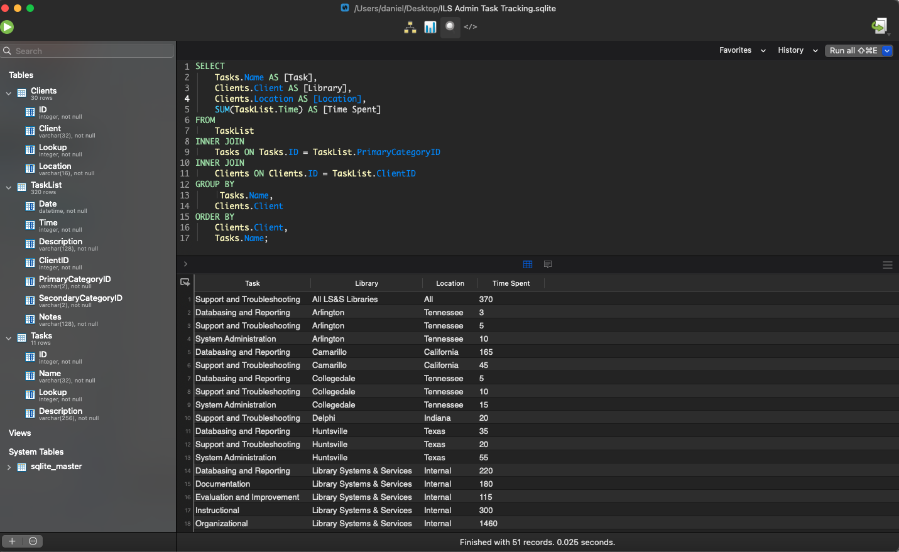

Slide 35
Okay, but why though?
Did I mention that it’s free?
You don’t need to buy Windows or stand up a database server
There are some great SQLite apps for macOS, Linux, and Windows
It’s easy to dump data from SQL Server to a CSV
And it’s easy to import that CSV into a SQLite database
And it’s easy to export that data out of SQLite into a CSV or JSON file
Great for noodling around and trying things with data
Without any risk to your production database
Combine data from various sources in new ways
Use it as the basis for an application or interact with it through code
Keep snapshots of your data for various projects
Share data with others without giving any special access to your database

Slide 36
Personal Case Studies
SCENARIO: Working on migrating a library from REDACTED ILS to Polaris
Piles of XML files with no sense to them
And they certainly can’t be understood by Polaris
SOLUTION:
Convert the XML to CSV and work with the CSV
Import into SQLite
Query the tables to get what our data migration specialist needs
SCENARIO: Migrating help desk ticketing systems
Well, at least we got some JSON from the export
Keep a database on hand to find wayward or older tickets
SOLUTION:
Massage the JSON file to get the data we really needed
Import the file into SQLite
SCENARIO: The spreadsheet from hell
Excel != Database
What’s a pivot table?
SOLUTION:
Convert that spreadsheet into CSV
You guessed it, import into SQLite

Slide 37
Personal App Recommendations
DB Browser for SQLite
Works on macOS, Linux, and Windows (Free)
https://sqlitebrowser.org/
DBeaver
Works on macOS, Linux, and Windows (Free)
https://dbeaver.io/
SQLPro for SQLite
Works on macOS ($50 or via Setapp subscription)
https://www.sqlitepro.com/

Slide 38
Discussion and Questions

Slide 39
Contact us
Eleanor
Email: eleanor@sasklibraries.ca
Discord: @Eleanor C - SILS
Matt
Email: mhammermeister@pinnaclelibraries.org
Discord: @Matt Hammermeister-Pinnacle (IL)
Katie
Email: kleblanc@cmpl.org
Discord: @Katie LeBlanc - CMPL (MI)
Daniel
Email: Daniel.Messer@lsslibraries.com
Discord: @Cyberpunk Librarian - LS&S

Slide 40
THANK YOU!

