Slide 1
Accessing sample files (This slide not part of video)
Note: Video best viewed full screen or in a large window in order to see Get & Transform examples properly
4 Handouts are available to accompany the video:
This PowerPoint file
Excel file for Example 1
Excel file for Example 2
Doc file for Example 2
I have no control over names of files. The doc file is actually a text file and simply needs to be renamed to BookList.txt for use with the second Excel file (ISBN Duplicates) or an Excel file you wish to build from scratch.
If you wish to follow along using the provided ISBN Duplicates excel file (example 2), the path to the text file will need to be edited to wherever you saved the BookList.txt file. See next slide for steps.

Slide 2
Accessing sample files (This slide not part of video)
To follow along using the ISBN Duplicates Excel file:
Open the file in Excel
You may need to click Enable in order to edit
Click on the Data tab
Click on Queries & Connections from the ribbon
Double click on the Booklist query on the right to edit it
Click on Source at the top of the Applied Steps
Edit the path in the formular bar to point to your path for BookList.txt
If you don’t see the formular bar click on the View tab and select Formula Bar checkbox, then click on the Home tab
To see effects of the steps on the data click on the applied steps on the right from top to bottom
Note: Not all steps in video are in the file since I remove the temporary steps as I go along
Excel files made with Excel 2019 & are untested with previous versions

Slide 3
Excel: Get & Transform
Julie Cole, Library Systems Administrator
Langara College

Slide 4
Get & Transform Overview
What is Get & Transform?
Comparison to other toolsets
Walk through examples:
How Get & Transform is better than Excel
Finding duplicate ISBNs
More Ideas of how to use Get & Transform
Resources for learning Get & Transform

Slide 5
What is Get & Transform?
Add on toolset to Excel to enhance its capabilities
Previously called Power Query
Allows you to get data from different sources and manipulate the data:
Formatting
Grouping
Compiling
Matching

Slide 6
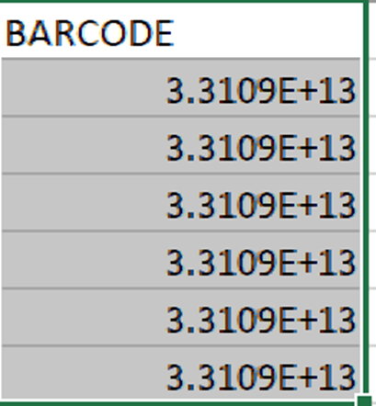
Get and Transform vs. Excel
Get & Transform is better at formatting and organizing non mathematical data
Some things I don’t like in regular excel
Getting Dates & Numbers to show correctly
Writing complicated string formulas
Using the Fill Down to copy the formulas
Moving columns

Slide 7
Python - Pros
Open Source
Powerful
Fast & memory efficient
Has interactive Jupyter Notebooks
End-to-end automation
Easy access to PostgreSQL and other dbs

Slide 8
Python - Cons
Bigger learning curve
Even though has Jupyter Notebooks…
Better with predictable data

Slide 9
OpenRefine and Get & Transform - Similarities
Many ways to transform data
Show you sequential steps
Allow you to undo steps
Have GUI & scripting language
Can repeat steps on new files
Have memory limitations

Slide 10
OpenRefine
Pros
Open Source
Supports Unicode
Great at cleaning very messy data
Clustering
Allows easy direct editing of data
Cons
Can’t edit steps once defined
GUI takes some effort to learn

Slide 11
Get & Transform
Pros
Easier than Excel formulas
GUI easier to learn more powerful
Can edit and insert steps
Can move data to charts/graphs
Cons
Horrible at Unicode
Direct Connection to PostgreSQL very complex

Slide 12
Access to Data - COVID
Working from home may have made it difficult for you to get to all the data you once could due to VPN, firewall rules etc.
Because you can do so much with just csv files, Get & Transform can be an easier way to manipulate data even if you no longer have access to SQL or Sierra directly.

Slide 13
Pause for Examples

Slide 14
Ideas
Where Data is NOT available in Sierra PostgreSQL
Loan Delimiter/Loan Rules look up table
Coverage Data
Fund Activity Report matching to Order information used to diagnose negative encumbrances
Finding duplicates
LibGuides Assets
Compiling and Grouping (importing of folders)
SUSHI COUNTER 5 data
Ezproxy log analysis
Matching
Bookstore lists to catalog via ISBN
Vendor Title lists to catalog via ID

Slide 15
Learning Resources
Oz du Soleil – Excel Expert
Great Basic course on LinkedIn Learning
YouTube Excel on Fire channel: https://www.youtube.com/channel/UCZgOVykPoRbSZQfY9YysiRQ
Microsoft Documentation
https://powerquery.microsoft.com/en-us/excel/ Consult if you have a different version
https://docs.microsoft.com/en-us/power-query/
https://docs.microsoft.com/en-us/powerquery-m/ Scripting language for more advanced operations
Blog: https://www.sumproduct.com/thought/power-query-blog-series
When googling search for “Power Query” as well as “Get & Transform”

Slide 16
THANK YOU
Questions?

