Slide 2
SSRS
Unlocking the Power in Polaris Reports
Trevor Diamond
trevor@bccls.org
Integrated Systems Librarian, BCCLS
Member-at-Large, IUG Steering Committee
Regional Users Group Liaison, IUG
Vice-Chair, Polaris ILS Advisory Committee

Slide 3
Today’s Agenda
Security Roles
Assigning and Modifying Roles for a Folder or Report
Linked Reports
Basic Subscriptions
Data Driven Subscriptions

Slide 4
Why Bother?
Server Resources
No Workstation License Required
Safety
Access Management

Slide 5
Getting Started
No (additional) Installation Required
PolarisExec
Task #1: Create a new system administrator
Assign Roles
Note: Userbase drawn from Active Directory
Optional
More Reports/Folders
Subscriptions

Slide 6
Security Roles
Browser
Access, run reports/files, create basic subscriptions
Publisher
Browser + adding new reports, creating linked reports, moving objects, edit some properties of objects
Content Manager
Publisher + Access/edit rights to all security, properties, and subscriptions on applicable objects
My Reports
Designed for use with a special My Reports folder. Allows Content Manager rights within folder, without access to security settings
System User*
Access to Report Builder, shared schedules
System Administrator*
All powerful genie!

Slide 7
Security Roles
Browser
Run reports, subscribe to reports, and navigate through the folder structure.
Report Builder
Create and edit reports in Report Builder
Publisher
Add items to a report server, including the ability to create and manage folders that contain those items
Content Manager
Full permission to manage report server content, including the ability to grant permissions to other users, and to define the folder structure for storing reports and other items.
My Reports
Each user gets a personal workspace, within which they have Content Manager level permissions
System User
view basic information about the report server such as the schedule information in a shared schedule.
System Administrator
can enable features and set defaults, set site-wide security, create role definitions in Management Studio, and manage jobs.
Custom!?

Slide 8
Setting Roles/Permissions
Cascading Permission by Default
Specific objects at lower levels can be tweaked
System v. Reports roles assigned separately!

Slide 9
Setting User Roles/Permission
Demonstration: http://test.bccls.org/reports

Slide 10
Linked Reports
“Shortcut” to a report
Same data source
Can tweak parameters (visibility and/or defaults)
Subscriptions on linked reports
Safe access to reports!

Slide 11
Creating a Linked Report
Demonstration: http://test.bccls.org/reports

Slide 12
Subscriptions
Setup report to run at any time
Delivery via email or Windows File Share
Email: Additional Setup Required
One time or recurring

Slide 13
Email Subscription Setup
C:\Program Files\Microsoft SQL Server\MSRS12.MSSQLSERVER\Reporting Services\ReportServer
RSReportServer.config
SendEmailToUserAlias False

Slide 14
Subscription: One Time
Demonstration: http://test.bccls.org/reports

Slide 15
Subscription: Recurring
Demonstration: http://test.bccls.org/reports

Slide 16
Data Driven Subscription
Data Driven?
Define users and parameters with SQL!
Enterprise Edition of SQL Server (or Developer, to try out)
TIP: There are other advantages to these editions (using your hardware to its full potential). Academic pricing is available to libraries.

Slide 17
Subscription: Data Driven
Demonstration: http://test.bccls.org/reports

Slide 18
Data Driven Subscription SQL
SELECT o.OrganizationID,
opppp.Value AS [Email],
DATEADD(MM,-1,GETDATE()) AS [BeginDate],
'The attached report is the circulation (by collection, material type, and shelf location) for ' + DATENAME(MM,DATEADD(MM,-1,GETDATE())) + ' for ' + o.Name + '.' AS [Comment],
'Monthly Circulation - ' + DATENAME(MM,DATEADD(MM,-1,GETDATE())) + ' ' + CAST(YEAR(DATEADD(MM,-1,GETDATE())) AS VARCHAR(4)) AS [Subject]
FROM Polaris.Polaris.Organizations AS [o] WITH (NOLOCK)
INNER JOIN Polaris.Polaris.OrganizationsPPPP AS [opppp] WITH (NOLOCK)
ON o.OrganizationID = opppp.OrganizationID
WHERE opppp.AttrID = '1'
AND o.OrganizationCodeID = '3‘
AND o.Name NOT LIKE 'Z%‘
AND o.Name NOT LIKE 'BC%'

Slide 19
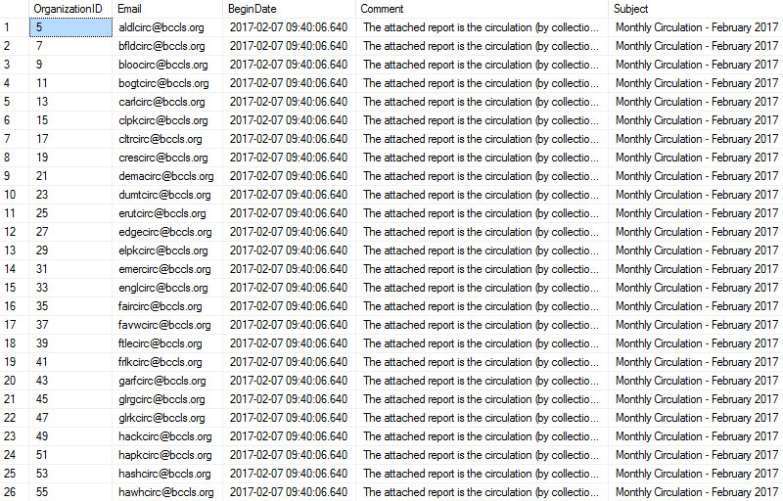

Slide 20
Resources
Security Roles
http://bhushan.extreme-advice.com/user-roles-and-permissions-in-ssrs/
SQL Edition Features
http://msdn.microsoft.com/en-us/library/cc645993.aspx
Report Server Edition Features
https://msdn.microsoft.com/en-us/library/mt742500.aspx
Email Configuration File
http://msdn.microsoft.com/en-us/library/ms157273.aspx
General Help Resource
http://msdn.microsoft.com/

Slide 21
Thanks for attending!
Questions!?!?!??

