Slide 1
Tips and Tricks for Using Create Lists in Sierra
Stacey Wolf
University of North Texas
Notes:
Hi I’m Stacey Wolf from the University of North Texas. I’m here to talk about some tips and tricks for using create lists in Sierra. I have a lot to cover in one hour, so I’ll probably go through a bit of it rather quickly. However, the slides will be available, with my speaker notes (I think) and I’m happy to answer questions here or via email.

Slide 2
Objectives
Review tools and functions in Create lists
Tips (Best Practices)
Tricks (Shortcuts and other little tricks)
Uses outside of Create Lists in Sierra
Use Cases
Notes:
Here are my objectives today…
Review tools and functions in create lists
Go over some Best Practices, Shortcuts and other little tricks
Review some of the Uses of create lists outside of Create Lists in Sierra
And examine some Use Cases like
Build a query
Import records to edit
Search using a JSON query
Search using Regular Expressions
Export information from a list
I’ve provided some links to some excellent resources on create lists at the end of my presentation.

Slide 3
Who am I?
Cataloging and Metadata Librarian at University of North Texas
Denton, TX
Sierra catalog ~3 mil. bib records
Regular job duties: Authority control, headings reports, database maintenance, e-resource record editing/loading
Me, Owen, Elizabeth, and Spencer at Meet the Teacher night – Fall 2022
Notes:
Cataloging and Metadata Librarian at University of North Texas
Denton, TX
10 years last month
Sierra catalog
~3 mil. bib records
I regularly work with authority, bib, item, and order records. I don’t have access to patron records, so I’m unsure how they work as well as most of the other record types not previously mentioned.
Regular job duties: Authority control processing with a vendor, headings reports, database maintenance, e-resource record editing and loading
On a personal note, my husband is an elementary school librarian, my kids graduate from kindergarten in a few weeks, I have a dog who likes to destroy fences, and I’m a pro at half finished projects in my house.

Slide 4
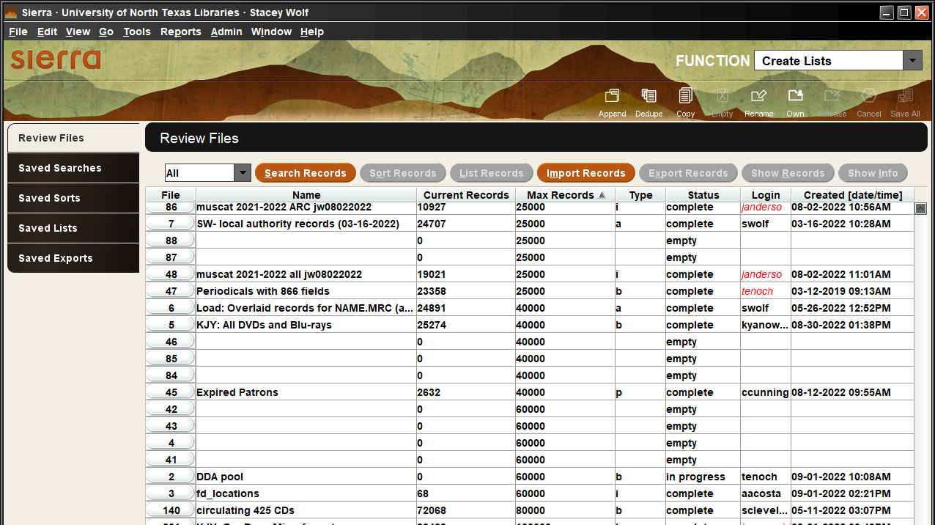
Notes:
Here’s what create lists looks like when you first click into it via the Function drop down. We have 256 review files ranging from 100 records to 100,000 records. We pay for a certain amount of records, not review files, so we can make files as big or as small as our library needs.

Slide 5
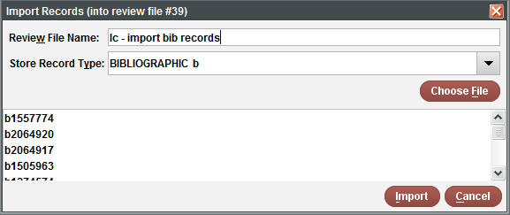
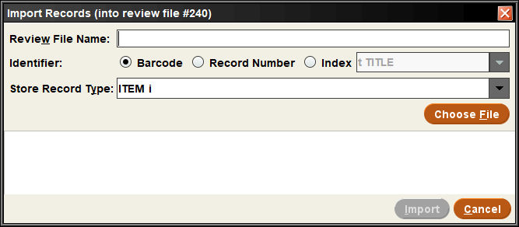
Software Release: Sierra 5.4.0_9
Notes:
We use version 5.4 of Sierra. Before this version, import records only allowed you to load record numbers. This forced me to use JSON queries to search for batches of barcodes, names, or control numbers since I rarely had the record numbers for the records I needed. 5.4 allows you to use barcode, record number, or an indexed term. This has made a lot of the processes I’d developed a few years ago obsolete, but I’m not complaining about my work getting easier and needing fewer workarounds.

Slide 6
Record 1: bib view Record 1: summary view Record 2: bib view
Record 1: bib view Record 1: summary view Record 2: summary view
Notes:
And in previous versions of Sierra, you could navigate between record type and the list would default back to the stored record type when you moved to the next record. For example, in a file of bib records, you could view the bib record and then the summary view of the same record, then when you go to the next record from the summary screen, Sierra has taken you back to the bib view of record 2. I had an excellent system worked out for reviewing order, item, and bib records from import invoices loads that only needed a few mouse clicks and used just a few keyboard shortcuts.
Now, with 5.4, whatever type of record you are viewing when you go to the next record is what you will see for record 2. So in a file of bib records, you could view the bib record and then the summary of that same record, then when you go to the next record, the list stays on the summary screen. This forced me to adapt how I review import invoice records, with the help of a new keyboard short cut. Nearly a year later, I’m getting used to it.

Slide 7
Toolbar functions
Notes:
Here are all of the tool bar Icons. I'll go through each briefly

Slide 8
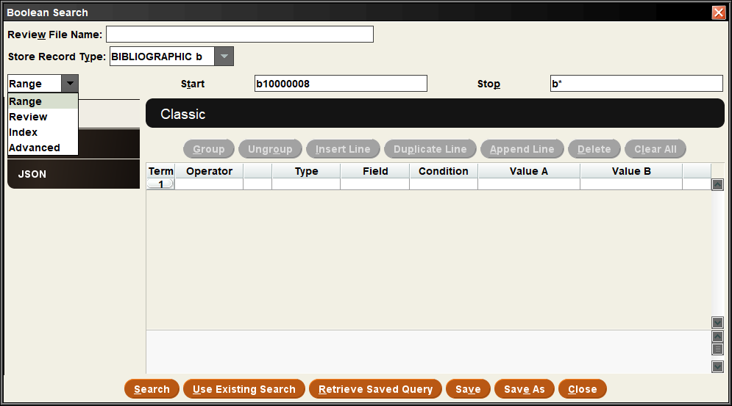
Append – adds to the end of an existing list
Notes:
Append allows you to add more records to the end of an existing query using a new query or an existing review file.

Slide 9
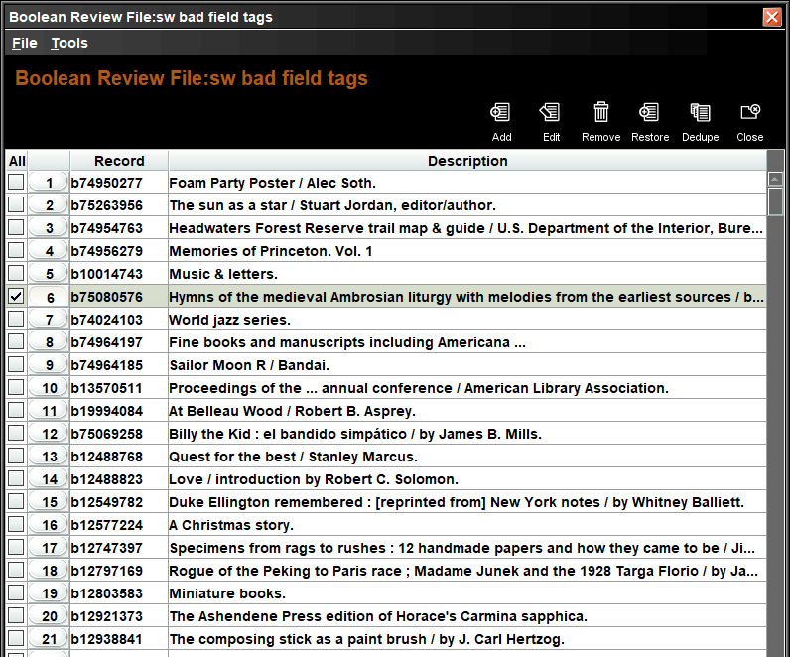
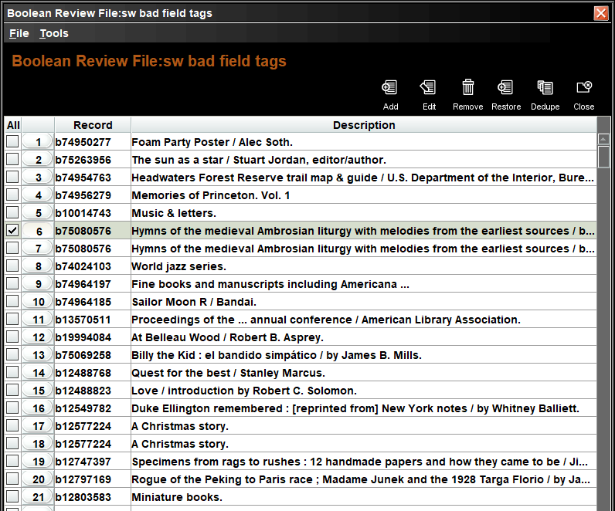
Dedupe
Notes:
Sometimes a search finds more than one match in a record and lists the record twice. Dedupe removes the extra copies of a record to give a more accurate count of how many records are affected.

Slide 10
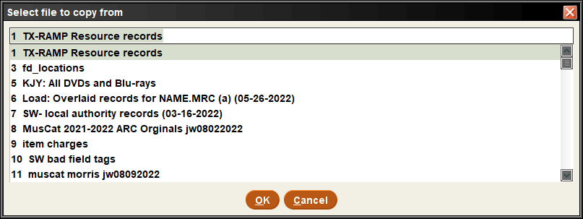
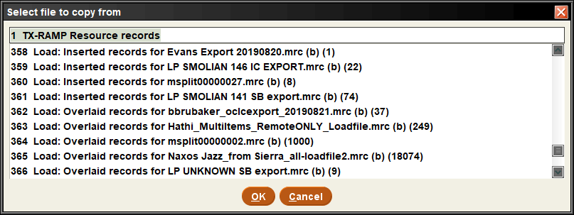
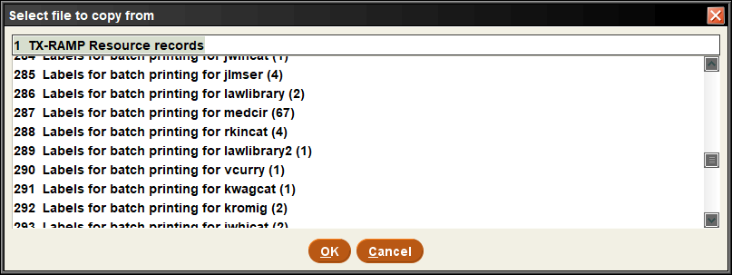
Copy – copies an existing review file or loads a file created during another process in Sierra
Notes:
Copy copies an existing review file, labels for batch printing, or a load file created during another process in Sierra

Slide 11
Empty – Clear All or delete the list
Notes:
Empty clears the list

Slide 12
Rename – renames the file
This WILL delete your list name, even if you cancel out of the dialog box.
It does NOT provide the current list name to make a small change
Only way I’ve found to copy the current list name is to highlight the list, click Search Records, click edit existing query, and highlight and copy the review file name.
Notes:
Guess what rename does – it renames the file. It will delete your list name; and it does not retain the name to make small adjustments

Slide 13
Own – prevents other users from editing or emptying that review file
Release - removes the lock on the file and allows editing or emptying again
Notes:
Own claims a list so others can’t edit or empty that review file. Release unlocks the file

Slide 14
Cancel
If a query is taking a long time, you may need to cancel it and start over. And sometimes it will take a few attempts to fully cancel and empty a file
Notes:
Cancel stops a search. This screen shot was taken a few days after the file had been created, which shows that this query got hung up and will never finish. Cancel it until it empties itself and rerun it; sometimes this takes a few tries before cancel actually stops the query.

Slide 15
Save All
No Clue. Never used it and couldn’t figure out how to make it even show up as an option to use.
Notes:
No clue

Slide 16
Create List Tools/Functions
Search Records
Sort Records
List Records
Import Records
Export Records
Show Records
Show Info
Notes:
Now I’ll go through each of these tools or functions. I’m going to go through this rather fast so we can get to the tips, tricks and use cases also.

Slide 17
Search Records
Notes:
If you don’t use an empty list, this warning comes up. You can erase what’s there and start a new query, re-run the existing query as it is, or edit the query before running it. Cancel allows you to close out without making any changes.

Slide 18
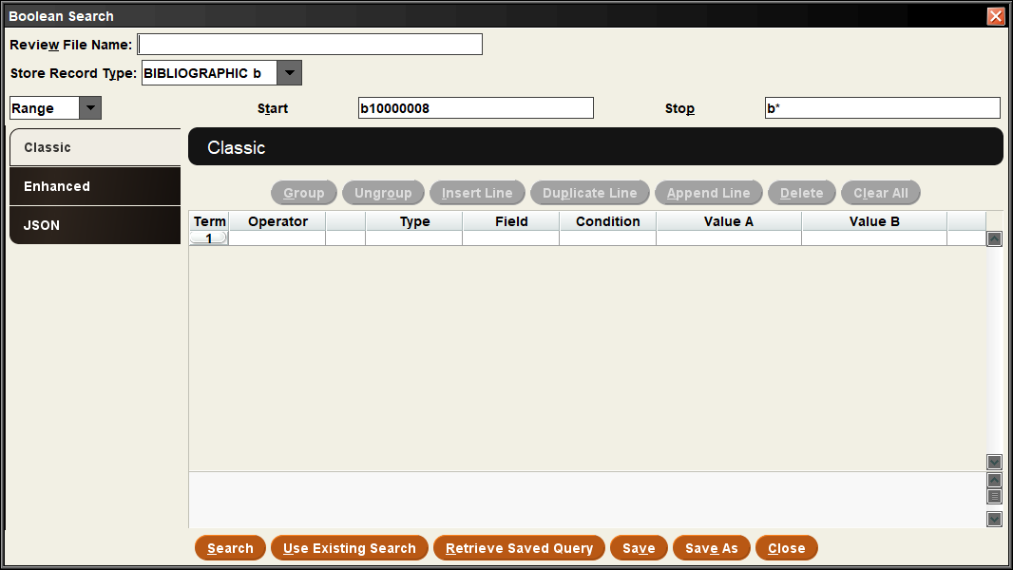
Notes:
Name your file, we will go over some naming conventions later during the tips section.

Slide 19
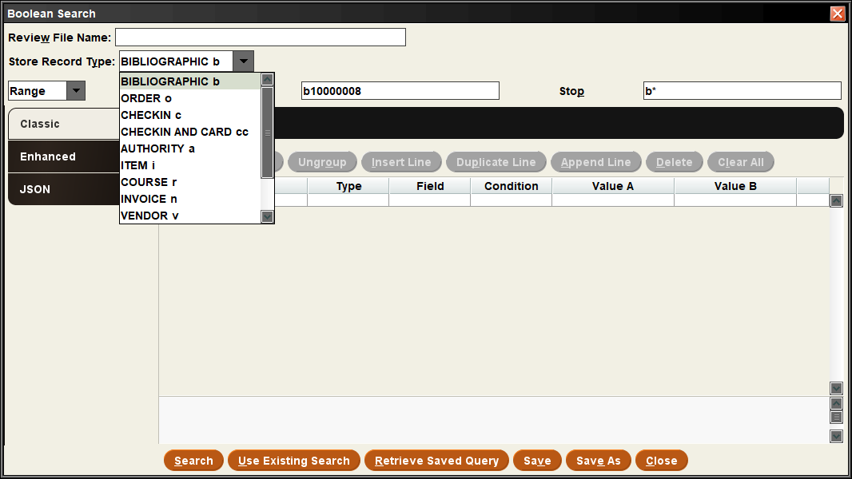
Notes:
Store record type options

Slide 20
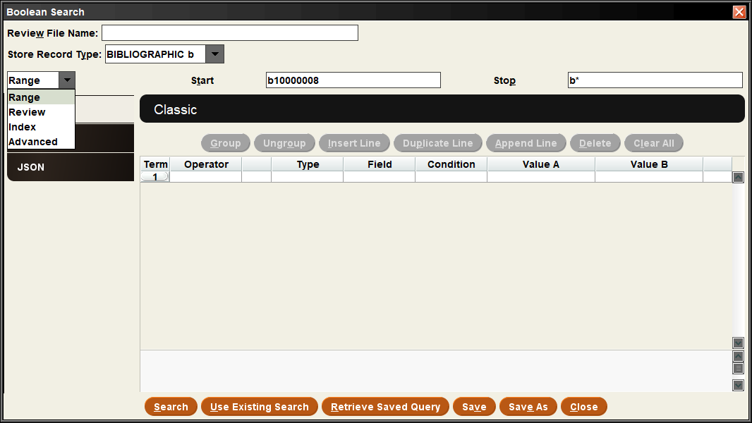
Notes:
The default is a range of bib record numbers
Our lowest is in the start box; the b* at the end will always find the last record loaded. It works for any of the the record types too, so i*, o*, p* etc.

Slide 21
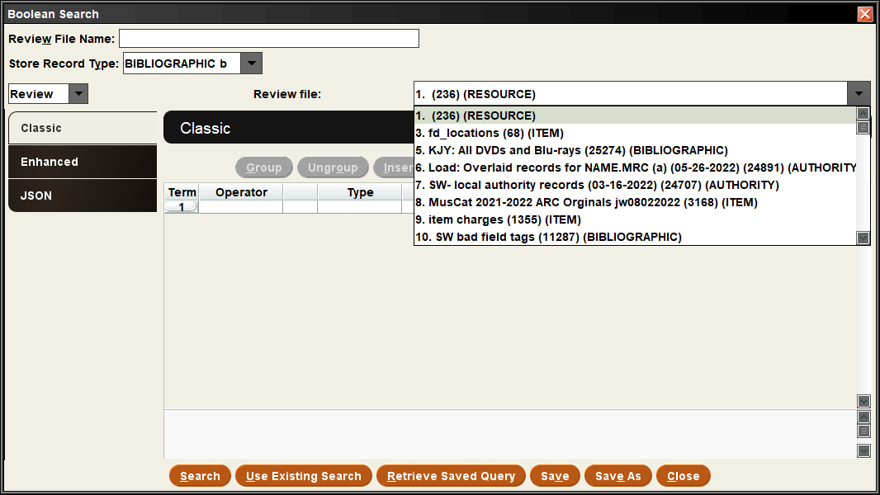
Notes:
Review uses another list as the source of records, For example, one of my colleagues maintains an owned list that has all of our current subscriptions, which they can then run more targeted lists off of for unpaid subscriptions, partially paid standing orders, and similar things for doing serial projections.

Slide 22
Notes:
Index allows you to search within various indexes, for example, a call number range.

Slide 23
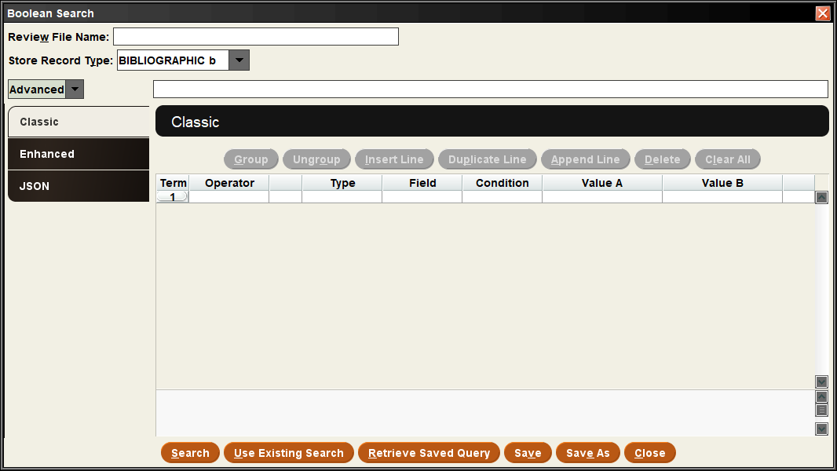
Notes:
I’m not sure how to use advanced. I’ve never needed it.

Slide 24
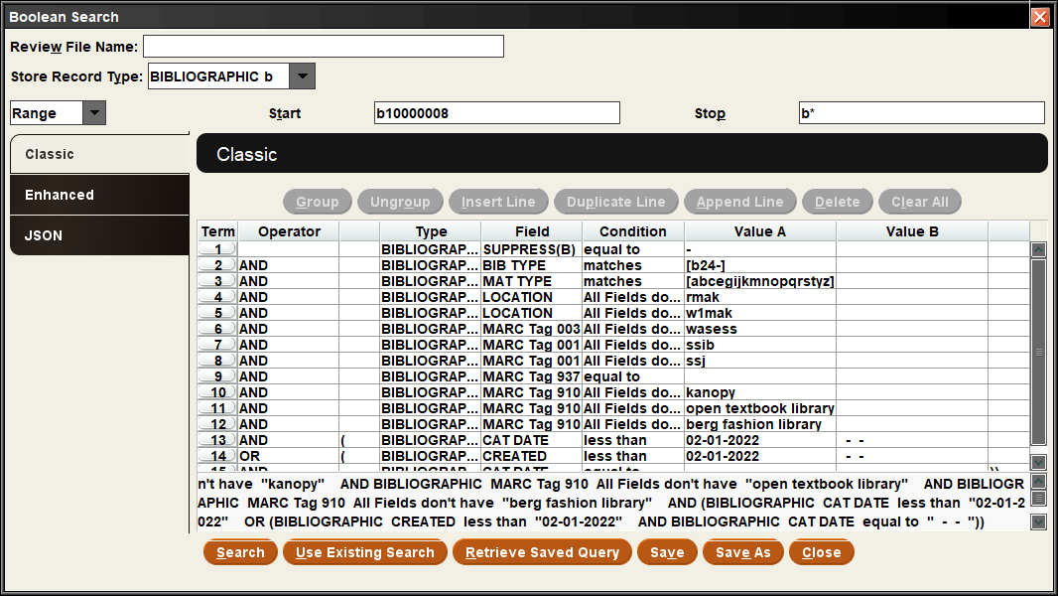
Notes:
Here is the classic search view, probably the one most everyone is familiar with.

Slide 25
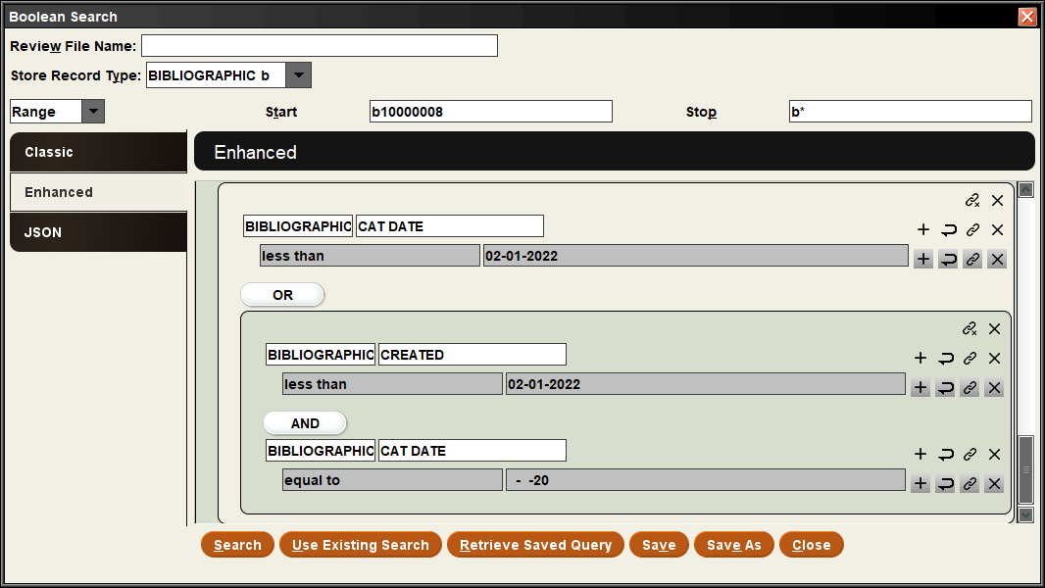
Notes:
Here is the enhanced view. I don’t use it so I’m not as familiar with it. I’m pretty sure one of the links at the end covers it though.

Slide 26
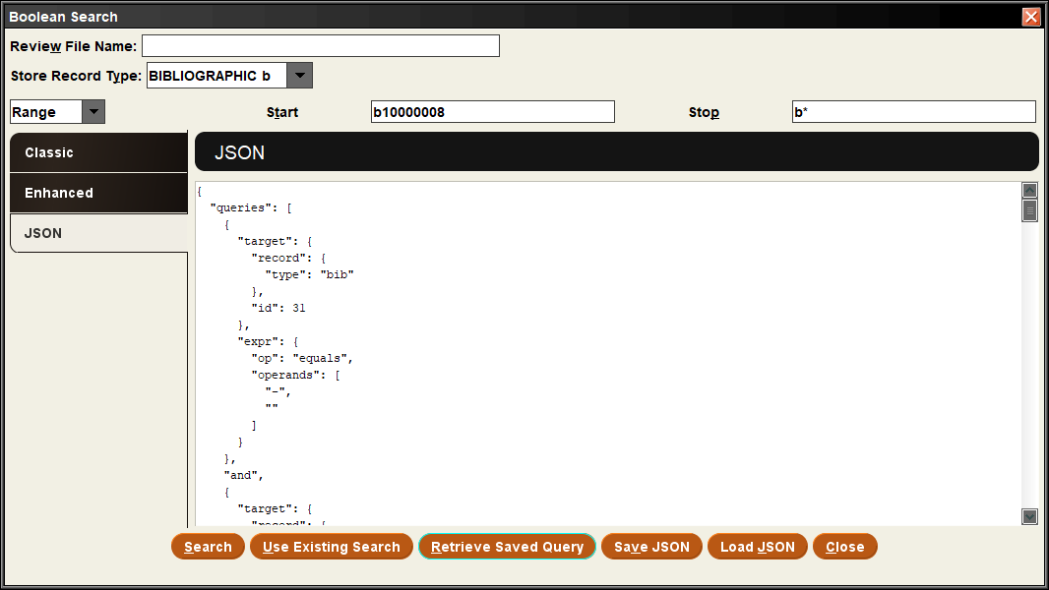
Notes:
This is the JSON search tab. It can be useful when you have dozens or more of the same search type. I’ll demonstrate it later with a use case.

Slide 27
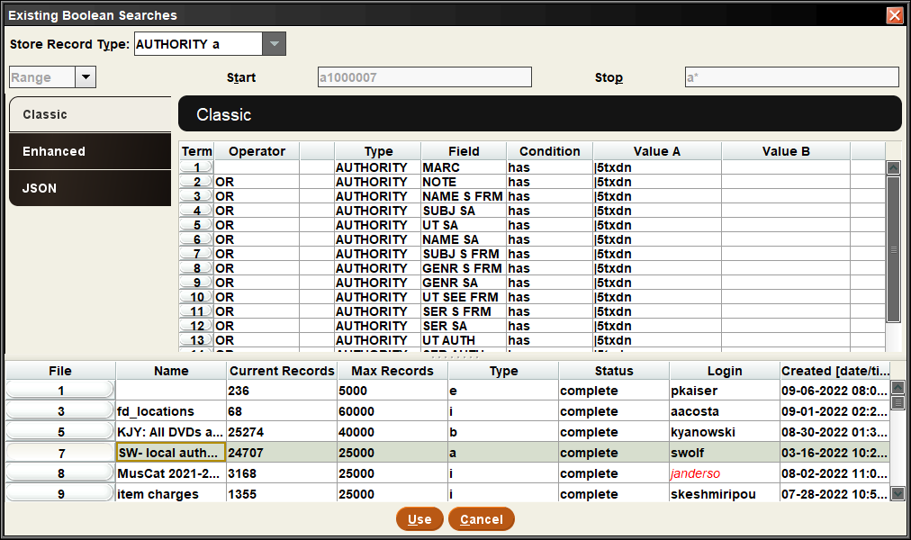
Notes:
Instead of building your own search, you can click “use existing search”. This brings up the search information for all of the other lists in Create lists. It’s nice if you want to make a change to a search but keep the original results still.

Slide 28
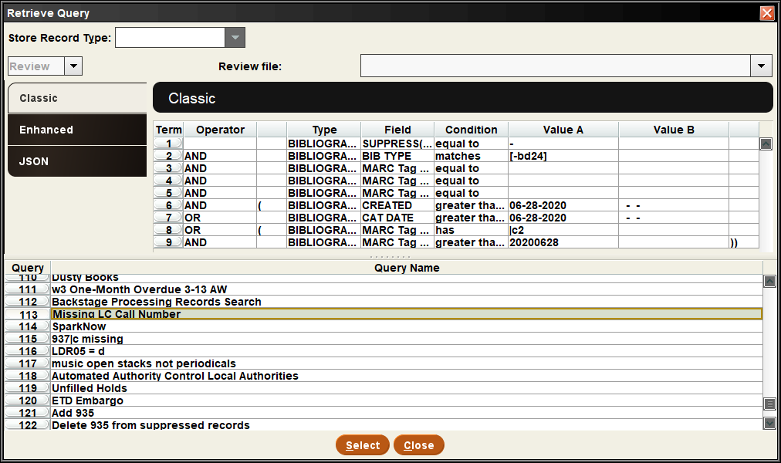
Notes:
“Retrieve saved query” pulls up a list of saved queries. I use this a lot with monthly maintenance projects. You can save or save as the query right next to the button.

Slide 29
Create List Tools/Functions
Search Records
Sort Records
List Records
Import Records
Export Records
Show Records
Show Info
Notes:
Sort records is just what it sounds like

Slide 30
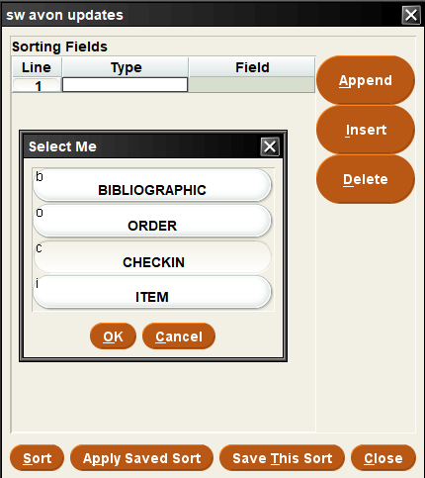
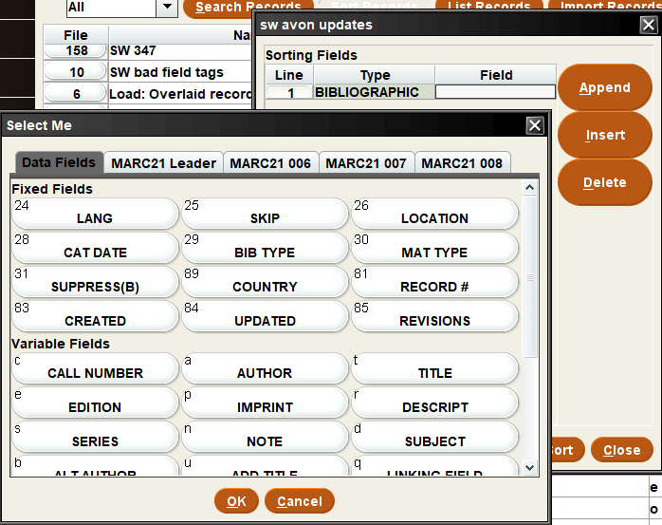
Sort Records
Notes:
You can sort by various record types and various fields. You can add more than one search term. You can save sorts and use them again later. I use this a lot to group records by location or something else that I can then use to break the list up after copying it. Then I can send different parts of the list to other catalogers for help.

Slide 31
Create List Tools/Functions
Search Records
Sort Records
List Records
Import Records
Export Records
Show Records
Show Info
Notes:
List records will print the values you select

Slide 32
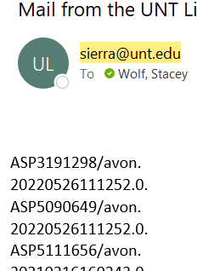
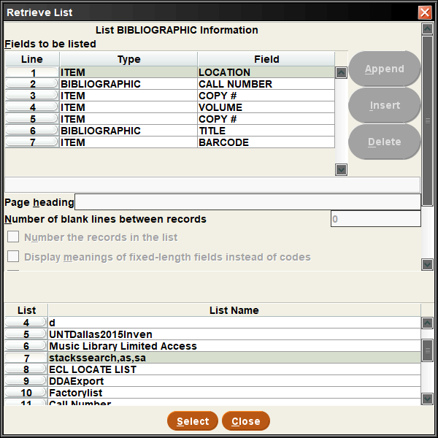
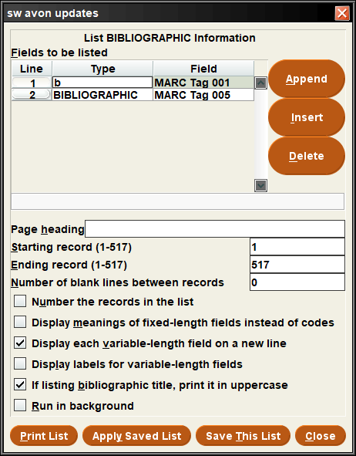
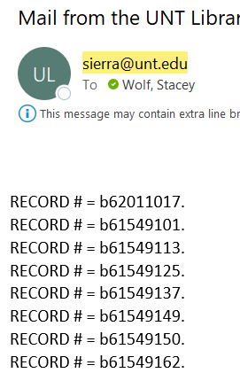
List Records
Notes:
Enter the fields you want to list. There are a few settings like # records, display meanings instead of codes, display each field on a new line, display labels for variable length fields. What you use will depend on how you want to use the data later. You can save and retrieve list settings too. When you print the list, you can have it emailed to you, saved as a file, or a few other options I rarely use.

Slide 33
Create List Tools/Functions
Search Records
Sort Records
List Records
Import Records
Export Records
Show Records
Show Info
Notes:
Import records is a handy newer function that I talk about a few different times.

Slide 34
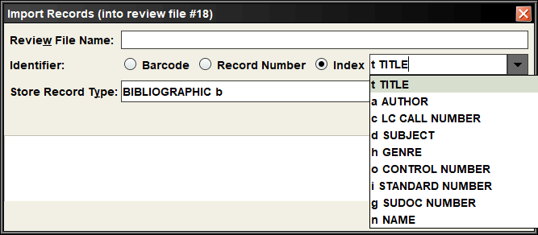
Import Records
Notes:
You can import a text or excel file with a list of barcodes, record numbers, or an indexed field. You specify the stored record type. They have replaced a lot of my JSON queries

Slide 35
Create List Tools/Functions
Search Records
Sort Records
List Records
Import Records
Export Records
Show Records
Show Info
Notes:
Export records is similar to list records, but it creates a tab delimited file

Slide 36
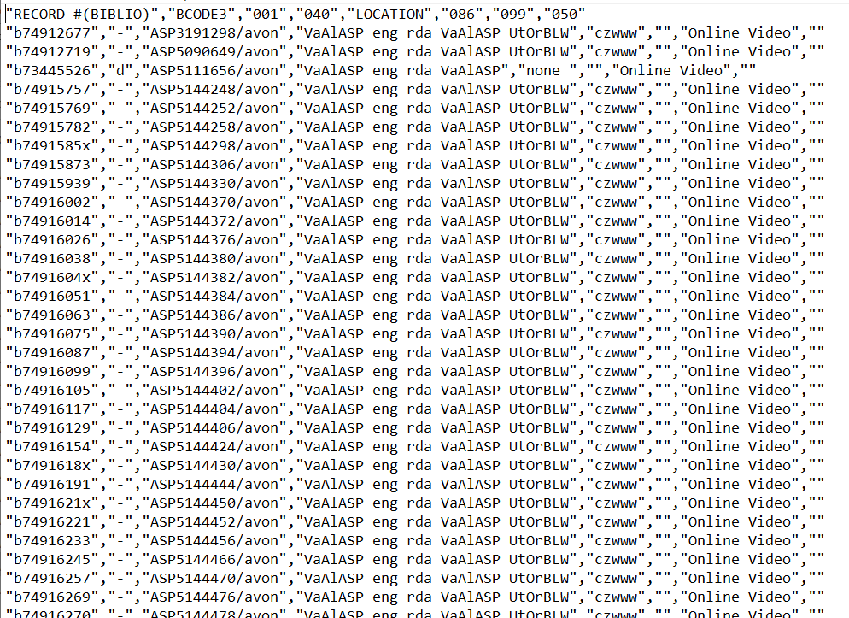
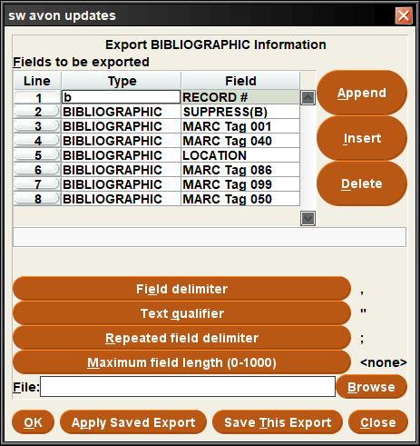
Export Records
Notes:
Like list records, you add what fields you want, set a few settings (if you need to, I rarely adjust them) and save to a file. Then you can export to excel and manipulate the data however you need. Here is an example of what it looks like

Slide 37
Create List Tools/Functions
Search Records
Sort Records
List Records
Import Records
Export Records
Show Records
Show Info
Notes:
Show records does just that

Slide 38
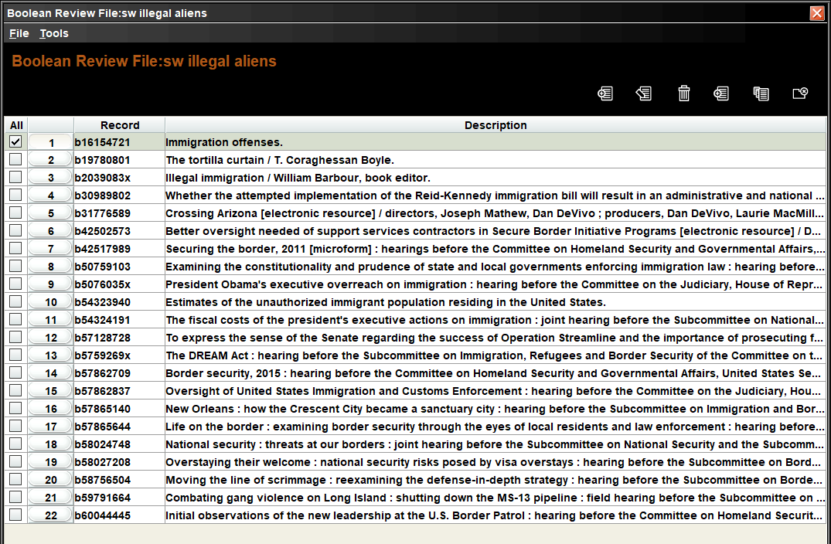
Show Records
Notes:
You can click show records or just double click the line to open up the records view. You can also click this once the list has at least one result but before it’s finished (if you’re just that impatient)

Slide 39
Create List Tools/Functions
Search Records
Sort Records
List Records
Import Records
Export Records
Show Records
Show Info
Notes:
Show info opens up a view only of the search terms for that review file

Slide 40
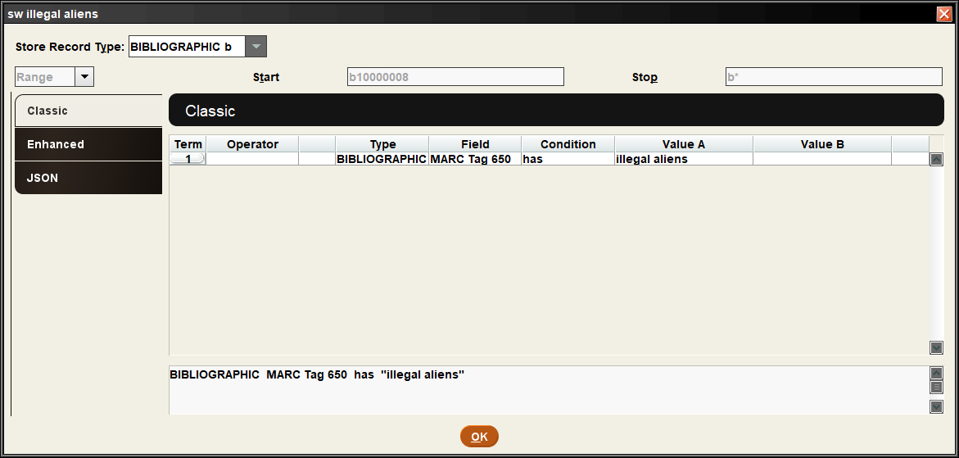
Show Info
Notes:
You can see the terms but can’t make changes. Handy if you have similar searches and you are trying to identify a specific one.

Slide 41
Tips (Best Practices)
Notes:
So, now, some tips or best practices. This will include things we try to do at UNT, but I’ve also included other institutions’ best.
We have a lot of various users creating review files and if we didn’t follow any rules, it’d be messy and hard to find anything. And we aren’t even part of a consortium of libraries! They tend to have more rules/best practices since they have so many users.

Slide 42
Plan it out before you begin
Ask yourself:
What do you want to search for?
What results do you want?
Be aware of which record type contains what data.
Need to know this in every step in the Create List process¹
Bibliographic Record | Item Record
Title | Location Code
Author | Call Number
Publication Date | Barcode Number
Subject Headings | Item Creation Date
Notes:
Before you begin, decide what it is you want to search for. … Think about what results you need so you know what search criteria to use.
Also, you need to be aware of which record type contains what data. The bibliographic record has the information about the title such as author, title, publication date, subject headings, etc. The item record has the information about individual copies such as the location code, call number, barcode number and the date the item record was created. You will need to know this in every step in the Create List process¹.

Slide 43
Naming convention examples
At UNT:
Use initials at the beginning of list names
At IFLA:
Two letter library code; descriptive word or name; date you want to keep the file until (til mm/dd/yy)¹
At Marmot:
Include your library name or code in the file name.
If you are using shared login, include your personal name in the file name.²
At Boreham Library:
The tilde ~ at the start of a file name means that it is a Featured List and should not be deleted or altered except by Technical Services staff.³
Notes:
Various naming conventions I found with a quick google search:
At UNT:
Use initials at the beginning of list names
At IFLA:
Two letter library code; descriptive word or name; date you want to keep the file until (til mm/dd/yy)¹
At Marmot:
Include your library name or code in the file name.
If you are using shared login, include your personal name in the file name.²
At Boreham Library:
The tilde ~ at the start of a file name means that it is a Featured List and should not be deleted or altered except by Technical Services staff.³

Slide 44
Why add initials at beginning of list names?
Sort by title
Easy to identify ownership
Helps identify your lists in other modules
Global Update
Data Exchange-Output MARC records
Notes:
Why should you add initials at beginning of list names?
It allows you to sort by title instead of initials. if you are part of a consortium it helps collocate your library’s lists. If you have a lot of owned lists as well as regular, not-owned lists, this could keep your lists together (unlike sorting by login).
Initials make it easy to identify ownership in cases where someone else runs a query for you or you are using a shared login.
They can also help identify your lists in other modules like global update, delete records, or data exchange-output marc records

Slide 45
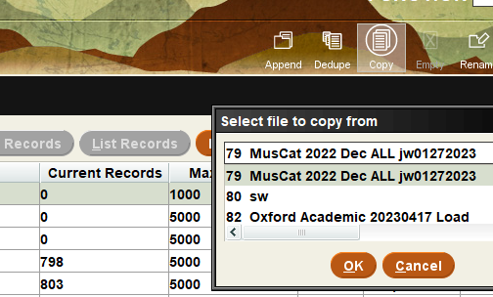
Use smallest capacity possible or move to smaller lists
When possible, use an available review file with the smallest capacity that will still fully accommodate your list
Run in a large list so it doesn’t fill up completely
Move to a smaller list if not many results
Notes:
When possible, use an available review file with the smallest capacity that will still fully accommodate your list
Or use the large lists for searches where you don’t know how many results you might get. This will prevent the list from filling up and stopping prematurely. But then move the results to a smaller list. Highlight the desired smaller list line, then use the copy button to find the original search. Then clear the original list.
So here I have an example. Line 86…3 hundred records in a list for 25 thousand should be moved. Line 88 is fine since it’s just shy of 25 thousand, so it’s nearly a full file.

Slide 46
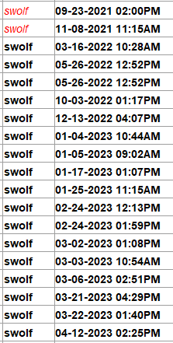
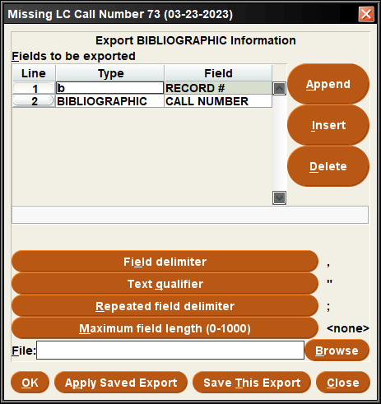
Delete or Export old lists
Notes:
Try to delete or export old lists when possible. I am bad about keeping lists for way too long; you can see here quite a few of my lists are rather old, going back to 2021. You can either save the search and run it again later when you need it. Or list or export information about the results so you can find them again. For example, my missing call number search here, I can export the record numbers to pull the same list later if needed. When saving the file, you can save as a comma separated value file or an excel sheet by following the name with .csv or .xlsx depending on what you want.
About once a year or whenever they notice we don’t have many review files left, our system admin will send an email to all Sierra users asking them to empty files when done with them and to Cancel and clear review files that are stuck “in progress.”

Slide 47
Two ways to save a search – 1
Notes:
There are two ways to save a search in Sierra for future use. You can save the search you built in Sierra.
Consortium libraries might ask that their users save their search only when it’s four lines or more and you do it on a regular basis (at least monthly). There are a limited number of searches you can save in Sierra and a long list makes it difficult to locate what you need. So in that case, I have another method.

Slide 48
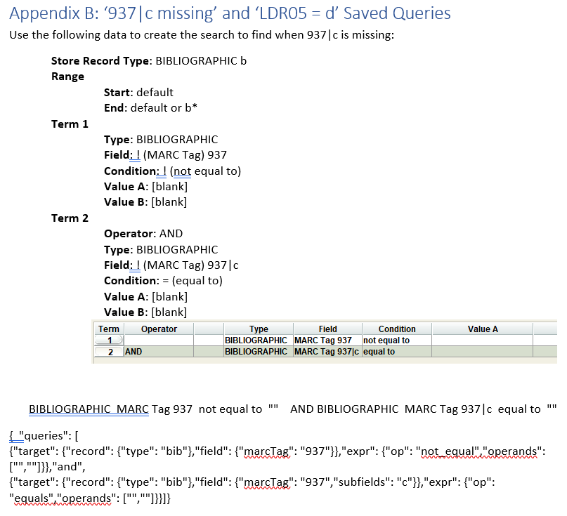
Two ways to save a search – 2
Notes:
We’ve been trying to include search information into our written procedures, at least in an appendix.

Slide 49
Two ways to save a search – 2
Notes:
You can see here that we have the text form of the query so you could copy and paste the information into each box.

Slide 50
Two ways to save a search - 2
Notes:
Then a screenshot of the query.

Slide 51
Two ways to save a search – 2
Notes:
The text version of the query that Sierra produces at the bottom of the query is next.

Slide 52
Two ways to save a search – 2
Notes:
Then we have the JSON format of the query. This makes it super quick to simply copy the JSON text from the procedure and copy it to the JSON tab in the search records function. Also ensures you don’t mistype anything. Once you paste the JSON query, you can switch back to the classic view to make any edits, like changing a date to the last time it was run or something similar to that. So if you aren’t allowed to save a list, this is a great option.

Slide 53
Common Conditions and their uses
equal to (=) = an exact match (used for location codes, statuses, and other fixed fields) or records without a given field if value A is blank
Notes:
Here are some common conditions and their uses.
Use equal to (=) if you’re looking for an exact match (used for location codes, statuses, and other fixed fields). Or if you search for a MARC tag is equal to blank, it will return records that don’t have that MARC tag.

Slide 54
Common Conditions and their uses
not equal to (!=) = an exact non-match. Handy to find records with that field if you set value A to blank
Notes:
Use not equal to (!=) if you’re looking for an exact non-match. If you search for a MARC tag is not equal to blank, that will find every record with that field

Slide 55
Common Conditions and their uses
between = searches a range. Both values entered will be included in your results, along with any between.
Notes:
Use between if you’re searching a range. Both values entered will be included in your results, along with anything in between.

Slide 56
Common Conditions and their uses
Use greater than (>) or less than (<) when searching dollar figures or dates. For dates, less than (<) means “before.”
Notes:
Use greater than (>) or less than (<) when searching dollar figures or dates. For dates, less than (<) means “before.”

Slide 57
Common Conditions and their uses
has = holds or a partial value
Notes:
Use has if you’re looking for holds or a partial value (call number Has FIC or message Has in transit). This is similar to equal to, but less precise so you will get more results

Slide 58
Tricks
Notes:
Now for a couple of tricks. These are less what you should do and more how you can do something.

Slide 59
Sorting Review Files
Column names change how the lists are sorted:
File #
Name
Current Records
Max Records
Type
Status
Login
Created
Drop down filters by status and current user
Notes:
Files are sortable by column. The default sort is by file number, or roughly by list capacity. You can re-sort by clicking on any column header (Name, Current Records, etc.). If you used initials at the beginning of the file names, all your lists will be grouped together when you sort by name. If you want to find which files you created, sort by username and find your Sierra username in the list.
The drop down feature filters by status and current user, filtering out irrelevant review files.

Slide 60
Previous record Next record
Ctrl+[
Previous record
Ctrl+]
Next record
Notes:
I’ve been using this keyboard shortcut forever, ctrl close bracket has helped sort through lists so quickly.

Slide 61
Previous attached record Next attached record
Ctrl+comma
Previous record
Ctrl+period
Next record
Notes:
This is a new shortcut I learned last year. Ctrl comma and ctrl period are really helpful with navigating the summary page of a record.

Slide 62
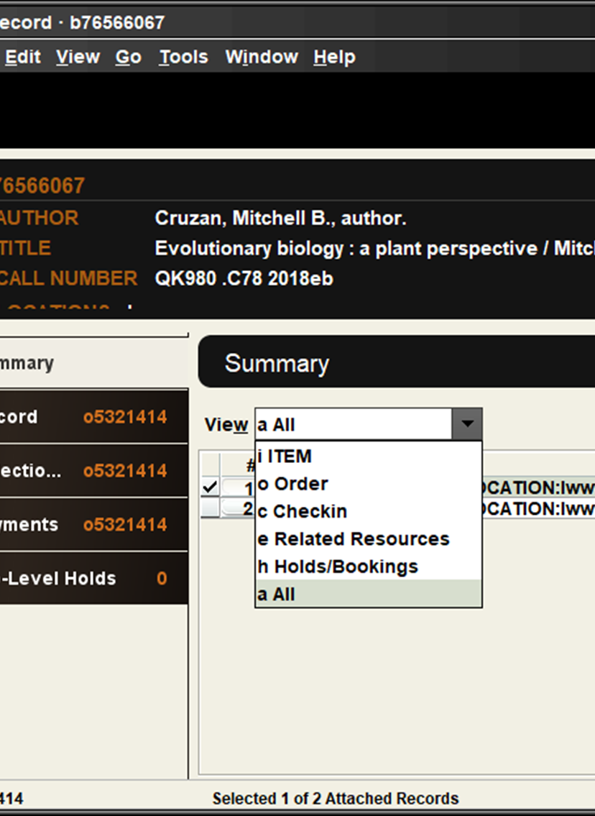
Previous attached record Next attached record
Ctrl+comma
Previous record
Ctrl+period
Next record
Notes:
Set view to All in the summary tab, Then you can view the first record and use ctrl period to go to the next one; for example, for a list of order records, this allows me to view order and then item records. When I go to the next record, it resets to display the order record, but the view all is still there. I can click through a whole list rather quickly using this short cut.

Slide 63
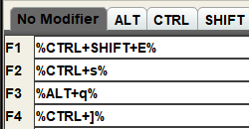
Macros
Open bib record
Save
Close bib record
Next bib record
Notes:
These were some of my most used macros for the longest time when I was doing authority work. I could just hover my hand over that first bank of function keys and rarely needed to do anything else while reviewing a list.

Slide 64
Create lists outside of create lists
Notes:
The rest of my tips and tricks will be trickled throughout the rest of the presentation. Like, did you know there are a lot of ways to use create lists outside of the create lists function?

Slide 65
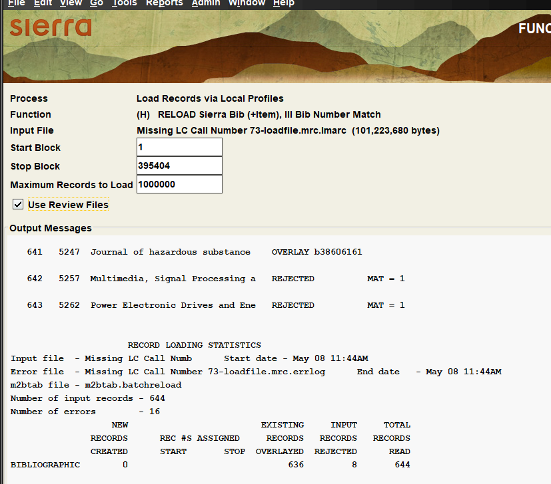
Data Exchange
Check “Use review files”
Load file
Use copy function in create lists to access the review files
Divided into loaded records and overlaid records
Notes:
When loading records in Data Exchange, if you check the box next to Use Review Files, it will gather the records that were inserted and overlaid into two different lists you can pick from by selecting Copy in a blank review file.

Slide 66
Remove loads from the copy records function
Notes:
The review file must be large enough to hold all of the records (noted in parentheses after the file name) or you get an error.
Best practice is to remove the file being copied if you aren’t going to need it again to prevent cluttering the lists with old, unneeded files.

Slide 67
Notes:
In Import invoices, you can Create a review file of the records you are loading.
Fill out the process options and then click the none button next to create review file

Slide 68
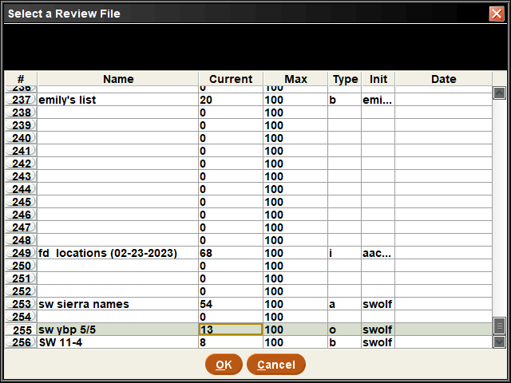
Notes:
You can select a list to save your records to. I like to scroll all the way to the bottom so it’s easy to find later without needing to sort.

Slide 69
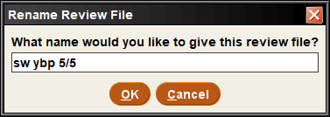
Notes:
Name your list. I copy the name to my clipboard so I can add to the same list by appending another invoice to the end after I load this one. I usually load three files (3 different YBP accounts for separate ebook platforms. All use the same procedure/workflow, so I tend to lump them together when I can). You have to re-set-up the process and re-select the desired list for each shipment. Sierra doesn’t keep the name of the list when you do this so I paste it back in instead of retyping it.

Slide 70
Notes:
Now you’ll see the review file name, which is where Sierra will save all of the order records it overlays during the import invoices function. Repeat this for all shipments like I said before; Sierra appends new shipments to the list.

Slide 71
Notes:
Global update is a powerful tool you can use to make changes to a list. Instead of using the index to search, change the left hand drop down to review file and find your file. This is where the initials at the beginning really helps.

Slide 72
Notes:
Something to note, global update divides up your lists based on record type. So if you aren’t working with a bibliographic record or don’t see your list right off, you will need to change the record type or check more than one.

Slide 73
Notes:
When you have the list information showing, you can toggle between most of the indexed fields in the record by right clicking the box that says location in this image.

Slide 74
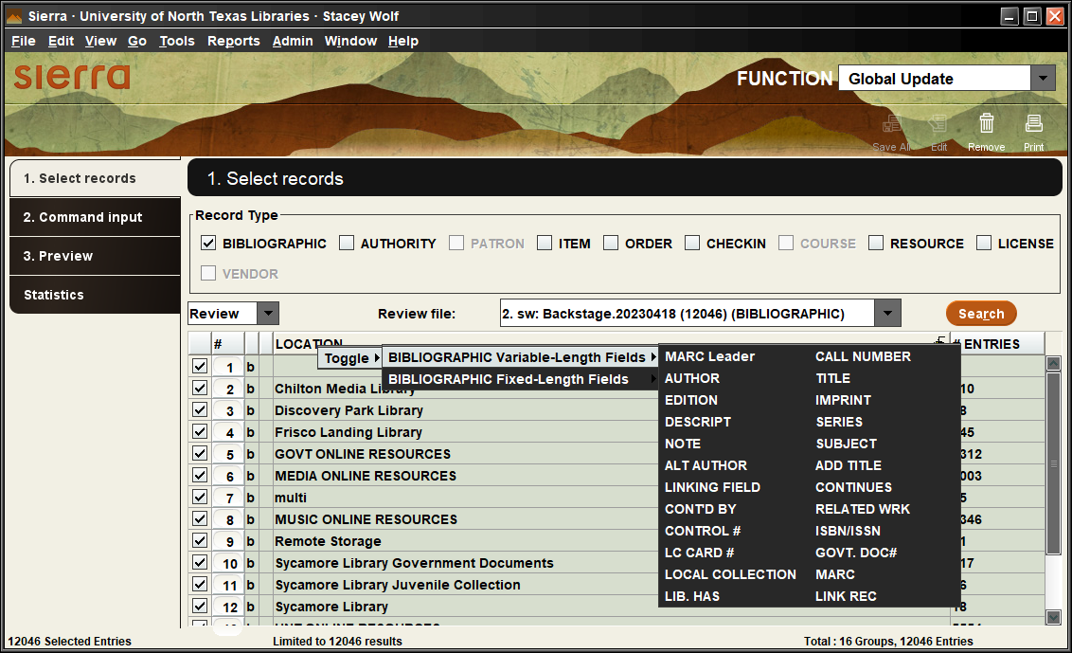
Notes:
You get a small command window that pops up with fixed fields and variable length fields.
You can change these to view different information in the records

Slide 75
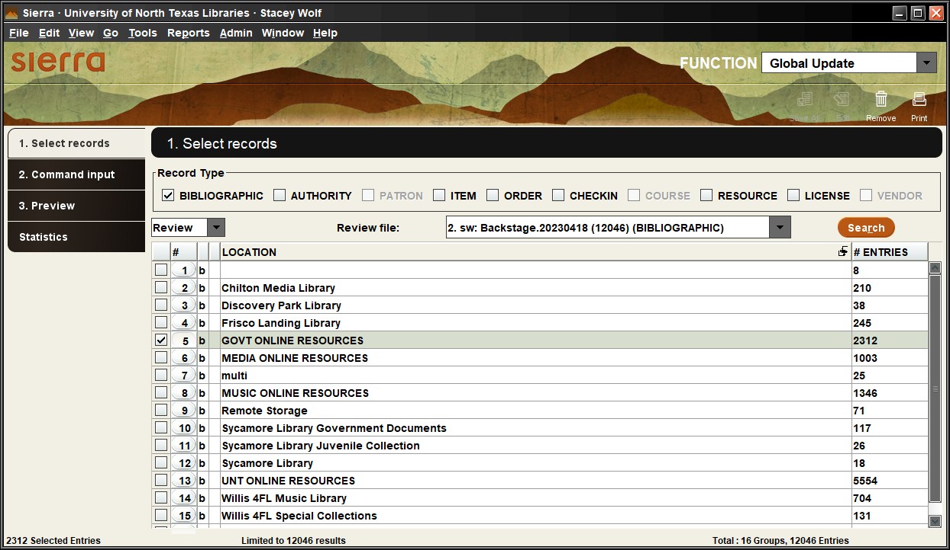
Notes:
I’ve even used it to delete a specific location out of a list or remove suppressed records from a list. Just click the box next to the number and then click the trash can under the function drop down to remove it.
If the trash can doesn’t show up at first, click search again. Make sure to check that it’s available before selecting items. I’ve selected a long list of entries to remove and then lost all of those checks when I have to click search again to get the remove button.
Be sure to copy the list before removing things if you think you’ll want to add them back in at some point. Once you delete, you can’t add back without going back to Create lists and rerunning the search.

Slide 76
Notes:
Global update allows you to make batch changes to the records. You can see all of the various options here. A common one I use in record loading sometimes is the delete duplicate field data. This deletes things that may have loaded twice or were protected in the overlay but also in the file of records.

Slide 77
Notes:
Delete records does just that; Deletes all of the records in a list
It’s not reversable, so only give permissions to delete to those who really need it.
Also be sure to name your lists for deletion well so you don’t pick the wrong one. But there is a preview when you select Start before clicking the delete records button.

Slide 78
Notes:
Headings report allow you to export the report to a review file of bib, authority, item or patron records. I don’t use this often because it only has the newest item that triggered it showing up on the headings report and not the duplicated records or other affected records depending on what feature you are looking at.
Select what format of record you want,

Slide 79
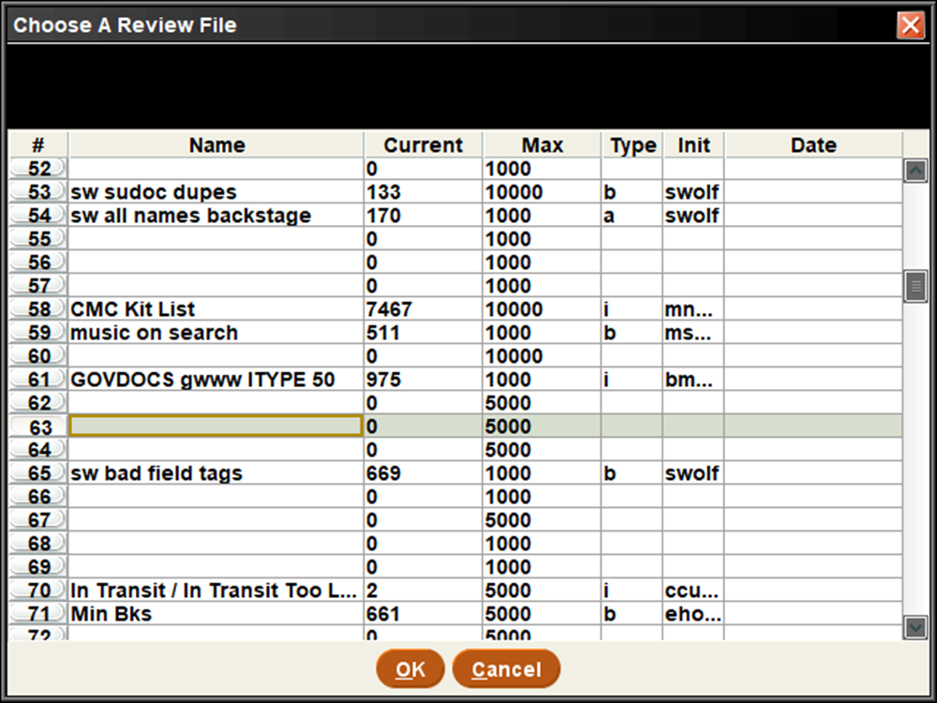
Notes:
then select a review file large enough for all of the entries.

Slide 80
Notes:
Then you get the headings report in a list. If I didn’t want to check all of these blind references to see if maybe it was a false positive, I could take this list straight to delete records and remove all of the blind references.

Slide 81
Use Cases
Notes:
And now for some use cases inside of create lists, like I mentioned in my objectives.

Slide 82
I want to find all missing, lost and paid, or claims returned items without a specific bib location
Notes:
I want to find all missing, lost and paid, or claims returned items without a specific bib location. Here is the query I’d use.

Slide 83
I want to find all missing, lost and paid, or claims returned items without a specific bib location
Notes:
This is a group of the item statuses that refer to missing, lost and paid, or claims returned codes

Slide 84
I want to find all missing, lost and paid, or claims returned items without a specific bib location
Notes:
These are the specific bib locations we want to exclude from our search

Slide 85
I want to find all missing, lost and paid, or claims returned items without a specific bib location
Notes:
When you are mixing “and” and “or” searches on more than 2 lines it’s necessary to group search lines in order to get the desired results.
In order to have the “and” lines apply to both the status codes and location codes, you must group the “or” lines together by highlighting all of them and clicking Group.
If a search strategy does not get you the results you wanted, check that your “ands” and “ors” are properly combined.¹

Slide 86
I want to find all missing, lost and paid, or claims returned items without a specific bib location
Notes:
You can use both item and bibliographic record types in the search terms. You could even add in other record types if those are attached to the bib records.

Slide 87
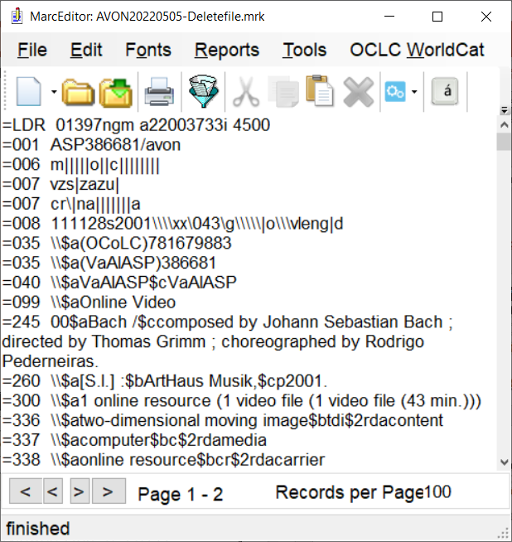
The vendor sent a file of MARC records to be deleted; how do I delete these records in Sierra?
Notes:
Next use case:
The vendor sent a file of MARC records to be deleted; how do I delete these records in Sierra? For this we will use import records.

Slide 88
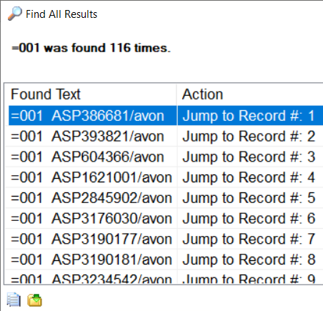
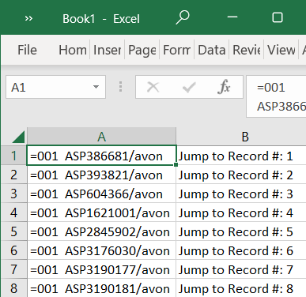
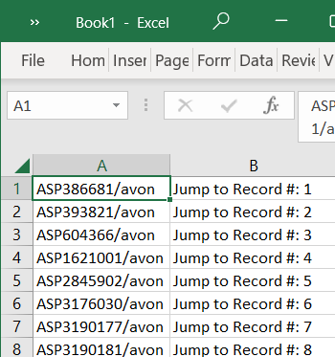
The vendor sent a file of MARC records to be deleted; how do I delete these records in Sierra?
Notes:
I use marcedit to isolate the matchpoint I want to use. In this case, I know the 001 field is my best option. If you have record numbers or an oclc number, that might be useful too.
I use excel to clean up the data so just the information I need to search with is in the first column. Save this file.

Slide 89
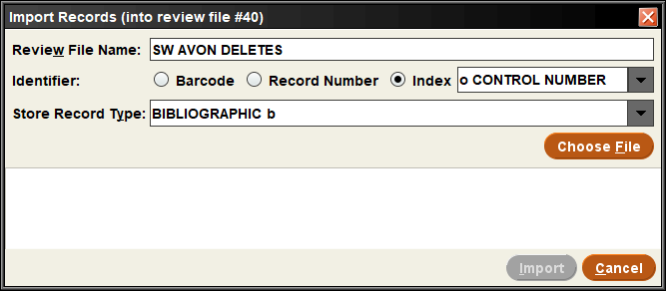
The vendor sent a file of MARC records to be deleted; how do I delete these records in Sierra?
Notes:
Open import records and then set the identifier to index control number (that’s where we index the 001 field).

Slide 90
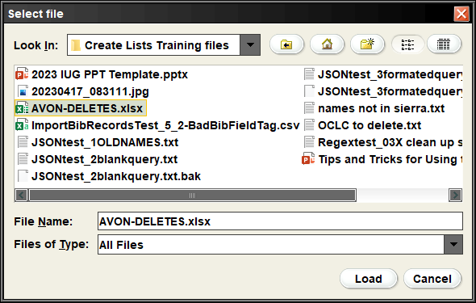
The vendor sent a file of MARC records to be deleted; how do I delete these records in Sierra?
Notes:
Navigate to your file you just created and click load

Slide 91
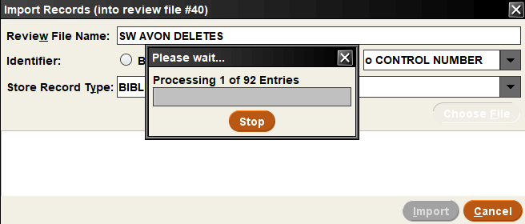
The vendor sent a file of MARC records to be deleted; how do I delete these records in Sierra?
Notes:
Sierra will provide a processing window.

Slide 92
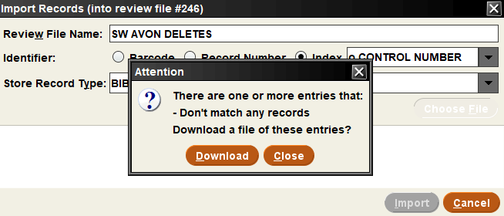
The vendor sent a file of MARC records to be deleted; how do I delete these records in Sierra?
Notes:
If it has records that don’t match, you have the option to save that to a file. This helps you figure out what didn’t match and allows you to go back and try it again later.

Slide 93
The vendor sent a file of MARC records to be deleted; how do I delete these records in Sierra?
Notes:
Here are the bib record numbers for those records that matched the control fields

Slide 94
The vendor sent a file of MARC records to be deleted; how do I delete these records in Sierra?
Notes:
Now that I have a list of records, I can use global update to batch update a fixed field to suppress/withdraw records. I can run a list to find all item records attached to these bib records. I can use the delete records function to delete the list. There are a lot of options moving forward, it depends on your goal.

Slide 95
My SQL query returned a list of bib record numbers to clean up; what next?
Notes:
My SQL query returned a list of bib record numbers to clean up; what next? Click the download button

Slide 96
My SQL query returned a list of bib record numbers to clean up; what next?
Notes:
Save the list as a csv file

Slide 97
My SQL query returned a list of bib record numbers to clean up; what next?
Notes:
If not done already, format list of bib records in Excel so that only the bib record number is in the first column

Slide 98
My SQL query returned a list of bib record numbers to clean up; what next?
Notes:
Click Import Bib records
Enter a File Name
Select Barcode, Record Number, or Index (plus what index to use)
Select Store Record Type
Click Choose File

Slide 99
My SQL query returned a list of bib record numbers to clean up; what next?
Notes:
Navigate to your file and load it

Slide 100
My SQL query returned a list of bib record numbers to clean up; what next?
Notes:
Click Import

Slide 101
My SQL query returned a list of bib record numbers to clean up; what next?
Notes:
Now you have a list of bib records from that query to help facilitate clean up

Slide 102
Do we have any of these names in our catalog? I need to check the author and alt author indexes.
Notes:
Do we have any of these names in our catalog? I need to check the author and alt author indexes. There are two options: Import records or use a JSON query.

Slide 103
Do we have any of these names in our catalog? I need to check the author and alt author indexes. Use Import Records.
Notes:
With the new functionality of import records, you could format the names like I’ll show you in the next method and load it with index a author. But what if I wanted to search authors, alt authors, and a subject index. Instead of running two imports, you could use a JSON query

Slide 104
Do we have any of these names in our catalog? I need to check the author and alt author indexes. Use a JSON query.
Notes:
You don’t need to know json to use this search function. Build your search in the classic tab and then transfer to the json tab. It will require outside manipulation of data, but it’s rather routine and once you figure it out, it’s easy to repeat and just have a step by step guide.
So here is my classic view of the query I want in order to search for the author and alt author indexes (I’m leaving out the subject index for time). Regular expressions use the $1 to indicate where to insert the original information, so using it as your value a makes for easy replacement later.

Slide 105
Do we have any of these names in our catalog? I need to check the author and alt author indexes. Use a JSON query.
Notes:
Here I’ve clicked over to the JSON tab and you can see it’s transformed my search from the classic view

Slide 106
Do we have any of these names in our catalog? I need to check the author and alt author indexes. Use a JSON query.
Notes:
You can see the record type we selected was bib. We wanted tag a (for author or main entries). And the our operation has and our value a appear in the last grouping. The or tells us that there is another target after this one, it’s just note in view.

Slide 107
Do we have any of these names in our catalog? I need to check the author and alt author indexes. Use a JSON query.
Notes:
We wanted tag a (for author or main entries). And the our operation has and our value a appear in the last grouping. The or tells us that there is another target after this one, it’s just note in view.

Slide 108
Do we have any of these names in our catalog? I need to check the author and alt author indexes. Use a JSON query.
Notes:
And the our operation has and our value a appear in the last grouping.

Slide 109
Do we have any of these names in our catalog? I need to check the author and alt author indexes. Use a JSON query.
Notes:
The or tells us that there is another target after this one, it’s just not in view.

Slide 110
Do we have any of these names in our catalog? I need to check the author and alt author indexes. Use a JSON query.
Notes:
Copy the JSON information to notepad++ (this allows replaces with regular expressions, which regular notepad does not). Now you can see the full query.
The picture on the right shows the query with all of the lines and tabs removed, which will allow for better manipulation in the next few steps. And this step is only needed once to set up the procedure if you create a step by step guide for future uses.

Slide 111
Do we have any of these names in our catalog? I need to check the author and alt author indexes. Use a JSON query.
Notes:
Here I have a list from OCLC of closed dates for names. I can copy this list to excel or notepad++ and sort and then clean up the names so old: 100 1 doesn’t appear any more. And change the delimiter
Each name should be on its own line​

Slide 112
Do we have any of these names in our catalog? I need to check the author and alt author indexes. Use a JSON query.
Notes:
Copy and paste all of the names so there are two groups of the same names. You can sort of see that in the image on the left here
Highlight the first group of names only
Use Search -> Replace (Ctrl-H) and Regular Expressions to add the query text around the names

Slide 113
Do we have any of these names in our catalog? I need to check the author and alt author indexes. Use a JSON query.
(.*)
Notes:
Find what: ​(.*)​
The .* will find everything on a line and the parenthesis tell the program to paste that where the $1 is

Slide 114
Do we have any of these names in our catalog? I need to check the author and alt author indexes. Use a JSON query.
{"target": {"record": {"type": "bib"},"field": {"tag": "a"}},"expr": [{"op": "has","operands": ["$1"]}]},"or",
Notes:
Replace 1 set of names with: ​ {"target": {"record": {"type": "bib"},"field": {"tag": "a"}},"expr": [{"op": "has","operands": ["$1"]}]},"or",
Here you can see the $1 is right where we want our information to go.

Slide 115
Do we have any of these names in our catalog? I need to check the author and alt author indexes. Use a JSON query.
Notes:
Check “Regular expression”​

Slide 116
Do we have any of these names in our catalog? I need to check the author and alt author indexes. Use a JSON query.
Notes:
Check “In selection”

Slide 117
Do we have any of these names in our catalog? I need to check the author and alt author indexes. Use a JSON query.
Notes:
Click “Replace All”​

Slide 118
Do we have any of these names in our catalog? I need to check the author and alt author indexes. Use a JSON query.
Notes:
You see here the first set is now contained within the target info we just added.
Highlight the second group of names now
Use Search -> Replace (Ctrl-H) and Regular Expressions to add the query text around the second set of names​

Slide 119
Do we have any of these names in our catalog? I need to check the author and alt author indexes. Use a JSON query.
(.*)
Notes:
Find what: ​(.*)​

Slide 120
Do we have any of these names in our catalog? I need to check the author and alt author indexes. Use a JSON query.
{"target": {"record": {"type": "bib"},"field": {"tag": “b"}},"expr": [{"op": "has","operands": ["$1"]}]},"or",
Notes:
Replace the this set of names with: {"target": {"record": {"type": "bib"},"field": {"tag": "b"}},"expr": [{"op": "has","operands": ["$1"]}]},"or",
Tag: b is the only real change so you could go into the replace line and find the a and turn it to b instead of replacing the whole thing. If you wanted to search the subject index also, you’d follow these steps but use tag: d (which is our tag for the subject index)

Slide 121
Do we have any of these names in our catalog? I need to check the author and alt author indexes. Use a JSON query.
Notes:
Check “Regular expression”​

Slide 122
Do we have any of these names in our catalog? I need to check the author and alt author indexes. Use a JSON query.
Notes:
Check “In selection”

Slide 123
Do we have any of these names in our catalog? I need to check the author and alt author indexes. Use a JSON query.
Notes:
Click “Replace All”​

Slide 124
Do we have any of these names in our catalog? I need to check the author and alt author indexes. Use a JSON query.
Notes:
Now we have all of our names inserted into a target line

Slide 125
Do we have any of these names in our catalog? I need to check the author and alt author indexes. Use a JSON query.
Notes:
Open a new tab in Notepad ++​
Copy the following JSON code into that new tab​
{​"queries":[​
ENTER FORMATTED SEARCH TERMS HERE​
]​}​

Slide 126
Do we have any of these names in our catalog? I need to check the author and alt author indexes. Use a JSON query.
Notes:
Then copy it into the JSON tab in your Search records screen. If there are any errors, use notepad++ to identify the line and general area to fix the problem. I usually remove that name or change a special character to a plain character since that’s typically the problem.

Slide 127
How can I find invalid subfields? Use Regular Expressions
Notes:
How can I find invalid subfields? Use Regular Expressions
Regular expression are a really useful tool and it’s great that create lists allows you to use them. This was a game changer when I was trying to do database clean up before we sent records to an authority control vendor (at least until I learned SQL and that really upped my ability to find very specific problems). I created queries to find all of the invalid subfields for each field. Here you can see my value A for each line is looking for a pipe character (our delimiter), and then anything that’s not one of the valid subfields for that field. I took that information from the LC MARC formats website. It finds all of the records with problems, but doesn’t tell me what the problem is, so I have to review that by hand and make changes individually.

Slide 128
How can I find title fields with two statements of responsibility? Use Regular Expressions
Notes:
How can I find title fields with two statements of responsibility? Use Regular Expressions
This regular expression finds any 245 field with two subfield c’s or two statement of responsibilities. There is an excellent handout by Richard V Jackson from a previous IUG in 2015 that has tons of information about how to use regular expressions in Sierra or Millennium create lists. I don’t know that how Sierra uses regular expressions has changed much since then; I haven’t had a problem with the handout’s information. I’ve linked it later in my presentation.

Slide 129
I need to create a list of music records sent to OCLC prematurely and export the OCLC #s
Notes:
Last use case: I accidentally sent brief music bib records to OCLC before they were supposed to go. I wanted to remove our holdings and delete the records from OCLC. I need to create a list of music records sent to OCLC prematurely and export the OCLC #s so I can send them to OCLC to have them deleted.
Here you can see my search terms- bib type equals b (brief); location equal to our music location; marc tag 937|c has exclude. The 937 field is how we keep track of records we send for authority control processing and these would have an exclusion note. I was supposed to use that note to remove the records from my file before sending to OCLC in the first place, but forgot. Hence the problem.

Slide 130
I need to create a list of music records sent to OCLC prematurely and export the OCLC #s
Notes:
Once you have your list, highlight the review file, click Export Records. Fill out the fields to be exported- here I’ve used marc field 035. Append adds another line to the end, Insert adds another line above the selected line.
I don’t usually change the field delimiter, text qualifier, repeated field delimiter or the max field length, but you could if your file would have those values within the data.
Click browse to select a place to save the file and a name for it. Click ok to export the OCLC numbers. You get a text file that looks like this that could then be sent to OCLC to delete records.

Slide 131
Awesome online resources
https://iflsweb.org/knowledge-base/create-lists/
Self-paced training:
https://marmot.org/content/sierra-create-lists-function-course
https://innovative.libguides.com/sierra/reports
Richard V. Jackson’s Regular Expressions in Create Lists:
https://wiliug.files.wordpress.com/2015/02/matches-handout-2015.pdf
https://iii-itlc.s3.amazonaws.com/LibGuides/LibGuides+Articles +and+Docs/Sierra/Reporting+Tools/Articles/IUG2021-Matches.pdf
Notes:
I’ve found some excellent resources online which I’ve linked here in no particular order.
The IFLS library system has a wonderful guide about how to use create lists. It’s geared toward their library system, but much of the information is still rather universal. In fact, I used a lot of it in my research for how a consortium might address create lists.
Marmot library network has an eight module, self-paced course; modules take about 30-40 mins and have slides, videos, Q&A, and exercises.
Innovative provides a lib guide with lots of various information about reporting tools, which includes create lists
Richard V. Jackson has some extremely useful guides on exactly how Sierra uses regular expressions within create lists. I’ve linked his 2015 handout as well as his updated 2021 IUG presentation

Slide 132
Awesome online resources (cont.)
Selected Past IUG presentations about Create Lists:
Mastering Create Lists by Richard V. Jackson
Looking for messy data: Create Lists and Excel tips and tricks by Mark Strang
Notes:
The first link here links to the results of a search in the IUG forum for past presentations on create lists. There were 31 earlier this week. I’ve linked some of the ones that have great basic intros to create lists
Mastering Create Lists by Richard V. Jackson
Older, but really breaks down the fundamentals of how Create lists works. I believe it’s still relevant to today’s version of Sierra
Looking for messy data: Create Lists and Excel tips and tricks by Mark Strang
Shows how to Export Create Lists results into Excel to manipulate data and then reimport to Sierra to make changes to records
https://forum.innovativeusers.org/search?expanded=true&q=%23conferences-events%20create%20lists

Slide 133
References
1 – https://iflsweb.org/knowledge-base/create-lists/
2 – https://marmot.org/content/sierra-create-lists-function-course
3 – http://blstaff.pbworks.com/w/page/6103611/Create%20Lists%20in%20Sierra%20%28tutorial%29

Slide 134
THANK YOU
Questions?
Stacey.Wolf@unt.edu

