Slide 1
Using Mobile Worklists
Limited Contact weeding
Roz Goldstein, Head of Tech Services, Widener University
rmgoldstein@widener.edu

Slide 2
Widener University
Widener University’s libraries include the main campus in Chester Pennsylvania as well as two law school campuses
The Delaware Law School is in Wilmington, Delaware only 20 minutes away
The Commonwealth Law School is in Harrisburg, Pennsylvania more than an hour and a half away from the main campus

Slide 3
Wolfgram Memorial Library
This project is limited to the circulating collection on the main campus in Chester, Pennsylvania
Wolfgram Memorial Library is the only library on this campus and serves the undergraduate and graduate students, as well as faculty and staff
The library celebrated it’s 50th anniversary this past fall

Slide 4
Wolfgram Memorial Library

Slide 5
Wolfgram Memorial Library from the air

Slide 6
Weeding traditions at Wolfgram Library
There is no history of consistent weeding of the circulating collection and no pressure from past administrations to engage in a systematic weeding project
Over the years weeding the circulating collection was dependent on the personality of the subject liaison librarian
Some sections of the circulating collection had been weeded over the years using the data retrieved via create lists and exported to spreadsheets
Parts of the collection have old, never circulated books deteriorating on the shelves

Slide 7
Weeding traditions – part 2
The reference collection has been heavily weeded at least twice in order to create more study space on our main level
Space was the major goal of these reference weeding projects
Tech Services staff was overwhelmed with the volume of work
Little thought was put into some of the weeding decisions
In at least one or two cases, the titles for current standing orders were discarded without sharing the information to the appropriate staff

Slide 8
OCLC’s GreenGlass analysis tool to the rescue
During the Summer 2019 our new library director introduced the idea that we contract with GreenGlass to analyze our data
In the Fall 2019 we sent the bib and item records to Greenglass to help with our collection management decisions
The data returned included OCLC holdings data with information on local and global holdings as well as the holdings on the comparator libraries we selected

Slide 9
Preliminary project plan
In early 2020 we began planning on how to move forward with the project
Plans were for made to evaluate the data during the spring semester
Physical weeding would be done during the summer months with fewer people in the library
Each subject liaison librarian was able to control the data points best fitting their subject
We will have access to our GreenGlass data for two years from Fall 2019

Slide 10
GreenGlass Query Screen

Slide 11
Some of the useful metrics from GreenGlass

Slide 12
COVID-19 and library closure
The University went to virtual classes after March 12th, 2020 and the library closed on Saturday March 14th
No one was allowed back on campus until late spring and then only one at a time in order to retrieve personal items or gather materials that would aid in their work
During the summer discussions began on how to weed a physical collection with minimal contact
The library re-opened to students during the fall semester, with limited hours
Staff not working at the User and Access Services desk are allowed to work before opening hours

Slide 13
Limited contact weeding for COVID-19 era
Previous weeding projects were much smaller projects, with multiple staff members handling the material in a short period of time
We wanted to move forward with this project although most of the library faculty and staff are still working remotely either most or all of the time
Materials are being quarantined between pulling from the shelves and being stamped and boxed
Using Mobile Worklists takes one set of hands out of the workflow

Slide 14
Mobile Worklists
The three campuses share our Sierra system
We acquired Mobile Worklists several years ago as part of our migration from Millennium to Sierra
For years we were unable to adjust our workflow to find a use for this app

Slide 15
Our past limited use of the Mobile Worklists app
Our Delaware Law School campus was able to find a use for Mobile Worklists when a pipe burst ruining large sections of their collection
Books had been discarded by a salvage company with no way to record what was gone
Mobile Worklists was the perfect tool to scan the remaining titles and delete the rest

Slide 16
There was once a chance we were going to use this app at Wolfgram Library
A few years ago, there was discussion at Wolfgram Library to begin an inventory project
The plan was that we would use Mobile Worklists – iPads were purchased in spite of the fact that many preferred the ease of an iPhone
A project plan was designed and tested
And then the project was forgotten

Slide 17
Mobile Worklists sign in screen

Slide 18
Mobile Worklists was the perfect solution for this weeding project
Mobile Worklists fit our needs perfectly and we already had the app
I created a shared Sierra account for the project so that “My Lists” would be available to everyone on the weeding team
Two staff members (scanners) volunteered to work on the pulling/scanning part of this project – 1 or 2 mornings per week
One staff member has experience weeding
One staff member has experience using Sierra

Slide 19
Scope of the project
The first 5000 or so titles were identified for weeding because they are freely available online in the public domain, we are still working in phase 1
The second phase will be 3-4 times larger
Our teaching faculty had the opportunity to review the discard lists – and recommended that the library retain a few hundred titles

Slide 20
Spreadsheets have not disappeared
The necessary data fields from GreenGlass are exported onto spreadsheets to be used for pulling and scanning
The scanner goes to the stacks, matching the items from the spreadsheet and then pulling and scanning the barcode
For any anomalies, there is a note field available – especially for titles missing from the shelf
Our barcodes are inside the back cover – slowing down the scanning process a little bit

Slide 21
The work flow
Staff are allowed into the library, preferably one at a time per functional area, in the morning hours before the library is open to the public
Each staff member scanning and pulling was paired with a member of the Tech Services Department
The scanning staff member delivers the finished book trucks to Tech Services.

Slide 22
The steps with Mobile Worklists are easy
Each scanner, pulls the books matching the titles from the spreadsheet.
The barcode is scanned as they fill the book truck
When the truck or trucks are full, they are delivered to Tech Services along with the annotated spreadsheet
The scanner texts or emails the recipient that another batch is ready
The recipient exports the list to the ILS (Sierra)

Slide 23
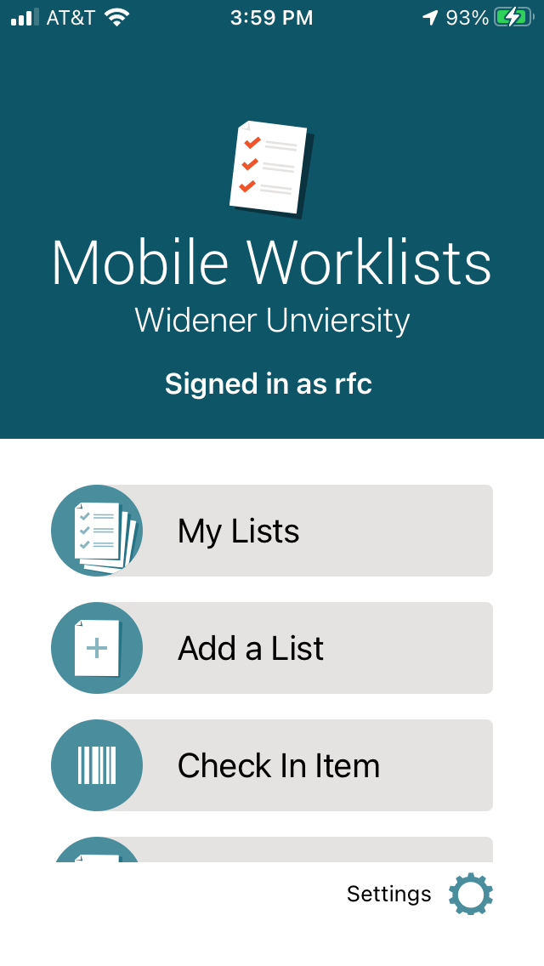
Signed onto Mobile Worklists

Slide 24
My Lists Display

Slide 25
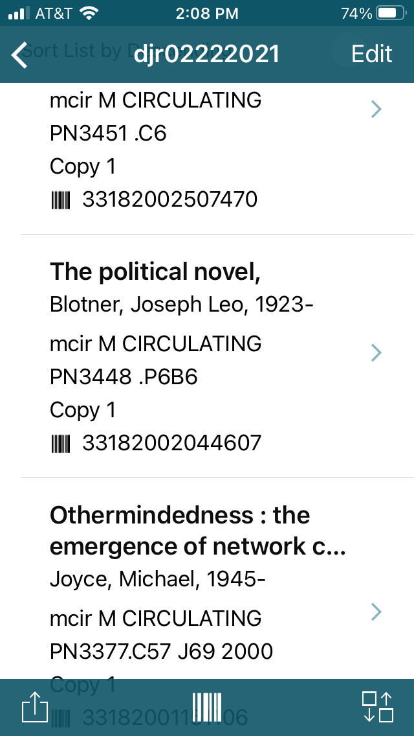
Resulting list
Click on upload icon on bottom left

Slide 26
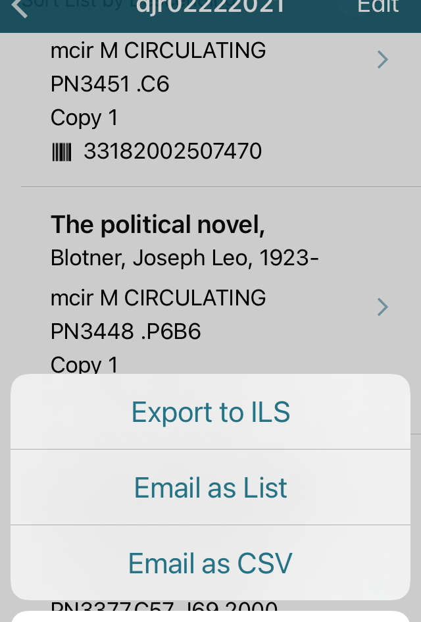
Click the export button
Export to ILS creates a copy in a review file in Create Lists.

Slide 27
Create lists

Slide 28
Easy to keep stats
Each Tech Services partner exports the list to a spreadsheet before beginning the deletion process
A saved export was created for uniformity
The statistical data on the spreadsheets are kept on a monthly basis to mirror the pre-COVID-19 procedures

Slide 29
Procedures were created to mirror in person weeding
Old – Book trucks filled with discards, sometimes with multi-volume sets close together, sometimes in random order
New – Book trucks filled with discards, call number order a bit more uniform, GreenGlass’s call number sort is less than perfect
Old – Tech Services staff scans barcode, pulls up bib in Sierra, grabs the OCLC number, deletes holdings from OCLC and deletes Sierra record
New – Tech Services staff pulls up the list in Sierra create lists, grabs the OCLC number from the bib record and follows old procedure
Old – Titles on truck are counted by call number for monthly stats
New – Exported data is saved for monthly stats

Slide 30
Going forward
Phase 1 of this project is to weed approximately 5,000 titles
Uncertain when we will return to working in person full time
The format of this project will be re-evaluated when the situation changes

Slide 31
In the meantime
We have made a dent in our weeding project
We have established closer inter-departmental relationships
The logistics of moving discards out of our building (we do not have a loading dock) works much smoother with our slower pace

Slide 32
THANK YOU
Questions?

Slide 33
Contact information
Roz Goldstein
rmgoldstein@widener.edu

