Slide 1
Hyperconvergence
and Why Making Your Own Cloud Might be the Answer
Troy Brown, IT Director
Brandon Chapman, Network Administrator
Illinois Heartland Library System

Slide 2
A little history…
7 Years Ago…
9 Illinois Library Systems merged into 2 systems
Illinois Heartland had 4 different automation platforms
Dynix Classic, two versions of Horizon, and III Millennium
6 Years Ago…
We went live on Polaris
Original hardware was recommended by Polaris staff through an RFP process

Slide 3
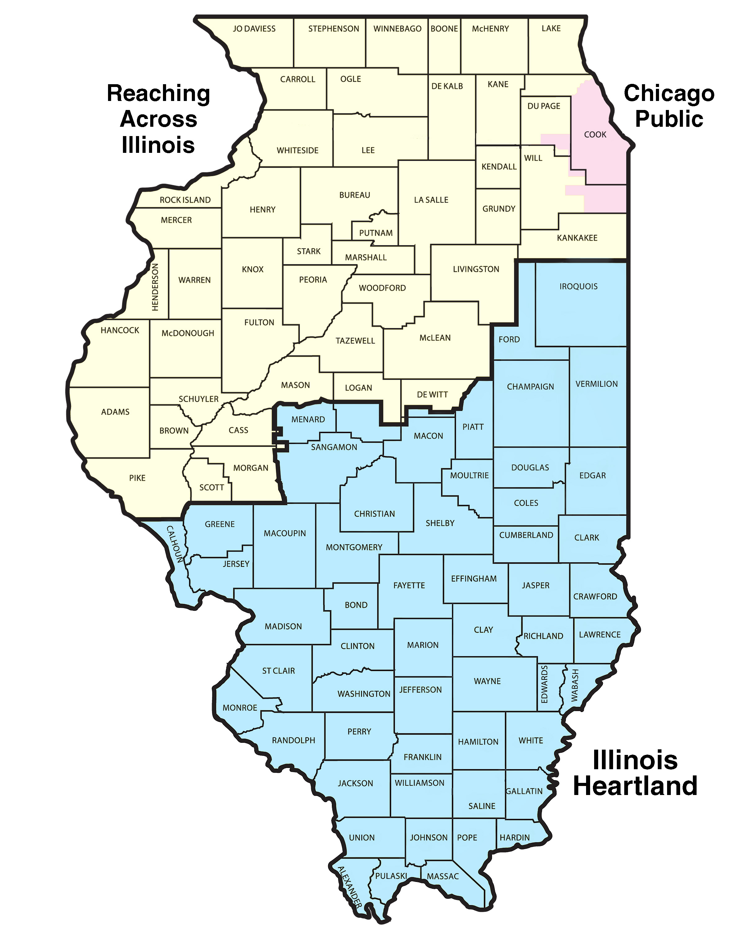
A little history…
Illinois Heartland Library System
521 Member Libraries: 30 Academic, 227 Public, 235 Schools, and 29 Specials
Provides delivery services to all members
Supports and offers the SHARE consortia to all members
SHARE
Currently 341 members with 480 physical locations
Offers cataloging services, training, technical support for Polaris, and mostly the ability to share all their materials between each other with our delivery service.

Slide 4
A little history…
SHARE Statistics
Locations: 480
Employees: 18
Staff PCs: ~1750 (2500 accounts)
Circulation: ~9 Million +
Holdings: 10 Million
Bibs: 1.7 Million
Patrons: 802,000

Slide 5
Original Configuration
2 separate clusters
Microsoft Hyper V 2012R2
2 separate shared disks
Full failover for each cluster

Slide 6
Time to Upgrade
Congested disk I/O
Limited redundancy and failover options
Back file transfer speeds
MS SQL server congestion when large reports were running.
Original 5-year warranty was over, and we were purchasing additional years.

Slide 7
Time to Upgrade - Questions
Cloud vs Physical?
Azure vs Amazon?
How long are we expecting the physical servers to last?
What’s our TOTAL costs?
Bandwidth, physical space, hardware…

Slide 8
Cloud vs Physical
I was ready to go to the cloud!
A lot invested in Microsoft already.
Getting anyone to tell you how much “cloud resources” to buy is impossible.
We went months talking to Microsoft, local vendors, and others.
We knew the cloud could do it, but HOW MUCH!?
OK! Physical it is…

Slide 9
Microsoft Hyper-Convergence
Combines several roles of Server 2016 to make a resilient new product
Hyper-V
Clustering
Storage Spaces Direct
Software Defined Networking
Also Azure cloud compatibility for backups (but we aren’t there YET)

Slide 10
New Configuration
6 x DellEMC R640 1U 2-socket chassis
Intel XEON Silver 10-core 14M cache @ 2.2Ghz
768GB of RAM/server. (4.6TB of RAM available total)
Dual 25 Gbps and Quad 10Gbps network cards
12 - 1.92TB SSD/server plus 2 – M.2 240G Sticks for boot.
(23T per server. 138T total)
Ready Node Support for 5 years on the cluster
Onsite installation and initial config by Dell/Microsoft
Storage Spaces Direct (S2D) w/ software defined storage and network

Slide 11
New Configuration
Any of our 45 Production guest servers can run on any server.
Polaris Production server now has 512GB of RAM dedicated to it.
MS SQL Datacenter loads our entire index into memory giving nearly instant access to SQL data
The Production DB is the only server running on CNODE4
Report server runs on separate hardware
Maximum fault tolerance at all levels of the config
15 minute maximum data loss of SQL data
Easy to expand with new servers

Slide 13
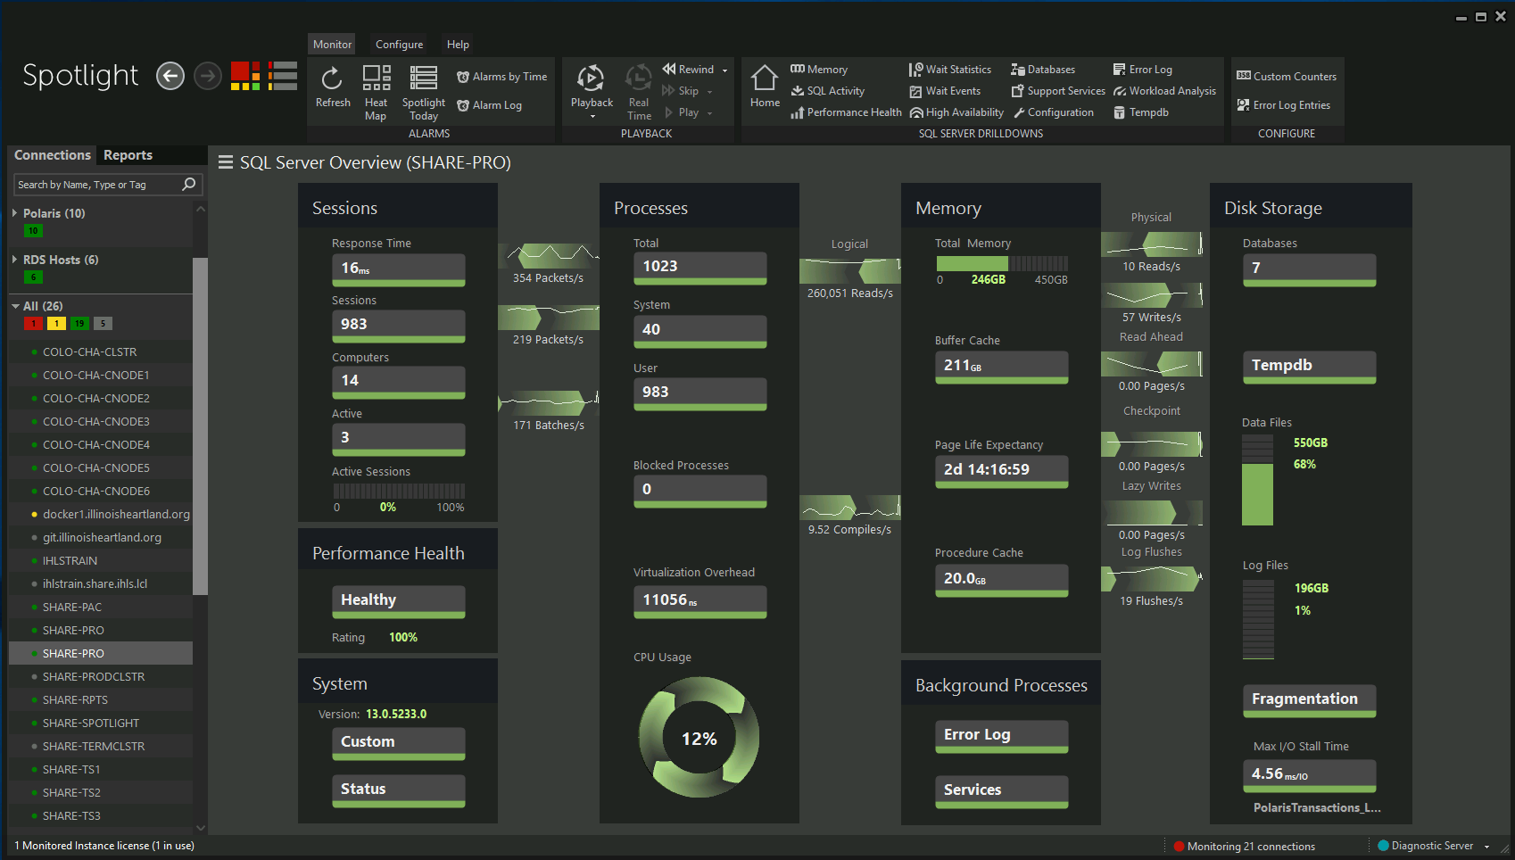

Slide 14
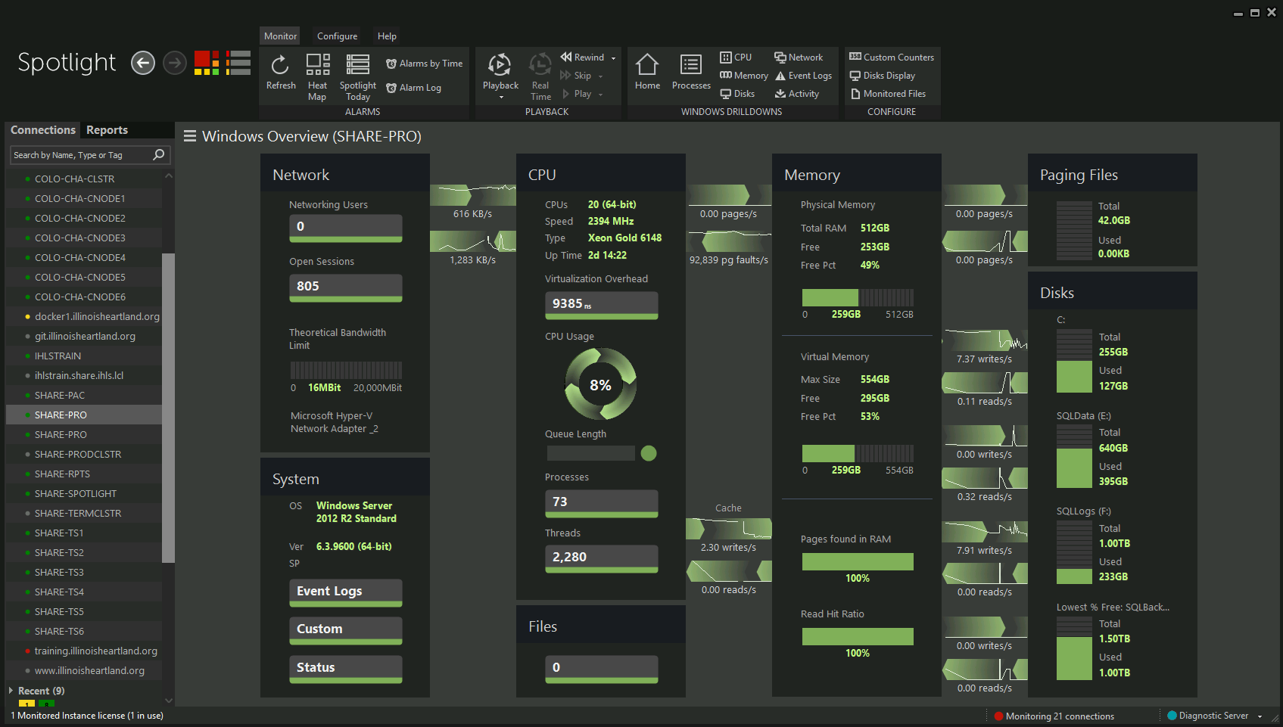

Slide 15
Monitoring and Maintenance

Slide 16
Monitoring and Maintenance
How do we monitor and maintain this thing?
Storage pool doesn't exactly show up in File Explorer like a regular drive
Traditional ways of node maintenance must account for the storage pool itself.

Slide 17
Monitoring Disk Health
Failover Cluster Manager:
Go to the cluster’s name, then “Storage”, then “Enclosures”

Slide 18
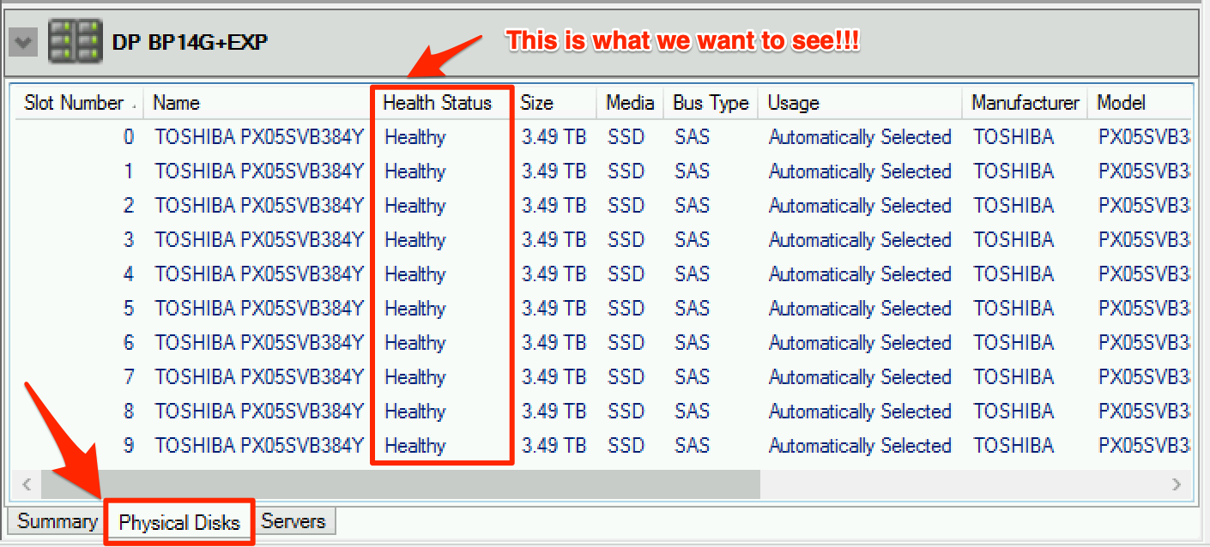
Monitoring Disk Health
Double-click on one of the ”Enclosures” and then at the bottom, click “Physical Disks”

Slide 19
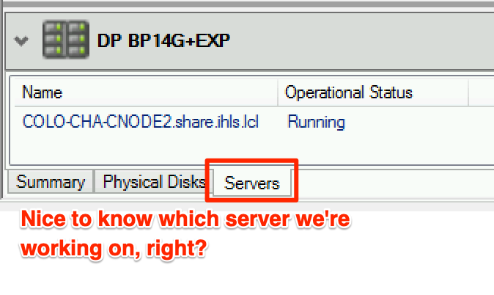
Monitoring Disk Health
Click on the ”Servers” tab and it will tell you which server the enclosure corresponds to:

Slide 20
Monitoring Disk Health
PowerShell commands:
Get-PhysicalDisk
Shows health status of every disk in the storage pool (not just on one node!)
If you have more than one storage pool (or you don’t want to include other disks like your OS volume, external drives, etc), use:
Get-StoragePool *YourStoragePoolNameHere* | Get-PhysicalDisk

Slide 21
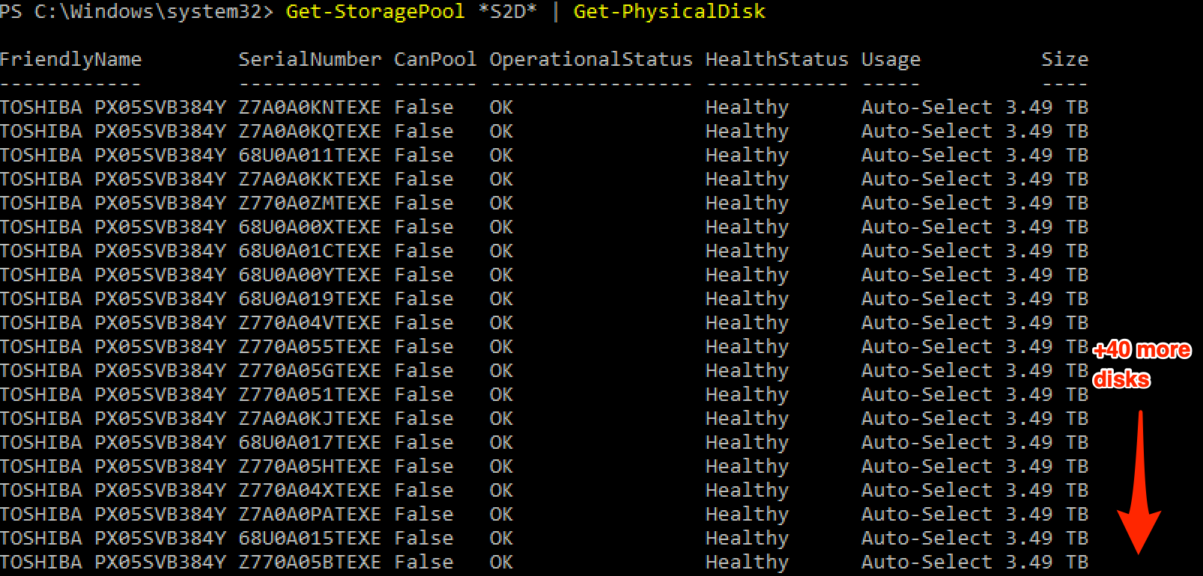
Monitoring Disk Health
Results:

Slide 22
Monitoring Disk Health
Ok, that’s too much to read through. Any better way?
Try this instead:
$disk = Get-PhysicalDisk |? HealthStatus –notlike Healthy
$disk
1) Shows only the disks that do NOT show “Healthy”
2) Yes, you have to have both lines—you’re defining the $disk variable on the first line and you’re showing its results on the
second.

Slide 23
Monitoring Disk Health
Because all of our disks are ”Healthy”, $disk will not show anything:

Slide 24
Monitoring Disk Health
Other ways:
Server Manager
File and Storage Services -> Volumes -> either Disks or Storage Pools
System Center Operations Manager
Windows Admin Center

Slide 25
Cluster Maintenance
Traditional Methods
Failover Cluster Manager
Right-click node, Pause -> Drain Roles -> do what you need to do (Windows Updates, driver/firmware updates, etc.) -> reboot
Right-click node, Resume -> Fail roles back.
Cluster-Aware Updating (CAU)

Slide 26
Cluster Maintenance
Storage Spaces Direct adds a little bit of a wrinkle to this:
Depending on the patch level of your Windows Server 2016 cluster nodes, Storage Maintenance Mode may or may not be properly enabled after pausing the cluster node or using CAU.
This can potentially cause problems with volumes detaching during a node reboot.

Slide 27
Cluster Maintenance
Whether manually pausing/resuming nodes or using CAU, Storage Maintenance Mode must be enabled before rebooting the node!
Easiest way to do this is to use pre-patch and post-patch scripts, and this is why:
https://bcthomas.com/2018/09/you-need-to-change-the-way-you-patch-s2d-clusters/

Slide 28
Cluster Maintenance
According to Microsoft MVP Brad Thomas on September 6, 2018:
If you’re running a Storage Spaces Direct (S2D) Cluster, you might have noticed some instability in recent months, specifically when it comes to patching and performing maintenance.
Well you’re in luck because 5 days ago, Microsoft released a new KB article that helps explain why you might have seen issues.
The scenario targeted by the Microsoft article is S2D Clusters running May (KB4103723) or later patch levels, where you experience Event ID 5120 during patching or maintenance, leading to things like CSV timeouts, VM pauses, or even VM crashes.
On top of this, the CSV crash might trigger a live dump, which can cause the node to drop out of the cluster when under load.
The above applies to Windows Server 2016. This is supposedly fixed in Windows Server 2019, but we haven’t had a chance to verify this.

Slide 29
Cluster Maintenance
What the pre-patch script does:
Waits until all storage jobs are complete before moving on.
Runs the PowerShell command Suspend-ClusterNode with a few other parameters (basically does the pause/drain part for you)
Puts the node in Storage Maintenance Mode. (because we don’t want those Event 5120 or other shenanigans)

Slide 30
Cluster Maintenance
1-prepatch.ps1
(NOTE: All credit goes to Microsoft MVP Ben Thomas for this script)
# Checks for any outstanding Storage Jobs
"Waiting for storage jobs to complete"
do {
Start-Sleep 5
}until(
# Running Repair Jobs are less than 1
((Get-StorageJob |Where-Object {$_.Name -eq 'Repair' -and $_.JobState -ne 'Completed'})|Measure-Object).Count -lt 1
)
"Storage Jobs finished"
# Suspend Cluster Host to prevent chicken-egg scenario
Suspend-ClusterNode -Name $env:COMPUTERNAME -Drain -ForceDrain -Wait
# Enter Storage Maintenance Mode
try {
Get-StorageFaultDomain -type StorageScaleUnit | Where-Object {$_.FriendlyName -eq "$($Env:ComputerName)"} | Enable-StorageMaintenanceMode -ErrorAction Stop
}
catch {
Resume-ClusterNode -Name $Env:COMPUTERNAME -Failback Immediate
throw "Failed to enter storage maintenance mode"
}

Slide 31
Cluster Maintenance
During Storage Maintenance Mode:
All I/O is paused on that node’s storage pool disks
Redundant data copies on the remaining nodes will be utilized to keep roles online (two and three-way mirroring will use mirrored copies, dual-parity will use parity calculations to reconstruct data)
For those of you that have managed traditional RAID arrays, don’t panic! This is normal for S2D.

Slide 32
Cluster Maintenance (More Details)
If you’re curious about what’s happening during Storage Maintenance Mode, run these two PowerShell commands:
function RefreshStorageJobStatus () { while($true) { Get-VirtualDisk | ft; Write-Host "-------- ---"; Get-StorageJob | Select Name,IsBackgroundTask,ElapsedTime,JobState,PercentComplete,@{label=”BytesProces sed (GB)”;expression={$_.BytesProcessed/1GB}},@{label=”Total Size (GB)”;expression={$_.BytesTotal/1GB}} | ft;Start-Sleep -s 1;Clear-Host; } }
RefreshStorageJobStatus

Slide 33
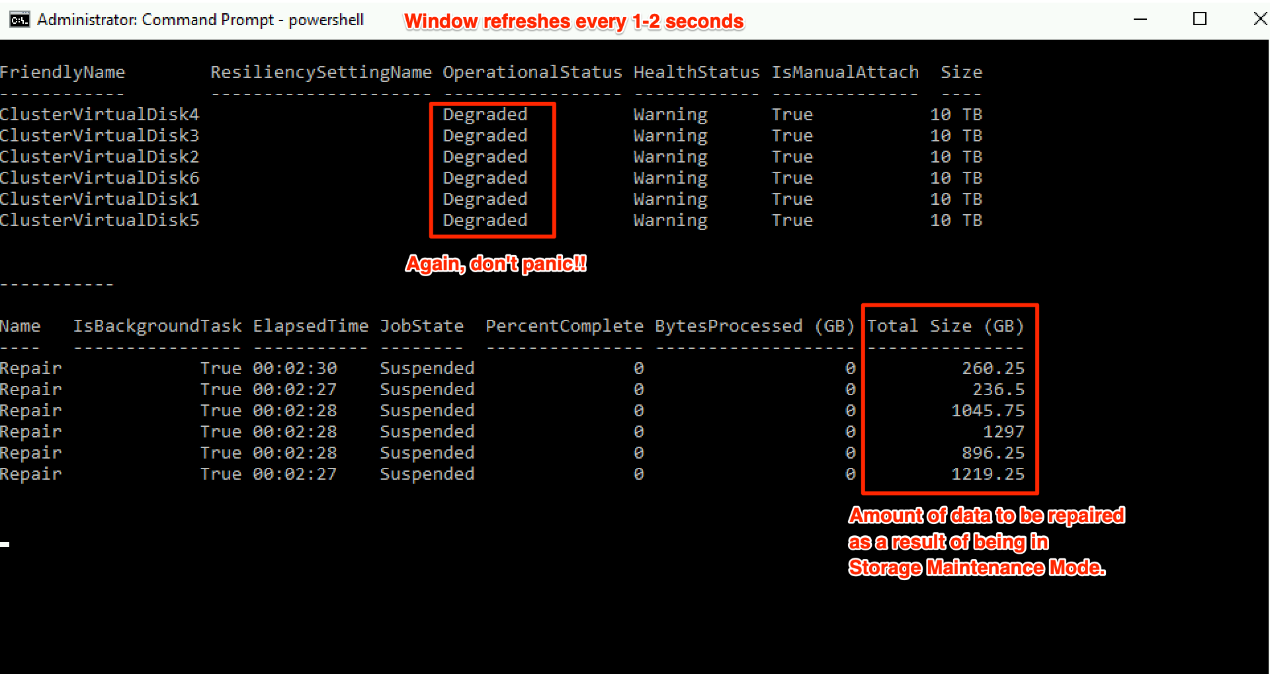
Cluster Maintenance
This is what you’ll see:

Slide 34
Cluster Maintenance
What the post-patch script does:
Checks for any nodes that are paused. If any are found, resume and fail roles back.
Takes the node out of Storage Maintenance Mode.

Slide 35
Cluster Maintenance
2-postpatch.ps1
(NOTE: All credit goes to Microsoft MVP Ben Thomas for this script)
# Check for any nodes left in a Paused State and Resume them
If ((get-clusternode -Name $Env:COMPUTERNAME).State -eq 'Paused') {
Resume-ClusterNode -Name $Env:COMPUTERNAME -Failback Immediate
}
# Exit Storage Maintenance Mode
Get-StorageFaultDomain -type StorageScaleUnit | Where-Object {$_.FriendlyName -eq "$($Env:ComputerName)"} | Disable-StorageMaintenanceMode

Slide 36
Cluster Maintenance
Finally, let’s run these one more time now that our node is back up and out of Storage Maintenance Mode:
function RefreshStorageJobStatus () { while($true) { Get-VirtualDisk | ft; Write-Host "-------- ---"; Get-StorageJob | Select Name,IsBackgroundTask,ElapsedTime,JobState,PercentComplete,@{label=”BytesProces sed (GB)”;expression={$_.BytesProcessed/1GB}},@{label=”Total Size (GB)”;expression={$_.BytesTotal/1GB}} | ft;Start-Sleep -s 1;Clear-Host; } }
RefreshStorageJobStatus

Slide 37
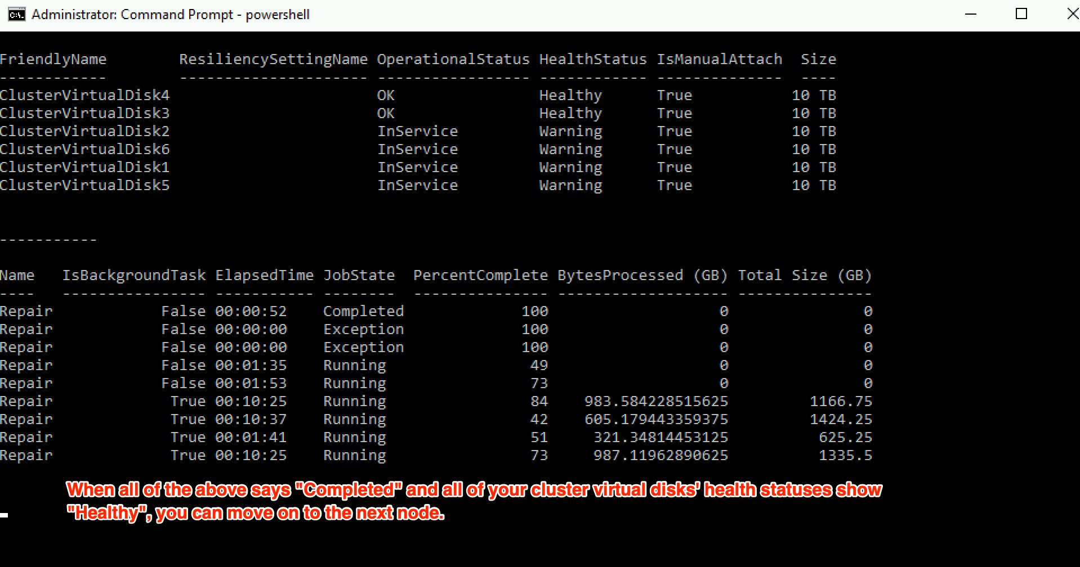
Cluster Maintenance
This is what you’ll see:

