Slide 1
Virtualization Does it have to be Complicated
Rex Helwig – Computer Network Services Manager

Slide 2
We are one of 23 Public Library Systems in New York State
We have 33 member Public Libraries and 1 Special Library which span 5 Counties from Lake Ontario to the Pennsylvania border and covers 2,507 square miles
The Central Library has their Polaris Clients loaded locally and access us via a direct connection through their Polaris Application Server. System HQ has Polaris Clients loaded locally also
All other libraries connect using Remote Desktop.
In 2016:
We had 535,534 Bibliographic Records.
1,002,914 Item Records
System-wide annual circulation was 1,900,071 checkouts and renewals

Slide 3
Infrastructure
We have a virtualized environment based on the Scale Computing Hyper Converged HC3 Data Center Platform (https://www.scalecomputing.com/)
The Hypervisor is Linux KVM with Scale Computing’s proprietary Graphical Interface
Our configuration consists of 4 nodes
Each node has:
128 GB RAM, 4-900 GB 10K HD’s (3.6 TB/node), 4 GB NIC’s, 6 core CPU
Cluster has:
512 GB RAM, 14.4 TB HD and 24 CPU cores
2 Dell N2024 Managed Gigabit Switches
Currently we are running 13 Virtual Machines on our Platform

Slide 4
What it Looks Like

Slide 5
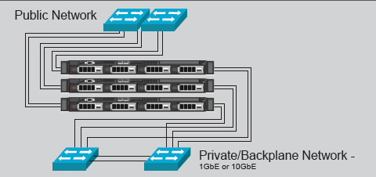
Network infrastructure
We have a pair of dedicated Dell N2024 Managed Gigabit switches with VLAN’s for the Backplane communication between the nodes and the connectivity to the LAN. Each node has 2 NIC’s for the backplane communication and 2 NIC’s for the LAN communication. Each Backplane and LAN NIC is plugged into a different switch for redundancy. Each switch has a single connection to our main LAN switch which are bound together. With this configuration, if any NIC on a node fails or if a switch fails, there isn’t any interruption of the backplane or LAN traffic.

Slide 6
Microsoft licensing
4 copies of MS Server 2012R2 Datacenter (1 for each node)
This allows me the flexibility to create as many VM’s as I want without having to purchase any additional Server Licenses (This licensing model changed for Server 2016 so plan accordingly)
MS SQL Server licensing has used the Core model in the past

Slide 7
Benefits from My Perspective
No SAN (Storage Area Network) and all of the complexities that come with it
If you need more storage capacity then you can add up to 8 nodes per cluster
Automatic failover of VM’s if a node fails
Move a VM from one node to another without any disruption in service
Firmware upgrades automatically move VM’s to the other nodes while each node is upgraded so there is no disruption in availability
Schedule when and how many VM snapshots are created and kept
You can create a new VM from any of the existing VM snapshots
Need more resources, add a node up to 8 nodes per cluster
It’s so easy to use

Slide 8
Scale computing dashboard

Slide 9
Future plans for this platform
When we purchased the platform we also purchased 4 additional years of hardware/software/support coverage.
When our current support contract is up, we can continue to purchase additional years until the hardware is no longer supported.
Possible SSD hard drive upgrade which includes 1 SSD drive for each node
Will require an upgrade to the backplane NIC’s and both switches to 10 Gigabit.
I could then select which VM’s I want to run on the SSD’s. For example, I could put the Polaris Production Server and PowerPAC servers on the SSD which should make them run faster. I’m not experiencing any latency issues currently so I’m still on the fence about it.

Slide 10
Live demo

