Slide 1
Updating the University Libraries Classic Catalog at the University of Memphis: A Report on WebPac Refreshing
Kenneth Haggerty, University of Memphis

Slide 2
Classic Catalog- Pre-Refresh

Slide 3
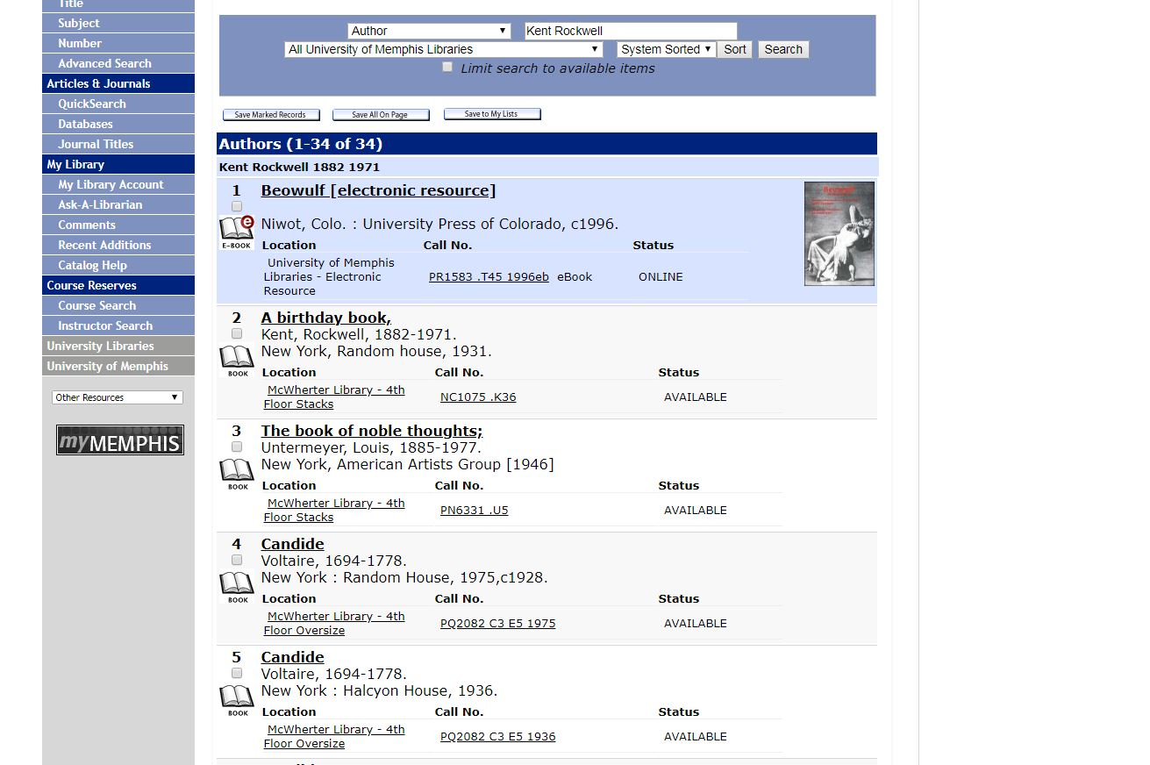

Slide 4
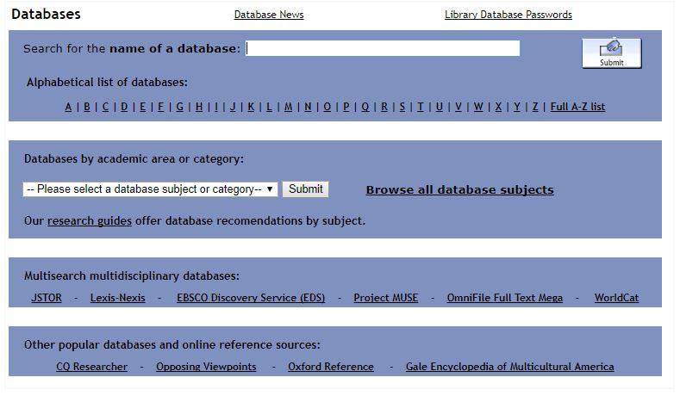

Slide 5
Timeline

Slide 6
Timeline
WebPAC Example Sets
Building a Mockup- Selection & Design
Library Logo
Color Palette
Library Links
Material Type Images
Feedback from Faculty and Staff

Slide 7
Timeline
Prior to May 28, 2019 – Library staff saves off any pages in Staging Directory that need to be retained.
May 28-31, 2019 – Innovative replaces screens in Staging Directory with new Example Set and imports new logos.
June 3-28, 2019 – Innovative works on WebPAC Refresher in Staging Directory. Library staff should not make any changes to the Staging Directory screens during the WebPAC Refresher.
July 1-12, 2019 – Library staff reviews draft WebPAC Refresher and submits changes.
July 15-19, 2019 – Innovative makes final changes to the Staging Directory pages.
July 22, 2019 – Publish Staging Directory to Live Directory and go live with refreshed WebPAC.

Slide 8
WebPac Examples

Slide 9
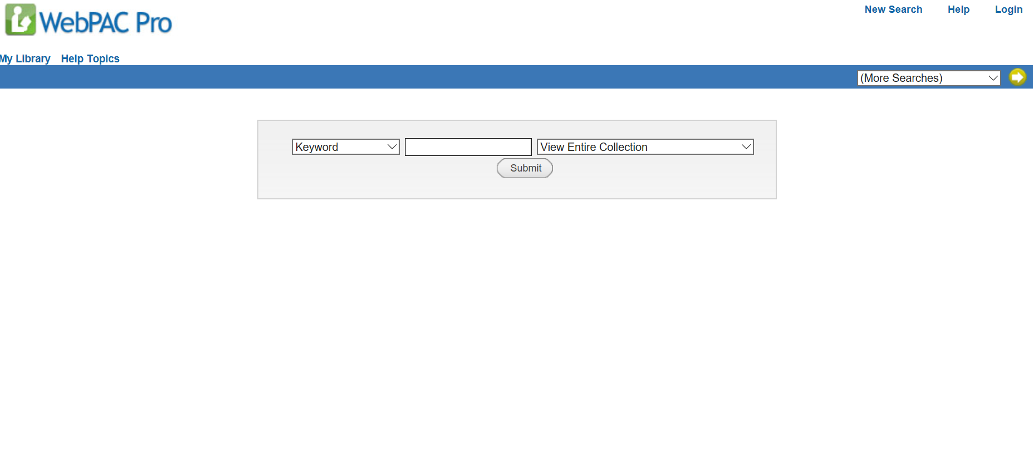

Slide 10
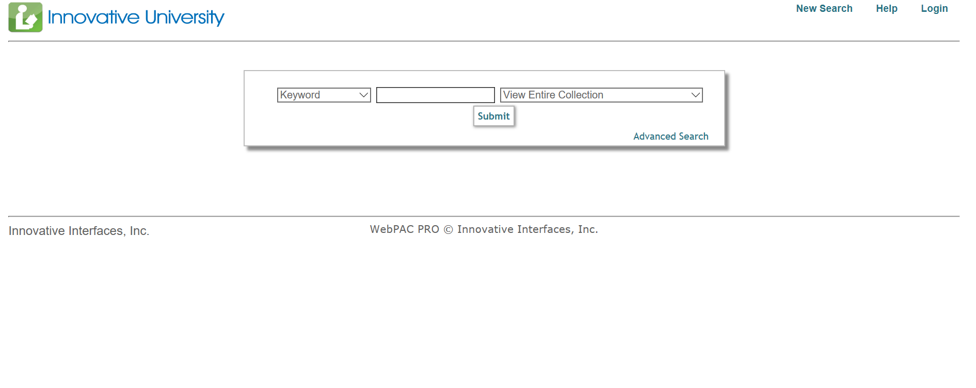

Slide 11
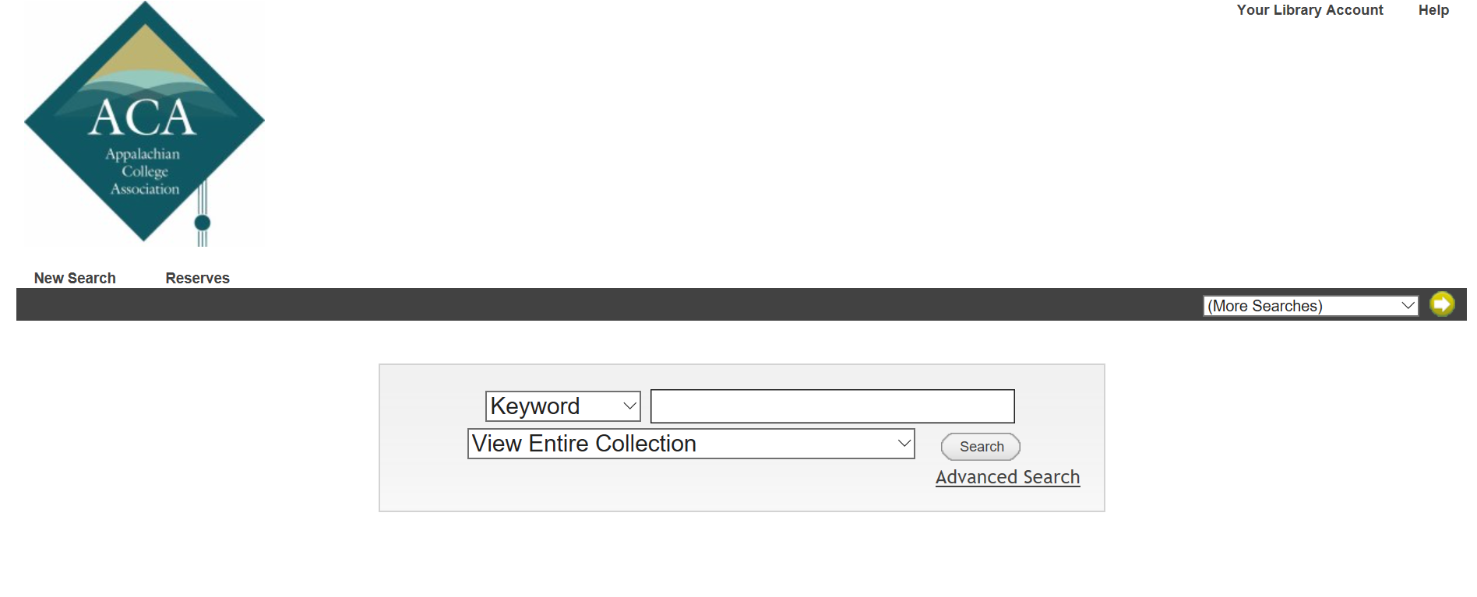

Slide 12
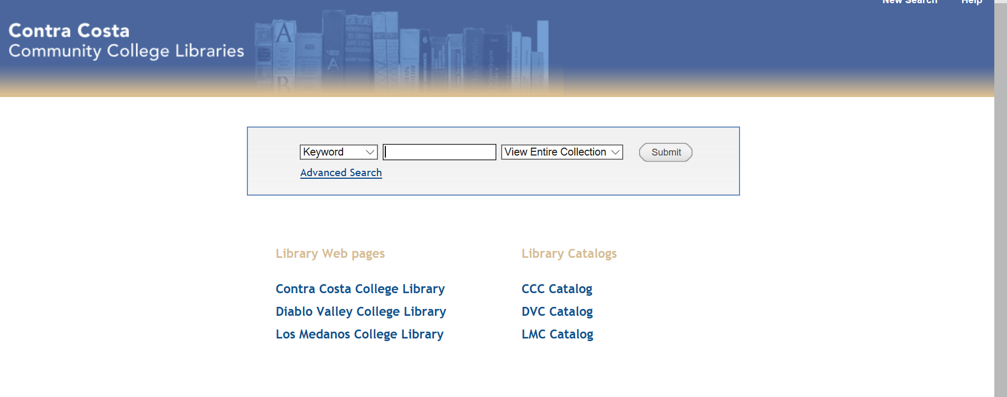

Slide 13
Mockups

Slide 14
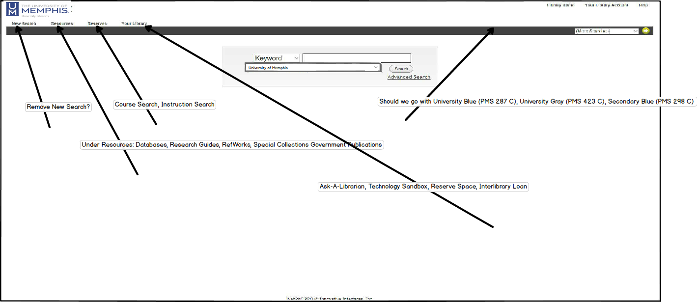

Slide 15
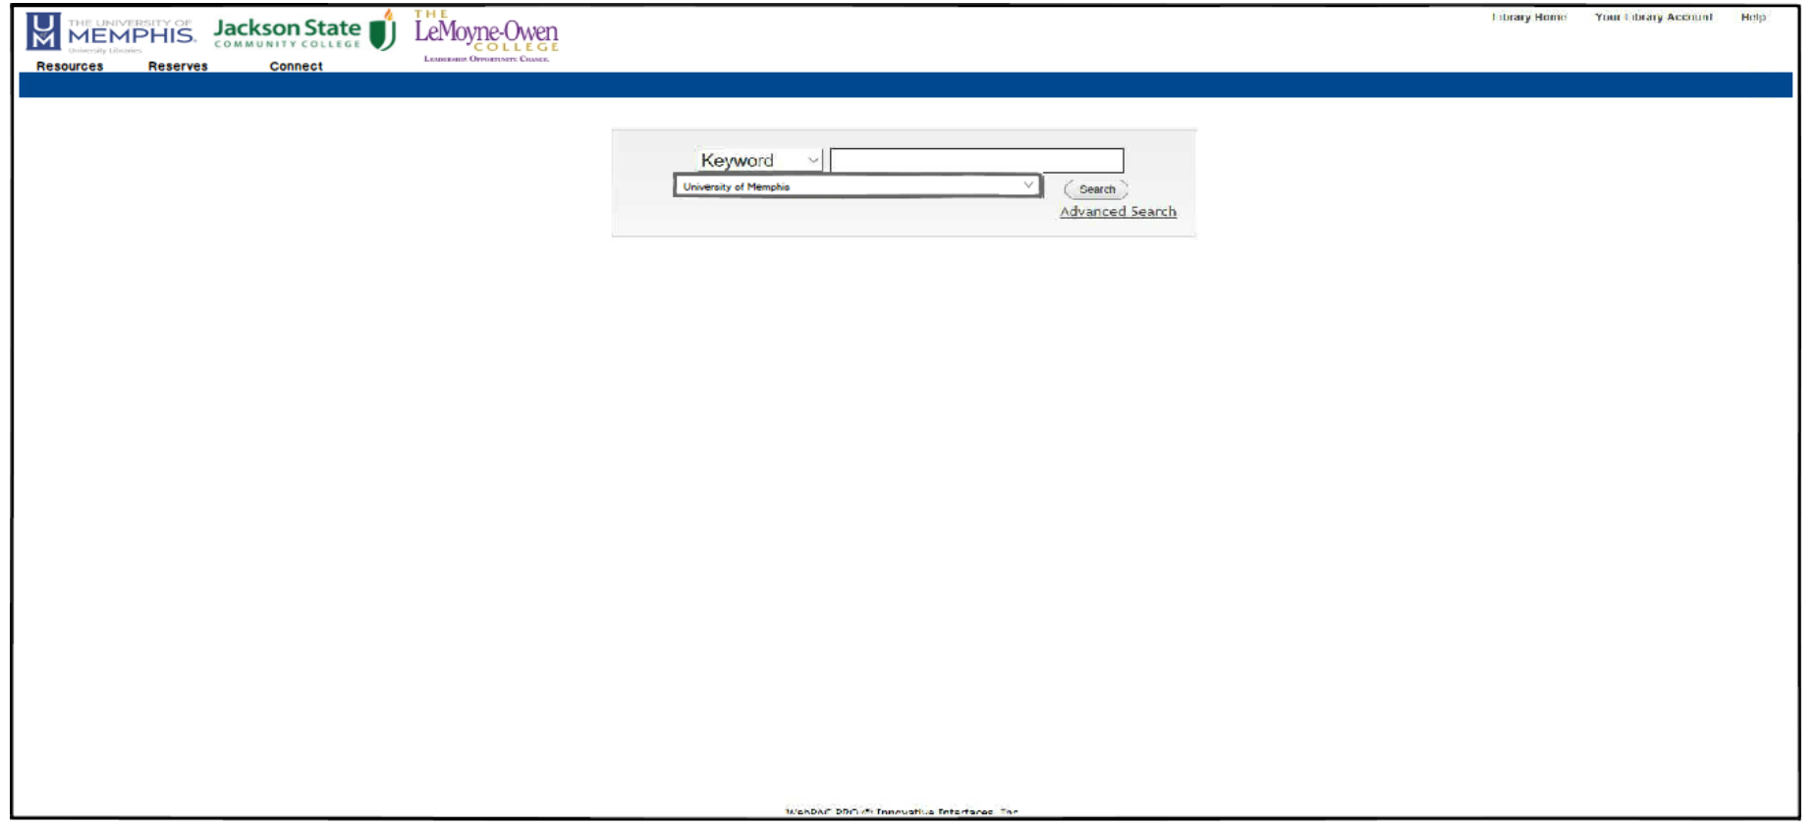

Slide 16
Current Classic Catalog

Slide 17
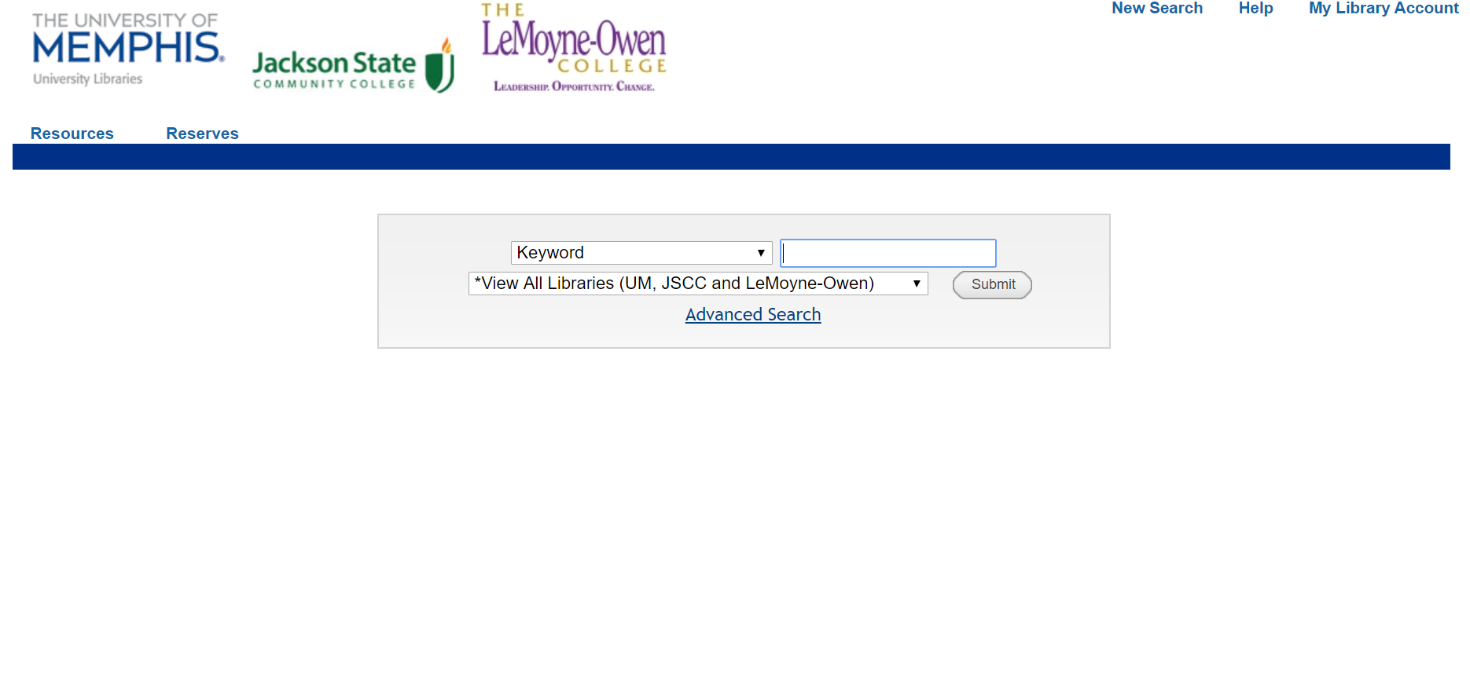

Slide 18
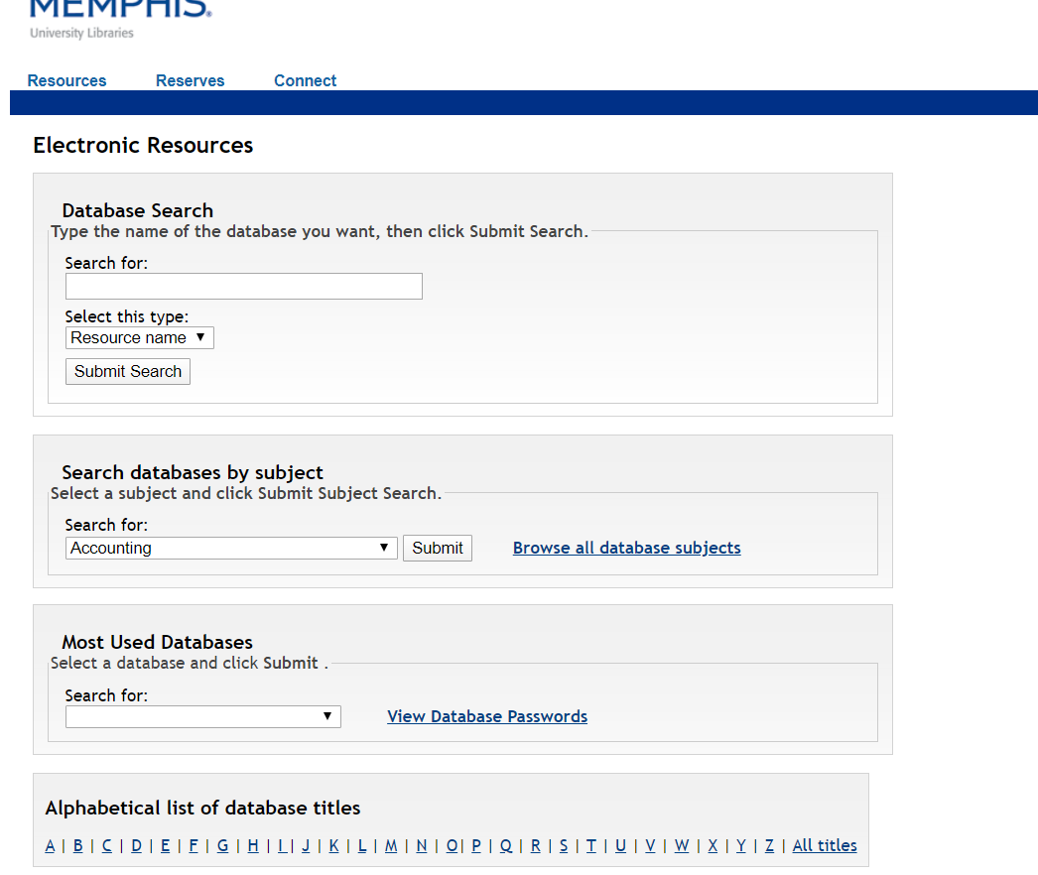

Slide 19
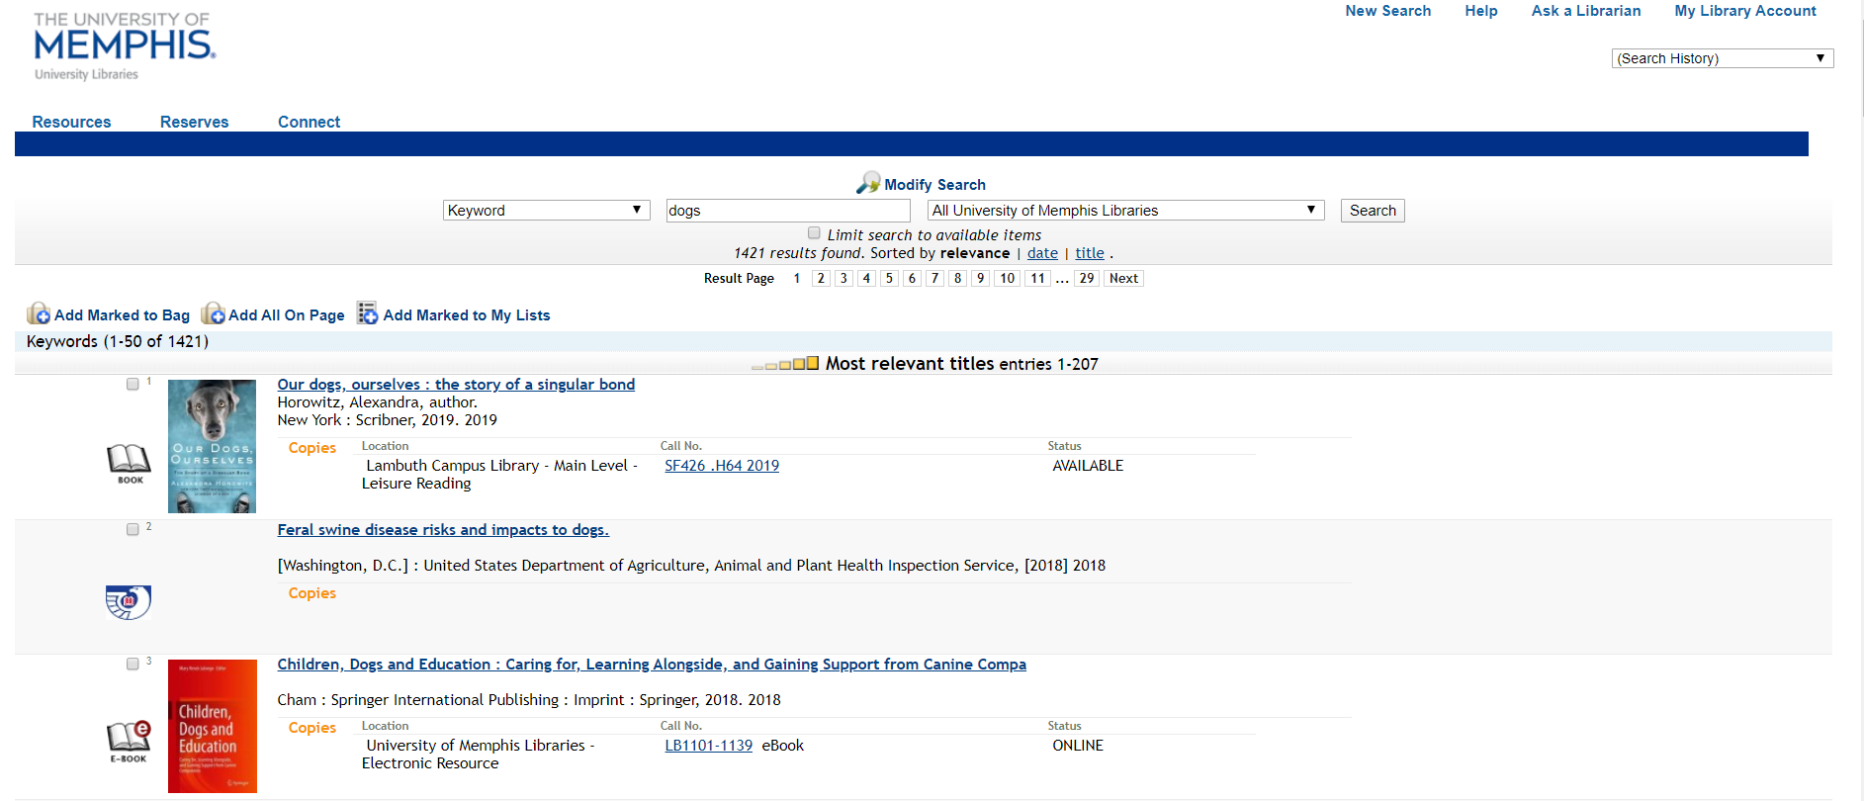

Slide 20
Thank You!
Questions?

