Slide 2
Beyond Logos and Links
Using the Encore Header to Add Functionality
Sam Cook
Systems Librarian for Public Services
Library Connection, Inc.
Windsor, CT
scook@libraryconnection.info

Slide 3
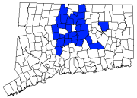
About Library Connection, Inc.
29 public libraries, 1 academic library
Migrated from Sirsi in 2014
Decided pre-migration to use Encore, not WebPAC
Libraries used to having locally customized versions of the OPAC

Slide 4
Why I Started Working On This
Libraries wanted persistent library limiter
+ I don’t like WebPAC and didn’t want us to use it
I’ll figure out a way to make it work in Encore!

Slide 5
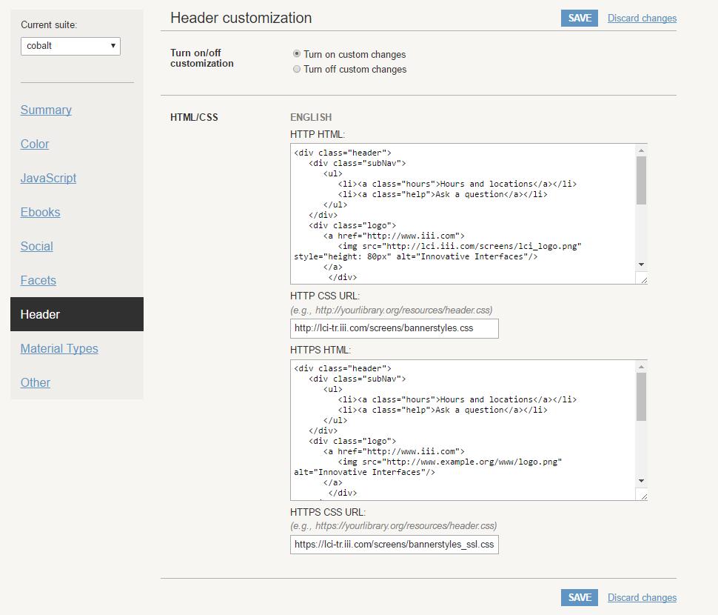
Basic Header Functionality
Edit the Encore Header in Sierra’s Administration Application
Best to put the CSS files onto Sierra server using Web Master

Slide 6
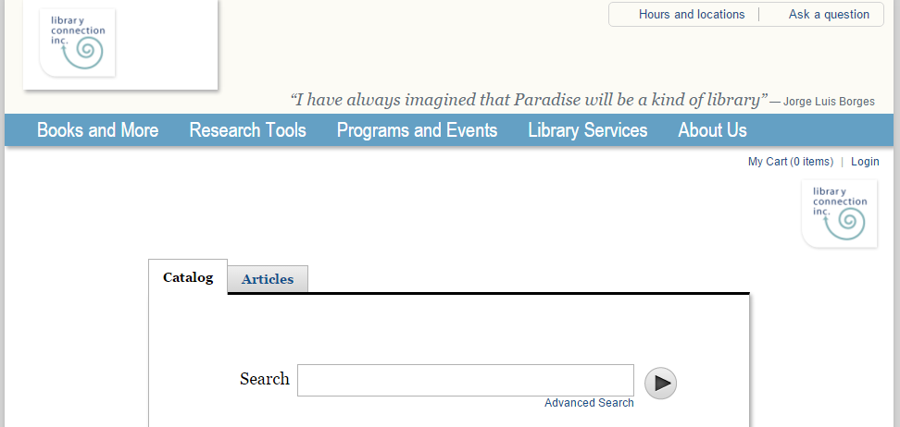
Basic Header Functionality
Most common use appears to be to have Encore mimic existing library website header.
Most Headers include library logo and links to library resources

Slide 7
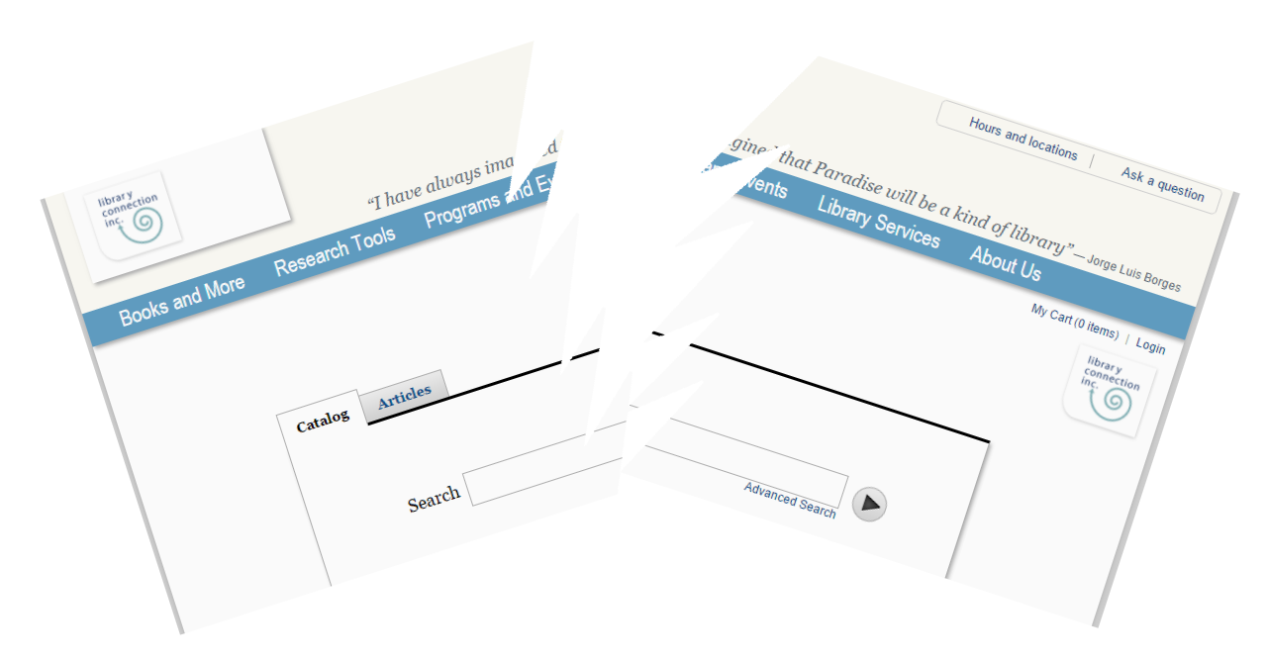
Risks
Encore could break if underlying code changes
Code affects every Encore page

Slide 8
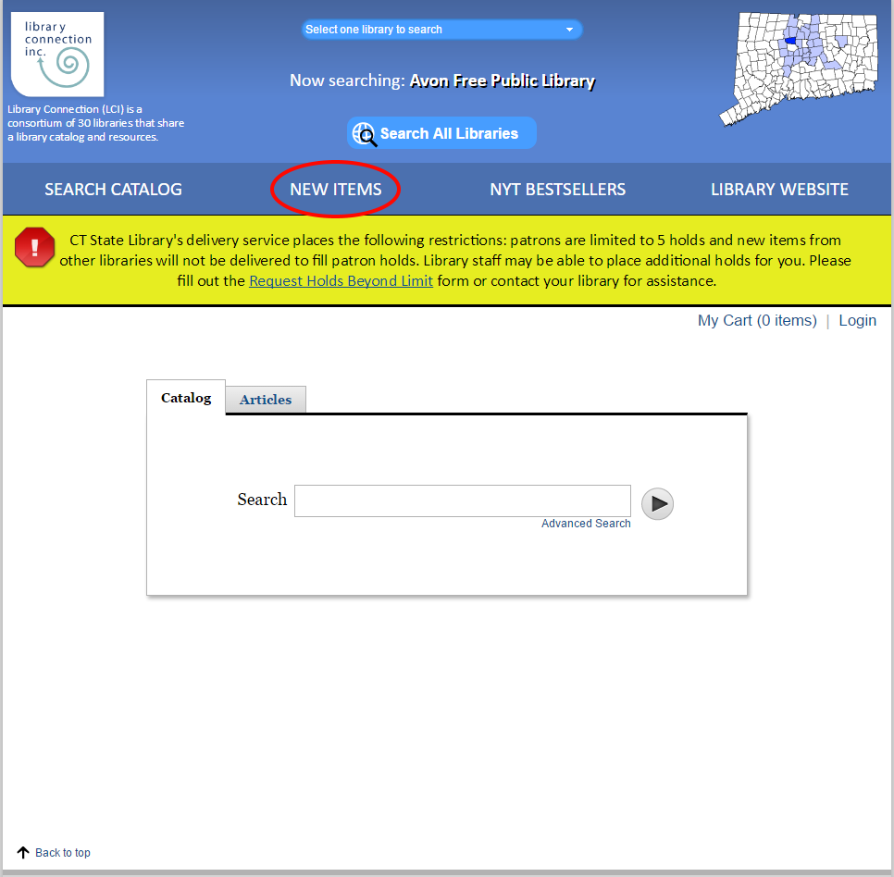
Functionality with HTML
Low Risk
Ex) Create replica Encore pages on local website to add pages with features that are not normally available in Encore

Slide 9
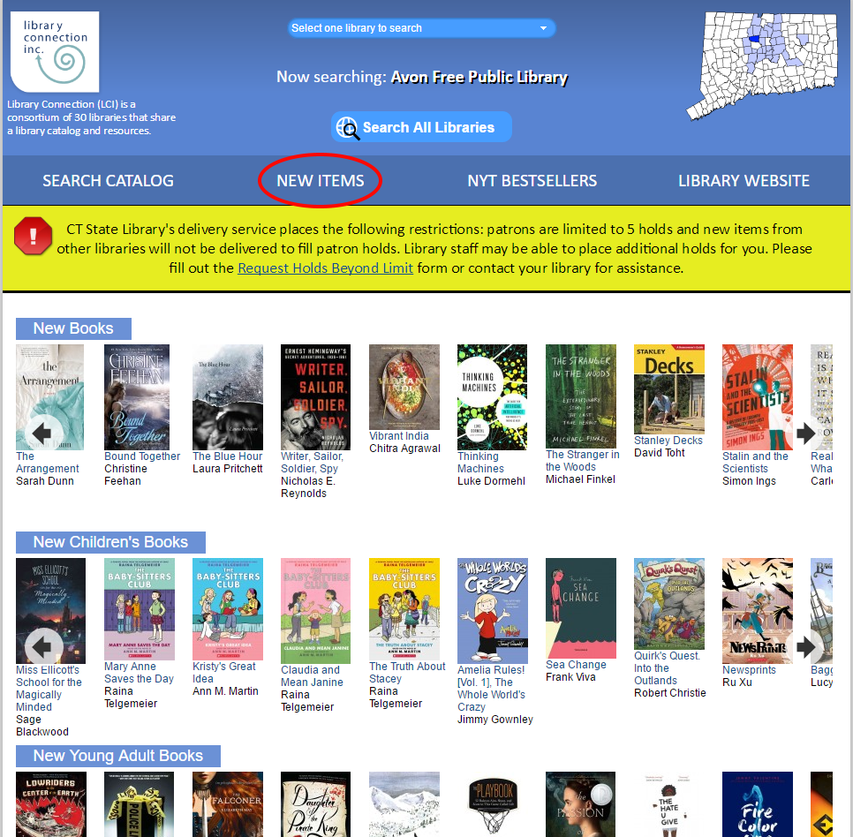
Functionality with HTML
New Items page stored on libraryconnection.info, not our Encore server
Most patrons won’t notice they’re not in Encore anymore

Slide 10
Functionality with CSS
Small risk
Just requires ignoring Innovative’s warning

Slide 11
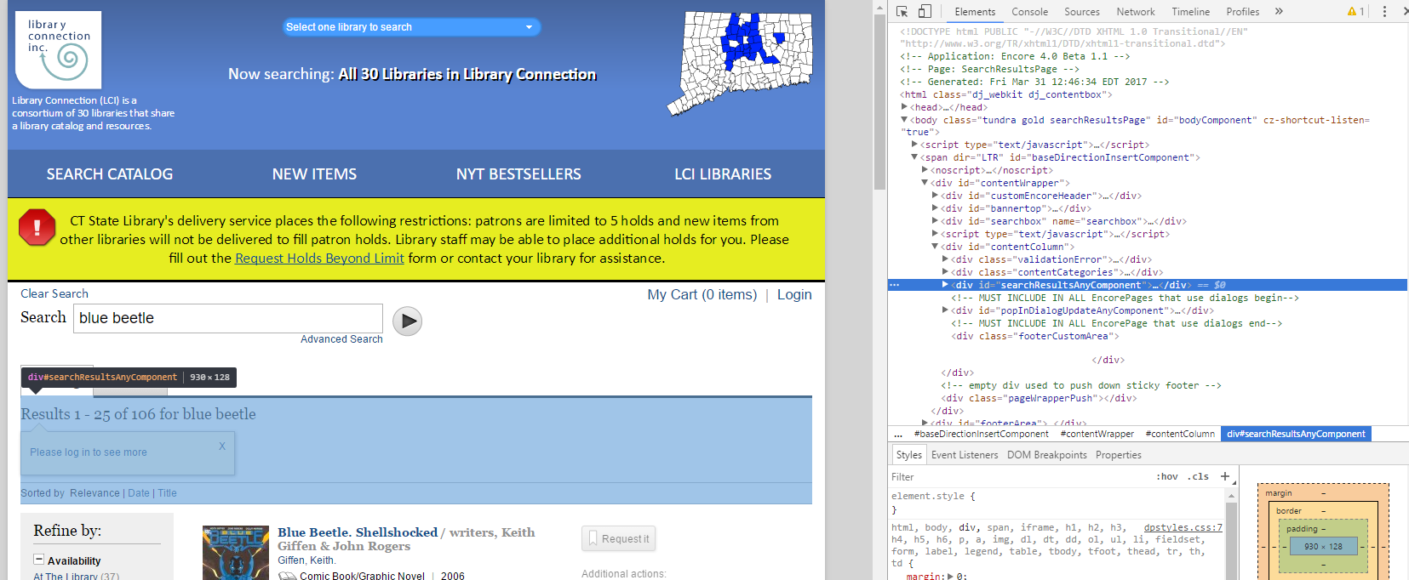
Functionality with CSS
Recommend using Chrome’s Inspect function to identify the relevant HTML tags and do a quick test of the results of adding CSS

Slide 12
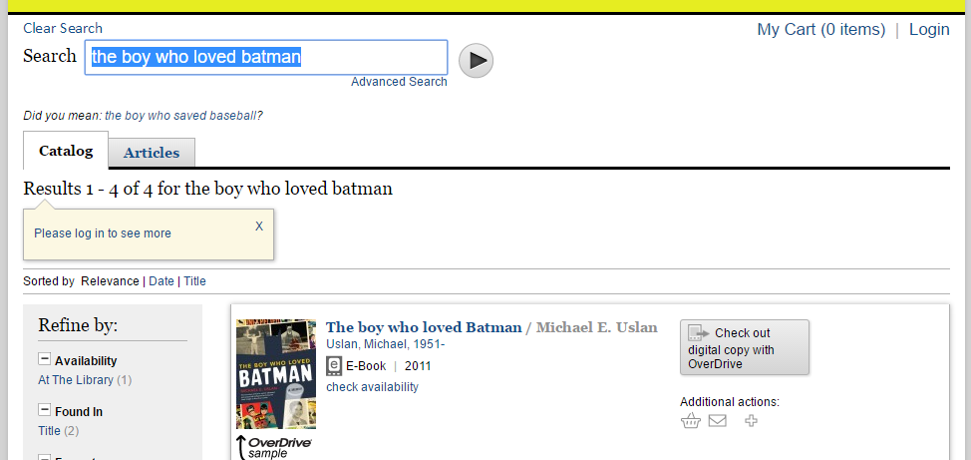
Functionality with CSS
.myAccountInfo {
font-size: 140%;
}
#articlesLoginAlert {
position:relative;
}
.overDriveInfo {
display:none;
}

Slide 13
Functionality with JavaScript
Increased risk
LCI uses to redirect patron directly to My Account page upon login
function getParameterByName(name) {
name = name.replace(/[\[]/, "\\[").replace(/[\]]/, "\\]")
var regex = new RegExp("[\\?&]" + name + "=([^&#]*)"),
results = regex.exec(location.search);
return results === null ? "" : decodeURIComponent(results[1].replace(/\+/g, " "));
}
var logintest = getParameterByName('loginReason');
if (logintest=="doDefault") {
gotoURL=myLibraryURL+"/iii/encore/myaccount";
window.location.replace(gotoURL);
}

Slide 14
Functionality with Cookies (aka Fancier JavaScript)
Highest risk
LCI uses to manipulate the locked facet for collections to create a persistent library limiter that can be changed by the user
Sample Cookie
encoreLockedCollection=Lf!facetcollections!1!1!Avon Free Public Library!!
Sample Code to Delete Cookie
<button id="globalsearch" type="button" onclick='document.cookie="encoreLockedCollection=;path=/iii/encore;expires=Wed, 01 Jan 1970";document.cookie="encoreLockedCollection=;path=/iii/encore/search;expires=Wed, 01 Jan 1970";window.location.href=myLibraryURL'>Search All Libraries</button>

Slide 15
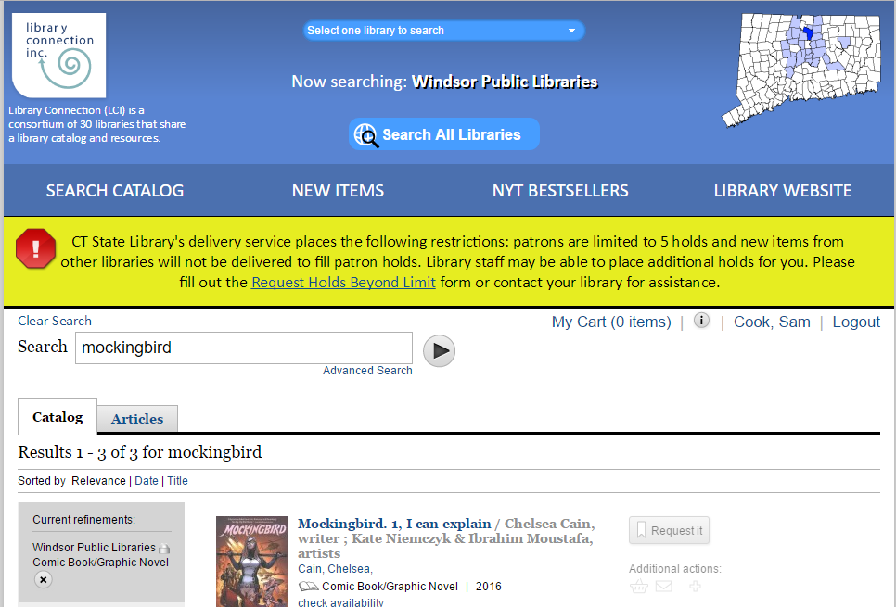
Functionality with Cookies (aka Fancier JavaScript)

Slide 16
Functionality with Cookies (aka Fancier JavaScript)
Other Uses? Persistent format search? Persistent language search?
Full code in IUG Clearinghouse at: http://innovativeusers.org/resources/index.php?option=com_content&view=article&id=174 (or just search for my name)

Slide 17
The Big Caveat
We have a second version of Encore associated with our training server. All testing was done there first.
Encourage Innovative to:
Add a staging version of Encore for testing new code, just like the staging version of WebPAC
Include some of this functionality in the underlying Encore code, rather than requiring these risky workarounds.

Slide 18
And that’s the end…
Questions? Comments? Concerns? Answers? Demands?

