Slide 1
LINKED DATA UPDATE
ECIUG – OCTOBER 17, 2017
Tammy Moorse, Cataloging & Metadata Librarian
Notes:
ECIUG Presentation – Linked Data Update October 17, 2017
Hello
Tammy Moorse
new cataloging and metadata library at Hamilton Public Library.
provide an update on our linked data initiative.

Slide 2
Intersection of Cataloging & Internet Search Engines
A little history of HPL’s linked data Initiative
What linked data on link.hpl.ca looks like
Zepheira’s value added content – The Good Stuff
Edmonton Public Library experience
Things that can improve
Notes:
We are going to cover:

Slide 3
Replacing MARC
State of Flux:
MARC needs to be changed or updated to account for hyper-linking
We are waiting for one to take off or gain more ground
Information seeking behaviour wants more than MARC can offer
Notes:
Cataloguing in MARC as we all know is THE standard for bibliographic records
Everyone is waiting for the next thing to replace MARC
MARC was not designed and has not been updated for the internet where there needs to be hyperlinks between titles, authors and subject headings
Debate is on whether MARC can provide the best access to customers conducting searches – good information seeking satisfaction

Slide 4
LIBHUB promises
…aims to raise the visibility of libraries on the web by actively exploring the promise of BIBFRAME and linked data.
From Georgia Fujikawa’s white paper ILS and LINKED DATA.
Notes:
LIBHUB – the beginning initiative for library linked data promised
Get library catalogues included in search engines, because they weren’t there
Raise Library visibility on the internet
So LIBHUB aims to raise the visibility of libraries on the web by actively exploring the promise of BIBFAME and linked data
BIBFRAME, developed by the Library of Congress is one potential candidate to replace or supplement MARC
No institutions catalogue in BIBFRAME exclusively
No vendors provide BIBFRAME records

Slide 5
A Little Scenario:
Have you seen this great new thing on HBO?
Notes:
Like to use this scenario when I talk about the promise of linked data:
Imagine that your friend mentions a great movie or TV series they just saw on HBO
You don’t have a subscription to the service
You want to know about that movie and things like the adaptation
Your first stop is the search engine to gather some information
Your search results list that you can buy the book and DVD at Amazon and Indigo
We’d like it to say it is available to borrow from Hamilton Public Library’s digital site, as a DVD, book and look there are other digital formats
The search engine knows what we have in our collection through the linked data initiative

Slide 6
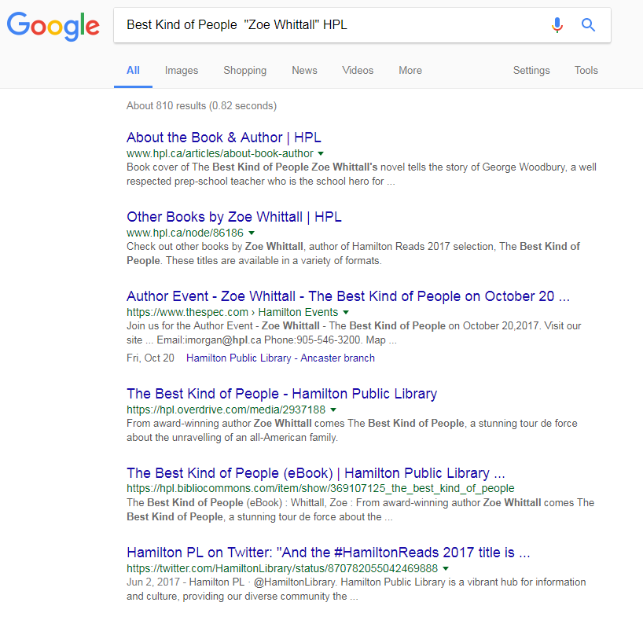
Search Results:
Notes:
We are starting to see the library catalogue appear in searches, like this one,
For Zoe Whittal’s Best Kind of People – Hamilton Reads selection for this year
But, it is only when we add HPL or Hamilton Public Library in our search string that these results point to our collection

Slide 7
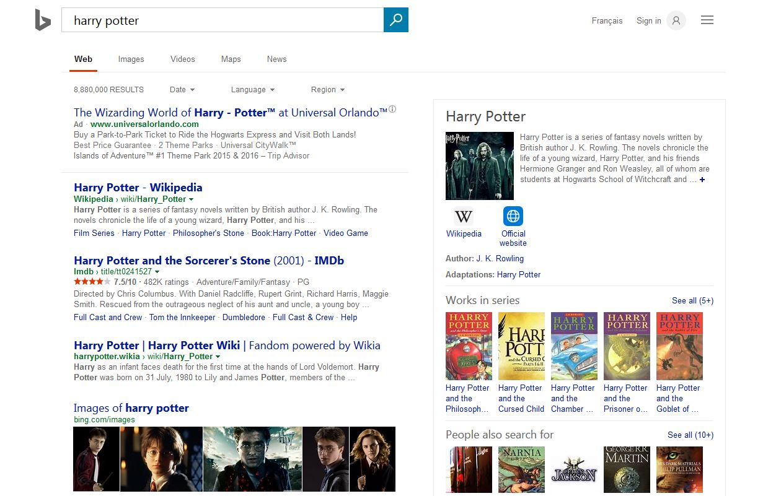
Get that key spot in the results:
Notes:
THIS SLIDE IS A MOCK UP OF A SEARCH AND IS NOT REALITY.
We’d rather have some results like this
Our collection comes up in the knowledge card or on the first page as a KEY option for searchers
Library customers go to search engines as their first point in searching
They come to the library catalogue only when they think or know we have what they want
Being in those choice spots provides that option right away, instant acknowledgement of what the public library has
Then we are where the customers are

Slide 8
Progress
Slate.com’s Future Tense Blog
LOOKING FOR AN E-BOOK? GOOGLE NOW TELLS YOU IF YOUR LOCAL LIBRARY HAS IT.
Only for US libraries right now, but…
http://www.slate.com/blogs/future_tense/2017/09/27/google_shows_search_results_for_e_books_in_public_libraries.html
Notes:
Slate.com on its Future Tense blog ran
Looking for an E-book? Google Now tells you If Your Local Library Has it.
Available only in the US, for now
Would love to know how they get the data for this
Hope it is drawing some of this from linked data from those libraries

Slide 9
HPL Linked Data
Signed on with Zepheira in 2015
Data conversion, server infrastructure and maintenance
Value added features starting to roll out
Notes:
HPL signed the LIBHUB promise followed by partnering with Zepheira in 2015
Zepheira is the vendor that converts our MARC records in to BIBFRAME format and hosts the data on their servers
Called Library Link Network
Offers us conversion, server infrastructure and maintenance
We don’t have to do it in house
Starting to roll out value added features that over lay the data

Slide 10
@ HPL 12 – 18 MONTHS AGO…
ILS migration from Virtua to Polaris
Complete change over of cataloging librarian staff
Notes:
October 2016 the library migrated ILS systems from Virtua to Polaris
MAJOR shift for libraries to undertake
Also had a complete change over in cataloging librarians.
I joined in December 2016
Before these events, were a few MARC record exports and conversions posted to our Library Link site
No statistics tracking system was put in place

Slide 11
CURRENTLY @ HPL
Notes:
Implemented consistent exports and refreshes of our linked data on the library link network

Slide 12
At Our End of September Refresh:
MARC Records:
Over 370,000 exported
BIBFRAME Records:
Over 1.5 million
LINKS:
Over 5.2 million

Slide 13
Five Star Open Data:
Tim Berners-Lee Concept:
Make your stuff available on the web in (whatever format) under an open license
Make your stuff available as structured data (excel over an image of a table)
Make your stuff available in a non-proprietary open format (CVS over Excel)
Use URIs to denote things, so people can point to your stuff
Link your data to other data to provide context
http://5stardata.info/en/
Notes:
Segue to Five Star Open Data… which is the highest standard for publishing data on the web.
Linked Data was proposed by Tim Berners-Lee
Following from this, he also proposed that the data should be published in a open format:
Make your stuff available on the web in (whatever format) under an open license
Make your stuff available as structured data (excel spreadsheet over an image of a data table)
Make your stuff available in a non-proprietary format (CVS over Excel)
Use URIs (universal resource indicators) to denote things, so people can point to your stuff with permanent links
Link your data to other data to provide context
http://5stardata.info/en/

Slide 14
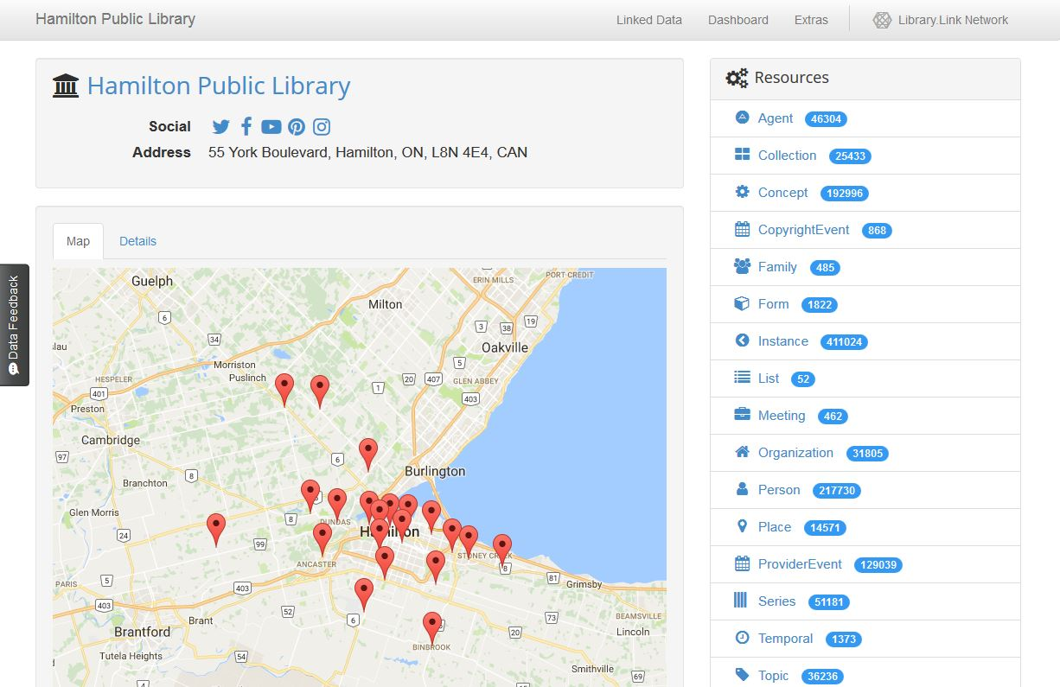
What HPL Linked Data Looks Like
Our linked data can be found at:
http://link.hpl.ca
No credentials needed
Notes:
This is the splash page for the HPL instance at : link.hpl.ca
It features information about the library and outlines the different types of links related to our data
All our data is secure – can’t be modified or deleted by users coming to the site
Will walk you through some screen grabs of a search using the Zoe Whittall as an example
Stop me if you have questions in this section…

Slide 15
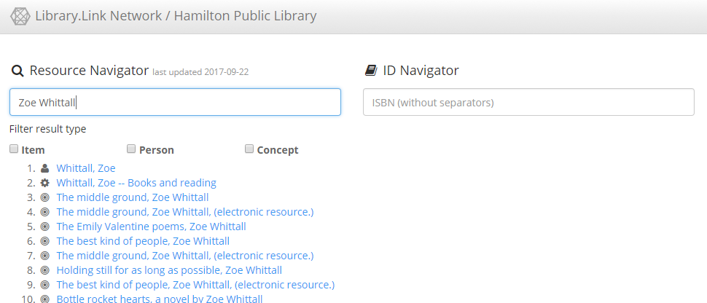
Notes:
Using the Resource Navigator search tool
#1 – person / author entry
#2 – subject heading (related to our book club subject headings)
#3 – Print Book
#4 – E-book – Overdrive record

Slide 16
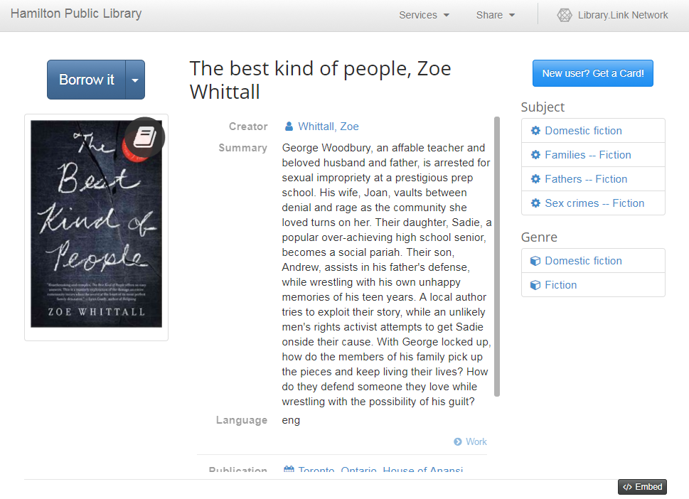
Notes:
Click through on #6
See the data about this print title
There is the link to creator information – which is the newer language
Each web page in this linked data network includes an EMBED button.
This generates the full link to this page and its data and links.
For the hard core cataloguers in the room
In the lower corner is the link to THE WORK – which is the broader entry

Slide 17
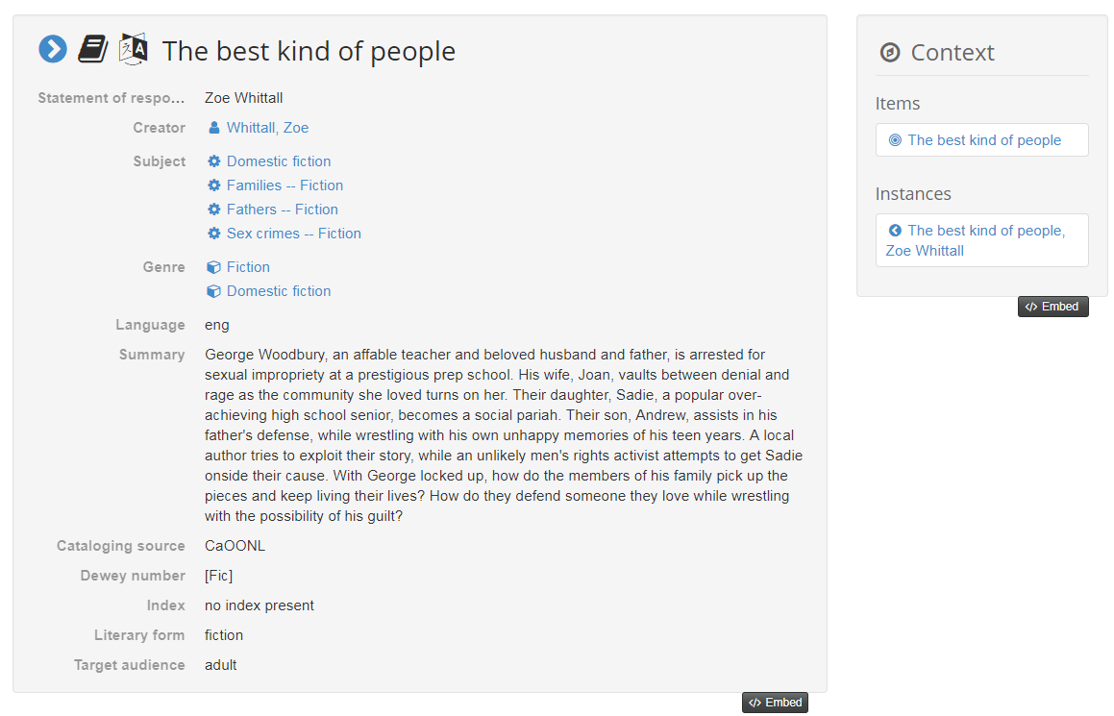
Notes:
So this is the full BIBFRAME record, which should unite ALL versions or links of this title that are included in our linked data
The Work comes out of BIBRAME drawing from what has been laid out in FRBR (functional requirements for bibliographic records)

Slide 18
Notes:
So coming back to the print instance
Users browsing this site can use it to travel in to our Bibliocommons catalog
Just click the Borrow It button.

Slide 19
HPL Bibliocommons
Notes:
If I am a customer I can place a hold on this title right away

Slide 20
Zepheira’s Value Added Content
Social Media
Our links can be: Tweeted
Posted to Facebook
Google+ and LinkedIn.
Notes:
In the past 6 months Zepheira has rolled out value added content
Provides ways of using linked data to increase traffic to the site and to the links
We now have access to social media features like pre-constructed Tweets, google+ and Facebook posts
Displayed links take customers right to the PAC listing
Mention: ZOE WHITTALL TWEET

Slide 21
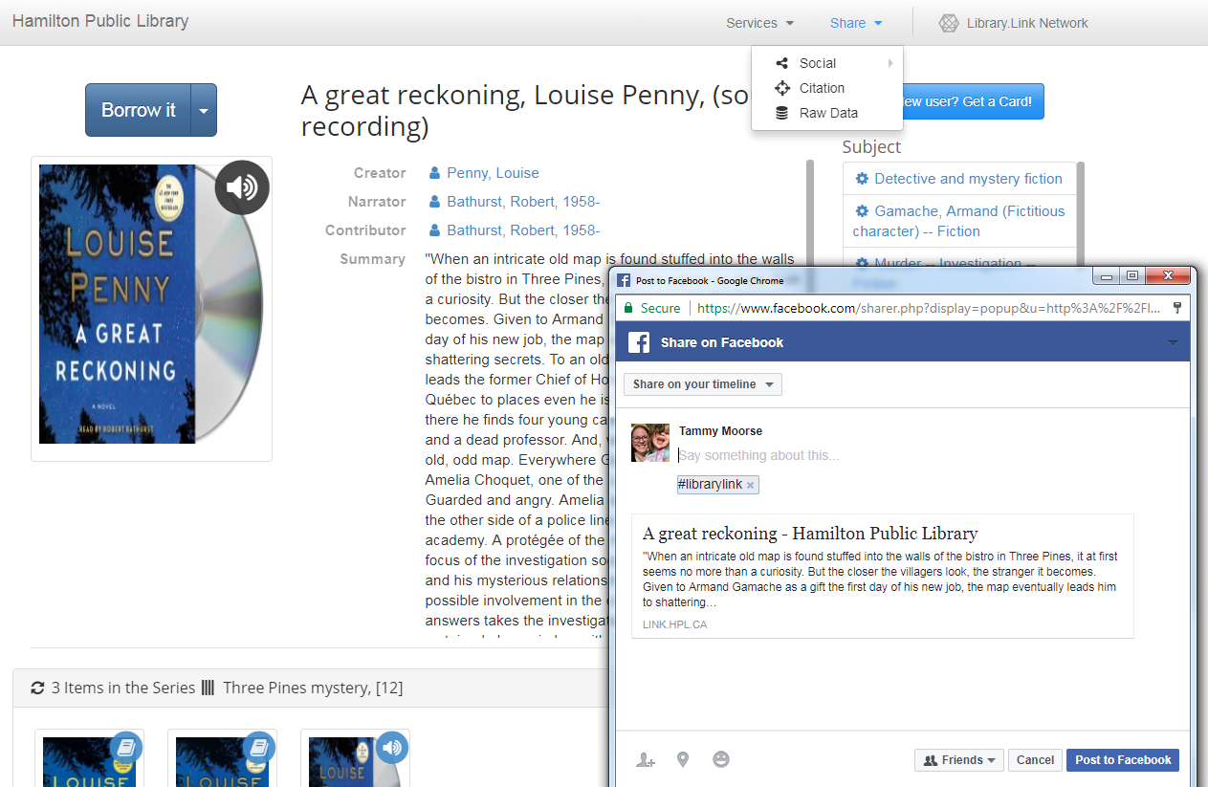
Notes:
This is built in to the drop-down menus at the top of the screen on the right, under SHARE and then SOCIAL.
Louise Penny audio book facebook post, just to mix up my examples

Slide 22
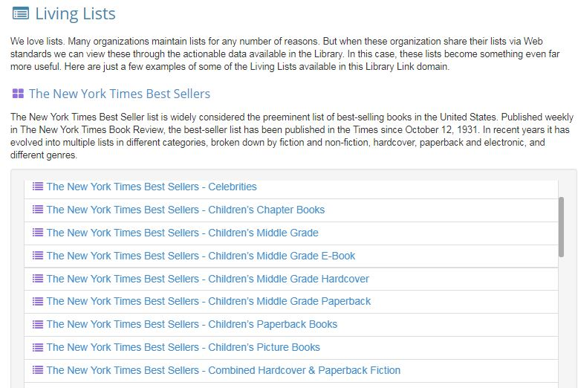
New York Times Best Seller Lists:
Notes:
Big issue to address is HOW TO USE linked data
To also create traffic through linked data by using linked data
Rolled out what they are calling the LIVING LISTS section
Their “Freebie” lists are the New York Times Best Sellers lists
These map over HPL linked data.

Slide 23
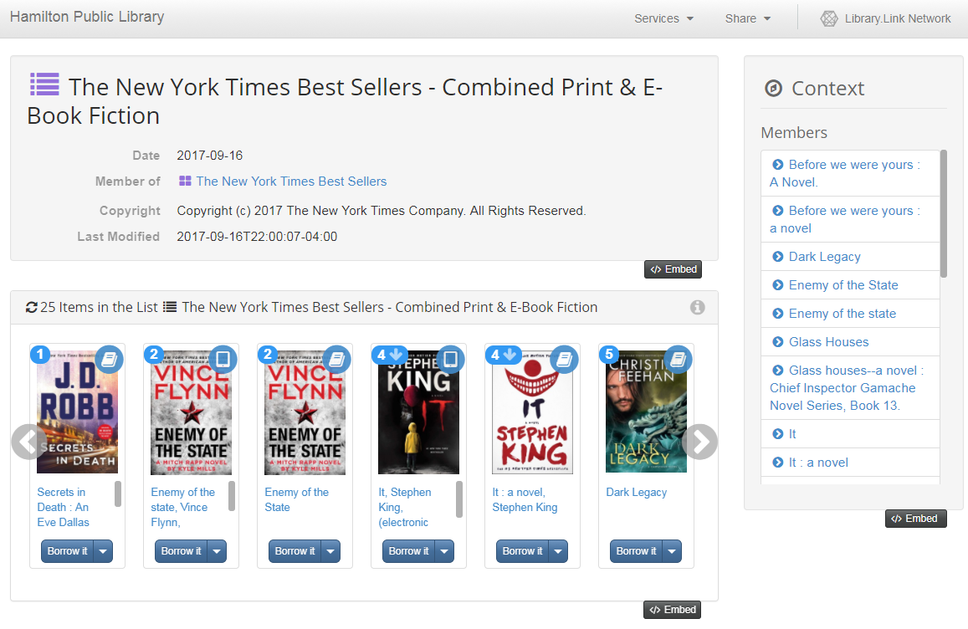
HPL NYT Holdings:
Notes:
Click on one of the Best seller lists, like the Combined Print & E-Book Fiction List for September 16, 2017
the page lists all our copies of both the e-books and the print copies.
The user can then click the title and follow through like we did with the Zoe Whittall example to place a hold on a copy

Slide 24
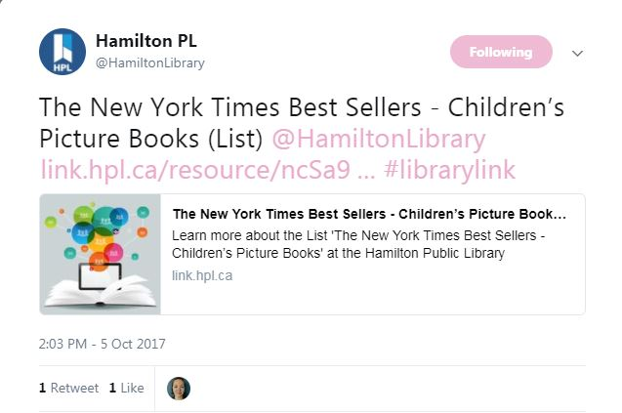
Tweeted Out This Month:
Notes:
We are starting to play and experiment with our linked data
Tweet that went out this month from the HPL Twitter account
Looking to study what web traffic this generates if we use it on a regular basis

Slide 25
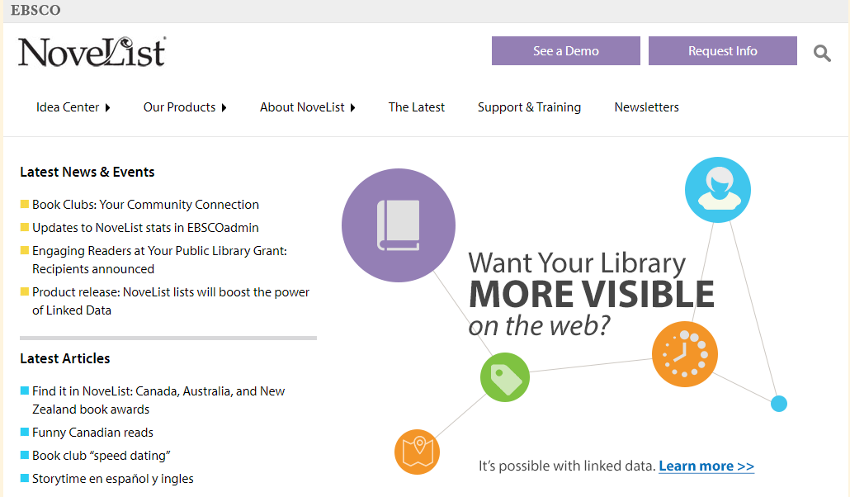
Notes:
Zepheira has partnered with EBSCO to offer premium list service
NoveList that would offer many more lists overlaid on library linked data

Slide 26
NEW Zepheria Statistics Features:
Share Stats – links shared on social media
Embedded Stats – links embedded in a web page, includes impressions.
Catalogue Click Stats – clicks between links and the catalog (PAC)
Notes:
This feature is in very early beta
Comes out of requests by libraries about usage and visibility
There are three sets of stats that they are starting to track (as of August):
SHARE STATS: for links shared on social media
EMBEDDED STATS: for links embedded in web pages, this includes impressions that are generated by these links
CATALOGUE CLICK STATS: clicks through from links to the catalogue of the library
We all know one of the best ways to calculate return on investment in initiatives like this is to have hard statistics
HPL does not have these at present.
But, Edmonton Public does:

Slide 27
Edmonton Public Library
Presented their experience at CULC / CARL meeting in Hamilton in May, 2017.
Feel they aren’t seeing a return on their investment.
Lack of web traffic, impressions and rankings.
Notes:
EPL presented information about their linked data instance with Zepheira at the joint CULC / CARL meeting in Hamilton this past May
CULC – Canadian Urban Libraries Council
CARL – Canadian Association of Research Libraries
Feel they aren’t seeing a return on their investment
Not seeing click throughs, impressions or an uptick in web traffic coming from their linked data.

Slide 28
Edmonton Public Library
Also an early adopter / BIBLOCOMMONS PAC
Consistent refresh
Super stats tracking
Notes:
EPL is also an early adopter library
Have been super consistent with their linked data practices
Consistent refreshes using
Really great tracking of web and usage statistics
And without giving away specifics, they are seeing roughly the same amount of traffic to their linked data as HPL

Slide 29
IN THE NEXT 12-18 MONTHS+
Notes:
We’ve got our data refresh going on a consistent basis
We’ve got all these fun features to play with
What are the next steps?

Slide 30
Linked Data Capacity Building Task Force
Created to build more use of HPL linked data
Create some best practices and workflows for staff and community partners
Build credibility with search engines for our web properties
Build credible and accurate stats to track linked data usage and impressions
Notes:
HPL has put together what we are calling the
Linked Data Capacity Building Task Force
We want to examine not only the fun features, but how we can build staff and community partner workflows around them
How we can best fit linked data use in to programming and social media
We want to see if we use our linked data more, will this translate in to more web traffic, better impressions and better spots in the search engine results

Slide 31
Building HPL Statistics
HPL needs to start building our web statistics on usage to accurately measure the impact of our linked data
More search engine credibility should result in our linked data showing up better on searches
Notes:
Get a little deeper
HPL has not been keeping stats on the traffic our linked data is creating
Anecdotally, our traffic is very low to almost nothing
We will look at the stats features that were rolled out in August
We’ll also look at building our own dashboard to capture what those stats do not

Slide 32
Do More of This:
Notes:
The task force includes staff from various departments
We’re going to look at harnessing the abilities of our Communications team and programming teams to make more of this happen with our social media accounts
Use the living lists and embeds for specific books within our collection
The task force will also look at doing search engine optimization for HPL information properties

Slide 33
SEO Projects
Search Engine Optimization - SEO
Use a few techniques to improve web properties:
Improve Wikipedia entries for all HPL branches
Improve Google+ entries for all HPL branches
Edit Worldcat reference to HPL and branches
Notes:
Looking at enhancing the following
Wikipedia entries, Google+ entries and WorldCat.
Includes all data for branches and bookmobile.
This should improve our knowledge graphs with the search engines
It is hoped that in turn increase the credibility linked data,
This is based on the library literature on SEO, libraries and linked data.

Slide 34
Missing From 5 Star Linked Data:
Missing Star is:
Link your data to other data to provide context
Need to be connected to web authorities that would provide key linkages such as Virtual International Authority File (VIAF) or Wikipedia
Notes:
Zepheira is aiming for 5 star linked open data
It is currently missing the last star / concept
Library linked data on the web needs to take the next step out of the Library Link Network and connect to other networks
We need to links between libraries and web authorities
Two key authorities
Wikipedia entries that align with linked data fields like creator, title, fictitious characters
OR
Linking to VIAF (Virtual International Authority File)

Slide 35
Where We Want To Be Next Year:
Better SEO and knowledge cards for HPL
Roll out workflows to staff for use of linked data in programming and communications
Study stats provided by Zepheira & supplement with our own stats
Notes:
We want to complete our SEO so that we have better knowledge cards on the search engines, giving more weight to our HPL brand and to our HPL linked data.
We’re going to look at and document how best to get linked data in to staff workflows.
We’re want to have to set up metrics on the HPL side
Use the new stats features from Zepheira
Accurately to track usage and impressions and see what difference our work has made
We’ll also push to have our linked data connected outside of HPL data.

Slide 36
Longer Term:
See linked data bring traffic and research to our Local History & Archives Department’s unique holdings and fonds
Plan for converting our Dublin Core archival data holdings to linked data in the future
Notes:
HPL has a wonderful local history and archives department
Longer term we want to migrate this Dublin Core metadata in to our library link network
It is thought that putting rare books and archival fonds on the web as linked data will open search opportunities for those doing academic and genealogical research
They can now find it in search engines over word of mouth or calling or emailing archives to find out what is in their collections

Slide 37
We want to be in the results:
Notes:
Libraries want to be in the search engine results.
Next year we’ll have made significant progress in doing this.

Slide 38
Questions Discussion: What is the biggest barrier to your library getting on board with linked data?
How can this barrier be overcome?

