Slide 2
Wrangling Renewals
Getting Your Print Subscriptions Under Control
Katie McCort cmccort@saclibrary.org
Sacramento Public Library
Acquisitions/Collection Development Supervisor
Sarah Frieldsmith sfrieldsmith@saclibrary.org
Sacramento Public Library
Integrated Library Systems Supervisor

Slide 3
Wrangling Renewals
Overview
Sacramento Public Library Print Periodicals
Microsoft Access
Control Tables
Form and Subform
Queries
Loading Data into Sierra
Downloadables
Fully functional Access database to download and populate with data
Excel and MarcEdit templates for loading order records and checkin records into Sierra
Text for load tables to load order records and checkin records into Sierra

Slide 4
Wrangling Renewals
Sacramento Public Library
28 Branches throughout Sacramento County
Branches are given a budget and select their own print subscriptions
Print subscriptions are paid for out of 20 distinct fund codes, many of which also have their own budgets
Print subscriptions are compiled and ordered centrally once a year
All print subscriptions are delivered to one central location, except daily newspapers, which are delivered directly to the branches
2017: 559 titles, 1863 unique print subscriptions, $129,639.30 annual total

Slide 5
Wrangling Renewals
Year 1: Print renewals compiled and budgeted on paper
Year 2: Print renewals compiled and budgeted in Excel spreadsheets.

Slide 6
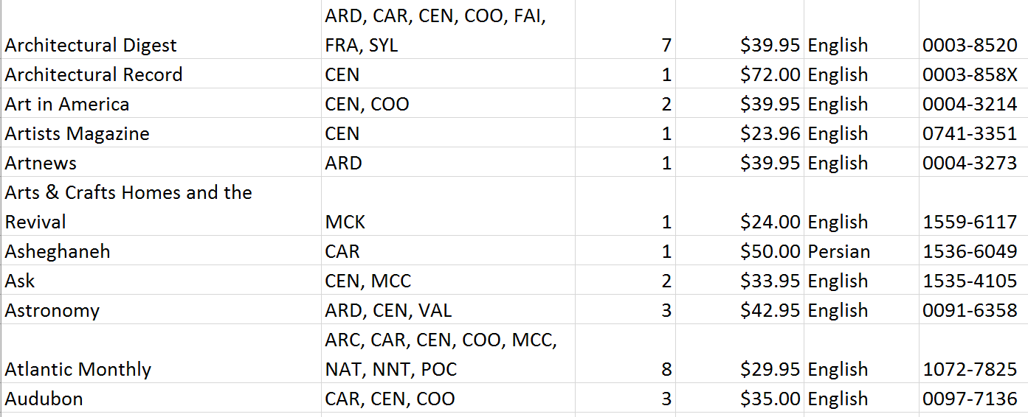
Wrangling Renewals
Compiling Print subscriptions with Excel
No real way to do real time branch or fund specific budgeting
Awkward to produce branch specific reports

Slide 7
Wrangling Renewals
We needed a way to budget for the fiscal year ahead and to see at a glance each branch’s print subscriptions
Sierra is quite capable of running reports on existing orders, but is not helpful in real time budgeting or branch specific print subscription reports

Slide 8
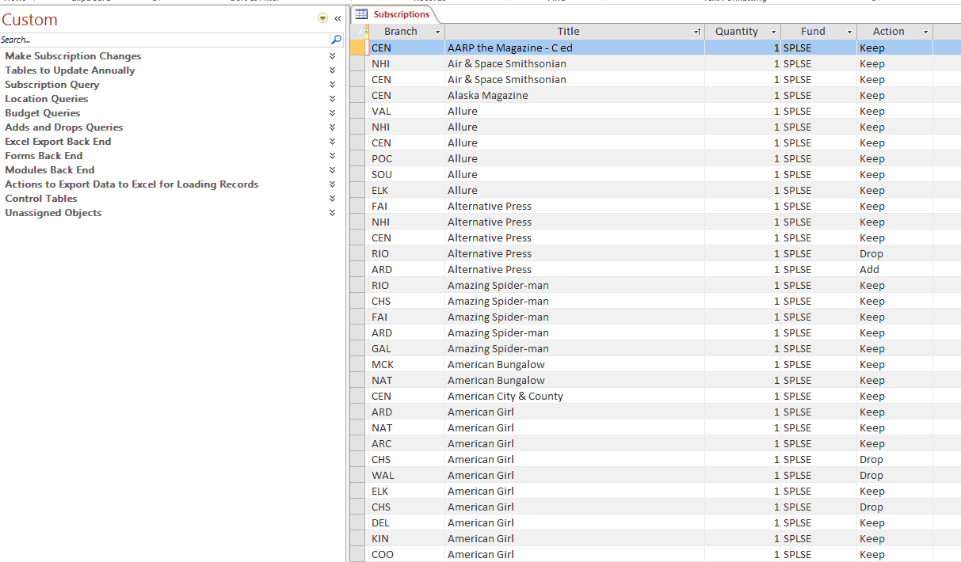
Wrangling Renewals
The Access Database is born

Slide 9
Wrangling Renewals
Control Tables: A controlled vocabulary
Actions (Add, Drop, or Keep)
Audience (Adult, Child, Teen)
Branches
Form
Frequency
Funds
Language
Months
Subscriptions
Vendors

Slide 10
Wrangling Renewals
Notes on the Control Tables
The tables include data such as format and frequency, in order to include that information in reports for the branches. Not all libraries may want to include this data
They include renewal date information so staff can limit searches by renewal date. Not all libraries may want to include this data
Some libraries may only have one fund code – they will still need to enter this fund code in the Funds table in order to use the budgeting reports

Slide 11
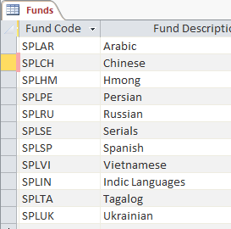
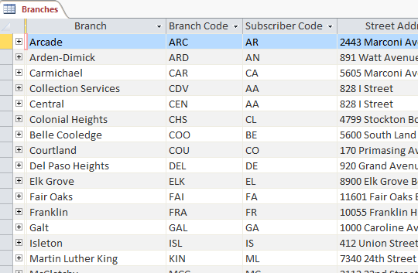
Wrangling Renewals
Sample Control Tables

Slide 12
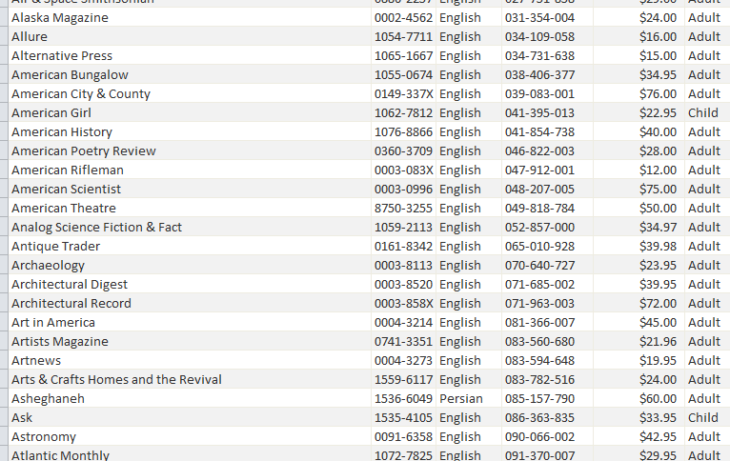
Wrangling Renewals
Titles Control Table
Bib number
Title
ISSN
Price
Vendor
Audience
Format
Frequency
Account Number
Subscriber Code (Ebsco)
Renewal Month
The setup requires a lot of data entry, but once the data is entered most can be rolled over year to year
If you get the bulk of your subscriptions from one vendor, use their spreadsheets to load the data into Access

Slide 13
Wrangling Renewals
Notes on the Fields in the Titles Table
We use Sierra’s bib number as the match point when loading the order records and checkin cards. If you do not load these records, you do not need to enter this data
Our location codes are built using the 3 letter branch code and the 1 letter audience code (a, t, or c). If your location codes are built differently you will need to change the structure of the checkin card and order record loading exports
Ebsco is our primary print subscription vendor. We include our account number, their title numbers, and their subscriber codes for our branches so we can email lists to Ebsco and load VEN TITLE# data in the checkin records. If you do not use Ebsco, you may not need to use these fields

Slide 14
Wrangling Renewals
Copy the data and structure into a new database each year
Tracking multiple years in a single database adds too large a layer of complexity
Annually update any data changes

Slide 15
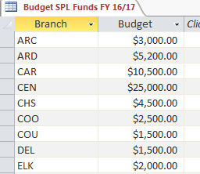
Wrangling Renewals
Tables to Update Annually
Budget Table
SPL pays for print subscriptions with Library funds (broken out by language), Library Friends funds, and Library Foundation funds. Each branch has their own budget, and many funds do as well
Every year, update the table with the new budgets for each branch

Slide 16
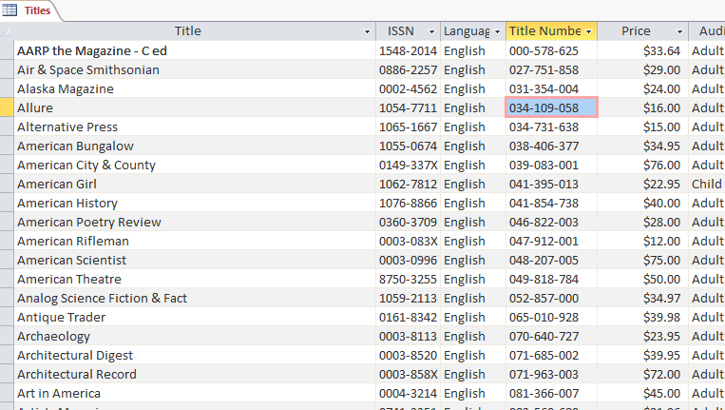
Wrangling Renewals
Tables to Update Annually
Titles Table
Update the table with any changes. The most common change usually is the price, but there may be others

Slide 17
Wrangling Renewals
Print Subscription Table and Form
The data entry form is broken down by branch code
Entering or changing data on the form edits or changes data in the table
The subsequent queries run off the table

Slide 18
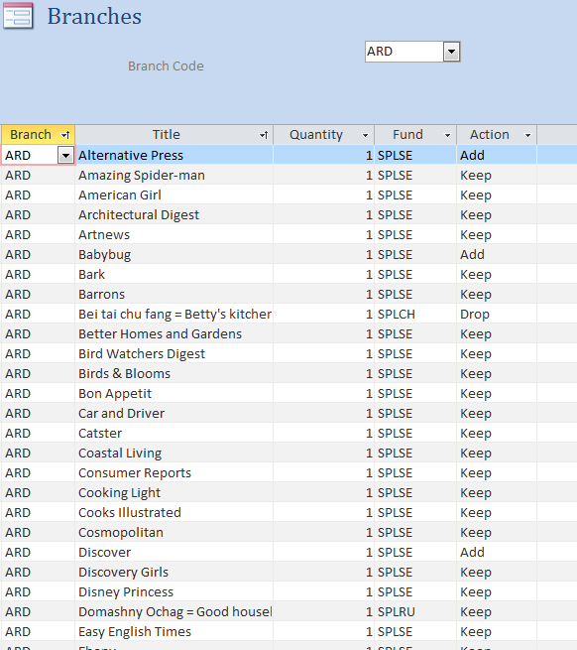
Wrangling Renewals
Print Subscription Table and Form
Select branches using the Branch Code drop down menu
Enter the titles each branch wants to receive and the fund used to pay for them
Indicate if the branch will be adding, dropping, or keeping each title.
Next year, when you copy over your database, you can remove the titles that were dropped the previous year and change those that were added to “keep.”

Slide 19
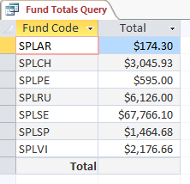
Wrangling Renewals
Budget Reporting Queries
Budget Check Query
Reports each branch’s total by fund and compares it to the amount budgeted
Fund Totals Query
Reports the total for each fund

Slide 20
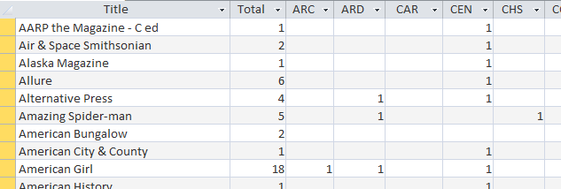
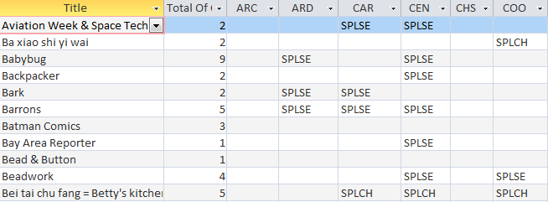
Wrangling Renewals
Location Reporting Queries
Locations Crosstab
Indicates which branches get what titles, and the total copies ordered
Branch Funds Crosstab
Indicates which branches get what titles, and what fund pays for it.
This table is especially useful if you are manually entering order records

Slide 21
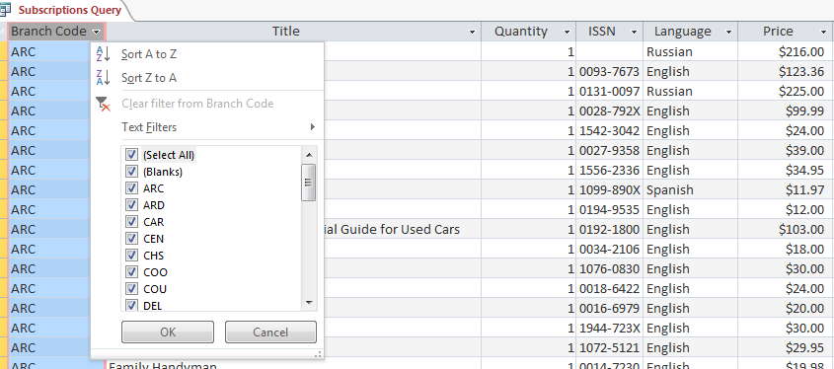
Wrangling Renewals
Subscription Compilation Queries
Subscriptions Query
Compiles all subscriptions
Can be limited by branch and exported to Excel for branch specific reports

Slide 22
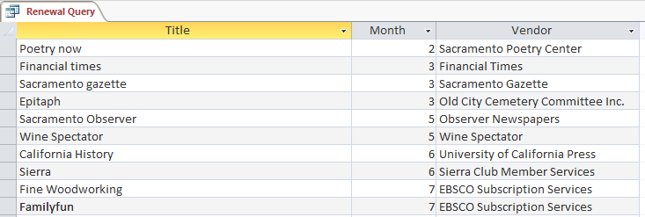
Wrangling Renewals
Subscription Compilation Queries
Renewal Query
Lists the month each title is due for renewal

Slide 23
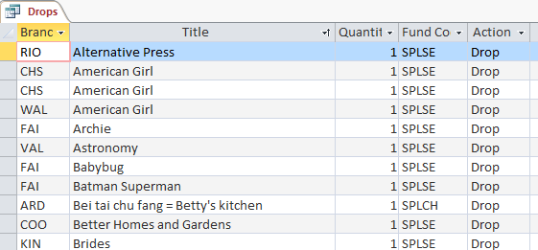
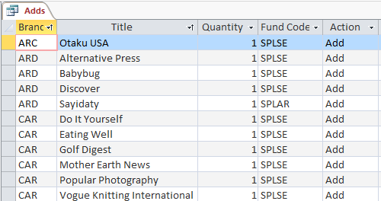
Wrangling Renewals
Adds and Drops
Reports which titles were added and dropped by each branch
The reports can be sorted by title or branch

Slide 24
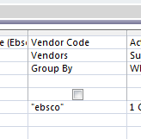
Wrangling Renewals
Query to Export Order Lists to a Vendor
Creates a list of titles for a given vendor
Users can limit the list by vendor code from Design View
Not all libraries may need to send all available fields to all vendors

Slide 25
Wrangling Renewals
Bonus: Downloading data from Access and Uploading it into Sierra
The ability to export order record and checkin card data from Access, and load it into Sierra using Data Exchange
Libraries can load order records, checkin cards, or both
This has been a long term project of ours, and we have only recently gotten it up and running
We used the order record loading process for the first time during the 2017 renewal cycle
We have not yet used the checkin record loading process during a renewal cycle

Slide 26
Wrangling Renewals
Downloading data from Access and Uploading it into Sierra Process Overview
The process is the same for order record loading and checkin card record loading – only the templates and load tables change
Export data from Access into Excel
Format Excel data according to template
Use the MarcEdit Export Tab Delimited Text function to create a .mrk file
Use MarcEdit to compile the .mrk file into a .mrc file
Load the .mrc file in Data Exchange using the appropriate load table

Slide 27
Wrangling Renewals
Run a Query to Create a Table to Run a Query
The order export uses a concatenation function. This must be run off a table, not a query
First one must run the Query to Create Table for Order Record Excel Export to create a table before one can run the Query to Export Order Record Data to Excel
The same applies for Query to Create Table for Checkin Record Excel Export and the Query to Export Checkin Record Data to Excel
Every time you export data to Excel, you MUST run a Query to Create Table for Record Excel Export before you can Run a Query to Export Record Data to Excel

Slide 28
Wrangling Renewals
Prep Tables and Unassigned Objects
The Query to Create Table for Order Record Excel Export creates a table named Order_Record_Export_Prep_Table
The Query to Create Table for Checkin Record Excel Export creates a table named Checkin_Record_Export_Prep_Table
Query created tables are automatically placed in Unassigned Objects
If you have already run one of these queries and have tables with these names, Access will prompt you to delete the old table and save the new one

Slide 29
Wrangling Renewals
Creating the Prep Tables

Slide 30
Wrangling Renewals
Concatenation Queries
The concatenation queries are under Excel Export Back End
The user does not need to open them, they will run automatically when the user runs the query to export data to Excel

Slide 31
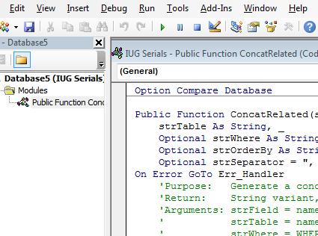
Wrangling Renewals
ConcatRelated Function
The concatenation query runs using the ConcatRelated function. This function does not come standard in Access and must be created manually
This function is included in the sample database
http://allenbrowne.com/func-concat.html

Slide 32
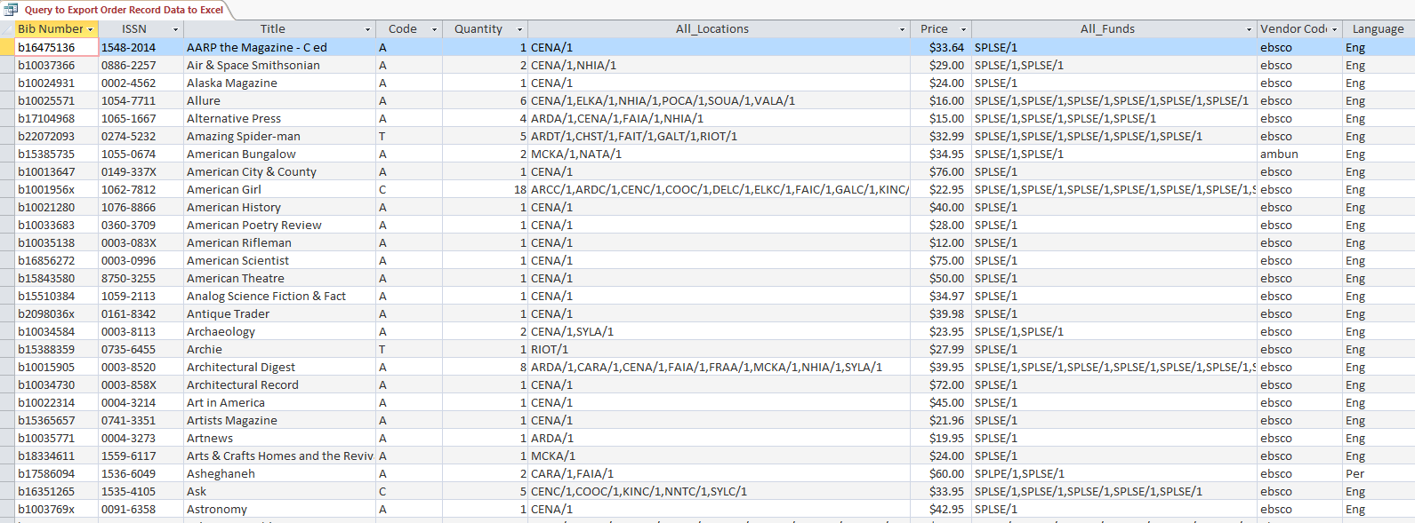
Wrangling Renewals
Export Queries
Example of Query to Export Order Record Data to Excel
Export this to excel

Slide 33
Wrangling Renewals
Order Data Export – Notes on the Data
Price must be in 00.00 format and must not include the “$” symbol
Our location codes are build using the 3 letter branch code and the 1 letter audience code (a, t, or c). If your location codes are built differently you will need to change the structure of the checkin card and order record loading exports
We include our audience codes in CODE1 of the order records
Location codes of order record loads must be in BRANCH/Quantity,BRANCH/Quantity format – no spaces
Fund codes must be in FUND/Quantity,FUND/Quantity format – no spaces
The fund code structure must match the branch code structure, even if the same fund is paying for all the copies

Slide 34
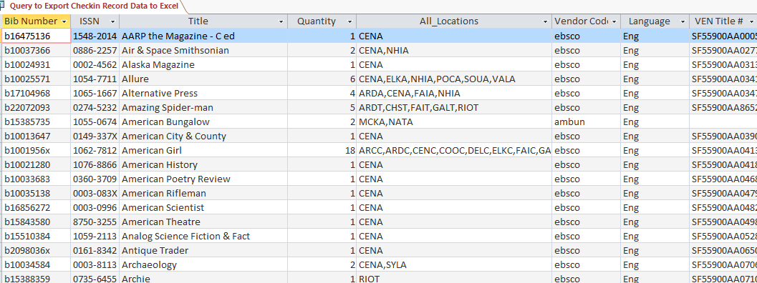
Wrangling Renewals
Export Queries
Example of Query to Export Checkin Record Data to Excel
Export this to Excel

Slide 35
Wrangling Renewals
Checkin Data Export – Notes on the Data
Our location codes are build using the 3 letter branch code and the 1 letter audience code (a, t, or c). If your location codes are built differently you will need to change the structure of the checkin card and order record loading exports
Location codes of checkin record loads must be in BRANCH/BRANCH/BRANCH format – no spaces – This is different from the order record location format
Ebsco builds VEN TITLE# from the account number, the subscriber code, and the title number. If your library does not use Ebsco, you may not need these fields
Boxes cannot be loaded with checkin records

Slide 36
Wrangling Renewals
The Excel Template and the MarcEdit Template
The fields in the Excel Template map to the fields in the MarcEdit Template
If you change one you must change the other
The templates uploaded to the IUG website include all available fields. Most libraries will probably not need to load all available fields

Slide 37
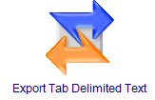
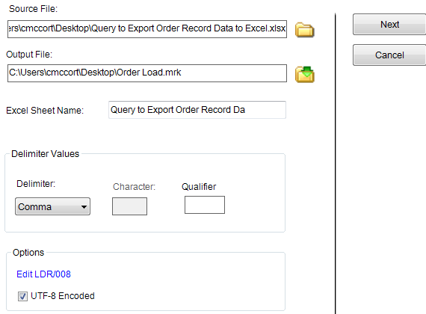
Wrangling Renewals
MarcEdit
Use the MarcEdit Export Tab Delimited Text Function
Enter the Source File and Output File
Make sure the Excel Sheet Name matches exactly
Change the Delimiter Value to Comma
Check UTF-8 Encoded

Slide 38
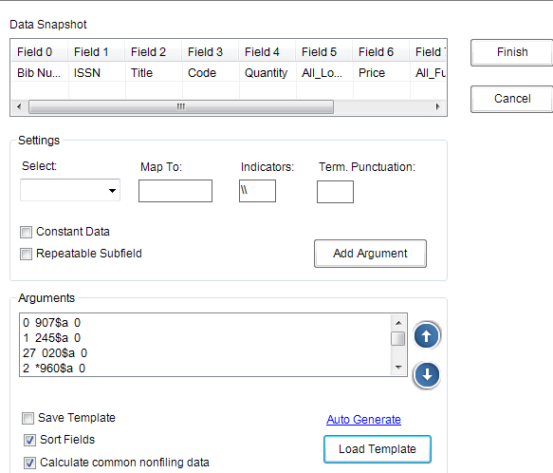
Wrangling Renewals
MarcEdit
Load the appropriate MarcEdit Delimiter Text Translator Template

Slide 39
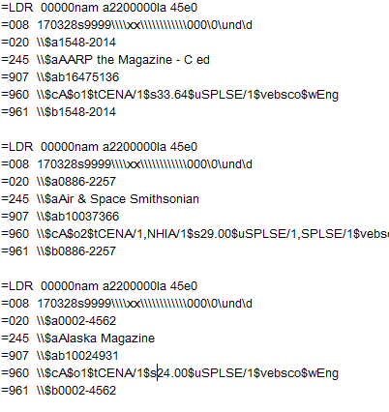
Wrangling Renewals
MarcEdit
The Export Tab Delimited Text Function will create a .mrk file
Use the MarcEdit function to compile the .mrk file into a .mrc file

Slide 40
Wrangling Renewals
Load Tables
.b number is the match point
Match and attach
The load table matches on the .b number and attaches a the new order or checkin record
If there are no matches, a new record is inserted
The sample load tables included in this presentation incorporate SPL New Record Templates. Other libraries will need to update the tables to include their templates instead

Slide 41
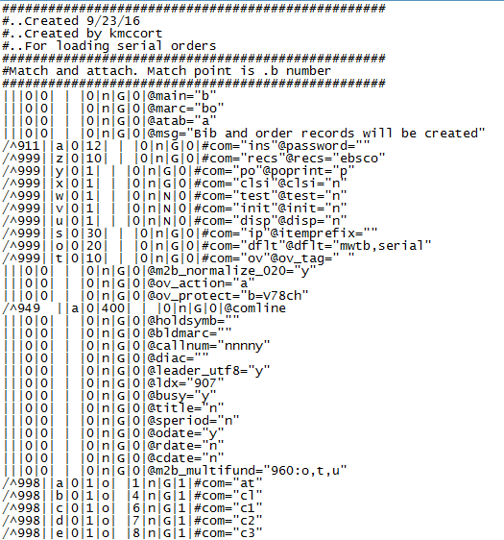
Wrangling Renewals
Load Tables
Load the .mrc file into Data Exchange using the appropriate load table
There are different load tables for order records and checkin records
The order records will load with a status 1 – ON HOLD. In order to encumber funds the user must create a review file in Create Lists and use Selection Lists to change their status to ON ORDER

Slide 42
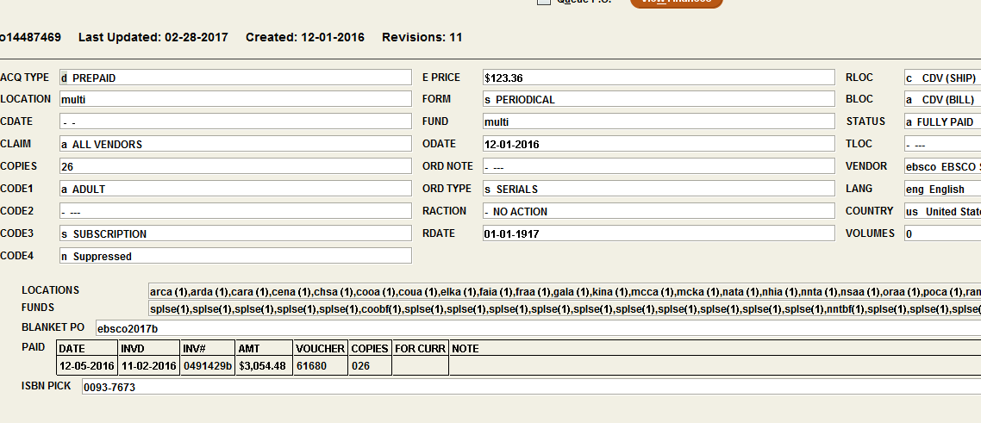
Wrangling Renewals
Loaded Order Record

Slide 43
Wrangling Renewals
Loaded Checkin Record

Slide 44
Wrangling Renewals
Resources Used
How to Create Subform links to Main Form: MS Access
https://www.youtube.com/watch?v=kOkUF7yqbt4
Concatenate values from related records
http://allenbrowne.com/func-concat.html
MarcEdit
http://marcedit.reeset.net/
IIf Function
https://support.office.com/en-us/article/IIf-Function-32436ecf-c629-48a3-9900-647539c764e3
Removing characters from field in MS Access database
http://stackoverflow.com/questions/10249929/removing-characters-from-field-in-ms-access-database-table

Slide 45
Wrangling Renewals
Getting Your Print Subscriptions Under Control
Katie McCort cmccort@saclibrary.org
Sacramento Public Library
Acquisitions/Collection Development Supervisor
Sarah Frieldsmith sfrieldsmith@saclibrary.org
Sacramento Public Library
Integrated Library Systems Supervisor

