Slide 1
Automating user information
Creation, Updating and Deleting across systems
Jason Fleming

Slide 2
Automation Timeline
2021
Illiad-Sierra user reconciliation
Using SQL from Sierra updated ILLiad patrons
2022
Sierra patron update app created
Took campus feed and updated Sierra using Patron API
2022
Illiad-Sierra job update
Update user status in Illiad based on Ptype in Sierra

Slide 3
Reconciling users across systems
The problem: Users create an account when they need to use interlibrary loan. The ILL manager manually verifies and updates records in a time consuming fashion
Solution: Use Sierra Patron data as the source of truth for user status information and automate

Slide 4
Weekly update job
illiad_user_update_job
This job runs every Monday at 0100. It disavows & clears users in Illiad. It also sends a CSV of possibly incorrect [sierra<->illiad] usernames/userids to Illiad Manager

Slide 5
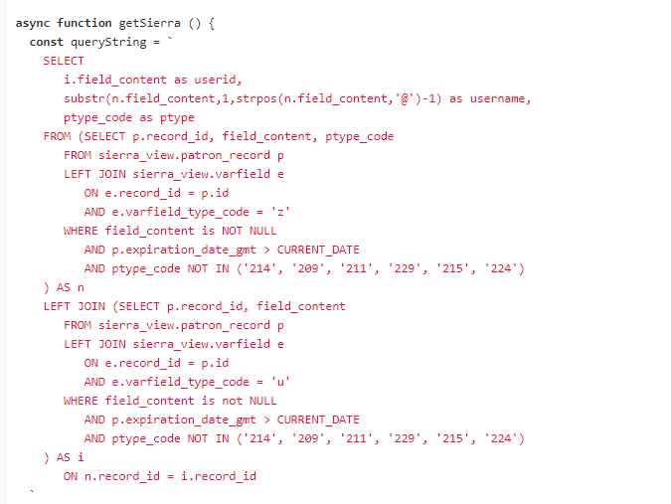
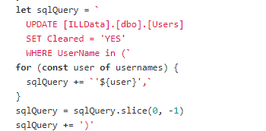
Connections
ILLIAD: MSSQL; SIERRA: PGSQL

Slide 6
Double check data
The application identifies partial matches for further examination. For example, a 'cleared' user in Illiad (but mismatched id) that are deactivated user/id in Sierra.
Emails are sent to head of interlibrary loan with accounts to check

Slide 7
Importing feeds from Banner using Patron API
Updates Sierra with Banner patron data.
a daily cron job reads banner data in an sftp folder folder of STU_LIBPAT.* and HRS_LIBPAT.* files.
  STU refers to student patrons. HRS is employee patrons.
Application compares banner data to Sierra patron data.
Updates or creates patrons in Sierra using API
Also, expires in Sierra active patrons in Sierra who are not in Banner file
Notification emails are sent when there is a failure of the system
Only adds or updates changed records

Slide 8
Caveats: for Sierra Patron Update application
The beginning and end of semester we still run a full load in data exchange to clear out the cobwebs
We have to change the expiration date at the end of the semester in the record template AND in the application

Slide 9
Updating status in records for ILL users automatically
The problem: Users graduate or become staff/faculty in the system and they don’t update their status on their own
Solution: Use Sierra Patron ptype to crosswalk their new status over to ILLiad

Slide 10
THANK YOU
Questions?

