Slide 1
The i-card: a library database card for every child
Gwyneth Jelinek & Lynn Yandell

Slide 2
The big idea
We wanted to ensure that all children had access to our online databases if they could not get a borrowing card or if it was blocked
Started in 2013 as a pilot with one elementary and middle school
Limited to our service area
Expanded to all public schools in 2014 and added private schools in 2016
Teacher cards added in 2015

Slide 3
Communicating with schools
Within the first two weeks of school, reach out to each school’s administration
Have your marketing department create a flyer
Explain the how, when, and why
Give them a hard deadline to provide a data file to the library
Follow up
Opt out list

Slide 4
Getting the data into Polaris
FPL decided the cleanest operation was to wipe and recreate the i-cards annually
This provides an annual opportunity to market the library to the school system and parents
At the beginning of the school year the schools provide us with a student data file
A new patron code, FPS Internet, was created to restrict borrowing
*FPS = Fayetteville Public Schools

Slide 5
Data File (that we beg for)
First Name
Last Name
School
Grade
Gender (M/F)
Birth date (mm/dd/yyyy)
Homeroom
Homeroom Teacher Name
I gotta make 56 fields out of this?

Slide 6
Massage the data for import
Import the school data into Microsoft Access
Create a make-table query that selects the data from this newly imported table of student records and adds a field called “Barcode”
New barcode value is created by adding database record ID + 55,555,000,000,000

Slide 7
Massage the data for import
Using the columns defined in the Polaris documentation, Importing Student Records:
Create a select query that creates all of the other fields that the Polaris import tool is expecting, 56 fields in all!
Export the results of this query as a pipe “|” delimited text file
Open the newly created text file in Notepad and insert a row on the top line in the following format:
1|<time>|<date>|<branchID>|<userID>|<workstationID>|20

Slide 8
Massage the data for import
Rename the text file to the following format: Begin file name with PTF_<date yyyymmdd><time hhmmss>_<workstation name>.TRN
Example:
PTF_20150115100000_LYANDELL.TRN
Copy the file to C:\ProgramData\Polaris\<current version>\OfflineTransaction
Open Polaris and click Circulation->Bookmobile

Slide 9
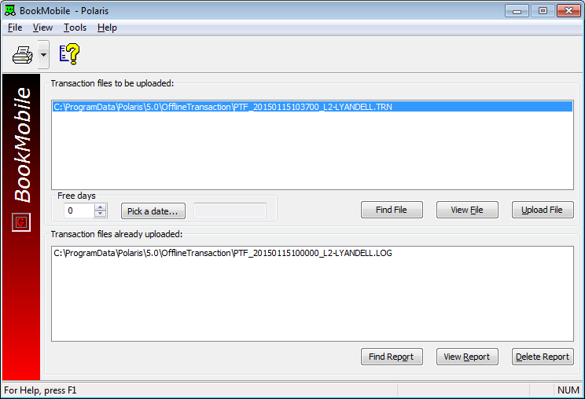

Slide 10
Remove the blocks!
Once the records are imported, you must remove the default block placed on each account. Create a record set with the following SQL in the find tool in Polaris:
SELECT Patrons.PatronID FROM Patrons WHERE Barcode Like '55555%' and systemblocks > 1
Tell Polaris you would like to open the record set. Make note of the record set ID # found at the top of the new record set, in this example the ID is 12365:

Slide 11
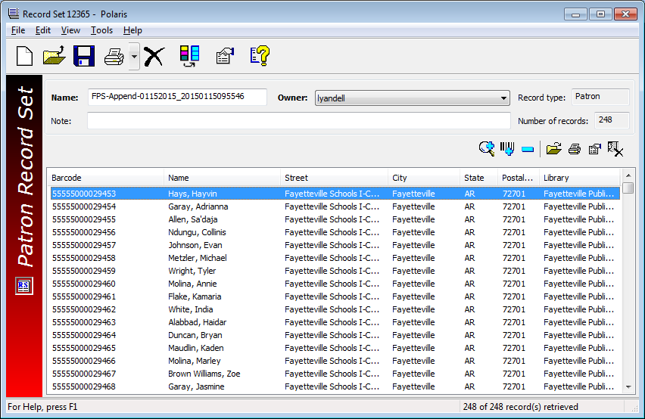

Slide 12
Remote to the production server and open SQL Server Management Studio. Open a new query and copy/paste the following SQL and change RecordSetID = ##### to whatever your recrodset ID is, i.e. RecordSetID = 12365:
begin tran
update Polaris.Patrons
set SystemBlocks = SystemBlocks - 512
where PatronID in
(Select PatronID from Polaris.PatronRecordSets where RecordSetID = #####)
and SystemBlocks>=512
Execute the query. Look at the number of “rows affected” – it should match the number of records in your recordset. If the numbers match, commit. If number don’t match, rollback.

Slide 13
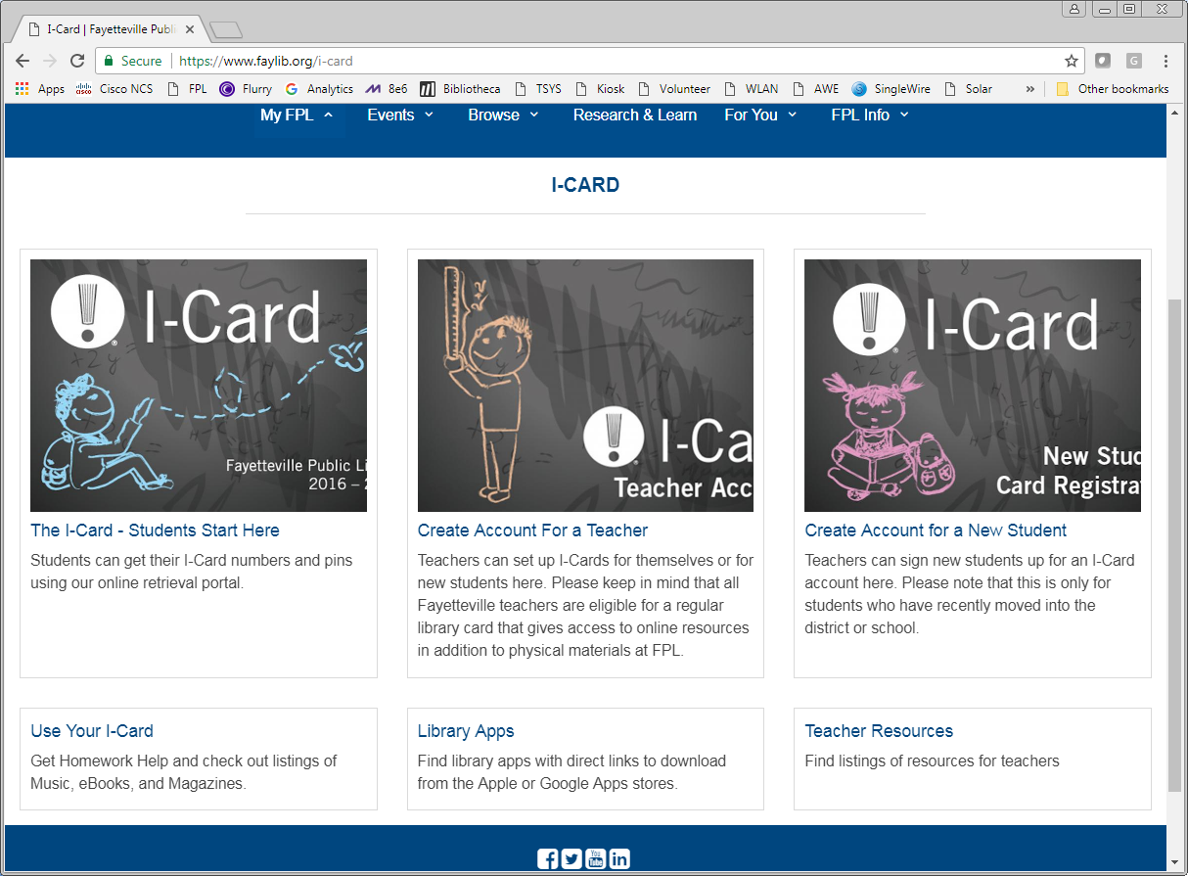

Slide 14
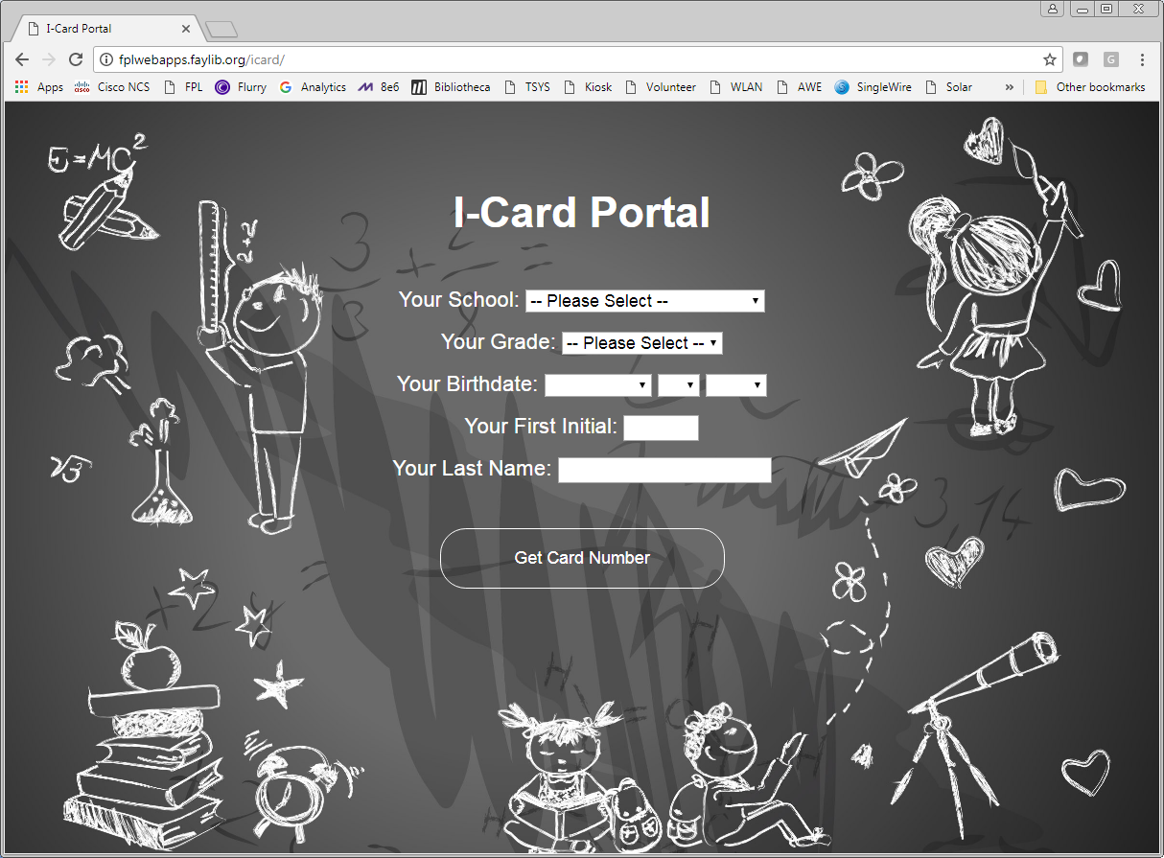

Slide 15
Distributing account numbers
Opt out list
Ordering cards: We decided that Middle school and younger would receive physical cards. Private schools also received physical cards. Other students would access via the portal.
Card distribution set up through school librarians
Database demos offered to teachers

Slide 16
Student accounts have the same address

Slide 17
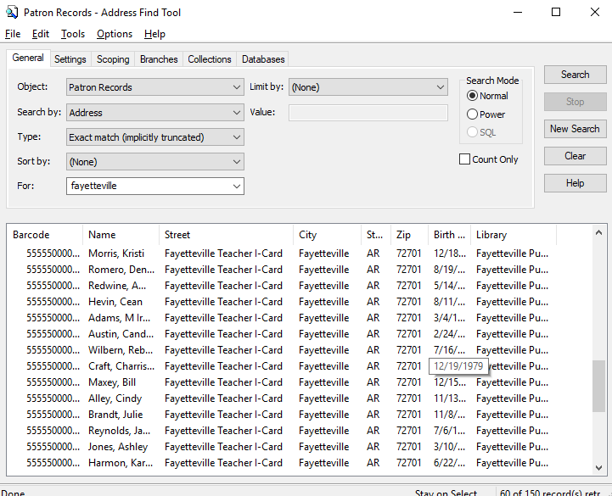
Teacher accounts have the same address

Slide 18
Managing requests that come via portal
Use next barcode number in sequence and keep track of teacher vs. student cards
Email student/teacher i-card number and information
Check opt out list
Make sure school is participating

Slide 20
Database maintenance
Purge at end of year BEFORE the accounts expire
It’s easy to identify accounts to purge via address field
If your e-books are integrated with Polaris, some accounts won’t delete automatically because e-books are checked out
Make sure staff who work with the students/teachers are apprised of deletions
Teacher i-cards are not purged. At the beginning of each year, school staff rosters are checked to ensure teacher is still with the district

Slide 21
Questions? Ask about our library expansion ☺
LYANDELL@FAYLIB.ORG
GJELINEK@FAYLIB.ORG

Slide 22
Library Journal 2005 Library of the Year

